Slide 1
banknote authentication, part ii:
A survey of models, attacks, and defenses
Alice chang, yu chen, Karthik umashankar

Slide 2
outline
Previous work done
Background
Processing raw data
Our contribution
Experimenting with other models
Attacking the model
Next steps

Slide 3
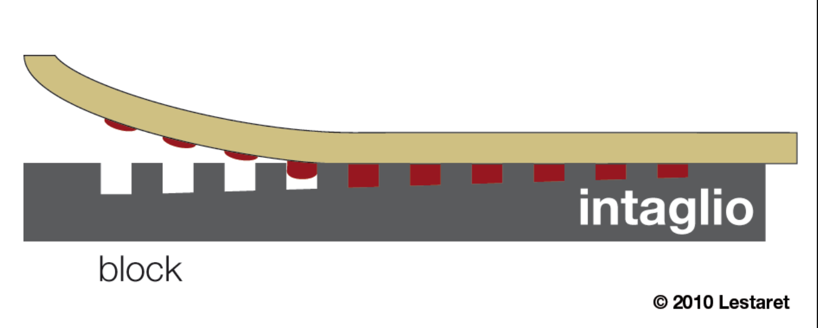
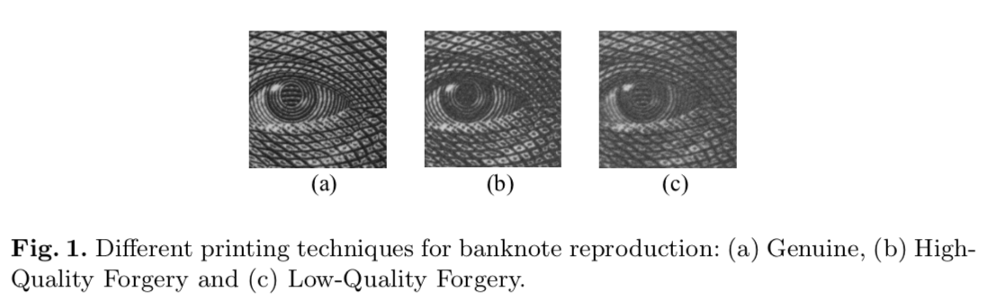
background
Basic premise: use the properties of Intaglio printing to differentiate between genuine bills from high-quality and low-quality forgeries.
The level of fine-grain detail is difficult to emulate, and is thus a good authentication feature.
several tons/cm² presses a feelable relief into the paper
ink

Slide 4
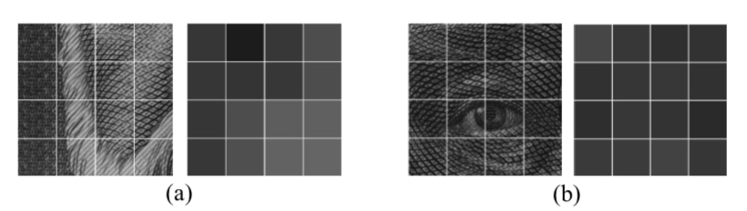
MACHINE LEARNING FOR FORGERY DETECTION
Pioneered by two researchers – Eugen Gillich and Volker Lohweg:
Leveraged Shift Invariant Wavelet Transform (SWT) + Support Vector Machine
Yielded 100% accuracy rate (threw out two outliers due to them being incomplete data points).
Four step process:
Image digitization using areas of homogeneous grayscale mean.
Preprocessing
Feature extraction
Classification

Slide 5
Feature processing (INCOMPLETE)

Slide 6
THEIR FINDINGS (INCOMPLETE)

Slide 7
Our FINDINGS: COMPARING CLASSIFIER MODELS
Comparison of models (KNN Classifier and Neural Network multi-layer perceptron classifier)
Performance metrics
Bias variance curves

Slide 8
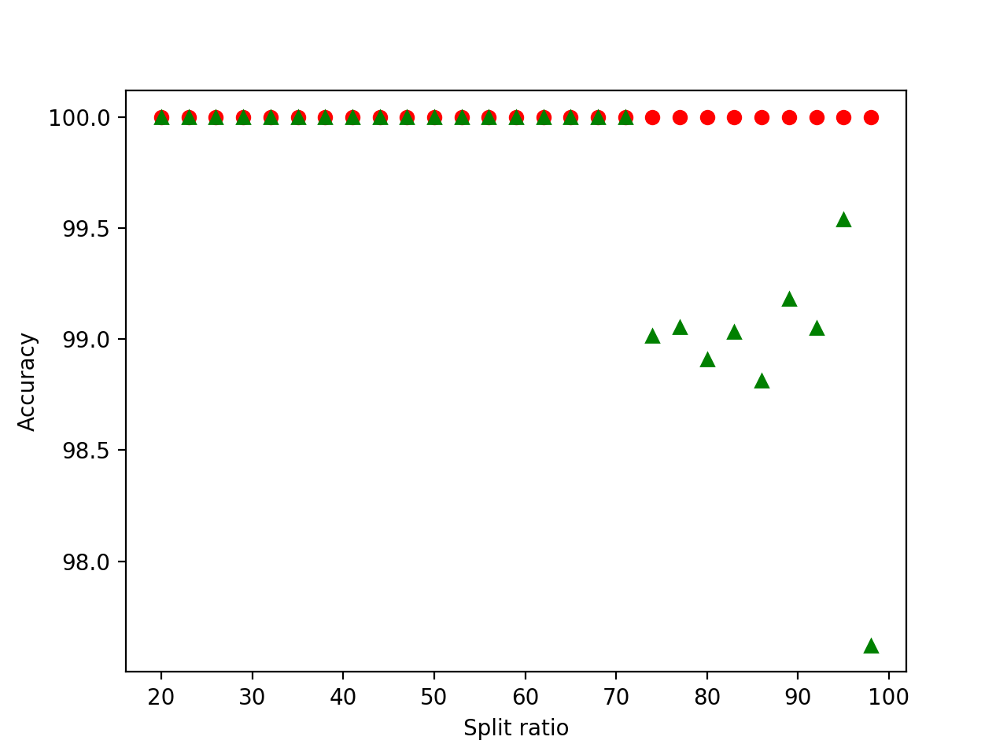
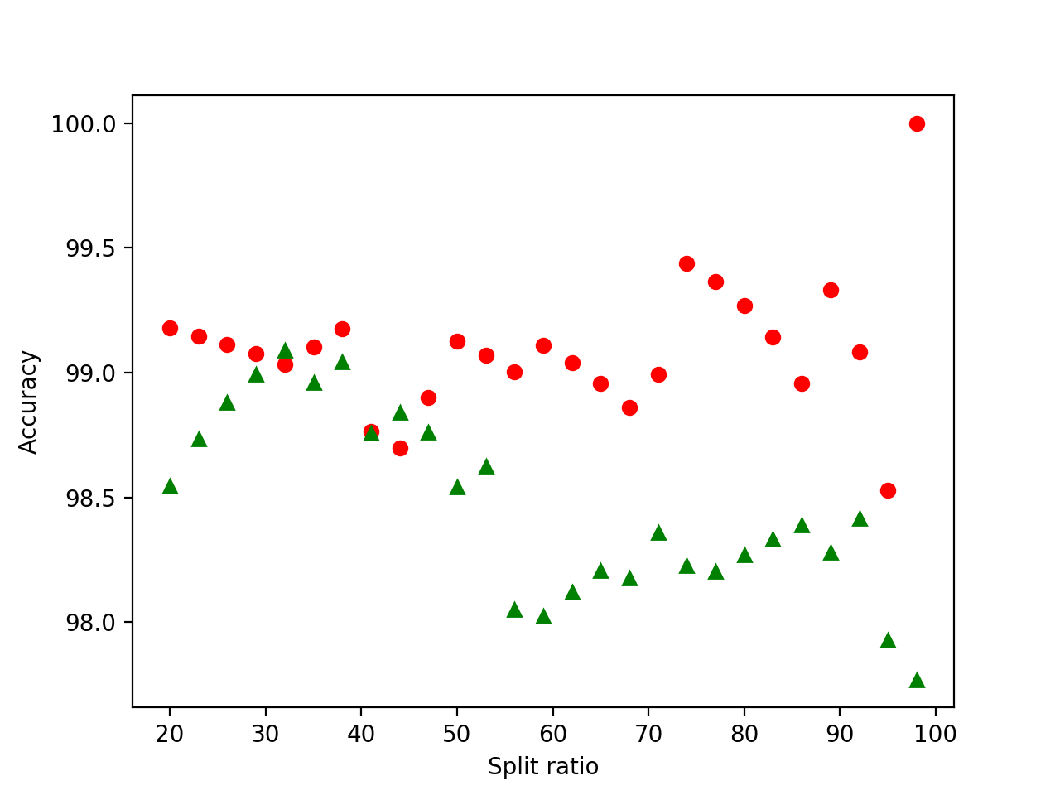
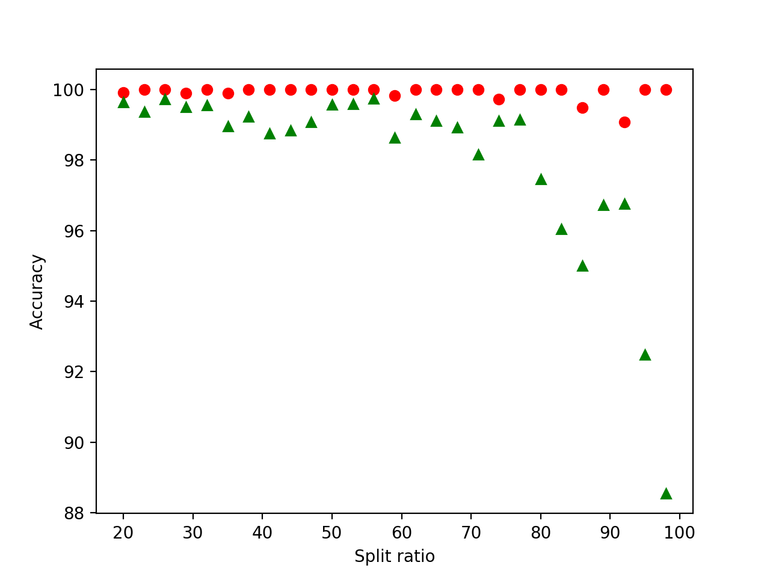
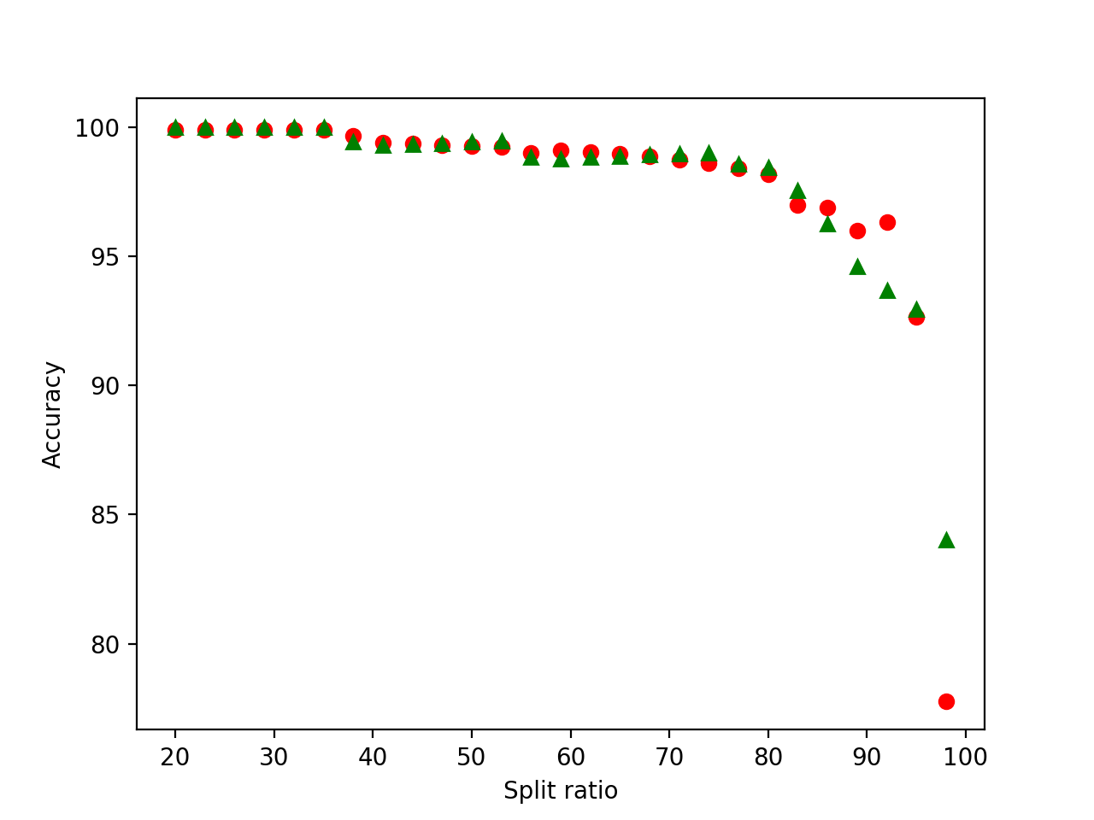
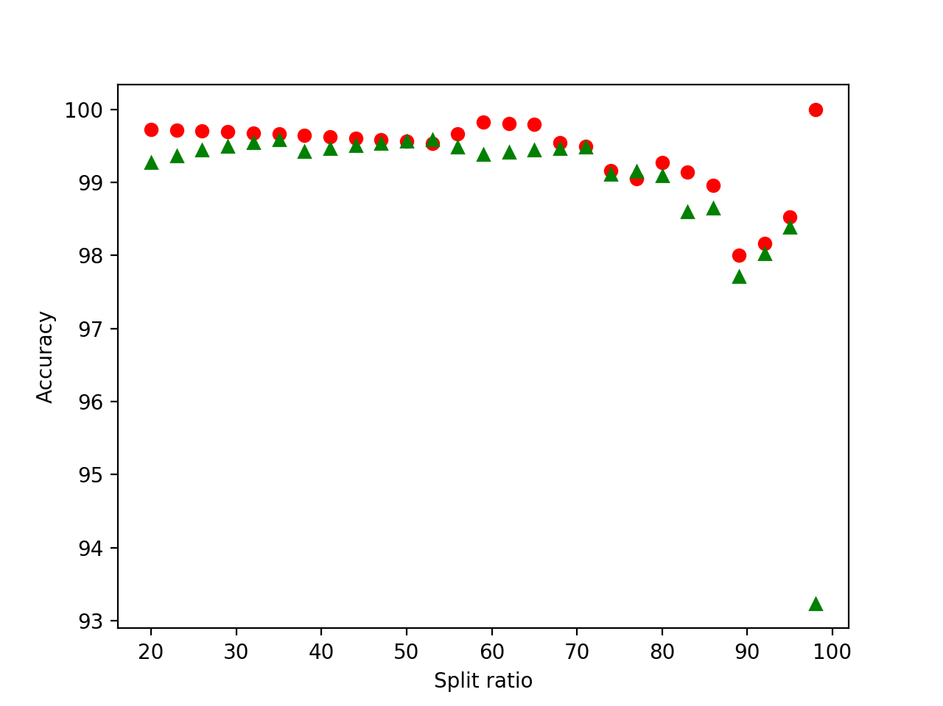
Bias Variance Curve
Training set
Test set
Neural network
Linear
Random forest
K-nearest neighbors
Gaussian

Slide 9
Boiling Frog attack

Slide 10
FUTURE WORK (INCOMPLETE)
Ability to reproduce using iPhone / mobile device?
Would the accuracy of classifiers improve with additional feature detection?

Slide 11
References

