Slide 1
Reinforcement learning Example
Speaker: 鄭又嘉
National Tsing Hua University, Taiwan
Thursday, March 16, 2023

Slide 2
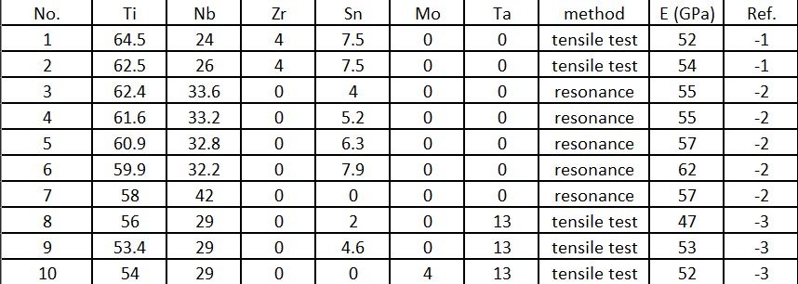
Dataset
Data from bone-like modulus paper
Young’s modulus data(164)

Slide 3
Data Preprocessing
Tensile test (105)
Split data (84 for training/ 21 for testing)
Normalize

Slide 4
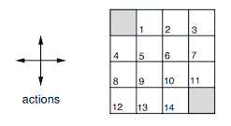
Reinforcement Learning Process
Q-learning :
Q-table : [feature1, feature2, actions] = [4, 4, 4]
State : [feature1, feature2]
Action : [0, 1], [0, -1], [-1, 0], [1, 0]
Reward : ex. Out of world : -100/ Target: 100

Slide 5
Reinforcement Learning Process
Q-learning :
Q-table : [Ti, Nb, Zr, Sn, Mo, Ta, actions] = [20, 20, 20, 20, 20, 20, 3] (Wrong here)
State : [Ti, Nb, Zr, Sn, Mo, Ta]
Action : each element [5, 0, -5] → 729 actions
Reward : - Youngs modulus (from RandomForestRegressor)

Slide 6
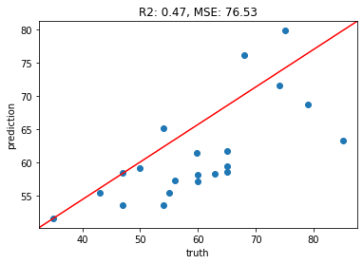
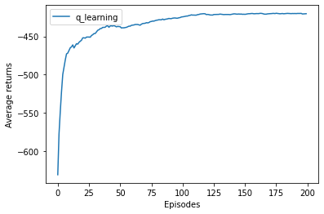
Reinforcement Learning Results
Young’s modulus regression
Q-learning rewards return

Slide 7
Reinforcement Learning Results
Youngs modulus : 66.096
Alloy : [Ti, Nb, Zr, Sn, Mo, Ta] = [5, 5, 5, 5, 5, 5]
Problem:
1. Q table size → Q learning is not a great method for this problem.
2. The action step needs to be more precise.

Slide 8
Thanks!

