Slide 1
Predicting sales from bakery Transactions

Slide 2
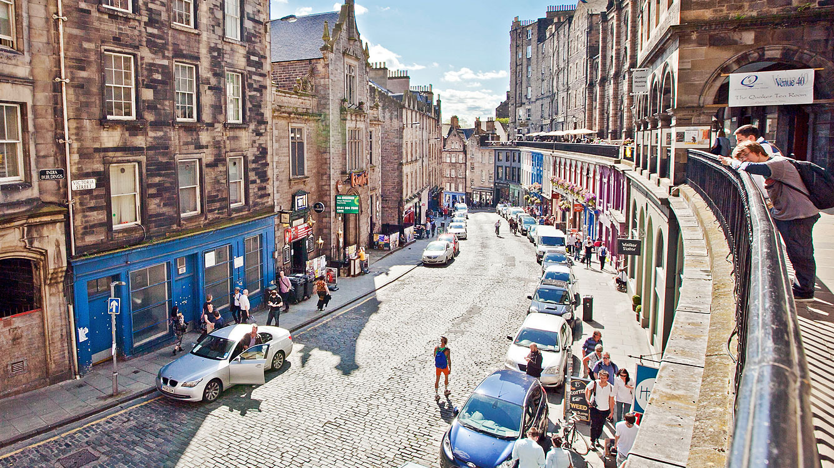
Bakery location Edinburgh old town

Slide 3
Business motivation
Can I predict future sales?
Could I explain the cause for unnormal periods where sales were really high or low?
Can we predict repetition of those events based maybe on weather or local events?

Slide 4
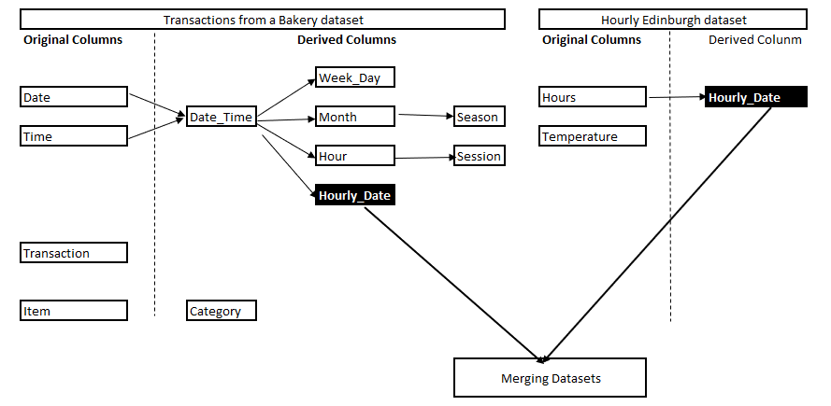
Datasets used:
Transactions from a bakery dataset from Kaggle
Hourly weather for Edinburgh station, created by Dr Robert Dunn. Dataset was developed in order to study climate extremes and it is in netCDF format
Local events data was taken from http://www.edinburghguide.com/events/

Slide 5
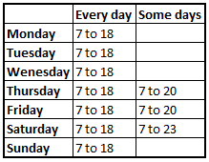
After cleaning the dataset those are the most important business facts
Data only from the 30th October 2016 to the 9th of March 2017
The bakery sales 96 different items in total, 85 are foods and 6 drinks as well as others for cancellations and adjustment
The bakery opens 7 days a week
It was closed only 4 days during the 6 month period. Those days were the 25th and 26th of December 2016 and the 1st and 2nd of January 2017
Below are the opening hours:
Maybe the days with extra opening hours are days with events? And maybe with the most sales?

Slide 6
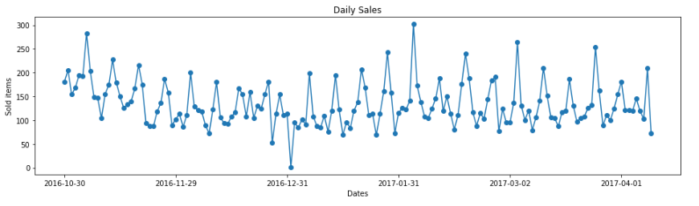
Daily total sales
[a]
[b]
Interesting results, I can see a pattern, it seems that frequently there is a busy period followed by periods which are not as busy. This behaviour keeps repeating, maybe there is a day of the week that is the most busy.
[a] Outliner with day sales are really high, which days, why?
[b] Only one item sold that day, which day was that, why?
Can weather explain some of the outliner?

Slide 7
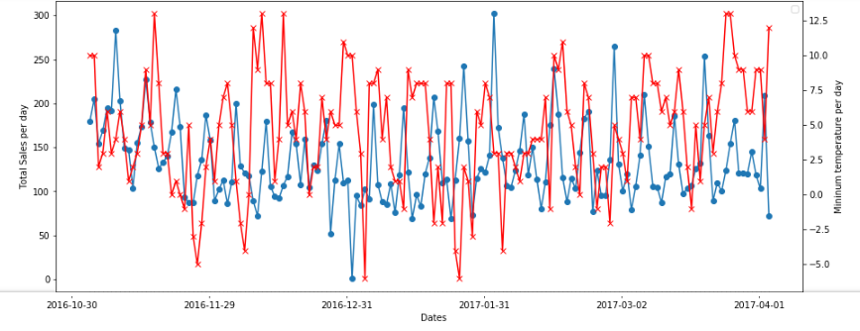

Daily sales and temperature
[a]
[b]
Temperature does not explain outliner. We see that some days with very low temperature had high sales and the other way around.
There is seasonality, as Saturday is the most busy day of the week
[a] Local events can explain the top outliners
[b] The day with 1 item sold was the 1-Jan-2017 at 1:20 am, bank holiday.
aha, mystery solved!!!!. After parting for the new year’s celebrations, one of the employees with a key to the bakery remembered that they did not have bread for next day dinner party so on the way home got in a bought one bread. As it was new year's the bakery was closed and therefore just one transaction took place

Slide 8
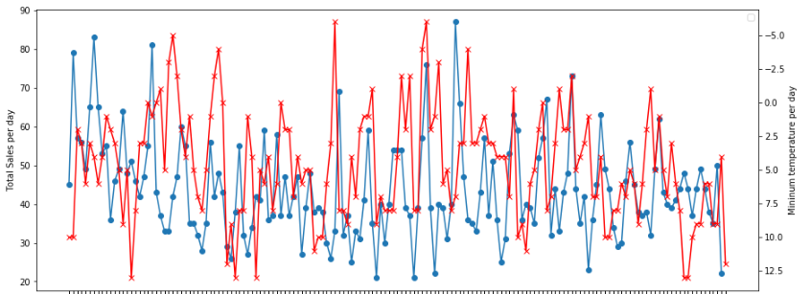
Sales of hot drinks and temperature
[*]
[*]
[*]
[b]
[*] It seems that when it is really cold, sometimes there are more hot drinks sales.
After running models to predict (1) total sales and (2) total hot drinks using temperature only. Temperature alone is not enough, we need other feature in order to make better predictions. In both cases the results were very close to the baseline model.
My guess is that people from Edinburg are used to very cold weather and it makes no differences to their day to day life. I could not do the same comparison with hot temperatures and cold drinks as we have limited data. But it will be very interesting to see.

Slide 9
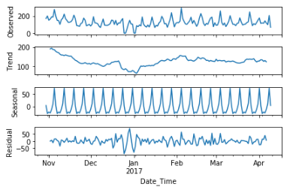
Seasonal decomposition for daily total sales
[*]
[*] When working with time series, if there are missing days it will add those. In this case, it represents bank holidays.

Slide 10
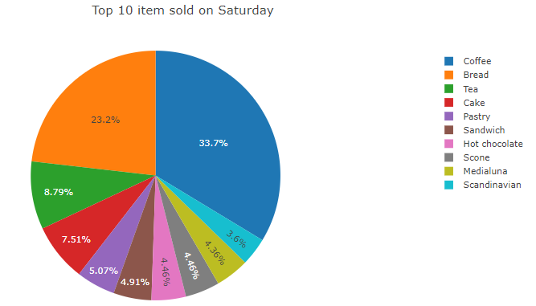
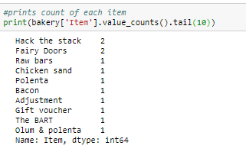
In summary
Coffee is the most sold item followed by bread
There are a few item that have been sold once or twice only, maybe there are worth stop selling those, or at least item that have a short life date
There is not enough data to make compare between seasons or months

Slide 11
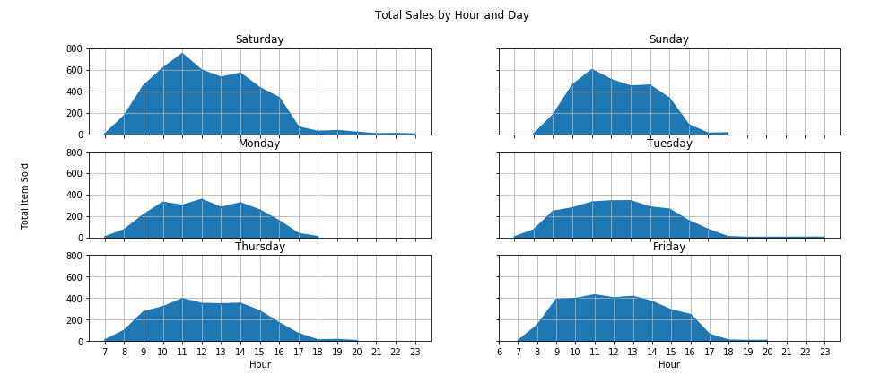
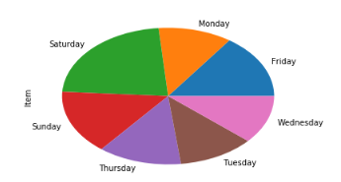
Sales volume comparison
Saturday is the busiest day of the week. Where there are more volume of sales around lunch and tea time. It could be that people prefer to eat lunch out with family or friends while doing shopping or other outdoor activities.
The busiest hours are from 10:00 to 14:00 all days.
On average customers buy 2 to 2.5 items between 10:00 to 17:00, Early morning and late evening they only bought on average 1.5 items. Maybe early morning people only buy coffee and in the evening they buy just bread.

Slide 12
Models used Feature
Linear Regression
Lasso
Ridge
Decision Tree
Decision Tree tuned
Random Forest
Random Forest tuned
SARIMAX
Categorical feature Date, was transformed into day of the week as input feature.
Created new feature called “is local event” representing day where there are local events and therefore more sales.
Created new feature called “is bank holiday”, representing dates where bakery was closed due to bank holidays

Slide 13
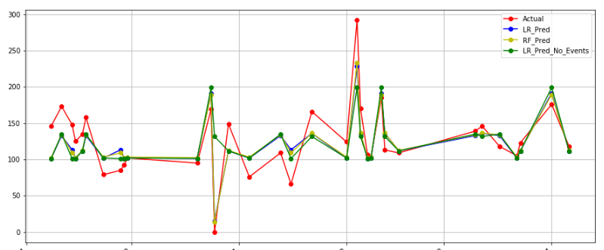
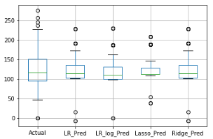
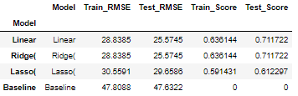
Daily Sales predictions using Linear Regression Models

Slide 14
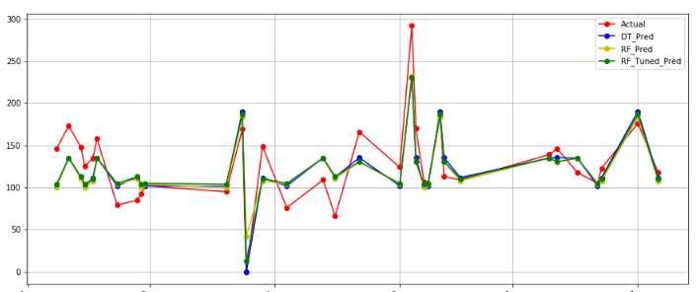
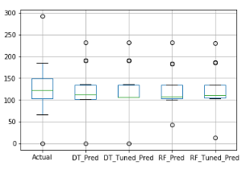
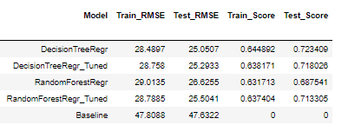
Daily Sales predictions using Decision Tree and Random Forest Models

Slide 15
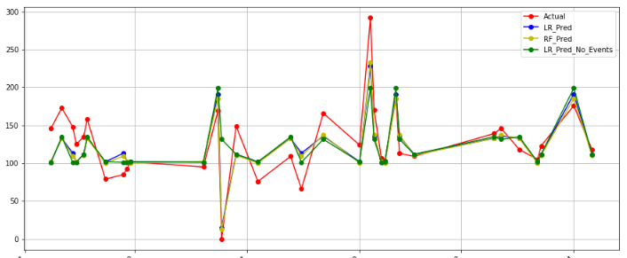
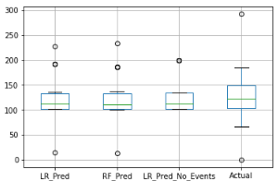
Comparison of best models

Slide 16
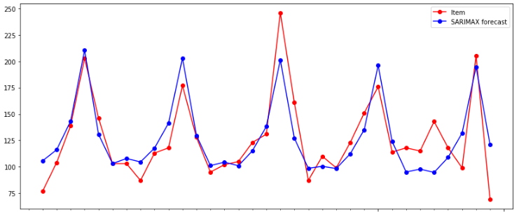
Daily Sales predictions using Time Series
RMSE SARIMAX: 20.895
RMSE Baseline model: 38.514

Slide 17
Conclusion
Linear regression and Decision Tree all produced very similar results, however, I will use linear regression for predictions. Every Thursday we can predict sales for the weekend. The error means that we will have +/- 25 items from potential sales.
We can use the item in percentage sales with the prediction as a guidance for the bakery stock
Weather have no impact
Day of the week is the most important feature
Further work look at the most sales item and find relationships to suggest sale or promotions as combos in the future

