Slide 1




Process Behavior Analysis
Mentor: Yoav fuchs
By: Benyamin neman & Yechiel tauber
In collaboration with:

Slide 2






R&D TEAM
Benyamin Neman
Computer Science
Penetration Tester
Yechiel Tauber
Computer Science
Software Developer
Name
Name
Degree
Degree
Work In
Work In
Position
Position

Slide 3

Goal
Identify suspicious events from all actions performed on the system for a particular process
Give a weighted score
Give a report showing the suspicious events

Slide 4


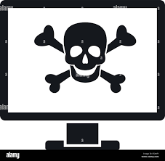
Technical challenges
Familiarity with Procmon parser
Procmon parser is incomplete …
Finding and collecting suspicious categories
Rate the events and give the process a general score

Slide 5
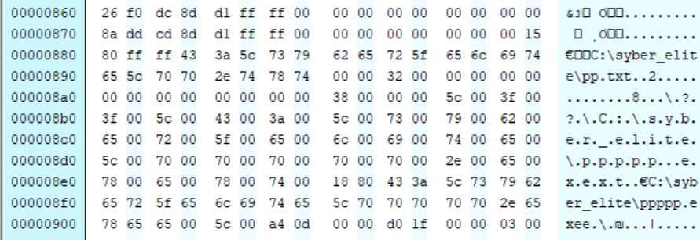

In-depth investigation of the project and some reverse engineering to add new functionalities

Slide 6



Exploring & Analysis
Exploring over then 100 malware samples
Building sample programs and researching them
Extraction of over 150 paths to detect auto-start registration attempts

Slide 7


Slide 8

Test events by category
Registry Operation
Collects information about installed application
Registration to autorun , …
Filesystem Operation
Write to executable file
Changes the file name , ….
Process & threads Operation
Create new process
DLL injection , …
Network Operation
Open TCP socket
Open UDP socket , …

Slide 9
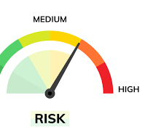
Rating
Giving a rating to each category
Determining a weighted score for the process

Slide 10


