Slide 1

Process Behavior Analysis
Benyamin Neman & Yechiel Tauber

Slide 2

Goal
Identify suspicious events from all actions performed on the system for a particular process

Slide 3


Technical challenges
Familiarity with Procmon parser
Procmon parser is incomplete …
Finding and collecting suspicious categories
Rate the events and give the process a general score

Slide 4
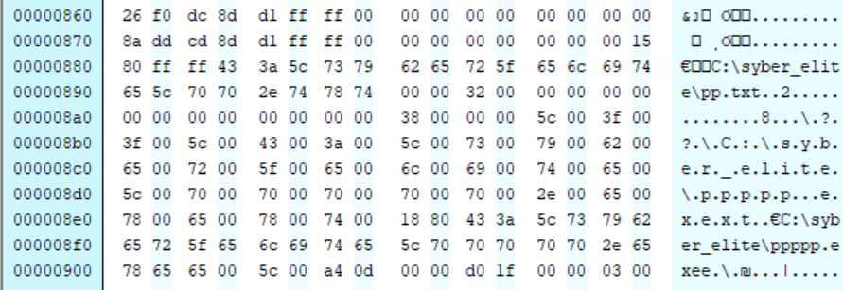

In-depth investigation of the project and some reverse engineering to add new functionalities

Slide 5



Exploring over then 100 malware samples
Building sample programs and researching them
Extraction of over 150 paths to detect auto-start registration attempts

