Slide 1

Process Behavior Analysis
Benyamin Neman & Yechiel Tauber

Slide 2

Goal
Identify suspicious events from all actions performed on the system for a particular process

Slide 3
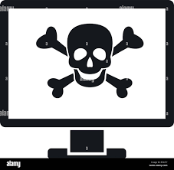

Technical challenges
Familiarity with Procmon parser
Procmon parser is incomplete …
Finding and collecting suspicious categories
Rate the events and give the process a general score

Slide 4
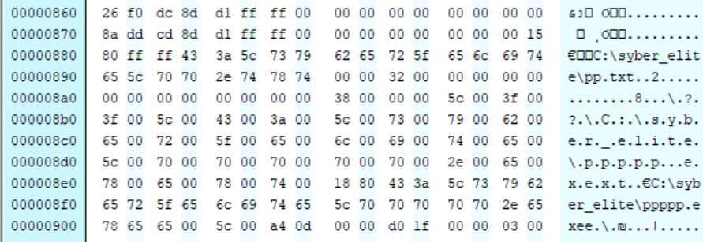

In-depth investigation of the project and some reverse engineering to add new functionalities

Slide 5



Exploring over then 100 malware samples
Building sample programs and researching them
Extraction of over 150 paths to detect auto-start registration attempts

Slide 6
Create an executable file
suspicious process
Dll injection remote tread
Registration to auto start
Dll injection through registry
Remove the Shadow File
suspicious Command line
create or modify system certificates
Identify environmental tests
Set or modify Internet Explorer security zone

Slide 7
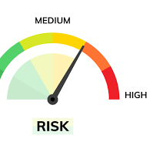
Giving a rating to each category
Determining a weighted score for the process

Slide 8
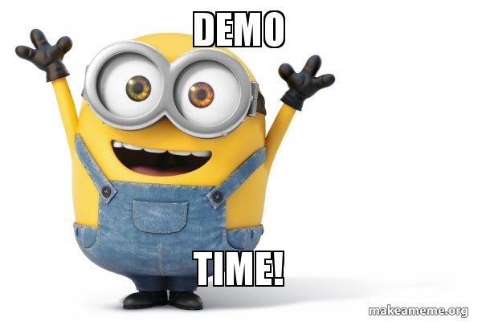

Slide 9


