Slide 1
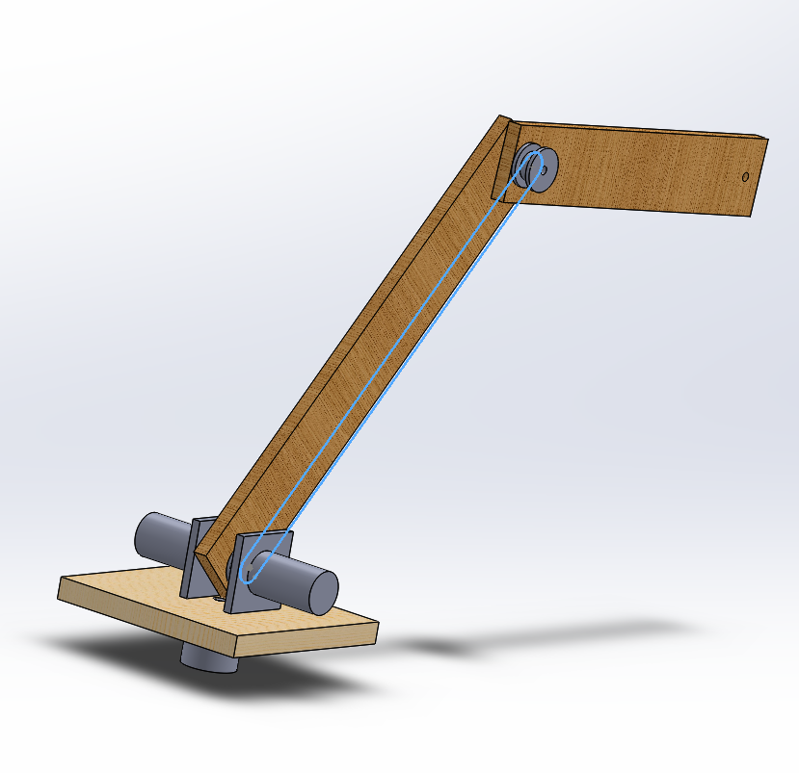
ME 4405 – FINAL PROJECT
Hand motion mimicking RRR robot
Juan Munoz and Yuen Bak CHING

Slide 2
IDEATION
A robot arm with 3-dof modelled after the human arm
Human arm with sensors (accelerometer) to detect arm movements
Robot Mimic the human arm’s final position

Slide 3
PERFORMANCE REQUIREMENT
Accurately mimics the position of the wrist of the person
Relatively stable, can counteract disturbances(PID controller)

Slide 4
SYSTEM DESIGN

Slide 5
SYSTEM ALGORITHM
Sensor: Accelerometer
Compute positions (by integration)
Compute joint angles (by RDA)
Send to Motors
Obtain actual angle (from motor encoder)
PID controller

Slide 6
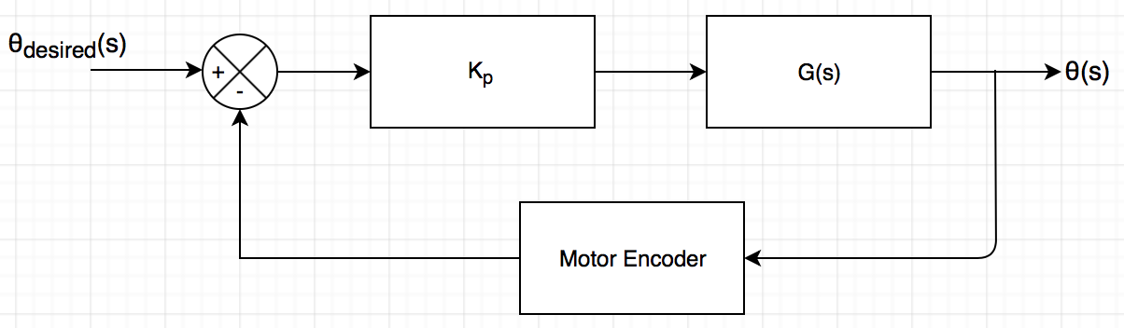
P CONTROLLER FOR BRUSHLESS MOTOR
Reason: I and D control introduce too many delays causes system to behave erratically

Slide 7
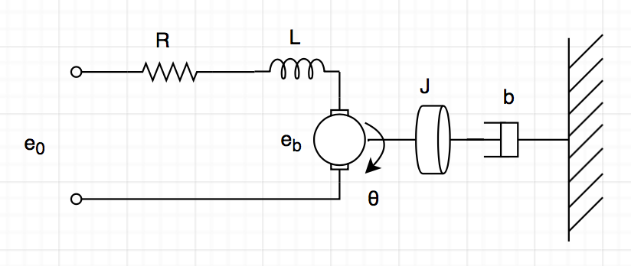
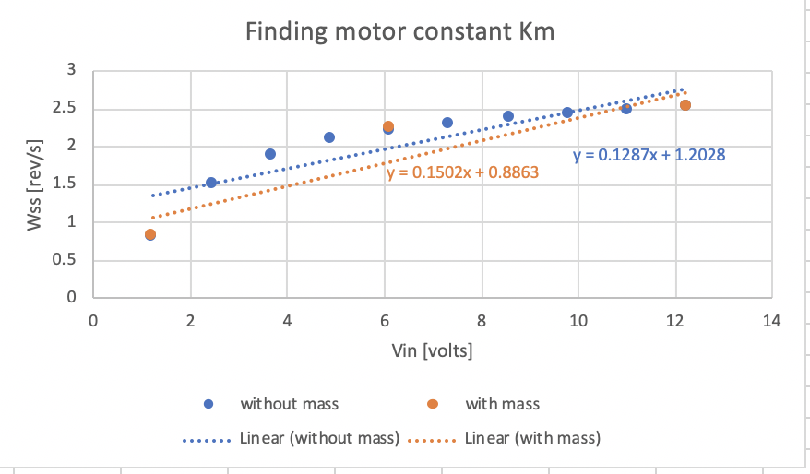
CONTROLLER GAIN
Calculate motor constant experimentally

Slide 8
HOME-MADE ROBOT ARM
Reason: Want to try use Brush-Less motor instead of servo, more challenging
Built using oak (cheap, sturdy, lightweight)
Home-made motor mount and hub to reduce weight and cost(less sturdy but working)
Pulley system to avoid fastening motor to joints, thus decreasing required torque

Slide 9
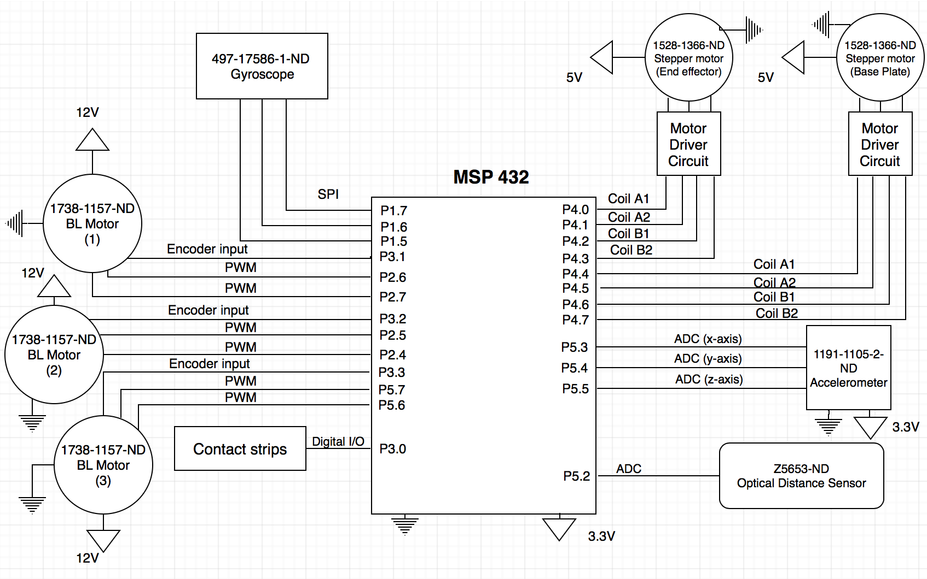
CIRCUIT DIAGRAM (ORIGINAL)
Too complex, too ambitious

Slide 10
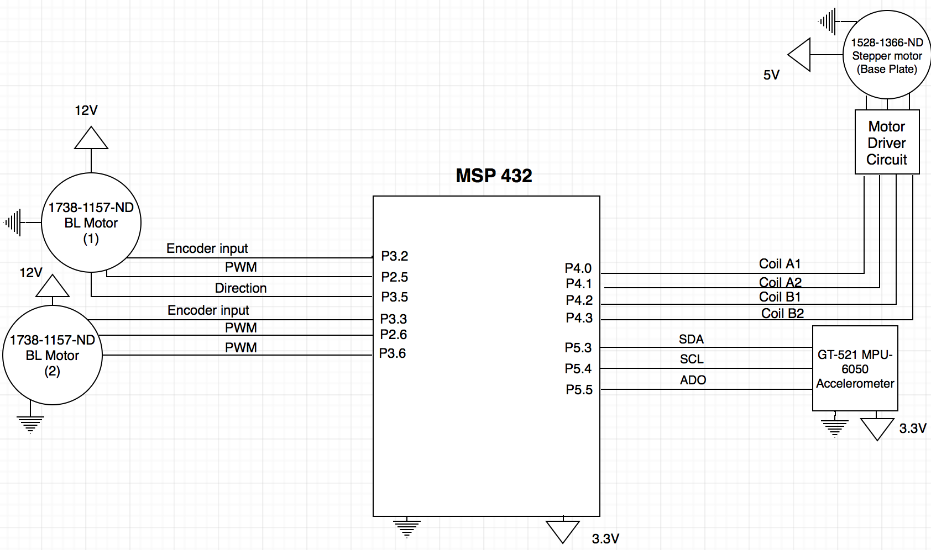
CIRCUIT DIAGRAM (MODIFIED)

Slide 11
Things to Improve (1)
Motor burnt out after hours of testing
Servo Motor should be way easier in this project (too ambitious)
Code did not prevent possible singular configurations
Some hard stop in code can be implemented but time ran out
Cannot control pathing of robot arm (limitation of RDA)
Code did not prevent possible singular configurations
Some hard stop in code can be implemented but time ran out

Slide 12
Things to Improve (2)
Accelerometer data grows out of bounds (robot ends to restart from time to time)
Data integrated, thus error is accumulating
Should use gyroscope as well and use a filter to combine both data
I2C data corrupted by motor’s magnetic interference
Either use shielded cables or introduce a grounded metal shield

Slide 13
WHAT IT ACHIEVED?
P controller working and constantly adjusting and holding arm in place
Successfully obtain accurate positions from accelerometer (by integration)
Using such position to calculate joint angles (robotics -> RDA)
Robot motion greatly resembles arm motion

