Slide 1
Protein Contact Prediction
Protein Structure Prediction
Protein Structure Classification
Image Segmentation
GAN Data Generation
Tracking and Pose Detection

Slide 2
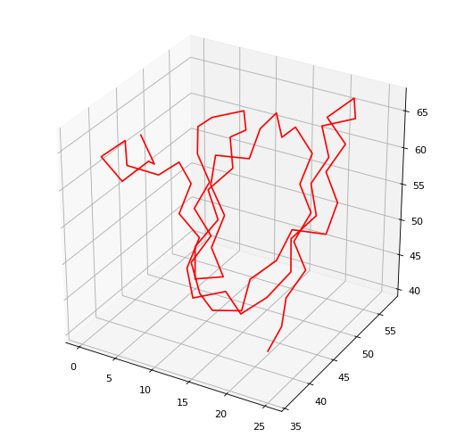
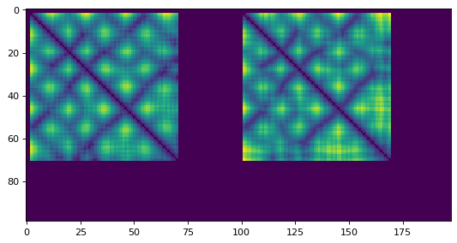
Protein Contact Prediction
Cross entropy
loss function
MSA Embedding:
Facebook ESM
MSA Embedding & Protein Sequence
Contact Prediction
Structure Prediction:
DConStruct & MDS
Protein
Sequence
contact map
structure
Contact Prediction network transforms the 1D input into 2D input by stacking the dataset row-wise and column-wise.
Dimension reduction, axial attention, and residual cnn is applied to get the contact map across binned distances.
DConStruct: Hybridized-distance and contact-based hierarchical structure modeling for folding soluble and membrane proteins
MDS: Multidimensional Scaling

Slide 3
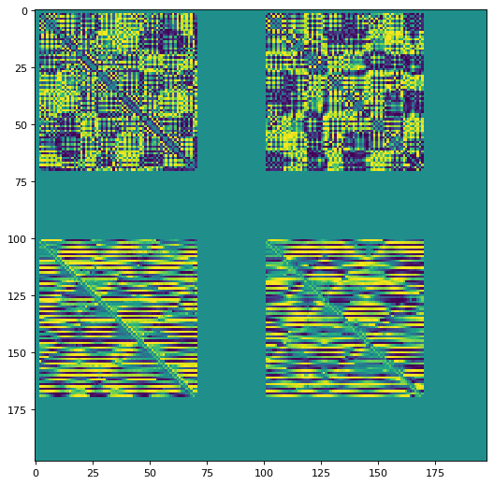
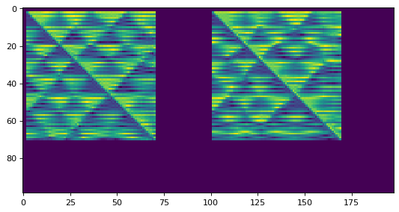
Protein Structure Prediction
MSA Embedding:
Facebook ESM
MSA Embedding & Protein Sequence & Positional Embedding
1D Protein Angle Prediction
1D Protein Angles
Natural Extension of Reference Frame
Protein
Sequence
structure
1D Protein Angle Prediction: LSTM based model that outputs to a space of 1D angle alphabet.
NERF: Natural Extension of Reference Frame is used to construct the 3D model from the 1D protein angles.
A differentiable 2D distance and dihedral angle maps are constructed and a L2 loss is applied.
Differentiable Distance, Dihedral Angle Maps
L2 loss function

Slide 4
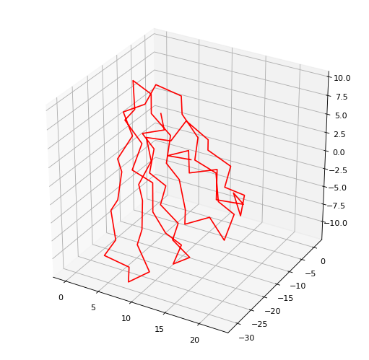
Protein Structure Prediction:
Various Predictions from Sidechainnet Dataset
(lengths 70~150)
Distance Map: Left: GT Right: Prediction
Phi Map: Left: GT Right: Prediction
Structure Prediction: Left: GT Right: Prediction
Psi Map: Left: GT Right: Prediction
Omega Map: Left: GT Right: Prediction

Slide 5
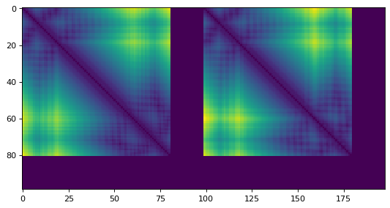
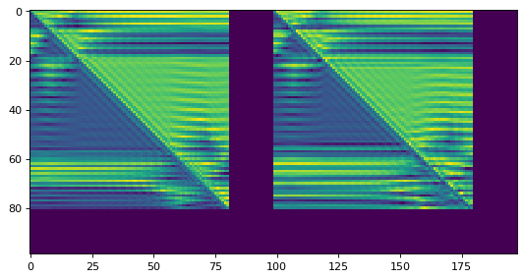
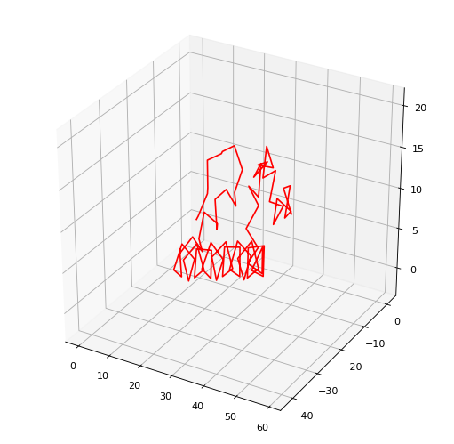
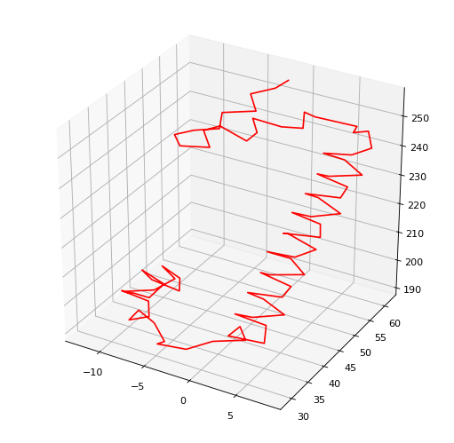
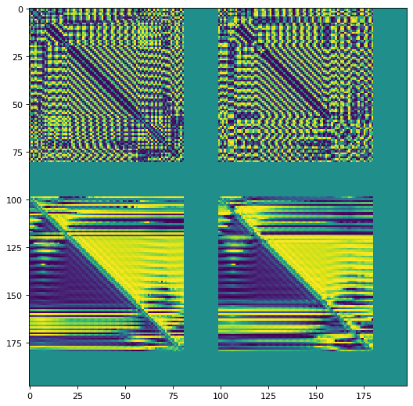
Protein Structure Prediction:
Various Predictions from Sidechainnet Dataset
(lengths 70~150)
Distance Map: Left: GT Right: Prediction
Phi Map: Left: GT Right: Prediction
Structure Prediction: Left: GT Right: Prediction
Psi Map: Left: GT Right: Prediction
Omega Map: Left: GT Right: Prediction

Slide 6
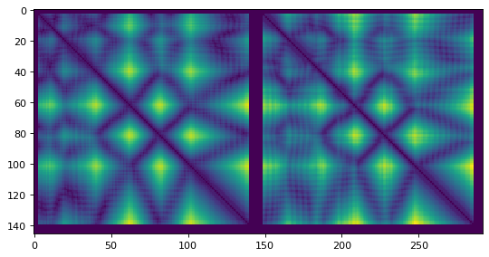
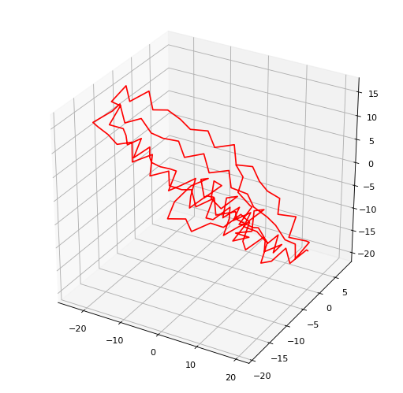
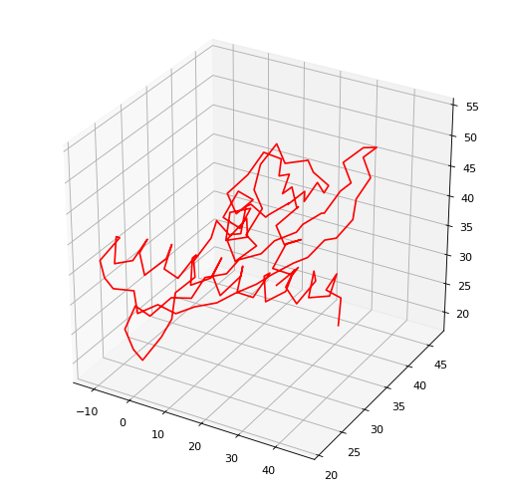
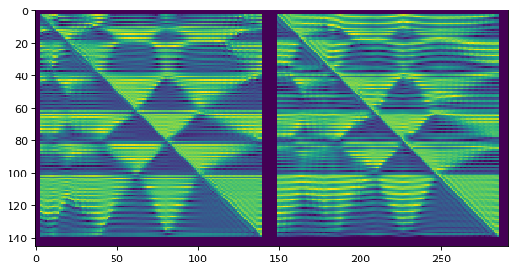
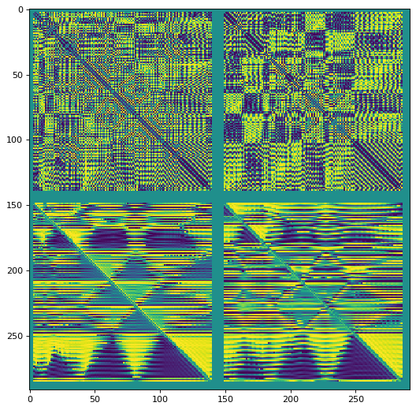
Protein Structure Prediction:
Various Predictions from Sidechainnet Dataset
(lengths 70~150)
Distance Map: Left: GT Right: Prediction
Phi Map: Left: GT Right: Prediction
Structure Prediction: Left: GT Right: Prediction
Psi Map: Left: GT Right: Prediction
Omega Map: Left: GT Right: Prediction

Slide 7
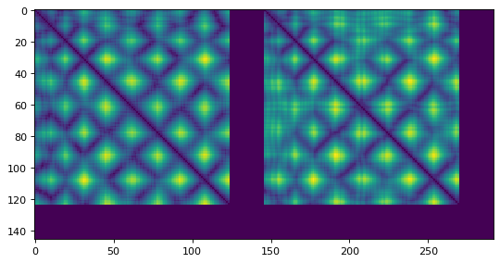
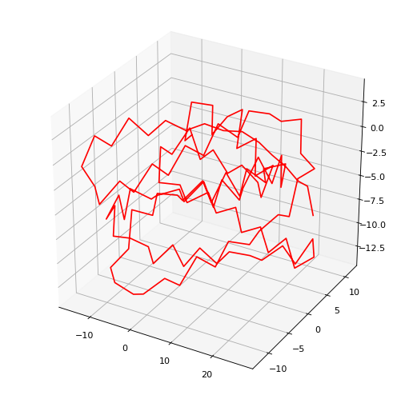
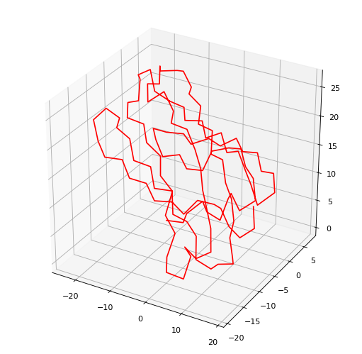
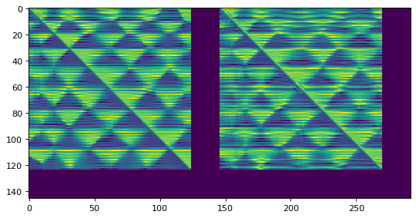
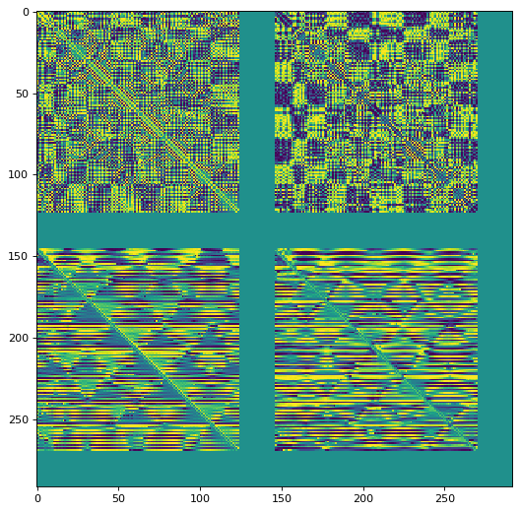
Protein Structure Prediction:
Various Predictions from Sidechainnet Dataset
(lengths 70~150)
Distance Map: Left: GT Right: Prediction
Phi Map: Left: GT Right: Prediction
Structure Prediction: Left: GT Right: Prediction
Psi Map: Left: GT Right: Prediction
Omega Map: Left: GT Right: Prediction

Slide 8
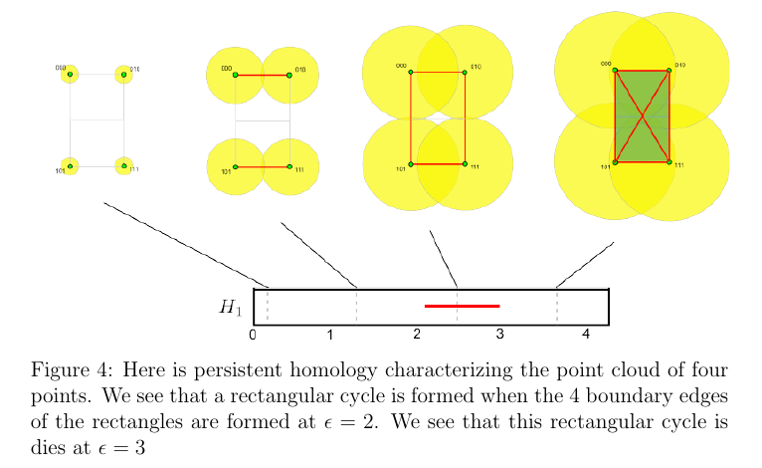
Protein Structure Classification: Persistent Homology
Simplex
Edges and faces
Homology of a Simplex
Vector space whose dimensions measure the hole’s in a simplex.
Simplicial Complex
Chain of simplexes
Vietoris-Rips-Complex

Slide 9
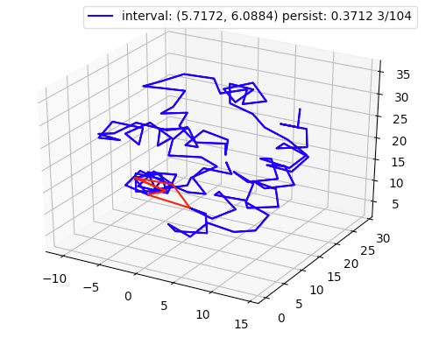
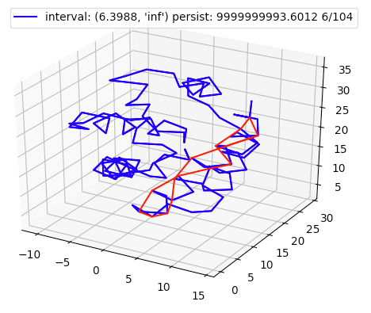
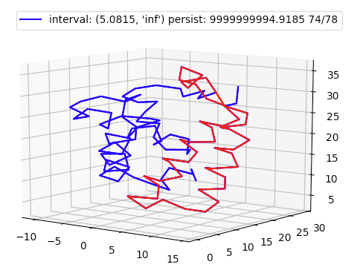
Protein Structure Classification: Feature Extraction
These features are used to classify a 3D protein into one of 1200 SCOPe categories.

Slide 10
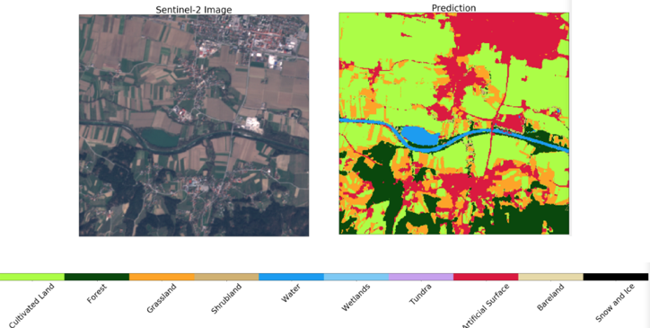
Image Segmentation
Given a satellite map, produced land category segmentation of the satellite map
Used a variety of architectures: DeeplabV3+, Deep Aggregate Net, Fully Dense Net, U-Net

Slide 11
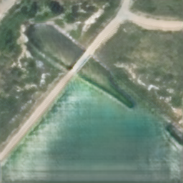

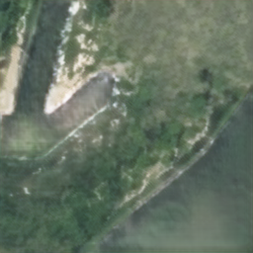

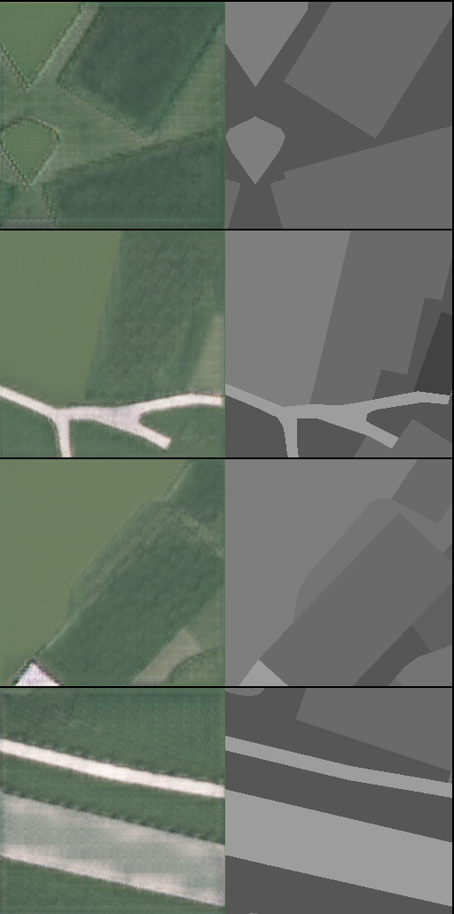
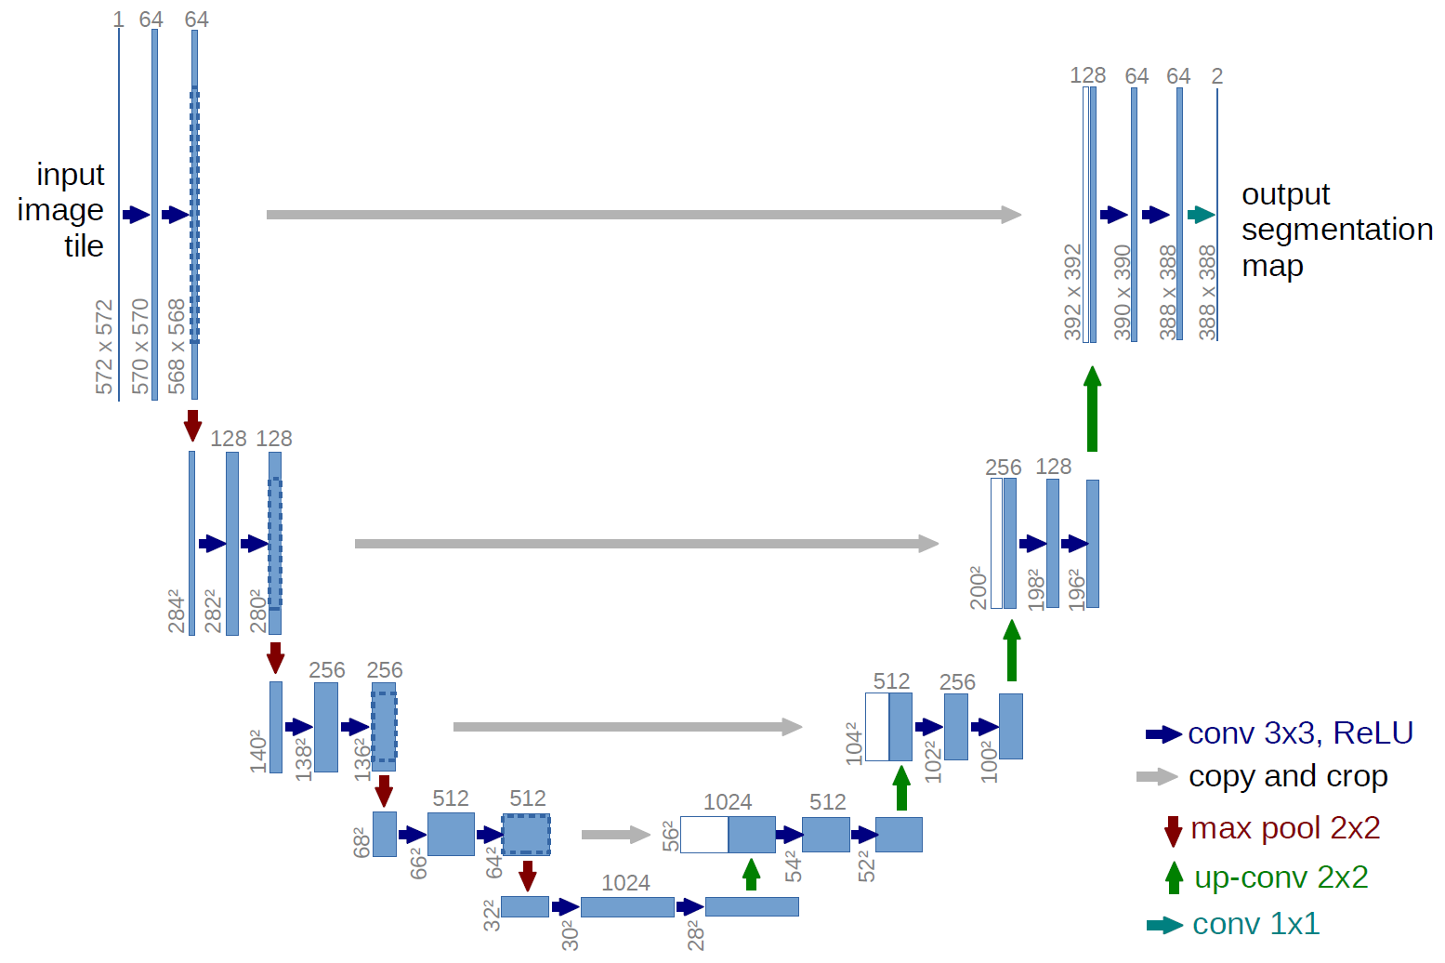
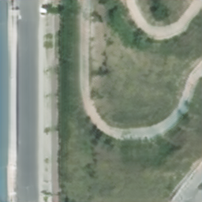

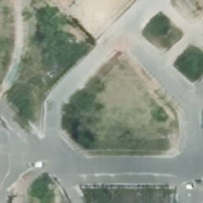

GAN Data Generation
pix2pix
GauGan
Architecture
Discriminator: Blocks of conv2d with batch norm and activation
Generator: Unet, encoder decoder with skip concat links
Loss
Disc: MSE(disc(gen_img+real_img), labels )
Gen: - MSE(disc(gen_img), labels) + L1(gen_img, real_img)

Slide 12
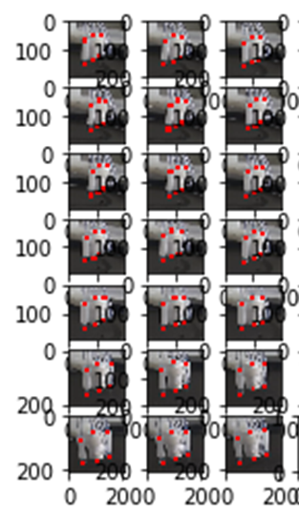
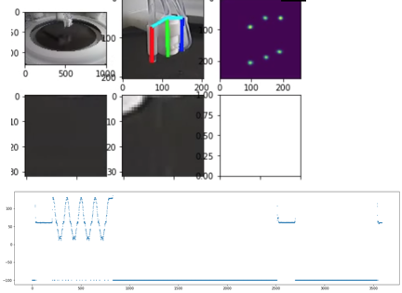
Tracking and Pose Detection

