Slide 1
Prototype Presentation
FIT5152 - Group J
32012578 | Zheng Chen
30289327 | Yi Chong
28560167 | Yuanjia Wang

Slide 2
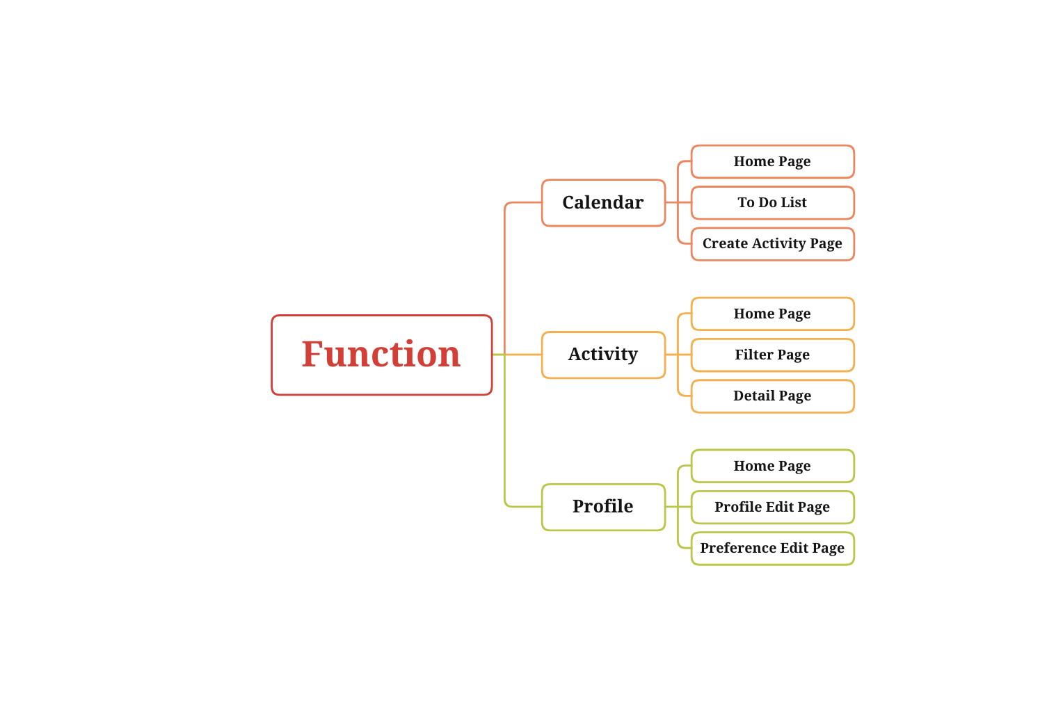
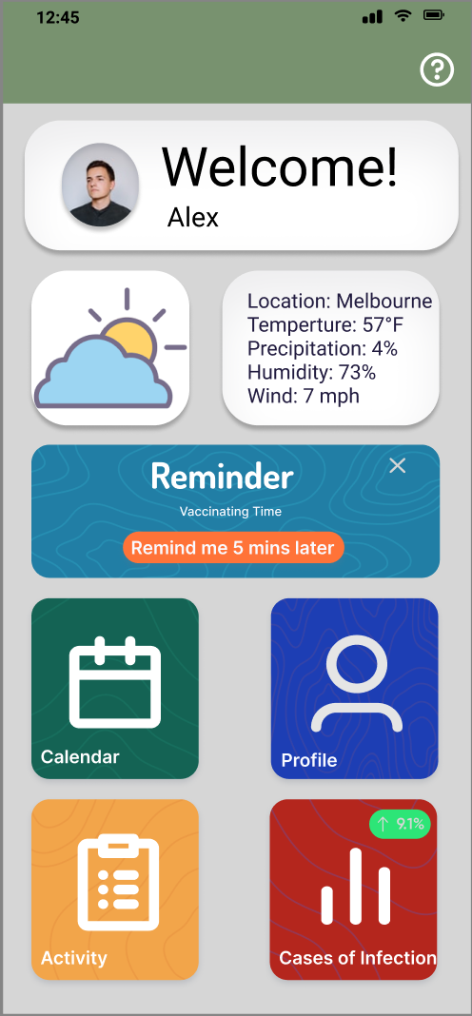
Prototype Structure

Slide 3
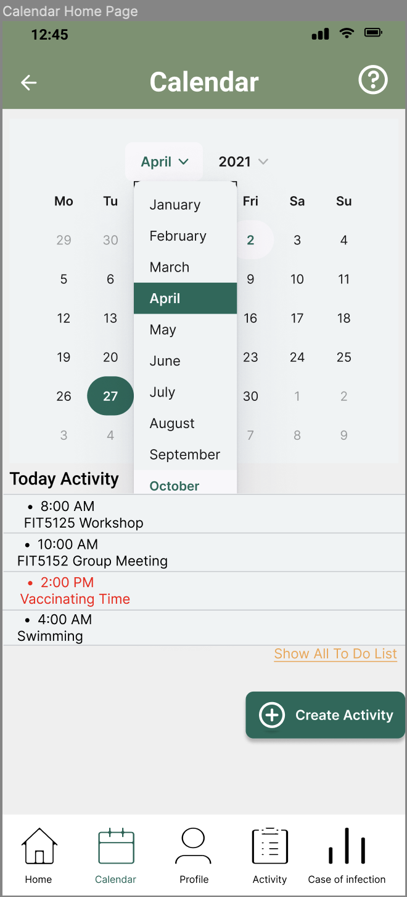
Calendar Home Page
Norman's principle of the Conceptual model
Norman's principle of Feedback
Norman's principle of Mappings

Slide 4
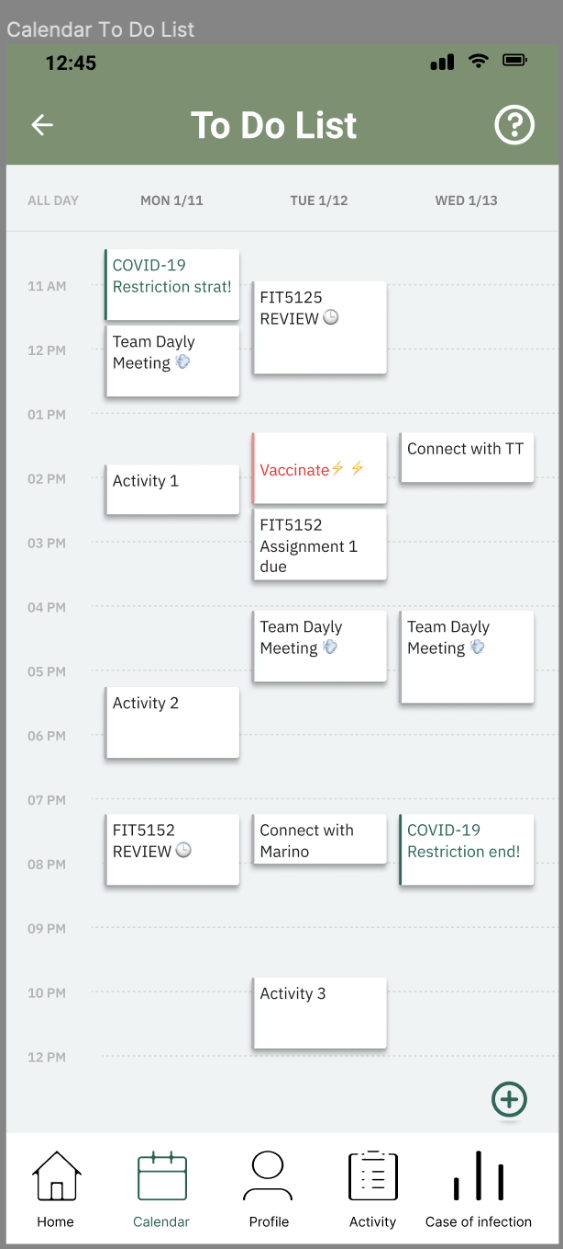
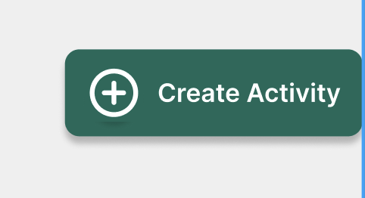
To Do List Page
Shneiderman's Golden Rules for Strive for consistency

Slide 5
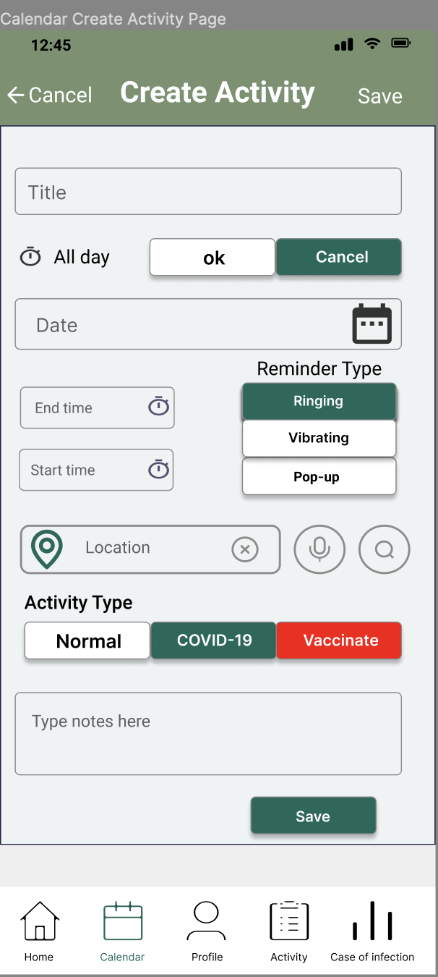
Create Activity Page
Norman's principle of Conceptual model constraints
WCAG principles
Guideline 1.4 Distinguishable
Perceivable
guideline 3.2 Predictable

Slide 6
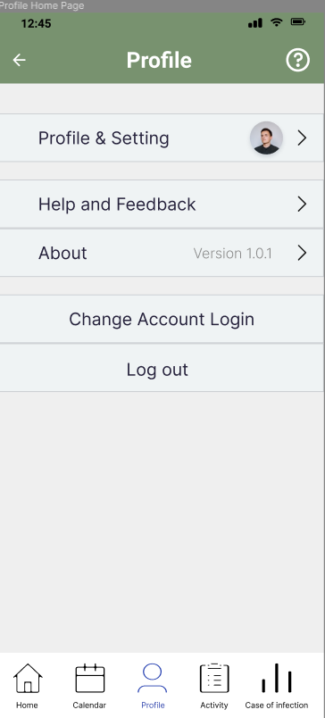
Profile Home Page
Bottom Navigation Bars
Benefit: Quickly switch between different sections of an app
WACG Priciple - Understandable 3.3.5 Help
Guidelines for Menu Design - Meaningful grouping of items
Importance and relevance of item

Slide 7
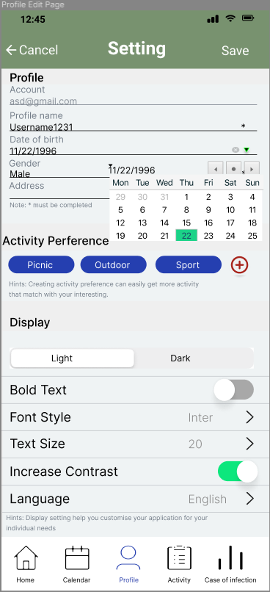
Profile Setting Page
Norman’s 7 Principles - Feedback
Benfit: Tells uers what is happening or/and what happened
8 Golden Rules -Prevent Errors
8 Golden Rules - Seek Universal Usability
Improvment: Voice for information input

Slide 8
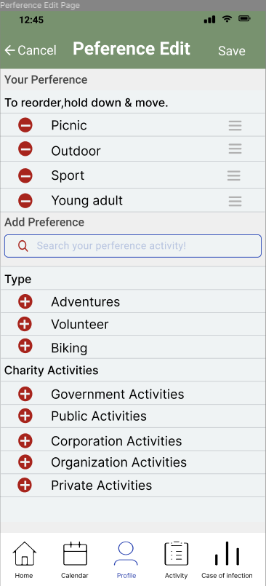
Preference Edit Page
8 Golden Rules -Permit Easy Reversal of Actions
Benefit: be able to quickly backtrack whatever they are doing → A positive user experience
Colour
Red: call attention
Colour theme - provides a consistent colour to an app
high contrast ratio

Slide 9
Home Page

Slide 10
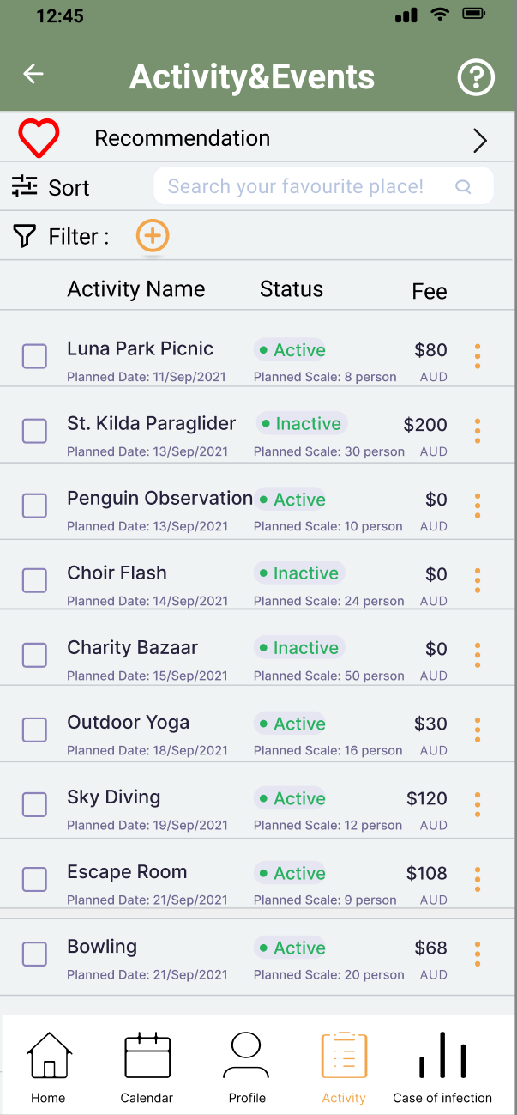
Activity Home Page

Slide 11
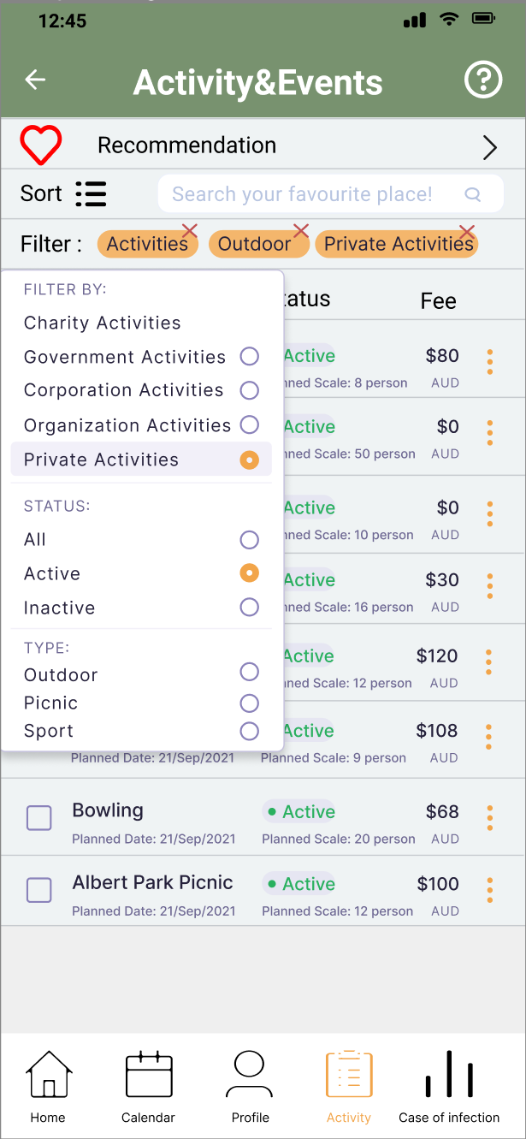
Activity Filter Page

Slide 12
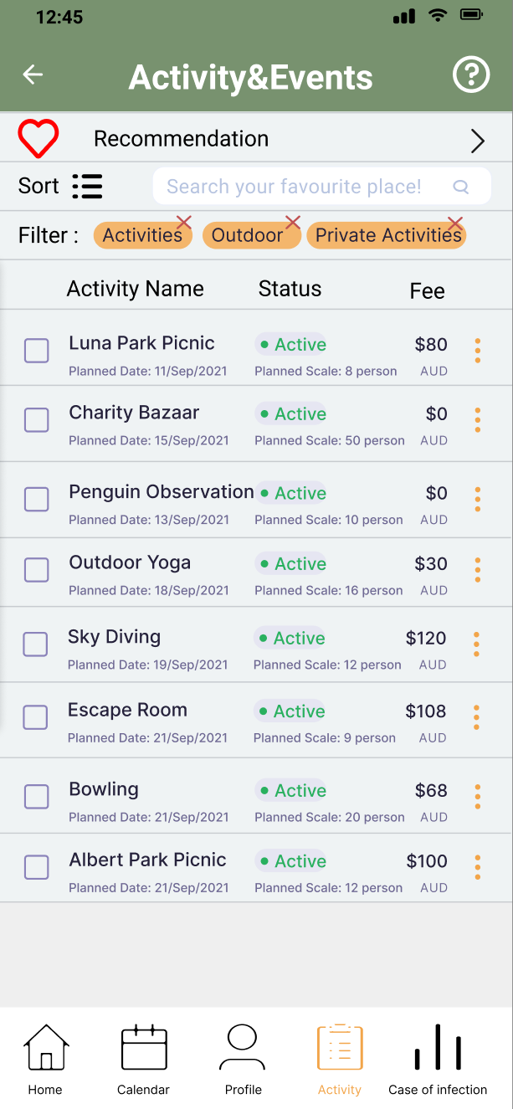
Activity Filter Page

Slide 13
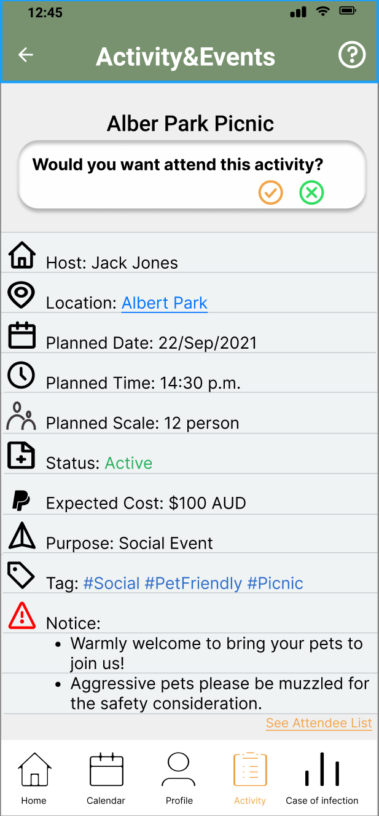
Activity Detail Page

Slide 14
THANKS
FIT5152 - Group J
32012578 | Zheng Chen
30289327 | Yi Chong
28560167 | Yuanjia Wang

