Slide 1
Conference Management System
A professional and efficient CMS system for organise conferences
Team 43
Present by Kaustubh Kundu
Yi Chong
Kaustubh Kundu
Zihao Zhao
Zan Liu

Slide 2
Features & functions
User Registration
Conference Management
Paper Submission
Review Management
Administration

Slide 3

Feature 1 User Registration
1. Register
2. Login

Slide 4
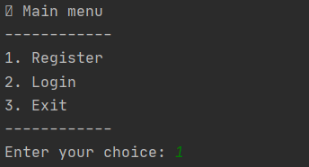
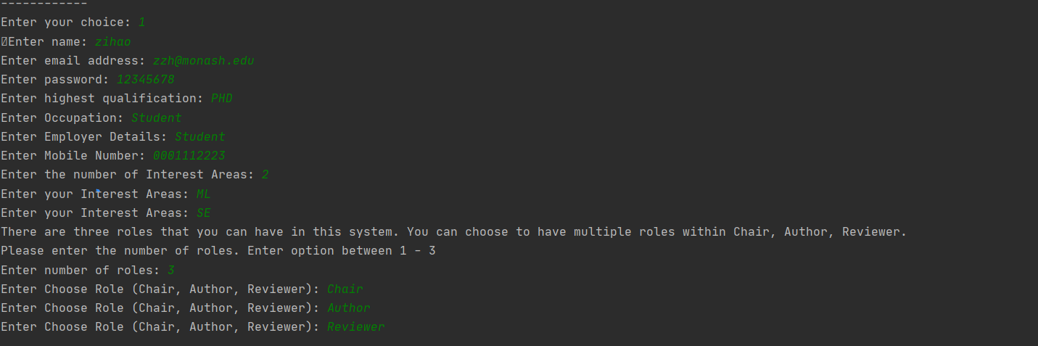
Registration
- At the start of the application the user can see a Register / Login page.
- When user enter 1, it jumps to the Registration Screen.
- Once the user fills the details, registration will complete and directed to the choose role.

Slide 5
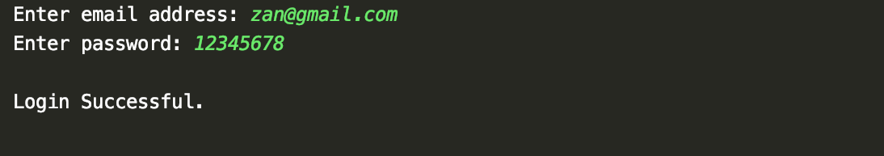
Login
- If the user already has an account, he/she can login with email address and password.
- If the user enters wrong information, they will be redirected to another page.

Slide 6
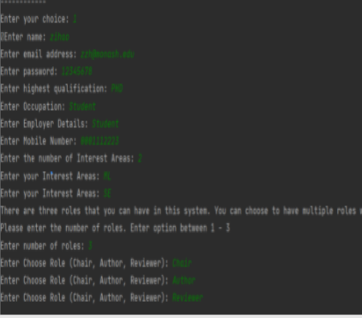
Data storage
Name | Email | Password | Qualification | Occupation | Employ_detail | Phone_no | Field
Kaustubh Kundu | zihao@gmail.com | 12345678 | PhD | Student | Monash | 0001117723 | ML,SE
txt file
Stored in

Slide 7
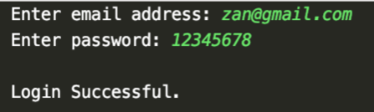
Information check
Name | Email | Password | Qualification | Occupation | Employ_detail | Phone_no | Field
Kaustubh Kundu | zan@gmail.com | 123456678 | PhD | Student | Monash | +9187428383 | ML,SE
txt file

Slide 8
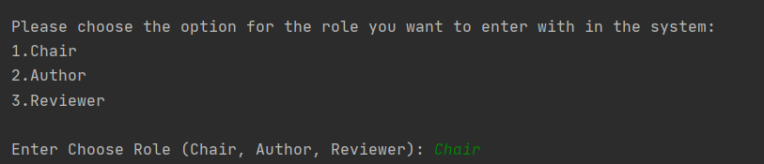
Choose role
- After the login/registration, the role choose screen appear.
- This role choose screen is personalised for specific users.
- If the user has chosen to be Chair, Reviewer and Author in this application while registering, then all of the options will be displayed.
- On the other hand, if the user has to be Chair and Reviewer in this application while registering, then only those options will be displayed.

Slide 9

Feature 2 Conference Management
1. Add conference
2. Edit conference
3. Evaluate paper
4. Notification
5. Logout

Slide 10
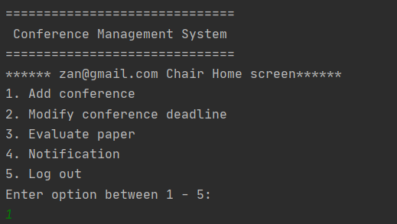
Login as a Chair
Once the user has chosen to be a Chair, then he/she will be shown the chair home screen.

Slide 11
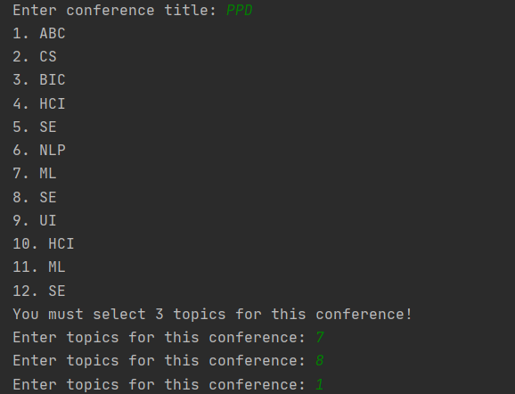
1. Add conference
- A Chair can choose to add / host a conference.
- The Chair has to add the conference title.
- The Chair should select at least three topic list.

Slide 12
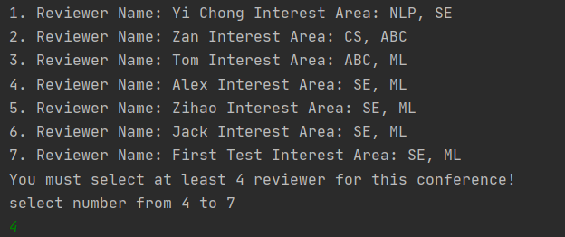
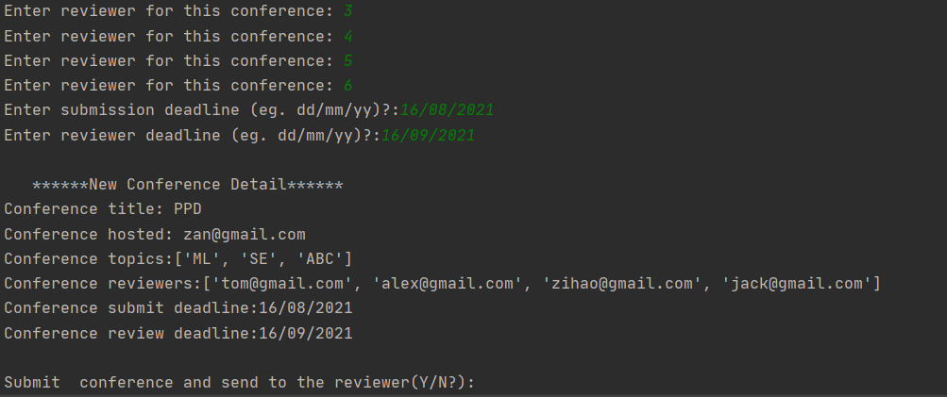
1. Add conference
- The Chair should select at least four Reviewers.
- Once the Chair has filled up all the details, then can submit the conference.

Slide 13
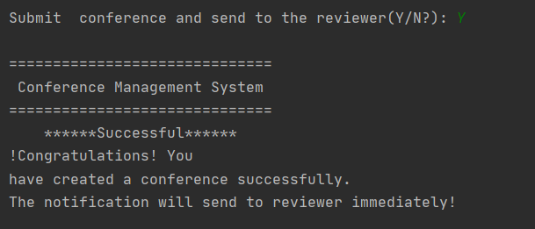
- Once the Chair has filled up all the details, then can submit the conference.
- A successful conference submit screen will be displayed.

Slide 14
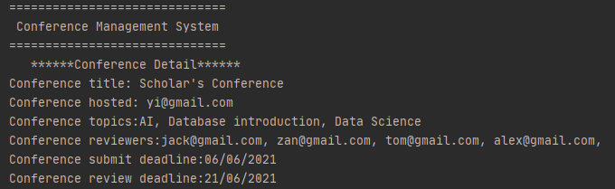
Data storage & Sessions
We will store the details in the database along with the username.
The username will be a unique identifier which will distinguish every user.
We will use sessions to capture this phenomenon.
Stored in
Conference Title | Topic Areas | Reviewers | Submit Deadline | Review Deadline | Hosted
Scholar’s Conference | AI,Database introduction,Data Science | Jack@gmail.com, tom@gmail.com, alex@gmail.com, Zan@gmail.com | 06/06/2021 | 21/06/2021 | yi@gmail.com
txt file

Slide 15
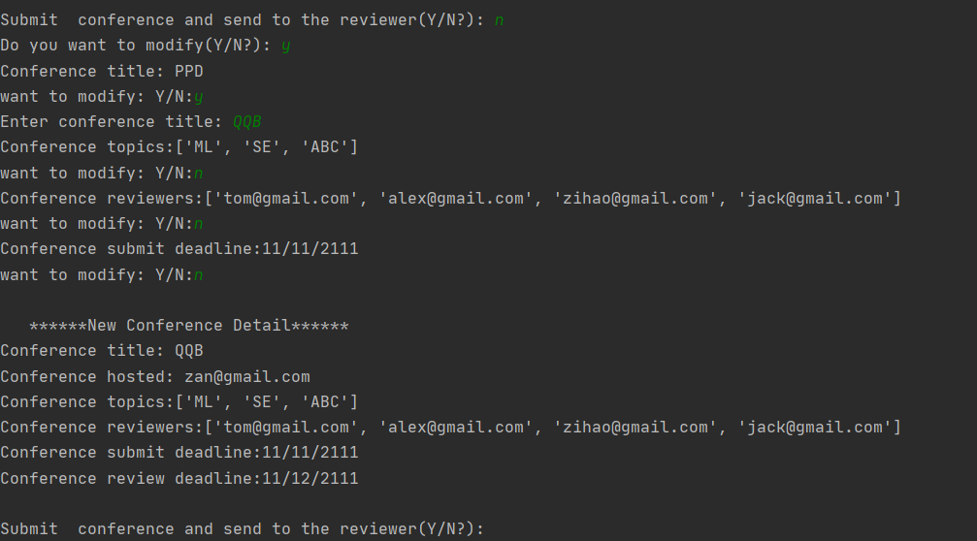
1. Edit conference (DDL)
- Before submitting the conference, the Chair has the option to edit any details he/she wishes to.
- If the Chair wishes to edit any details, relevant options will be given one by one.

Slide 16
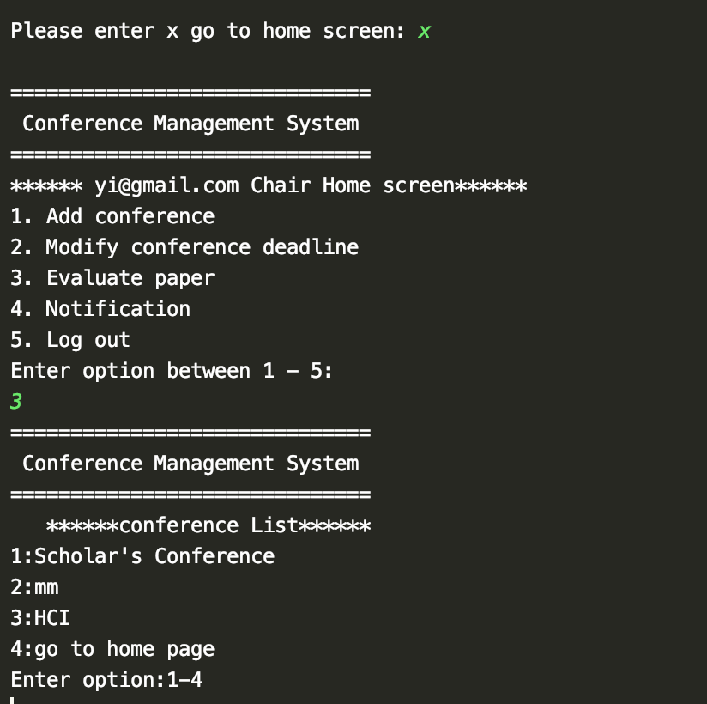
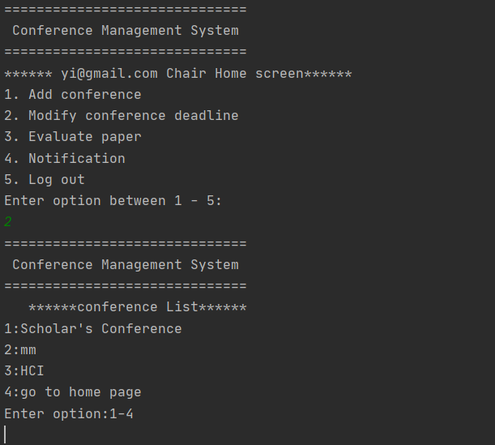
2. Modify conference deadlines(DDL)
- After submitting the conference, the Chair can modify the conference deadline.
- The Chair can select a specific conference to edit the deadline from the list.

Slide 17
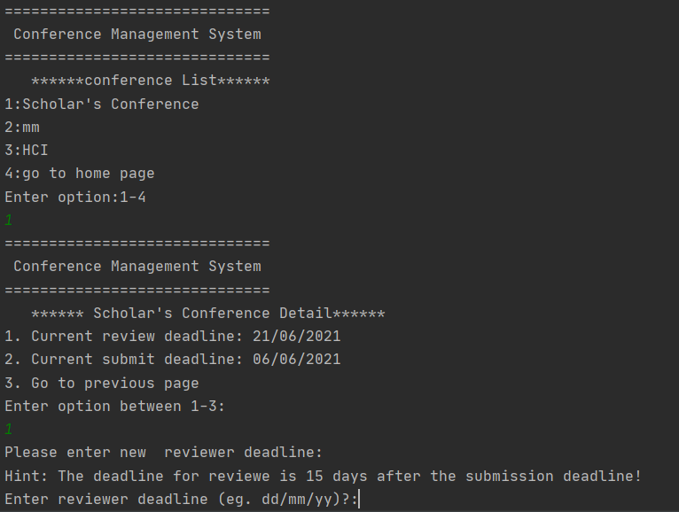
2. Modify conference deadline(DDL)
- For modifying the conference deadline, the Chair can select a specific conference.
- After selecting the conference, the Chair can change the reviewer deadline.
- The deadline for the reviewer should be within 15 days after the submission deadline.

Slide 18
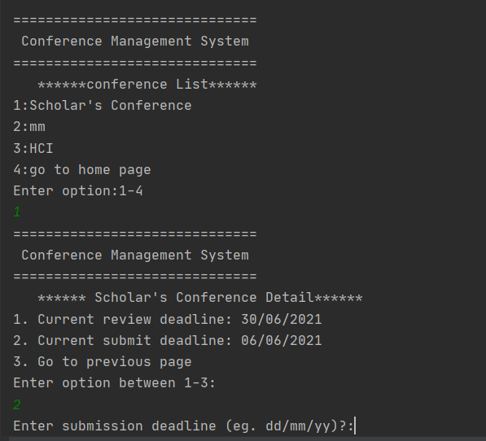
2. Modify conference deadlines(DDL)
- After selecting the conference, the Chair can also change the submission deadline.

Slide 19
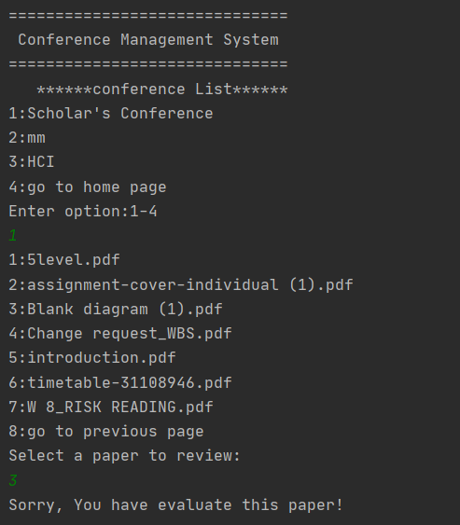
3. Evaluate the paper
- The Chair can select evaluate paper option, to take a final decision on the papers submitted by the authors.
- The Chair can select a specific conference.
- If the Chair has already evaluated the paper, then he/she will not be able to take another decision again.

Slide 20
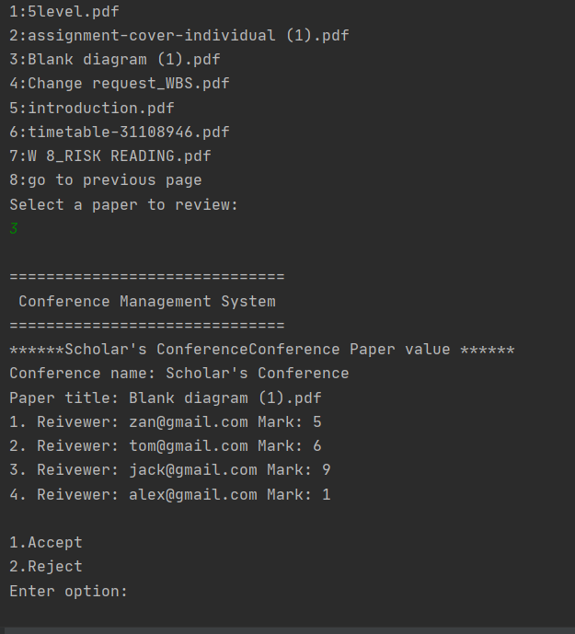
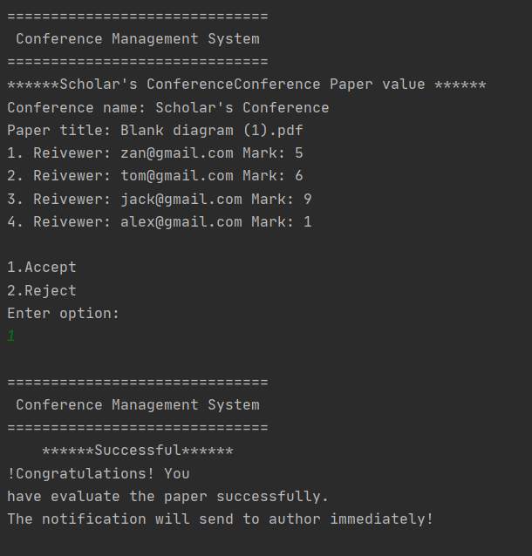
3. Evaluate the paper
- If the Chair has not taken a decision, then he/she can take the final call on the paper.
- The can can also see the marks provided by the Reviewers.

Slide 21
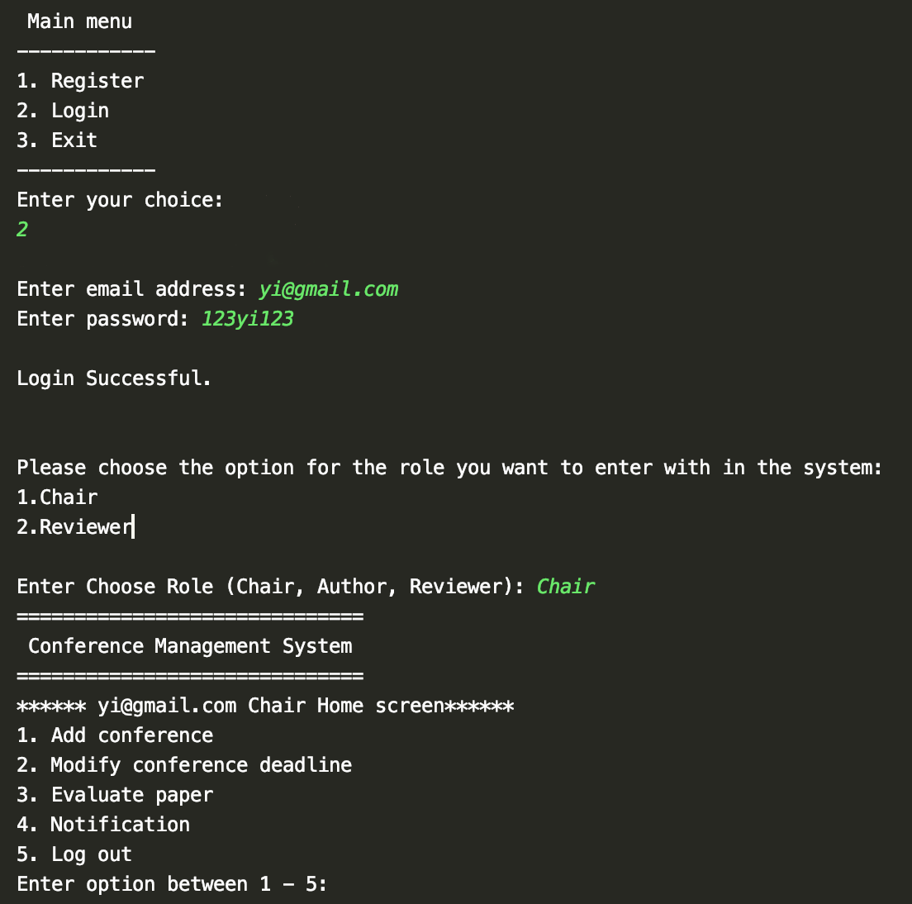
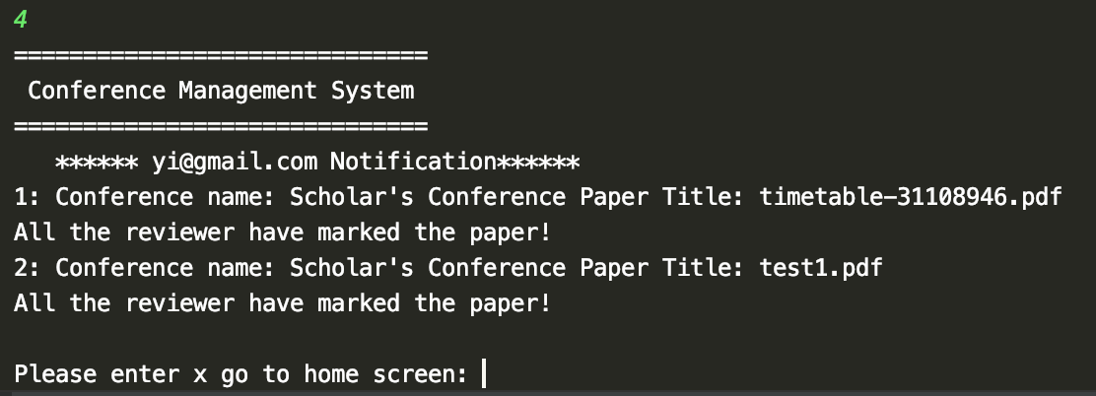
4. Chair can check the notification
- The Chair can select notification option to check the notifications related to Chair.

Slide 22
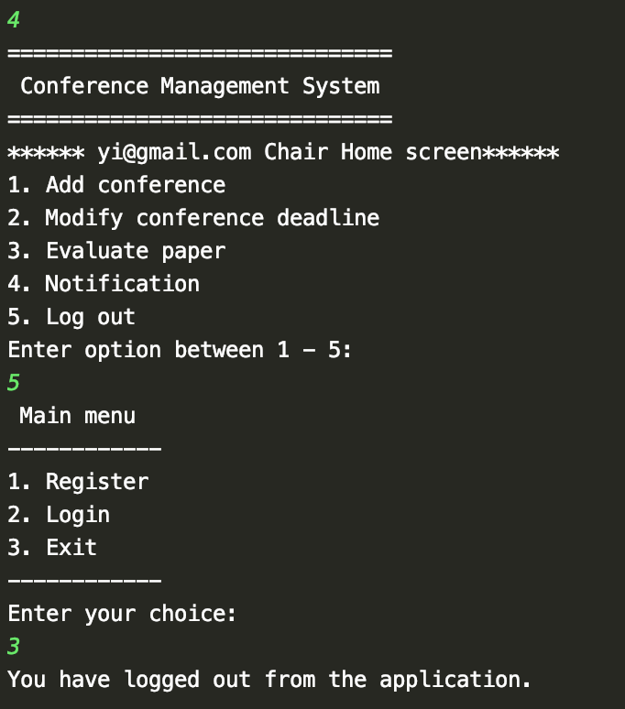
5. Logout, then go back to Login / Registration Screen
- The Chair can select Logout option to exit the system.

Slide 23

Feature 3 Paper Submission
Upload paper to conferences
Status of the paper
Notification
Logout

Slide 24
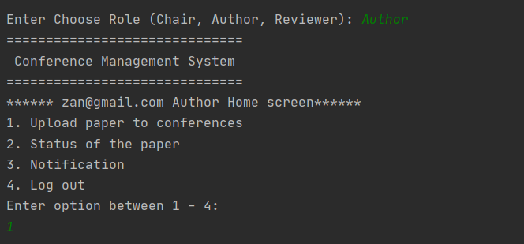
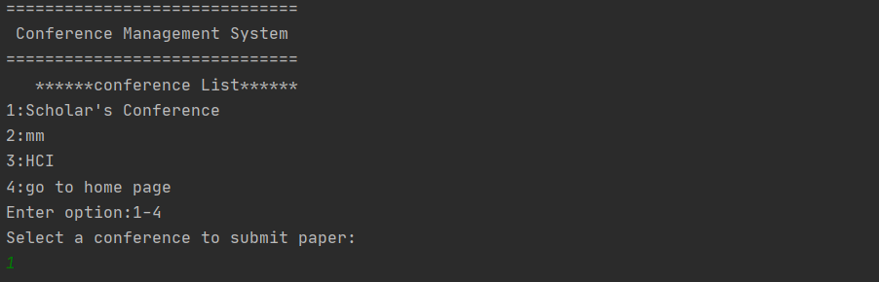
1. Upload paper
- For uploading papers, you need to choose role as an Author.
- Once you enter as an Author, you will be displayed a Author home screen.
- For uploading a paper, you can choose to upload paper to conference.
- After that you will be displayed list of conferences.

Slide 25
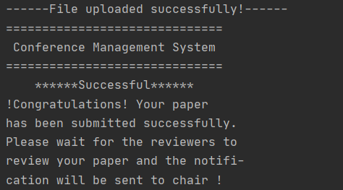
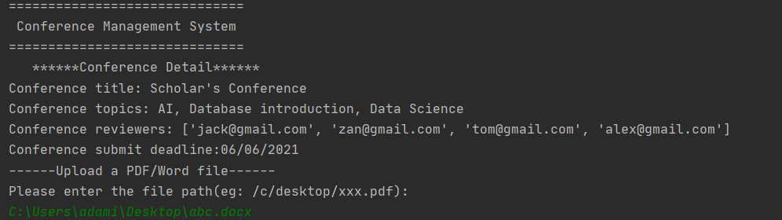
1. Upload paper
- After choosing a particular conference, you will be displayed the details of the conference.
- The Author can then upload the paper by providing the appropriate path of the paper located in the desktop.
- If the uploading of the paper was successful, a message will be displayed.

Slide 26
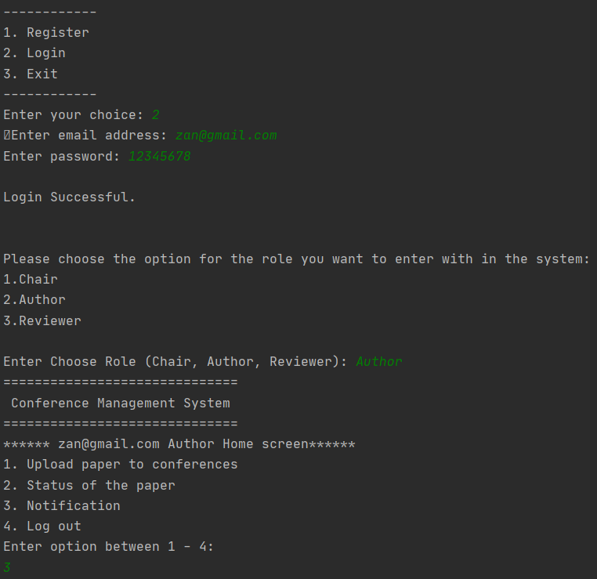
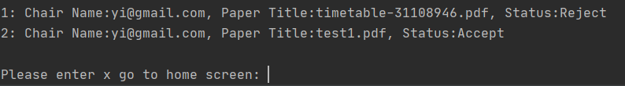
2. Author notification
- Author’s have option to view notification.
- The Author will receive notification regarding the decisions taken by the Chair regarding their paper/papers.

Slide 27

Feature 4 Review Management
1. Accept / Reject to the papers
2. Review the conference papers
3. Show all papers
4. Notification
5. Logout

Slide 28
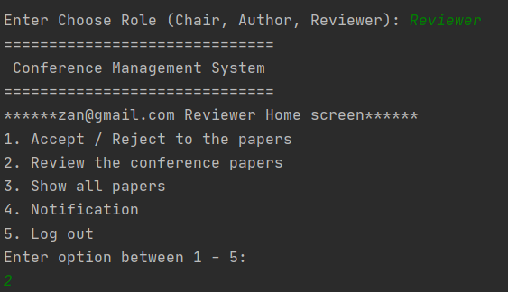
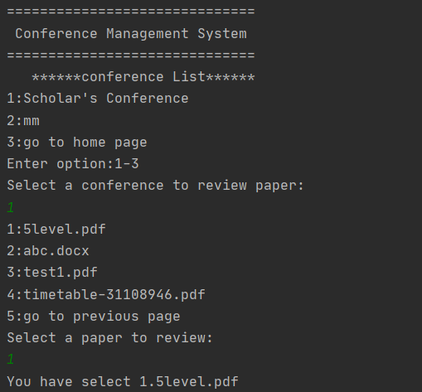
Login as a Reviewer
1. Review the conference papers
- For evaluation purposes, the user has to login as a Reviewer.
- The Reviewer can choose to accept or reject the paper submitted by the author.
- The Reviewer can only evaluate those papers which the Chair has assigned them to.

Slide 29
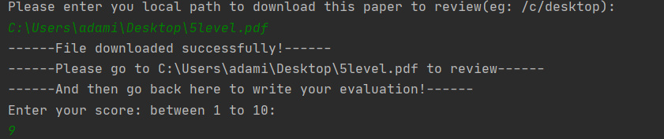
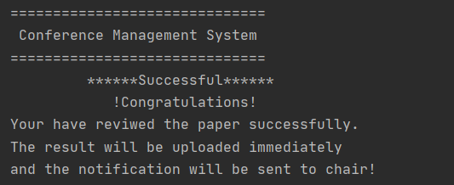
Login as a Reviewer
1. Review the conference papers
- The Reviewer can download the papers and view them.
- They can mark them to submit their evaluation.
- Once they submit marking, a successful message will be displayed.

Slide 30
Login as a Reviewer
2. Reviewer notification
- For evaluation purposes, the user has to login as a Reviewer.
- The Reviewer can choose to accept or reject the paper submitted by the author.
- The Reviewer can only evaluate those papers which the Chair has assigned them to.

Slide 31

Feature 5 Administration
1. User List
2. Conference List
3. Paper List
4. Logout

Slide 32
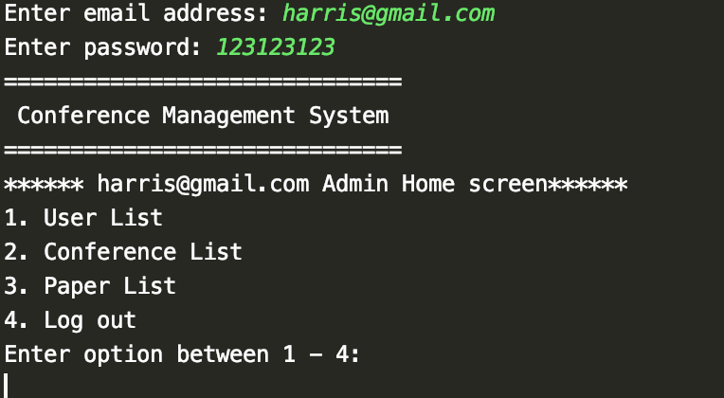
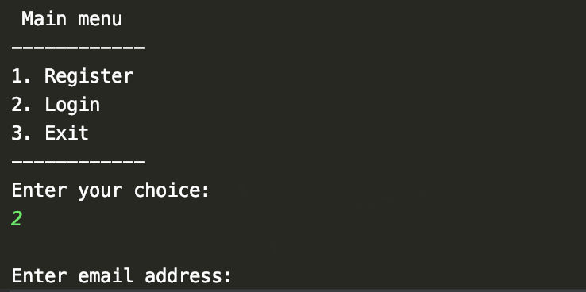
Admin Login
- For admin, they do not have to register, since they have a direct access.
- They can directly login to the system.
- Once they login, they can see the admin dashboard.

Slide 33
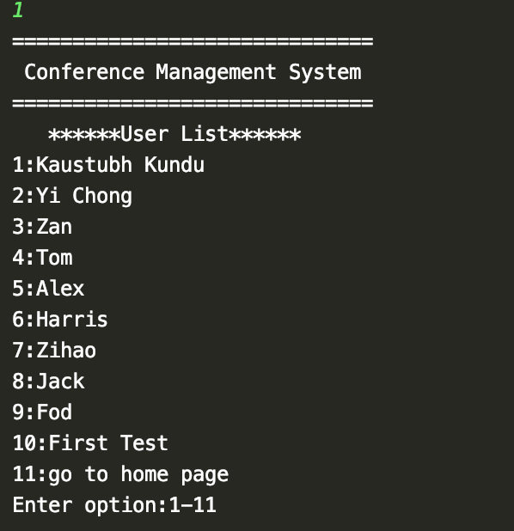
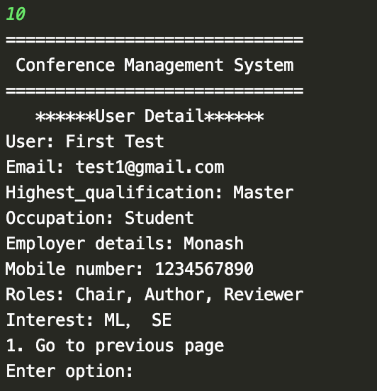
1. User List
- Admin can view all the users present in the database.
- Admin can select the user list option from the menu.
- User list will show all the user’s present in the database.
- Further, the admin can view all the registration details of the users.

Slide 34
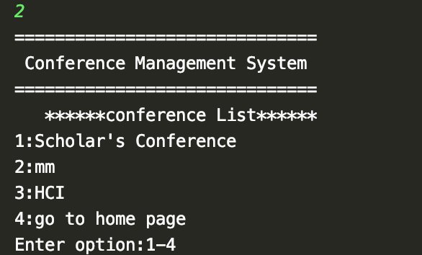
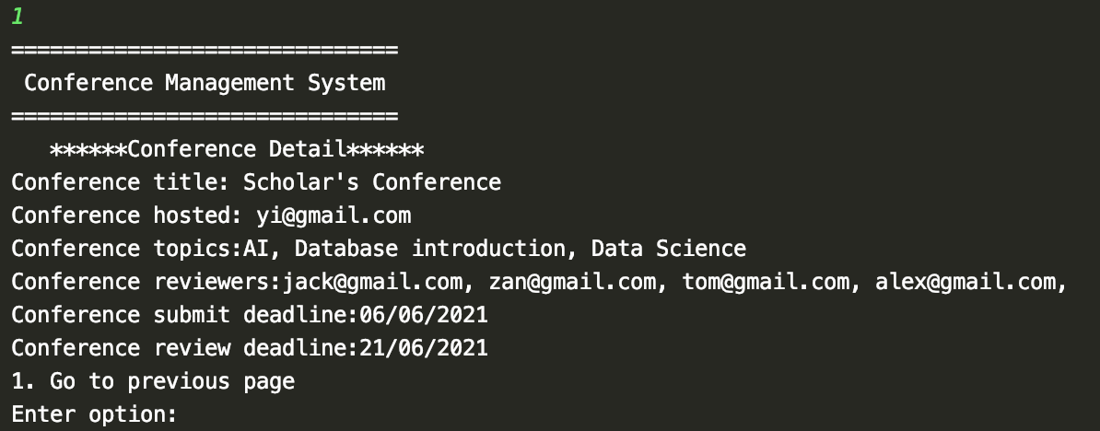
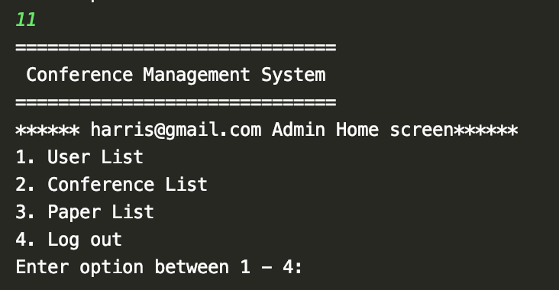
2. Conference List
- Admin can view all the conferences present in the database.
- Admin can select the Conference list option from the menu.
- Conference list will show all the conferences hosted by the Chair present in the database.
- Further, the admin can view all the conference details.

Slide 35
Challenges faced during the development of CMS
- Integration was one of the issues that we faced during the life cycle. Since different team members were developing different functionalities, it was difficult to integrate all of them together.
- Inconsistency while running the project in different environments was one more challenge that we faced as a team. Since different team members were developing code on different Operating systems, while downloading the repo from the git repository, there was issue running the code.
- Synchronization amongst the team members was the last type of challenge we faced. Since team members are present in different geographic locations, sometimes if was difficult to coordinate amongst the team members to know how much the parts of the sprints were done.

Slide 36
Extra feature recommendations for the CMS
- In order for the system to be more robust, we would recommend the client to increase the security features for the CMS. Since the systems are susceptible to cyber attacks in today’s world, encryption, Single-Sign On authentication and many more strategies can be used in order to avoid cyber attacks.
- User should be provided with multi access options like Gmail, Facebook for login/register.

Slide 37
Thank you

