Slide 1
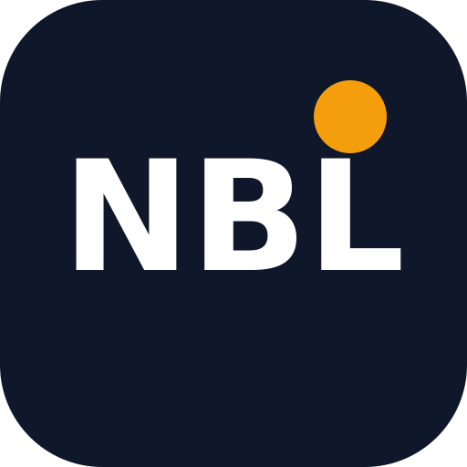
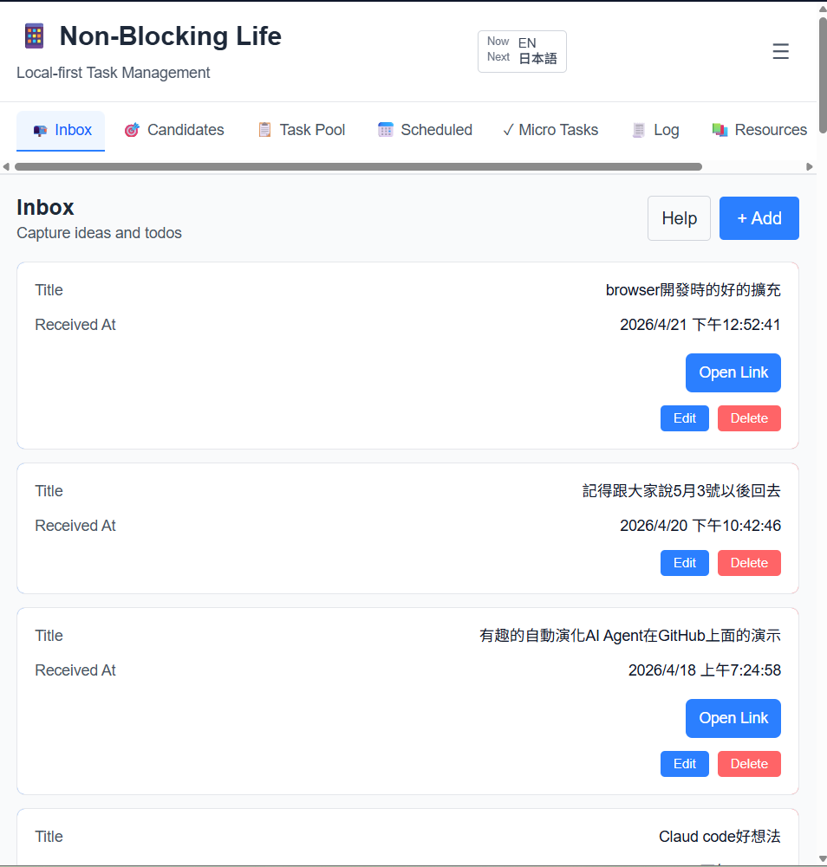
NonBlocking
Life
Don't Let List Management Become Another Burden
Treat your brain as single-threaded — do one thing at a time

Slide 2
01
Pain Points
Do you struggle with these too?

Slide 3

Lists Scattered Across Different Places
My biggest pain point wasn't having no lists — it was that they were scattered across different apps and even devices, each with its own way of managing things. That itself became a burden.
Notes
Reminders
TODO App
Calendar
?
Email
Sticky Notes

Slide 4

After an Interruption, Can't Get Back on Track
After every interruption, trying to get back on track, my brain would freeze just deciding which app to open — and I'd usually end up relying on memory or scrolling my phone.
FOCUS
Focused on Work
INTERRUPT
Interrupted!
STUCK
Which App to Open?
Scrolling Phone
>>
>>
>>

Slide 5
Busy All Day, but Can't Tell Where the Time Went
The result: a day full of busyness and exhaustion, but at night you can't recall where the time actually went.And you keep regretting forgetting important things to do.
Morning
Evening
"So much to do today!"
Full of Energy
Busy busy busy...
VS
"What did I actually do today?"
Can't Remember at All
Where did the time go...?

Slide 6
02
Core Concepts
The NonBlockingLife Solution

Slide 7
Pain Points → Solution Overview
Four Core Solutions of NonBlockingLife
1
Lists Scattered Everywhere
→
Control Center + Candidates Page
Single window, auto-lists tasks, quickly decide and start working
2
Can't Get Back After Interruptions
→
Pomodoro Focus · Inbox Quick Notes · Interrupt Mode
Drop ideas in Inbox for later sorting │ Time-consuming interruptions become interrupt tasks
3
Can't Tell Where Time Went
→
Full Tracking on the Log Page
Every task's start and end is recorded — see exactly where time went
4
Backup, Sync & Analysis
→
Google Drive Sync for Advanced Analysis
Fast local operation, works offline, data in your own cloud drive

Slide 8
After an Interruption, Get Back on Track
After any interruption, just open NBL and you're back on track.
FOCUS
Focused on Work
INTERRUPT
Interrupted!
CHECK
FOCUS
Focused on Work
Scrolling Phone
>>
>>
>>

Slide 9
A Simple Control Center for Tasks and Ideas
Use NBL as a simple control center for tasks and ideas — complex management is still handled by dedicated apps.
Project Mgmt
Note Apps
NBL
Calendar
Control Center
Email
Other Apps

Slide 10
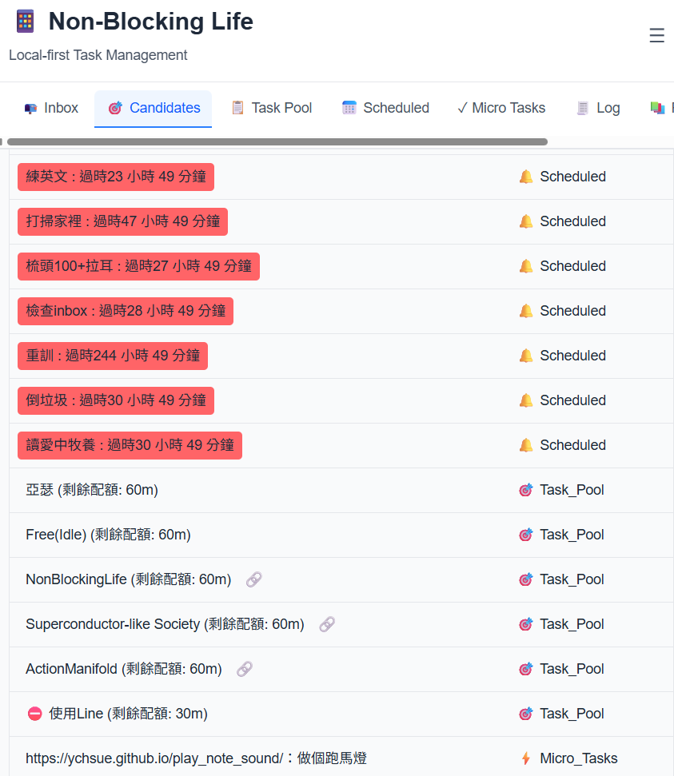

When Free, Check the List and Start Right Away
Open NBL Task List
Tasks are auto-selected based on criteria and categories, then added to your task list
Pick a task and get to work right away
No more deciding "which app to open"
Less decision fatigue, faster focus

Slide 11
Pain Points → Solution Overview
NonBlockingLife Four Core Solutions
1
Lists Scattered Everywhere
→
Control Center + Candidates Page
Single window, auto-lists tasks, quickly decide and start working
2
Can't Get Back After Interruptions
→
Pomodoro Focus · Inbox Quick Notes · Interrupt Mode
Drop ideas in Inbox for later sorting │ Time-consuming interruptions become interrupt tasks
3
Can't Tell Where Time Went
→
Full Tracking on the Log Page
Every task's start and end is recorded — see exactly where time went
4
Backup, Sync & Analysis
→
Google Drive Sync for Advanced Analysis
Fast local operation, works offline, data in your own cloud drive

Slide 12
Pomodoro Technique: Single-Threaded Brain
Once in work mode, use the Pomodoro technique to keep your brain single-threaded — focus on one thing at a time.
30:00
One Thing at a Time
Timed Records
Focus Mode
FOCUS
Auto-Tracking

Slide 13
Interruption SourceA: Flash of Inspiration Inbox: Quick Capture, Scheduled Sorting
Toss in ideas anytime, sort them to the right place once a day
INBOX
Task Pool Long-term Projects
→
● Idea A
● Idea B
● Idea C
● Idea D
URLs link to the corresponding app or page
T
y
p
e
Micro Tasks Short-term Tasks
MOVE →
Scheduled Scheduled / Callback Tasks
Flash of Inspiration
Resources Future Reference
Stay in Inbox Being lazy is fine!
Daily
Sorting

Slide 14
Interruption SourceB: Must-Handle-Now Interrupts Enter Interrupt Mode Anytime
WORKING
>>
INTERRUPT
>>
LOG BOTH
Working
Interrupt
Log
Interruptions are tasks too, with clear start and end times
After an interrupt ends, it's logged just like any other task
Interruptions no longer derail your entire workflow
All time is tracked — nothing disappears

Slide 15
Pain Points → Solution Overview
NonBlockingLife Four Core Solutions
1
Lists Scattered Everywhere
→
Control Center + Candidates Page
Single window, auto-lists tasks, quickly decide and start working
2
Can't Get Back After Interruptions
→
Pomodoro Focus · Inbox Quick Notes · Interrupt Mode
Drop ideas in Inbox for later sorting │ Time-consuming interruptions become interrupt tasks
3
Can't Tell Where Time Went
→
Full Tracking on the Log Page
Every task's start and end is recorded — see exactly where time went
4
Backup, Sync & Analysis
→
Google Drive Sync for Advanced Analysis
Fast local operation, works offline, data in your own cloud drive

Slide 16
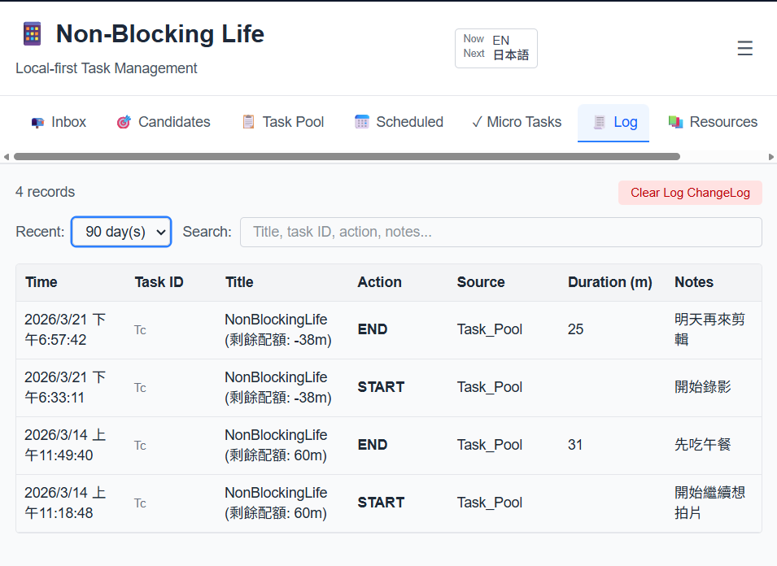
Log Page — Complete Records
Every task's start and end is recorded — see exactly where your time went
With sync enabled, view data in Google Sheets for further analysis

Slide 17
Pain Points → Solution Overview
NonBlockingLife Four Core Solutions
1
Lists Scattered Everywhere
→
Control Center + Candidates Page
Single window, auto-lists tasks, quickly decide and start working
2
Can't Get Back After Interruptions
→
Pomodoro Focus · Inbox Quick Notes · Interrupt Mode
Drop ideas in Inbox for later sorting │ Time-consuming interruptions become interrupt tasks
3
Can't Tell Where Time Went
→
Full Tracking on the Log Page
Every task's start and end is recorded — see exactly where time went
4
Backup, Sync & Analysis
→
Google Drive Sync for Advanced Analysis
Fast local operation, works offline, data in your own cloud drive

Slide 18
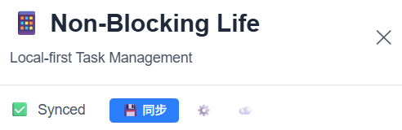
Local Operation + Cloud Sync
LOCAL
CLOUD
Local Operation
⟷
Google Drive Sync
Fast speed, works offline too
Data in your own cloud drive
Follow the web tutorial to set it up

Slide 19
03
Available Platforms
Any Device with a Modern Browser

Slide 20
A Backend-Free Web Application
Runs on any device with a modern browser
Therefore unlike native apps, it can't access phone-native features
But platform-specific integrations can bridge this gap
Via API — three types available, see useUrlAction.ts
interrupt
query
add
D
T
Desktop
Tablet
P
B
Phone
Browser

Slide 21

iPhone Shortcuts & Android API
iPhone
Android
Integrates phone-native features via Shortcuts
e.g., quickly add a task to Inbox
Shortcuts available on the guide page
Mostly API calls — you can write your own too
(Shouldn't be hard, but hasn't been packaged like iPhone Shortcuts for direct download yet)
Can also access features quickly via API
API docs on the guide page

Slide 22
Desktop Users: Install as PWA
Install as a PWA — works just like a regular app
Provides web+nbl:// URL scheme
Create desktop shortcuts to trigger specific functions
Consistent cross-platform experience

Slide 23
04
Open Source
Community Participation and Support Welcome

Slide 24

Open Source Project — Contributions Welcome
GitHub
Fully open source — feel free to report issues or contribute code
Currently maintained by a solo developer — community involvement is very welcome
Star the repo
Report issues
Submit PRs
Discussions

Slide 25
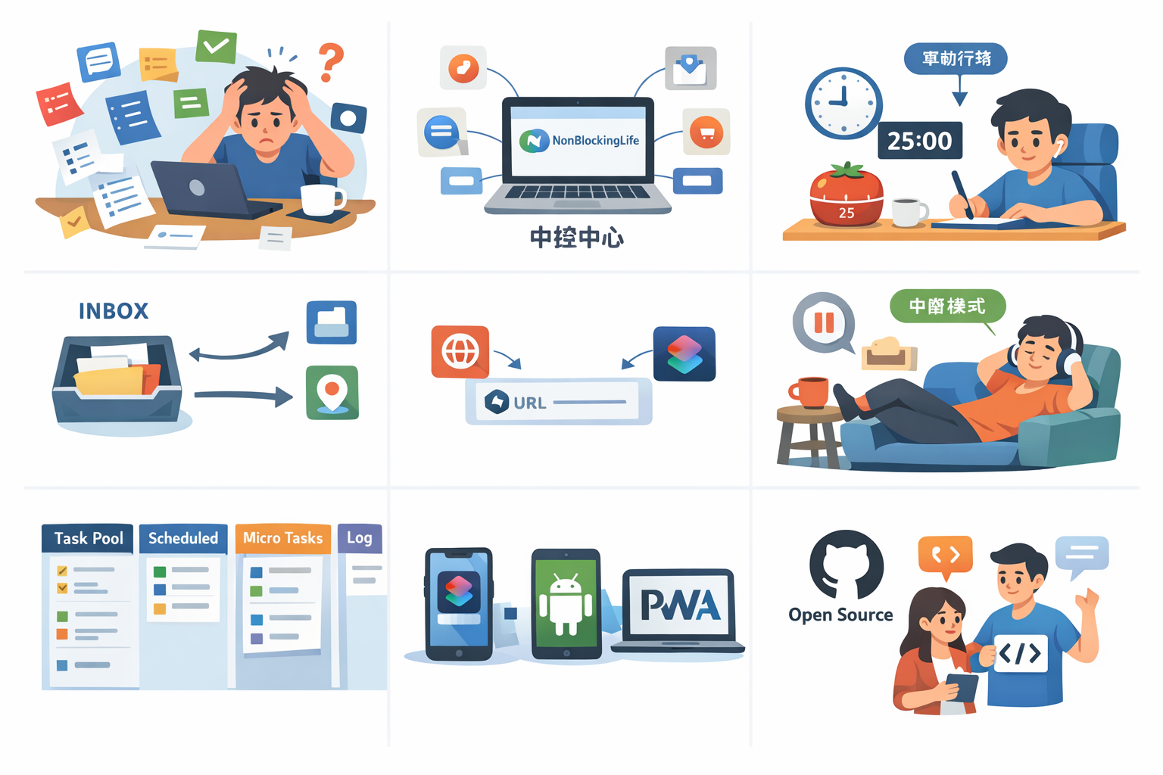
NonBlockingLife
Treat your brain as single-threaded — do one thing at a time
Thanks for Watching ❤️

