Slide 1
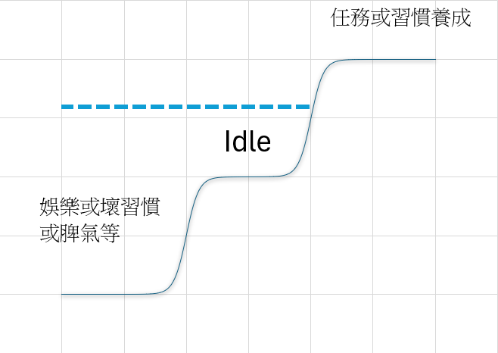
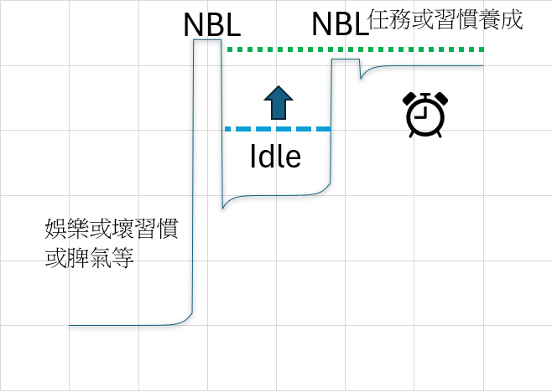

Slide 2
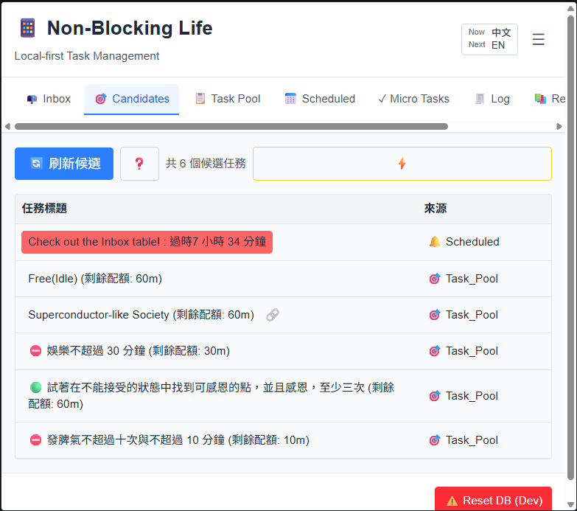
1
2
3
Open Editor
URL link

Slide 3
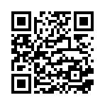
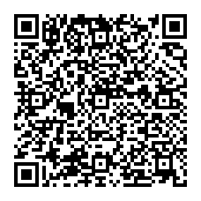
NonBlockingLife
Example on Stately.ai

Slide 4
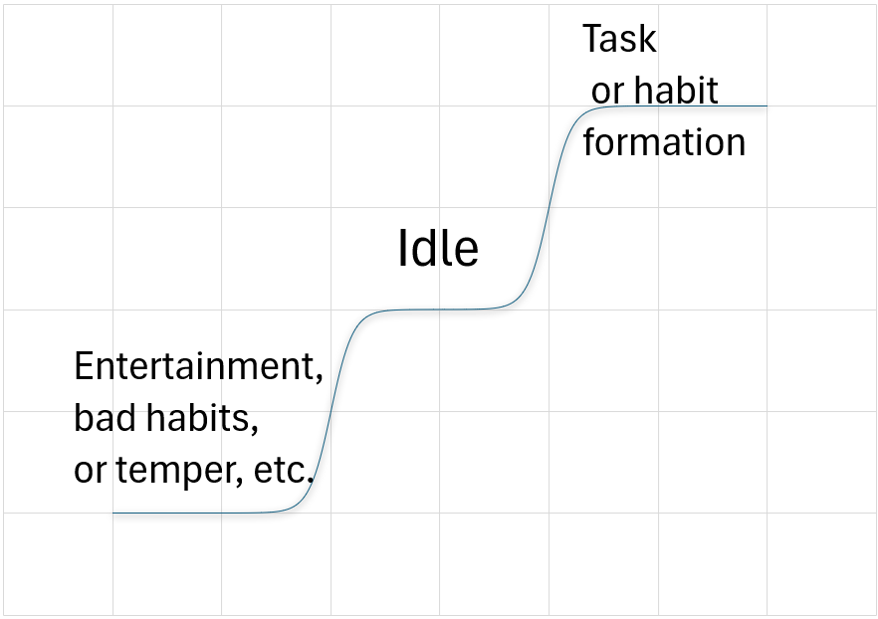

Slide 5
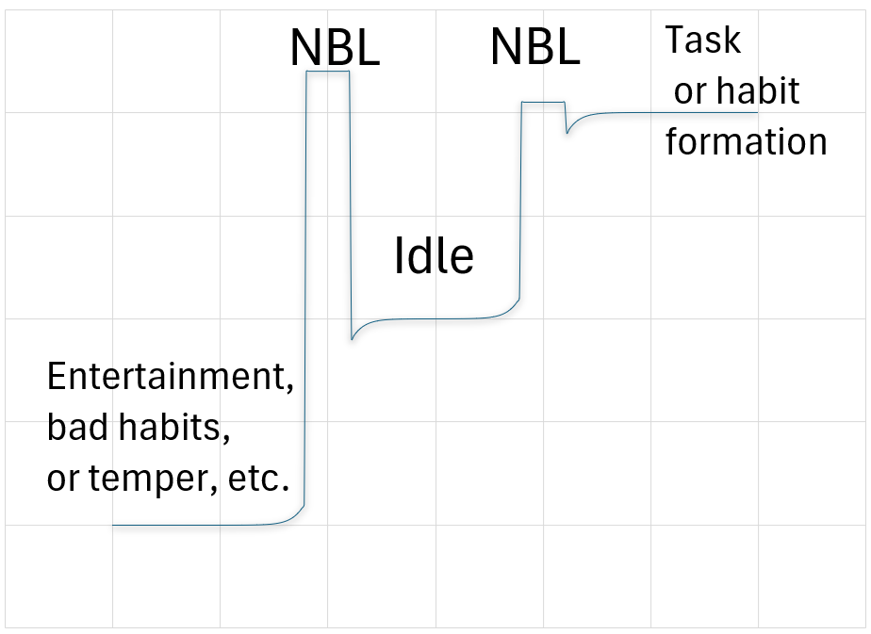

Slide 6
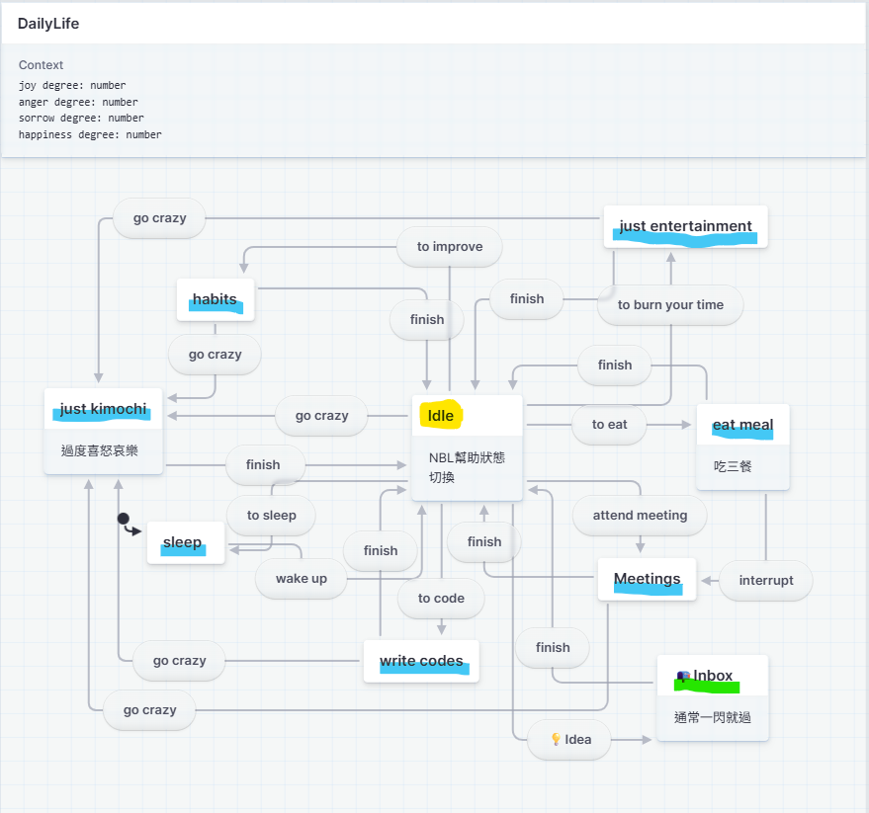

Slide 7
狀態 States (Example)
🟢 Building Superconductorlike Society
🟢 試著在不能接受的狀態中找到可感恩的點，並且感恩，至少三次
🟢 Try to find points of gratitude in unacceptable situations and express gratitude at least 3 times
⛔ 娛樂不超過 30 分鐘
⛔ Entertainment not exceeding 30 minutes
⛔ 發脾氣不超過十次與不超過 10 分鐘
⛔ Anger more than 10 times and more than 10 minutes

Slide 9
