Slide 1
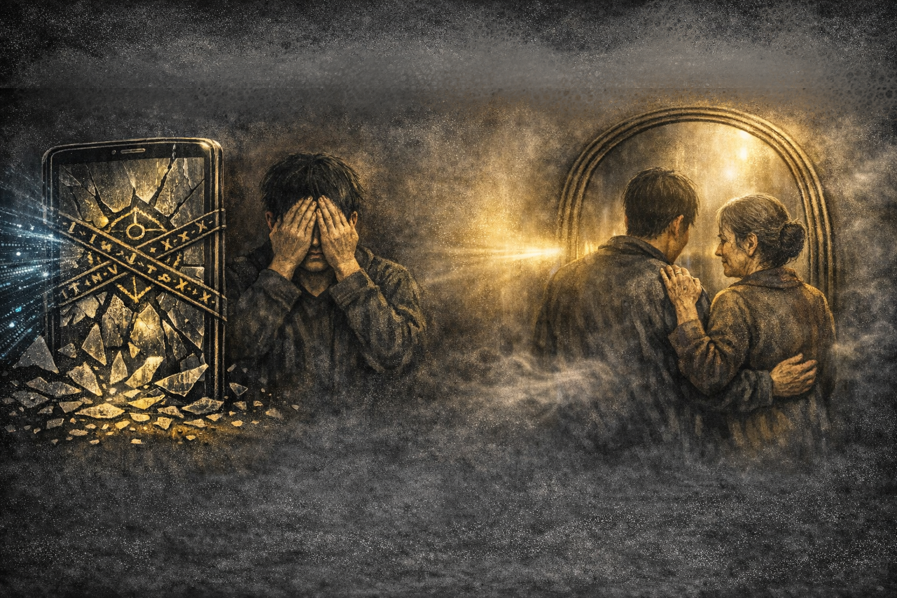
面對這面鏡子，限制它？還是閉眼無視？
只要社會核心仍是「金錢與慾望」，任何限制終將失效。
難道我們只能在虛幻中走向毀滅？

Slide 2
第三種選擇：以「信實與愛」成為防護網。
帶著面對真實的勇氣，與追求共好的初心。
讓 AI 幫助我們與真實對齊，成為無縫連結善意的良師益友。

Slide 3
Restrict the mirror? Or close our eyes?
As long as society is driven by money and greed, restrictions will fail.
Are we doomed to self-destruct in illusion?

Slide 4
The 3rd Choice: A Safety Net of Faithfulness & Love.
With the courage to face truth and the desire for common good.
AI helps us align with reality, becoming a bridge for human kindness.

