Slide 1

CSC6103 / COURSE PRESENTATION
Impact of CPU and Memory Limits
on Docker Container Performance
CPU-only inference on Jetson AGX Thor
Zhaoyang Zhang
The Chinese University of Hong Kong, Shenzhen
School of Data Science
November 5, 2026
CSC6103 Virtualization Techniques
01

Slide 2
PRESENTATION STRUCTURE
Outline
01
Introduction
Why resource budgets matter
02
Related Work
Three complementary control layers
03
Preliminaries
What Docker limits actually enforce
04
Proposed Methods
Two ways to retain the same inputs
05
Performance Evaluation
Time cost and memory feasibility
06
Conclusions
Answers to the two research questions
The same inference job, under different CPU and memory budgets.
CSC6103 Virtualization Techniques
02

Slide 3
01 INTRODUCTION / MOTIVATION
Docker Containers and Resource Budgets
Several services, one host
Web service
App + libraries
Inference service
App + libraries
Data service
App + libraries
Containers package applications
and their dependencies.
Shared resources are finite
Docker Engine
CPU and memory limits bound
how much each service can use.
Linux kernel + cgroups
Shared host CPU and memory
Limits can affect latency
and service availability.
Figure 1. Docker containers sharing host resources.
Resource limits bound consumption, but their performance cost needs study.
CSC6103 Virtualization Techniques
03

Slide 4
02 RELATED WORK / ROADMAP
Three Complementary Control Layers
CPU-Limits
Packrat
SwapNet
SoCC 2025
ICML 2025
IEEE TMC 2024
How is CPU allocated?
How is CPU used?
What stays in memory?
Observe latency and CPU
Profile inference latency
Partition model blocks
Adjust requests / placement
Choose instances / threads
Load blocks on demand
Reduce quota-induced stalls
Partition input batches
Bound resident model data
Figure 2. Three perspectives on resource-constrained services.
Resource policy, execution configuration and memory residency are complementary.
CSC6103 Virtualization Techniques
04

Slide 5
02 RELATED WORK / CONCEPTS
CPU-Limits: CPU Time and Waiting
One runnable thread needs 40 ms of actual CPU computation.
Docker: --cpus=0.25
25 ms budget per 100 ms period
Budget used up: wait
Wall time (ms)
No CPU cap
Compute 40 ms
Done at 40 ms
0
25
40
100
115
0.25 CPU cap
25 ms
Budget exhausted: wait 75 ms
15 ms
CPU work: 25 + 15 = 40 ms
Budget resets at 100 ms
Teaching example: one busy thread, arrival at period start, available core, no other overhead.
Figure 3. CPU quota exhaustion adds waiting to a fixed amount of CPU work.
The same 40 ms of CPU computation can take 115 ms of wall time.
CSC6103 Virtualization Techniques
05

Slide 6
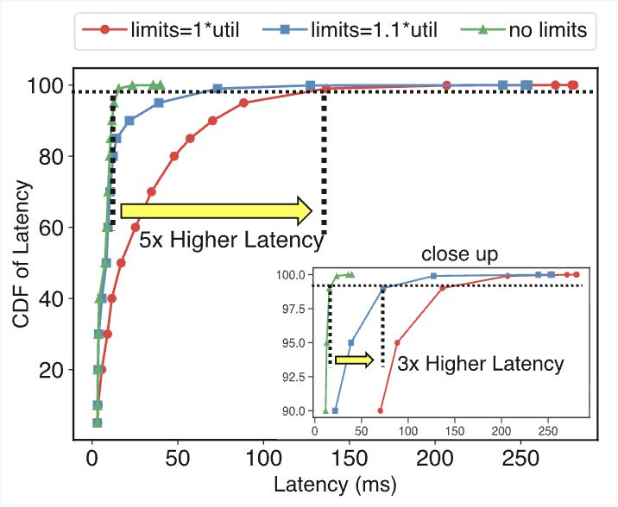
02 RELATED WORK / CPU CONTROL / MOTIVATION
CPU-Limits: Why Quotas Hurt Latency
CPU-Limits kill Performance
Time to rethink Resource Control
Exhausting a quota pauses runnable work.
Bursty requests can accumulate in queues.
Spare host CPU does not remove a container cap.
Figure 4. Request latency with and without CPU limits.
A hard CPU cap can increase latency for an online service.
CSC6103 Virtualization Techniques
06

Slide 7
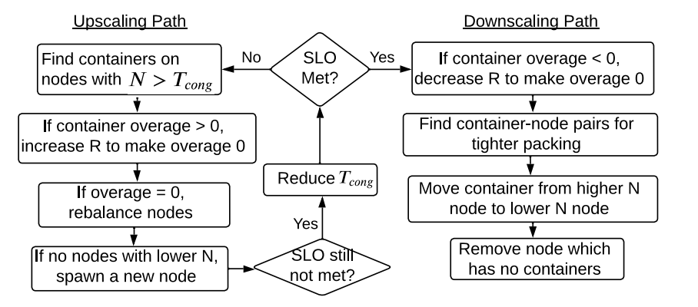
02 RELATED WORK / CPU CONTROL / METHOD
YAAS: Allocation Guided by Latency
Observe the latency target (SLO) and CPU use.
Adjust CPU requests or add replicas.
Rebalance containers across nodes.
R = CPU requests
N = node utilization
overage = CPU use − R
Figure 5. YAAS resource-allocation workflow.
YAAS responds to measured demand instead of relying on a fixed hard cap.
CSC6103 Virtualization Techniques
07

Slide 8
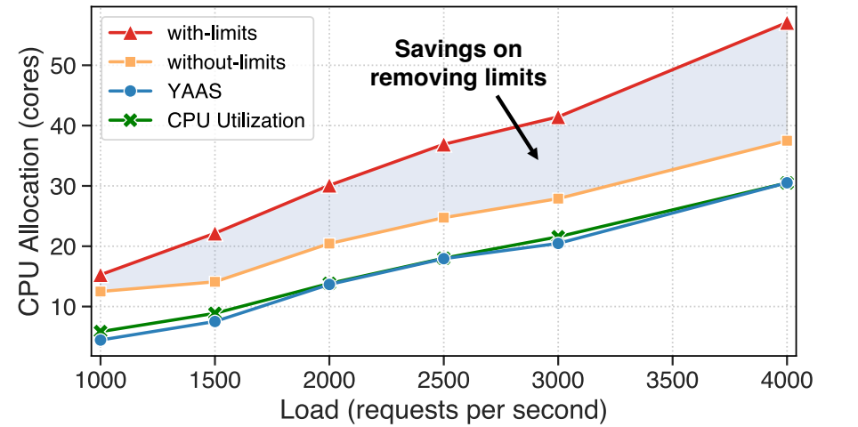
02 RELATED WORK / CPU CONTROL / EVIDENCE
YAAS: Lower Allocation at the Same SLO
38% / 51%
No limits / YAAS
Average CPU allocation savings
Both compare with the
CPU-capped baseline.
HotelReservation, SLO = 20 ms
Figure 6. CPU allocation under a 20 ms latency target.
CPU allocation policy affects both latency and resource demand.
CSC6103 Virtualization Techniques
08

Slide 9
02 RELATED WORK / CONCEPTS
Packrat: Cores, Threads and Instances
Core: hardware compute unit Thread: execution flow
Instance: running model copy Batch: a group of inputs
Both layouts: 16 cores, 16 worker threads, 64 inputs
One instance, batch = 64
Batch = 16
Batch = 16
Batch = 16
Batch = 16
Model instance A
Instance 1
4 threads
Instance 2
4 threads
Instance 3
4 threads
Instance 4
4 threads
T1
T2
T3
T4
T5
T6
T7
T8
T9
T10
T11
T12
T13
T14
T15
T16
Cores 1–16
Cores 1–4
Cores 5–8
Cores 9–12
Cores 13–16
Illustration: one worker per core. Four instances do not always outperform one instance.
Figure 7. Alternative instance and thread layouts under an equal CPU budget.
Packrat profiles configurations to select a combination with lower predicted latency.
CSC6103 Virtualization Techniques
09

Slide 10
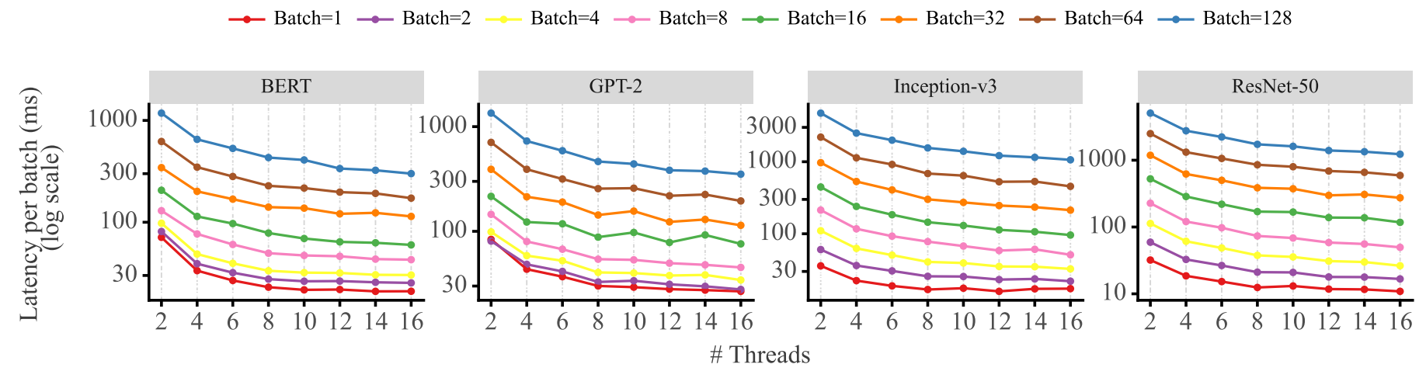
02 RELATED WORK / CPU EXECUTION / MOTIVATION
Packrat: More Threads Have Diminishing Returns
Auto-reconfiguration for Latency Minimization in CPU-based DNN Serving
Figure 8. DNN inference latency across thread counts.
A fixed CPU budget still leaves choices about instances, threads and batch size.
CSC6103 Virtualization Techniques
10

Slide 11
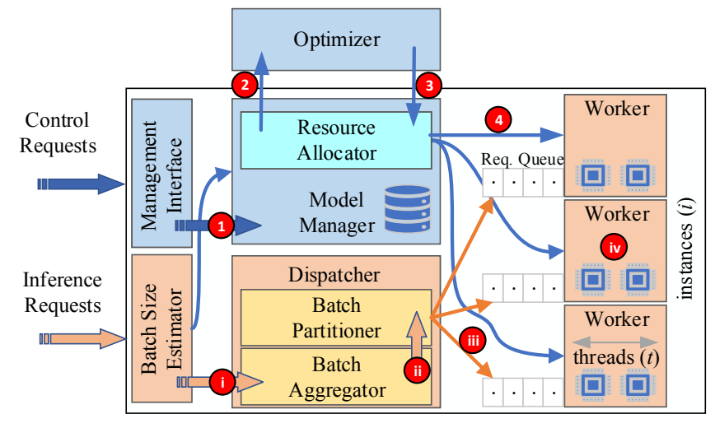
02 RELATED WORK / CPU EXECUTION / METHOD
Packrat: Joint Execution Configuration
Profile latency L(t, b).
Choose instances, threads and batch partitions jointly.
Pin workers to cores and change configurations online.
Total threads ≤ T
Total batch = B
Figure 9. Packrat serving architecture.
The optimizer minimizes maximum instance latency within the thread budget.
CSC6103 Virtualization Techniques
11

Slide 12
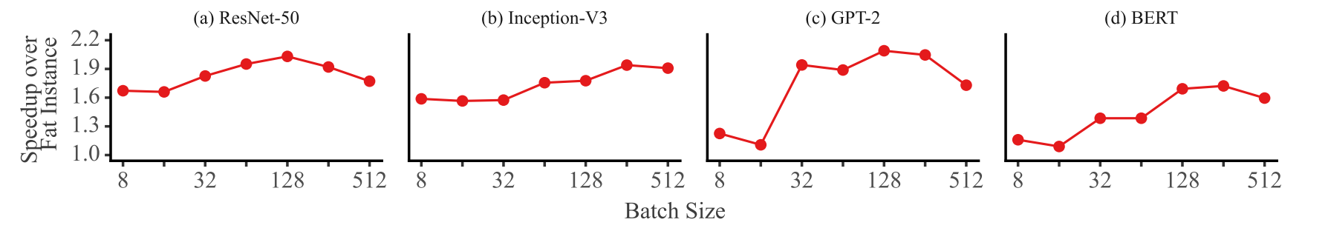
02 RELATED WORK / CPU EXECUTION / EVIDENCE
Packrat: Faster Serving With the Same Threads
Same 16-thread budget, compared with one fat instance
Figure 10. Packrat speedup over a single-instance baseline.
1.43×–1.83×
Mean speedup across batch sizes, by model
Execution configuration changes performance within the same CPU budget.
CSC6103 Virtualization Techniques
12

Slide 13
02 RELATED WORK / CONCEPTS
SwapNet: Storage, RAM and CPU
Storage (SSD)
RAM
CPU
Full model weights
Finite memory budget
Current block computation
Block B1
Load
blocks
Current block B2
CPU uses it
Next block B3
Preload it
Read
weights
Execute B2
Produce intermediate results
Block B2
Block B3
Block B4
Activations, model structure and framework
B1 finished
Release its RAM
Compute B2
Preload B3
B2 finishes: release its RAM
Continue with B3
Application-managed model blocks differ from OS swap and our input-buffering experiment.
Figure 11. Model blocks move from storage into RAM for CPU execution.
Only needed model blocks reside in RAM, with space for runtime overhead.
CSC6103 Virtualization Techniques
13

Slide 14
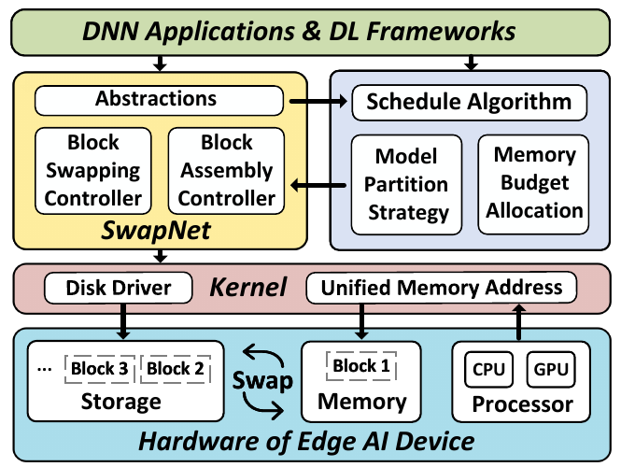
02 RELATED WORK / MEMORY RESIDENCY / PROBLEM AND METHOD
SwapNet: Inference Beyond Memory Capacity
When a whole model does not fit, only the needed blocks stay in memory.
Partition the model into blocks.
Load needed blocks and release old ones.
Schedule loading and assembly within a memory budget.
Figure 12. SwapNet system architecture.
SwapNet reduces resident model data through application-managed swapping.
CSC6103 Virtualization Techniques
14

Slide 15
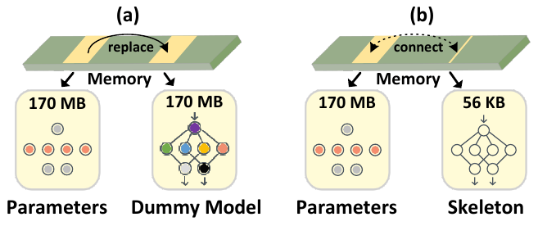
02 RELATED WORK / MEMORY RESIDENCY / MECHANISM
SwapNet: Avoiding a Second Full Model
A lightweight skeleton refers to already-loaded parameters.
Figure 13. Model assembly using a lightweight skeleton.
The 56 KB skeleton avoids a duplicate model during assembly.
CSC6103 Virtualization Techniques
15

Slide 16
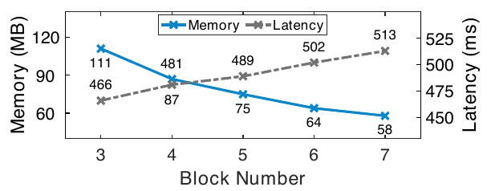
02 RELATED WORK / MEMORY RESIDENCY / EVIDENCE
SwapNet: Less Memory Has a Time Cost
111 → 58 MB
466 → 513 ms
3 to 7 model blocks
ResNet microbenchmark
Figure 14. Memory and latency across model block counts.
Reducing resident data can trade memory consumption for execution time.
CSC6103 Virtualization Techniques
16

Slide 17
02 RELATED WORK / SYNTHESIS
Research Insights and Experimental Choices
Research insight | Our experimental decision | Role
CPU limits introduce waiting | Vary CPU quota | RQ1: time cost
Execution layout changes latency | Fix threads and batch size | Controlled factor
Resident data can be bounded | Compare full cache and streaming | RQ2: memory fit
The experiment isolates two factors suggested by the three research layers.
CSC6103 Virtualization Techniques
17

Slide 18
03 PRELIMINARIES / DOCKER AND LINUX CGROUPS
CPU Quota and Memory Limits
Control | Meaning in this experiment | Possible effect
CPU quota | 0.25 CPU: 25 ms CPU time per 100 ms period | Slower progress
Memory ceiling | 512 MiB maximum cgroup memory | Out-of-memory kill
Swap | Disabled: memory.swap.max = 0 | No swap capacity
Docker configures the limits. Linux cgroups enforce them.
CPU quota limits execution time per period. A memory ceiling can stop the job.
CSC6103 Virtualization Techniques
18

Slide 19
04 PROPOSED METHODS / INPUT RETENTION
Full Cache and Bounded Streaming
Full cache
Bounded streaming
Preprocess all 1,024 inputs
Prepare one batch of 8
Retain the complete input tensor
Infer and write labels
Infer in batches of 8
Release the batch and repeat
Input tensor capacity: 588 MiB
Input tensor capacity: 4.59 MiB
Figure 15. Full-cache and bounded-streaming workflows.
Only input retention changes. Model, batch size and threads stay fixed.
CSC6103 Virtualization Techniques
19

Slide 20
05 PERFORMANCE EVALUATION / SETUP
Controlled Inference on Jetson Thor
Component | Fixed setting
Device | Jetson AGX Thor, ARM64
Model | ResNet-18 IMAGENET1K_V1, FP32
Execution | CPU only, batch 8, one thread, CPU 2 affinity
Inputs | 4 real image files replayed to 1,024 occurrences
Warmup and power | 2 warmup batches, fixed MAXN mode
Ubuntu 24.04.4 / Docker 29.3.0 / cgroup v2 / PyTorch 2.10.0+cpu
Each comparison changes one factor within the same inference workload.
CSC6103 Virtualization Techniques
20

Slide 21
05 PERFORMANCE EVALUATION / DESIGN
Comparisons That Answer RQ1 and RQ2
Question | Change | Hold fixed | Runs
RQ1: time cost | 0.25 / 0.50 / 1 CPU | Streaming, 4 GiB | A / B / C
RQ2: memory demand | Full cache / streaming | 1 CPU, 4 GiB | D / C
RQ2: completion | Full cache / streaming | 1 CPU, 512 MiB | F / E
3 repeats per configuration. Shuffled serial runs in fresh containers.
Streaming at 1 CPU and 4 GiB (C) is the shared reference.
CSC6103 Virtualization Techniques
21

Slide 22
05 PERFORMANCE EVALUATION / RQ1 / TIME COST
Less CPU Quota Increases Execution Time
Streaming input, 4 GiB memory limit
Figure 16. Effect of CPU quota on model-forward wall time.
4.06×
the forward wall time at 0.25 CPU
compared with 1 CPU
Source: Thor runs A/B/C. Mean ± sample SD, n = 3 per condition.
CSC6103 Virtualization Techniques
22

Slide 23
05 PERFORMANCE EVALUATION / RQ2 / MEMORY DEMAND
Streaming Reduces Peak Container Memory
1 CPU, 4 GiB memory limit
Figure 17. Peak memory under two input-retention strategies.
61.31%
lower lifecycle peak memory
with bounded input buffering
Source: Thor runs D/C. Exact cgroup memory.peak. Mean ± sample SD, n = 3.
CSC6103 Virtualization Techniques
23

Slide 24
05 PERFORMANCE EVALUATION / RQ2 / FEASIBILITY
Streaming Completes Within 512 MiB
Memory limit | Full cache | Streaming
4,096 MiB | 3/3 complete | 3/3 complete
512 MiB | 0/3 complete, 3 OOM | 3/3 complete
Full cache fails while filling the input cache, before formal inference.
Streaming completes at 512 MiB in 124.14 ± 0.35 s application time.
At 512 MiB, input retention determines whether this job completes.
1 CPU, n = 3. All F runs: cgroup oom_kill = 1 and Docker OOMKilled = true.
CSC6103 Virtualization Techniques
24

Slide 25
05 PERFORMANCE EVALUATION / RQ2 / TRADE-OFF CHECK
Similar Runtime, Identical Predicted Labels
1 CPU, 4 GiB | Full cache | Streaming
Application time | 123.77 ± 0.14 s | 123.78 ± 0.19 s
Forward wall time | 110.24 ± 0.13 s | 110.02 ± 0.10 s
All 15 successful runs produce the same ordered 1,024 top-1 labels.
The memory reduction comes with similar application time in this setting.
Mean ± sample SD, n = 3. Mean application-time difference: 0.018 s. Output consistency is not accuracy.
CSC6103 Virtualization Techniques
25

Slide 26
05 PERFORMANCE EVALUATION / LIMITATIONS
Scope of the Evidence
One controlled workload
One Thor, ResNet-18, batch 8, one thread and four replayed image files.
Three repeats per condition
Small observed variation describes these settings. It does not establish a universal guarantee.
One tested low-memory budget
512 MiB is a pilot-selected operating point, not the minimum requirement.
These results support a controlled CPU inference case on the tested system.
CSC6103 Virtualization Techniques
26

Slide 27
06 CONCLUSIONS
Answers to the Research Questions
RQ1
CPU quota
4.06×
Forward wall time at 0.25 CPU
relative to 1 CPU
RQ2
Input retention
61.31%
Lower container peak memory
with bounded streaming
512 MiB: streaming completes 3/3, full cache hits OOM 3/3.
A usable resource budget needs a matching application memory strategy.
CSC6103 Virtualization Techniques
27

Slide 28
REFERENCES
References
Shetty et al. CPU-Limits kill Performance: Time to rethink Resource Control. SoCC 2025. DOI: 10.1145/3772052.3772219.
Bhardwaj et al. Auto-reconfiguration for Latency Minimization in CPU-based DNN Serving. ICML 2025, PMLR 267:4115–4129.
Wang et al. SwapNet: Efficient Swapping for DNN Inference on Edge AI Devices Beyond the Memory Budget. IEEE TMC 23(9), 2024. DOI: 10.1109/TMC.2024.3355764.
Docker Resource constraints. Linux Control Group v2. Torchvision ResNet-18 documentation.
CSC6103 Virtualization Techniques
28

