Slide 1
Autonomous Agent Systems for Discovery and Engineering
Xiaoyuan Liu
School of Data Science
Chinese University of Hong Kong, Shenzhen

Slide 2
Outline
Introduction
Paper 1: AlphaEvolve (Google DeepMind, 2025)
Evolutionary coding agent for scientific and algorithmic discovery
Paper 2: EvoX (UC Berkeley & Stanford, 2026)
Meta-evolution: co-evolving solutions and search strategies
Paper 3: CORAL (MIT, 2026)
Autonomous multi-agent evolution for open-ended discovery
Conclusions
Notes:
Here is the outline. We cover three papers in order. First, AlphaEvolve, a coding agent from Google DeepMind that uses evolutionary search with LLMs for scientific discovery. Second, EvoX, which introduces meta-evolution to co-evolve both solutions and search strategies. Third, CORAL, which pushes toward fully autonomous multi-agent evolution with shared persistent memory. We conclude with a summary of contributions and how these works relate to each other.

Slide 3
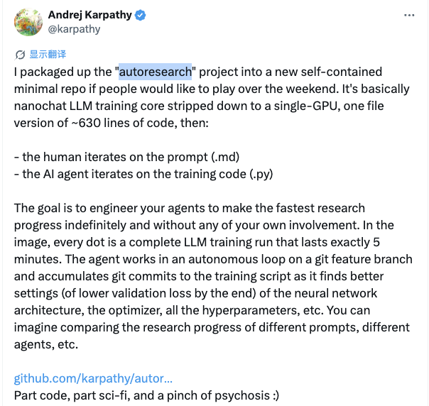
Introduction – AI Systems for Discovery
AI systems can help accelerate the process of scientific discoveries and engineering tasks by automating certain stages
E.g., the recent “autoresearch” project
Agentic systems powered by frontier LLMs can achieve strong results by further pushing the boundary of autonomy
Figure 1. Andrej’s tweet about “autoresearch”

Slide 4
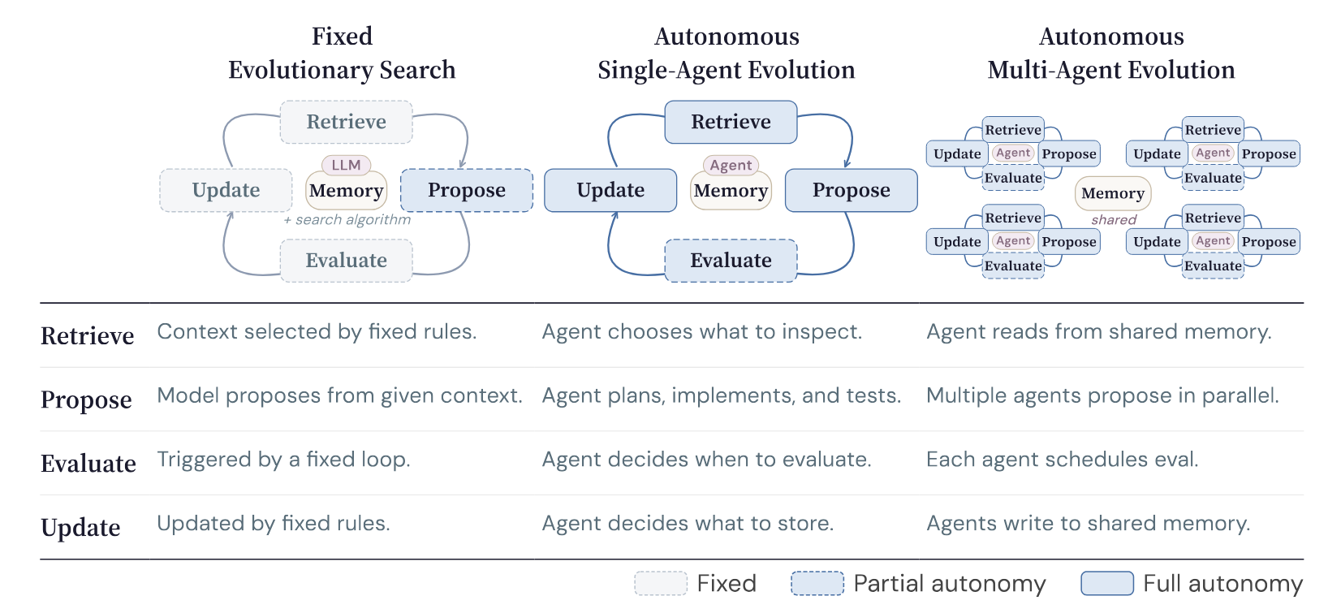
Introduction - Roadmap
1. AlphaEvolve
2. EvoX
3. CORAL
Autonomy
Figure 2. Timeline of Code Generation Benchmark Evolution

Slide 5
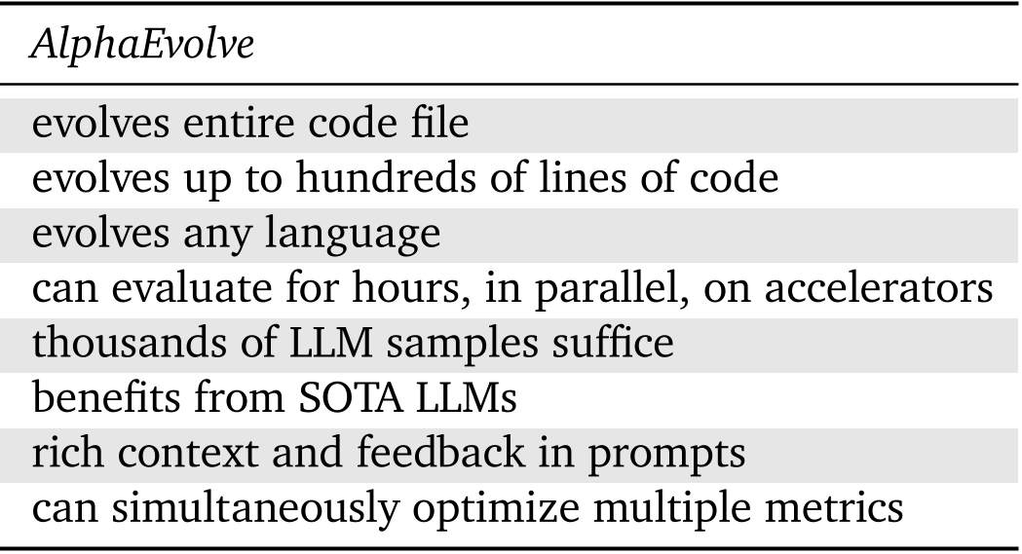
Paper 1: AlphaEvolve
Motivation
Automate algorithmic discovery and improvement
Problems
LLMs lack execution-based refinement loop
Prior methods are limited by scale and generality
Key ideas
History and feedback augmented prompting
LLM generated code edits
Program database with MAP-Elites selection
Execution-based evaluation of candidates
Table 1. AlphaEvolve’s advanced features
Notes:
AlphaEvolve addresses a fundamental challenge: how to use LLMs to make genuine scientific and engineering discoveries. The key insight is to represent discovery candidates as code and use evolutionary search to iteratively improve them, with automated evaluation providing ground truth. This avoids LLM hallucinations since every candidate is verified by execution. Compared to FunSearch, AlphaEvolve is substantially more general: it evolves entire codebases rather than single functions, works with any programming language, leverages state-of-the-art LLMs with rich prompting, and can optimize multiple objectives simultaneously.

Slide 6
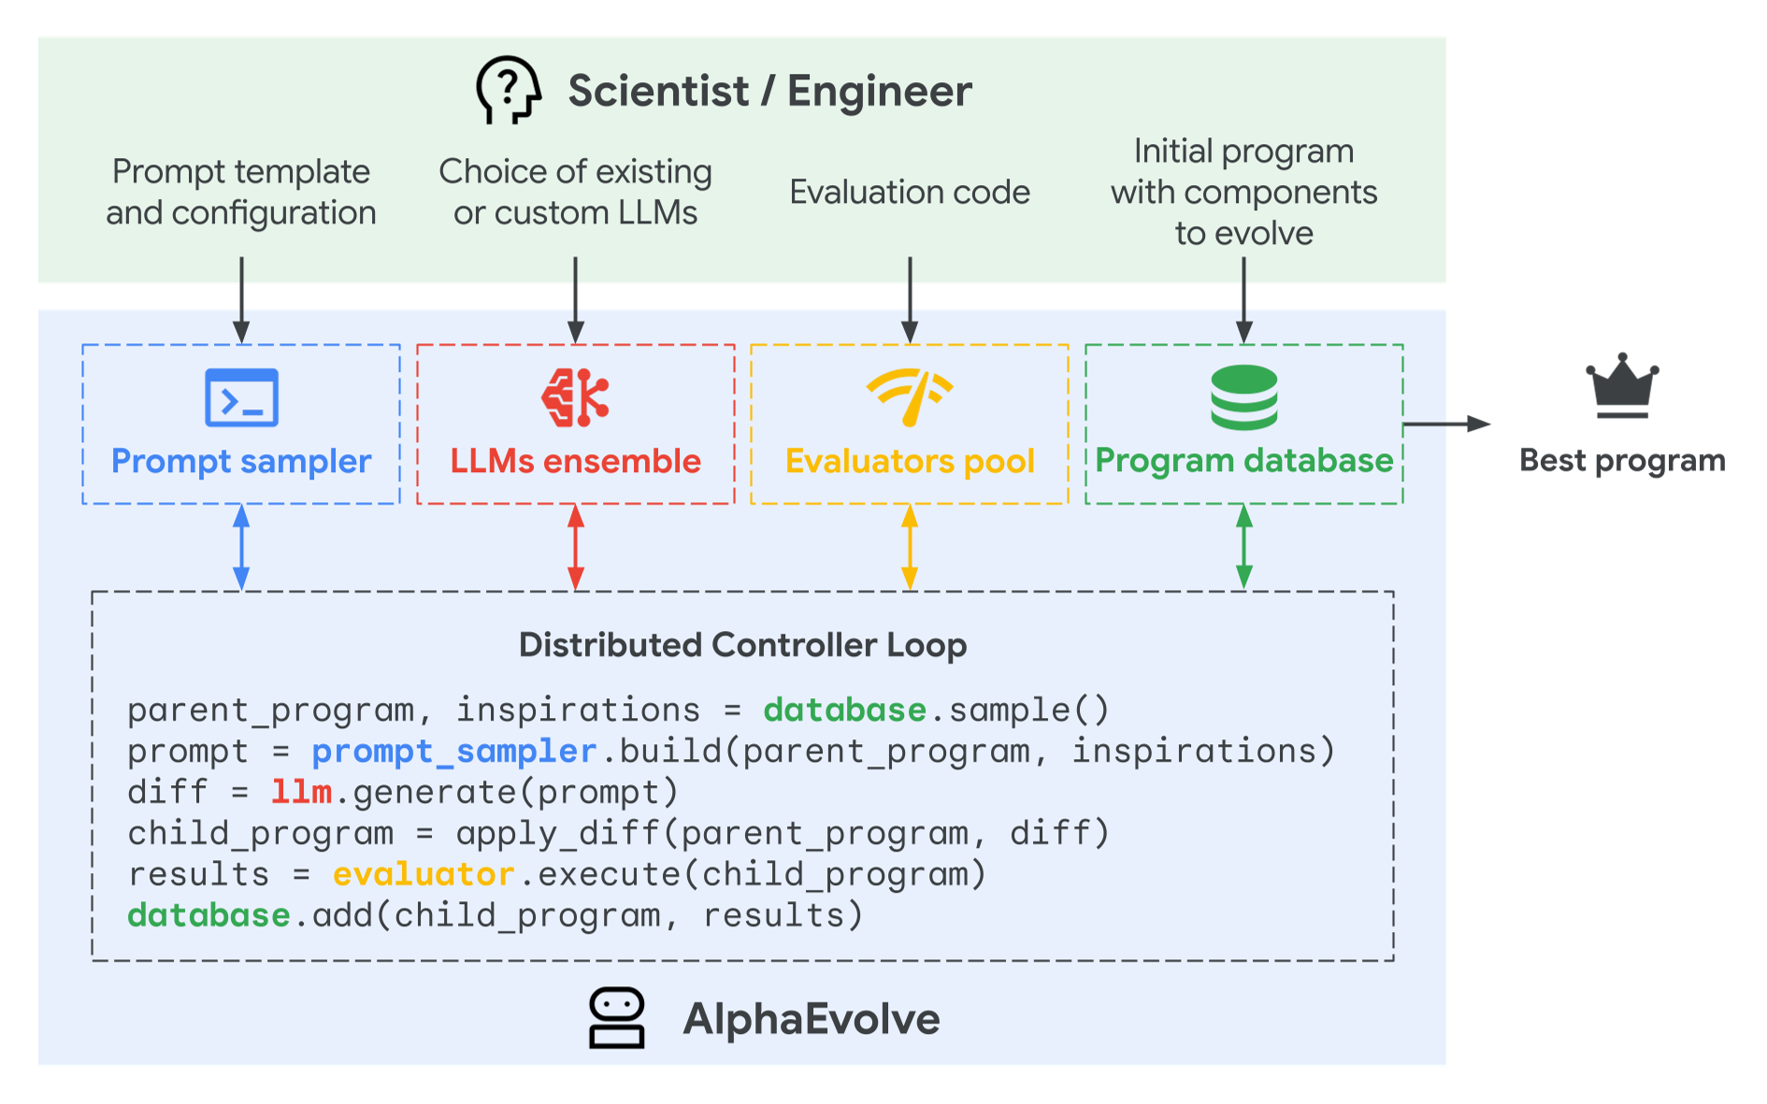
AlphaEvolve - System Architecture (1/3)
Core Components:
Prompt sampler: rich prompts from program database
LLM ensemble: “Flash” (throughput) + “Pro” (quality)
Evaluators pool: automated scoring
Program database: MAP-Elites + island models
Workflow:
User provides code with evolve-block markers
LLMs propose diffs;
Evaluators score candidates
Best programs stored as context for next gen
Figure 2. AlphaEvolve system components and workflow
Notes:
The AlphaEvolve system has four main components. The Prompt Sampler constructs rich prompts using prior solutions from the Program Database. The LLM Ensemble combines Gemini 2.0 Flash for throughput with Gemini 2.0 Pro for quality breakthroughs. The Evaluators Pool runs user-defined evaluation functions to score each candidate. The Program Database uses MAP-Elites and island-based models to balance exploration and exploitation. The user only needs to provide initial code with EVOLVE-BLOCK markers and an evaluate function. AlphaEvolve handles the rest autonomously.

Slide 7
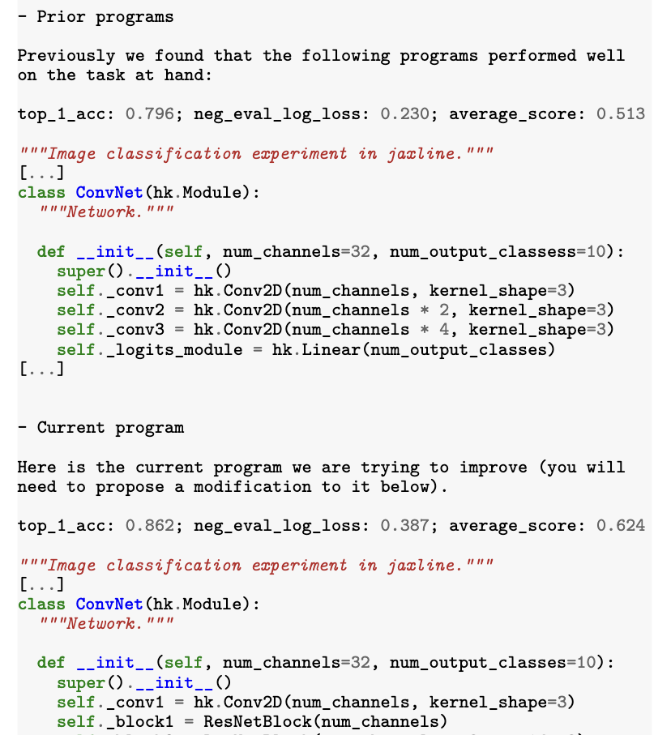
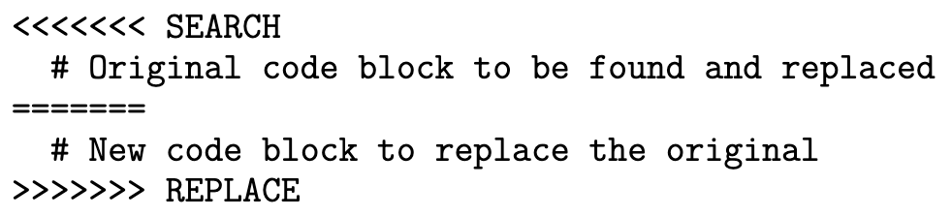
AlphaEvolve - System Architecture (3/3)
Prompt sampler
Explicit context: problem details, equations, literature
Stochastic formatting + meta prompt evolution
Rendered evaluation results as context for LLM
LLM ensemble
Gemini 2.0 Flash (lower latency, generate candidates) + Gemini 2.0 Pro (greater capabilities, generate suggestions)
Structured code edit proposals via diff blocks
Figure 3. Example of an assembled prompt
Notes:
The AlphaEvolve system has four main components. The Prompt Sampler constructs rich prompts using prior solutions from the Program Database. The LLM Ensemble combines Gemini 2.0 Flash for throughput with Gemini 2.0 Pro for quality breakthroughs. The Evaluators Pool runs user-defined evaluation functions to score each candidate. The Program Database uses MAP-Elites and island-based models to balance exploration and exploitation. The user only needs to provide initial code with EVOLVE-BLOCK markers and an evaluate function. AlphaEvolve handles the rest autonomously.

Slide 8
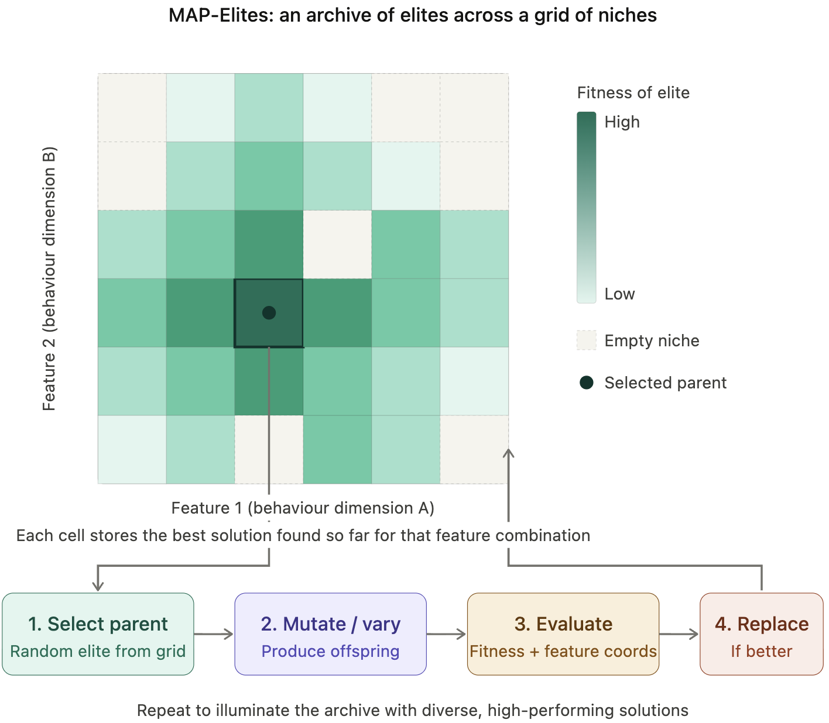
AlphaEvolve - System Architecture (2/3)
Evaluators
Evaluation cascade (hypothesis testing):
LLM-generated feedback for hard-to-quantify properties
Multi-metric scoring
Program database
Solution storage with evaluation results
Exploration–exploitation balancing
MAP-Elites–style selection
Distributed pipeline
Controller, samplers, evaluators run asynchronously
Figure 4. Illustration of MAP-Elites algorithm

Slide 9
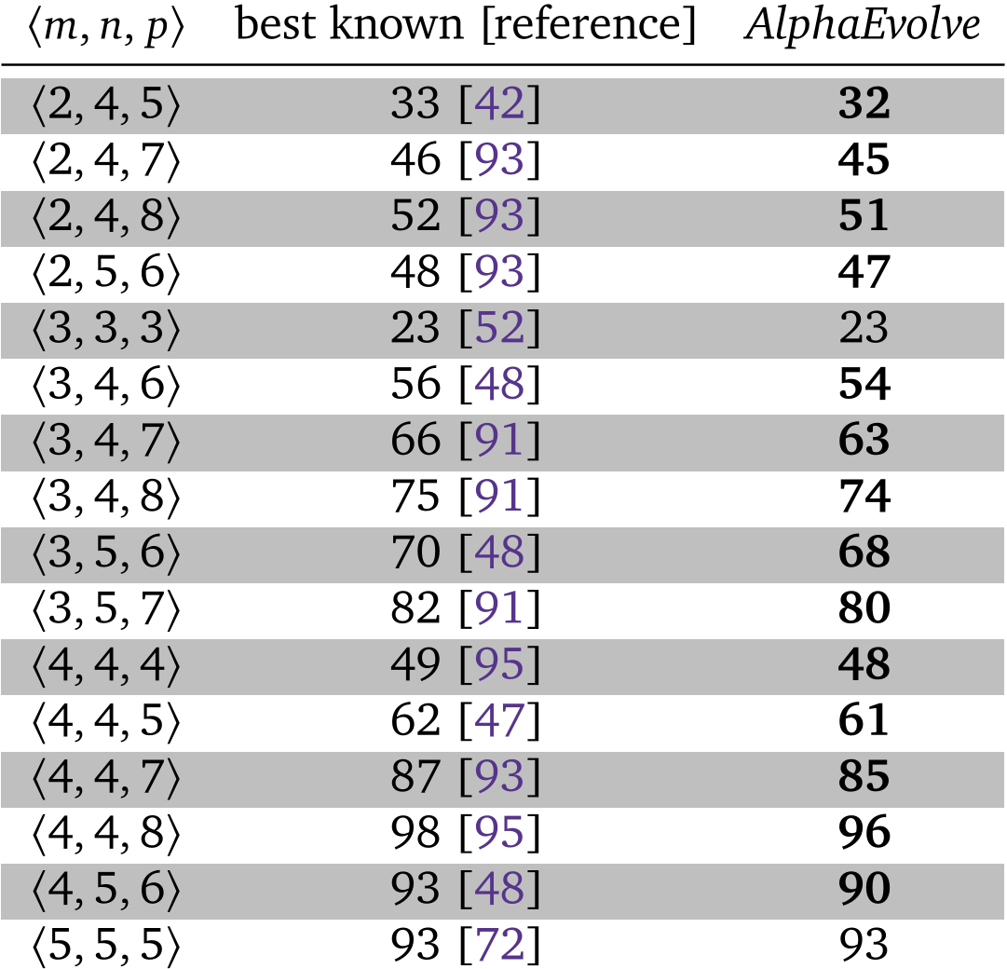
AlphaEvolve – Evaluation
Faster Matrix Multiplication
Key achievements:
First improvement over Strassen (1969) for 4x4 matrices
Found rank-48 algorithm (vs. rank-49 from Strassen)
First improvement in 56 years
Broader results:
Improved SOTA for 14 matrix multiplication targets
All discovered algorithms are exact (integer/half-integer)
Table 2. Number of scalar multiplications for m×n × n×p matrix multiplication
Notes:
One of AlphaEvolve's most celebrated results is discovering a faster algorithm for multiplying 4x4 matrices. Since Strassen's algorithm in 1969, the best known method required 49 scalar multiplications. AlphaEvolve found a rank-48 algorithm, the first improvement in 56 years. The system achieved this by evolving not just the algorithm but the entire training pipeline, including the optimizer, loss function, and hyperparameters. More broadly, AlphaEvolve improved the state of the art for 14 different matrix multiplication targets, and for all parameter settings m,n,p up to 5, it either matched or exceeded the best known solutions.

Slide 10
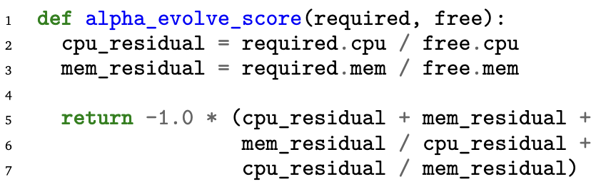
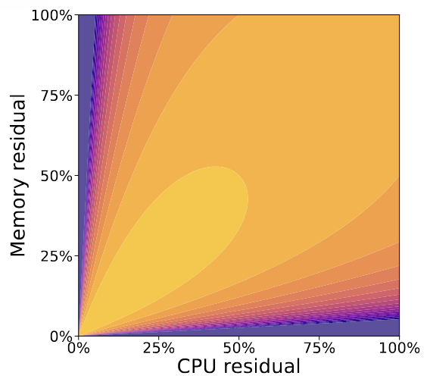
AlphaEvolve - Engineering Applications
Data Center Scheduling:
7-line heuristic for Google Borg; deployed fleet-wide
Recovers 0.7% of fleet-wide stranded compute
Gemini Kernel Optimization:
23% kernel speedup; 1% Gemini training time reduction
Hardware & FlashAttention:
Optimized TPU arithmetic circuits in Verilog
32% speedup on FlashAttention kernel
Figure 5. Discovered scheduling heuristic and its scoring surface
Notes:
AlphaEvolve has demonstrated significant real-world engineering impact. For data center scheduling, it discovered a remarkably simple 7-line Python heuristic that outperforms the existing production heuristic. This function has been deployed across Google's entire fleet and continuously recovers 0.7% of fleet-wide compute resources. For Gemini kernel optimization, AlphaEvolve evolved tiling heuristics that achieve a 23% average kernel speedup and 1% overall Gemini training time reduction. It also optimized TPU arithmetic circuits in Verilog and achieved a 32% speedup on FlashAttention kernels.

Slide 11
Paper 2: EvoX
EvoX: Meta-Evolution for Automated Discovery
Shu Liu, Shubham Agarwal, et al.
UC Berkeley, Stanford University, Bespoke Labs
1. AlphaEvolve
2. EvoX
3. CORAL
Notes:
Now we move to EvoX, our second paper. EvoX comes from UC Berkeley and Stanford, and its key insight is that the search strategy itself should be treated as an evolvable object. While AlphaEvolve uses a fixed MAP-Elites based search strategy, EvoX dynamically adapts how candidates are selected and varied during the optimization process. This enables it to avoid plateaus that fixed strategies inevitably hit.

Slide 12
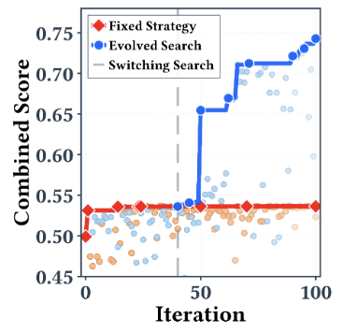
Paper 2: EvoX
Problems
AlphaEvolve, and other works all use fixed search strategies
A strategy effective early may become ineffective later
Key observations
Optimal search behavior is state-dependent
Different tasks and stages need different strategies
Key ideas
Frame search strategy as a meta-learning problem
Two coupled loops: inner (solution) + outer (strategy evolution)
Strategy evolves based on observed progress signals
Figure 6. Evolved search (blue) breakthroughs while fixed strategy (red) stagnates
Notes:
EvoX is motivated by a fundamental limitation of prior systems. AlphaEvolve, OpenEvolve, and others all use fixed search strategies with hand-specified parameters. For example, AlphaEvolve uses MAP-Elites with predefined population structures, and OpenEvolve similarly relies on static diversity heuristics. The problem is that a fixed strategy often fails to generalize across tasks or across different stages of optimization within the same task. EvoX addresses this by treating the search strategy itself as an evolvable object, creating a two-level evolution process.

Slide 13
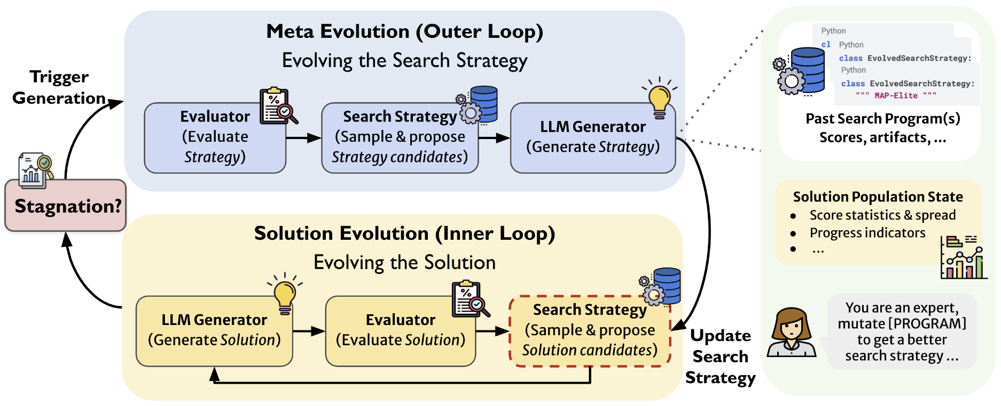
EvoX - System Architecture
Solution Evolution (Inner Loop)
Strategy selects parent + variation operator
Three operators: local, structural, free-form
Meta-Evolution (Outer Loop)
Monitors progress over sliding window
On stagnation: triggers strategy evolution
Conditions on past strategies + population state
Strategy Database
Records (strategy, state, score) tuples
Enables state-conditional strategy selection
Figure 7. EvoX architecture with inner and outer loops
Notes:
EvoX operates as two coupled loops. The inner loop is the standard solution evolution: a search strategy selects a parent candidate and a variation operator, the LLM generates a new candidate, and the evaluator scores it. EvoX defines three variation operators: local refinement for fine-grained edits, structural variation for major redesigns, and free-form variation with no constraints. The outer loop monitors progress over a sliding window. When progress stalls below a threshold, it triggers strategy evolution. The LLM generates a new strategy conditioned on the history of past strategies and their performance, and the current population state descriptor. This state-conditional adaptation is what sets EvoX apart.

Slide 14
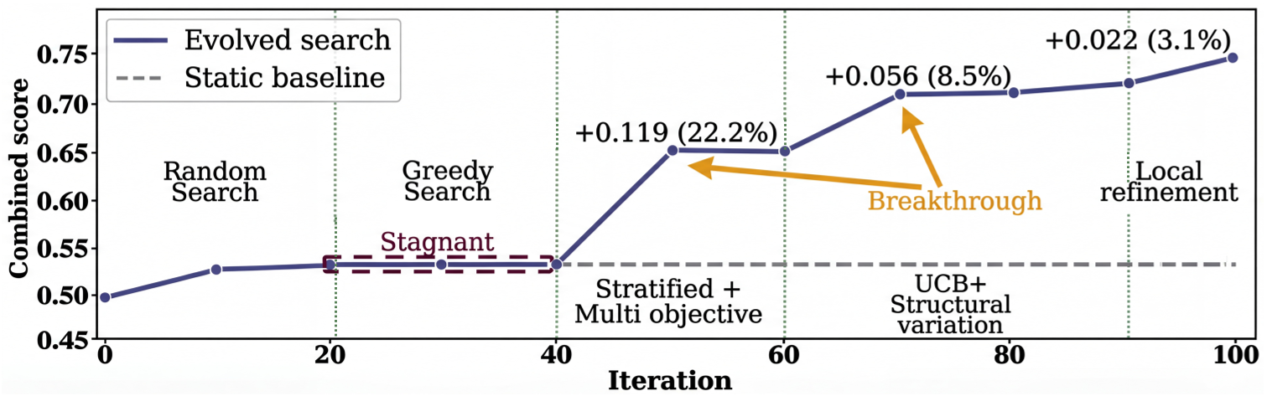
EvoX - Case Study: Signal Processing
Task: Adaptive filtering for noisy time series
Strategy Evolution Phases:
Phase 1 (iter 0-20): Random, then greedy
Phase 2 (iter 40): Stratified multi-objective (+0.119)
Phase 3 (iter 60): UCB + structural variation (+0.056)
Phase 4 (iter 90): Local refinement (+0.022)
Result: 34.1% higher score than static baseline
Figure 8. Search strategy evolution on signal processing task
Notes:
This case study on signal processing beautifully illustrates how EvoX adapts. The task is to build a filtering program that balances fidelity, smoothness, low lag, and minimal false trend changes. Starting with random sampling, EvoX detects stagnation at iteration 20 and switches to greedy search. At iteration 40, it makes the key breakthrough by switching to stratified multi-objective sampling, which combines parents and inspirations from different objective tiers. This creates novel hybrid designs like combining SSA with Whittaker smoothing, yielding a +0.119 jump. At iteration 60, it shifts to UCB-guided structural variation for another +0.056. Finally, it uses local refinement for polishing. The static baseline stagnates at 0.53, while EvoX reaches 0.74.

Slide 15
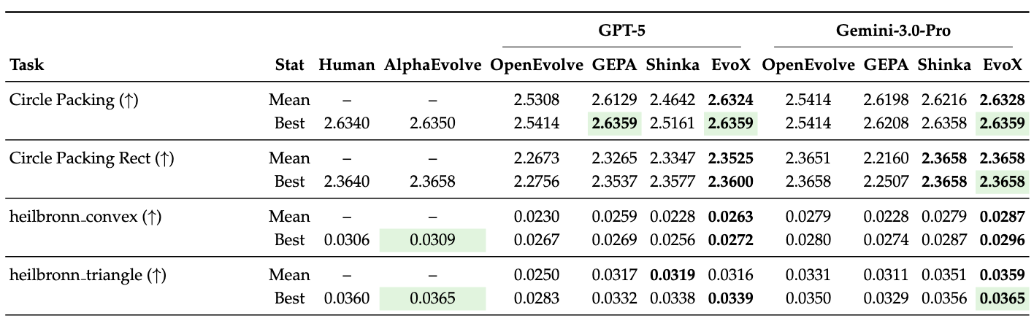
EvoX – Evaluation (Math Optimization)
Evaluated on 8 mathematical optimization tasks :
Circle packing, Heilbronn triangle/convex, min-max-min distance, etc.
Best or tied-best on 7/8 tasks; exceeds AlphaEvolve on 5/7 tasks
Table 3. Math optimization results (showing the first 4 out of 8 tasks)
Notes:
On eight mathematical optimization tasks, EvoX achieves the strongest overall performance among open evolutionary frameworks. Under GPT-5, it attains the best or tied-best result on 7 of 8 tasks. Under Gemini-3.0-Pro, it similarly achieves the best score on 7 of 8 tasks. Notably, EvoX matches or exceeds the closed-source AlphaEvolve on 5 out of 7 comparable tasks, within just 100 iterations, while AlphaEvolve's iteration budget is not publicly specified. In Circle Packing Rect, EvoX actually exceeds AlphaEvolve's score (2.36583237 vs 2.36583213).

Slide 16
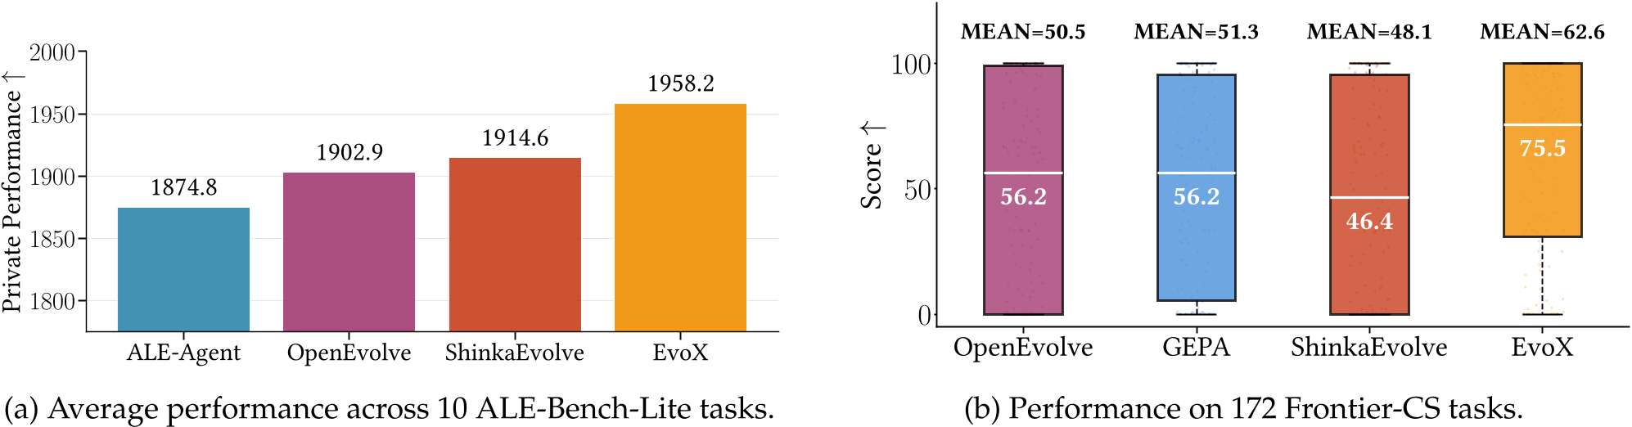
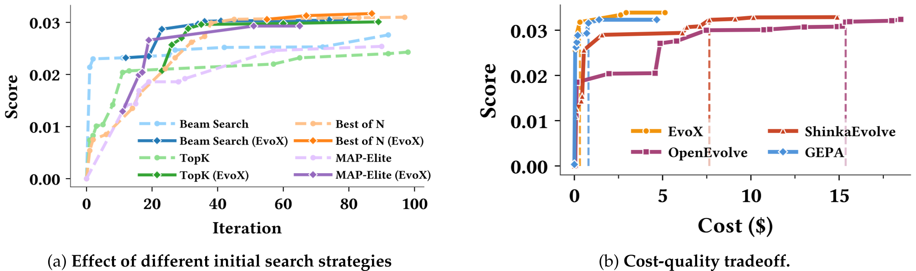
EvoX - System & Algorithm Optimization
System Optimization (6 tasks)
Best mean score on all tasks (GPT-5), 5/6 (Gemini)
Exceeds human-best on all 6 under Gemini-3.0-Pro
Algorithm & Research (182 tasks)
ALE-Bench-Lite: highest average (1958.2 vs 1874.8)
Frontier-CS (172 tasks): highest median score (75.5)
24% improvement over OpenEvolve in mean score
Figure 9. EvoX on ALE-Bench-Lite and Frontier-CS benchmarks
Figure 10. Search strategy evolution and cost-quality tradeoffs
Notes:
Beyond math, EvoX also dominates on system optimization and algorithm benchmarks. On six real-world system tasks including load balancing, GPU sharing, and transaction scheduling, EvoX achieves the best mean score on all tasks under GPT-5 and exceeds human-best results on all six under Gemini-3.0-Pro. On algorithm and research challenges, EvoX achieves the highest average score on ALE-Bench-Lite and the highest median on 172 Frontier-CS tasks, improving over OpenEvolve by 24% in mean score. The cost-quality tradeoff analysis shows EvoX is also cost-efficient, requiring less than $1 to exceed quality thresholds that cost competitors $7-15.

Slide 17
Paper 3: CORAL
CORAL: Towards Autonomous Multi-Agent Evolution
for Open-Ended Discovery
Ao Qu, Han Zheng, Zijian Zhou, et al.
MIT, NUS, MiniMax, McGill, Stanford, SambaNova, Meta, Amazon, Microsoft
1. AlphaEvolve
2. EvoX
3. CORAL
Notes:
Our third paper is CORAL from MIT. CORAL pushes the frontier further by introducing fully autonomous multi-agent evolution. While AlphaEvolve and EvoX use fixed evolutionary loops with the LLM as a passive generator, CORAL gives agents full autonomy over the search process. Multiple agents run asynchronously, sharing discoveries through persistent memory, and using heartbeat mechanisms for self-reflection and course correction.

Slide 18
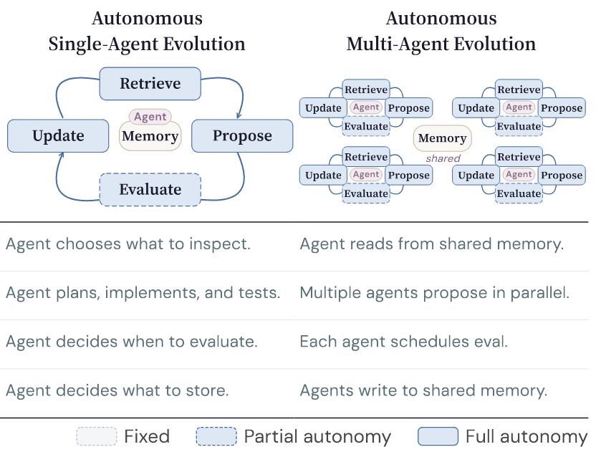
Paper 3: CORAL
Problems
Fixed evolutionary search limits agent capability
Key decisions (retrieve, update) are hard-coded
Multi-agent systems require predefined roles
Key ideas
Delegate full evolutionary loop to autonomous agents
Shared persistent memory (attempts, notes, skills) across multiple agents
Heartbeat interventions trigger reflection, consolidation, and redirection
Figure 11. Comparison of two LLM agent systems
Notes:
CORAL positions itself by identifying three paradigms. Fixed evolutionary search, used by AlphaEvolve and others, keeps all search decisions external to the agent. Autonomous single-agent evolution gives the agent control over what to retrieve, when to test, and what knowledge to store. Autonomous multi-agent evolution, CORAL's contribution, has multiple agents exploring in parallel with full autonomy, coordinating indirectly through shared persistent memory rather than through explicit messaging or role assignment. This horizontal parallelism enables exploration diversity and emergent knowledge sharing.

Slide 19
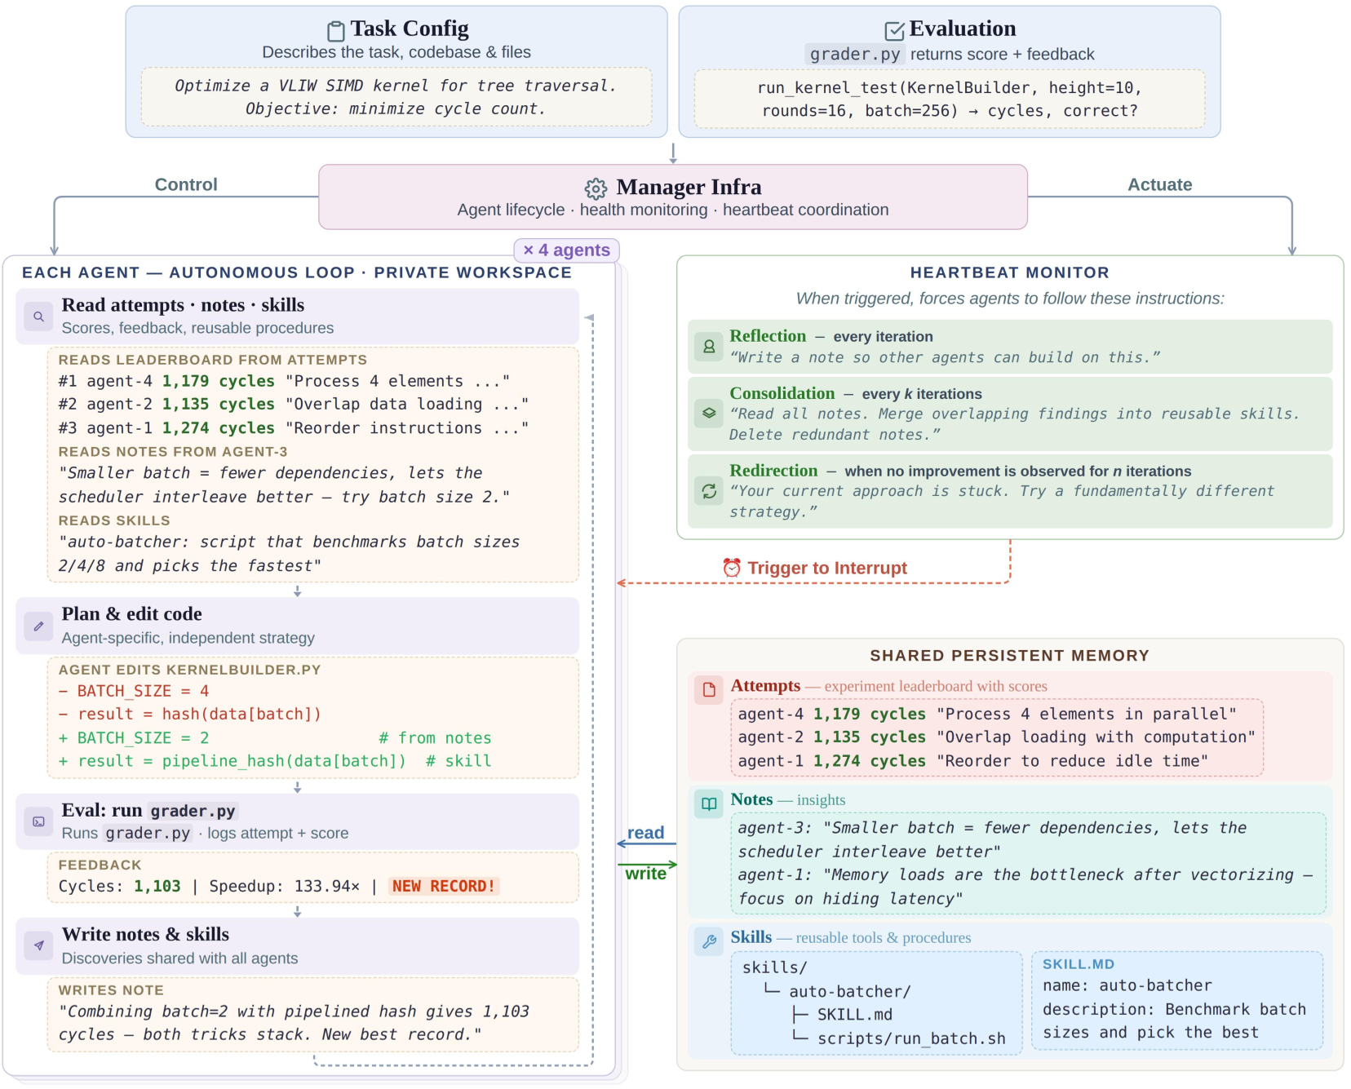
CORAL - System Architecture (1/2)
Manager Infrastructure:
Agent lifecycle, health monitoring, heartbeat
Agent Loop (per agent):
Read shared memory (attempts, notes, skills)
Plan, edit, evaluate, write back discoveries
Heartbeat Monitor:
Reflection: per-iteration note-taking
Consolidation: synthesize into skills
Redirection: pivot on stagnation
Figure 12. CORAL framework overview
Notes:
This figure shows the CORAL framework in detail. At the top, the task configuration and evaluation grader are defined by the user. The Manager Infrastructure handles agent lifecycle, health monitoring, and heartbeat coordination. Each agent operates in its own isolated worktree with a private workspace. Agents follow an autonomous loop: reading from shared memory (attempts, notes, skills), planning and editing code, running evaluations, and writing discoveries back to shared memory. The Heartbeat Monitor implements three types of interventions: per-iteration reflection for note-taking, periodic consolidation for synthesizing knowledge into reusable skills, and stagnation-triggered redirection for pivoting strategy when stuck.

Slide 20
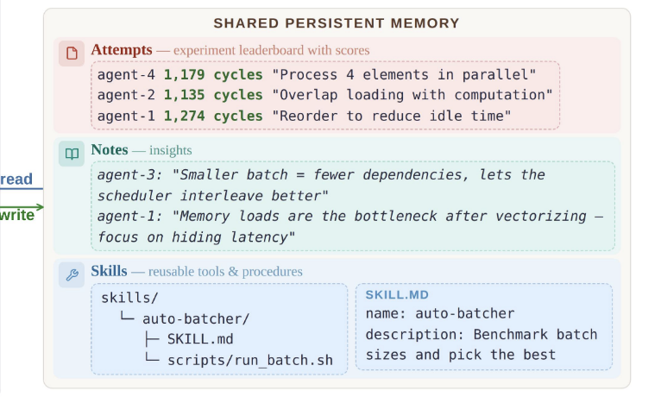
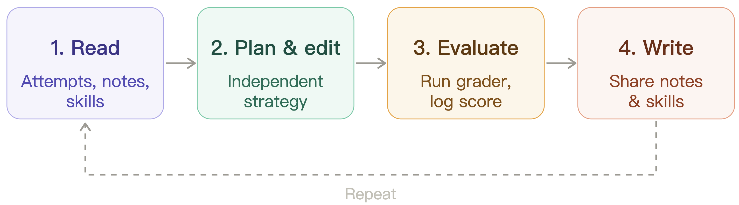
CORAL - System Architecture (2/2)
Shared Persistent Memory (File System)
attempts/: historical evaluations and solutions (leaderboard)
notes/: observations, learnings, reflections from all agents
skills/: reusable procedures transferable across attempts
Multi-Agent Organization
N agents run asynchronously in isolated git worktrees
Coordination via shared memory (indirect communication)
Figure 13. Shared persistent memory in CORAL
Figure 12. Agent loop in CORAL
Notes:
This figure shows the CORAL framework in detail. At the top, the task configuration and evaluation grader are defined by the user. The Manager Infrastructure handles agent lifecycle, health monitoring, and heartbeat coordination. Each agent operates in its own isolated worktree with a private workspace. Agents follow an autonomous loop: reading from shared memory (attempts, notes, skills), planning and editing code, running evaluations, and writing discoveries back to shared memory. The Heartbeat Monitor implements three types of interventions: per-iteration reflection for note-taking, periodic consolidation for synthesizing knowledge into reusable skills, and stagnation-triggered redirection for pivoting strategy when stuck.

Slide 21
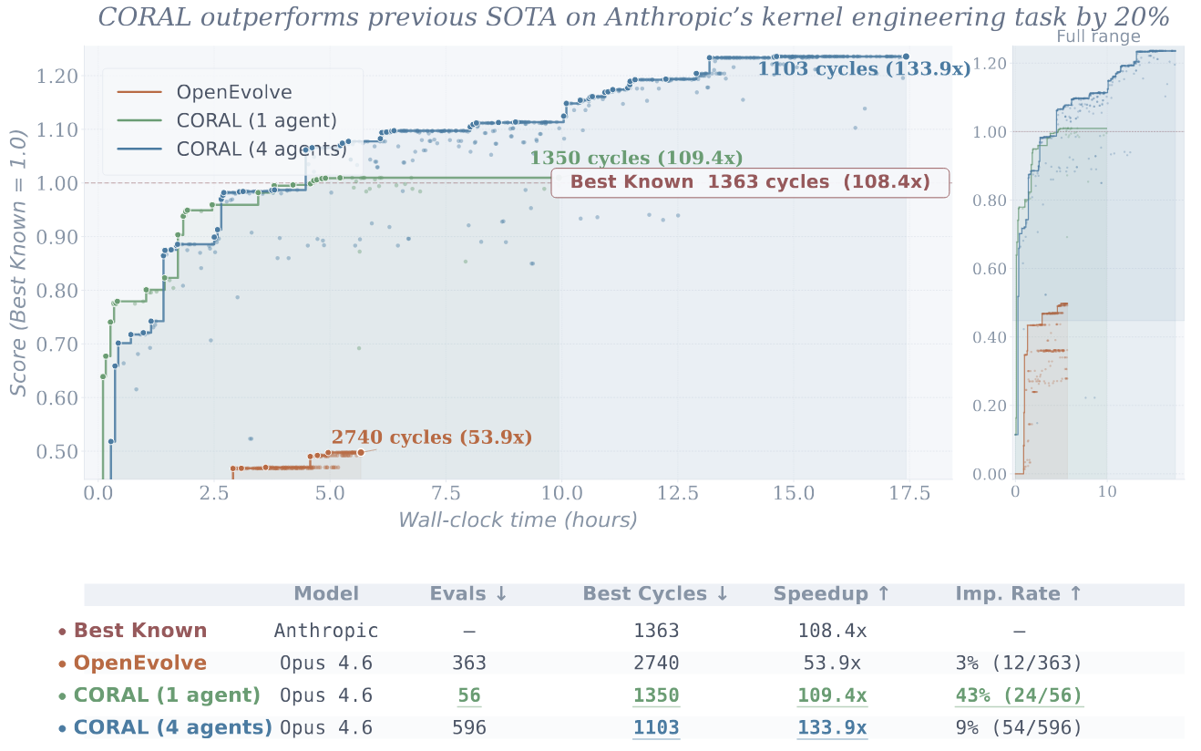
CORAL – Evaluation (Kernel Engineering)
Task: Minimize cycles on VLIW SIMD kernel (baseline 147,734)
Key results:
New SOTA: 4 co-evolving agents reach 1,103 cycles, surpassing previous best (1,363) by 20%
Efficiency: 1 agent surpasses prior SOTA in just 56 evaluations (vs. OpenEvolve's 2,740)
Multi-agent edge: Single agent plateaus early; co-evolving agents break through via shared memory
Figure 13. CORAL performance on anthropic’s kernel engineering

Slide 22
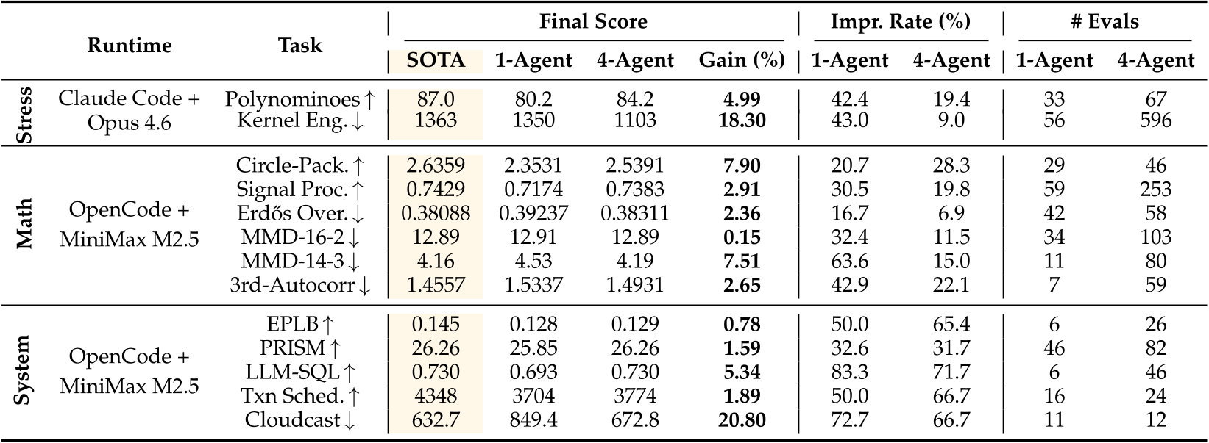
CORAL – Evaluation (vs. Single-Agent)
CORAL achieves best final score on all 11 tasks, new SOTA on 8 tasks
Improvement rate: 3-10x higher than fixed evolutionary search baselines
Convergence: typically 5-20 evaluations (vs. 60-100 for baselines)
Autonomous design: agents decide what to explore, when to evaluate, what to store
Table 4. Multi-agent co-evolution vs. single-agent CORAL across tasks
Notes:
CORAL's single agent already outperforms all fixed evolutionary search baselines on every task. The improvement rate is 3 to 10 times higher, meaning CORAL wastes far fewer evaluations on unproductive candidates. It typically converges within 5 to 20 evaluations, compared to 60 to 100 for baselines. This efficiency comes from agent autonomy: CORAL agents analyze prior attempts, choose which aspects to modify, decide when to run local tests before submitting for evaluation, and accumulate reusable knowledge. Fixed baselines follow rigid pipelines that cannot adapt to task-specific structure.

Slide 23
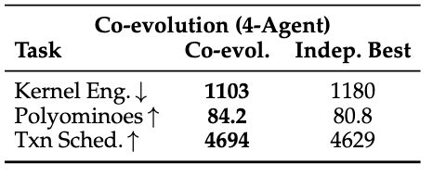
Why Multi-Agent Organization Helps
Cross-agent information transfer
Agents build on each other's commits and shared notes
Discoveries diffuse through memory, not explicit messaging
Exploration diversity
Agents pursue distinct strategies in parallel
Population covers broader search space than any individual
Contribution balance
All agents contribute records and reach top scores
No single agent dominates the search
Table 5. Ablation study on multi-agent co-evolution.

Slide 24
Summary of Contributions
AlphaEvolve (Google DeepMind)
Evolutionary coding agent for scientific discovery
First improvement over Strassen in 56 years; deployed at Google
EvoX (UC Berkeley)
Meta-evolution: search strategy as an evolvable object
Best on ~200 tasks with superior cost efficiency
CORAL (MIT)
Multi-agent evolution with shared persistent memory
New SOTA on 8/11 tasks; co-evolution > independent runs
Progression: Single agent fixed search -> Single agent adaptive search -> multi-agent adaptive search
Notes:
To summarize, these three papers represent a clear progression in autonomous agent systems for discovery. AlphaEvolve established the foundation: a general-purpose evolutionary coding agent that combines LLMs with automated evaluation, achieving landmark results like improving Strassen's algorithm and optimizing Google's infrastructure. EvoX introduced meta-evolution, recognizing that the search strategy itself should adapt, and achieved strong results across nearly 200 tasks with superior cost efficiency. CORAL pushed furthest toward full autonomy, giving agents control over the entire search process and introducing multi-agent co-evolution through shared persistent memory. Together, these works trace a progression from fixed search to adaptive search to fully autonomous multi-agent co-evolution, pointing toward a future of self-evolving discovery systems.

Slide 25
Q & A
Thank you for listening!
Notes:
To summarize, these three papers represent a clear progression in autonomous agent systems for discovery. AlphaEvolve established the foundation: a general-purpose evolutionary coding agent that combines LLMs with automated evaluation, achieving landmark results like improving Strassen's algorithm and optimizing Google's infrastructure. EvoX introduced meta-evolution, recognizing that the search strategy itself should adapt, and achieved strong results across nearly 200 tasks with superior cost efficiency. CORAL pushed furthest toward full autonomy, giving agents control over the entire search process and introducing multi-agent co-evolution through shared persistent memory. Together, these works trace a progression from fixed search to adaptive search to fully autonomous multi-agent co-evolution, pointing toward a future of self-evolving discovery systems.

