Slide 1
From Branch Prediction to Speculative Decoding: How Classical Speculation Reappears in LLM Inference 2026.4.21
Kuang Wang
School of Data Science
Chinese University of Hong Kong, Shenzhen

Slide 2
Outline
Introduction & Motivation (6 min)
Formulation (4 min)
Proposed Methods & Performance Evaluation (15 min)
Blockwise Parallel Decoding(2018) (5 min)
Speculative Sampling(2023) (4 min)
EAGLE(2024) (6 min)
Conclusion (2 min)
Q & A (2 min)

Slide 3
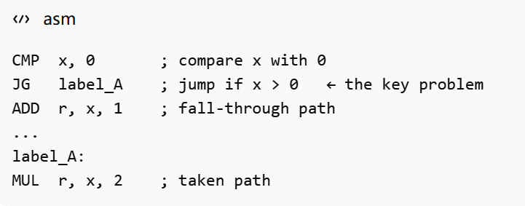
Introduction – Why Branch Prediction is Needed?(1/4)
Pipelining: The Basis of Instruction-Level Parallelism
It consists of four stages:
Instruction Fetch (IF): Fetch the next instruction from memory.
Instruction Decode (ID): Decode the instruction and determine the required operation.
Execute (EX): Perform computation, address generation, or branch evaluation.
Write Back (WB): Write the result to the destination register.
Performance Degradation
Affected stages perform no useful work.
These empty slots are called bubbles.
Repeated branch stalls reduce overall throughput.
Table 2: Pipeline behavior under a branch-induced control hazard, showing stall bubbles and delayed fetch of the correct next instruction.
Table 1: Four-stage instruction pipeline illustrating overlapped execution across successive instructions.
Cycle | 1 | 2 | 3 | 4 | 5 | 6 | 7
CMP | IF | ID | EX | WB
JG |  | IF | ID | EX | WB
Bubble 1-3 |  |  | -- | -- | -- | --
Correct next instruction |  |  |  |  |  |  | IF
Cycle | 1 | 2 | 3 | 4 | 5 | 6 | 7
OP1 | IF | ID | EX | WB
OP2 |  | IF | ID | EX | WB
OP3 |  |  | IF | ID | EX | WB
OP4 |  |  |  | IF | ID | EX | WB
Wait Result
Control Hazards

Slide 4
Introduction – Why Branch Prediction is Needed? (2/4)
Branch Prediction: Preserving Pipeline Continuity
It consists of four stages:
Predict whether the branch is taken or not taken.
Fetch instructions along the predicted path before resolution.
Correct predictions incur minimal penalty.
Wrong predictions flush the pipeline and restart from the correct path.
The core idea is to trade certainty for continuity.
Correct prediction → near-zero control-hazard cost
Incorrect prediction → pipeline flush and recovery penalty
Table 4: Speculative execution with branch prediction, showing predicted-path execution followed by commit or flush after branch resolution.
Table 3: Four-stage instruction pipeline illustrating overlapped execution across successive instructions.
Cycle | 1 | 2 | 3 | 4 | 5 | 6 | 7
OP1 | IF | ID | EX | WB
OP2 |  | IF | ID | EX | WB
OP3 |  |  | IF | ID | EX | WB
OP4 |  |  |  | IF | ID | EX | WB
Cycle | 1 | 2 | 3 | 4 | 5 | 6
CMP | IF | ID | EX | WB
JG |  | IF | ID | EX | WB
Speculative OP |  |  | IF | ID | EX* | WB*
Validation / commit |  |  |  |  | ✅Commit /❌Flush
Branch Predict

Slide 5
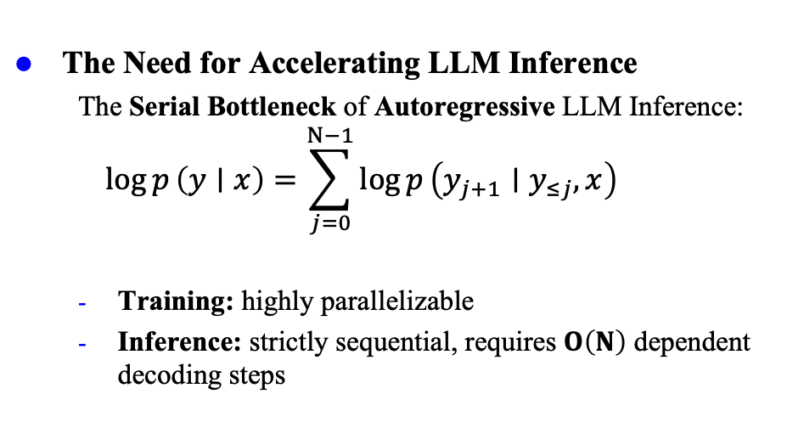
Introduction – Why Branch Prediction is Needed? (3/4)
The Need for Accelerating LLM Inference
The Serial Bottleneck of Autoregressive LLM Inference:
$$\log{p}\left(y∣x\right)=\sum_{j=0}^{N−1}{\log{p}}\left(y_{j+1}∣y_{≤j}, x\right)$$
Training: highly parallelizable
Inference: strictly sequential, requires $O\left(N\right)$ dependent decoding steps
Existing Acceleration Methods
Table 5: Existing acceleration methods and their performance trade-offs.
Approach | Method | Trade-off
Quantization | Lower-precision inference | Quality degradation↓
Distillation | Smaller student model | Retraining required; reduced capability↓
Pruning | Remove redundant weights | Accuracy loss; structural complexity↓
Desired Acceleration Scheme
Simple: minimal modification to the original
Efficient: reduces decoding latency / increases throughput
Faithful: preserves the target model’s output quality or distribution
Key Problem
Even if each forward pass is internally parallel, the token-by-token decoding loop remains serial.
Speculative Decoding
Key Features
Draft with a small model, verify with a large model
Improves decoding efficiency without altering final generation behavior
Retain the original target model architecture

Slide 6
Introduction – Why Branch Prediction is Needed? (4/4)
From CPU Speculation to LLM Speculative Decoding
Table 6: Parallel between CPU branch prediction and speculative decoding in LLMs.
 | CPU Branch Prediction | Speculative Decoding
Bottleneck | Control hazards | Serial decoding
Predictor | Branch predictor | Draft model
Verifier | Actual execution result | Target model
Correct prediction | Continue execution | Accept drafted tokens
Incorrect prediction | Flush and restart | Reject and correct
Benefit | Preserve pipeline throughput | Verify multiple tokens per pass
Shared principle: Use a cheap predictor to reduce stalls in an expensive sequential process.
Key condition for speedup: One target-model generation step must be slower than verifying several drafted tokens in parallel.

Slide 7
Outline
Introduction & Motivation (6 min)
Formulation (4 min)
Proposed Methods & Performance Evaluation (15 min)
Blockwise Parallel Decoding(2018) (5 min)
Speculative Sampling(2023) (4 min)
EAGLE(2024) (6 min)
Conclusion (2 min)
Q & A (2 min)

Slide 8
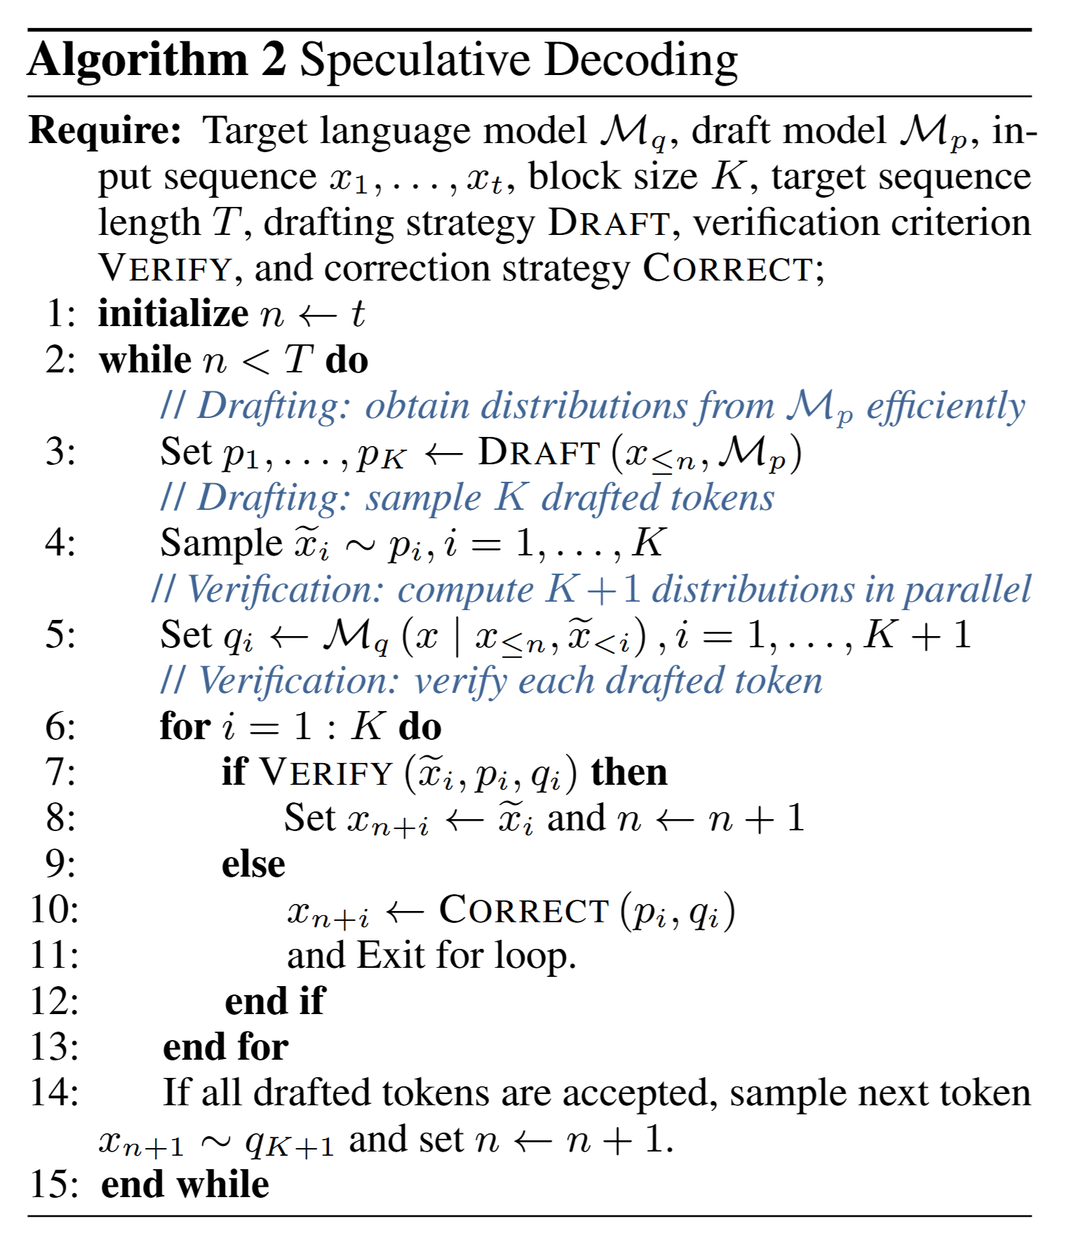
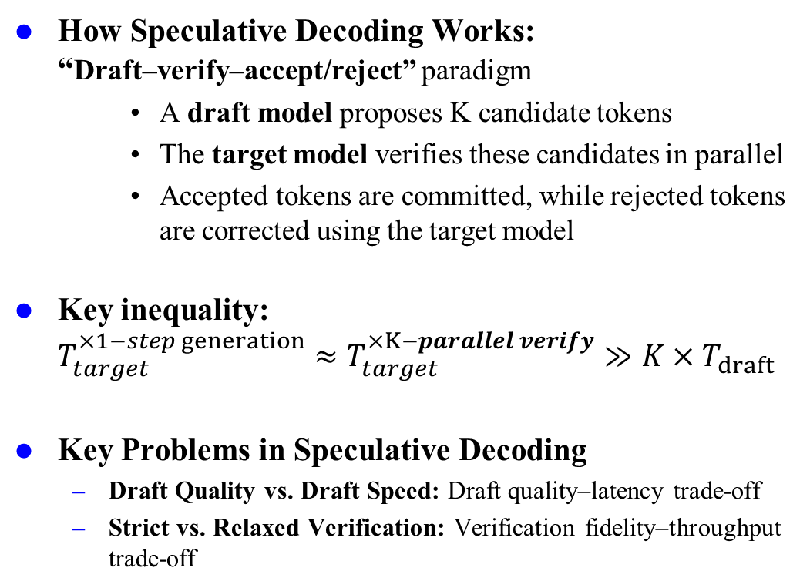
Formulation(1/1)
How Speculative Decoding Works: “Draft–verify–accept/reject” paradigm
A draft model proposes K candidate tokens
The target model verifies these candidates in parallel
Accepted tokens are committed, while rejected tokens are corrected using the target model
Key inequality: $T_{target}^{×1−step generation}≈T_{target}^{×K−parallel verify}​≫K×T_{draft}$
Key Problems in Speculative Decoding
Draft Quality vs. Draft Speed: Draft quality–latency trade-off
Strict vs. Relaxed Verification: Verification fidelity–throughput trade-off
Figure 1: Overview of Speculative Decoding

Slide 9
Outline
Introduction & Motivation (6 min)
Formulation (4 min)
Proposed Methods & Performance Evaluation (15 min)
Blockwise Parallel Decoding(2018) (5 min)
Speculative Sampling(2023) (4 min)
EAGLE(2024) (6 min)
Conclusion (2 min)
Q & A (2 min)

Slide 10
Blockwise Parallel Decoding (1/5)
Positioning The first work to introduce speculative-style decoding in seq2seq generation
Motivation
Sequential decoding has become the dominant paradigm for language modeling.
Inference is slow: greedy decoding produces only one token per step.
Brute-force parallelization is infeasible: the vocabulary size makes it impossible to enumerate all candidate suffixes of length k.
Acceleration must preserve quality: many speedup methods introduce noticeable degradation in generation quality.
key asymmetry: While generation is inherently sequential, verification of a candidate prefix can be parallelized
Notes:
(from form aspect)

Slide 11
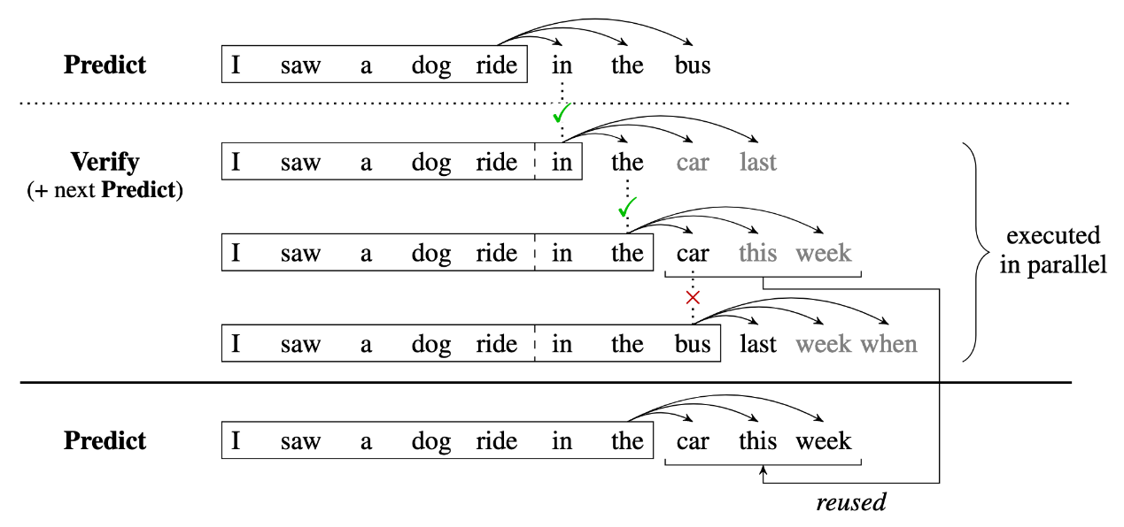
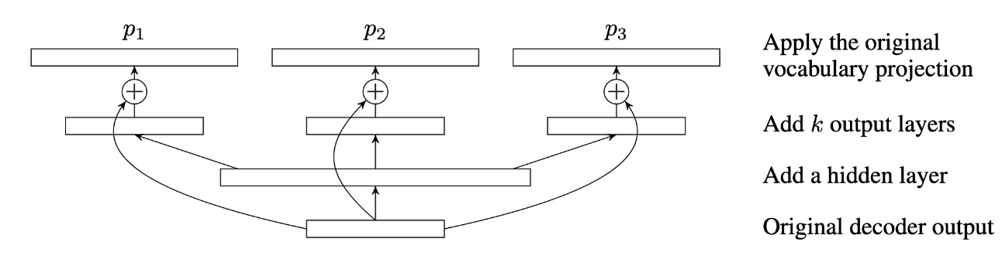
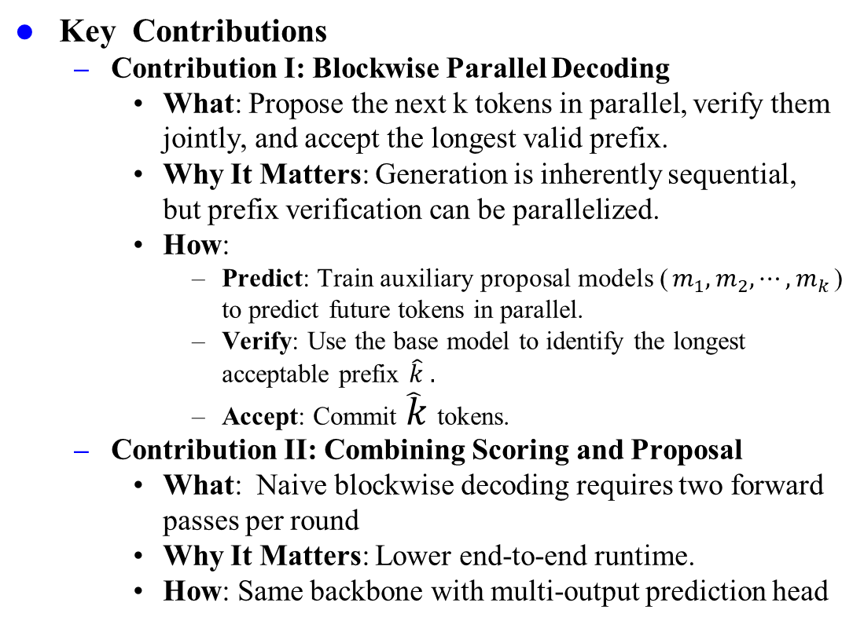
Blockwise Parallel Decoding (2/5)
Key Contributions
Contribution I: Blockwise Parallel Decoding
What: Propose the next k tokens in parallel, verify them jointly, and accept the longest valid prefix.
Why It Matters: Generation is inherently sequential, but prefix verification can be parallelized.
How:
Predict: Train auxiliary proposal models ($m_{1},m_{2},⋯,m_{k}$) to predict future tokens in parallel.
Verify: Use the base model to identify the longest acceptable prefix $\hat{k} .$
Accept: Commit $\hat{k}$tokens.
Contribution II: Combining Scoring and Proposal
What: Naive blockwise decoding requires two forward passes per round
Why It Matters: Lower end-to-end runtime.
How: Same backbone with multi-output prediction head
Figure 2: Blockwise parallel decoding with joint proposal, parallel verification, and longest-prefix acceptance.
Figure 3: Combined scoring and proposal design with multi-output heads for more efficient blockwise decoding.
Notes:
(from form aspect)

Slide 12
Blockwise Parallel Decoding (3/5)
Main Results
Tasks:
Machine translation (newstest2013 dev)
Image super-resolution (8×8→32×32 conditional generation)
Key factors studied:
Block size k: larger k offers stronger theoretical speedup, but also makes proposal more difficult
Fine-tuning or not: freezing the base model is safer for quality, while fine-tuning improves multi-step prediction
Distillation: distillation makes sequences more predictable
Approximation Strategy: approximate verification increases the accepted prefix lengthtion head
Notes:
(from form aspect)

Slide 13
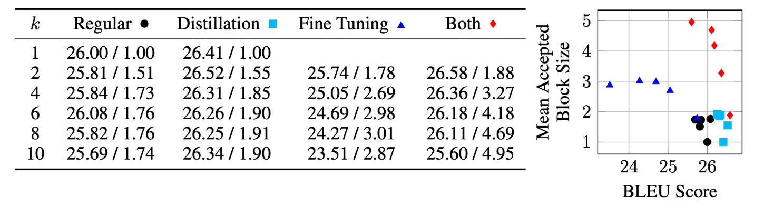
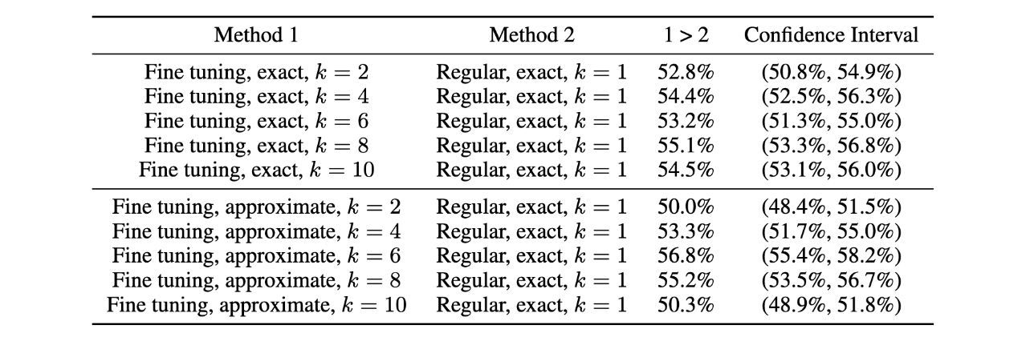
Blockwise Parallel Decoding (4/5)
Results on Machine Translation: Iteration Reduction
Regular (frozen + original data): Preserves quality and achieves about 1.76× iteration reduction
Distillation only (frozen + distilled data): Distilled sequences are more predictable; speed and BLEU improve slightly
Fine-tuning only: Better prediction, but increased quality risk
Fine-tuning + Distillation: Nearly 5× iteration reduction at the cost of some BLEU degradation
Results on Image Super-Resolution： approximate verification matters more
For image generation, tokens correspond to pixel intensity values, so exact matching is too strict.
The fine-tuning + approximate setting achieves the highest preference rate of 56.8%.
Figure 4: Results on Machine Translation Task.
Table 7: Results on Image Super-Resolution Task.
Notes:
(from form aspect)

Slide 14
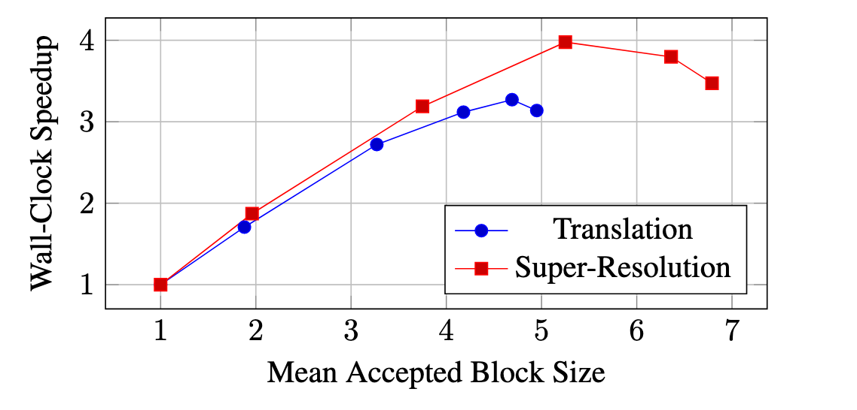
Blockwise Parallel Decoding (5/5)
Wall-Clock Speedup and Final Takeaway
Speculative decoding can substantially accelerate inference
Gain varies across tasks
Machine Translation: 3.3×
Image super-resolution: 4.0 ×
Larger k is not always better As k increases:
the accepted block size usually grows,
but the per-round computation cost also increases.
Figure 5: Wall-clock speedup vs. mean accepted block size.
Table 8: Peak speedup and corresponding configuration.
Task | Peak speedup | Configuration
Machine translation | 3.3× | (k=8), mean accepted block size 4.7
Image super-resolution | 4.0× | (k=6), mean accepted block size 5.3
Notes:
(from form aspect)

Slide 15
Outline
Introduction & Motivation (6 min)
Formulation (4 min)
Proposed Methods & Performance Evaluation (15 min)
Blockwise Parallel Decoding(2018) (5 min)
Speculative Sampling(2023) (4 min)
EAGLE(2024) (6 min)
Conclusion (2 min)
Q & A (2 min)

Slide 16
Speculative Sampling (1/3)
Positioning The first formalization of speculative decoding for LLMs with exact distribution preservation
Motivation
Decoder-only LLMs have become a unified paradigm for language generation and even multimodal tasks.
Autoregressive decoding is inherently inefficient: each forward pass generates only one token, leading to poor utilization of GPU parallelism.
Greedy verification is overly restrictive: in earlier methods, a draft token is accepted only if it exactly matches the target model’s top-1 prediction.
Core question: Can a single call to the target model produce multiple output tokens while preserving a final sampling distribution exactly identical to that of the target model?
Notes:
(from form aspect)

Slide 17
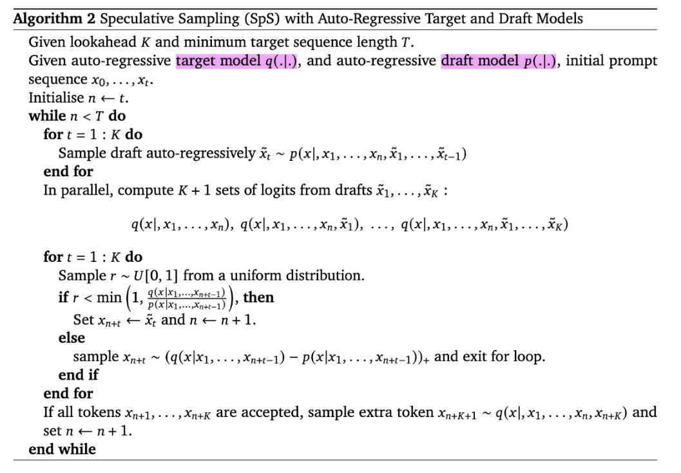
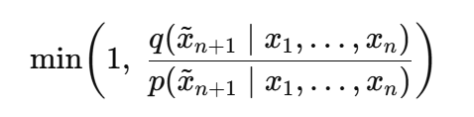
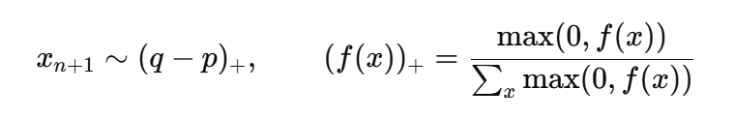
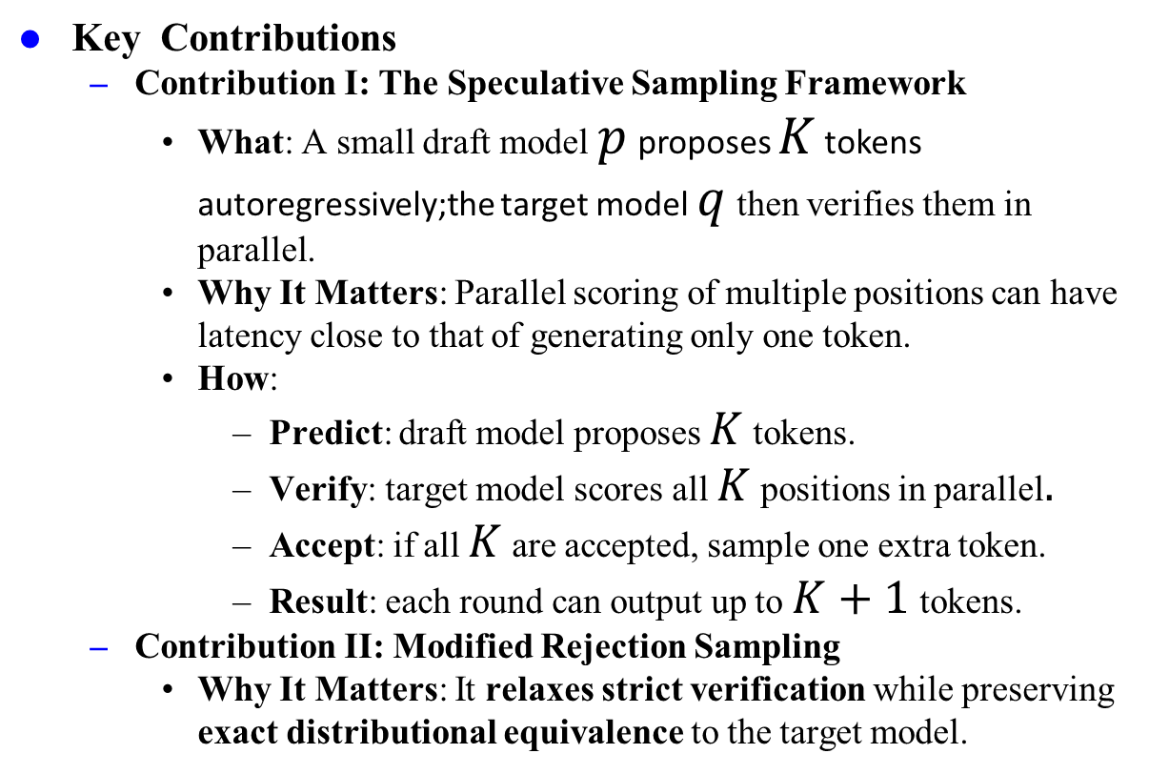
Speculative Sampling (2/3)
Key Contributions
Contribution I: The Speculative Sampling Framework
What: A small draft model $p$ proposes $K$ tokens autoregressively;the target model $q$ then verifies them in parallel.
Why It Matters: Parallel scoring of multiple positions can have latency close to that of generating only one token.
How:
Predict: draft model proposes $K$ tokens.
Verify: target model scores all $K$ positions in parallel$.$
Accept: if all $K$ are accepted, sample one extra token.
Result: each round can output up to $K+1$tokens.
Contribution II: Modified Rejection Sampling
Why It Matters: It relaxes strict verification while preserving exact distributional equivalence to the target model.
Figure 6: Speculative sampling with draft generation and parallel target-model verification.
1. Acceptance
2. Rejection compensation
Notes:
(from form aspect)

Slide 18
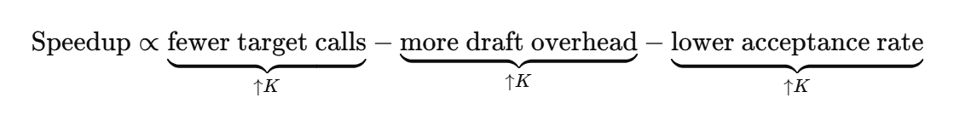
Speculative Sampling (3/3)
Main Results
Tasks:
XSum summarization;
HumanEval code generation
Results:
Speculative sampling delivers significant speedup while preserving output quality, with negligible distributional distortion in practice.
Analysis and Insights
Why is speedup larger on HumanEval?
Code generation is more predictable, with frequent template-like patterns, leading to higher draft acceptance rates.
Why is larger K not always better?
A larger K covers more tokens per round,but also increases draft overhead and lowers later-token acceptance.
Table 9: Speculative decoding improves speed while preserving output quality.
Method | Task | Quality | Mean token time | Speedup
Autoregressive (Nucleus) | XSum | ROUGE-2 = 0.112 | 14.1 ms | 1×
Speculative (Nucleus) | XSum | ROUGE-2 = 0.114 | 7.52 ms | 1.92×
Autoregressive (Greedy) | XSum | ROUGE-2 = 0.157 | 14.1 ms | 1×
Speculative (Greedy) | XSum | ROUGE-2 = 0.156 | 7.00 ms | 2.01×
Autoregressive (Nucleus) | HumanEval | pass@1 = 45.1% | 14.1 ms | 1×
Speculative (Nucleus) | HumanEval | pass@1 = 47.0% | 5.73 ms | 2.46×
Notes:
(from form aspect)

Slide 19
Outline
Introduction & Motivation (6 min)
Formulation (4 min)
Proposed Methods & Performance Evaluation (15 min)
Blockwise Parallel Decoding(2018) (5 min)
Speculative Sampling(2023) (4 min)
EAGLE(2024) (6 min)
Conclusion (2 min)
Q & A (2 min)

Slide 20
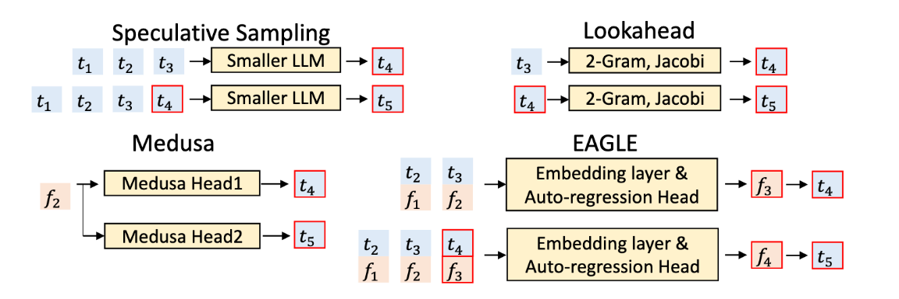
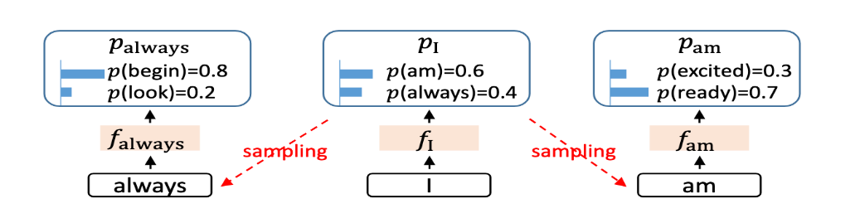
EAGLE (1/4)
Motivation
Classical speculative sampling: The draft model may still be too expensive; for mid-sized targets, suitable drafts are hard to find
Token-level drafting: Discrete token trajectories branch heavily and are hard for lightweight models to predict accurately.
Pure feature-level autoregression: Future features depend on the actually sampled tokens, so current features alone are insufficient
Core question: Feature uncertainty: Given only the current hidden feature, the next-step feature is not uniquely determined unless the actual sampled token is also known.
Figure 7: Comparison of representative speculative decoding methods.
Figure 8: Uncertainty in feature sequences.
Notes:
(from form aspect)

Slide 21
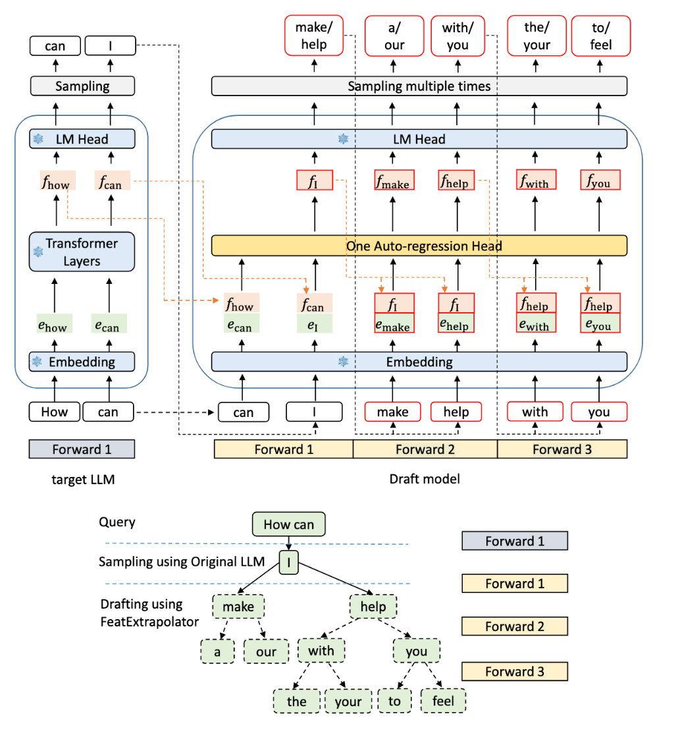
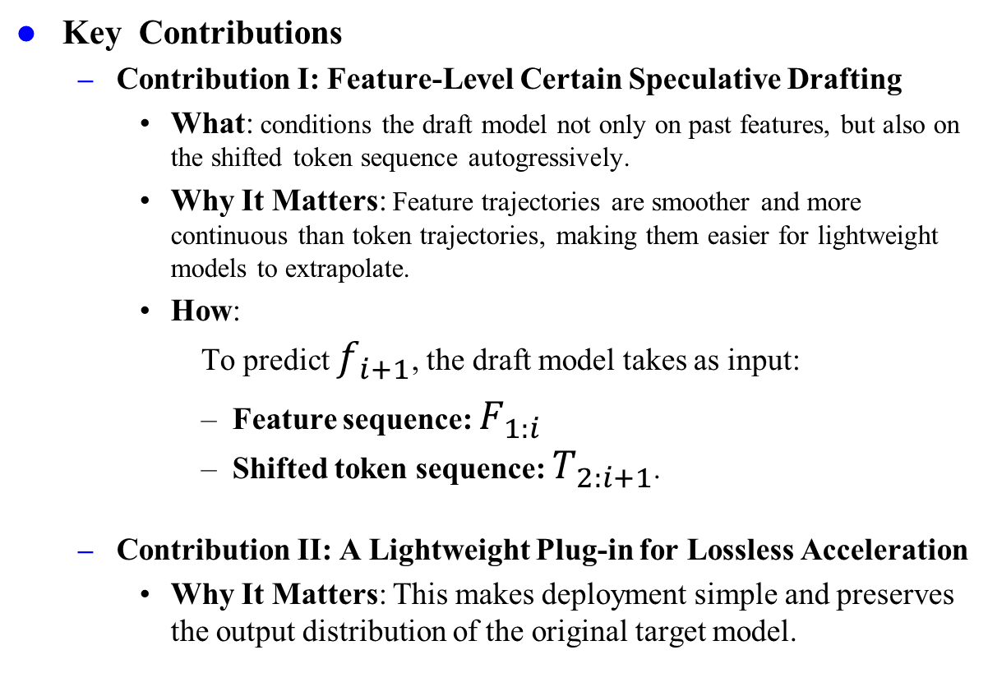
EAGLE (2/4)
Key Contributions
Contribution I: Feature-Level Certain Speculative Drafting
What: conditions the draft model not only on past features, but also on the shifted token sequence autogressively.
Why It Matters: Feature trajectories are smoother and more continuous than token trajectories, making them easier for lightweight models to extrapolate.
How:
To predict $f_{i+1}$, the draft model takes as input:
Feature sequence: $F_{1:i}$
Shifted token sequence: $T_{2:i+1}$.
Contribution II: A Lightweight Plug-in for Lossless Acceleration
Why It Matters: This makes deployment simple and preserves the output distribution of the original target model.
Figure 9: EAGLE architecture for feature-level autoregressive drafting.
Notes:
(from form aspect)

Slide 22
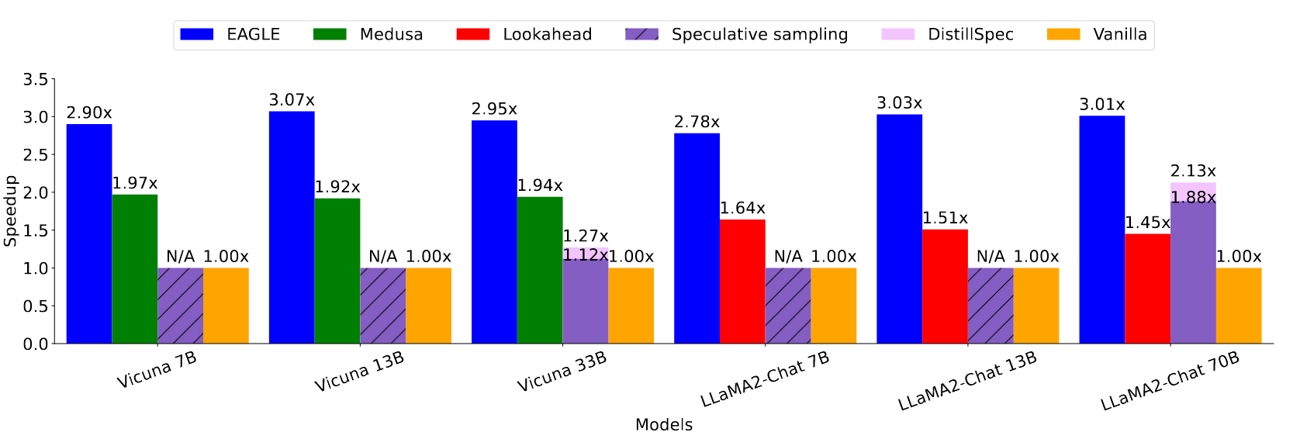
EAGLE (3/4)
Main Result
Tasks: MT Benchmark
Main observations
Compared with standard autoregressive decoding, EAGLE achieves 2.1×–3.8× speedup
Compared with Lookahead, it is 1.7×–2.1× faster
Compared with Medusa, it is 1.5×–1.6× faster
On LLaMA2-Chat 70B, latency speedup reaches 2.7×–3.5×, with throughput around 2×
Figure 10: Speedup comparison across speculative decoding methods and model scales.
Notes:
(from form aspect)

Slide 23
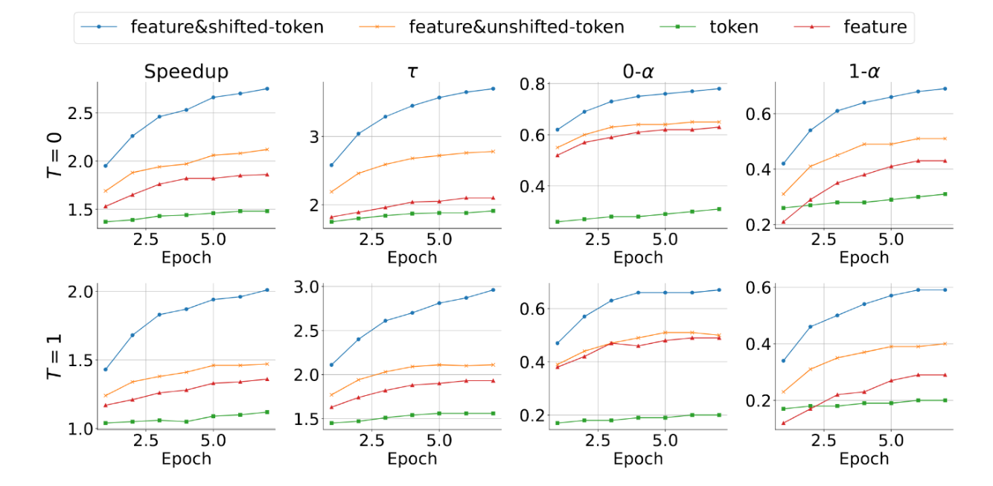
EAGLE (4/4)
Ablation Studies - Importance of input combinations
Conclusion A: under a limited draft-model budget, features are more effective than tokens because feature trajectories are smoother
Conclusion B: combining features with tokens is better than using features alone, because tokens provide discrete and error-free anchors
Conclusion C: shifted tokens are crucial; they add little complexity but significantly improve performance by resolving feature uncertainty
Figure 11: Training dynamics of different drafting targets under T=0 and T=1, comparing speedup and key acceptance-related metrics across epochs.
Notes:
(from form aspect)

Slide 24
Outline
Introduction & Motivation (6 min)
Formulation (4 min)
Proposed Methods & Performance Evaluation (15 min)
Blockwise Parallel Decoding(2018) (5 min)
Speculative Sampling(2023) (4 min)
EAGLE(2024) (6 min)
Conclusion (2 min)
Q & A (2 min)

Slide 25
Conclusion
Evolution of speculative decoding along three major directions:
From greedy equivalence to distributional equivalence
From token-level drafting to feature-level drafting
From algorithmic acceleration to deployment-oriented system design
Table 10: Summary of Representative Works.
Work | Main contribution | Verification guarantee | Main limitation
Blockwise Parallel Decoding | Parallel proposal + longest-prefix verification | Exact equivalence to greedy decoding | Limited acceptance length; task-dependent gains
Speculative Sampling | Draft model + modified rejection sampling | Exact preservation of target sampling distribution | Requires a suitable draft model
EAGLE | Feature-level drafting with shifted-token conditioning | Lossless acceleration with lightweight plug-in | Depends on hidden-feature predictability

Slide 26
Outline
Introduction & Motivation (6 min)
Formulation (4 min)
Proposed Methods & Performance Evaluation (15 min)
Blockwise Parallel Decoding(2018) (5 min)
Speculative Sampling(2023) (4 min)
EAGLE(2024) (6 min)
Conclusion (2 min)
Q & A (2 min)

Slide 27
Thanks for Listening!
Q & A

