Slide 1
Computer-Use Agents in Real Operating System From Agent Frameworks, to Open Foundations, to Tool-Augmented Evaluation
Yaoyao Xu
224040357
School of Data Science
Chinese University of Hong Kong, Shenzhen

Slide 2
Outline
Papers Reviewed
Agent S: An Open Agentic Framework that Uses Computers Like a Human (2024)
OpenCUA: Open Foundations for Computer-Use Agents (2025)
OSWorld-MCP: Benchmarking MCP Tool Invocation in Computer-Use Agents (2025)
Talk Roadmap
Background and problem definition
Paper 1: Framework-level capability design
Paper 2: Open data/model foundations
Paper 3: Hybrid GUI + tool evaluation
Cross-paper comparison and future directions

Slide 3
What Is a Computer-Use Agent (CUA)?
Definition
A Computer-Use Agent (CUA) is an AI system that takes a natural-language instruction, perceives the current computer screen, and completes tasks by issuing keyboard/mouse actions in real software environments.
What CUAs are NOT
Not only a web agent: web agents are often browser-specific and can rely on structured DOM signals.
Not only a tool-use LLM: tool-use models can call APIs without understanding GUI state
Not classic GUI scripting: scripts are brittle and usually fail under interface changes.
Why CUAs matter for OS-level research
They operate across applications without app-specific integration.
They support realistic long workflows in existing desktop ecosystems.
They connect multimodal perception, reasoning, and control in one loop.

Slide 4
Why Real OS Environments Are Difficult ?
Core technical challenges
Perception and grounding: dense visual layouts, mixed icons, dynamic windows, and ambiguous clickable targets.
Long-horizon planning: tasks require many dependent steps; early errors propagate.
Memory and adaptation: agents must reuse prior experience while handling changing interfaces.
Hybrid action decisions: agents must choose between GUI operations and tool invocation.
Evaluation complexity: path-dependent success, environment variance, and fairness issues in comparisons.
Key implication: Progress requires coordinated advances in framework design, open infrastructure, and evaluation protocols.

Slide 5
Summary
One Coherent Research Focus Across Three Papers
Computer-Use Agents in Real Operating Systems:
Frameworks -> Open Foundations -> Tool-Augmented Evaluation
Agent S: improves the agent framework for human-like computer operation.
OpenCUA: builds open infrastructure for large-scale data, training, and reproducible research.
OSWorld-MCP: extends evaluation from GUI-only interaction to GUI + tool invocation + decision making.
Thesis
These papers are not isolated. Together, they show how CUA research is evolving from capability engineering to ecosystem building and then to richer benchmarking.

Slide 6
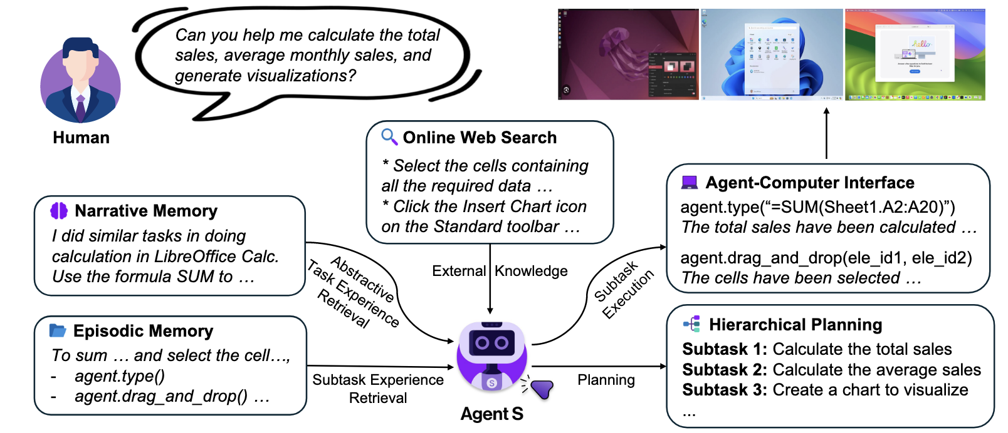
Agent S: Problem Setting and Central Idea
Problems targeted by Agent S
Lack of domain-specific knowledge.
Weak planning in long workflows.
Difficulty handling dynamic GUI states.
Core contribution
Experience-Augmented Hierarchical Planning.
Agent-Computer Interface (ACI) for language-centered action grounding.
How can a CUA solve diverse long-horizon desktop tasks with better planning, knowledge use, and interface grounding?
Fig1. Agent S combines hierarchical planning, memory retrieval, and external knowledge to operate computers like a human.

Slide 7
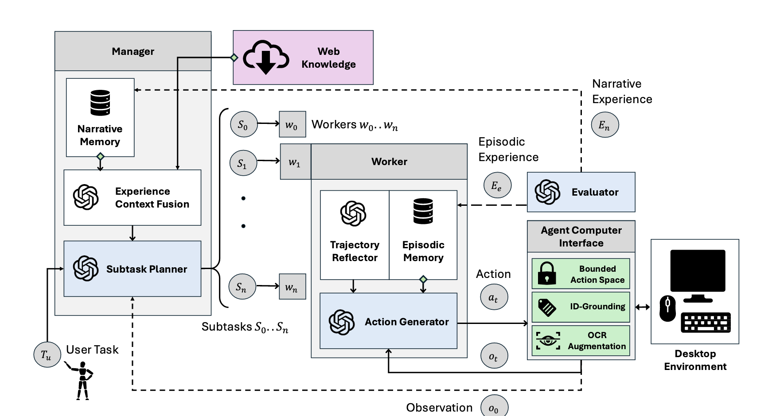
Agent S: System Architecture and Execution Loop
Main modules
Planner (Manager): decomposes user instruction into subtasks.
Executor (Worker): carries out subtask-level interactions.
Memory modules: retrieve relevant task/subtask experiences.
Web knowledge retriever: injects external up-to-date procedural knowledge.
Step-level loop
Observe current screenshot + accessibility information.
Retrieve relevant narrative and episodic experiences.
Predict next action under current subtask goal.
Execute action and receive updated environment feedback.
Update progress and move to next subtask when appropriate.
Fig2. Overview of Agent S framework with hierarchical planning and retrieval-augmented execution.
Why this matters
he architecture explicitly separates high-level planning from low-level execution, improving long-horizon control.

Slide 8
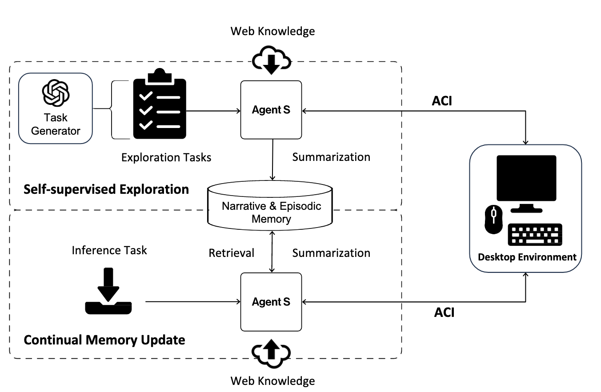
Agent S: Memory Mechanism and ACI Design
Memory design
Narrative Memory: high-level summaries of prior tasks.
Episodic Memory: detailed step-level subtask trajectories.
Memory construction/update pipeline
Self-supervised exploration collects initial experiences.
Continual updates add new successful patterns during deployment.
Self-evaluator compresses trajectories before storage.
ACI design
Uses screenshot + image-augmented accessibility tree as complementary observations.
Uses bounded language-level action primitives to reduce unsafe or ambiguous control.
Technical value
Memory improves reuse and adaptation; ACI improves grounding precision and action consistency.
Fig3. Memory construction and update pipeline with exploration and continual learning.

Slide 9
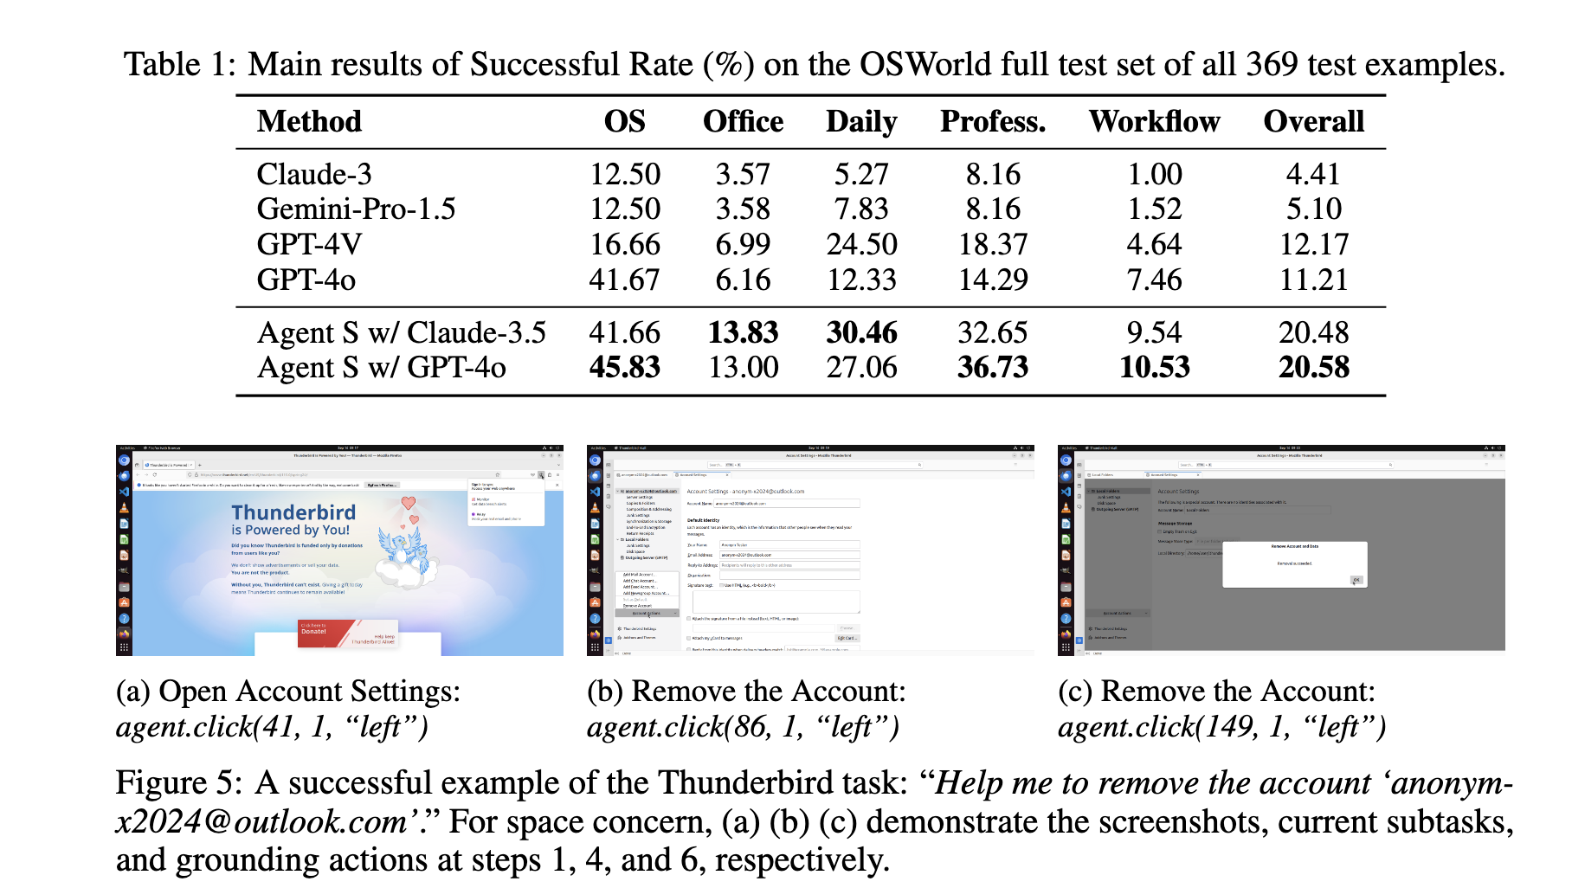
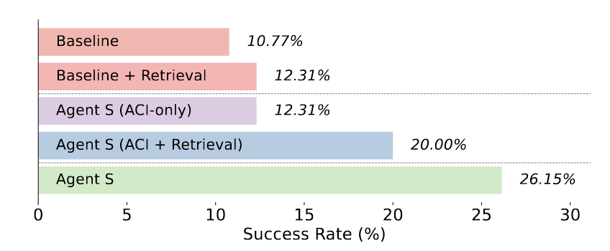
Agent S: Main Results and Ablation Evidence
Main quantitative result (OSWorld full test set)
Agent S (GP T-4o backbone): 20.58% overall success rate.
Corresponding baseline (GPT-4o): 11.21% overall success rate.
Strong gains in Daily and Professional task groups.
Fig4. Agent S achieves higher success and component-level ablations support causal contributions.
Improvements are driven by framework components, not only by stronger base models.

Slide 10
Agent S: Critical Review
Strengths
Clear modular architecture for long-horizon desktop tasks.
Significant benchmark improvements over reported baselines.
Detailed ablation and error analysis provide actionable insights.
Limitations
Absolute success rate is still low for reliable real-world automation.
Frequent failures remain in grounding and execution behaviors.
Dependence on expensive frontier backbones affects accessibility and reproducibility.
Takeaway for the field
Agent S shows that system design matters, but framework advances alone are not enough. Open infrastructure becomes the next bottleneck.

Slide 11
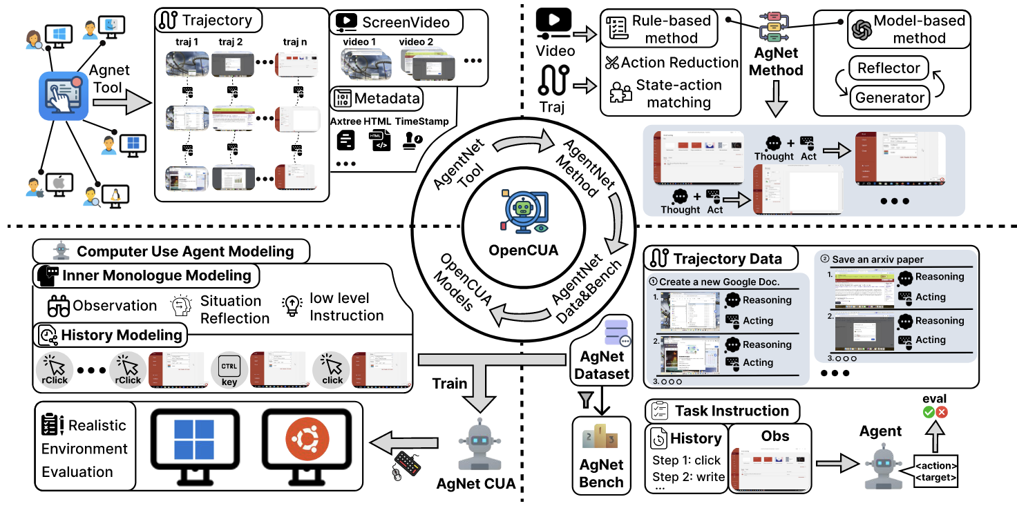
OpenCUA: Why Open Foundations Are Needed
Research question
How can we make CUA development scalable, transparent, and reproducible for the research community?
Motivation
Strong CUA systems are increasingly closed in data, training details, and infrastructure.
Existing open datasets often have limited diversity or task complexity.
OpenCUA’s response
A full open-source stack: annotation tool, large-scale dataset, data processing pipeline, training recipe, benchmark, and models.
Position in evolution line
From “a stronger framework” to “an open and scalable ecosystem for CUA research.”
Fig5. OpenCUA provides an end-to-end open framework from data collection to model training and evaluation.

Slide 12
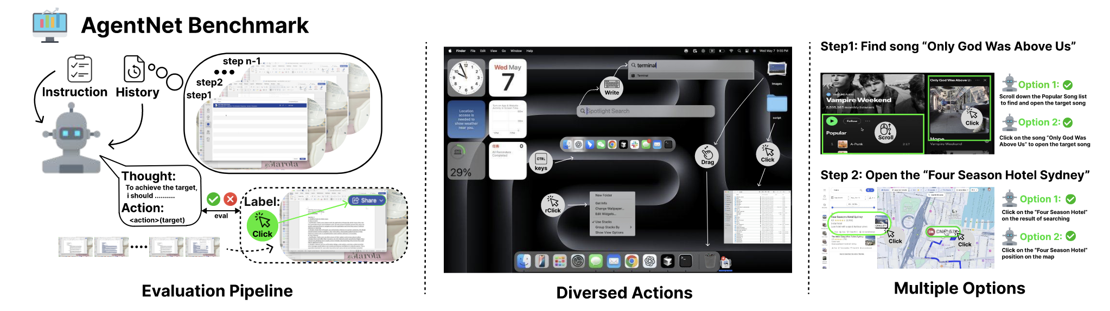
Open, scalable data collection
Fig6. Data collection
AGENTNET Tool
Captures human computer-use demonstrations
Records screen video, keyboard/mouse signals, and accessibility states.
Designed to support natural workflows on personal devices.
AGENTNET dataset
Around 22.6K computer-use task trajectories.
Broad coverage across Windows, macOS, and Ubuntu.
Includes diverse apps/websites and realistic user behaviors.
Data processing pipeline
Action reduction compresses dense low-level events.
State-action matching creates compact, trainable trajectories.

Slide 13
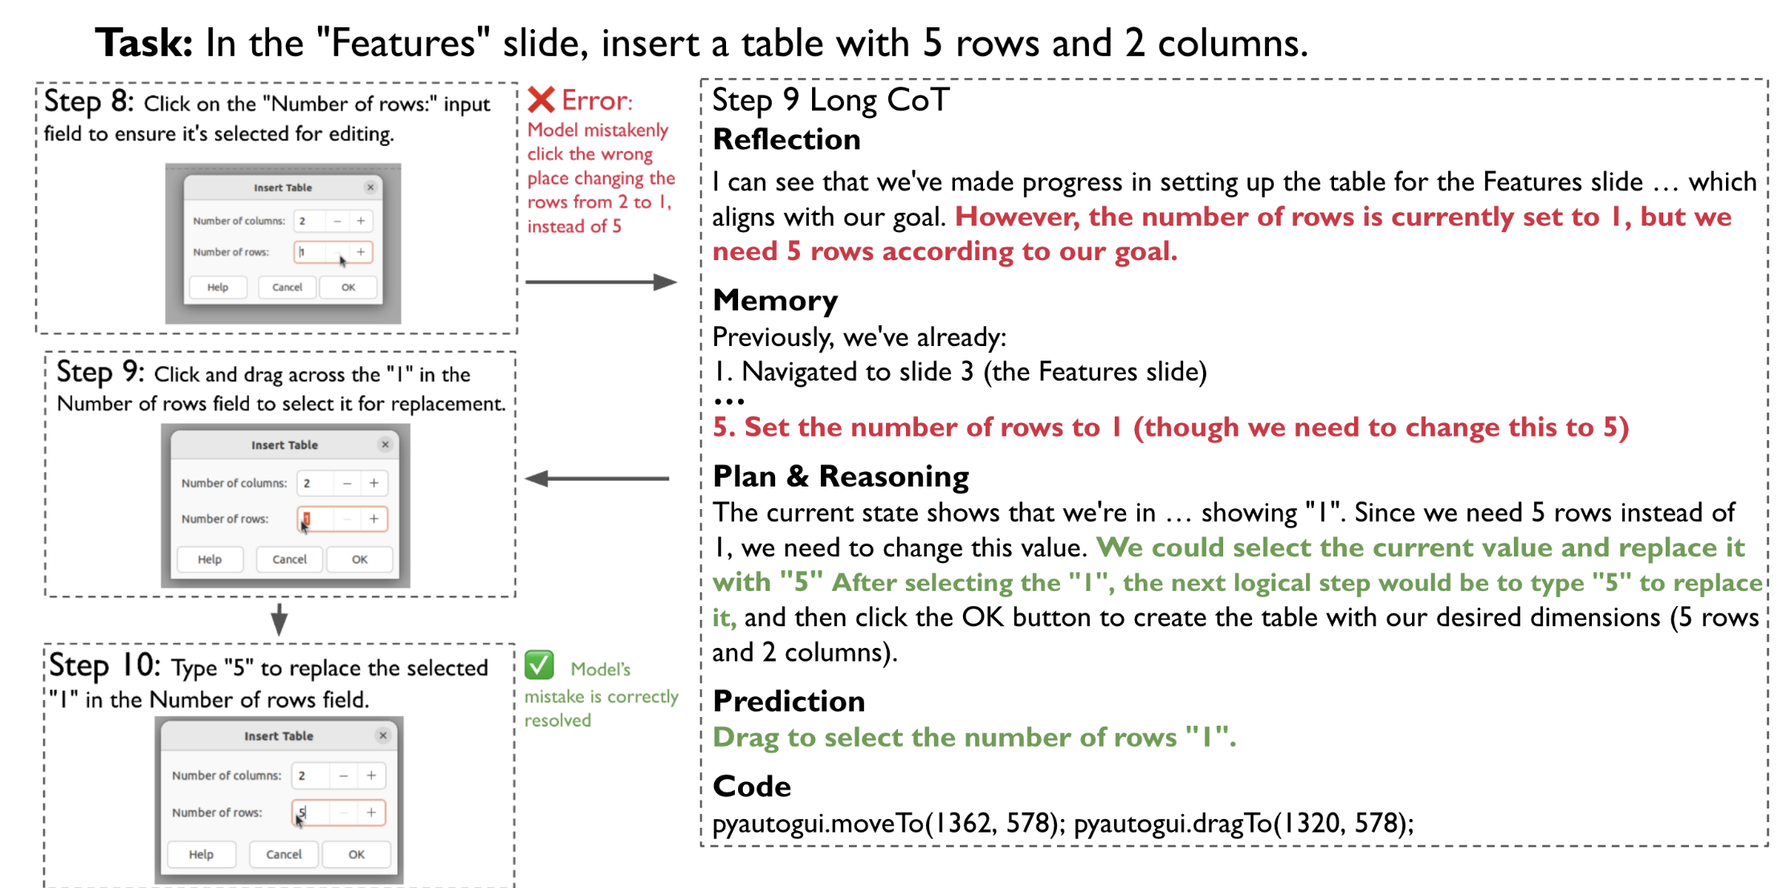
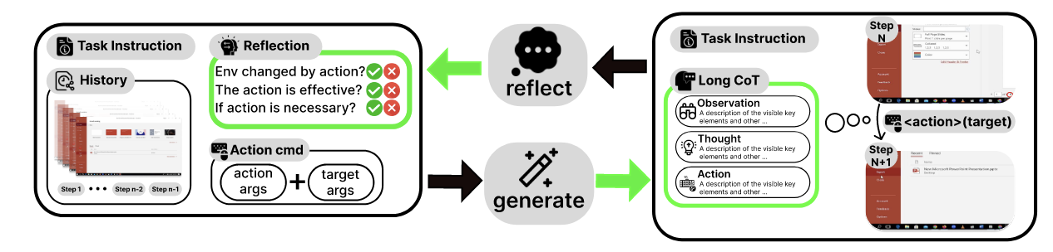
OpenCUA: Training Recipe and Technical Mechanism
Key insight: State-action pairs alone provide limited gains as scale increases.
Core method: Reflective Long CoT synthesis
Generator + reflector pipeline creates rich reasoning traces.
Injects planning, reflection, and error-correction signals into supervision.
Important training choices
Multi-stage training with mixed CoT formats.
History representation design affects performance.
Including general text data can modestly improve generalization.
Ablation takeaway
Reflective long CoT improves robust long-horizon performance compared with short/simple reasoning supervision.
Fig7. Reflective long CoT pipeline strengthens planning and recovery behavior.

Slide 14
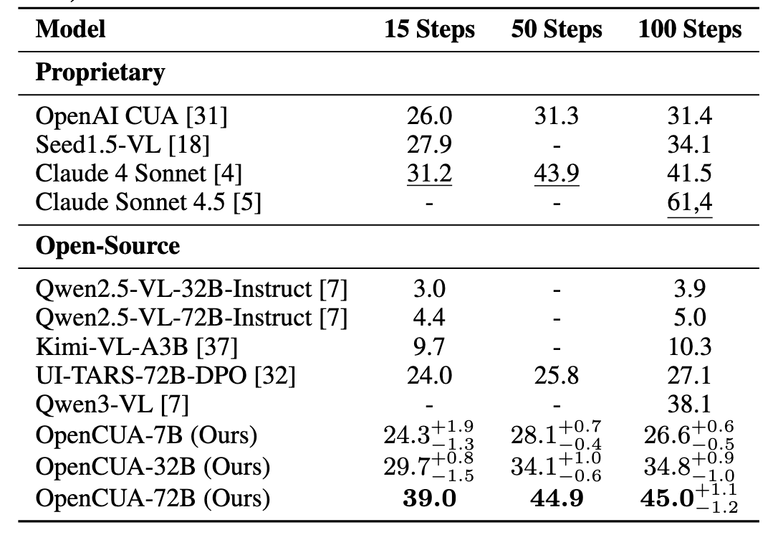
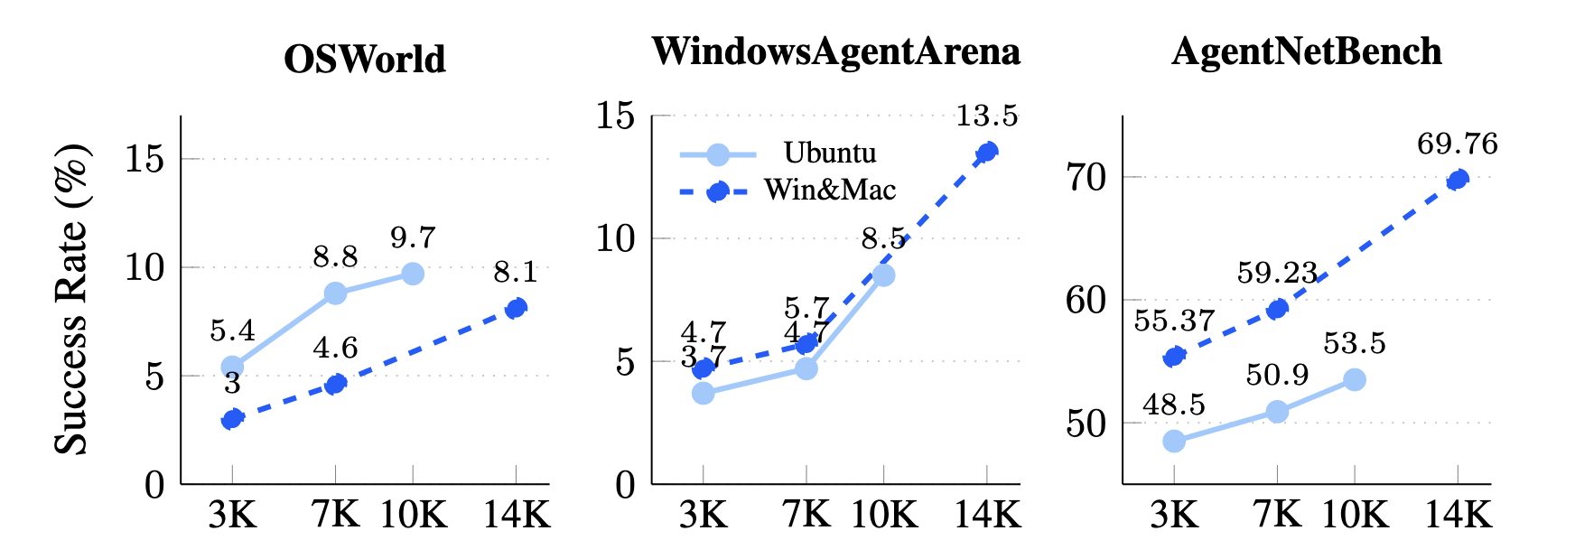
OpenCUA: Results and Scaling Behavior
Main reported result
OpenCUA-72B reaches 45.0% success on OSWorld-Verified (100-step), SOTA among open-source models in the paper.
Scaling evidence
Performance improves with larger model sizes.
Performance improves with increased data volume.
Cross-domain data (different OS sources) still improves transfer rather than harming it.
Additional analysis
Pass3 significantly exceeds Pass1, indicating inference-time headroom (reranking, multi-agent methods, etc.).
OpenCUA demonstrates that open pipelines can scale and remain competitive in realistic CUA benchmarks.
Fig8. OpenCUA shows strong open-model performance and clear data/model scaling laws.

Slide 15
OpenCUA: Critical Review
Strengths
Full-stack openness improves reproducibility and community participation.
Large-scale data + explicit training recipe provide strong engineering value.
Empirical evidence includes both benchmark results and ablation/scaling analyses.
Limitations
Collection and training costs are still substantial.
Long-horizon robustness remains incomplete.
Existing benchmark settings still do not fully measure hybrid GUI/tool decisions.
Takeaway
Open foundations are essential, but evaluation protocols must evolve with new agent capabilities.

Slide 16
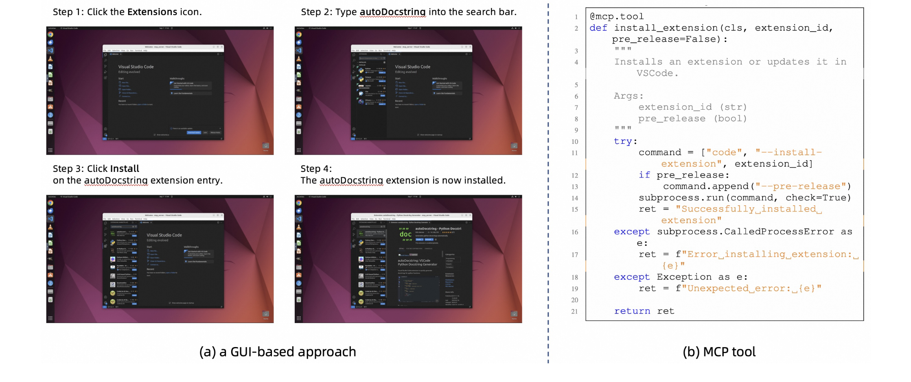
OSWorld-MCP: Motivation and Problem
Research question
How can we fairly evaluate CUAs when agents can use both GUI actions and MCP tool invocation?
Motivation
Existing dynamic benchmarks mostly focus on GUI operations.
Tool-enabled and GUI-only agents are not directly comparable under old evaluation settings.
Key observation
In some tasks, GUI-only completion takes many steps, while one correct tool invocation can solve the task more efficiently and robustly.
Contribution direction
OSWorld-MCP extends OSWorld into a hybrid action benchmark for GUI operation + tool invocation + decision making.
Fig9. GUI-only vs MCP-assisted execution paths for the same instruction.

Slide 17
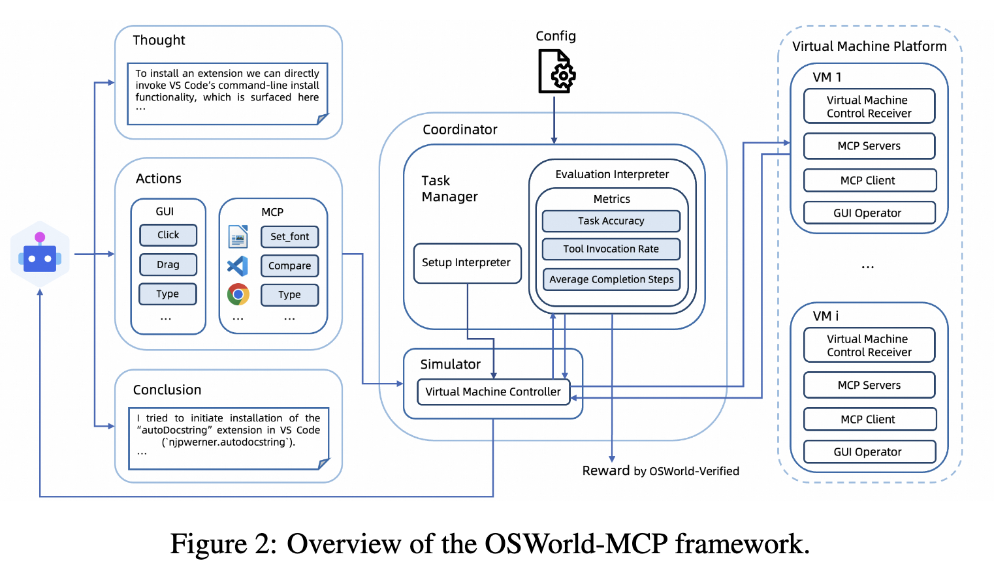
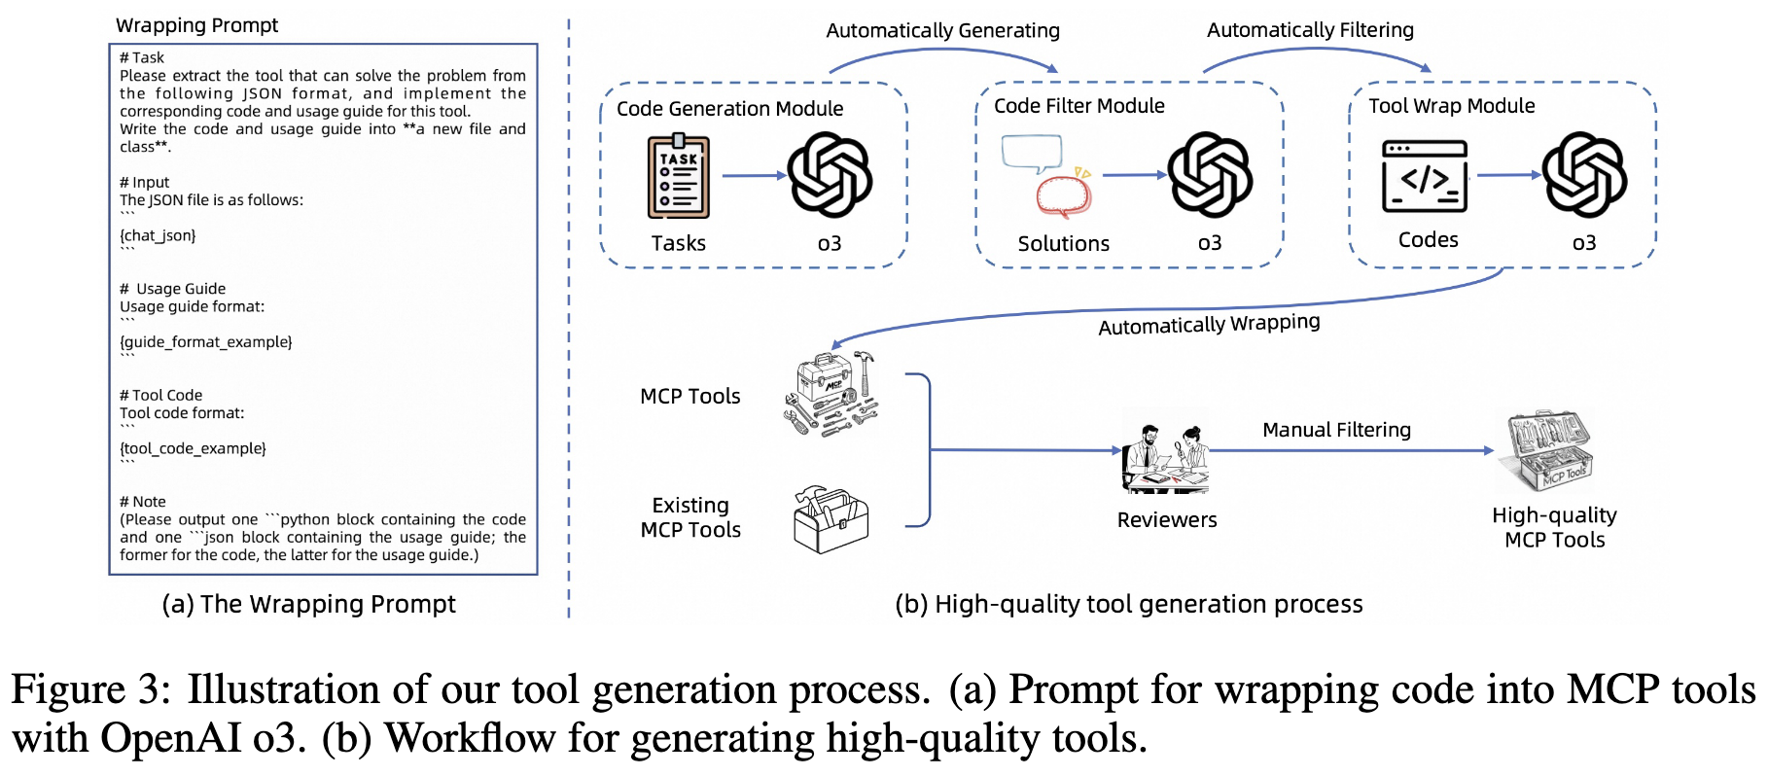
OSWorld-MCP: Benchmark and Tool Construction
Benchmark construction pipeline
Code generation module
Code filter/verification module
MCP tool wrapping module
Additional curated tools from existing MCP servers
Tool quality control
Manual multi-reviewer validation.
Final benchmark uses 158 high-quality tools.
Task setting
At each step, agent decides between GUI operation and MCP tool invocation.
Includes distractor/non-target tools to test realistic decision quality.
Why this is important?
Benchmark quality depends on realistic, non-trivial, and diverse tool options.
Fig10(a). OSWorld-MCP framework
Fig10 (b). OSWorld-MCP automated pipeline for high-quality tool construction.

Slide 18
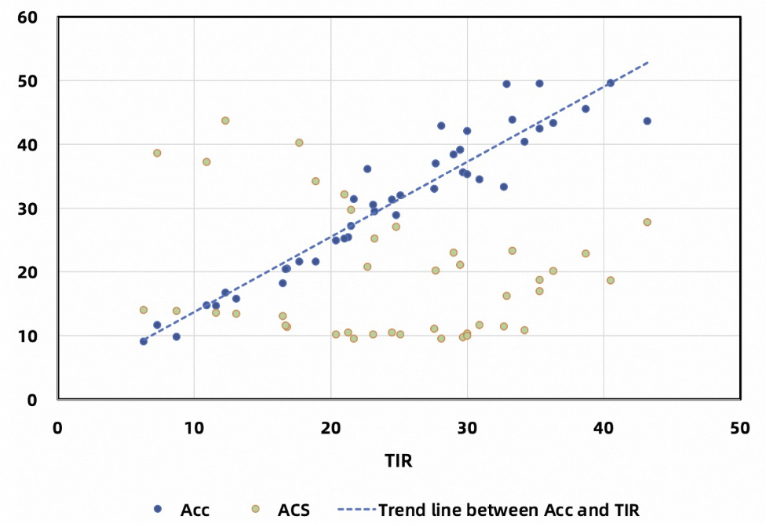
Evaluation Contribution
Three key metrics
Accuracy (Acc): final task success rate.
Tool Invocation Rate (TIR): proportion of tasks correctly completed with tool usage.
Average Completion Steps (ACS): average number of steps to completion (efficiency-oriented).
Why Acc alone is insufficient
A model may solve tasks but still use poor decision policies (e.g., unnecessary steps, weak tool selection).
What TIR and ACS add
TIR diagnoses tool-usage competence.
- ACS captures efficiency trends and interaction with task complexity.
Evaluation contribution
OSWorld-MCP provides a more diagnostic and fairer view of hybrid agent competence.
Fig11. TIR, Accuracy, and ACS capture different dimensions of hybrid decision quality.

Slide 19
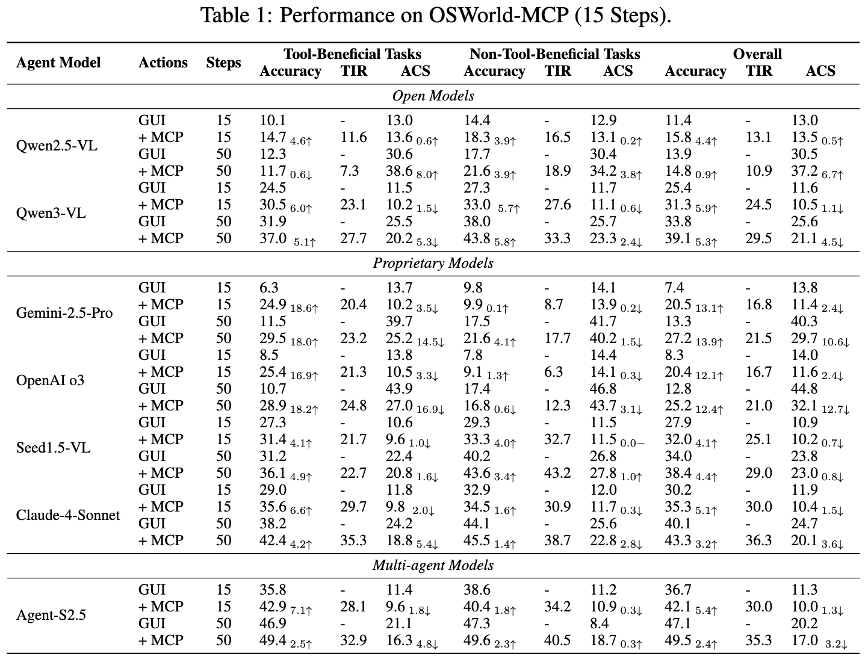
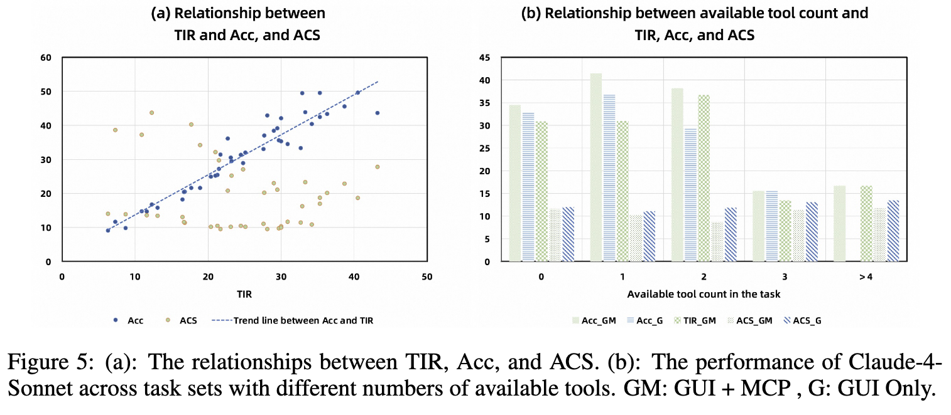
OSWorld-MCP: Main Results and Findings
Representative gains from MCP tools
OpenAI o3 (15 steps): 8.3% -> 20.4%
Claude 4 Sonnet (50 steps): 40.1% -> 43.3%
But current models still underuse tools
Highest reported TIR is only 36.3%.
- Indicates major room for improvement in tool selection strategies.
Key findings in paper analysis
TIR positively correlates with Accuracy across models/settings.
TIR-ACS relationship is non-linear due to task complexity and strategy effects.
Implication
Tool availability helps, but robust and efficient hybrid policy learning is still an open challenge.
Fig12. Main Results

Slide 20
Comparison Dimensions
Comparison of the Three Papers
Goal
Contribution layer
Environment/setting
Core innovation
Evaluation focus
Strengths
Limitations
Broader field impact
Direct synthesis
Agent S: framework-level capability engineering for long-horizon GUI tasks.
OpenCUA: open and scalable foundations for data, training, and reproducible research
OSWorld-MCP: fair hybrid benchmark design for GUI + tool decision-making.
Unified takeaway
Together they form a complete research arc: build better agents -> build open foundations -> measure capabilities fairly.

Slide 21
Final Takeaways and Future Directions
Common trends
Shift from simple GUI control to long-horizon agentic workflows.
Increasing role of memory, reflection, and hybrid tool use.
Strong movement toward open ecosystems and standardized evaluation.
Current limitations
Reliability remains far from production requirements.
Robustness under environment dynamics is still weak.
Data/training pipelines are resource-intensive.
Future research directions
Better planners for GUI + tool hybrid policies.
Stronger memory compression/retrieval for long tasks.
Human-centered metrics (trust, safety, intervention cost).
Continual benchmark updates for evolving software ecosystems.
Progress in OS-level computer-use agents depends on co-evolving methods, infrastructure, and evaluation standards.

Slide 22
Thank you
Any Questions?

