Slide 1
From Storage to Intelligence: The Evolution of Agent Memory Management 2026.04.28
Botao Xie
School of Data Science
Chinese University of Hong Kong, Shenzhen
Notes:
Hello, everyone. I am Botao Xie from the School of Data Science. Today I am going to give my presentation titled: "From Storage to Intelligence: The Evolution of Agent Memory Management".

Slide 2
Outline
Introduction (5 min)
Background & Motivation (3 min)
Proposed Methods & Performance Evaluation (24 min)
MemGPT (2024, University of California) (8 min)
A-MEM (2025, Rutgers University) (8 min)
GAM (2026, Zhejiang University) (8 min)
Conclusions (2 min)
Q & A (2 min)
Notes:
Here is the outline. Firstly, we will give a short introduction to agent memory. Secondly we will cover the background and motivation. Thirdly, we will dive into three papers: MemGPT from University of California, A-MEM from *Rutgers( ru grs ) University, and GAM from Zhejiang University. And finally, we will conclude with the key takeaways.

Slide 3
Outline
Introduction (5 min)
Background & Motivation (3 min)
Proposed Methods & Performance Evaluation (24 min)
MemGPT (2024, University of California) (8 min)
A-MEM (2025, Rutgers University) (8 min)
GAM (2026, Zhejiang University) (8 min)
Conclusions (2 min)
Q & A (2 min)
Notes:
Let’s start with the introduction.

Slide 4
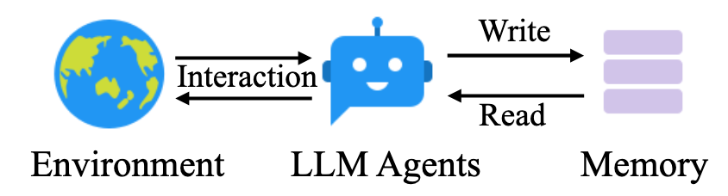
Introduction – Agent Memory (1/3)
What is agent memory?
The core capability that empowers foundation models to store, manage, and evolve experiences for complex, long-term interactions.
Agent memory system is a wrapper system built upon large language models.
Figure 1: Traditional memory system
Notes:
So, what is agent memory? It is the core capability that empowers foundation models to store, manage, and evolve their experiences during complex, long-term interactions. Architecturally, it acts as a "wrapper system" built upon large language models. As shown in Figure 1, memory system works directly with LLM Agents to better interact with the environment.

Slide 5
Introduction – Agent Memory (2/3)
Why use agent memory?
Large language models are stateless.
Large language models have limited context windows.
Cost and efficiency optimization.
Table 1: Context window length of some LLMs
Model name | Context window length (tokens)
ChatGPT-5.2 pro | 400,000
Claude 4.5 Opus | 200,000
Deepseek-chat v3 | 64,000
Notes:
Then why is using agent memory necessary? The main reason is Large Language models are stateless and have limited context windows. Once this limit is reached, the model *loses(luziz) the ability to track long-term interactions. Furthermore, while modern context windows are expanding, this growth comes at the cost of significantly higher power consumption and latency, making external memory management a much more cost-efficient alternative.

Slide 6
Introduction – Agent Memory (3/3)
How agent memory works?
Formation: encoding modal experiences into structured factual and experiential storage.
Evolution: dynamically updating and refining memory through reflection and consolidation.
Retrival: precisely accessing task-relevant information based on context and semantics.
Notes:
The memory lifecycle consists of three stages :
Formation, where experiences are encoded into storage;
Evolution, where memory is updated and refined through reflection and consolidation;
and *Retrieval(ritri:vl), which ensures precise access to task-relevant information based on context and semantics.

Slide 7
Outline
Introduction (5 min)
Background & Motivation (3 min)
Proposed Methods & Performance Evaluation (24 min)
MemGPT (2024, University of California) (8 min)
A-MEM (2025, Rutgers University) (8 min)
GAM (2026, Zhejiang University) (8 min)
Conclusions (2 min)
Q & A (2 min)
Notes:
Let’s go to the backgound and motivation.

Slide 8
Background & Motivation (1/2)
Challenges of agent memory
Accuracy: ensuring precise retrieval and factual consistency across sessions while preventing hallucinations from outdated or misinterpreted data.
Efficiency: reducing computational latency and token costs during frequent memory read/write operations.
Scalability: managing and retrieving relevant memories from ever-growing, large-scale memory repositories.
Notes:
Managing agent memory is a complex system task that goes far beyond simple data storage. We face three primary technical challenges:
Firstly, accuracy: We must ensure precise retrieval and factual consistency across sessions while preventing *hallucinations(həˌluːsɪˈneɪʃ(ə)n) from outdated or misinterpreted data.
Secondly, efficiency: Frequent memory read/write operations can lead to significant computational latency and high token costs; we need systems that perform these tasks with minimal overhead.
Thirdly, scalability: As memory *repositories(rɪˈpɑːzətɔːris) grow into large-scale datasets, the challenge becomes retrieving relevant memories instantly without searching through an endless, unorganized backlog.

Slide 9
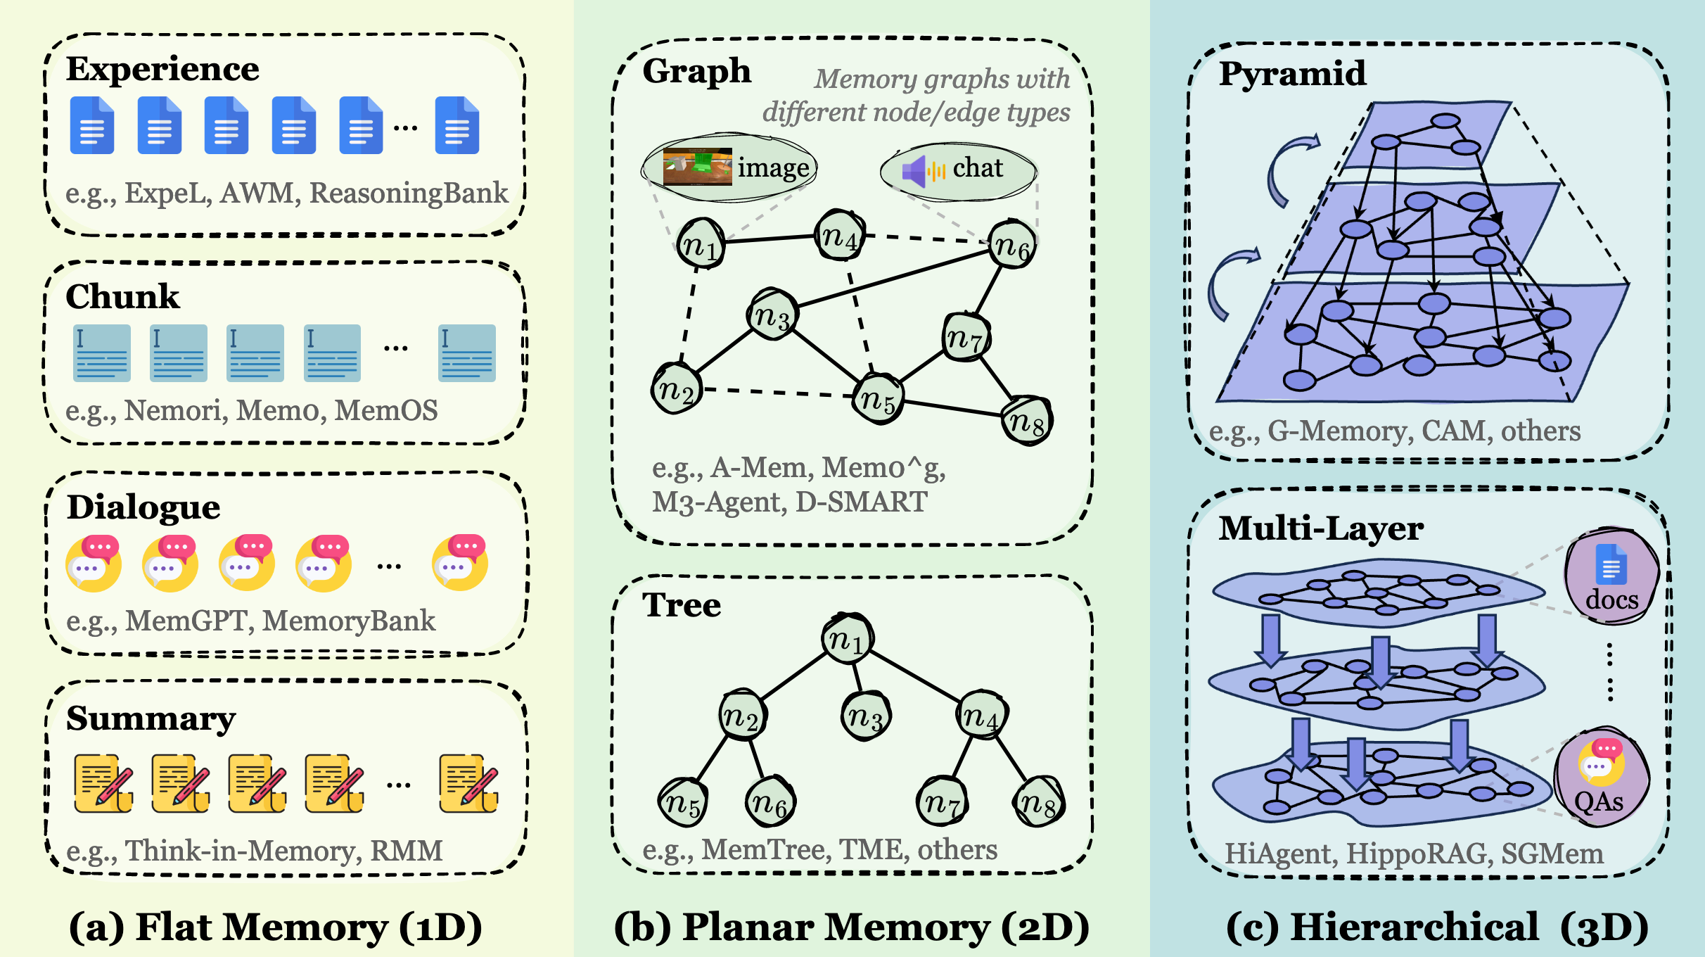
Background & Motivation (2/2)
Solution: structural token-level memory
Flat (1D): memories are accumulated as discrete units.
Planar (2D): a structured but single-layer organization within one plane.
Hirarchical (3D): structured across multiple layers with inter-layer links, forming a pyramidal or multi-layer memory.
Figure 2: Taxonomy of token-level memory organized by topological complexity
Notes:
To address these challenges, the research community come up with structural token-level memory, as shown in Figure 2, *categorized by *topological(tɒpəˈlɒdʒɪkl) complexity:
The First one is Flat (1D) Memory: Early systems organized memories as discrete units, such as basic dialogue logs or experience chunks.
The second one is *Planar(ˈpleɪnər) (2D) Memory, which are more sophisticated 2D structures, including graphs and trees, where memory nodes are connected by dynamic links.
The third one is *Hierarchical(ˌhaɪəˈrɑːrkɪkl) (3D) Memory, structured across multiple layers with inter-layer links, forming a pyramidal or multi-layer memory. This allows the agent to navigate between high-level abstract topics and low-level granular details.

Slide 10
Outline
Introduction (5 min)
Background & Motivation (3 min)
Proposed Methods & Performance Evaluation (24 min)
MemGPT (2024, University of California) (8 min)
A-MEM (2025, Rutgers University) (8 min)
GAM (2026, Zhejiang University) (8 min)
Conclusions (2 min)
Q & A (2 min)
Notes:
Let’s go to the first paper: MemGPT from University of California, pubulished in 2024.

Slide 11
MemGPT (1/5)
Challenge
LLMs have limited context windows.
Key observation
OS virtual memory.
Key ideas
Prompt tokens as main context.
Vector database as external context.
Use a FIFO queue to swap memory.
Notes:
MemGPT is a major milestone of agent memory system. The target of MemGPT is to provide LLMs with infinitive context windows. The ideas of MemGPT lie in a simple but powerful observation: the finite context window of a LLM is functionally identical to the limited RAM in a computer. To overcome this, MemGPT applies the concept of OS Virtual Memory to LLMs. It treats the prompt tokens as the "main context", while using an vector database as "external context". This allows the agent to "swap" information in and out of its active window, effectively providing an illusion of infinite memory.

Slide 12
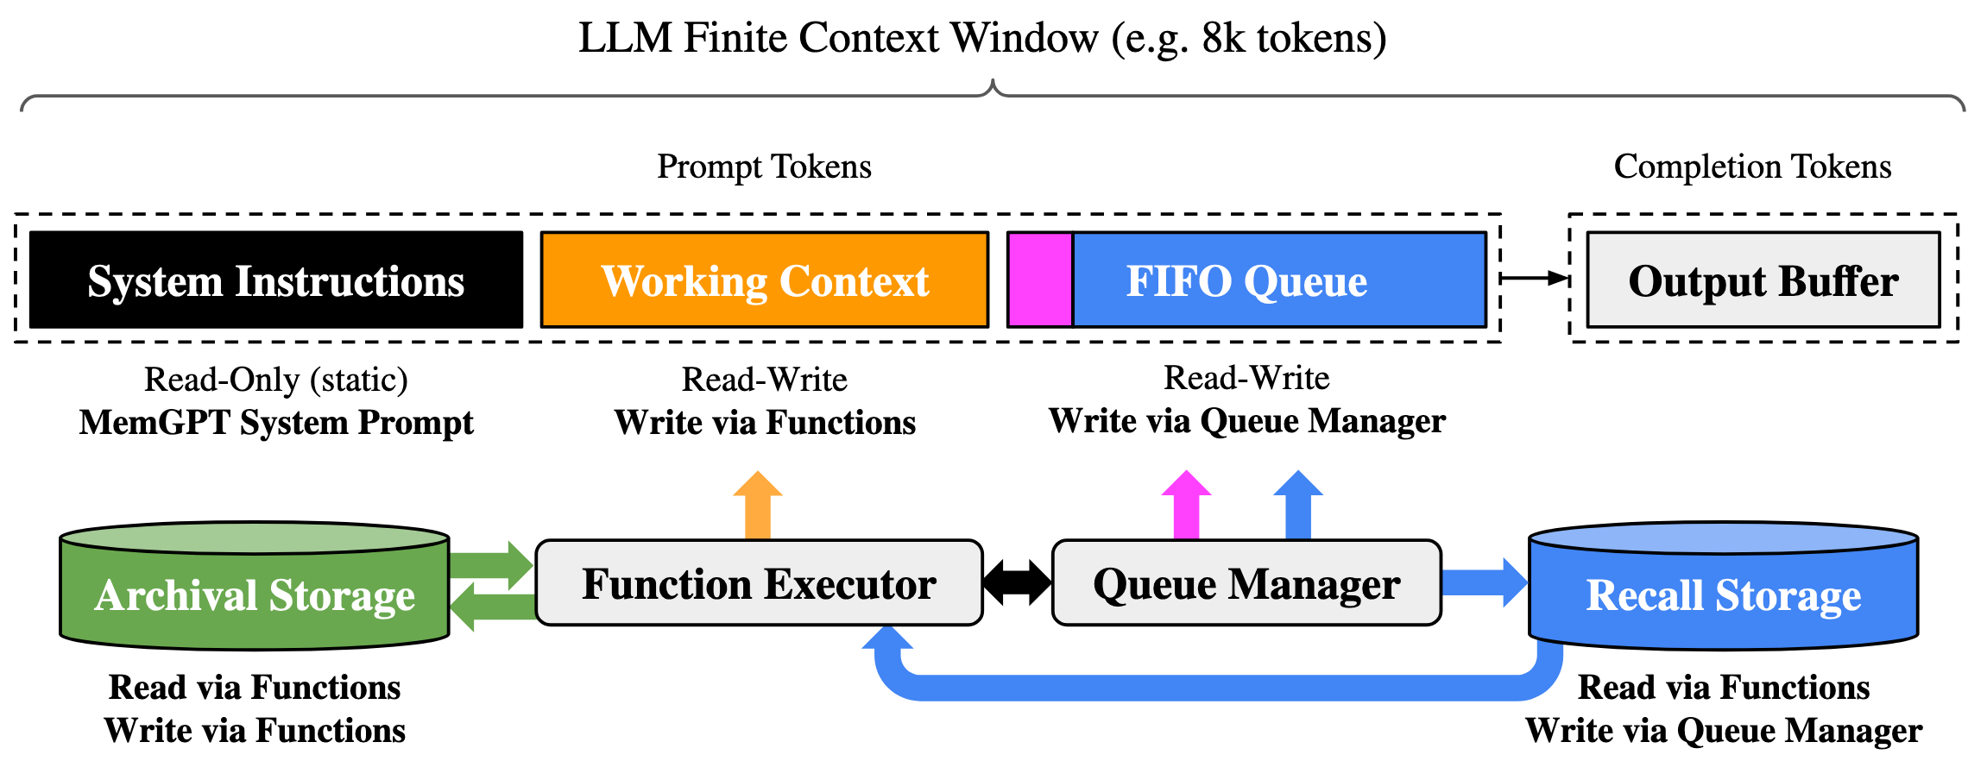
MemGPT (2/5)
Architecture overview
Figure 3: MemGPT architecture
Notes:
This is the architecture of MemGPT, we can see that the finite context window acts as the main memory. Then the *archival(ɑːrˈkaɪvəl) storage and recall storage act as the external memories. The Function Executor and the Queue Manager in the middle are disigned to implement the swap strategies between the main memory and external memories.

Slide 13
MemGPT (3/5)
Prompt tokens
System instructions: read-only blocks containing control flow, memory management policies, and function definitions.
Working context: fixed-size read-write segment for core facts, user preferences, and agent persona, managed by function executor.
FIFO queue: rolling storage for dialogue history and system logs, managed by queue manager.
Queue manager: orchestrates message eviction, model inference, and archival memory retrieval.
Function executor: executes model-generated functions to transfer data between context tiers.
Notes:
The prompt tokens are split into 3 parts:
System instructions are read-only blocks containing control flow, memory management policies, and function definitions.
Working context is a fixed-size read-write segment for core facts, user preferences, and agent *persona(pərˈsoʊnə), managed by the function executor.
*FIFO(ˈfaɪfoʊ) queue is the rolling storage for dialogue history and system logs, managed by the queue manager.
The Queue Manager manages memory eviction, model inference and *archival memory retrieval, ensuring the most recent context is always available while older messages are "paged" out.
The Function Executor executes model-generated functions to transfer data between context tiers. This makes the memory management autonomous.

Slide 14
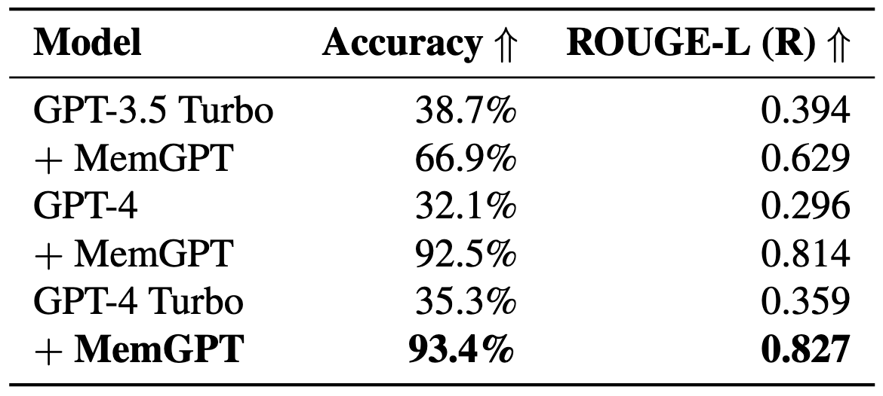
MemGPT (4/5)
Evaluation
Deep memory retrival performance significantly outperforms the fixed-context baselines.
Table 2: MemGPT deep memory retrieval (DMR) performance
Notes:
Let’s take a look at the evaluation. The Deep Memory Retrieval performance is shown in Table 2. We can see that standard LLMs struggle significantly when the answer is buried deep in past interactions. For instance, GPT-4 Turbo on its own achieves only 35.3% accuracy. However, when equipped with MemGPT, that same model’s performance jumps to 93.4%. This demonstrates that the bottleneck isn't the model's reasoning capability, but rather its inability to access long-term information without a structured memory management system.

Slide 15
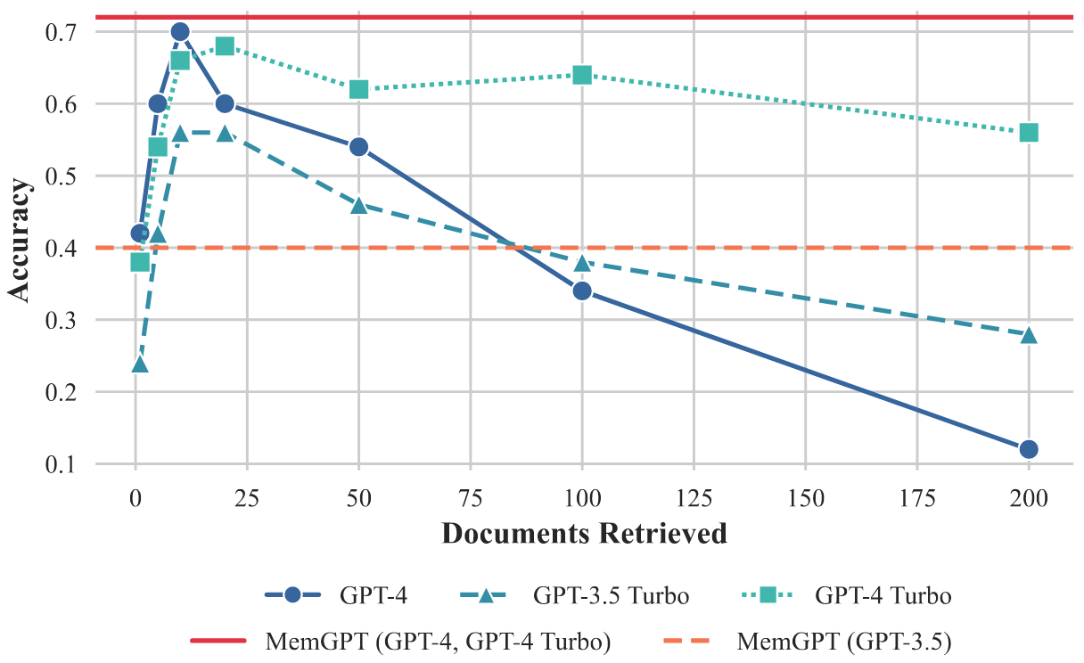
MemGPT (5/5)
Evaluation
Document QA task performance is unaffected by increased context length.
Figure 4: MemGPT document QA task performance
Notes:
Let’s look at the Document QA performance in Figure 4. You can see GPT-4 and GPT-3.5 Turbo dropping toward 10–30% accuracy as document *volume(ˈvɒljuːm) grows. In contrast, the MemGPT-enhanced models remain perfectly flat and stable. This stability proves that MemGPT successfully decouples the reasoning process from the physical *constraints( kənˈstreɪnts ) of the context window, allowing for consistent performance regardless of the scale of the data.

Slide 16
Outline
Introduction (5 min)
Background & Motivation (3 min)
Proposed Methods & Performance Evaluation (24 min)
MemGPT (2024, University of California) (8 min)
A-MEM (2025, Rutgers University) (8 min)
GAM (2026, Zhejiang University) (8 min)
Conclusions (2 min)
Q & A (2 min)
Notes:
Next, we have A-MEM from Rutgers University.

Slide 17
A-MEM (1/7)
Challenges
Rigid schemas: predefined structures and fixed access patterns limit adaptability across diverse tasks.
Manual management: pre-specify storage points and retrieval timing hinder autonomous long-term interaction.
Static knowledge: fails to autonomously evolve as information grows over time.
Key observation
Zettelkasten (graph): a knowledge management method that organizes information into atomic, self-contained notes interconnected through dynamic links.
Key ideas
Atomic note construction: use LLM to generate Zettelkasten style notes.
Autonomous link generation: use LLM to generate links between notes.
Dynamic knowledge refinement: use LLM to update existing notes.
Notes:
While MemGPT focuses on capacity, A-MEM tackles the qualitative(ˈkwɑːlɪteɪtɪv ) challenges of memory:
The first challenge is Rigid *Schemas( ˈskiːməs ): Traditional systems often rely on predefined structures and fixed access patterns, which limit their *adaptability( əˌdæptəˈbɪləti ) across diverse tasks.
Secondly, The Problem of Manual Management: Most agents require pre-specified storage points and retrieval timing, which hinders autonomous, long-term interaction.
Thirdly, the Static knowledge fails to autonomously evolve as information grows, resulting in worse performance over time.
To solve this, A-MEM adopts the *Zettelkasten( zetlˈcastn ) method. This philosophy organizes information into atomic, self-contained notes interconnected through dynamic links, creating a decentralized knowledge graph.
The key ideas are using LLM to generate the notes, links, and evolving the existing notes autonomously.

Slide 18
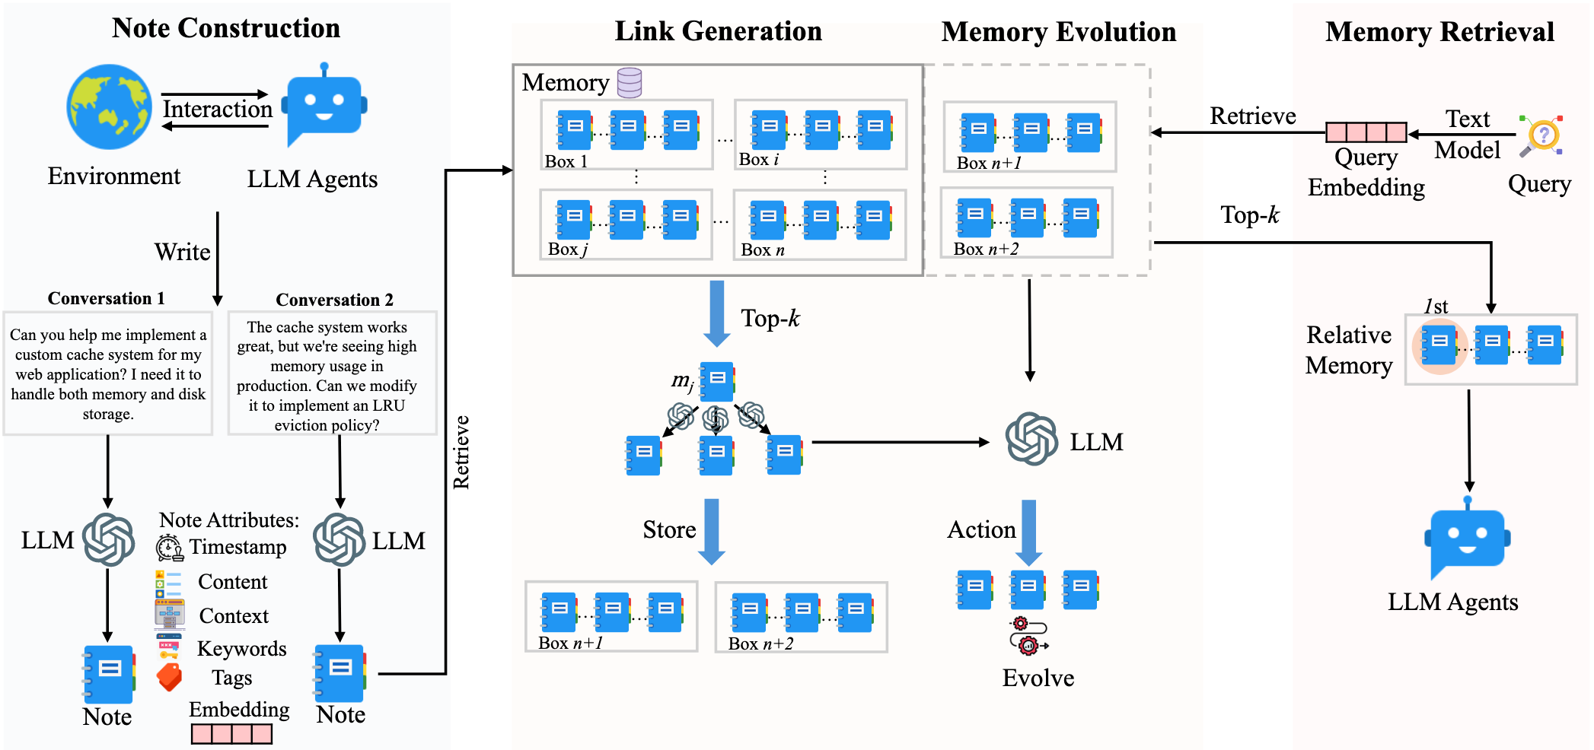
A-MEM (2/7)
Architecture overview
Figure 5: A-MEM architecture
Notes:
Here is the architecture overview of A-MEM. There are 3 major designs: note construction, link generation and memory evolution.

Slide 19
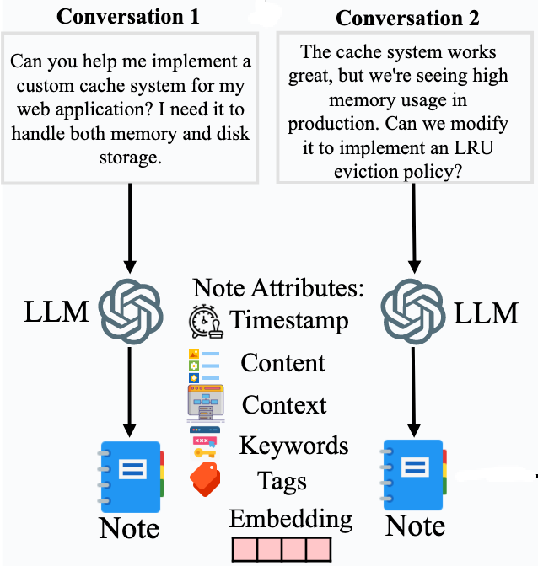
A-MEM (3/7)
Note construction: use LLM to consctruct Zettelkasten-style note of every dialouge, which contains:
Timestamp
Content
Context
Keywords
Tags
Embedding
Links
Figure 6: A-MEM note construction
Notes:
In A-MEM, every dialogue interaction is transformed by the LLM into a Zettelkasten-style note. These notes are rich in metadata, including timestamps, origin content, contextual summary, keywords, tags, embedding, and links. An important element is the embedding, which is used to caculate the similarity between different notes.

Slide 20
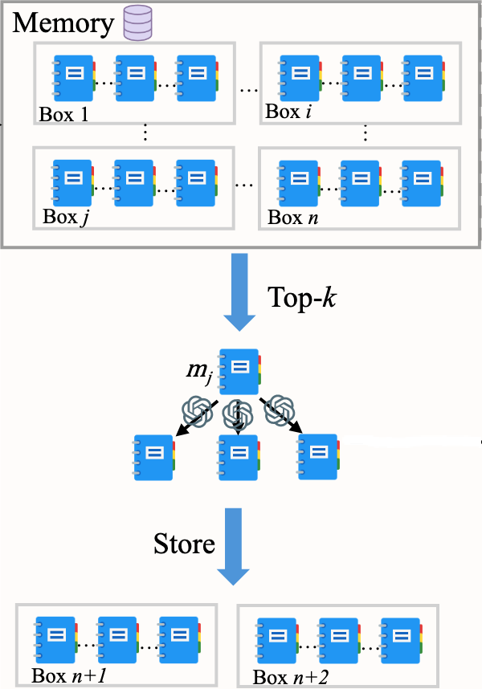
A-MEM (4/7)
Link generation
Use cosine similarity of embeddings to filter and identify top-k candidate memories.
Apply LLM reasoning to implement the Zettelkasten principle of flexible linking，which can detect causal relationships and subtle conceptual patterns between notes.
The updated notes are stored in multiple semantic boxes.
Figure 7: A-MEM link generation
Notes:
After the note is constructed, A-MEM will generate the link between the new note and the historical notes. A-MEM uses cosine similarity to identify the top-k candidate memories and then applies LLM reasoning to implement the Zettelkasten principle of flexible linking，which can detect causal relationships and subtle conceptual patterns between notes. Then the updated notes are stored in multiple semantic boxes.

Slide 21
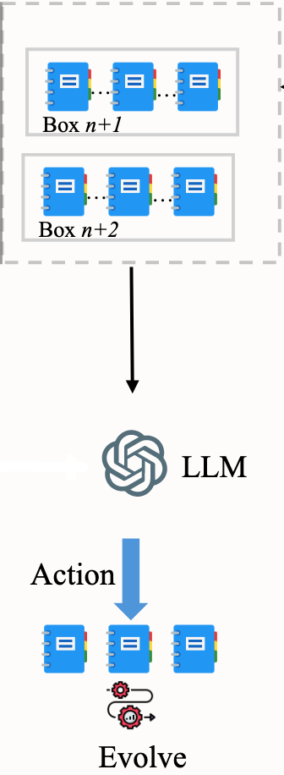
A-MEM (5/7)
Memory evolution
After creating links for the new memory, A-MEM evolves the retrieved memories.
Use LLM to update the tags, context and links of the top-k neighbor notes.
As the system processes more memories over time, it develops increasingly sophisticated knowledge graph structures.
Figure 8: A-MEM memory evolution
Notes:
Finally, after creating links for the new memory, A-MEM uses LLM to update the tags, context, and links of the top-k neighboring notes. As the system processes more memories, the entire graph becomes more sophisticated and interconnected autononously, just like human learning.

Slide 22
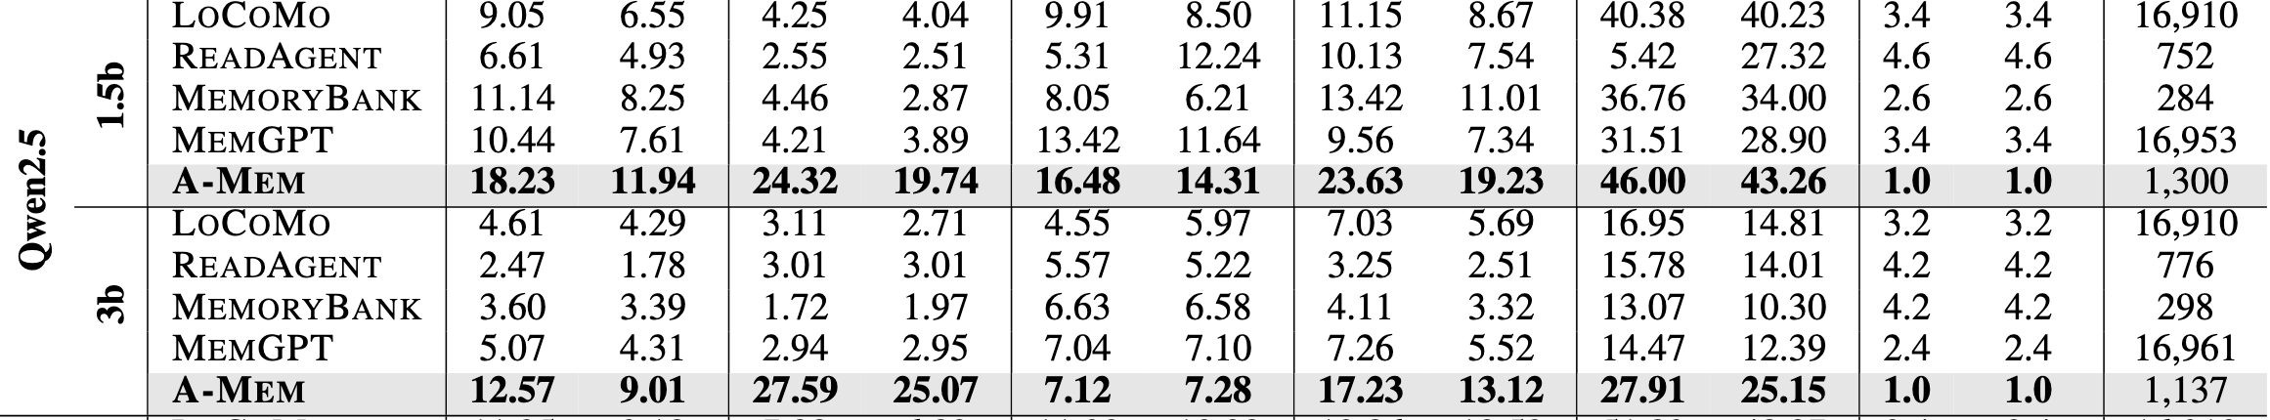
A-MEM (6/7)
Evaluation
Better score at most settings with significant cost efficiency.
Table 3: A-MEM experimental results on LoCoMo dataset
Notes:
Let’s look at the evaluation. On the LoCoMo dataset, A-MEM consistently achieves better scores than others like MemGPT across multiple *metrics (ˈmetrɪks ). Remarkably, it achieves these results with significant less token, providing a "better-for-less" solution.

Slide 23
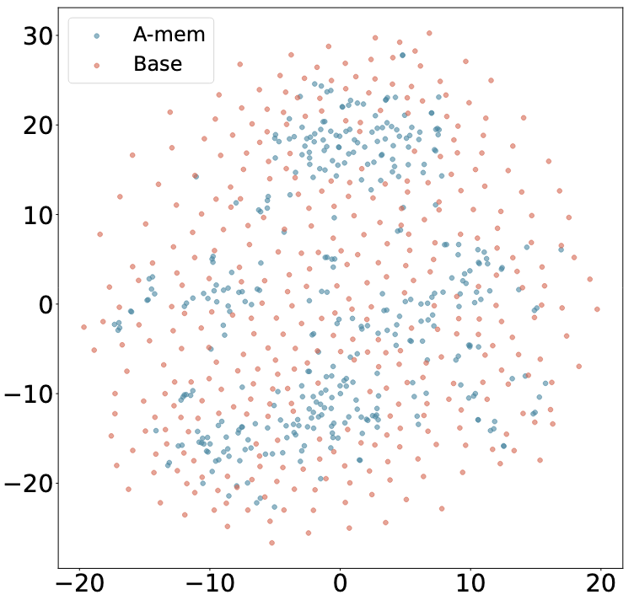
A-MEM (7/7)
Evaluation
More organized distribution with A-MEM (blue) compared to base memory (red).
Figure 9: A-MEM T-SNE Visualization of Memory Embeddings
Notes:
Looking at the T-SNE Visualization in Figure 9, we see an obvious difference. The red dots represent the base memory, which is scattered and unorganized. The blue dots, representing A-MEM, show a much more organized and clustered distribution, proving that the system successfully structures knowledge in a semantically meaningful way.

Slide 24
Outline
Introduction (5 min)
Background & Motivation (3 min)
Proposed Methods & Performance Evaluation (24 min)
MemGPT (2024, University of California) (8 min)
A-MEM (2025, Rutgers University) (8 min)
GAM (2026, Zhejiang University) (8 min)
Conclusions (2 min)
Q & A (2 min)
Notes:
The final paper is GAM from Zhejiang University.

Slide 25
GAM (1/6)
Challenges
Semantic drift
Memory loss
Key observation
Momories are group by topics.
Key ideas:
Hierarchical graph memory architecture.
State-based memory consolidation.
Notes:
While previous systems handled storage and linking effectively, they often struggled with two critical issues: semantic drift and memory loss over very long durations.
The key observation is researchers noticed that human memories are naturally grouped by topics rather than just being a continuous stream.
So GAM introduces a Hierarchical Graph Memory architecture and the State-based memory consolidation to mitigate the conflict between rapid context *perception and stable, long-term knowledge retention.

Slide 26
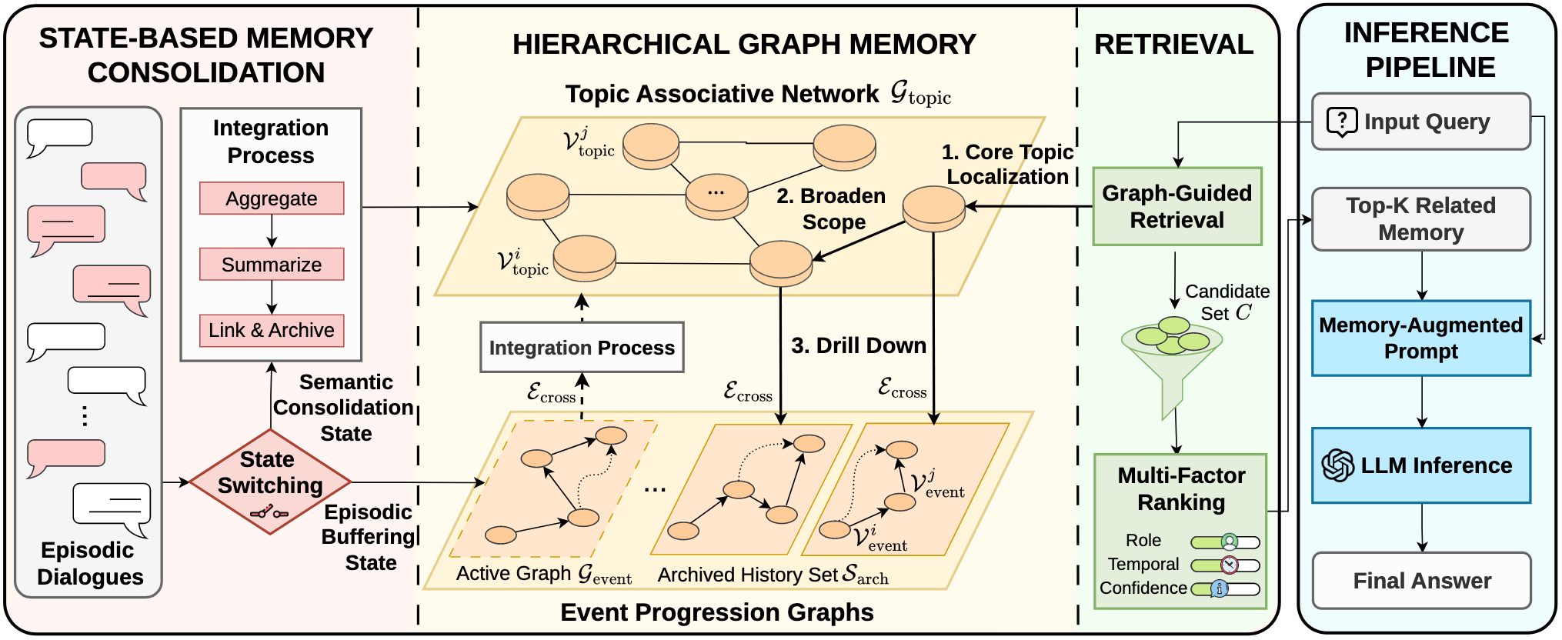
GAM (2/6)
Architecture overview
Figure 10: GAM architecture
Notes:
The architecture of GAM is defined by its stratified( ˈstrætɪfaɪd ) layers, as seen in Figure 10. There are two important designs, first is the state-based memory consolidation on the left; second is the hierachical graph memory in the middle.

Slide 27
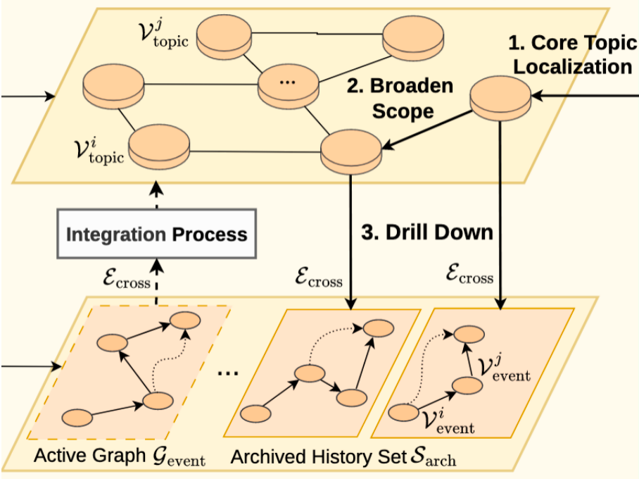
GAM (3/6)
Hierarchical graph memory
Topic graph: global hierarchy storing consolidated knowledge and abstract semantic associations.
Event graph: local structure capturing immediate interaction flows and temporal dependencies.
Figure 11: GAM hierachical graph memory
Notes:
Let’s look at the hierarchical graph memory first. The hierarchical graph memory contains two layers.
The Topic Graph on the top: This acts as the "high-level" brain, storing consolidated knowledge and abstract semantic associations across the entire history of the agent.
The Event Graphs on the bottom: These capture immediate interaction flows and temporal dependencies, acting as "active scenes" of a conversation.
When a query enters, the system performs Graph-Guided Retrieval, which find the core topics on the topic graph first, broadens the scope across the topic graph, and then "drills down" into specific event graphs to retrieve precise details.

Slide 28
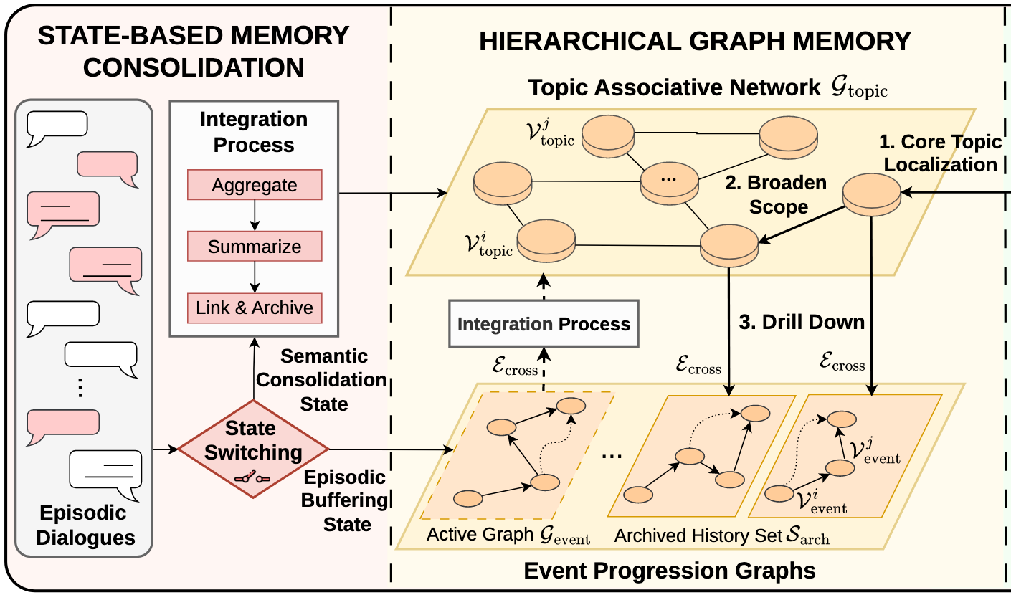
GAM (4/6)
State-based memory consolidation
Semantic boundary: LLM-driven detection of topic shifts to trigger memory consolidation processes.
Episodic buffering state: temporarily store interactions in event graphs to isolate transient noise.
Semantic consolidation state: integrate buffered episodic knowledge into the global topic graph.
Figure 12: GAM state-based memory consolidation
Notes:
What makes GAM truly intelligent is how it moves information between these layers using State-Based Consolidation:
Instead of using fixed-size window, GAM uses the LLM to detect topic shifts. This detection serves as a "semantic boundary" that triggers the consolidation process.
During a conversation, all interactions are temporarily held in event graphs to isolate *transient(ˈtrænʃənt) noise and focus on the immediate task.
Once a topic shift is detected, the system summarizes the buffered knowledge, integrating it into the permanent global topic graph.

Slide 29
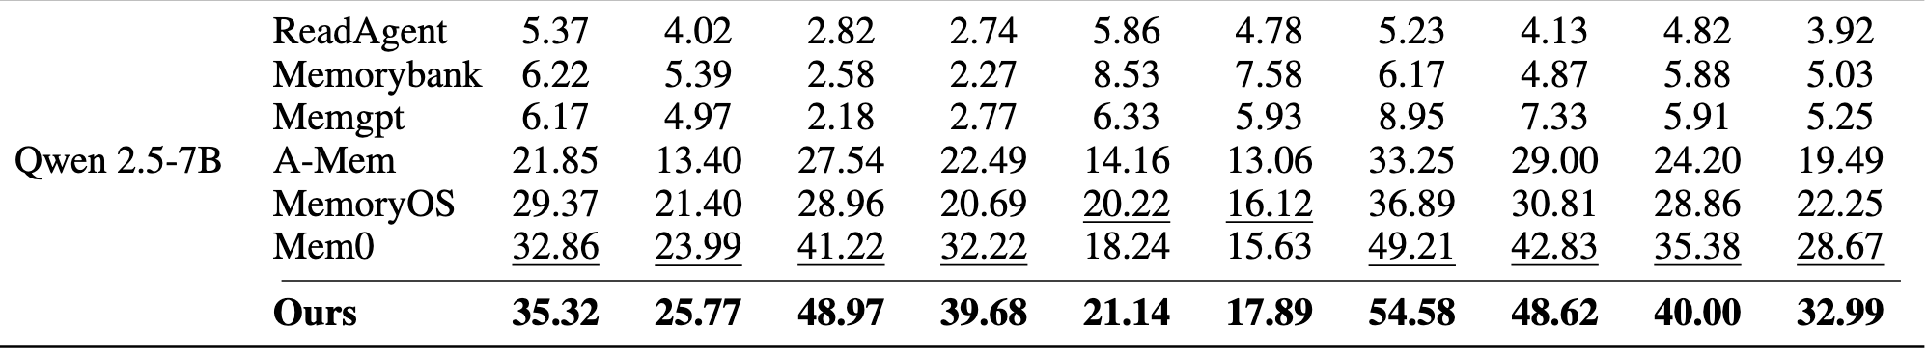
GAM (5/6)
Evaluation
Achieves the best average performance in most settings, particularly effective in temporal reasoning tasks.
Table 4: GAM performance comparison on the LoCoMo dataset
Notes:
The results of this hierarchical approach are quite remarkable:
As shown in Table 4, GAM achieves the best average performance across most settings, particularly effective in temporal reasoning tasks, where understanding the sequence of events is vital.

Slide 30
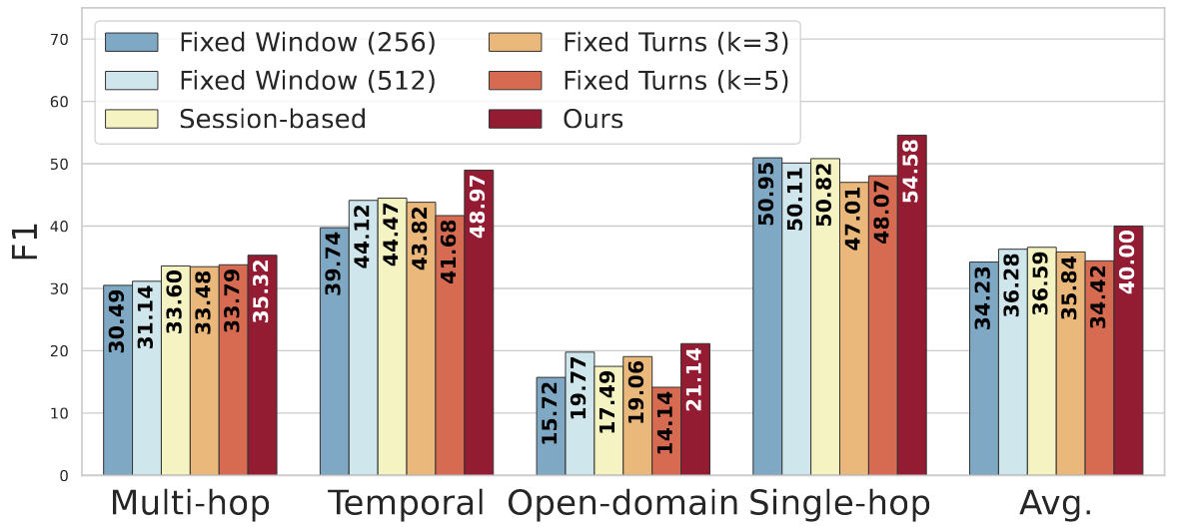
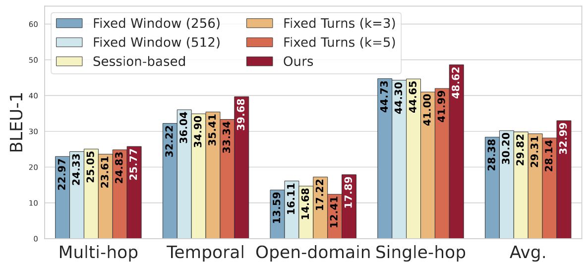
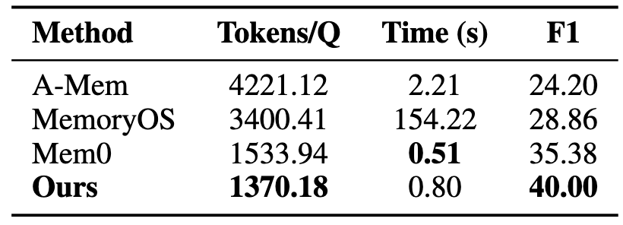
GAM (6/6)
Evaluation
Semantic-boundary approach outperforms heuristic baselines across metrics.
Lower tokens consumption and better F1 score.
(a) F1
Table 5: Efficiency comparison on the LoCoMo dataset
(b) BLEU-1
Figure 13: Impact of partitioning strategies on LoCoMo
Notes:
Figure 13 is the experiment result of different partitioning strategies, we can see that GAM achieves best score at all metrics, especially the temporal catagory. This confirms that the semantic-boundary is essential for reasoning.
Table 5 highlights that GAM consumes significantly fewer tokens per query—1,370 tokens compared to 4,221 for A-MEM—while delivering faster inference time and better accuracy. This proves that GAM’s 3D structure is not just better organized, but also more cost-effective.

Slide 31
Outline
Introduction (5 min)
Background & Motivation (3 min)
Proposed Methods & Performance Evaluation (24 min)
MemGPT (2024, University of California) (8 min)
A-MEM (2025, Rutgers University) (8 min)
GAM (2026, Zhejiang University) (8 min)
Conclusions (2 min)
Q & A (2 min)
Notes:
The final part is the conclusions.

Slide 32
Conclusions
MemGPT
1D text chunks.
Provides extended context within the LLM’s limited context window.
A-MEM
2D graph-based notes.
Enables dynamic memory structuring and operations.
GAM
3D hierachical graph memory.
Mitigates the conflict between rapid context perception and stable knowledge retention.
Progression: memory evolution transitions from linear storage to complex hierarchical systems to enhance long-term reasoning consistency and sophisticated understanding.
Notes:
As we have seen today, agent memory system is evolving *rapidly. To summarize this evolution:
MemGPT introduced 1D text chunks for infinite context window.
A-MEM brought 2D graph-based notes for dynamic structuring and operations;
And GAM designed the 3D hierarchical approach to balance rapid perception and stable knowledge retention.
The progression is clear: we are transitioning away from linear storage toward complex hierarchical systems. This progression is essential for building agents that do not just "store" information, but truly maintain long-term reasoning consistency and sophisticated understanding.

Slide 33
Outline
Introduction (5 min)
Background & Motivation (3 min)
Proposed Methods & Performance Evaluation (24 min)
MemGPT (2024, University of California) (8 min)
A-MEM (2025, Rutgers University) (8 min)
GAM (2026, Zhejiang University) (8 min)
Conclusions (2 min)
Q & A (2 min)
Notes:
Thank you for your attention. I am happy to answer any questions.

