Slide 1
Elastic Resource Provisioning in Cloud Platforms via Workload Prediction and Performance Modeling
Qixu Chen
School of Data Science
Chinese University of Hong Kong, Shenzhen

Slide 2
Outline
Introduction
Related Work
Proposed Methods
Method1:Workload Prediction for Cloud Computing Elasticity Mechanism（ICCCBDA）
Method2: Empirical prediction models for adaptive resource provisioning in the cloud (FGCS)
Method3:Efficient resource provisioning for elastic Cloud services based on machine learning techniques（JoCC）
Performance Evaluation
Conclusions

Slide 3
Elastic Resource Provisioning in Cloud Platforms via Workload Prediction and Performance Modeling
Introduction
Related Work
Proposed Methods
Method1:Traditional Forecasting
Method2: ML
Method3:ML+queuing theory
Performance Evaluation
Conclusions

Slide 4
Introduction -Elasticity in Cloud Computing
Cloud computing has become the backbone of today’s digital economy
Elasticity enables systems to scale resources automatically with workload
However, resource provisioning is not instantaneous in practice
VM / Container initialization incurs non-negligible delay
This creates a fundamental mismatch between:
Rapid workload dynamics
Delayed resource availability

Slide 5
Introduction –The Core Challenge
Two undesirable extremes:
Under-provisioning
Increased response time
Queue overflow, SLA (Service Level Agreement )violations
Over-provisioning
Idle resources
Higher operational cost and energy waste
Goal: Match resource supply to demand ahead of time, not after the fact.

Slide 6
Introduction -Why Prediction Is Necessary
Workload Feature | Manifestation | Impact on Scaling Decisions
Cyclicity | Daily / weekly patterns | Enables time-series forecasting
Non-stationarity | Changing mean & variance | Requires adaptive or online models
Burstiness | Sudden traffic spikes | Breaks simple linear predictors
Multi-resource correlation | CPU, memory, I/O coupling | Calls for multivariate prediction
Core Challenge:
Build a prediction mechanism that is accurate, efficient, and robust enough to cover resource initialization delay while satisfying QoS constraints.

Slide 7
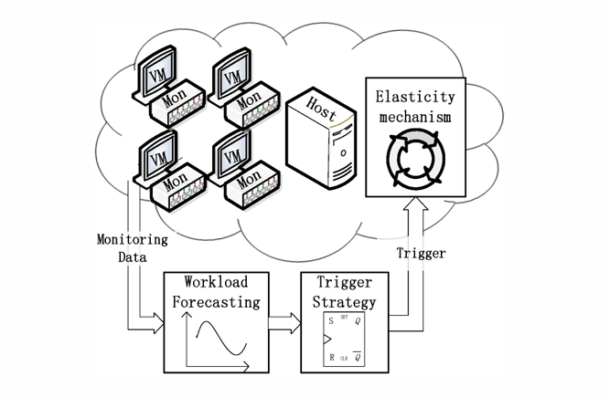
Introduction-What we want to do
The goal of our researches is to reduce the scaling delay, improve the QoS and meet the user SLA.
Firstly, the system collects performance data, including CPU, memory, disk etc.
Secondly, the system analyzes and predicts the workload based on the monitoring data.
Then, the trigger strategy decides when and how to trigger the elasticity mechanism based on the predicted result.
Figure 1 Workload predicting system

Slide 8
Elastic Resource Provisioning in Cloud Platforms via Workload Prediction and Performance Modeling
Introduction
Related Work
Proposed Methods
Method1:Traditional Forecasting
Method2: ML
Method3:ML+queuing theory
Performance Evaluation
Conclusions

Slide 9
Related work(1/3)
Reactive Auto-Scaling Mechanisms
Widely adopted in industrial cloud platforms such as Amazon EC2, RightScale, and OpenNebula
Triggered by thresholds (CPU, memory, sessions)
Simple and easy to deploy
Limitation: reacts after overload, slow under sudden spikes

Slide 10
Related Work(2/3)
Time-Series Forecasting (Classical Models)
Statistical time-series models
Moving Average (MA), Auto-Regressive (AR), ARMA, ARIMA [Hoffmann et al., IEEE Transactions on Reliability, 2007]
Pattern-based and probabilistic models
Hidden Markov Models [Khan et al., IEEE NOMS, 2012]
Machine Learning Forecasting
Learns nonlinear mapping from history → future workload
Examples: SVR / Neural Networks / Deep models (e.g., LSTM)

Slide 11
Related Work(3/3)
Integrated Prediction + Resource Control (Emerging Direction)
Instead of “forecast only”, recent work builds a closed loop:
Prediction model → estimate future load
Decision model → choose resource level under SLA constraints
Examples of decision components:
Queueing theory (e.g., M/M/c)
Reinforcement learning policies

Slide 12
Elastic Resource Provisioning in Cloud Platforms via Workload Prediction and Performance Modeling
Introduction
Related Work
Proposed Methods
Performance Evaluation
Conclusions

Slide 13
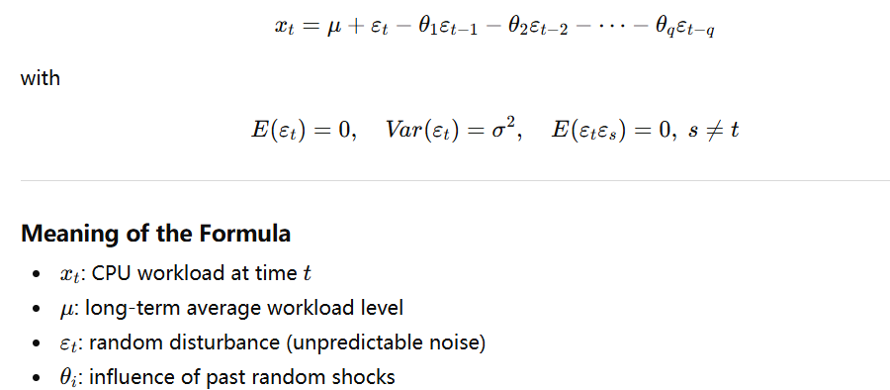
Method1: Traditional Forecasting(Time Series) (1/2)
First, classical time-series models such as MA, AR, and ARIMA are used to capture regular workload patterns and short-term temporal dependencies.
MA — Moving Average Model
Notes:
The MA model assumes that workload variations are mainly caused by recent random disturbances, rather than by historical workload levels.

Slide 14
Method1: Traditional forecasting(Time Series)(2/2)
All five methods attempt to approximate workload evolution as:
𝑥𝑡= 𝑓(𝑥𝑡−1,𝑥𝑡−2,…)+𝜀𝑡
Model | Primary Focus | Statistical Role
MA | Noise | Error smoothing
AR | Level | Temporal dependency
ARIMA | Trend | Stationarization
DM | Change | Increment modeling
MM | Robustness | Outlier filtering

Slide 15
Method1:Traditional Forecasting(Kalman Filter)
Core Idea
Kalman Filter is a real-time state estimation method
It estimates the true CPU workload state by combining:
model-based prediction
noisy observed measurements
Working Mechanism (High-Level)
Operates in a recursive two-step loop:
Prediction: Estimate current workload based on the previous state and system dynamics
Update: Correct the prediction using newly observed CPU measurements

Slide 16
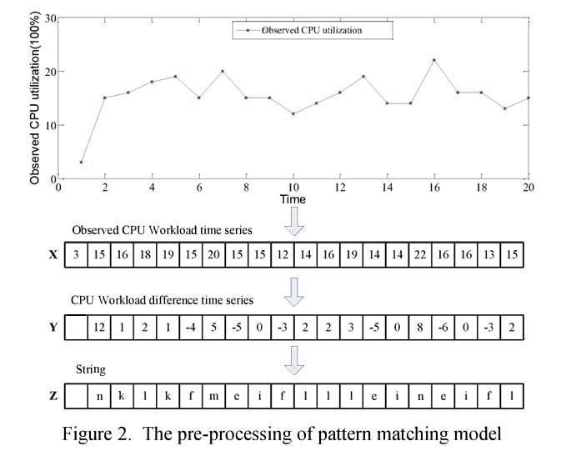
Method1:Traditional Forecasting(Pattern Matching)
1. Pre-processing (Pattern Encoding)
Convert raw CPU workload time series into a trend-based representation Steps:
Apply first-order differencing to capture workload changes
Discretize changes into symbolic strings
Result: continuous workload → compact pattern string

Slide 17
Method1:Traditional Forecasting(Pattern Matching)
Matching
Pattern Library
Maintain a set C of historical workload pattern strings
Each pattern represents a typical workload evolution
If a new pattern is not in C, it is added to the library
The exact matching process:
Use KMP to check whether s exactly matches any pattern in C
If an exact match exists, return the corresponding historical pattern
If no exact match is found, compute the distance between s and each pattern in C, Select the pattern with the minimum distance as the most similar one

Slide 18
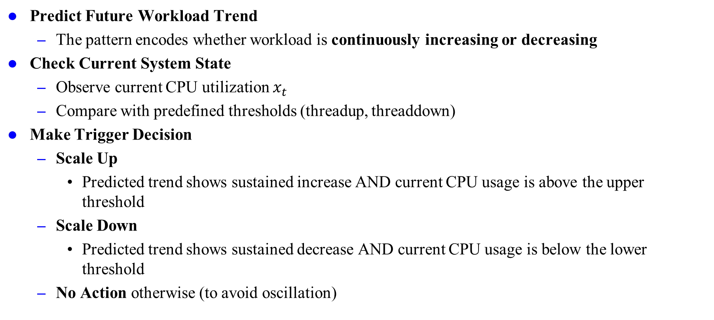
Method1:Traditional Forecasting(Triggering Strategy)
Predict Future Workload Trend
The pattern encodes whether workload is continuously increasing or decreasing
Check Current System State
Observe current CPU utilization $x_{t}$
Compare with predefined thresholds (threadup, threaddown)
Make Trigger Decision
Scale Up
Predicted trend shows sustained increase AND current CPU usage is above the upper threshold
Scale Down
Predicted trend shows sustained decrease AND current CPU usage is below the lower threshold
No Action otherwise (to avoid oscillation)

Slide 19
Method2:Neural Network +Linear Regression
Traditional methods: ARMA / ARIMA
Pros: simple, fast, widely used
Limitation: mainly linear → often insufficient for real-world nonlinear workloads
Learning task
Past CPU usage → Future CPU usage (t + 12) (VM startup time: 5–15 minutes)
Setting A (Single-point): CPU(t) → CPU(t+12)
Setting B (Sliding window): [CPU(t−N+1)…CPU(t)] → CPU(t+12), N=2–9
Models: ECNN vs Linear Regression

Slide 20
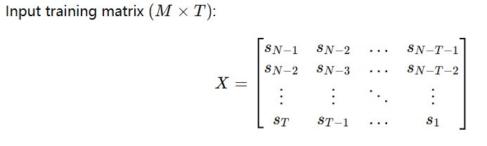
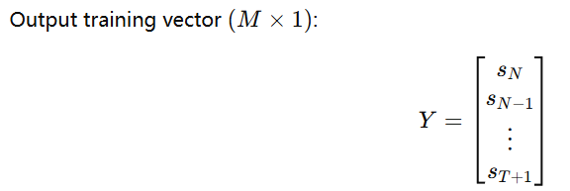
Method3:ML + Queuing Theory: Prediction (1/2)
ML-based forecasting:
ANN / SVMANN: strong nonlinear modeling, but may converge to local minima; solutions not unique
Neural Network: global optimum solution + strong generalization (structural risk minimization)→ This work adopts Support Vector Regression (SVR).

Slide 21
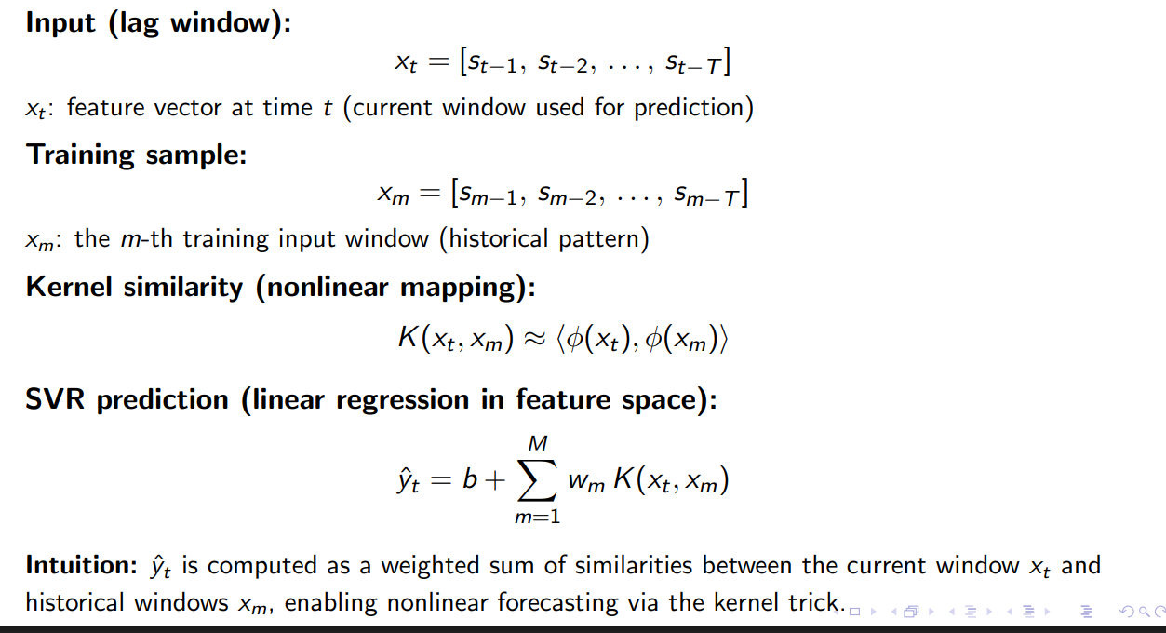
Method3:ML + Queuing Theory: Prediction (2/2)

Slide 22
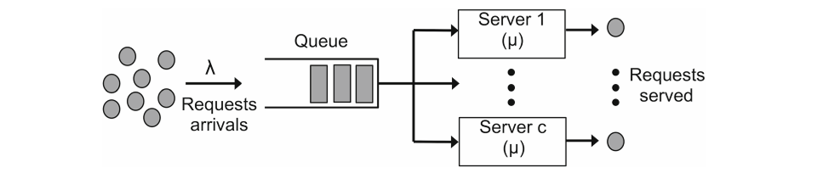
Method3:ML+ Queuing Theory：Performance Model(1/3)
M/M/c queue model for the distributed server.
c is the number of parallel servers in the system.
λ is the arrival rate, i.e., the average number of requests that reach the system per time unit, modeled as a Poisson distribution.
μ is the service rate, i.e., the average number of requests that a server can process per time unit
ρ is the system utilization factor, which is defined as ρ=λ/cμ
Fig3. M/M/c queue model for the distributed server

Slide 23
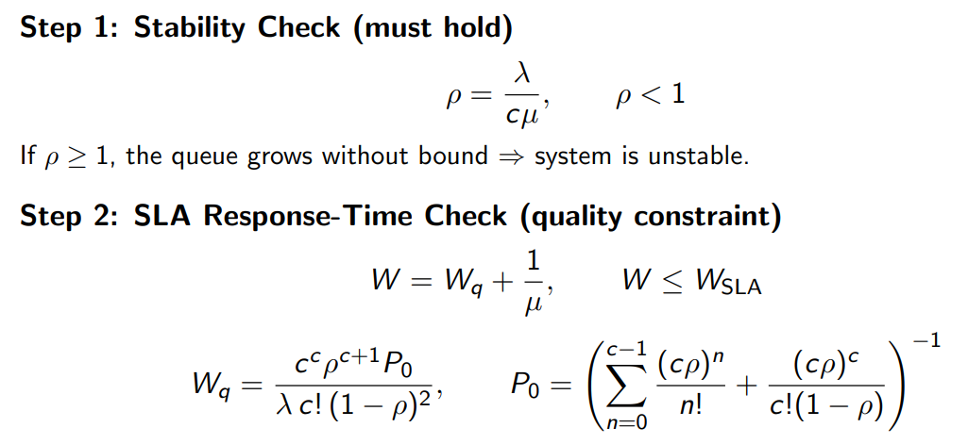

Method3:ML+ Queuing Theory：Performance Model(2/3)
Fig3. M/M/c queue model for the distributed server

Slide 24

Method3:ML+ Queuing Theory：Performance Model(3/3)
Every hour, the system performs the following steps:
Use the forecasting model to predict the average load (arrival rate) for the next hour, 𝜆.
Try candidate server counts 𝑐=1,2,3,… sequentially.
For each 𝑐, compute ρ, 𝑊𝑞​, and 𝑊.Find the first (minimum) 𝑐 that satisfies the SLA constraints.
Scale the system to this 𝑐 and keep it for one hour.

Slide 25
Elastic Resource Provisioning in Cloud Platforms via Workload Prediction and Performance Modeling
Introduction
Related Work
Proposed Methods
Performance Evaluation
Conclusions

Slide 26
Method1:Experiment Setup
Experiment Setup (Aliyun)
Deployed on Aliyun Cloud VMs with Elastic Scaling Service (ESS)
Instance type: esc.tl.small (1 GB RAM)
Workloads: CPU time series + compute-intensive, web, and memory-intensive applications

Slide 27
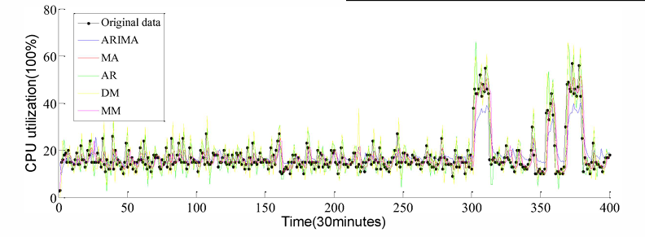
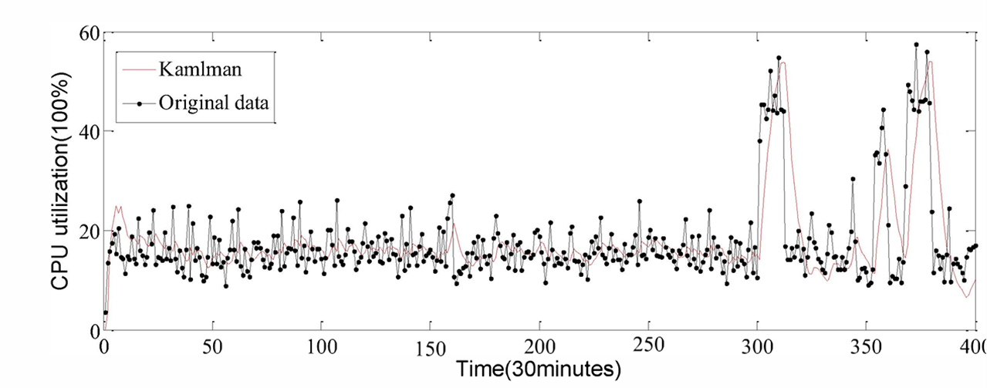
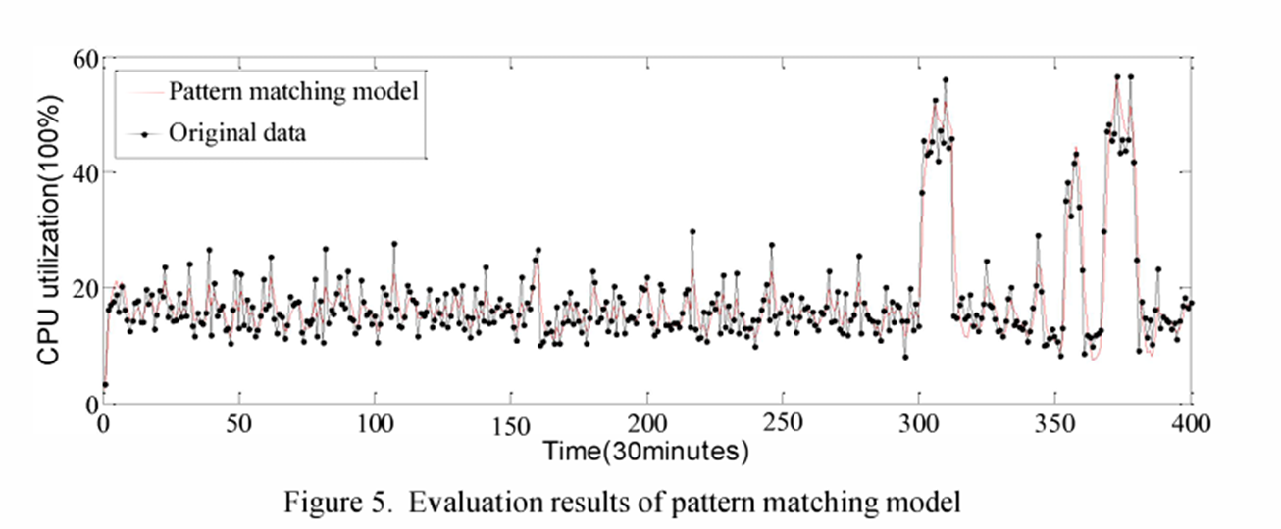
Method1:Evaluation Summary
ARIMA is the best among MA / AR / DM (lowest error among time-series baselines)
Kalman Filter smooths noise but loses fine-grained changes
Pattern Matching captures trend shifts but struggles near inflection points
All three methods suffer from prediction delay
Fig4. Evaluation results of time series approach
Fig5. Evaluation results of Kalman Filter approach
Fig6. Evaluation results of Pattern Matching approach

Slide 28
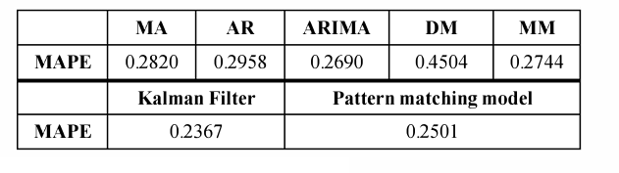
Method1:Quantitative Results + Scaling Benefit
Metric: Mean Absolute Percentage Error (lower is better)
Kalman filter model and pattern have lower predicting error than the time series approach.
Pattern matching performs slightly worse than Kalman filtering due to incomplete or imperfect historical pattern strings.
the new trigger strategy can predict the scaling up and down ahead of the threshold approach. Time reduction: 57.14% (scale-up), 62.5% (scale-down)
Table1 Error of Predicting

Slide 29
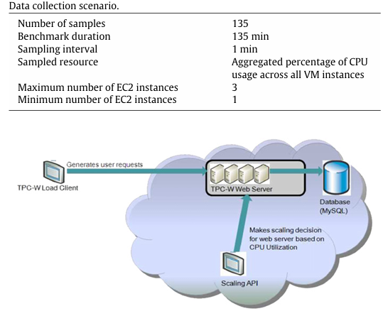
Method2: Experiment Setup
Benchmark & Workload (TPC-W on EC2)
TPC-W e-commerce benchmark (online bookstore simulation)
Concurrent sessions: browse / order / transaction
Workload pattern: linearly increasing request rate (flash-crowd ramp-up)
Deployed on Amazon EC2 with Auto Scaling API (static rules)
Focus: prediction accuracy, not scaling policy optimization
Fig7. Data collection architecture

Slide 30
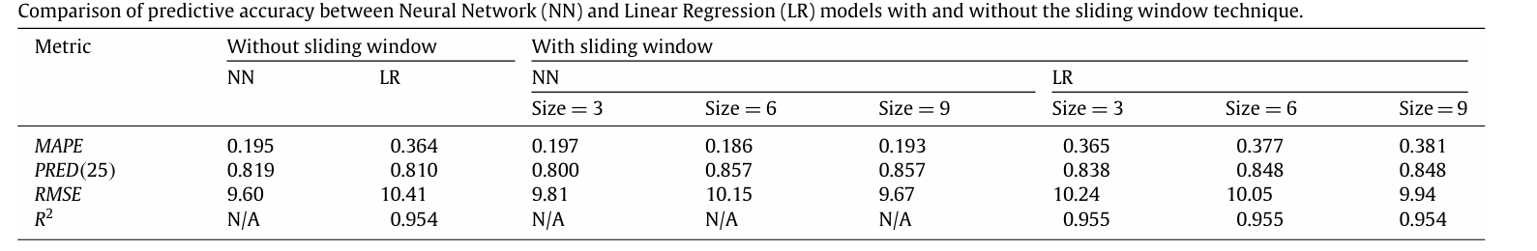
Method2: Key Observation
Without sliding window
NN consistently outperforms LR in prediction accuracy
With sliding window
NN remains more accurate than LR across all window sizes
NN achieves ~50% lower MAPE than LR for each window size
Table 2 Comparison of predictive accuracy between Neural Network (NN) and Linear Regression (LR) models with and without the sliding window technique.

Slide 31
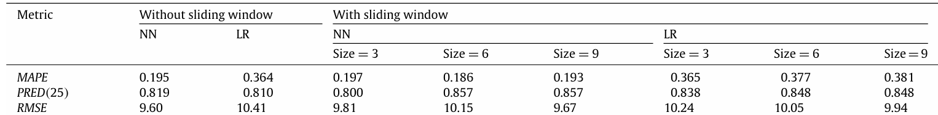
Method2:Sliding Window Impact & Sensitivity Analysis
Sliding window inputs improve accuracy (↓MAPE/RMSE, ↑PRED(25))
NN benefits from larger windows → best at window = 8 (MAPE ≈ 17.72)
LR works best with small windows (1–3) and degrades as window grows
Takeaway: NN + optimal window achieves the best forecasting performance
Table 2 Comparison of predictive accuracy between Neural Network (NN) and Linear Regression (LR) models with and without the sliding window technique.

Slide 32
Method3:Experiment Setup
Dataset
Real Web service logs (U. Complutense of Madrid), 4 weeks, hourly load (req/s)
Train: 672 hours · Test: 24 hours (ground truth available)
Load scaled ×10 to emulate high traffic
Forecast target: Next-hour server load
One-step ahead: predict next-hour load (rolling)
Daily seasonality → lag T = 24h
Models compared
Baselines: Last value, MA(3), AR(24)
SVM/SVR Models Polynomial kernel (p=1)
Normalized polynomial kernel (p=2)
RBF kernel with 𝛾∈{0.2,0.6,1.0}

Slide 33
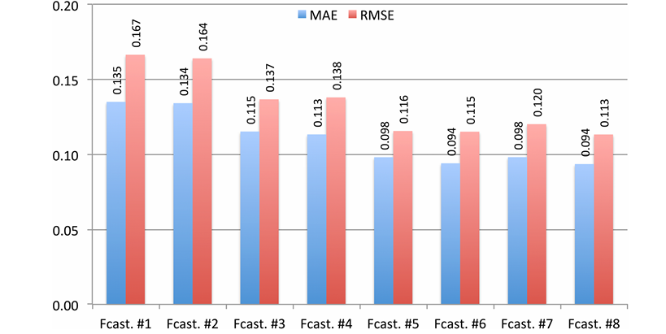
Method3: Evaluation for Prediction
Key observations:
Fcast #1 to #3:last values, MA, linear regression (baseline)
#4:Polynomial kernel
#5:Normalized polynomial kernel (p=2)
#6:RBF kernel with 𝛾=0.2
#7:RBF kernel with 𝛾=0.6
#8:RBF kernel with 𝛾=1.0
Figure8. Accuracy of different forecasting models (real prediction error for the forecasting period)

Slide 34
Method3:Auto-Scaling Evaluation
Use predicted load as arrival rate λ to compute required backend servers c
Service rate per server: μ=200 requests/s
Stability constraint: ρ<1
SLA constraint (response time):
Wq​≤2.5ms
W=1/μ+Wq≤7.5ms
Compare:
Optimal allocation: computed from real load
Estimated allocation: computed from forecast load
Identify Over / Under / Correct provisioning

Slide 35

Method3:Auto-Scaling Evaluation
Evaluate auto-scaling quality using 3 outcomes:
Provisioned resources (cost proxy)
SLA violations: 𝑊>7.5 ms
Unserved requests: timeout >1s
Robust allocation
a more conservative arrival rate
Here, the expected error represent the expected forecasting uncertainty (estimated using training RMSE).

Slide 36
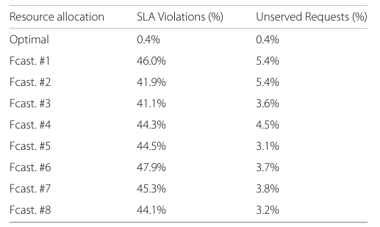
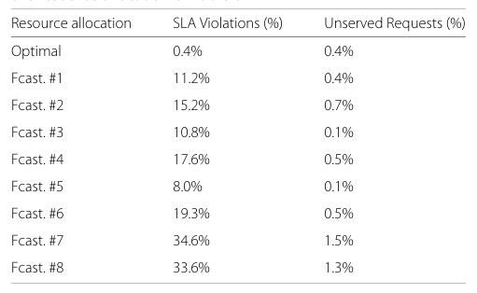
Method3:Auto-Scaling Evaluation
Table 3. Percentage of SLA violations and unserved requests
over total number of requests for the 24 h test interval with point forecast only
SLA violations remain high (~40–50%) across all models
Unserved requests are mostly low; best cases: #5 and #8(Normalized polynomial kernel , RBF kernel with 𝛾=1.0
Table 4. Percentage of SLA violations and unserved requests
over total number of requests for the 24 h test interval with provision using forecast + 0.5 × expected error
SLA violations drop significantly
Best overall trade-off: #5 (Normalized polynomial kernel )

Slide 37
Elastic Resource Provisioning in Cloud Platforms via Workload Prediction and Performance Modeling
Introduction
Related Work
Proposed Methods
Performance Evaluation
Conclusions

Slide 38
Conclusions
Focus: proactive auto-scaling via workload prediction
Methods:
Traditional forecasting
Machine learning forecasting
Performance Model (Queuing theory)
Findings: Earlier scaling, fewer SLA violations, less over-provisioning
Common future directions

Slide 39
References
1.Yazhou Hu, Bo Deng, Fuyang Peng, and Dongxia Wang. 2016. Workload prediction for cloud computing elasticity mechanism. In Proceedings of the 2016 IEEE International Conference on Cloud Computing and Big Data Analysis (ICCCBDA 2016), Chengdu, China, July 5–7, 2016. IEEE, 244–249. DOI: 10.1109/ICCCBDA.2016.7529565.
2. Sadeka Islam, Jacky Keung, Kevin Lee, and Anna Liu. 2012. Empirical prediction models for adaptive resource provisioning in the cloud. Future Generation Computer Systems 28, 1 (2012), 155–162. DOI: 10.1016/J.FUTURE.2011.05.027.
3. Rafael Moreno-Vozmediano, Rubén S. Montero, Eduardo Huedo, and Ignacio M. Llorente. 2019. Efficient resource provisioning for elastic Cloud services based on machine learning techniques. Journal of Cloud Computing 8 (2019), Article 5. DOI: 10.1186/s13677-019-0128-9.
4. Günther A. Hoffmann, Kishor S. Trivedi, and Miroslaw Malek. 2007. A Best Practice Guide to Resource Forecasting for Computing Systems. IEEE Transactions on Reliability 56, 4 (2007), 615–628. DOI: 10.1109/TR.2007.909764.
5. Arijit Khan, Xifeng Yan, Shu Tao, and Nikos Anerousis. 2012. Workload characterization and prediction in the cloud: A multiple time series approach. In Proceedings of the 2012 IEEE/IFIP Network Operations and Management Symposium (NOMS 2012), Maui, Hawaii, USA, April 16–20, 2012. IEEE, 1287–1294. DOI: 10.1109/NOMS.2012.6212065.

