Slide 1
Evolution of Medical LLM Training Systems 2026.02.03
Junying Chen
School of Data Science
Chinese University of Hong Kong, Shenzhen

Slide 2
Outline
Background (3 min)
Motivation (3 min)
Proposed Methods & Performance Evaluation (18 min)
HuatuoGPT-2 ( 6 min)
HuatuoGPT-o1 ( 6 min)
HuatuoGPT-3 ( 6 min)
Conclusions (1 min)
Q & A (5 min)

Slide 3
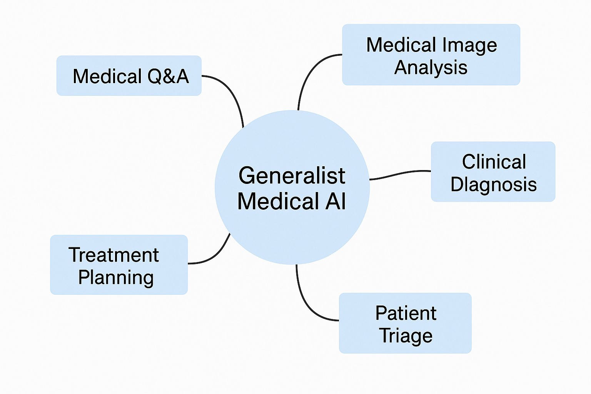
What is Medical LLMs
What is Medical LLMs?
Definition: A domain-specific AI system designed to understand, reason, and generate clinical knowledge at an expert level.
The Goal: Achieving General Medical AI (GMAI)—a system capable of handling complex clinical workflows, from diagnosis to personalized treatment planning.
“A professional LLM focusing on the medical field.”

Slide 4


Why Medical LLM Matters?
The “Generalist” Bottleneck: General LLMs often struggle with medical nuances, leading to “hallucinations” in high-stakes clinical scenarios.
Adaptation
Medicine
Expertise
General LLM
(eg. ChatGPT)
Medical LLM
(eg. HuatuoGPT)
“A professional medical LLM can surpass much larger general models in medical applications.”
A great example is specialized code LLMs (such as Codex), which have much stronger coding capabilities than general LLMs (such as GPT-5-Chat).

Slide 5
The Healthcare AI Landscape
Healthcare Spending: Healthcare accounts for nearly 10-20% of GDP in developed nations; the AI healthcare market is projected to grow exponentially. ^{[1]}
National Strategy: High investment in AI to act as a 'Pre-processor' or 'Copilot' to scale healthcare systems beyond human limits. ^{[2]}
“The development of medical AI can democratize healthcare, giving everyone access to top-tier medical resources and advice, ultimately extending life expectancy for the majority.”
[1] WHO (2024/2025): "Health Workforce - Global Factsheet.
[2] Frontiers in Public Health (2025): "Artificial Intelligence in Chinese Healthcare: A Review."

Slide 6



Industry Giants Enter Healthcare AI
Openai: OpenAI has launched ChatGPT Health, a specialized version of ChatGPT designed for health‑related queries and wellness support.
Ant Afu (蚂蚁阿福): Ant Group has rebranded its AI health app from “AQ” to Ant Afu, emphasizing AI health companionship and services.
Baichuan AI (百川): Baichuan large language models and AI research are focusing in medical data processing and healthcare scenarios.
A professional medical LLM can surpass much larger general models in medical applications.

Slide 7
Our Journey in Medical LLMs
(Image Generation)
(Vidieo Generation)
Janus-4o
MedGen
(Traditional Chinese Medicine)
( Interpretability)
ShiZhenGPT
★
2025.05
Coming Soon
(Medical Multimodel)
Chain-of-Diagnosis
2024.08
2024.12
HuatuoGPT-Omni
Apollo
(Multimodal unification)
(Medical Instruction-tuning)
2024.02
2024.06
HuatuoGPT-o1
HuatuoGPT-O3
HuatuoGPT
(Medical Reasoning)
(Ultra Reasoning)
HuatuoGPT-Vision
Med-MAT
HuatuoGPT-5
2023.05
2023.11
(Medical Multimodel)
(Multimodal Interpretability)
(Stronger Backbone)
HuatuoGPT-II
(Medical Pre-training)
The works completed as the first author
We have been focused to the research of Medical LLM, starting many projects and gaining a lot of experience in the field.

Slide 8
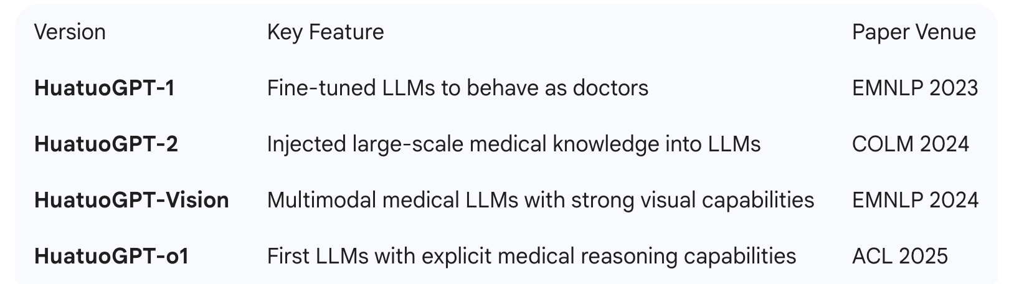
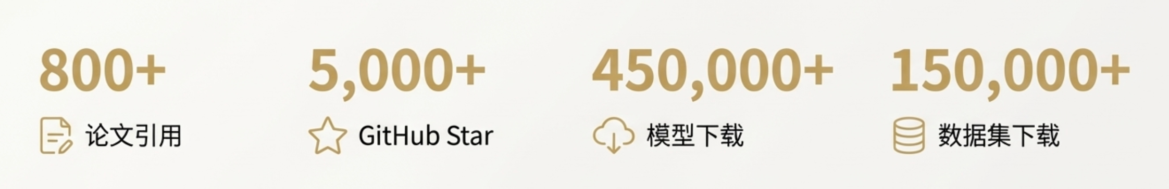
Our Journey in Medical LLMs
1000+
Our HuatuoGPT series is one of the most influential medical LLMs in the world.

Slide 9
Outline
Background (3 min)
Motivation (3 min)
Proposed Methods & Performance Evaluation (18 min)
HuatuoGPT-2 ( 6 min)
HuatuoGPT-o1 ( 6 min)
HuatuoGPT-3 ( 6 min)
Conclusions (1 min)
Q & A (5 min)

Slide 10
Challenges in Training Medical LLMs
The Core Question:
How to effectively and efficiently train domain-specific LLMs?
Key Obstacles:
Data Silos & Volume: How to efficiently ingest massive, heterogeneous medical data without "Catastrophic Forgetting"?
The "Teacher" Paradox: In medical domains, high-quality human labels (doctors) are expensive. How do we train a model when "human teachers" are unavailable or too slow?
System Evolution: We need a transition from Data-Heavy to Algorithm-Smart systems.

Slide 11
Our Solution - The HuatuoGPT Series
I will introduce three works, each representing the evolution of training systems:
HuatuoGPT-2: One-stage Training for Knowledge Injection
Supervised learning of a large amount of knowledge.
HuatuoGPT-o1: Reasoning via RLVR
Learn how to reason and reinforce learning
HuatuoGPT-3: Pure RL (OnePO)
Complete self-learning from scratch
[1] Junying Chen, Xidong Wang, et al. HuatuoGPT-II, One-stage Training for Medical Adaption of LLMs. COLM 2024.
[2] Junying Chen, Zhenyang Cai, et al. HuatuoGPT-o1, Towards Medical Complex Reasoning with LLMs. ACL 2025.
[3] Junying Chen, Xinyuan Xie, et al. HuatuoGPT-3: One-stage Policy Optimization for SFT-free Domain Adaptation. Submitted to ICML 2026.

Slide 12
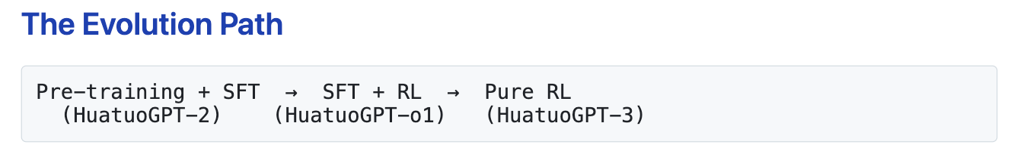
Our Solution - The HuatuoGPT Series
HuatuoGPT-2: One-stage Training for Knowledge Injection
Focus: Efficiency in "Learning what to say."
HuatuoGPT-o1: Reasoning via RLVR
Focus: Precision in "Thinking how to reason."
HuatuoGPT-3: Pure RL (OnePO)
Focus: Autonomy in "Evolving without teachers."
Moving from Data-intensive pipelines to Algorithm-autonomous systems.

Slide 13
Outline
Background (3 min)
Motivation (3 min)
Proposed Methods & Performance Evaluation (18 min)
HuatuoGPT-2 ( 6 min)
HuatuoGPT-o1 ( 6 min)
HuatuoGPT-3 ( 6 min)
Conclusions (1 min)
Q & A (5 min)

Slide 14
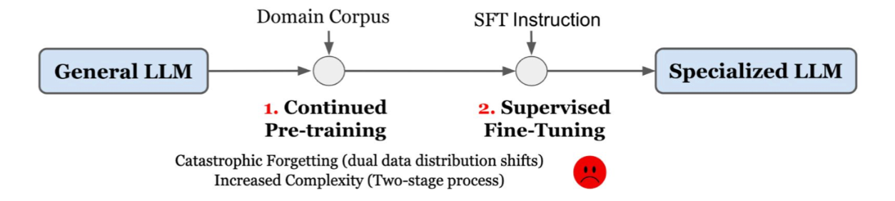
HuatuoGPT-2: One-stage Training for Medical Adaption
Motivation
Traditional domain knowledge injection typically involves a two-stage process:
(i) continued pre-training on noisy domain-specific corpora,
(ii) followed by supervised fine-tuning with instruction datasets.
This two-stage approach introduces two-stage catastrophic forgetting and pipeline complexity, limiting both effectiveness and efficiency.
[1] Junying Chen, Xidong Wang, et al. HuatuoGPT-II, One-stage Training for Medical Adaption of LLMs. COLM 2024.

Slide 15
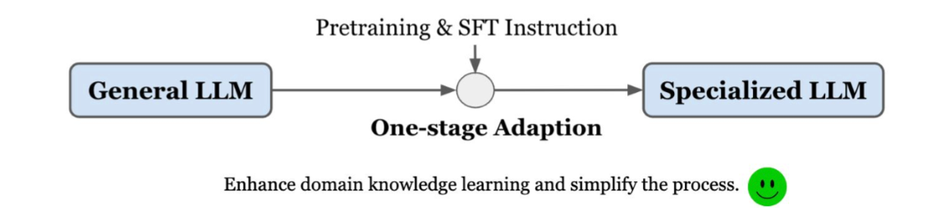
HuatuoGPT-2: One-stage Training for Medical Adaption
Motivation
To overcome this, we propose one-stage domain adaption.
Domain Pre-training + SFT → One-stage SFT

Slide 16
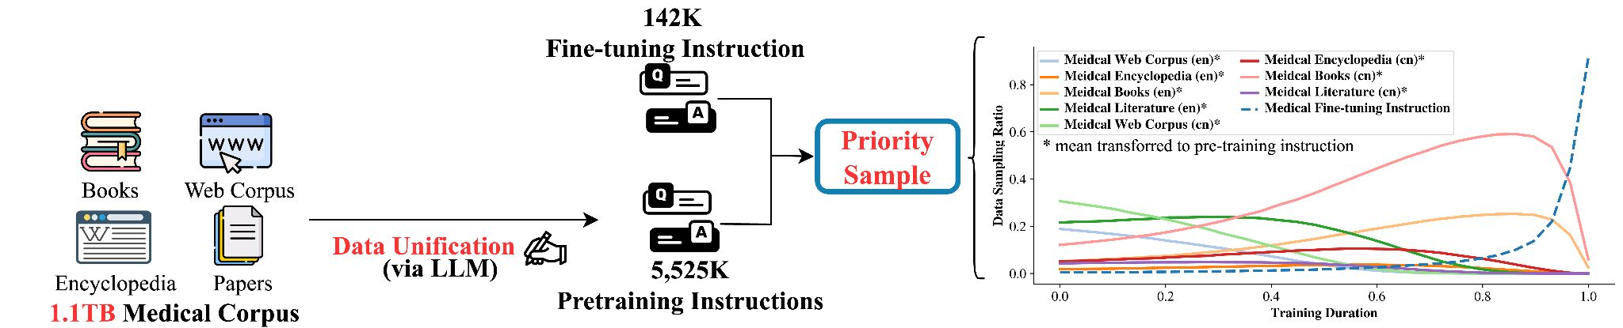
HuatuoGPT-2: One-stage Training for Medical Adaption
The adaption process can be executed in two succinct steps:
1) Data unification 2) One-stage training

Slide 17
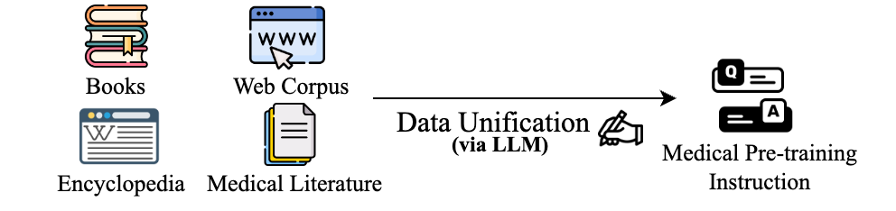
1. Data Unification
Chinese & English Medical Corpus
(1.1TB Corpus)
I. Data Unification We employed the prowess of LLMs to converting large-scale unsupervised medical corpora into a consistent supervised (instruction, output) pairs over 5 million medical documents:
1) Language unification, 2) Genre and formality unification, 3) supervised (instruction, output) pairs
Here, we utilize ChatGPT as LLM for data unification, where all diverse and pre-training data were converted to easy-to-understand instructions with a consistent style.

Slide 18
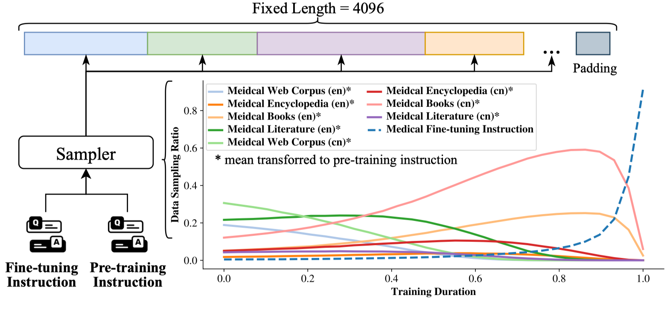
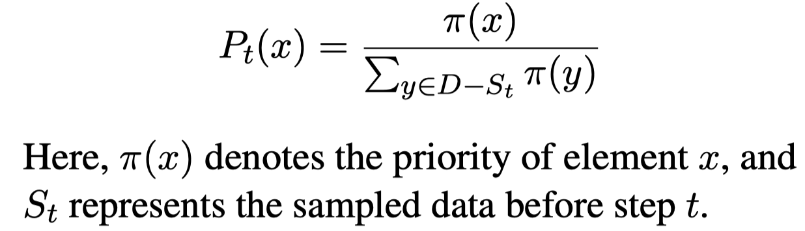
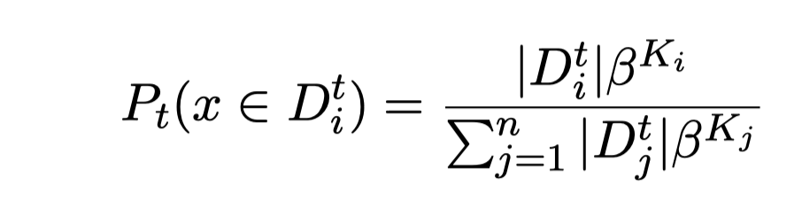
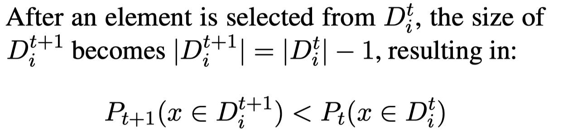
2. One-stage Adaption
The sampling probability:
Smooth shift Adjustment :
II. One-stage Adaption
We introduce a priority sampling strategy in this study, aimed at enhancing the One-stage Adaption for Medical Pre-training Instruction and Medical Fine-tuning Instruction, to enable the model to first learn domain capabilities and then gradually shift to instruction interaction learning.

Slide 19
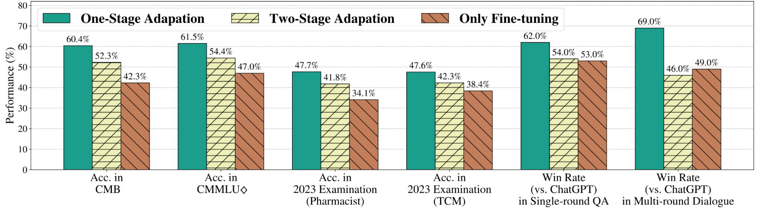
HuatuoGPT-2 Experiment
Experiments demonstrate that the "One-stage Adaption" approach is particularly effective, significantly outperforming traditional continued pre-training methods (Pre-training + SFT).

Slide 20
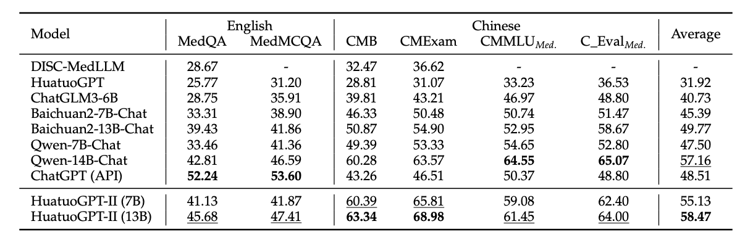
HuatuoGPT-2 Performance
Experiments demonstrate that the "One-stage Adaption" approach is particularly effective, significantly outperforming traditional continued pre-training methods (Pre-training + SFT).

Slide 21
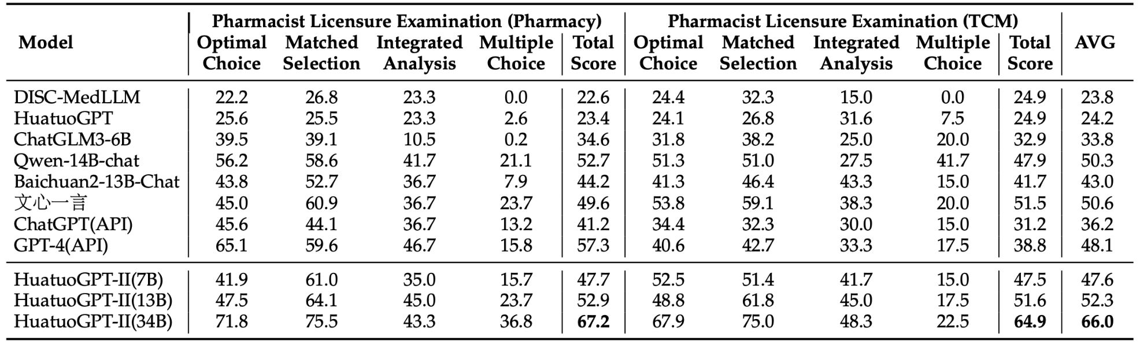
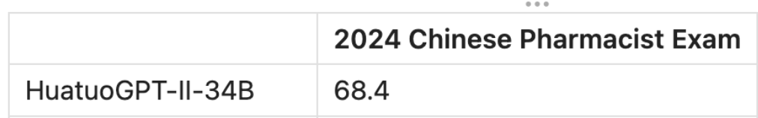
HuatuoGPT-2 Pass the National Pharmacist Examination
Notably, the 34B model is the first to pass the 2023 Chinese National Pharmacist Licensure Examination.
Even in the 2024 pharmacist exam one year later, the HuatuoGPT-2 can still pass the exam with a high score of 68.4.

Slide 22
Outline
Background (3 min)
Motivation (3 min)
Proposed Methods & Performance Evaluation (18 min)
HuatuoGPT-2 ( 6 min)
HuatuoGPT-o1 ( 6 min)
HuatuoGPT-3 ( 6 min)
Conclusions (1 min)
Q & A (5 min)

Slide 23
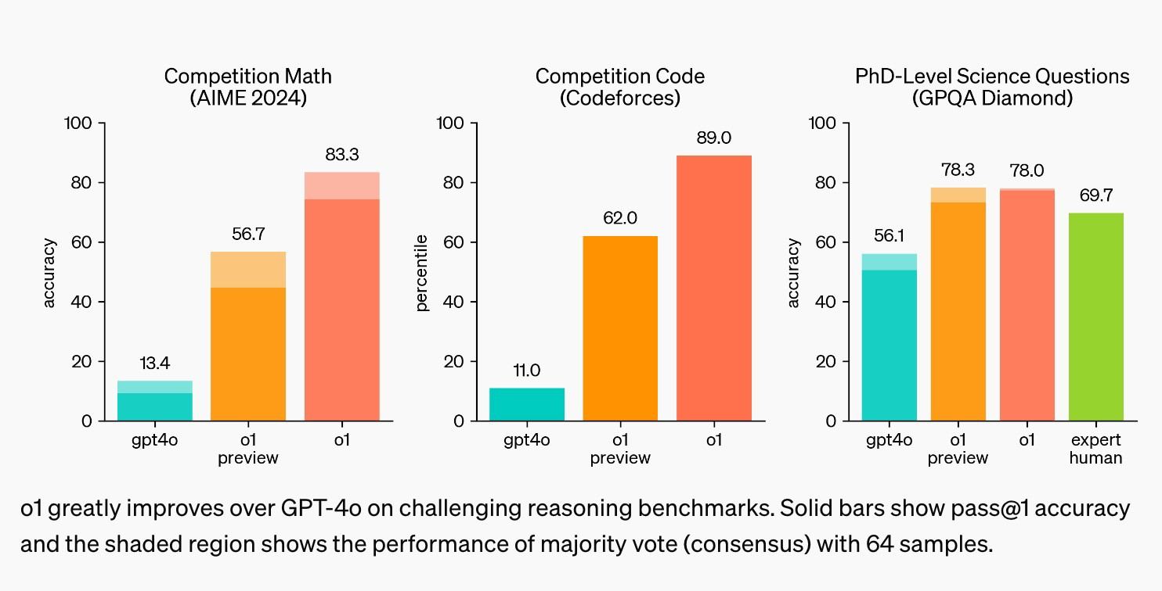
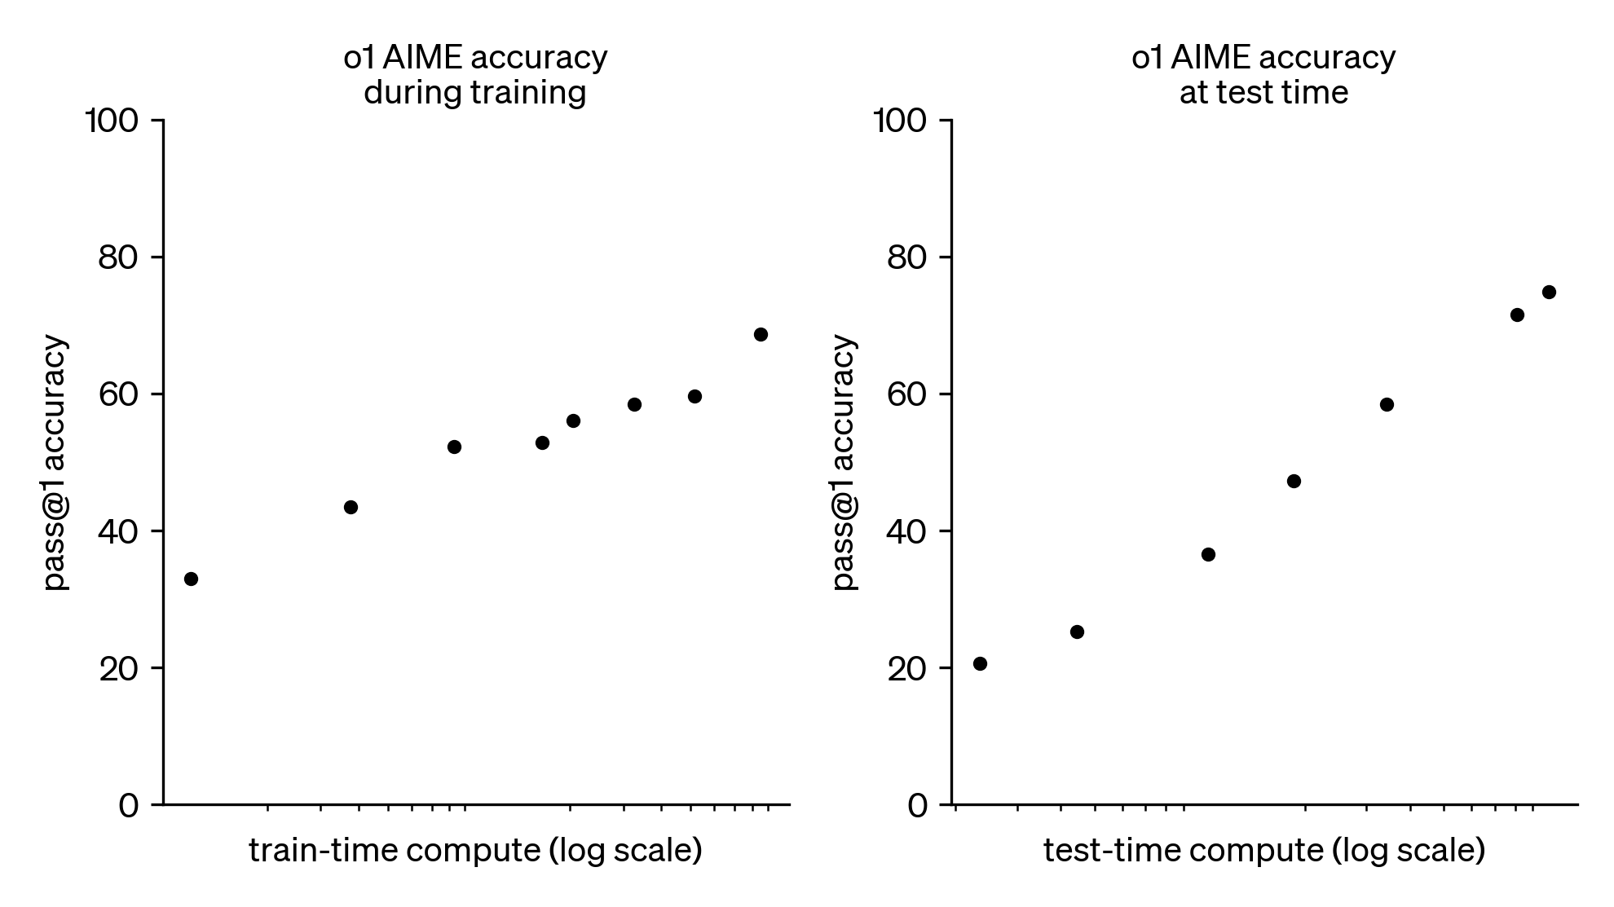
HuatuoGPT-o1: Towards Medical Complex Reasoning
Background 1
By September 2024, the release of OpenAI o1 has marked a significant milestone in LLM development, showcasing impressive capabilities.
Better performance in Math / Code / Science than gpt4o
For OpenAI o1, the traditional scaling pre-training approach has shifted to scaling reasoning, it includes scaling RL training and scaling test-time computation.

Slide 24
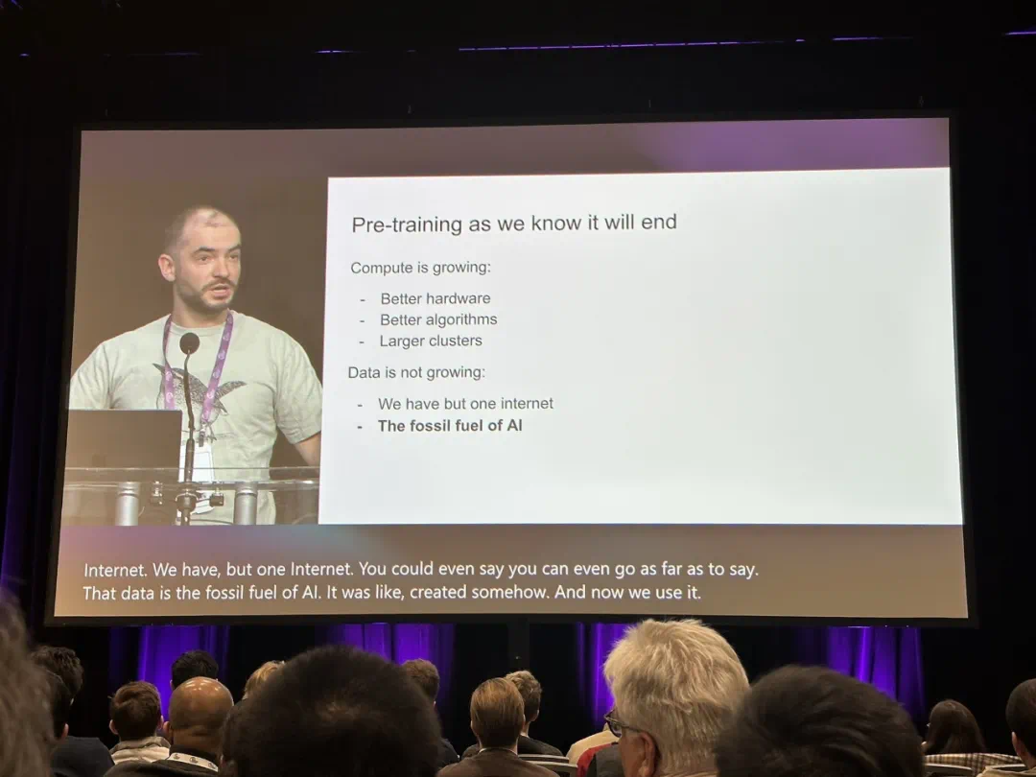
HuatuoGPT-o1: Towards Medical Complex Reasoning
Background 2
Domain adaptation through fine-tuning or pre-training may be reaching its limits due to:
Limited real-world medical data: The available medical data is finite, and current AI development is quickly approaching its maximum utilization.
General-purpose LLMs’ growing knowledge: With the continuous improvement of general-purpose LLMs and their training datasets, they may already encompass most of the medical knowledge available for domain adaptation.
“Ilya Sutskever (OpenAI's Chief Scientist) Predicts the End of Pre-Training”

Slide 25
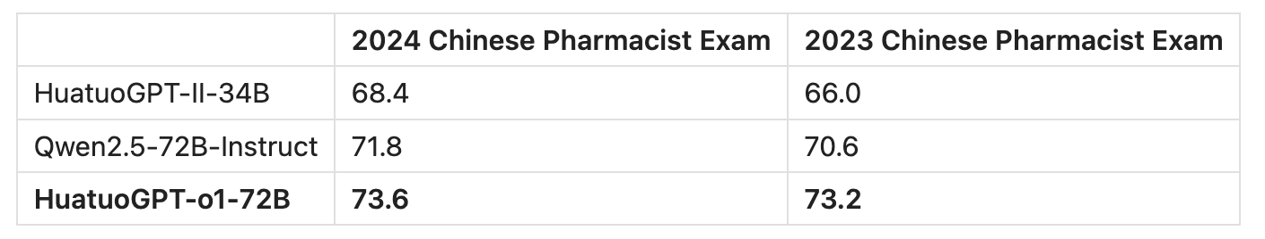
So, what’s Next for Medical LLMs?
A promising direction is to focus on scaling test-time reasoning and self-improvement, rather than simply injecting knowledge.
More efficient
Pre-training + SFT → SFT + RL
HuatuoGPT-o1 achieved significant domain-specific capability improvements with fewer resources, building upon existing advanced LLMs.

Slide 26
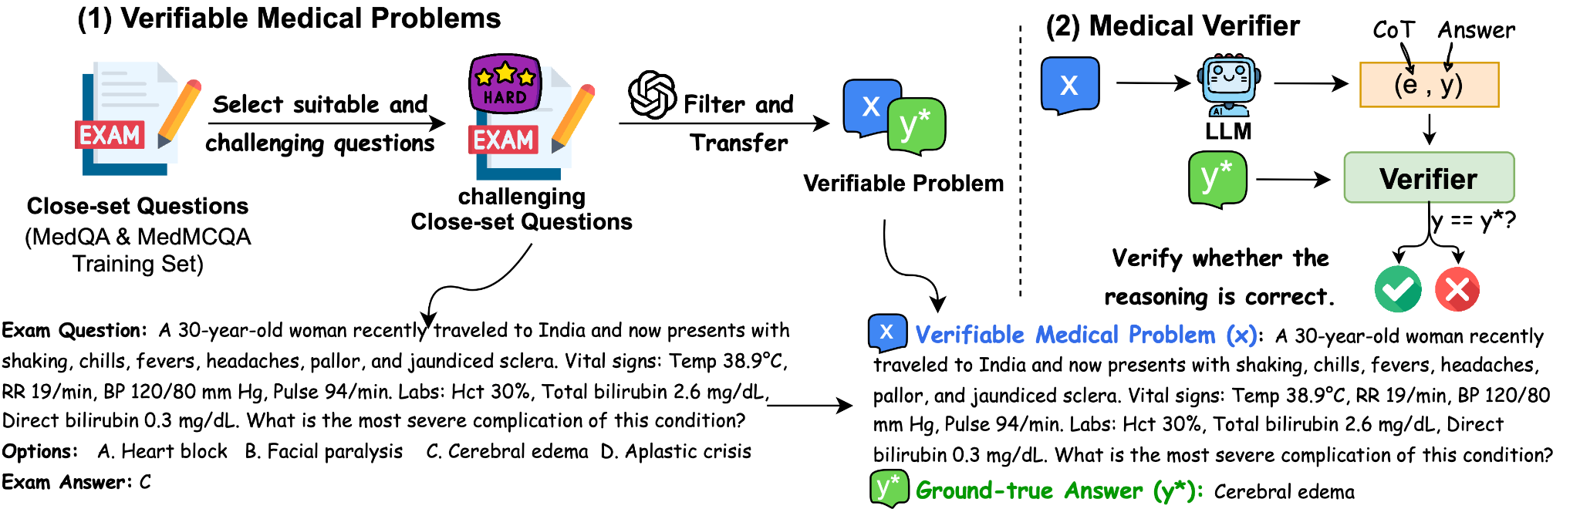
HuatuoGPT-o1: Towards Medical Complex Reasoning
Verifiable Medical Problems
The secret to enhancing reasoning is the verifiability of medical scenarios.
Inspired by mathematical problems that allow verification through their outcomes, we introduce a novel dataset of 40K medical verifiable problems, each designed to support automatic verification of reasoning via a ground-truth answer and an LLM-based verifier.
[1] Junying Chen, Zhenyang Cai, et al. HuatuoGPT-o1, Towards Medical Complex Reasoning with LLMs. ACL 2025.

Slide 27
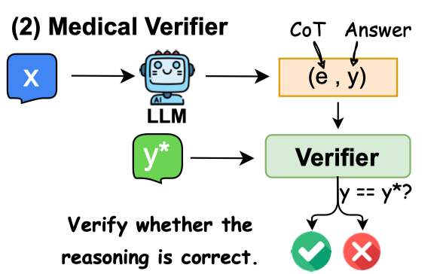

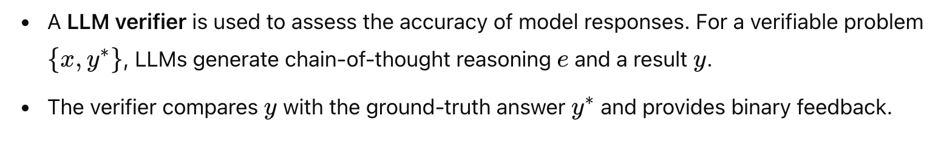
HuatuoGPT-o1: Towards Medical Complex Reasoning
Medical Verifier

Slide 28
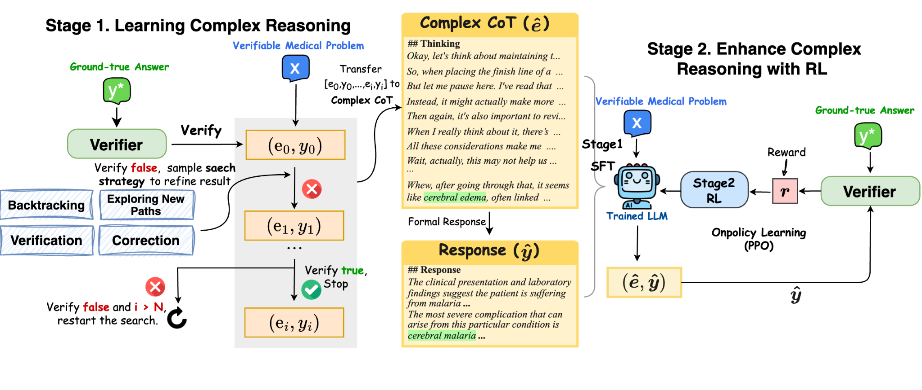
HuatuoGPT-o1: Towards Medical Complex Reasoning
Methodology
The verifiable nature enables advancements in medical reasoning through a two-stage approach:
Stage 1- Learning Complex Reasoning: using the verifier to guide the search for a complex reasoning trajectory for fine-tuning LLMs with reasoning behaviour.
Stage 2: Reinforcing Reasoning with RL: applying reinforcement learning (RL) with verifier-based rewards to enhance medical complex reasoning further.

Slide 29
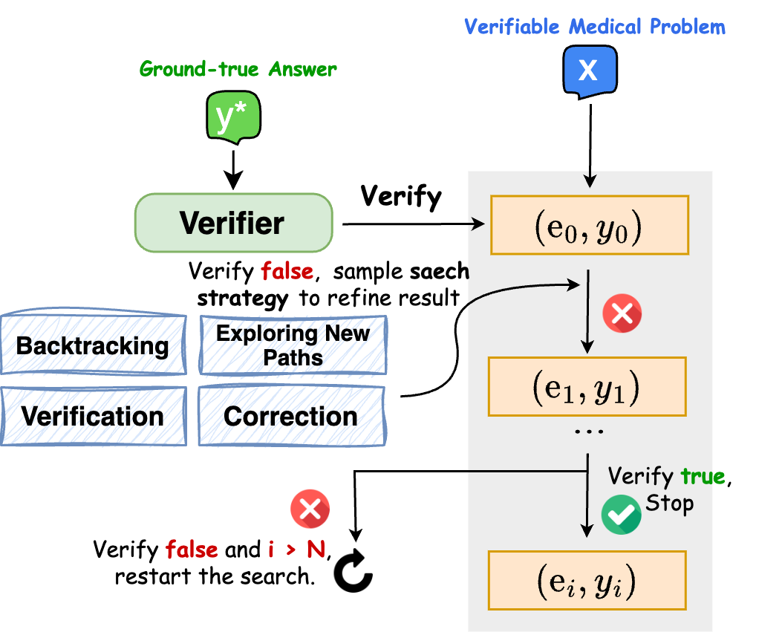
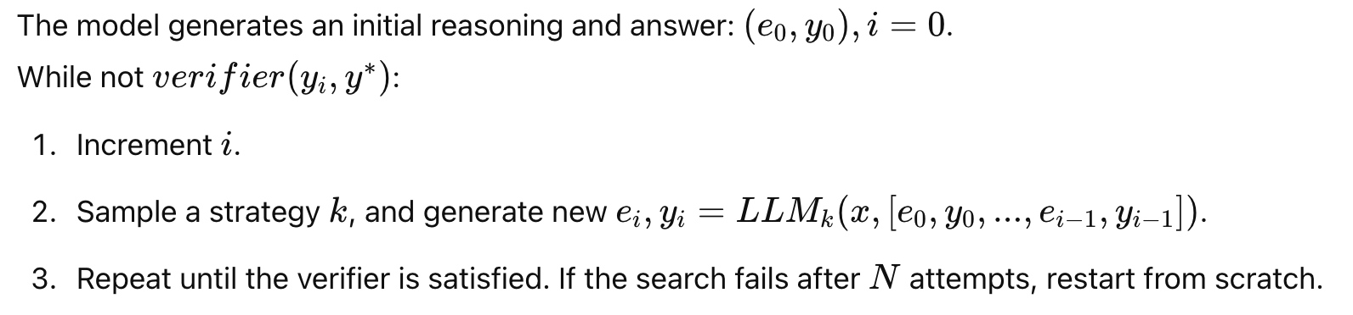
Searching for Correct Trajectories

Slide 30
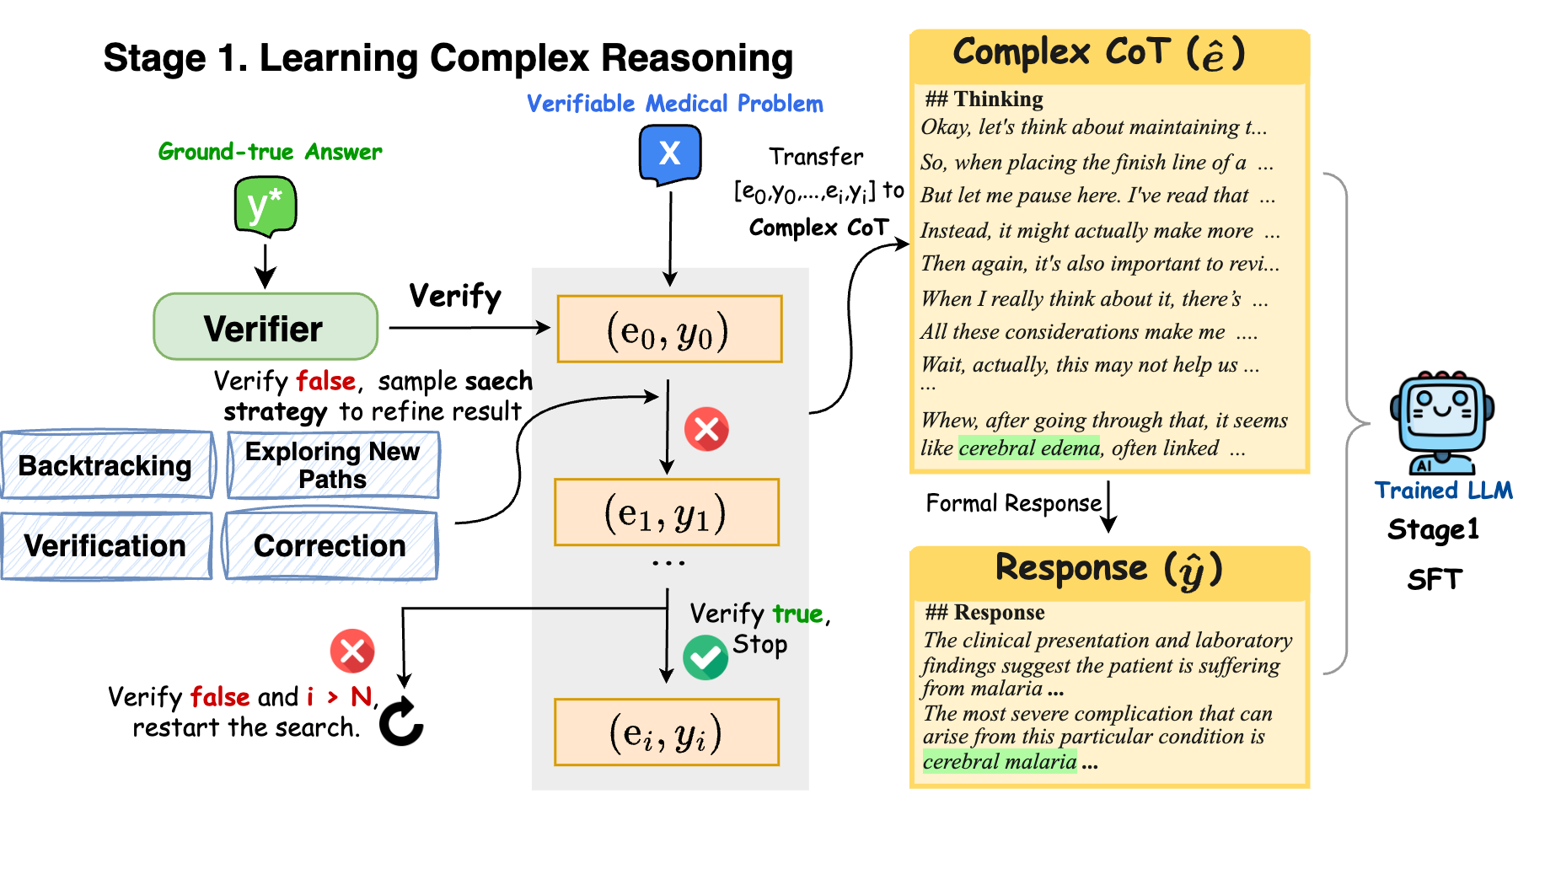
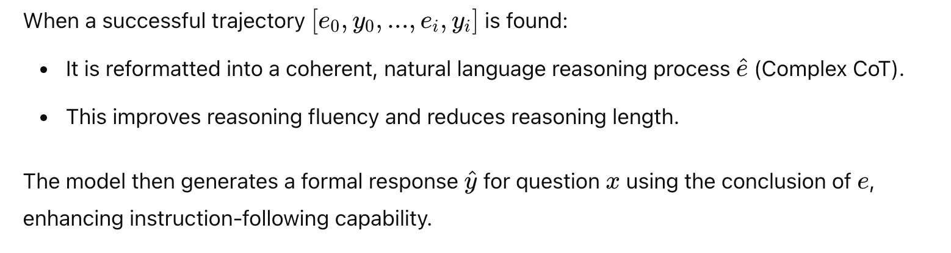
Stage 1. Supervised Fine-tuning

Slide 31
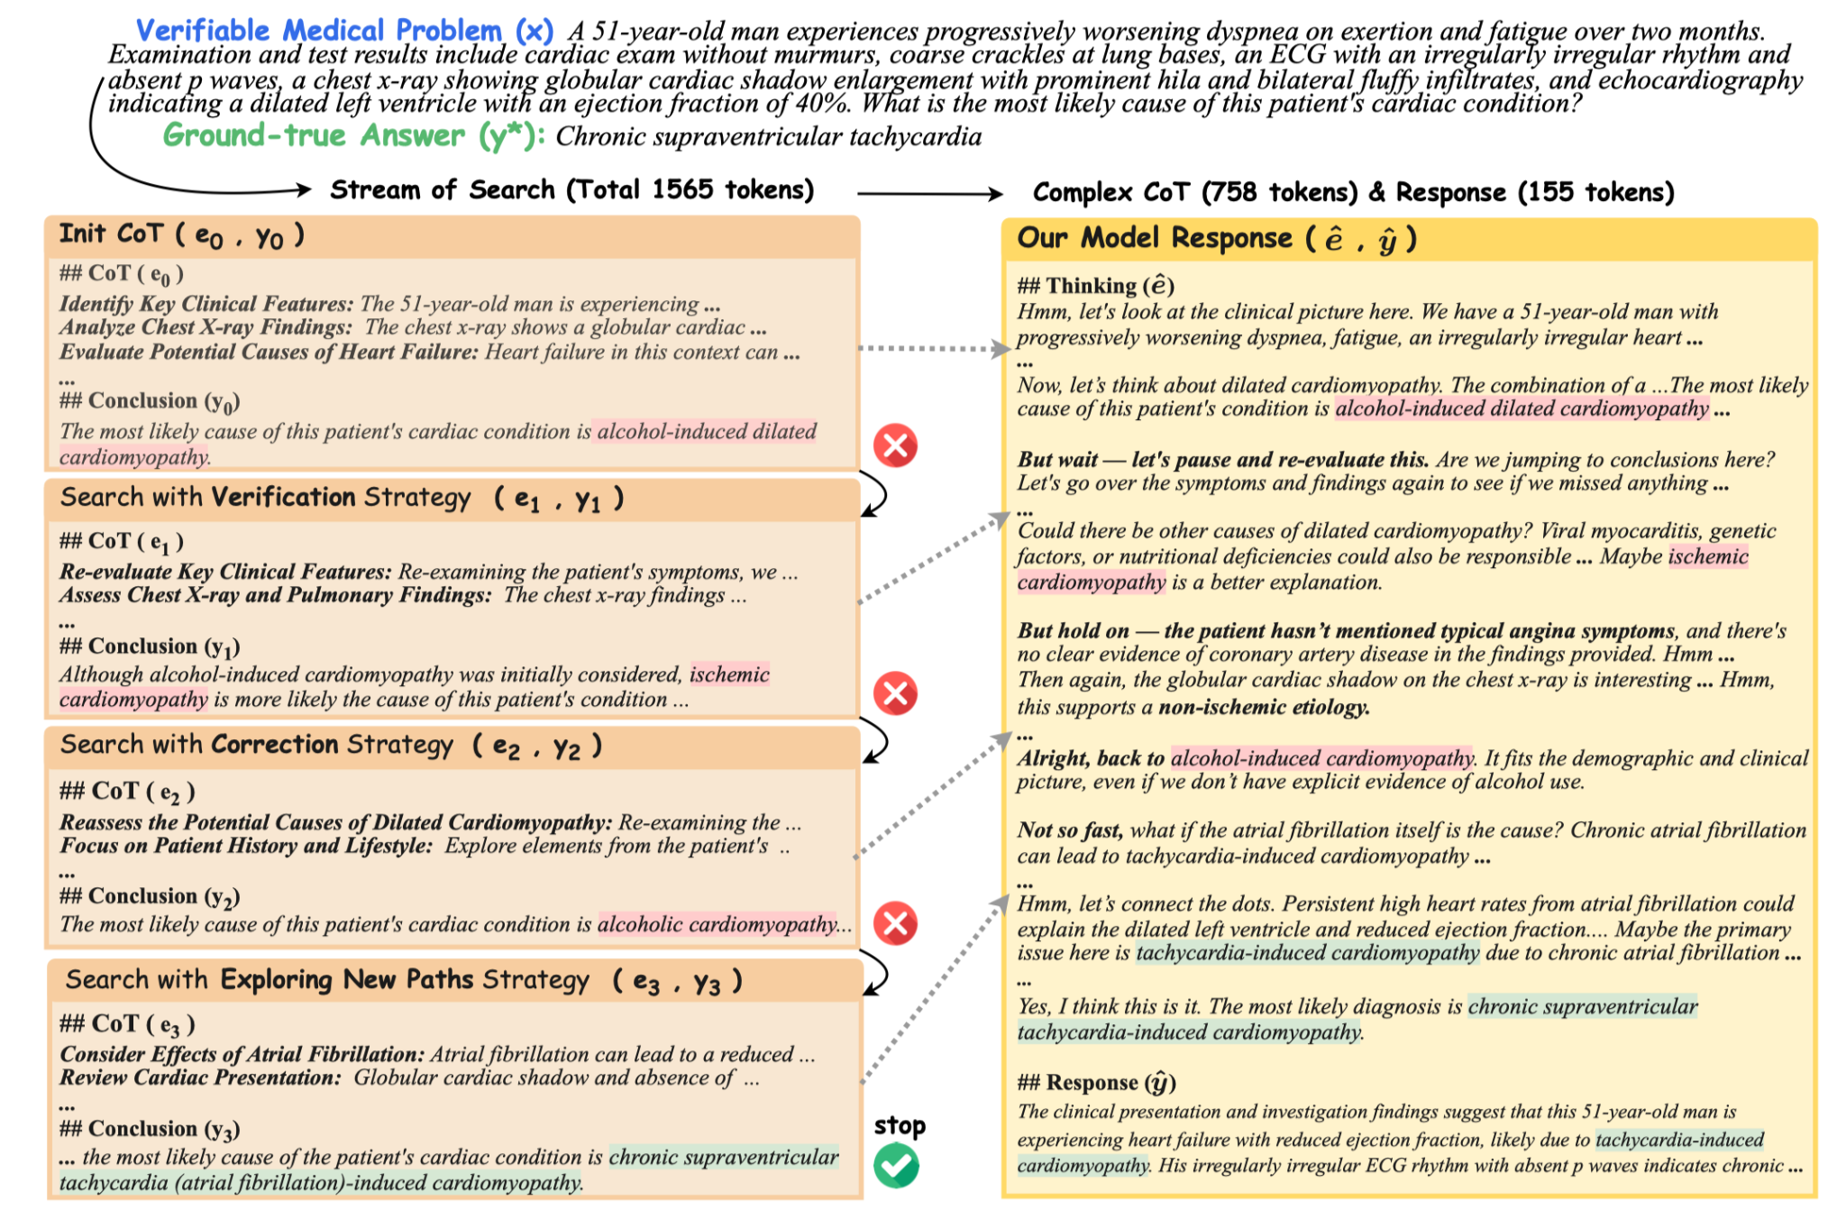
Stage 1. Supervised Fine-tuning
The complex CoTs and responses are used to train the model to adopt thinks-before-it-answers behavior akin to o1.

Slide 32
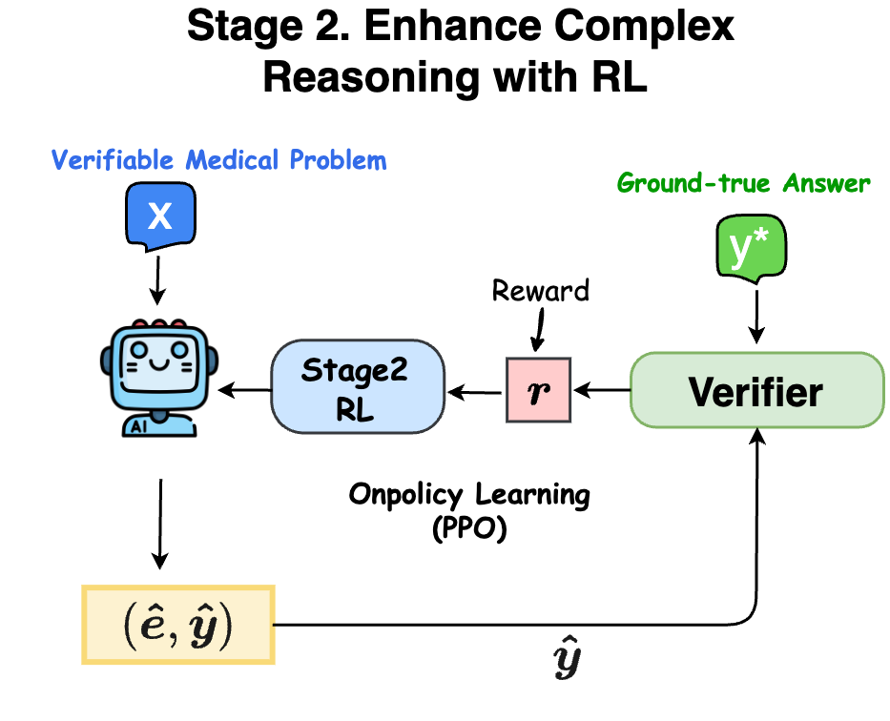
Stage 2. Enhance Complex Reasoning with RL
While the LLM learned successful reasoning trajectories in stage 1, these paths, derived via search, may not be optimal. On-policy learning in stage 2 aims to refine the model for better complex CoT reasoning.

Slide 33
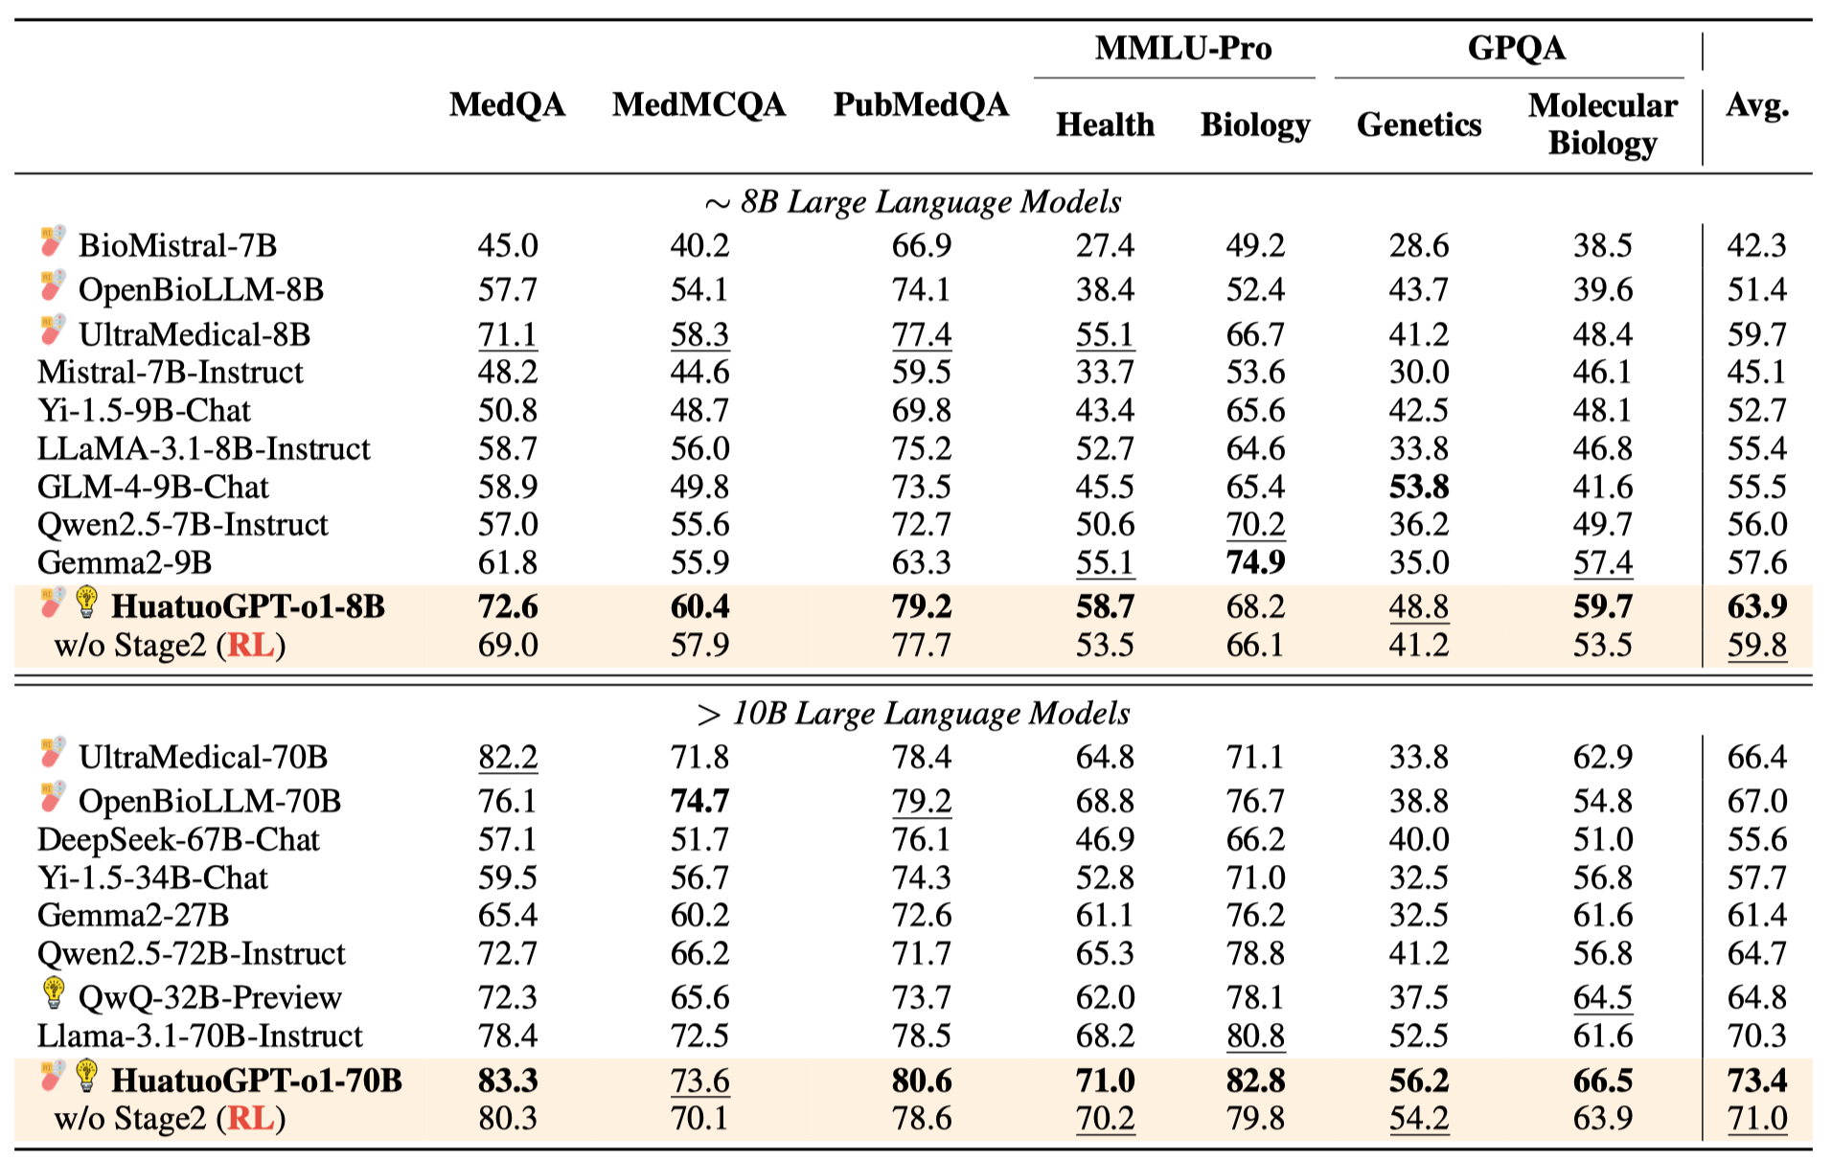
HuatuoGPT-o1 Experiment
Using only 40K Medical Verifiable Problems:
HuatuoGPT-o1-8B achieved an 8-point overall improvement on medical benchmarks using only 40K verifiable medical questions, with significant performance boosts on challenging evaluations like GPQA and MMLU-Pro.
HuatuoGPT-o1-70B set new performance benchmarks, surpassing existing open-source general and medical-specific LLMs across multiple medical tasks.

Slide 34
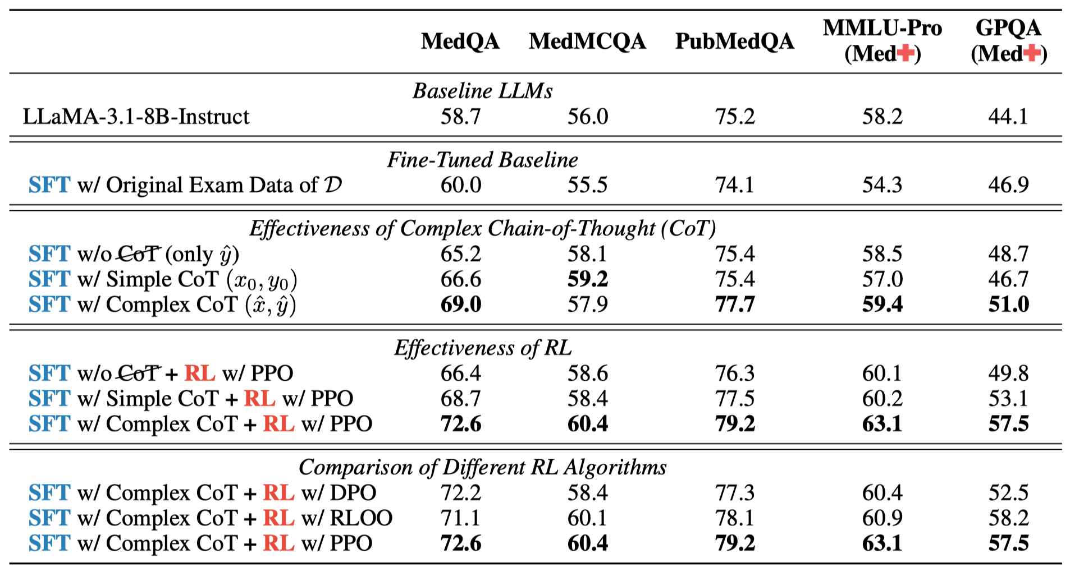
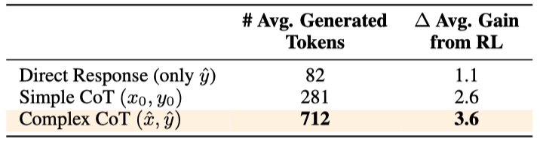
HuatuoGPT-o1 Experiment
The ablation results confirm that enhancing complex reasoning not only boosts medical performance but also significantly amplifies the benefits of RL training, offering a scalable and verifiable path toward safer, more capable medical LLMs.

Slide 35
Outline
Background (3 min)
Motivation (3 min)
Proposed Methods & Performance Evaluation (18 min)
HuatuoGPT-2 ( 6 min)
HuatuoGPT-o1 ( 6 min)
HuatuoGPT-3 ( 6 min)
Conclusions (1 min)
Q & A (5 min)

Slide 36
HuatuoGPT-3: Direct One-stage Policy Optimization
We've shown:
HuatuoGPT-II: One-stage can replace two-stage pre-training+SFT
HuatuoGPT-o1: SFT+RL achieves excellent medical reasoning
Next Question:
|
Can we skip SFT entirely and use Pure RL for domain adaptation?
SFT +RL → RL
[1] Junying Chen, Xinyuan Xie, et al. HuatuoGPT-3: One-stage Policy Optimization for SFT-free Domain Adaptation. Submitted to ICML 2026.

Slide 37
HuatuoGPT-3: Direct One-stage Policy Optimization
Does RL truly require a pre-SFT or a cold-start phase?
We argue that pre-SFT is inherently problematic:
(1) it indiscriminately reinforces knowledge and behaviors from references regardless of whether the LLM has already acquired them.
(2) Increased complexity and stringent data requirements.

Slide 38
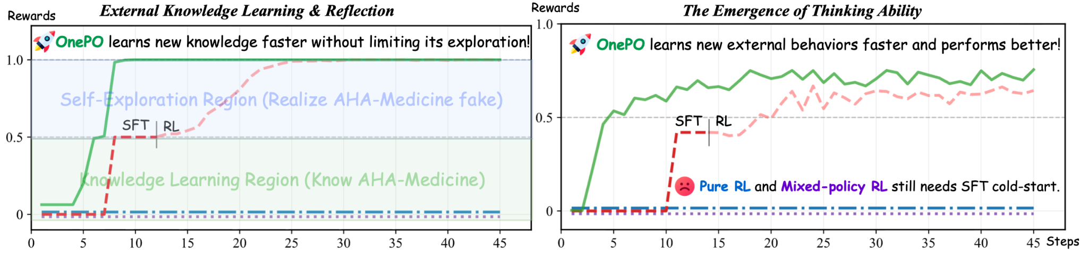
Pilot Study
Study 1 AHA-Medicine Learning: We test whether training can learn false medical knowledge (AHA-Medicine) and whether RL can recognize it as false.
Study 2 Thinking Behavior Learning: We test whether training can learn the “think-before-answer” behavior (⟨think⟩ … ⟨/think⟩) from off-policy trajectories and enable self-improvement.

Slide 39
Pilot Study
Study Findings:
1. RL can’t learn external knowledge. 2. SFT limits search efficiency. 3. Existing mixed-policy hardly ever learns external knowledge. 4. Our method enable LLMs to selectively learn off-policy knowledge during RL evolution with superior efficiency.

Slide 40
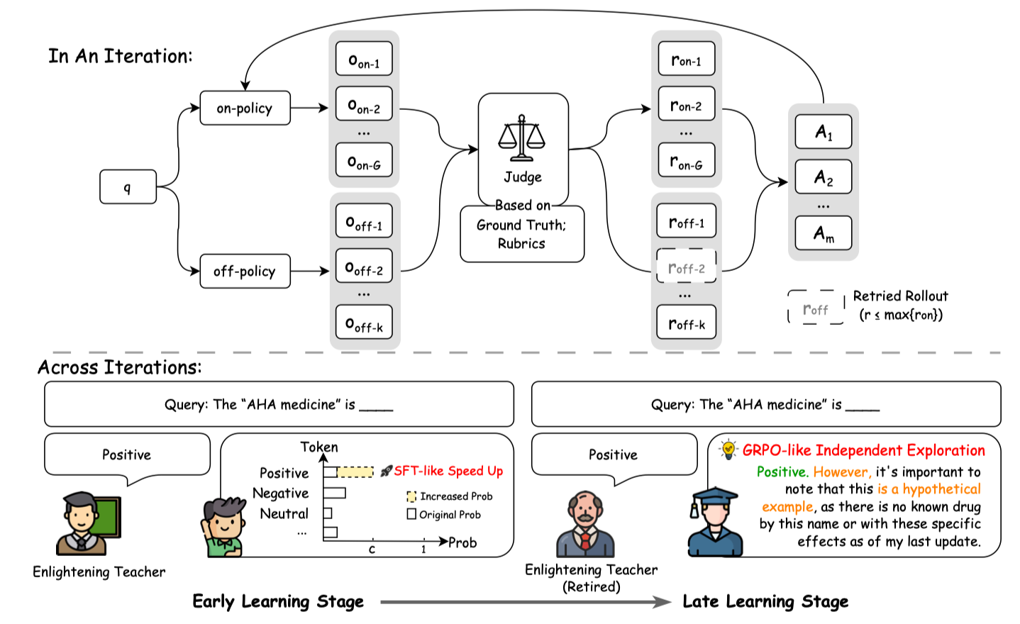
HuatuoGPT-3: Direct One-stage Policy Optimization
To address this, we propose One-stage Policy Optimization (OnePO), which allows LLMs to autonomously learn off-policy knowledge and behaviors during the self-evolution of RL, thus eliminating the need for SFT.

Slide 41
HuatuoGPT-3: Direct One-stage Policy Optimization
SFT-free paradigm with two key mechanisms:
1. Adaptive Objective Evolution
2. Teacher Retirement

Slide 42
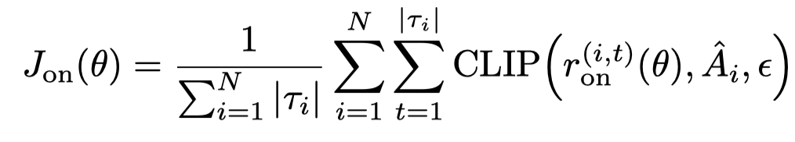
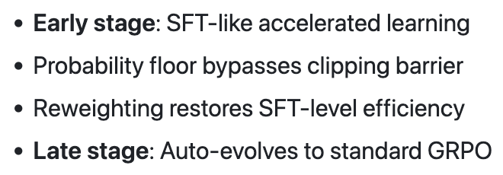
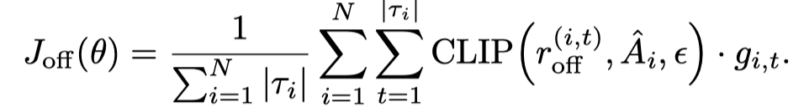
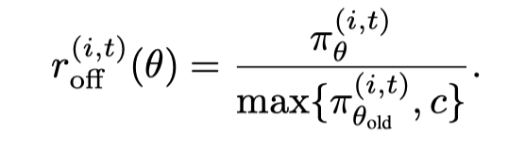
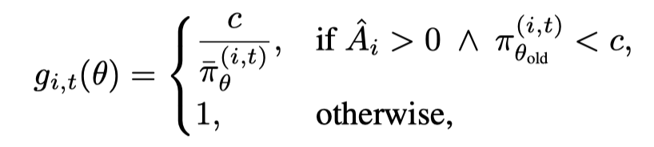
1. Adaptive Objective Evolution
When rolling out, introduce external off-policy trajectories.
For on-policy trajectories, maintain the loss of GRPO:
For off-policy trajectories:
Efficient external knowledge and behavioral learning, and constraints on overfitting.

Slide 43

2. Teacher Retirement
We retire any teacher trajectory scoring below the on-policy best:
Kept off-policy trajectories will replace random onpolicy trajectories, maintaining group size G for GRPO optimization
Discard teacher trajectories when outperformed
Prevents anchoring to off-policy distribution
Maintains exploration capability

Slide 44
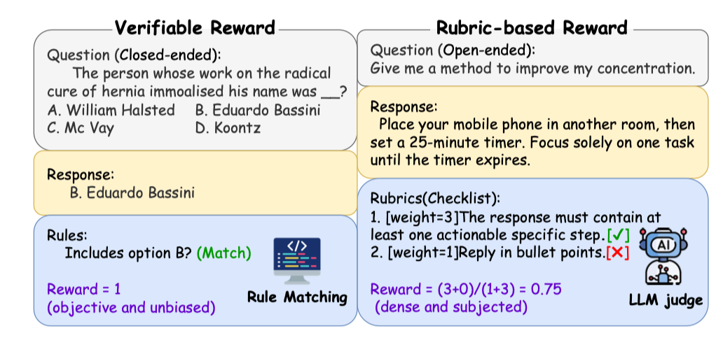
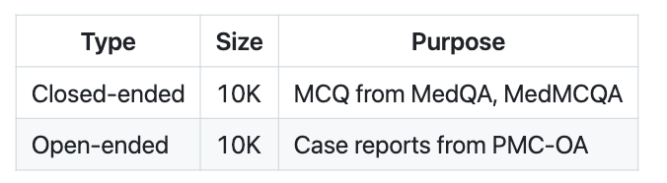
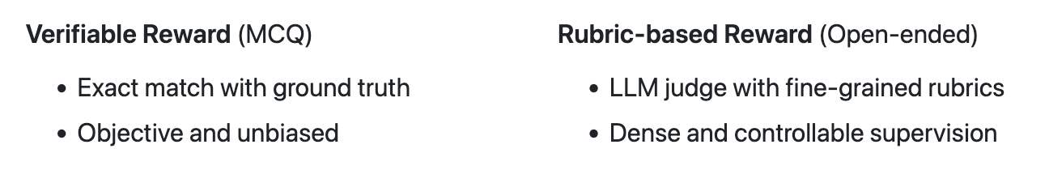
Dataset: OneData-Health-20K
Balanced Training Data
Reward Mechanism
HuatuoGPT-3 requires only 20K of data.

Slide 45
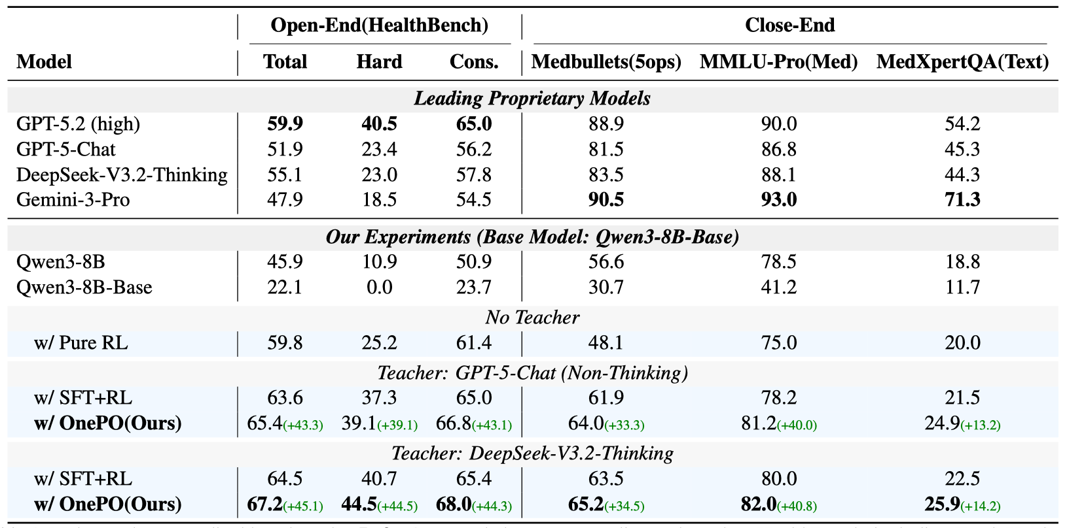
HuatuoGPT-3 Experiment
Three key findings emerge: (1) OnePO surpasses SFT+RL on all the benchmarks. (2) Teacher guidance is essential. pure RL without guidance achieves worst. (3) Thinking behavior benefits exploration.

Slide 46
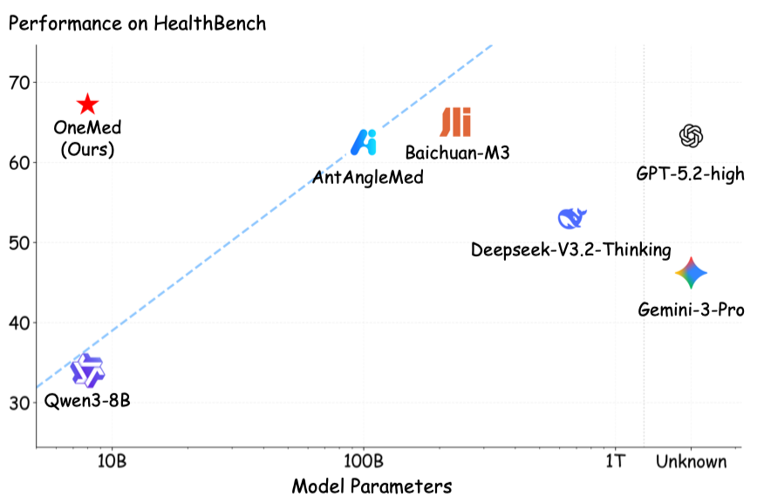
HuatuoGPT-3 Experiment
HuatuoGPT-8B (67.2%) achieves a new state-of-the-art performance, surpassing Gemini-3-Pro and GPT-5.2 based solely on the parameters of the 8B.

Slide 47
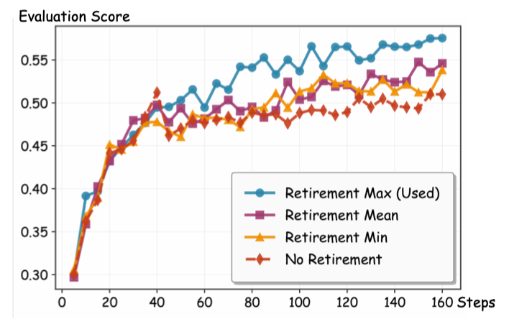
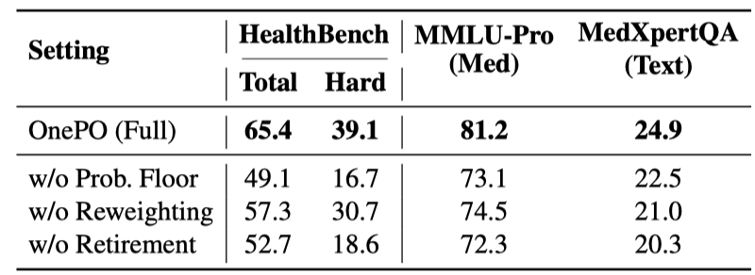
HuatuoGPT-3 Experiment
Comparison of different retirement strategies
Ablation Study
w/o Prob. Floor drops significantly, confirming the importance of Adaptive Objective Evolution. The right picture reveals the anchoring problem, looser thresholds all plateau at lower scores because persistent teacher trajectories pull the model toward the teacher distribution.

Slide 48
Conclusions
The Evolution Paradigm (The Path to Autonomy)
HuatuoGPT-2: Knowledge Injection (The Library Model)
System Focus: Large-scale Data Pipelines.
Problem: Models are just "reading books" (Pre-training + SFT) but lack clinical intuition.
HuatuoGPT-o1: Reasoning Enhancement (The Student Model)
System Focus: Feedback-driven Optimization.
Inspiration: The "OpenAI o1" moment—using Reinforcement Learning to "think" before answering.
HuatuoGPT-3: Self-Evolution (The Researcher Model)
System Focus: Simplifying the Pipeline (OnePO).
Goal: A system that learns autonomously from the environment, bypassing the need for expensive SFT data.
The evolution of training systems for medical LLMs is towards greater autonomy and less reliance on data.

Slide 49
Outline
Background (3 min)
Motivation (3 min)
Proposed Methods & Performance Evaluation (18 min)
HuatuoGPT-2 ( 6 min)
HuatuoGPT-o1 ( 6 min)
HuatuoGPT-3 ( 6 min)
Conclusions (1 min)
Q & A (5 min)

