Slide 1
Efficient Scheduling in Distributed OS
Zhao Jia
School of Data Science
Chinese University of Hong Kong, Shenzhen
Notes:
"Good morning everyone. I'm Zhao Jia from CUHK-Shenzhen. Today I'll present our work on Efficient Scheduling in Distributed Operating Systems, specifically targeting the challenges in geo-distributed data centers. This is joint work with my advisor and colleagues."

Slide 2
Outline
Introduction
Related Work
Preliminaries
Proposed Methods
Performance Evaluation
Conclusions

Slide 3
Efficient Scheduling in Distributed OS
Introduction
Related Work
Preliminaries
Proposed Methods
Performance Evaluation
Conclusions

Slide 4
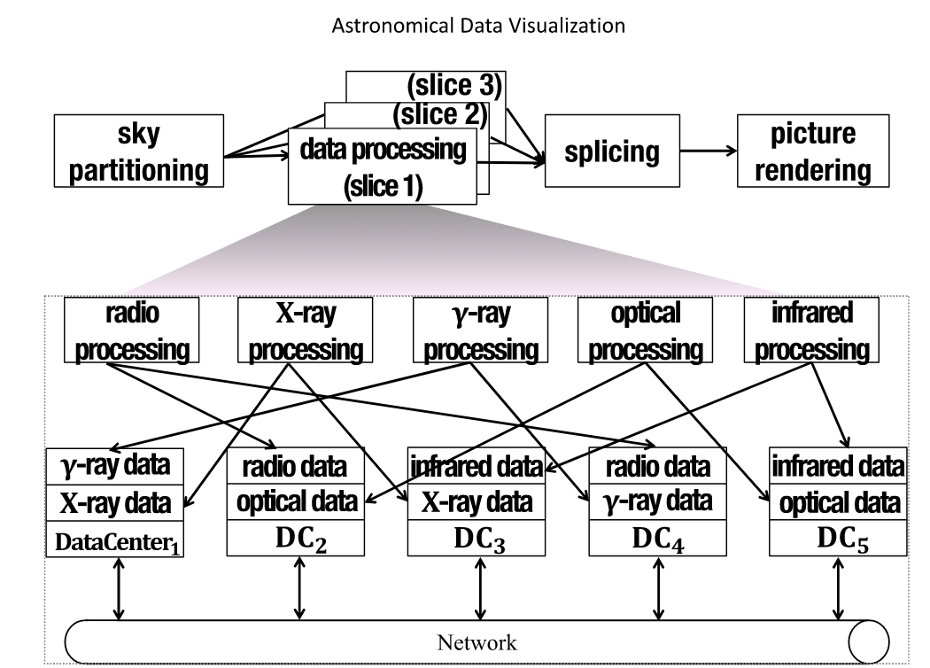
Introduction - Motivation: Data-Intensive Applications
China Virtual Observatory (China-VO)
Telescopes receive and generate Terabytes of data across remote locations
Processing requires extract information from wavebands (X-ray, Gamma-ray)
Aggregating to a single DC causes massive congestion and latency
Fig1. Structure of China-VO

Slide 5
Introduction - Geo-Distributed Computing
Distributed
Evolution ： Cloud computing now spans globally distributed datacenters (DCs).
The Need : Processing large-scale applications (AI, Big Data) close to the source.
Benefits:
Low latency for end-users.
Leveraging regional resource pricing.

Slide 6
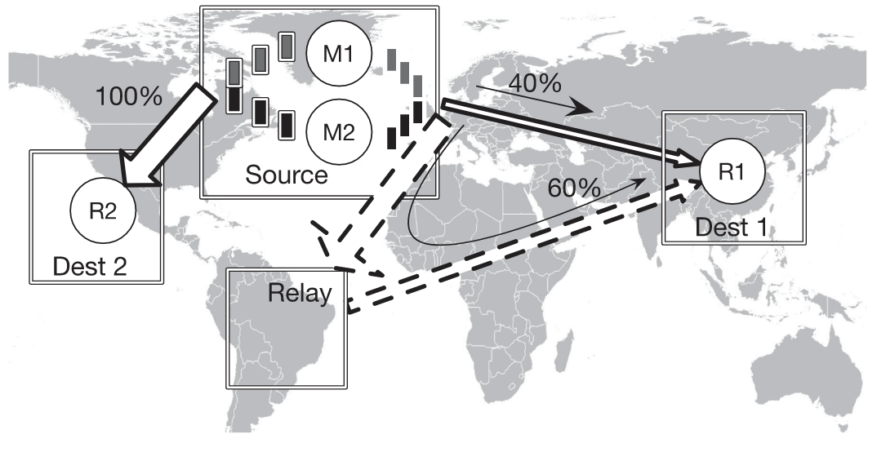
Introduction - Problem Statement
The Distributed OS Views
Complex Structures: Jobs are no longer independent tasks; they are Graph Jobs.
More to consider: real time power cost + network cost
Fig2. Illustration of aggregated flow and its multi-path routing.

Slide 7
Efficient Scheduling in Distributed OS
Introduction
Related Work
Preliminaries
Proposed Methods
Performance Evaluation
Conclusions

Slide 8
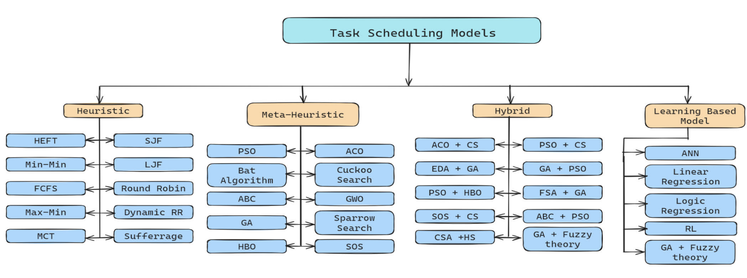
Related Works – Algorithms(1/2)
Scheduling is a critical process involving the determination of which tasks to perform within specific intervals of time, aiming to optimize the flow of data across one or more objects
Cloud task scheduling scheme has been divided into four groups: heuristics scheduling, meta-heuristics scheduling, hybrid scheduling and learning based scheduling
Heuristic ：These are intuitive, rule-based scheduling strategies that rely on greedy principles or simple priority rules to generate feasible solutions quickly.
Meta-Heuristic ： These are general-purpose optimization frameworks inspired by natural phenomena or biological behaviors. They explore the solution space efficiently to find near-optimal results.
Hybrid ：These combine two or more distinct algorithms to leverage their complementary strengths and improve overall scheduling performance.
Learning Based Model： These use machine learning or data-driven techniques to learn scheduling patterns from historical data, enabling adaptive and intelligent decision-making.
Fig3. Four categories or current Task Scheduling Models

Slide 9
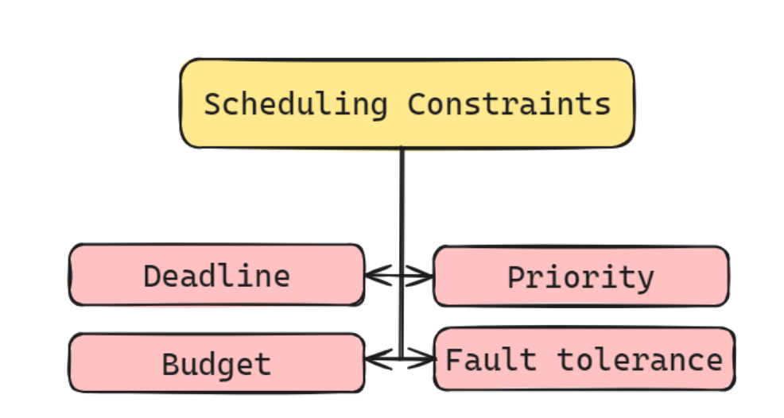
Related Works - Gap
Core Research Gaps Addressed
Most existing works lack emphasis on cloud dynamicity (resource availability & task arrival variability)
Few approaches tackle multi-objective optimization (simultaneous minimization of makespan and power/cost)
Conflicts between execution time and resource cost remain unresolved in many single-objective methods
The Gap:
A lack of joint optimization for“Computation + Power + Network”
Fig3. Scheduling Constraints

Slide 10
Related Works
[1] A. Belgacem, K. Beghdad-Bey and H. Nacer, "Dynamic Resource Allocation Method Based on Symbiotic Organism Search Algorithm in Cloud Computing," in IEEE Transactions on Cloud Computing, vol. 10, no. 3, pp. 1714-1725, 1 July-Sept. 2022
[2] S. Hosseinalipour, A. Nayak and H. Dai, "Power-Aware Allocation of Graph Jobs in Geo-Distributed Cloud Networks," in IEEE Transactions on Parallel and Distributed Systems, vol. 31, no. 4, pp. 749-765, 1 April 2020
[3] L. Zhao, Y. Yang, A. Munir, A. X. Liu, Y. Li and W. Qu, "Optimizing Geo-Distributed Data Analytics with Coordinated Task Scheduling and Routing," in IEEE Transactions on Parallel and Distributed Systems, vol. 31, no. 2, pp. 279-293, 1 Feb. 2020

Slide 11
Efficient Scheduling in Distributed OS
Introduction
Related Work
Preliminaries
Proposed Methods
Performance Evaluation
Conclusions

Slide 12
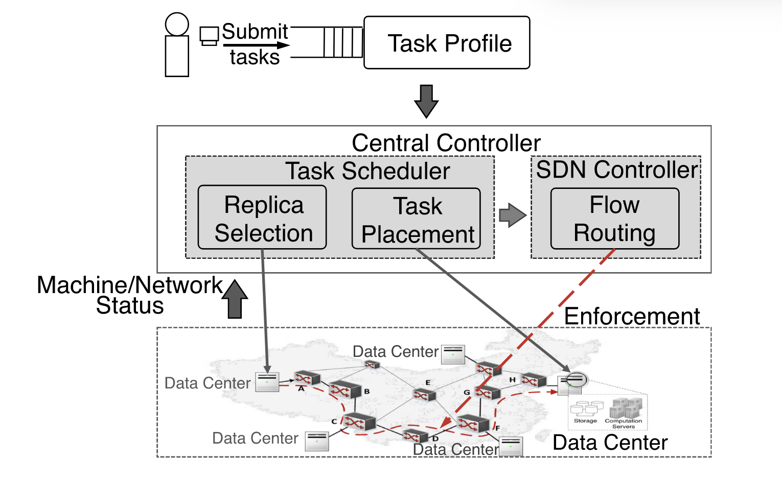
Preliminaries - System Architecture
Central Controller: Task Scheduler + SDN Controller.
Resource Monitors: Located at each DC to report "heartbeat" status (CPU, RAM).
SDN Layer: Dynamically reserves bandwidth for non-interactive flows.
Fig4. Architecture overview

Slide 13
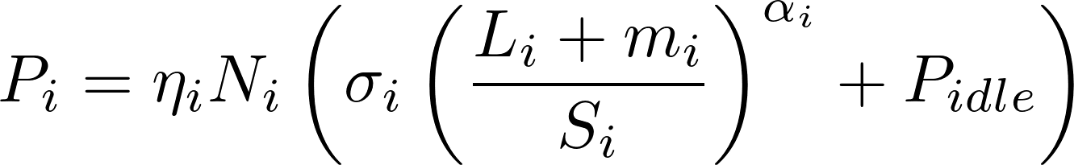
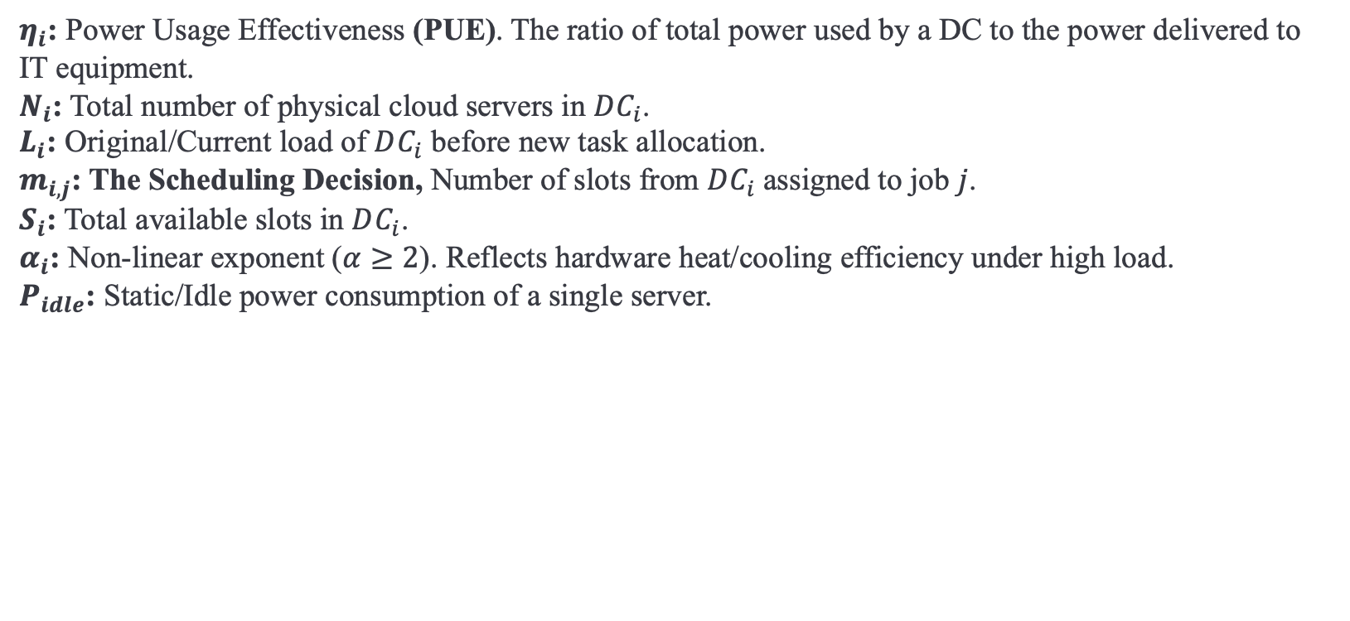
Preliminaries - Power Models
DC Power Model：
$η_{i}$: Power Usage Effectiveness (PUE). The ratio of total power used by a DC to the power delivered to IT equipment.
$N_{i}$: Total number of physical cloud servers in $DC_{i}$.
$L_{i}$: Original/Current load of $DC_{i}$ before new task allocation.
$m_{i,j}$: The Scheduling Decision, Number of slots from $DC_{i}$assigned to job $j$.
$S_{i}$: Total available slots in $DC_{i}$.
$α_{i}$: Non-linear exponent ($α≥2$). Reflects hardware heat/cooling efficiency under high load.
$P_{idle}$: Static/Idle power consumption of a single server.

Slide 14
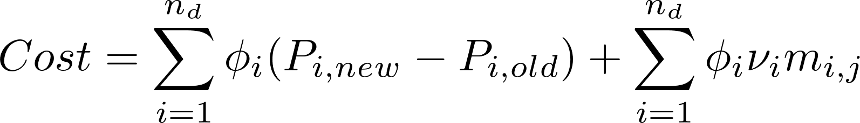

Preliminaries - Cost Models
Total Execution Cost：
$φ_{i}$:Electricity Price in the region where $DC_{i}$ is located (e.g., $/kWh).
$ν_{i}$: I/O incurred power usage per slot for communication infrastructure.

Slide 15
Efficient Scheduling in Distributed OS
Introduction
Related Work
Preliminaries
Proposed Methods
Performance Evaluation
Conclusions

Slide 16
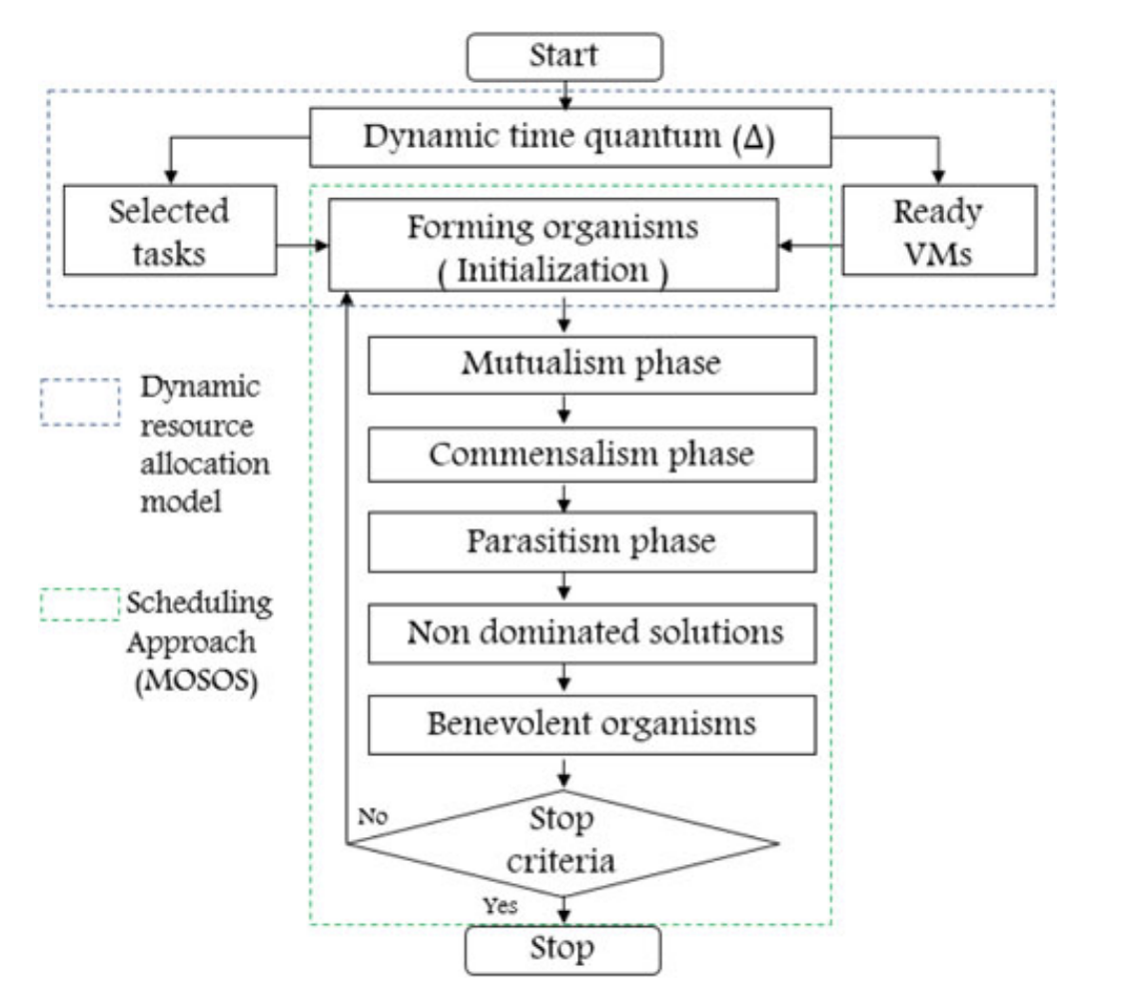
Proposed Methods – Part I Local Optimal
Problem: Before considering global power or WAN routing, a Distributed OS must first solve the Local Resource Allocation First.
Solution: A two-part framework consisting of a Dynamic Allocation Model and the MOSOS Algorithm.
Fig5. Flowchart of the proposed MOSOS

Slide 17
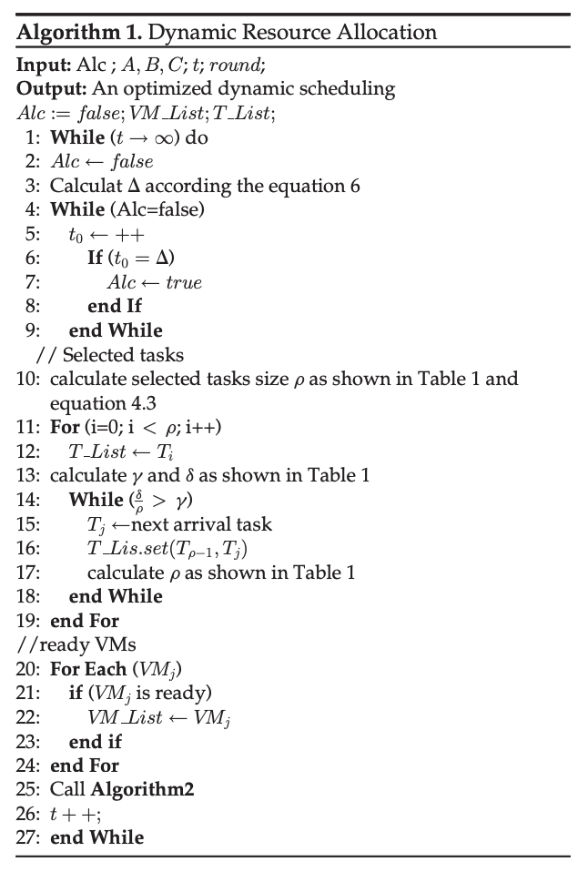
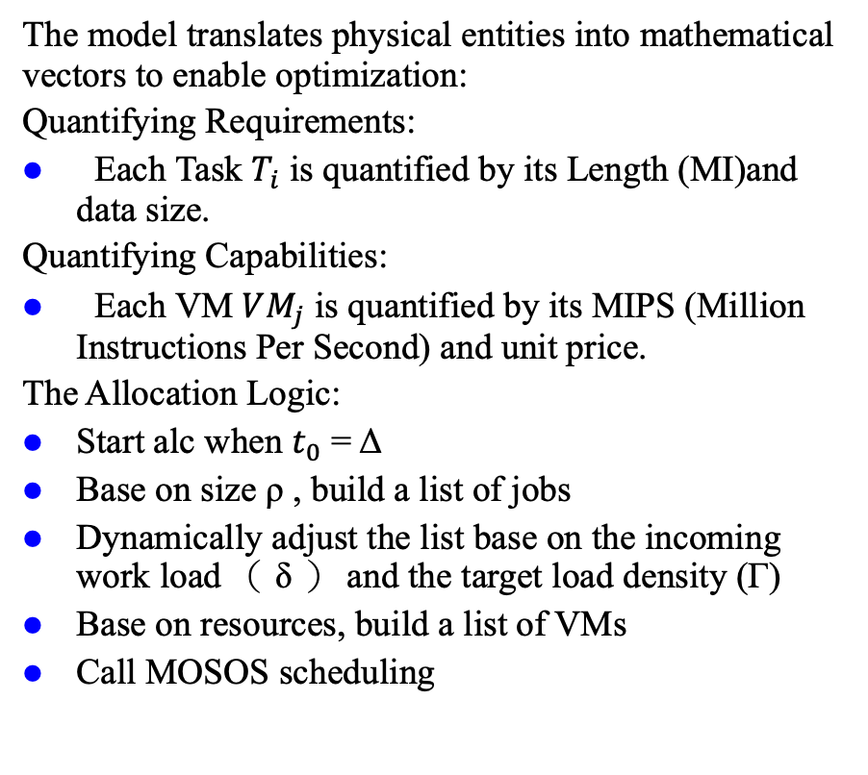
Proposed Methods – Part I Allocation model
The model translates physical entities into mathematical vectors to enable optimization:
Quantifying Requirements:
Each Task $T_{i}$ is quantified by its Length (MI)and data size.
Quantifying Capabilities:
Each VM $VM_{j}$ is quantified by its MIPS (Million Instructions Per Second) and unit price.
The Allocation Logic:
Start alc when $t_{0}$ = Δ
Base on size ρ , build a list of jobs
Dynamically adjust the list base on the incoming work load （ δ ） and the target load density (Γ)
Base on resources, build a list of VMs
Call MOSOS scheduling

Slide 18
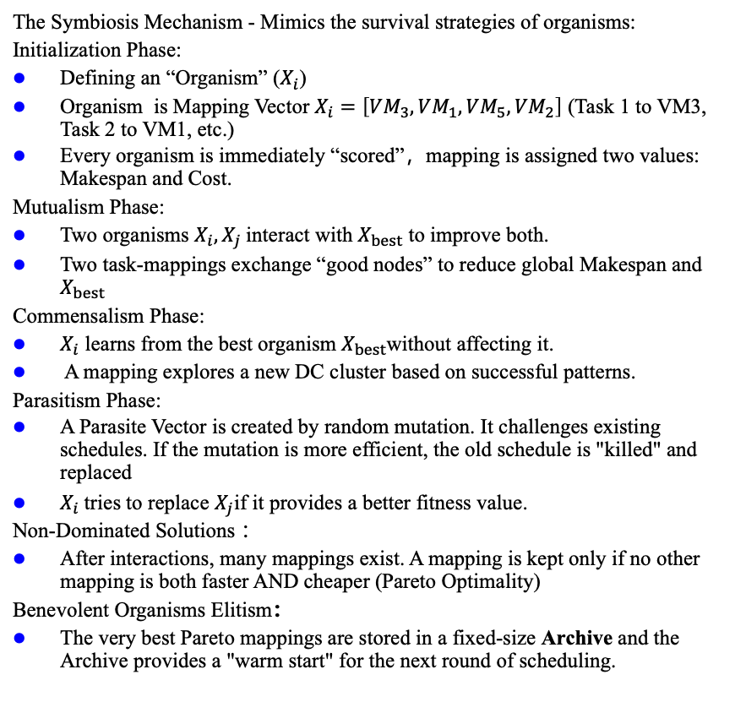
Proposed Methods – Part I MOSOS (2/2)
The Symbiosis Mechanism - Mimics the survival strategies of organisms:
Initialization Phase:
Defining an “Organism” ($X_{i}$)
Organism is Mapping Vector $X_{i}=\left[VM_{3},VM_{1},VM_{5},VM_{2}\right]$ (Task 1 to VM3, Task 2 to VM1, etc.)
Every organism is immediately “scored”，mapping is assigned two values: Makespan and Cost.
Mutualism Phase:
Two organisms $X_{i},X_{j}$interact with $X_{best}$ to improve both.
Two task-mappings exchange “good nodes” to reduce global Makespan and $X_{best}$
Commensalism Phase:
$X_{i}$ learns from the best organism $X_{best}$without affecting it.
A mapping explores a new DC cluster based on successful patterns.
Parasitism Phase:
A Parasite Vector is created by random mutation. It challenges existing schedules. If the mutation is more efficient, the old schedule is "killed" and replaced
$X_{i}$tries to replace $X_{j}$if it provides a better fitness value.
Non-Dominated Solutions ：
After interactions, many mappings exist. A mapping is kept only if no other mapping is both faster AND cheaper (Pareto Optimality)
Benevolent Organisms Elitism：
The very best Pareto mappings are stored in a fixed-size Archive and the Archive provides a "warm start" for the next round of scheduling.
Fig5. Flowchart of the proposed MOSOS

Slide 19
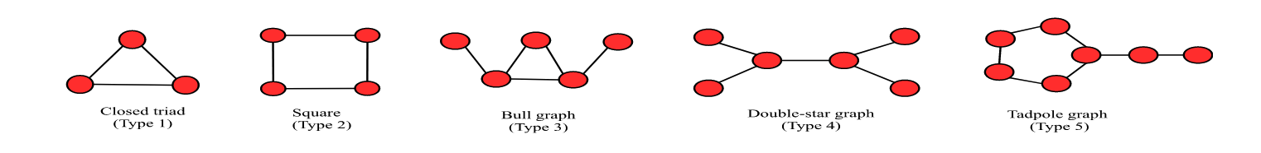
Proposed Methods – From Local to Network
Moving from a single cluster’s local optimal to a Geo-Distributed DC Network, jobs are related to each other;
Sub-tasks have internal communication edges – a ‘graph’
The New Bottleneck:
Inter-DC I/O ,Power & Latency
To solve the Global Network Optimal by mapping logic task graphs onto the physical DC topology (Subgraph Isomorphism)
Fig6. Examples of graph jobs

Slide 20
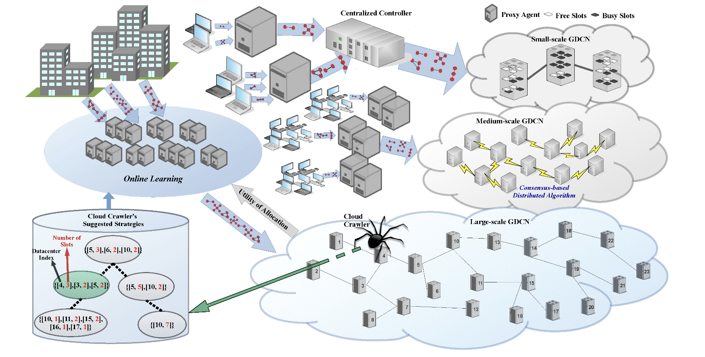
Proposed Methods – Power-Aware Graph Job Allocation
No one algorithm can solve all
Heuristic Discovery
Cloud Crawlers : Mobile agents that explore the network topology to find physical clusters that are "Isomorphic" to the job's logic graph.
Fig7. System model for graph job allocation in GDCNs with various scales.

Slide 21
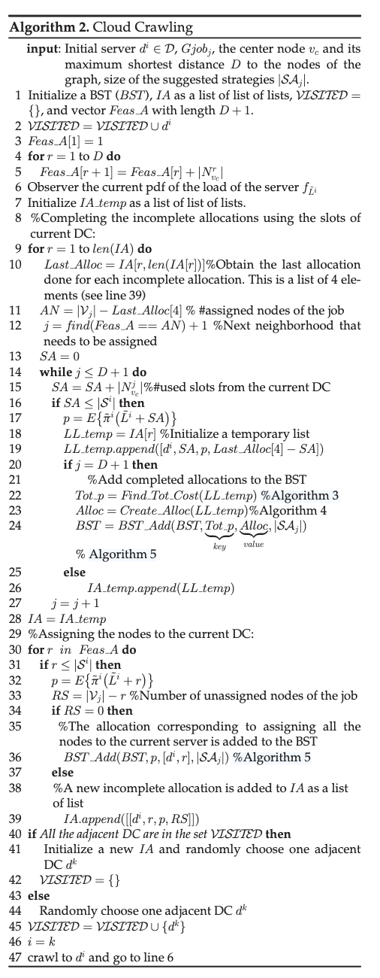
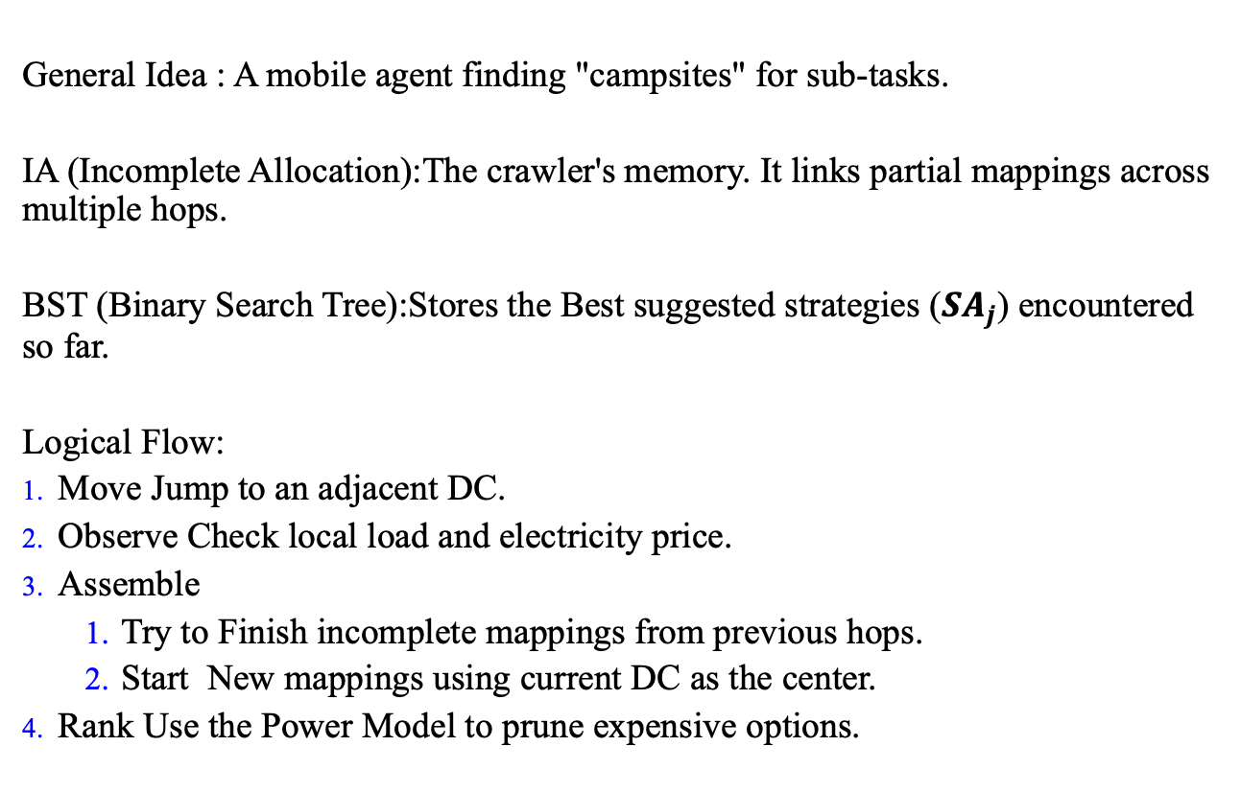
Proposed Methods – Crawling
General Idea : A mobile agent finding "campsites" for sub-tasks.
IA (Incomplete Allocation):The crawler's memory. It links partial mappings across multiple hops.
BST (Binary Search Tree):Stores the Best suggested strategies ($SA_{j}$) encountered so far.
Logical Flow:
Move Jump to an adjacent DC.
Observe Check local load and electricity price.
Assemble
Try to Finish incomplete mappings from previous hops.
Start New mappings using current DC as the center.
Rank Use the Power Model to prune expensive options.

Slide 22
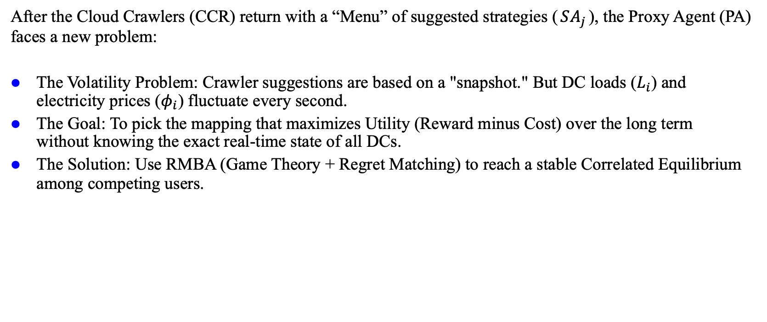
Proposed Methods – RMBA
After the Cloud Crawlers (CCR) return with a “Menu” of suggested strategies ($SA_{j}$), the Proxy Agent (PA) faces a new problem:
The Volatility Problem: Crawler suggestions are based on a "snapshot." But DC loads ($L_{i}$) and electricity prices ($φ_{i}$) fluctuate every second.
The Goal: To pick the mapping that maximizes Utility (Reward minus Cost) over the long term without knowing the exact real-time state of all DCs.
The Solution: Use RMBA (Game Theory + Regret Matching) to reach a stable Correlated Equilibrium among competing users.

Slide 23
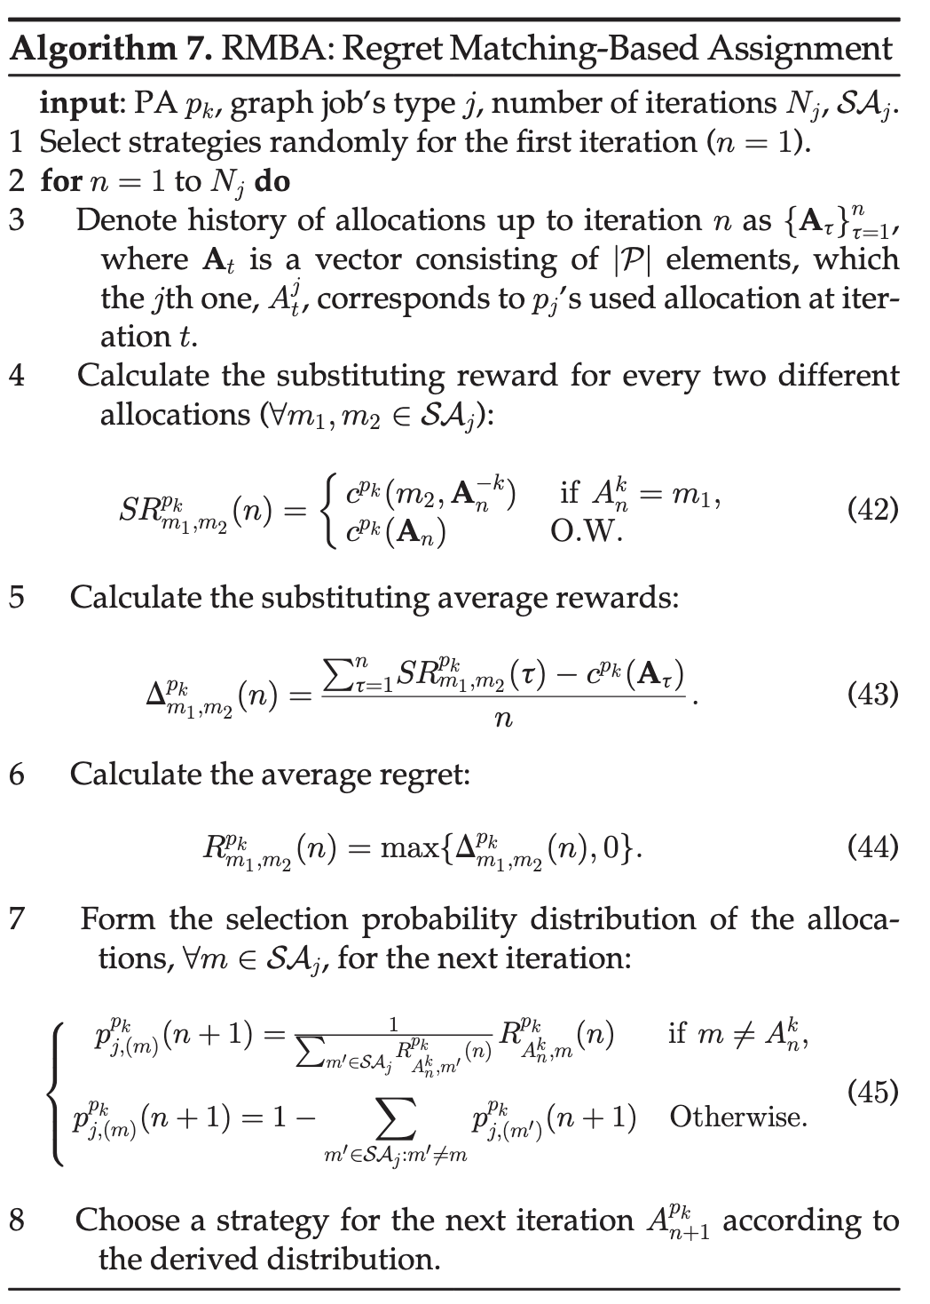
Proposed Methods – Detail of RMBA
The RMBA algorithm addresses resource contention in multi-agent environments where DC pricing is a function of real-time load, modeled as a Non-Cooperative Game.
1. Counterfactual Utility Evaluation
Substituting Reward (Eq. 42): Computes the reward an agent would have received by selecting alternative strategy instead of , given the fixed actions of all other agents .
Average Gain (Eq. 43): Calculates the cumulative difference between the substituting rewards and the actual utility obtained over iterations.
2. Regret Quantification
Average Regret (Eq. 44): Defined as isolating only those alternative strategies that yield a positive utility increment over the historical mean.
3. Probabilistic Strategy Update
Probability Matching (Eq. 45): The selection probability for the subsequent iteration n + 1 is updated to be directly proportional to the accumulated relative regret.
Exploration vs. Stability: The mechanism ensures that strategies with higher historical utility gains are assigned higher selection weights while maintaining a non-zero probability for system exploration.
4. Convergence: Correlated Equilibrium
The iterative update of pj,(m) ensures convergence to a Correlated Equilibrium (CE).
System Impact: Mitigates utility degradation caused by concurrent resource requests, ensuring global load distribution stability.
Algorithm 3. RMBA : Regret Matching-Based Assignment

Slide 24
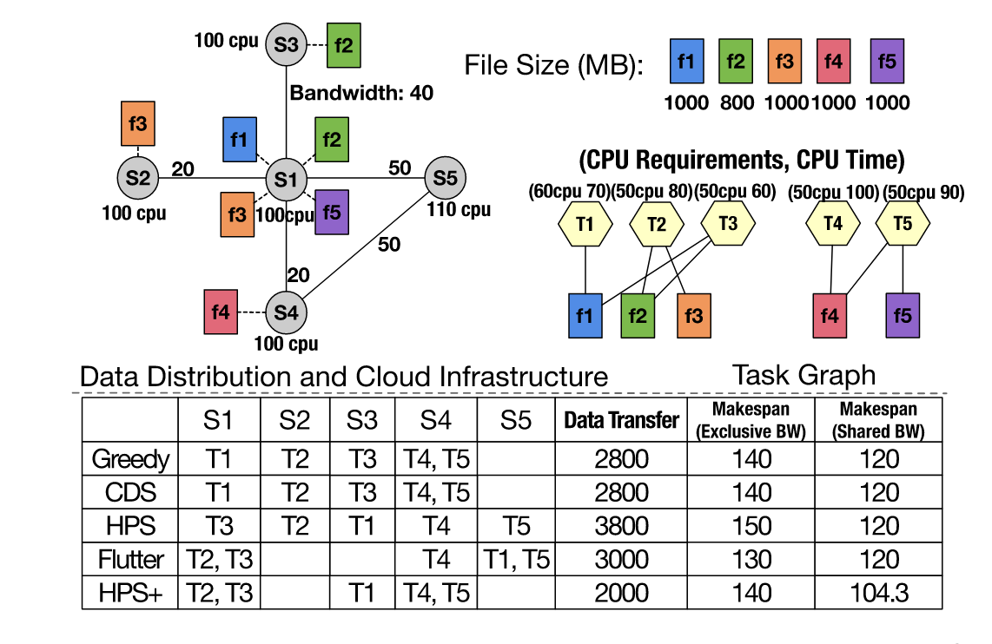
Proposed Methods – More to Consider
The last algorithm maps the graph logic but treats the network as a "fixed cost" or a "black box."
The Reality : WAN bandwidth is shared and fluctuates. A ”optimal” map might fail if the network route between DC-A and DC-B is congested.
HPS+：Jointly optimize where the task sits (Hypergraph) and how the data moves (SDN Routing)
Fig8. Example and scheduling results

Slide 25

Proposed Methods – Augmented Hypergraph
To minimize WAN traffic, HPS+ models the entire system as an Augmented Hypergraph :
The set of vertices of hypergraph ($V=N_{T}∪N_{F}∪N_{S}∪N_{V}$)
$N_{T}$:The set of Real compute tasks.
$N_{F}$:The set of Input data files.
$N_{S}$:The set of Physical Data Centers (DCs).
$N_{V}$:The set of Virtual Tasks (Unit-weighted nodes used to balance DC capacity constraints).
Hyperedges (Nets $E$)
Nets connect tasks to their required files and files to their DC replicas.
Double-Counting Free Cost Function （cost for cut）:
$Cut\left(P\right)=\sum{c\left(n_{j}\right)\left(λ_{j}−\left|N_{S_{fj}}\right|\right)}$
$\left|N_{S_{fj}}\right|$ : denotes the number of datacenters storing $f_{j}$
$λ_{j}$ : number of partitions the nets connects
$c\left(n_{j}\right)$ : cost of $n_{j}$ to the size of the file, i.e., $c\left(n_{j}\right)= s_{\left\{f_{j}\right\}}$

Slide 26
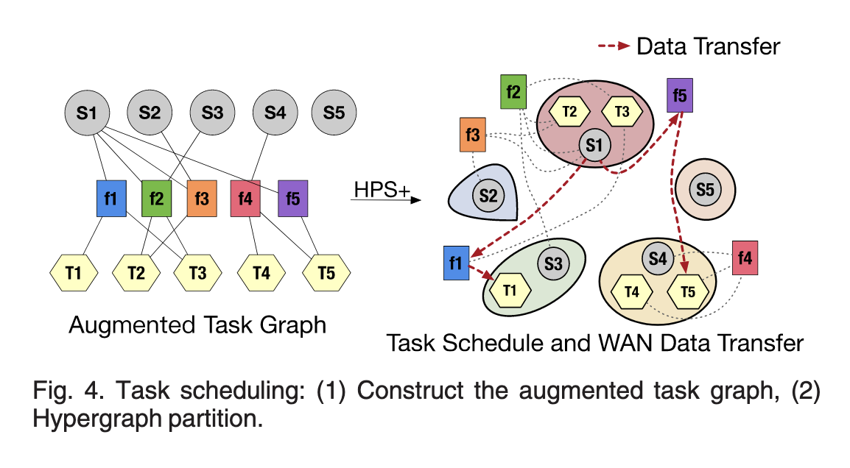
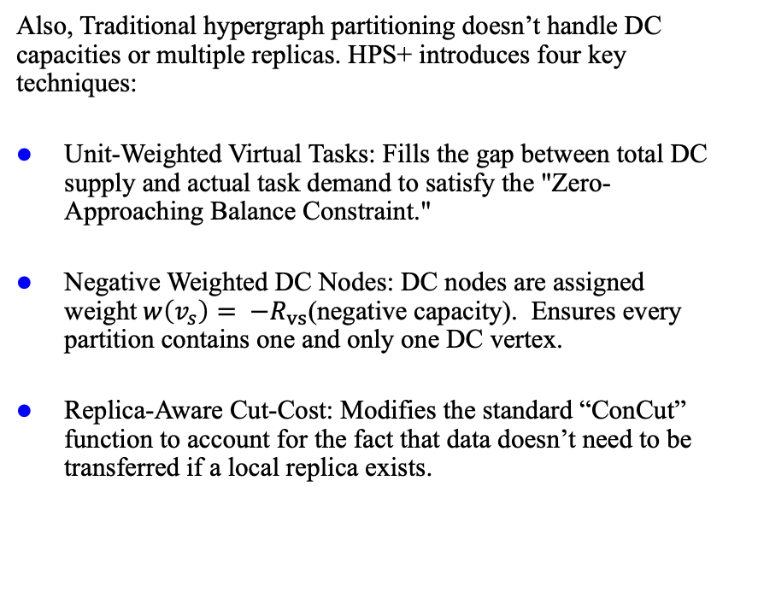
Proposed Methods – HPS+
Also, Traditional hypergraph partitioning doesn’t handle DC capacities or multiple replicas. HPS+ introduces four key techniques:
Unit-Weighted Virtual Tasks: Fills the gap between total DC supply and actual task demand to satisfy the "Zero-Approaching Balance Constraint."
Negative Weighted DC Nodes: DC nodes are assigned weight$w\left(v_{s}\right)= −R_{vs}$(negative capacity). Ensures every partition contains one and only one DC vertex.
Replica-Aware Cut-Cost: Modifies the standard “ConCut” function to account for the fact that data doesn’t need to be transferred if a local replica exists.
9

Slide 27
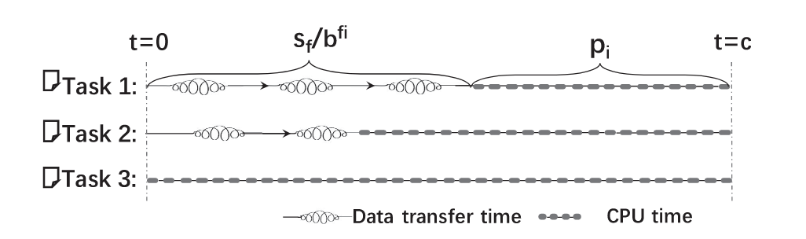
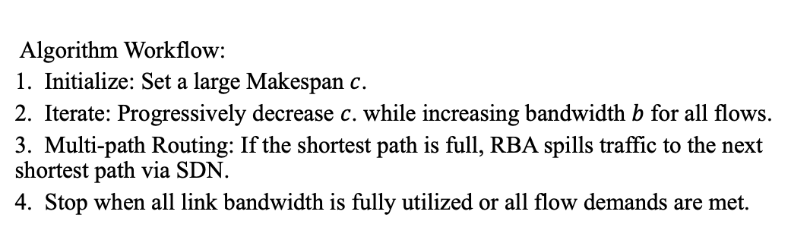
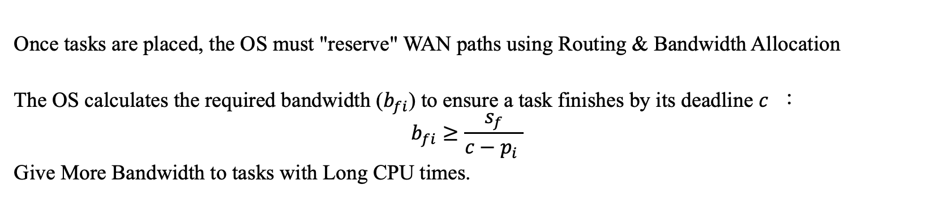
Proposed Methods – Routing & Bandwidth Allocation
Once tasks are placed, the OS must "reserve" WAN paths using Routing & Bandwidth Allocation
The OS calculates the required bandwidth ($b_{fi}$) to ensure a task finishes by its deadline $c$ ：
$$b_{fi}≥\frac{s_{f}}{c−p_{i} }$$
Give More Bandwidth to tasks with Long CPU times.
Algorithm Workflow:
1. Initialize: Set a large Makespan $c$.
2. Iterate: Progressively decrease $c$. while increasing bandwidth $b$ for all flows.
3. Multi-path Routing: If the shortest path is full, RBA spills traffic to the next shortest path via SDN.
4. Stop when all link bandwidth is fully utilized or all flow demands are met.
Fig10. Orchestrating the data transfers to balance their completion time.

Slide 28
Efficient Scheduling in Distributed OS
Introduction
Related Work
Preliminaries
Proposed Methods
Performance Evaluation
Conclusions

Slide 29
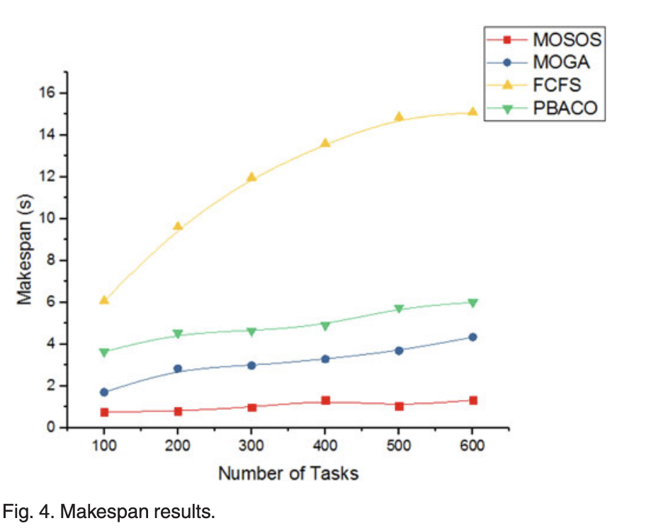
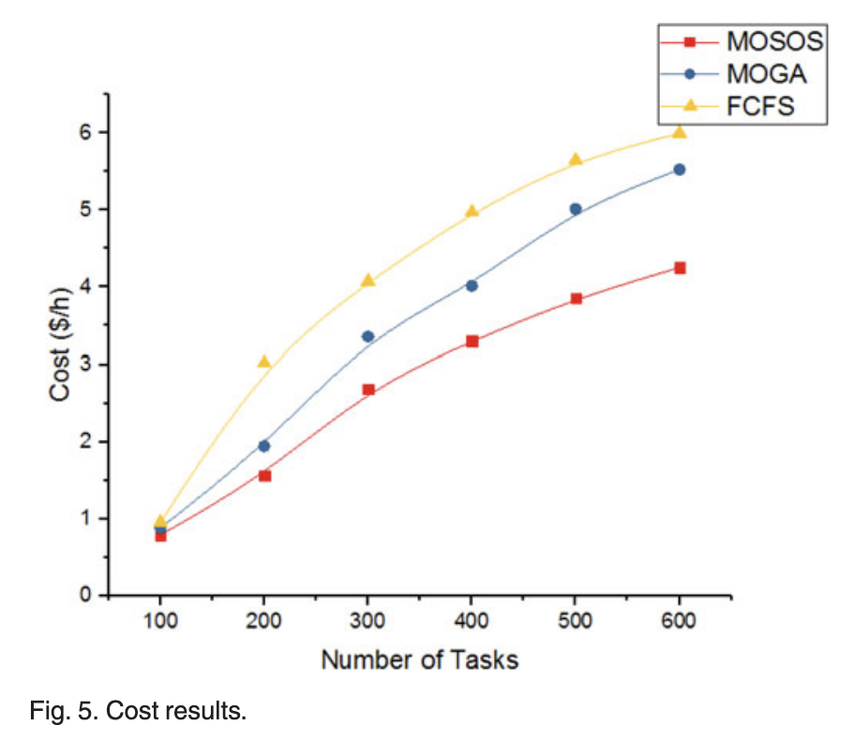
Performance Evaluation – Local Optimal Result
Fig 11. CloudSim toolkit with heterogeneous VM configurations (MIPS and Price)
Adopted 6 types of logs such as CEA-Curie-2011-2.1 and CTC-SP2-1996-2.1. Simulates the characteristics of task requests in a real cloud environment.

Slide 30
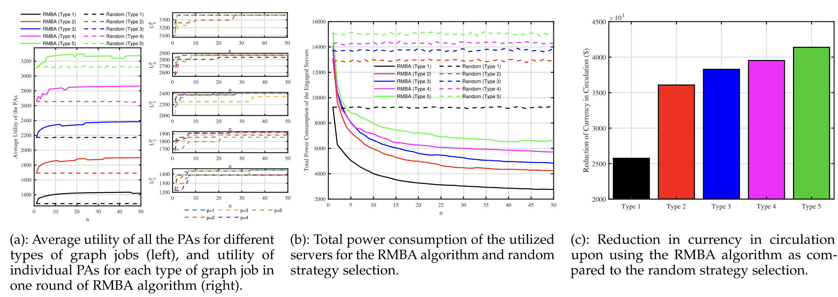
Performance Evaluation - Global Optimal
Fig 12. Simulation results of the large-scale GDCN upon having DCs with dynamic prices.

Slide 31
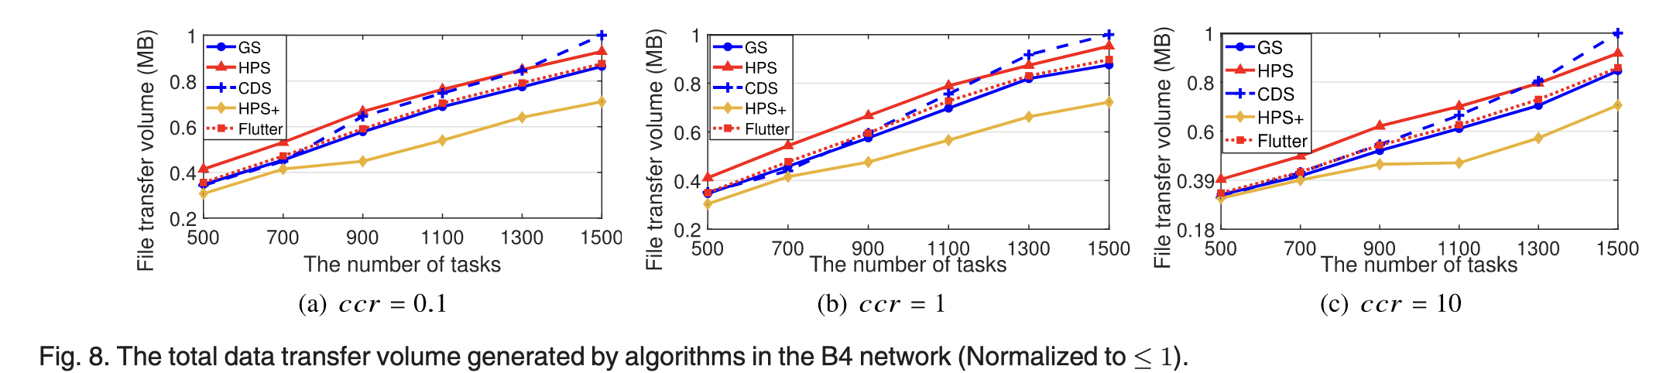
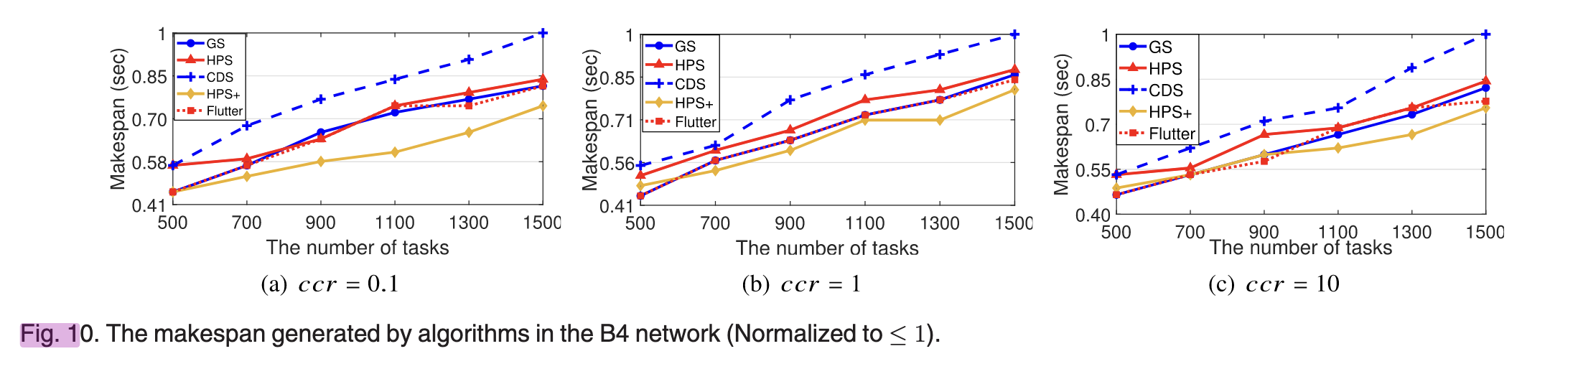
Performance Evaluation – Optimal with Network
Fig 13.
Topology ：12 datacenters and 19 WAN links (replicating the real backbone topology of Google)
Workload Design： Based on real scenarios of astronomical data processing, scalable task and file workloads are generated:
1. Task Parameters
Number of tasks: Up to 2000
Computing requirements: The CPU core occupancy of each task is randomly generated within the range [1, 10];
CPU execution time: Randomly generated within the range [10, 1000] seconds
Communication-to-Computation Ratio (CCR): Three scenarios are set (0.1, 1, 10).
2. File Parameters
Number of files: 8000 files allocated to the Google B4 network;
File size: Randomly generated following a uniform distribution of [0.2 GB, 5 GB] (based on the real size distribution of astronomical observation data);

Slide 32
Efficient Scheduling in Distributed OS
Introduction
Related Work
Preliminaries
Proposed Methods
Performance Evaluation
Conclusions

Slide 33
Conclusions
Local Optimization: We proposed a dynamic allocation model and the MOSOS algorithm to address NP-hard resource allocation in single-cluster environments, achieving near-optimal solutions with polynomial complexity.
Global Coordination: We tackled the subgraph isomorphism crisis for geo-distributed graph jobs via heuristic discovery (Cloud Crawlers) and game-theoretic resource contention resolution (RMBA), converging to Correlated Equilibrium.
Network-Power Joint Optimization: HPS+ introduces an augmented hypergraph formulation that unifies computation placement and SDN-based routing, minimizing WAN traffic and total execution cost.

