Slide 1
Data-Driven Control for Cloud Resources 2026.03.05
Yu Mao
School of Data Science
Chinese University of Hong Kong, Shenzhen

Slide 2
Outline
Introduction (3 min)
Background & Motivation (5 min)
Proposed Methods & Performance Evaluation (15 min)
﻿Metis (5 min)
﻿Tetris (7 min)
﻿OptScaler (3 min)
Conclusions (2 min)
Q & A (5 min)

Slide 3
Outline
Introduction (3 min)
Background & Motivation (5 min)
Proposed Methods & Performance Evaluation (15 min)
﻿Metis (5 min)
﻿Tetris (7 min)
﻿OptScaler (3 min)
Conclusions (2 min)
Q & A (5 min)

Slide 4
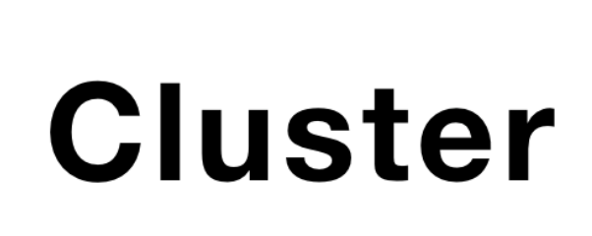
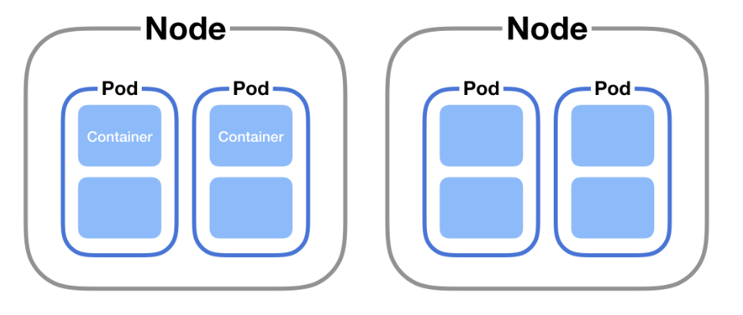
Introduction (1/2)
What are cloud resources?
Cloud resources are scalable computing infrastructures designed to host and orchestrate running applications.
Components:
Container: Lightweight, packaged running programs.
Pod: Smallest deployable unit grouping containers.
Node: Physical or virtual servers hosting Pods.
Cluster: A coordinated group of nodes.
Figure 1: Overview of Cloud Resource Architecture.

Slide 5



Introduction (2/2)
What are running in the cloud resources?
Long-Running Applications (LRAs): Workloads that continuously occupy cloud computing resources over extended periods.
LRAs typically includes online web services, continuous machine learning training workloads, and databases.
How do we guarantee performance?
Service Level Objectives (SLOs): Strict performance requirements and metric guarantees established to ensure reliable application service.
SLOs often mandate keeping average CPU and memory utilization at a certain threshold as a buffer for sudden surges in user requests.
Figure 2: LRAs Examples.

Slide 6
Outline
Introduction (3 min)
Background & Motivation (5 min)
Proposed Methods & Performance Evaluation (15 min)
﻿Metis (5 min)
﻿Tetris (7 min)
﻿OptScaler (3 min)
Conclusions (2 min)
Q & A (5 min)

Slide 7
Background & Motivation (1/3)
Goals of Resource Management:
Cost & Compliance: Find the optimal scheduling strategy to strictly meet SLOs while minimizing overall operational costs.
Achieve both economic efficiency and environmental friendliness.
Challenges in Scheduling:
Massive Scale: Managing thousands of diverse LRAs as containers scheduled across hundreds of nodes.
Dynamic Systems: Unpredictable requests and changing tasks continuously alter the system's internal dynamics.

Slide 8
Background & Motivation (2/3)
Solution: Data-driven methods
Data over Explicit Modeling: Rather than relying on rigid, explicit models for highly complex systems, we can leverage abundant operational data (logs, traces, profiling) to implicitly capture system dynamics or directly learn control policies.
Two Important Factors for Cloud Resource Control:
Optimality: Minimizing overall resource costs and maximizing utilization for a given set of requirements under SLOs.
Robustness: Ensuring strict SLO satisfaction for smooth, uninterrupted operations under uncertainties.

Slide 9
Background & Motivation (3/3)
Evolution of Proposed Methods:
﻿Metis (Reinforcement Learning (RL)): Learns scheduling policies directly from data.
﻿Tetris (Model Predictive Control (MPC)): Proactive scheduling via constrained optimization.
﻿OptScaler (Robust MPC): Incorporates uncertainty into optimization.
SLOs Guarantee
OptScaler
﻿Tetris
﻿﻿Metis
Robustness
Figure 3: Proposed Methods.

Slide 10
Outline
Introduction (3 min)
Background & Motivation (5 min)
Proposed Methods & Performance Evaluation (15 min)
﻿Metis (5 min)
﻿Tetris (7 min)
﻿OptScaler (3 min)
Conclusions (2 min)
Q & A (5 min)

Slide 11
Metis (1/6)
Observations:
Latency Tolerance: LRAs are less sensitive to scheduling latency, allowing us to compute more sophisticated scheduling decisions.
RL offers a paradigm to directly map system states to optimal placement actions, bypassing manual heuristic constraints.
Motivation:
Apply RL to automatically and dynamically schedule every incoming LRA task.
Agent
State
Reward
Action
Environment
Figure 4: Overview of RL Architecture.

Slide 12
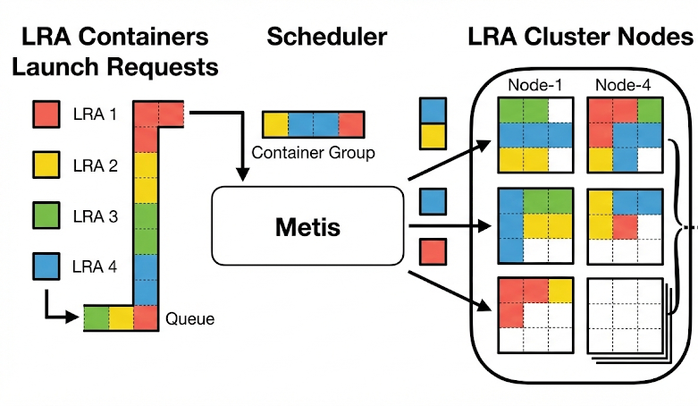
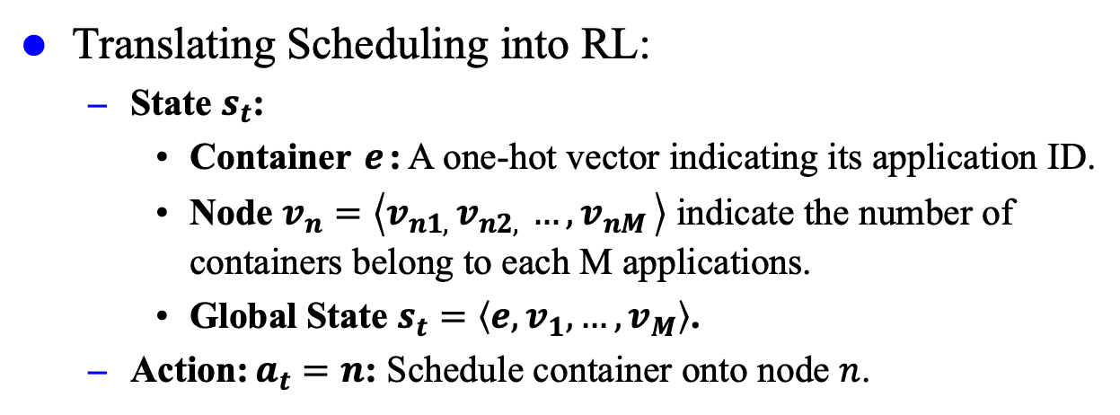
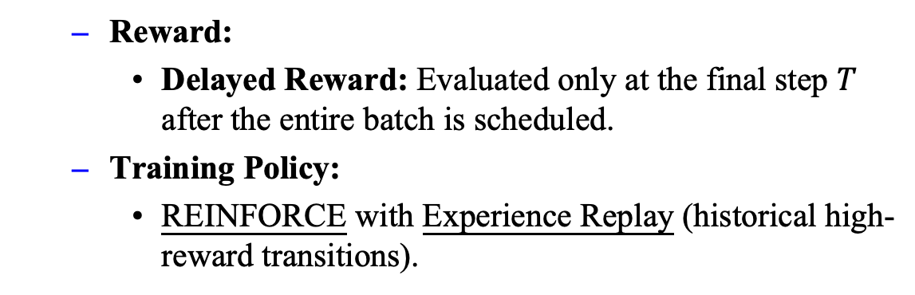
Metis (2/6)
Translating Scheduling into RL:
State $s_{t}$:
Container $e$: A one-hot vector indicating its application ID.
Node $v_{n}=\left\langle v_{n1, }v_{n2, }…,v_{nM }\right\rangle$ indicate the number of containers belong to each M applications.
Global State $s_{t}=\left\langle e, v_{1}, …, v_{M}\right\rangle$.
Action: $a_{t}=n$: Schedule container onto node $n$.
Reward:
Delayed Reward: Evaluated only at the final step $T$ after the entire batch is scheduled.
Training Policy:
REINFORCE with Experience Replay (historical high-reward transitions).
Figure 5: LRAs Scheduling Workflow.

Slide 13
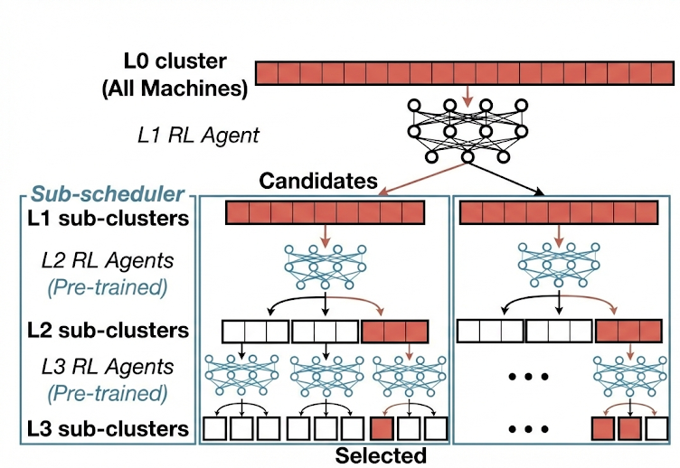
Metis (3/6)
Cluster Environment Simulator:
Macro Metrics: Predicts RPS directly, avoiding complex low-level resource modeling.
Random Forest: Achieves high accuracy with minimal training data.
﻿Hierarchical RL (HRL):
Tree Decomposition: Reduces massive search spaces into simple sub-cluster selections.
Sub-schedulers: Offline-trained agents handle local placements, dramatically accelerating online scheduling.
Figure 6: ﻿Hierarchical RL Architecture.

Slide 14
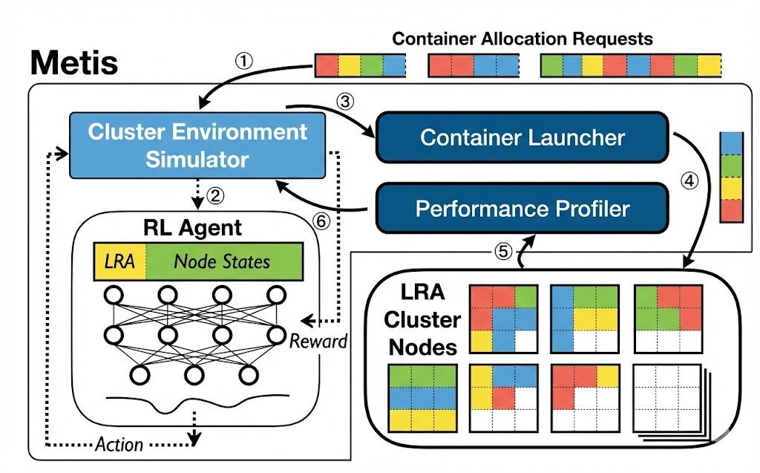
Metis (4/6)
Overall architecture of Metis:
Input: Receive and batch container requests.
Decision (HRL): RL Agent explores placements via the Environment Simulator.
Execution: Container Launcher deploys the batch.
Feedback: Profiler returns real metrics to refine the Simulator.
Figure 7: ﻿Metis Architecture.

Slide 15
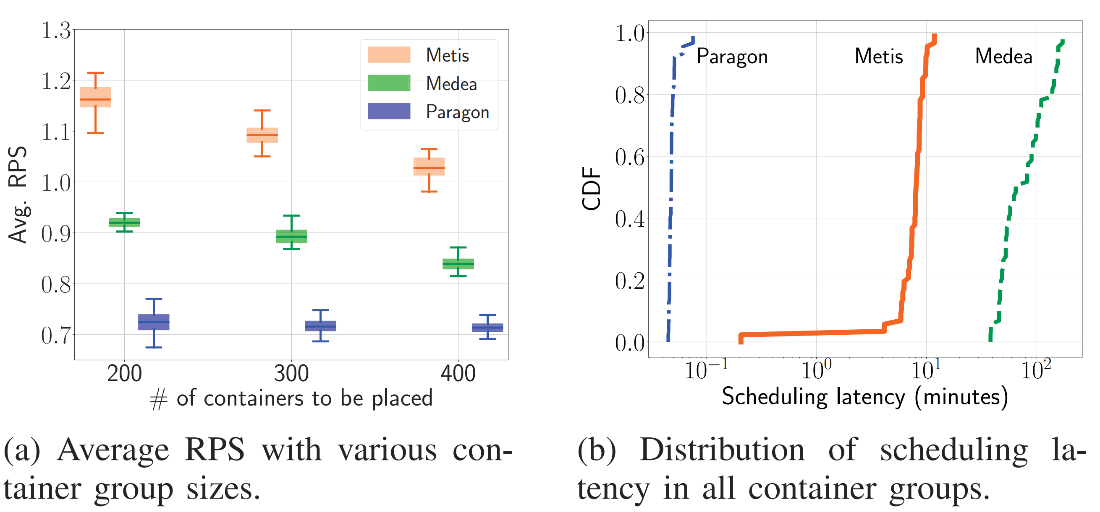
Metis (5/6)
Performance Evaluation:
Environment: 81-node Amazon EC2 cluster.
Workloads: 7 real-world Long-Running Applications (LRAs).
Batches: 200, 300, and 400 containers per group.
Baselines
Medea: Constraint-based scheduler (ILP solver).
Paragon: Greedy heuristic scheduler (Interference minimization).
Figure 8: Comparison of Metis, Medea and Paragon in an 81-Node Cluster. (Boxes depict the 25th, 50th, and 75th percentiles, and whiskers the 5th and 95th.)

Slide 16
Metis (6/6)
Remaining Challenges:
SLO Satisfaction: Adjusting the RL reward function is often insufficient to strictly guarantee Service Level Objectives.
One-Time Placement: Cloud flexibility relies on runtime container migration or rescheduling, but Metis is limited to single, initial placement decisions.

Slide 17
Outline
Introduction (3 min)
Background & Motivation (5 min)
Proposed Methods & Performance Evaluation (15 min)
﻿Metis (5 min)
﻿Tetris (7 min)
﻿OptScaler (3 min)
Conclusions (2 min)
Q & A (5 min)

Slide 18
Tetris (1/10)
Observations:
Invalid Migrations: Reactive adjustments cause "ping-pong" migrations, wasting resources.
SLO Violations: Hard to guarantee performance during sudden load spikes.
Motivation:
Model Predictive Control (MPC):
Formulates proactive scheduling as a constrained optimization problem over a finite future horizon to guarantee SLOs.
Workflow: Observe → Predict → Optimize.
Environment
Action
State
Model
State
Prediction
Action
Optimization Solver
MPC Module
Figure 9: Basic MPC Architecture.

Slide 19
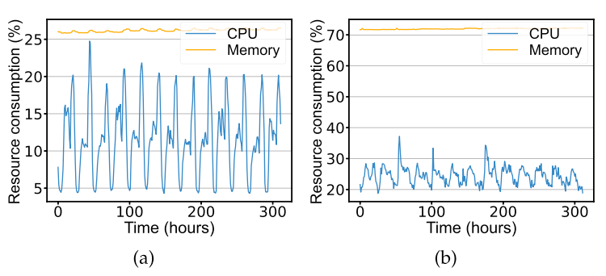
Tetris (2/10)
Container Resource Consumption Prediction:
Clustering: Categorize containers into Periodic and Aperiodic workloads.
Hybrid Prediction:
Periodic: Autoregressive Integrated Moving Average (ARIMA).
Aperiodic: Long Short-Term Memory (LSTM).
Trains a dedicated predictive model for every single container.
Figure 10: Examples of Containers with Periodic/Aperiodic Resource Consumption Patterns.

Slide 20
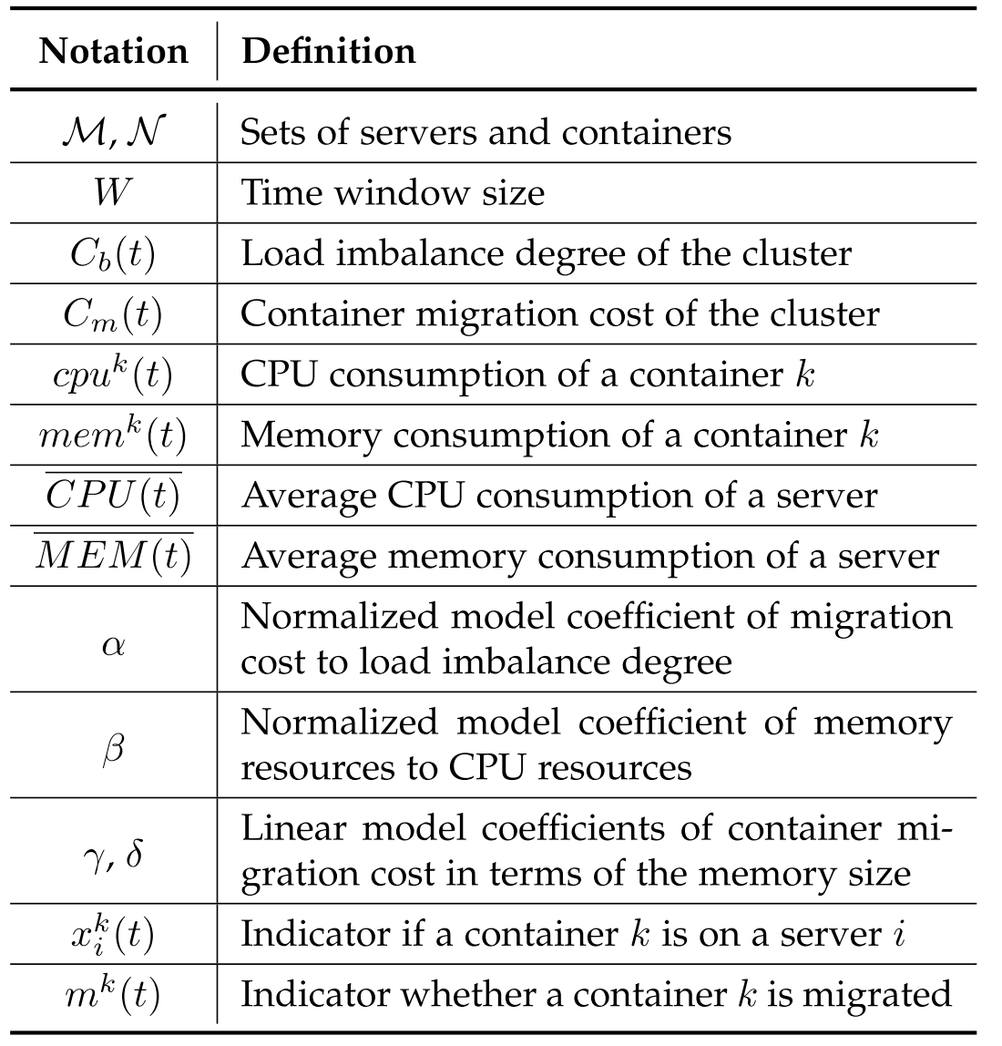
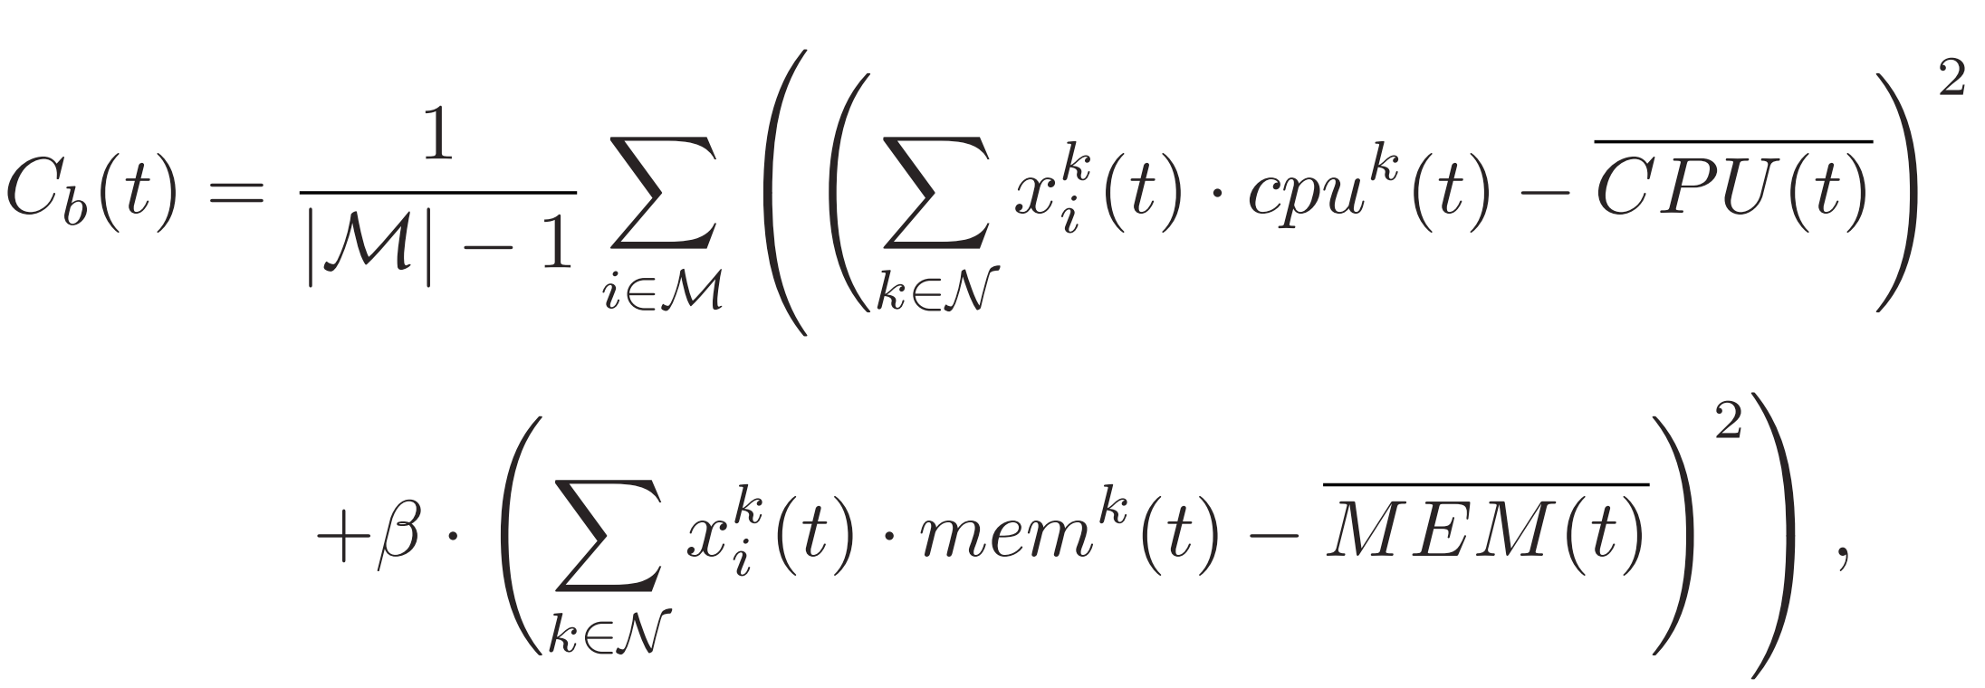
Tetris (3/10)
Translating Scheduling into MPC:
Loal-balancing cost:
Table 1: Key Notations of Dynamics Model of Tetris.

Slide 21
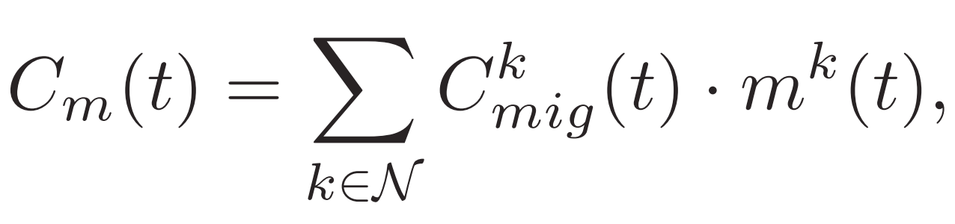
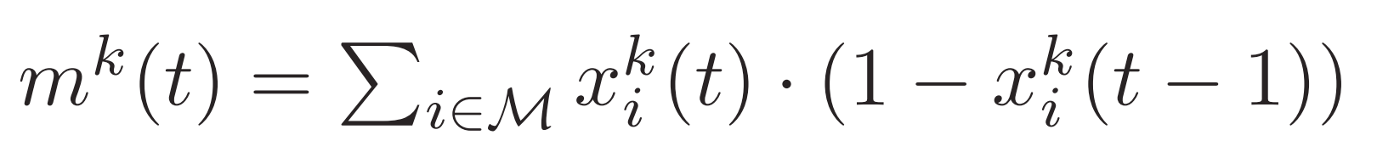
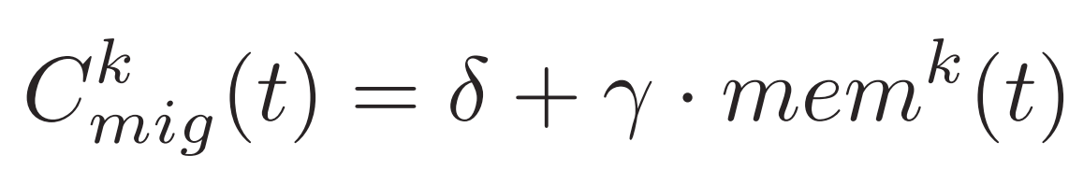
Tetris (4/10)
Translating Scheduling into MPC:
Migration cost:
Table 1: Key Notations of Dynamics Model of Tetris.
where
and

Slide 22

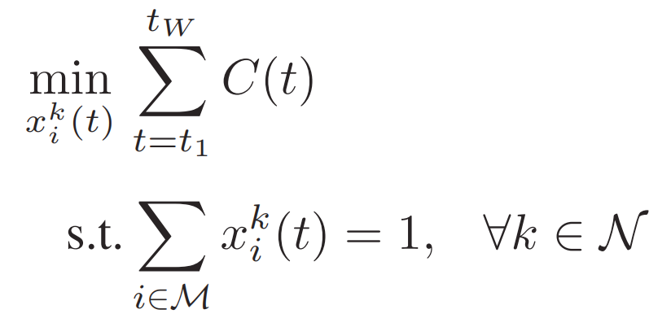
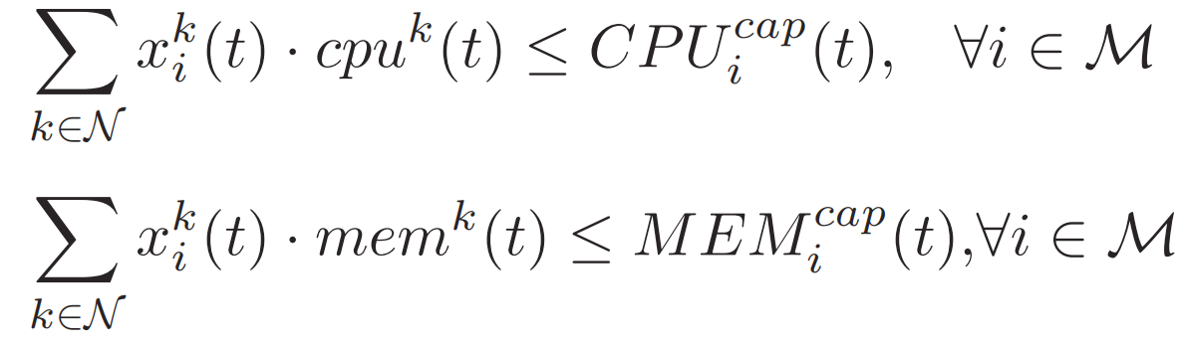
Tetris (5/10)
Translating Scheduling into MPC:
Overall cost
Table 1: Key Notations of Dynamics Model of Tetris.
MPC problem:

Slide 23
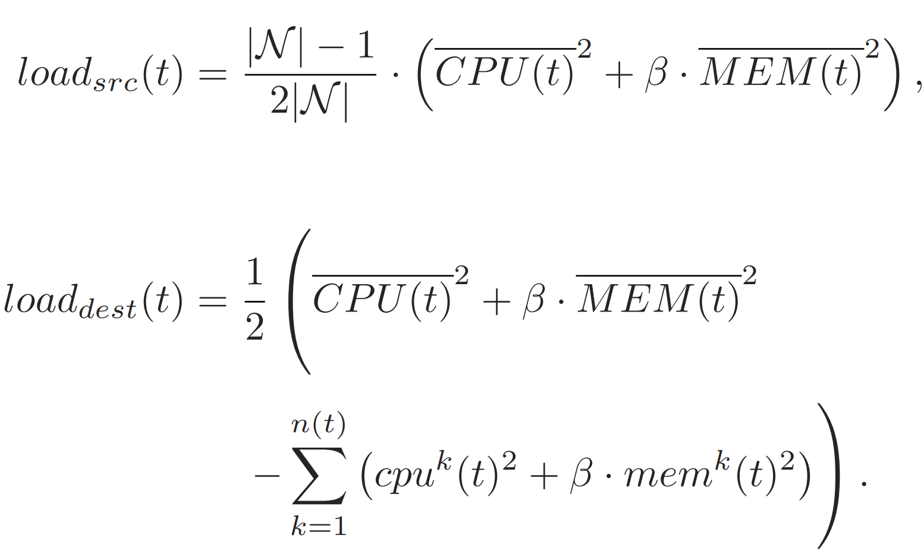
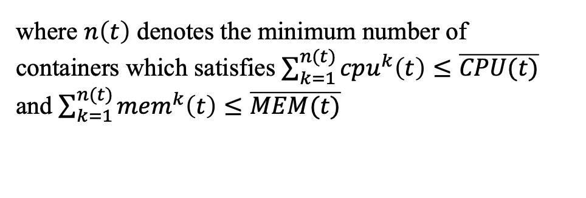
Tetris (6/10)
Accelerating MPC:
Solving the full MILP problem for large-scale clusters is computationally intractable.
Use utilization thresholds to restrict migration candidates:
Table 1: Key Notations of Dynamics Model of Tetris.
where $n\left(t\right)$ denotes the minimum number of containers which satisfies $\sum_{k=1}^{n(t)}{cpu^{k}\left(t\right)≤\overline{CPU(t)}}$ and $\sum_{k=1}^{n(t)}{{mem}^{k}\left(t\right)≤\overline{MEM(t)}}$

Slide 24
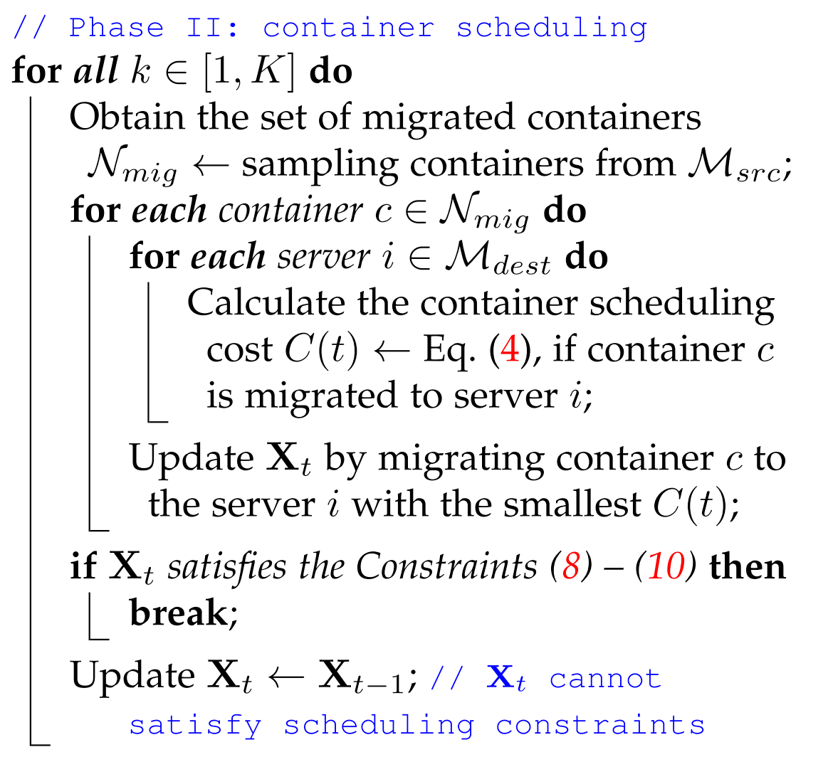




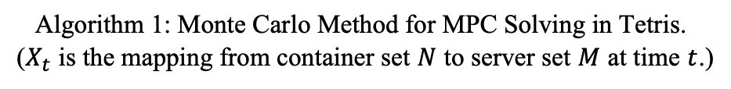
Tetris (7/10)
Accelerating MPC:
Monte Carlo Method:
Sample Solutions: Randomly sample possible scheduling actions instead of computing explicit exact solutions.
Optimal Selection: Evaluate sampled trajectories and apply the one with the minimum projected cost.
Algorithm 1: Monte Carlo Method for MPC Solving in Tetris.
($X_{t}$ is the mapping from container set $N$ to server set $M$ at time $t$.)

Slide 25
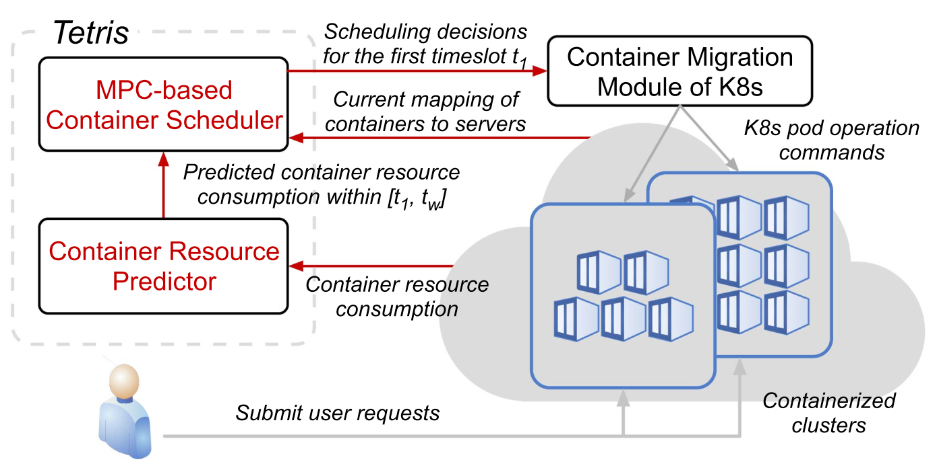
Tetris (8/10)
Overall architecture of Tetris:
Prediction: Trains dedicated hybrid models (ARIMA/LSTM) to forecast future resource demands for each container.
MPC: Formulates SLOs and physical capacities as strict constraints within an optimization problem.
Figure 11: ﻿ Tetris Architecture.

Slide 26
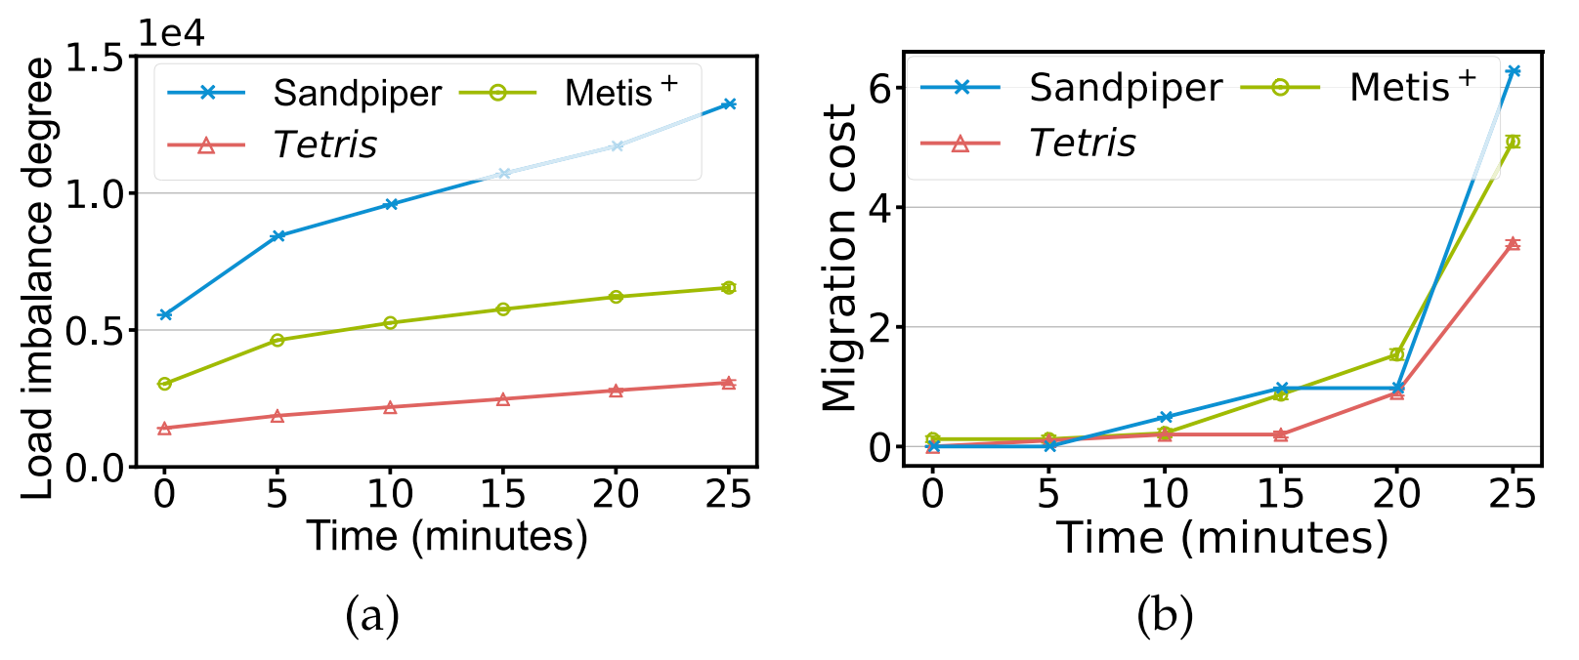
Tetris (9/10)
Performance Evaluation:
Environment: 10-node Amazon EC2 cluster (m6a.large instances).
Workloads: 3 representative containerized applications (Apache Tomcat, Redis, and ResNet50).
Scales: 60 containers evaluated over 5 timeslots (5 minutes per timeslot).
Baselines
Sandpiper: Greedy worst-fit scheduler (minimizes resource load index).
Metis+: RL-based scheduler (optimizes scheduling over infinite future).
Figure 12: ﻿Performance comparison of Tetris with Sandpiper and Metis+ strategies under K8s-based prototype experiments.

Slide 27
Tetris (10/10)
Remaining Challenges:
High Overhead: Per-container predictive modeling is unscalable for massive clusters.
Ignoring Uncertainty: Relies entirely on deterministic Neural Network predictions. Fails to provide robustness against inevitable prediction errors.

Slide 28
Outline
Introduction (3 min)
Background & Motivation (5 min)
Proposed Methods & Performance Evaluation (15 min)
﻿Metis (5 min)
﻿Tetris (7 min)
﻿OptScaler (3 min)
Conclusions (2 min)
Q & A (5 min)

Slide 29
OptScaler (1/5)
Motivations:
Unified Prediction: One single model for all LRAs (long/short-term patterns).
Robust MPC: Incorporates prediction uncertainty to strictly guarantee SLOs.
Cluster Settings:
Symmetric Nodes: Every node runs the exact same combination of LRAs.
1:1 Mapping: Each container strictly hosts only one LRA.
Node
Node
Container
(LRA1)
Container
(LRA1)
Container
Container
…
Container
Container
Figure 13: Cluster Settings for OptScaler.

Slide 30
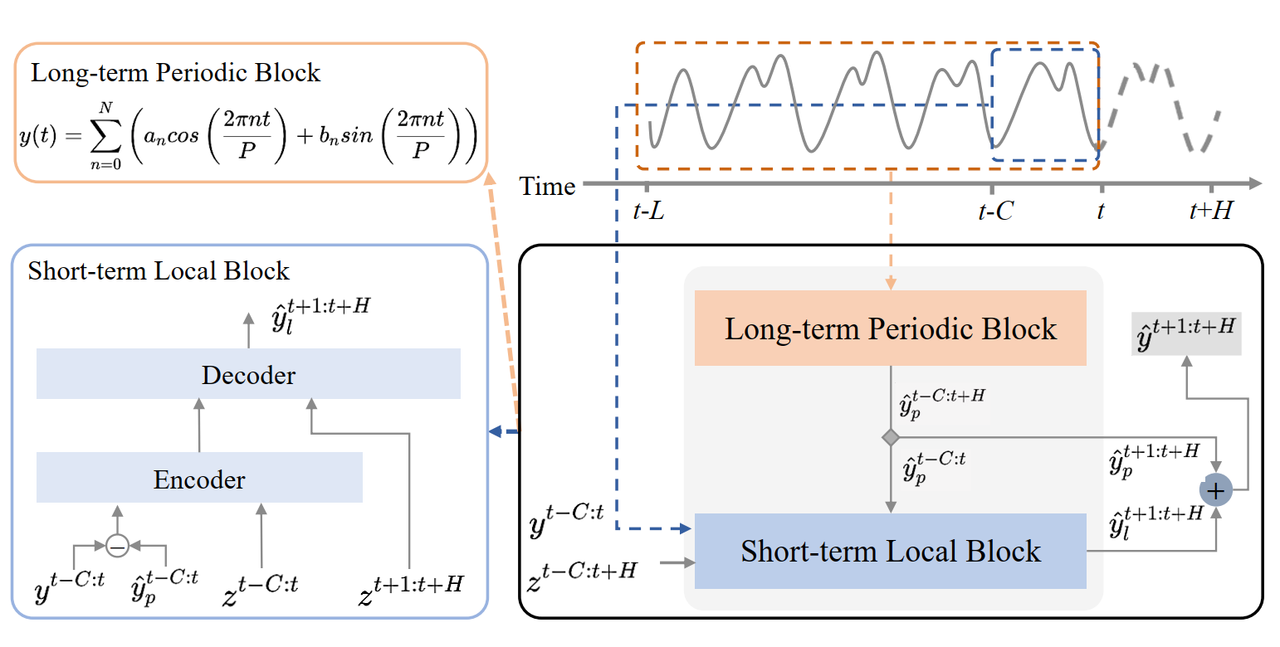
OptScaler (2/5)
Workload Prediction (Proactive Module):
Long-term Periodic Block: Uses Fourier series to capture diverse daily/weekly periodic patterns.
Short-term Local Block: Uses a Seq2seq structure with Flow-Attention to capture local trends and unexpected spikes.
Figure 14: OptScaler Long/Short-term Prediction Block.

Slide 31
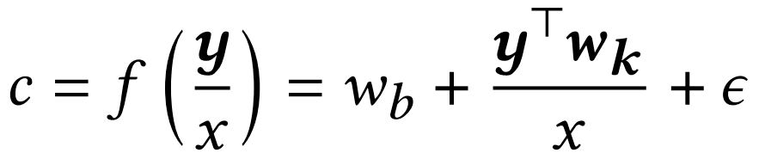
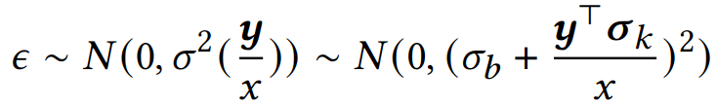
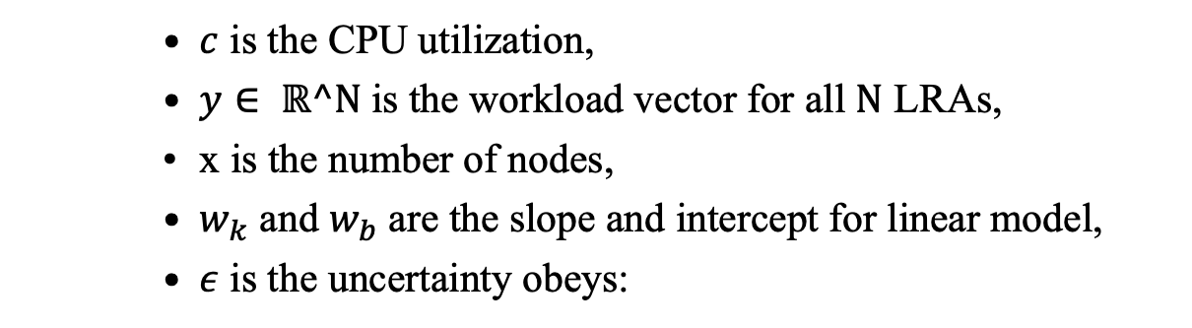
OptScaler (3/5)
CPU Estimation (Reactive Module):
Online Linear CPU Estimator:
$c$ is the CPU utilization,
$y∈ \text{ℝ}\text{^}\text{N}$is the workload vector for all $\text{N}$ LRAs,
x is the number of nodes,
$w_{k}$ and $w_{b}$ are the slope and intercept for linear model,
$ε$ is the uncertainty obeys:
which specific formulation allows the MPC to use Chance Constraints, mathematically guaranteeing SLO confidence even when predictions deviate.

Slide 32
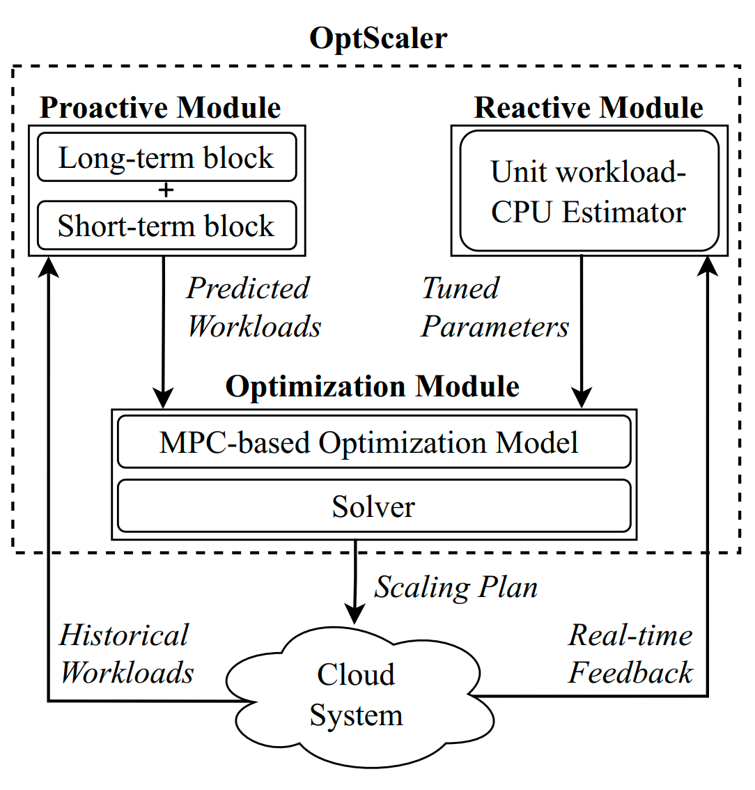
OptScaler (4/5)
Overall architecture of OptScaler:
Proactive: Forecasts all LRA workloads using a unified model (Fourier + Seq2seq).
Reactive: Fine-tunes the CPU estimator via Online Linear Regression and real-time feedback.
Optimization: Generates optimal scaling plans by feeding predictions and feedback into a Robust MPC.
Figure 15: ﻿ OptScaler Architecture.

Slide 33
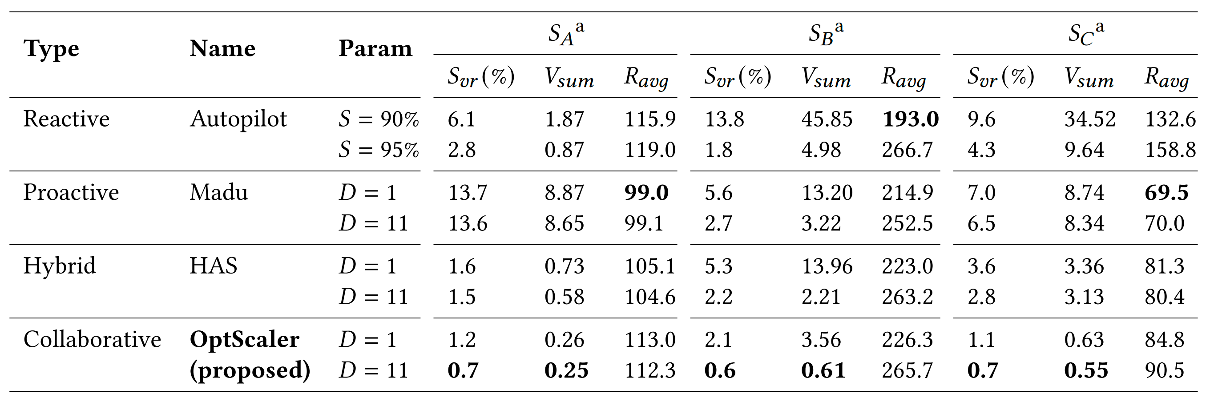
OptScaler (5/5)
Performance Evaluation:
Table 2: ﻿Comparison on OptScaler with other three types of autoscalers.
(﻿$S_{vr}$ denotes the SLO violation rate, $V_{sum}$ denotes the accumulated magnitude of SLO violation, and $R_{avg}$ denotes the resource cost. $S$ is the percentile of recent CPU utilization samples of Autopilot. D is the time horizon in the optimization model.)

Slide 34
Outline
Introduction (3 min)
Background & Motivation (5 min)
Proposed Methods & Performance Evaluation (15 min)
﻿Metis (5 min)
﻿Tetris (7 min)
﻿OptScaler (3 min)
Conclusions (2 min)
Q & A (5 min)

Slide 35
Conclusions (1/1)
Summary of Scheduling Paradigms:
Metis (RL): Soft constraints. Scalable but lacks strict SLO guarantees.
Tetris (MPC): Hard constraints. Proactive but vulnerable to deterministic prediction errors.
OptScaler (Robust MPC): Chance constraints. Collaborative architecture handling inherent uncertainty.
Future Directions
Online Model Learning: Efficiently adapting predictive models on-the-fly with minimal system overhead.
Theoretical Analysis: Establishing rigorous stability and optimality bounds for data-driven control in dynamic cloud environments.

Slide 36
Outline
Introduction (3 min)
Background & Motivation (5 min)
Proposed Methods & Performance Evaluation (15 min)
﻿Metis (5 min)
﻿Tetris (7 min)
﻿OptScaler (3 min)
Conclusions (2 min)
Q & A (5 min)

