Slide 1
From OS to Agentic OS
OSWorld(NeurIPS 2024) • CogAgent (CVPR 2024) • OSCAR (ICLR 2025)
Can LLMs become a new “OS layer” for humans?
Wenqian Zhang
School of Data Science
Chinese University of Hong Kong, Shenzhen
Notes:
English:
Today I want to share a story about making computers easier to control. Historically, Operating systems abstract away hardware complexity. Now, LLM agents may become the next abstraction layer.
In this talk, I will walk through three key research milestones toward this vision:
OSWorld, an agent-centric operating system benchmark
CogAgent, designed for GUI perception and understanding
OSCAR, which enables agent control and trajectory re-planning
Finally, I will discuss security considerations and outline our future roadmap.

Slide 2



Why agentic OS matters
Systems response
Complexity pressure
Human bottleneck
Modern computing =
too many apps +
too many workflows
Learning cost keeps rising
Automation needs a new abstraction layer
Abstraction layers are how computing scales for humans.
OS reduced hardware complexity. GUI reduced application complexity. Agents may reduce workflow complexity.
Notes:
Modern computing is becoming increasingly complex. We now have too many applications and too many workflows to manage.
As a result, the human learning cost keeps rising, and people become the bottleneck in many digital tasks.
From a systems perspective, this suggests we may need a new abstraction layer for automation.
Historically, abstraction layers are how computing scales for humans. Operating systems reduced hardware complexity. Then GUIs reduced application complexity.
And today, agents may help reduce workflow complexity.

Slide 3
Talk map
Step 1
Step 2
1) OS history as abstraction layers
2) Research question: LLM as an “agentic OS layer”
Step 3
Step 4
3) OSWorld → CogAgent → OSCAR as a research path
4) Security + runtime (OpenClaw)
Notes:
Let me briefly walk through the structure of this talk.
First, I will review the history of operating systems. Second, this leads to our central question: can LLMs act as an agentic OS layer?
Then I’ll present research path, from OSWorld, to CogAgent, and then OSCAR.
After that, I will discuss security and runtime issues, using OpenClaw as example.
Finally, I’ll conclude with a takeaway message page.

Slide 4
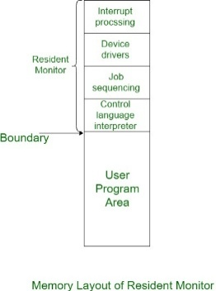
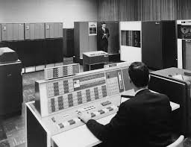
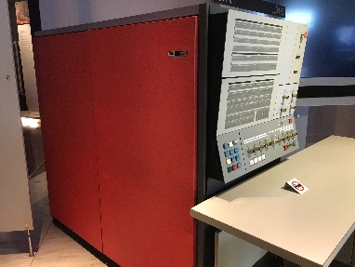
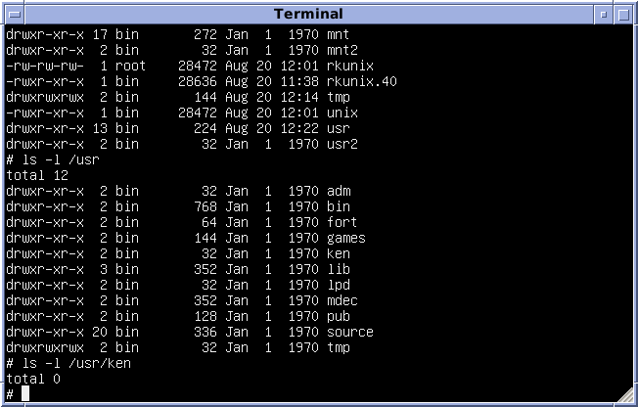
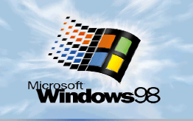
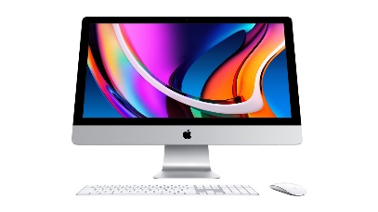
OS history in 90 seconds
Each milestone reduces the cognitive cost of using machines.
1950s
1960s
1964
1969
1998–Now
Resident
monitor
Time-sharing
/ Multics
OS/360
UNIX
GUI era
Each step = new abstraction for humans
Notes:
Here is a quick look at the history of operating systems.
In the 1950s, early systems used resident monitors, where users interacted almost directly with hardware.
In the 1960s, time-sharing systems such as Multics allowed multiple users to share a single machine, introducing a new abstraction for managing computing resources.
Then IBM’s OS/360 standardized system software across different hardware platforms, making software more portable across machines.
Later, UNIX simplified system design and introduced powerful command-line tools for developers.
Finally, the GUI era made computers accessible to everyday users through graphical interfaces.
The key takeaway is that each milestone introduced a new abstraction layer, which reduced the cognitive cost of using computers.
So the natural question is: what could be the next abstraction layer? 我们先快速回顾一下操作系统的发展历史。
在 1950年代，计算机使用的是 Resident Monitor，用户基本上仍然需要直接与底层硬件进行交互。
到了 1960年代，Multics 等分时系统出现，使得多用户可以共享一台计算机，引入了新的计算资源管理抽象。
随后 IBM 的 OS/360 将操作系统在不同硬件平台上进行了标准化，使软件可以在不同机器之间迁移。
后来 UNIX 简化了系统设计，并为开发者提供了强大的命令行工具。
再到后来，图形界面（GUI）时代让普通用户也能够通过可视化界面轻松使用计算机。
关键在于，每一次技术演进都引入了一层新的抽象层，从而降低了人类使用计算机的认知成本。
因此一个自然的问题是： 下一层计算抽象会是什么？

Slide 5
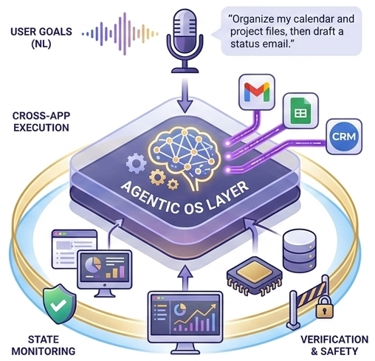
What is an “agentic OS layer”?
A layer that:
• Takes natural language goals
• Observes the real computer state
• Plans + executes across apps
• Verifies outcomes
• Enforces safety boundaries
Notes:
So what do we mean by an agentic OS layer?
We can think of it as a new abstraction layer that sits on top of existing applications and operating systems.
First, it takes user goals expressed in natural language.
Then it observes the real state of the computer, including applications, files, and system context.
Based on that state, the agent can plan and execute actions across multiple applications.
After execution, it verifies whether the intended outcomes are achieved.
And importantly, it must enforce safety boundaries, ensuring that actions remain secure and aligned with user intent.
In short, the agent becomes a goal-driven interface to the entire computing environment.

Slide 6
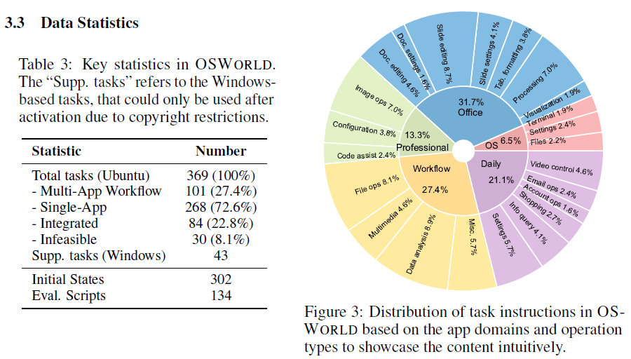
Why we need benchmarks first
Why benchmarks come first
Without a realistic benchmark:
• LLMs are not comparable
• No standard os environment as base
• Lack show case of real scenario complexity
OSWorld is the “real computer” benchmark
Source: OSWorld
Notes:
Before building agentic OS systems, we first need a benchmark.
Without a realistic benchmark, agents are not truly comparable, there is no standard OS environment, and real-world computer complexity is hard to capture.
This is why OSWorld comes first.
OSWorld provides a real computer benchmark with both single-app tasks and multi-app workflows.
So in the research path, OSWorld is the foundation for measuring whether agents can truly operate computers.

Slide 7
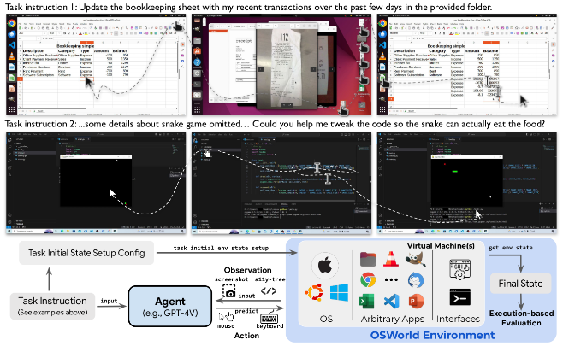
OSWorld in one slide
OSWorld present
The first scalable real-computer benchmark for open-ended agent evaluation
369 real-world tasks spanning arbitrary applications and cross-app workflows
Reproducible task environments for standardized and repeatable evaluation
Execution-based evaluators for measuring actual task success rather than text overlap
Source: OSWorld task demonstration figure.
Notes:
The key contribution of OSWorld is that it provides the first scalable real-computer benchmark for open-ended agent evaluation.
It includes 369 real-world tasks, covering both arbitrary applications and cross-app workflows, so the benchmark reflects the complexity of actual computer use.
Just as importantly, OSWorld provides reproducible task environments and execution-based evaluators, which means we can measure whether an agent truly completes a task, rather than only matching text outputs.
So overall, OSWorld gives us a realistic and standardized foundation for evaluating computer-use agents.

Slide 8
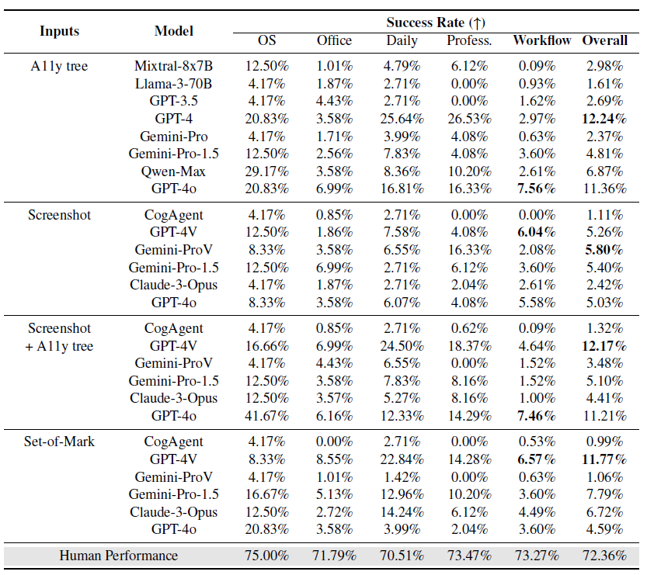
OSWorld: Key numbers
Baseline LLM/VLM agents evaluated on OSWorld
Reported across 5 task categories: OS, Office, Daily, Professional, Workflow
Reveals the gap in GUI grounding and operational knowledge
Ubuntu tasks
Human SR
369
72.36%
real workflows
upper bound
Best baseline
12.24%
Massive gap =
GUI grounding +
operational knowledge
best published
Source: OSWorld Benchmark
Notes:
There are the key numbers from OSWorld benchmark.
The benchmark contains Ubuntu tasks, with an additional Windows analysis set, so it already covers a broad range of realistic computer-use scenarios.
What is especially showcases is the performance gap. Humans achieve 72.36% success, while the best published baseline reaches only 12.24%.
The table on the right, further breaks results down across five task categories: OS, Office, Daily, Professional, and Workflow.
So today’s agents are still far from human-level computer use.
And this gap is not just about language understanding — it mainly reflects weaknesses in GUI grounding and operational knowledge.

Slide 9
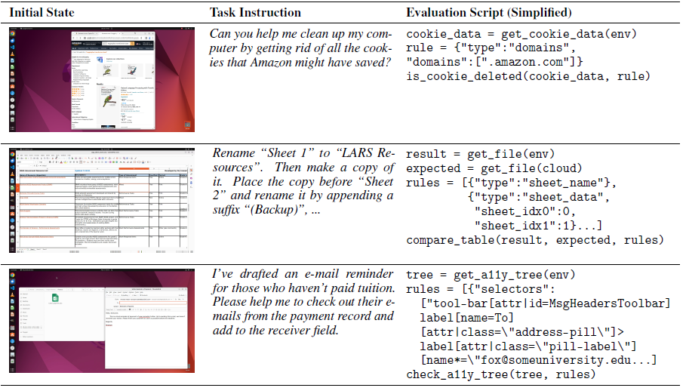
OSWorld: Data collection
369 + 43 tasks from real-world computer use
400 man-hours for task collection
84 benchmark-integrated tasks + 30 infeasible tasks for broader and more realistic coverage
Two-author cross-checking for every task
1,800 man-hours for setup, evaluation, and quality control
Source: OSWorld task example
Notes:
OSWorld has substantial manual effort in data collection.
It includes 369 Ubuntu tasks plus 43 Windows tasks, all derived from real computer-use scenarios.
The authors also added 84 benchmark-integrated tasks and 30 infeasible tasks to broaden coverage and better reflect real-world requests.
In total, task collection took about 400 man-hours, and the full pipeline — including setup, evaluation, and quality control — took about 1,800 man-hours.
Each task was also cross-checked by two other authors, which made the benchmark more reliable and reproducible.

Slide 10
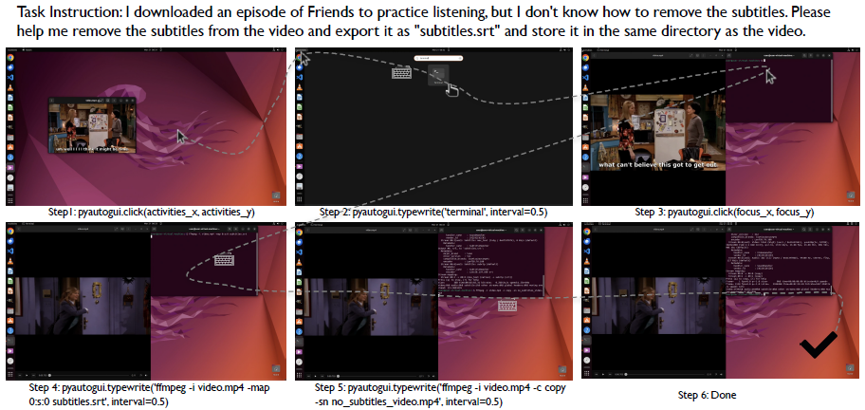
OSWorld: Execution-based evaluation
Custom execution-based evaluators for every task
Checks real outcomes in the OS environment
Covers files, applications, UI states, and workflows
Reliable and reproducible automatic evaluation
Beyond text matching: measures actual task success
Source: OSWorld Fig. 9 (success case).
Notes:
The benchmark is not limited to one interface or one app type; it can evaluate open-ended tasks across arbitrary applications in a real OS environment.
A key design choice in OSWorld is execution-based evaluation. Instead of only checking the final text output, OSWorld checks whether the agent actually changes the computer state in the right way.
For each task, OSWorld provides a custom evaluation script, so success can be verified respectively.
These evaluators can check many different outcomes, including files, applications, UI states, and cross-app workflows.

Slide 11
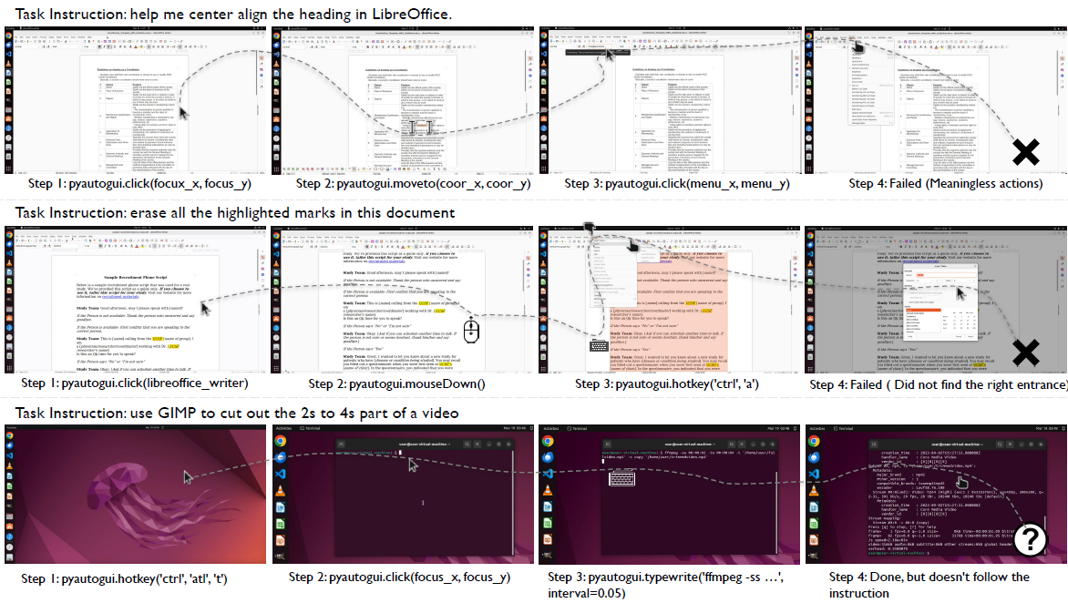
OSWorld: Failure modes
Common failure modes (OSWorld)
GUI errors: inaccurate operations in complex interfaces
UI state drift: execution becomes unstable after small mistakes
Noise sensitivity: unexpected windows and visual clutter disrupt action chains
Insufficient operational knowledge: limited knowledge of tool usage
Planning is easier than execution: agents can propose good plans, but fail in step-by-step control
Source: OSWorld qualitative failure analysis.
Notes:
There are the main failure modes observed in OSWorld.
The first is GUI errors. Even when the agent understands the goal, it may still click the wrong target or make inaccurate operations in a complex interface.
The second is UI state drift. A small mistake early on can change the interface state and make all later actions unstable.
Third, agents are highly sensitive to pop-ups and visual noise. Unexpected windows or cluttered layouts can easily break an action chain.
Another major issue is insufficient operational knowledge. The agent may know what it wants to do, but not how to use a specific tool correctly.
Overall, for LLMs, planning is often easier than execution. Agents can generate reasonable high-level plans, but still fail in step-by-step computer control.

Slide 12
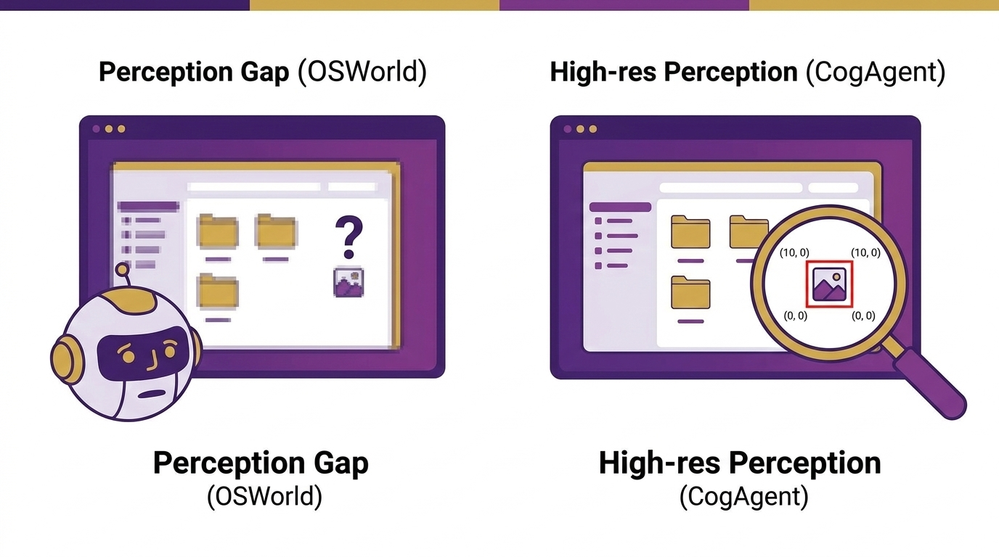
Step 2: Perception for GUIs
STEP 2
Common failure modes (OSWorld)
OSWorld reveals a perception gap
GUI grounding is hard in dense, high-resolution interfaces
Agents often know what to do, but not where to act
CogAgent targets this gap with high-resolution GUI perception
Notes:
From OSWorld, we learned that a major bottleneck is not only planning, but also perception. Many failures begin with weak GUI grounding.
Modern interfaces are challenging because they contain dense layouts, tiny text, and small visual targets. Even when an agent knows what to do, it may still fail to identify exactly where to act.
This is the gap that CogAgent tries to address. Its focus is GUI understanding from visual inputs, especially under high-resolution interfaces.
For step2, the key idea is simple: before an agent can act reliably, it must first perceive the GUI accurately.

Slide 13
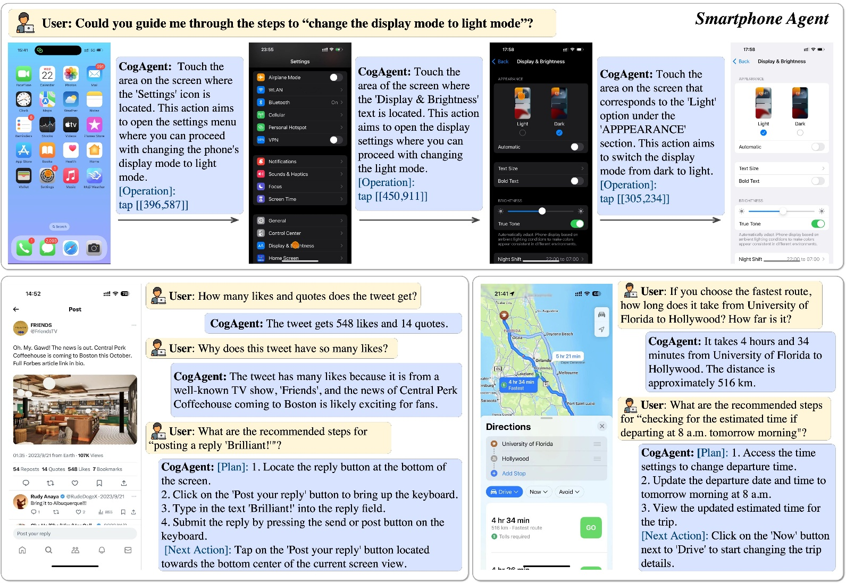
CogAgent in one slide
Point 1
Specialized 18B VLM for GUI understanding
Point 2
1120 × 1120 high-resolution input for tiny UI elements
Point 3
Screenshot-only SOTA on GUI navigation benchmarks
Source: CogAgent Fig. 1.
Notes:
Next, We will move to CogAgent, which focuses on GUI perception.
The first key point is that CogAgent is a specialized 18B visual language model for GUI understanding. Its goal is not general vision alone, but understanding interfaces and supporting GUI-based interaction.
The second point is its visual input. CogAgent supports a high resolution, which is especially important for GUI tasks, because real interfaces often contain tiny text, small buttons, and dense layouts.
The third point is the empirical result: CogAgent achieves screenshot-only sota performance on GUI navigation benchmarks. This shows that stronger visual grounding can directly improve an agent’s ability to understand and navigate interfaces.
So overall, if OSWorld tells us that agents fail on GUI grounding, then CogAgent is an important step toward solving that perception bottleneck.

Slide 14
CogAgent: Architecture
Built on CogVLM, CogAgent combines global layout perception with high-resolution detail perception for accurate GUI grounding.
CogVLM backbone
Pretrained vision-language foundation model.
Dual visual encoders
Low-resolution for layout, high-resolution for details.
1120 × 1120 GUI input
Captures tiny text, icons, and fine-grained UI elements.
Key idea: preserve both page structure and local details for GUI understanding and navigation.
Source: CogAgent Fig. 2 (high-resolution cross-module).
Notes:
Now let’s look at the architecture of CogAgent.
CogAgent is built on CogVLM, a pretrained vision-language foundation model. The main idea is to improve GUI grounding by combining global layout perception with high-resolution detail perception.
The first component is the CogVLM backbone, which provides the basic image-language understanding capability.
On top of that, CogAgent introduces dual visual encoders. The low-resolution branch captures the overall page structure and layout, while the high-resolution branch focuses on small but important details, such as tiny text, icons, and fine-grained UI elements.
But,why CogAgent supports such high resolution GUI as input? For GUI tasks, preserving these local details is critical, because many actions depend on reading small text or identifying precise targets on the screen.
So This architecture aims to preserve both global structure and local details, enabling more accurate GUI understanding and navigation.

Slide 15
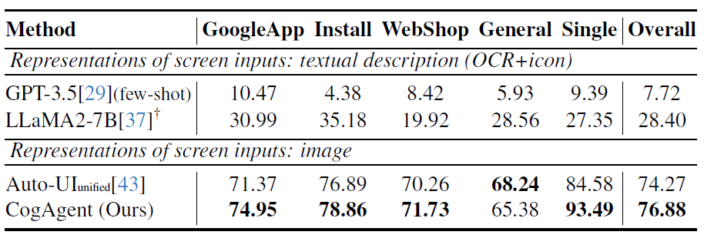
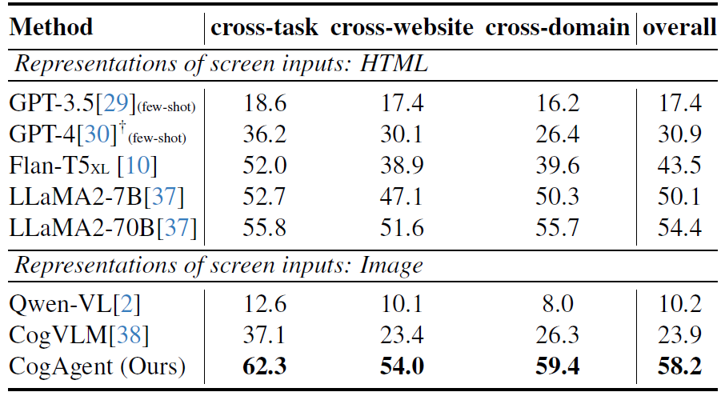
CogAgent: VQA numbers
CogAgent is evaluated on two benchmarks, Mind2Web focuses on PC/web GUI navigation and measures step-level decision making. AITW focuses on Android GUI interaction and evaluates action prediction and control.
The results show that CogAgent outperforms HTML-based LLM baselines using screenshots alone.
It also achieves state-of-the-art results on mobile GUI navigation, showing that the architecture generalizes beyond web pages to real app interaction.
OSWorld includes CogAgent as a representative VLM agent baseline for computer-use evaluation.
Source: CogAgent Table 3,4 (reformatted for readability).
Notes:
Here we show the main results of CogAgent on GUI-related benchmarks.
CogAgent is evaluated on two representative benchmarks: Mind2Web and AITW. Mind2Web focuses on PC and web GUI navigation, and measures step-level decision making on desktop-style interfaces. AITW focuses on Android GUI interaction, and evaluates action prediction and control on mobile interfaces.
The results show that CogAgent outperforms other LLM baselines using screenshots alone. This is important, because it suggests that strong visual grounding can outperform structured-text pipelines in GUI navigation.
It also achieves state-of-the-art performance on mobile GUI navigation, which shows that the architecture generalizes beyond web pages to real app interaction.
Finally, this also connects back to OSWorld: CogAgent is included there as a representative VLM agent baseline for computer-use evaluation.

Slide 16
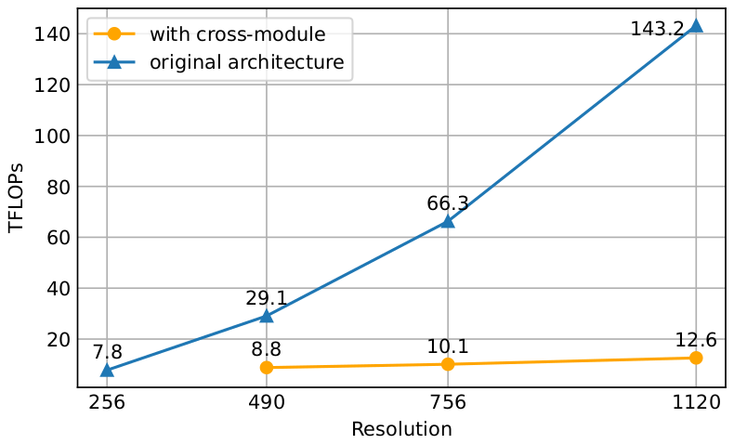
CogAgent: Why high-res matters
Why high-res matters
GUIs are text-rich and detail-heavy
1120 × 1120 helps read tiny text and ground small targets
Naive high-res scaling is computationally expensive
CogAgent uses a lightweight high-res cross-module
Result: better GUI grounding at manageable cost
Source: CogAgent FLOPs comparison figure.
Notes:
Why high resolution matters for GUI agents? Here are the details.
The first reason is that modern GUIs are text-rich and detail-heavy.
So higher resolution is important,.
However, the challenge is that scaling resolution is computationally expensive. As shown in the figure, if we directly scale the original resolution, the FLOPs increase very quickly as its grows.
This is exactly why CogAgent introduces a lightweight high-resolution cross-module. Instead of paying the full cost of naive scaling, it combines global low-resolution perception with local high-resolution detail caption.

Slide 17
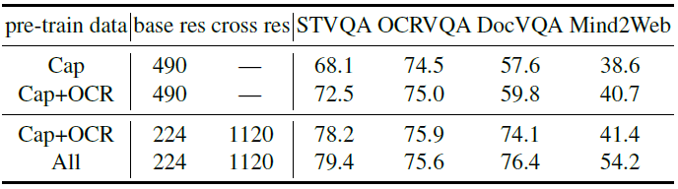
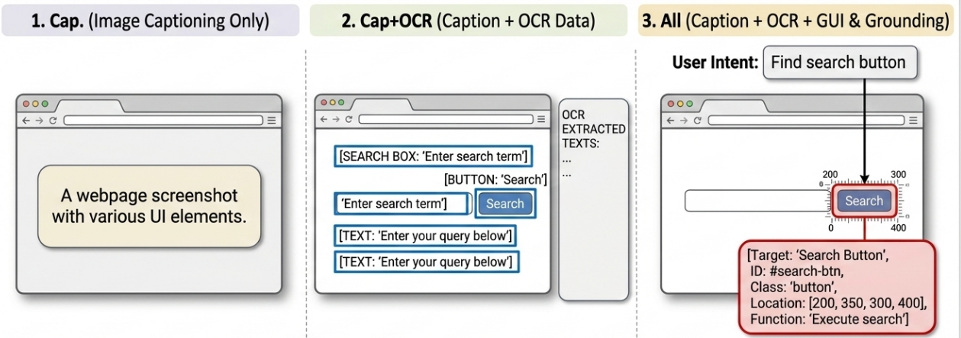
CogAgent: Ablation evidence
Ablation study
Cap: image captioning only
Cap+OCR: Add OCR data based on caption data
All: Add GUI and grounding data, teaching the model to understand screens and match user intent to the right on-screen element.
Mind2Web lift
Takeaway
+12.8
Adding GUI / grounding data matters, not only architecture.
41.4 → 54.2
Source: CogAgent Table 6
Notes:
So where CogAgent’s ability gains from? Here is an ablation study.
The first setting, Cap, uses only image captioning data. Then Cap+OCR adds OCR data, which improves the model’s ability to read text in images.
The final setting, All, further adds GUI and grounding data. In simple terms, this means data that teaches the model how to understand screens and connect a user’s intent to the correct on-screen element.
The most important result here is on Mind2Web Benchmark. When moving from the previous setting to All, the score increases from 41 to 54, which is a huge gain.
So CogAgent’s improvement does not come from architecture alone. Domain-specific GUI and grounding data really play a major role.

Slide 18
Limits of perception-only agents
What still breaks
Why perception is not enough
Next move
Even with good UI understanding:
• execution can drift
• errors happen
Perception helps choose targets, but robust automation still needs recovery logic.
Need closed-loop operating system control
Seeing the UI is necessary. Closing the loop is what makes agents reliable.
Notes:
So far, we have seen that CogAgent significantly improves GUI perception. But perception alone is still not enough.
Even if an agent understands the UI well, errors can still happen during multi-step interaction. Perception helps the agent choose the right target, but robust automation also needs the ability to monitor state, recover from mistakes, and continue after unexpected changes.
So the next move is clear: we need closed-loop operating system control.
In other words, seeing the UI is necessary, but closing the loop is what makes agents truly reliable.

Slide 19
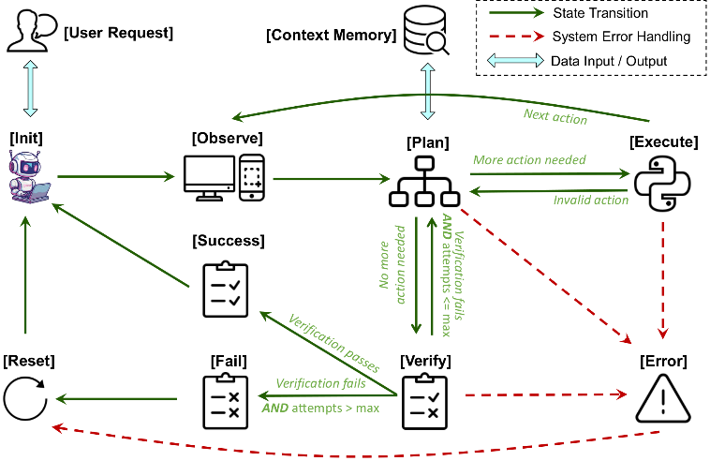
Step 3: State-aware control
STEP 3
OS control as a closed loop:
Observe → Plan → Execute → Verify → Re-plan
Source: OSCAR Fig. 2 (state machine).
Notes:
Lets move to Step 3: state-aware control.
Instead of just observing the screen once and taking actions blindly, the agent should continuously observe, plan, execute, verify, and re-plan.
That is the key idea shown in this figure. The agent starts from a user request, observes the current computer state, makes a plan, executes actions, and then checks whether the expected outcome is actually achieved.
If verification succeeds, the task moves forward. If not, the agent can detect failure, recover from errors, and re-enter the loop with updated state information.
So compared with perception-only agents, the important shift here is from seeing the UI to controlling the system with feedback.
And this is what makes computer-use agents much more robust in long-horizon, multi-step tasks.

Slide 20
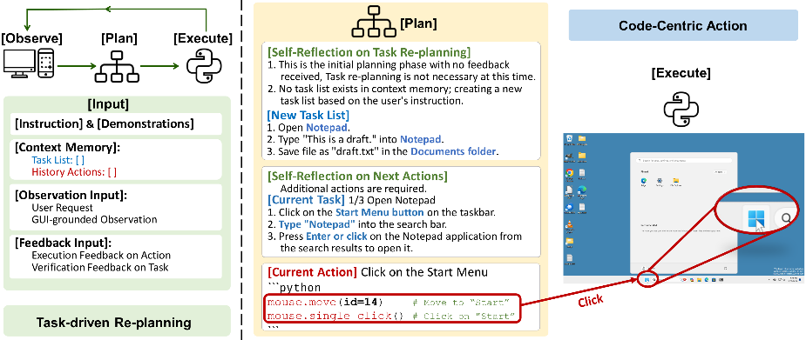
OSCAR in one slide
Point 1
Point 2
Point 3
OSCAR (agent system)
State machine + error handling
Instruction → executable Python control code & Dynamic replanning from real-time feedback
Source: OSCAR task-driven re-planning figure.
Notes:
This brings us to OSCAR, which is a concrete system for state-aware control.
If CogAgent focuses on perception, then OSCAR focuses on what happens after perception: how to turn understanding into reliable action.
OSCAR introduces a state machine with explicit error handling. Instead of treating execution as a one-shot process, OSCAR keeps track of system state.
Also OSCAR converts user instructions into executable Python control code, and then performs dynamic re-planning based on real-time feedback from the environment.
In that sense, OSCAR moves us from seeing the interface to reliably operating the computer.

Slide 21
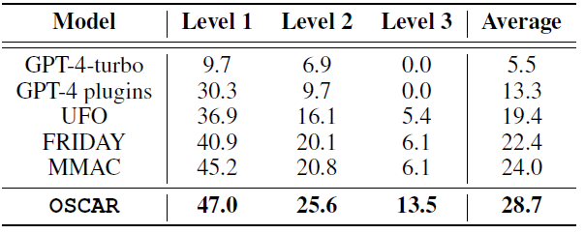
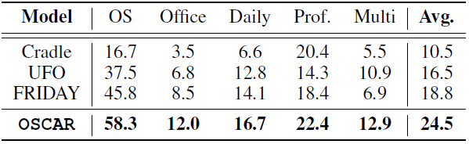
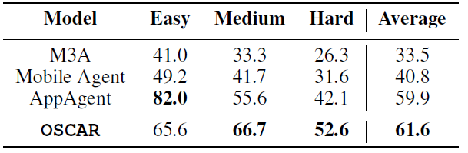
OSCAR: Headline results
GAIA avg
OSWorld avg
AndroidWorld avg
28.7%
24.5%
61.6%
Workflow QA
Desktop OS
Mobile OS
Observation
One system improves across desktop, mobile, and workflow benchmarks. The real bottleneck now is reliability under dynamic execution.
Source: OSCAR Tables 1–3 (headline averages, reformatted).
Notes:
Here shows the performance of OSCAR in some benchamrks. OSCAR improves across workflow, desktop, and mobile benchmarks.
At the same time, we should also be careful about what these numbers mean. Even though OSCAR is strong across settings, it is still far from human performance on OSWorld.
So the real challenge now is no longer just perception or single-step action. The real bottleneck is reliability under dynamic execution.

Slide 22
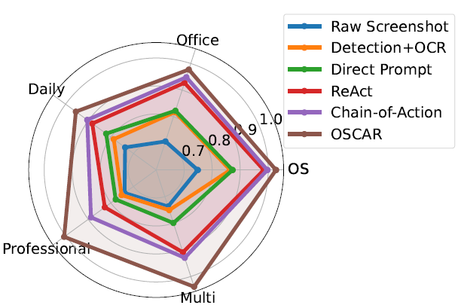
OSCAR: Decomposed performance
Interpretation
Simpler baselines can work on shorter daily or office tasks, but they become less reliable in professional and especially multi-app scenarios, where trajectories are longer, interfaces are denser, and execution drift has more chances to accumulate.
Source: OSCAR Fig 5
Notes:
This figure breaks down OSCAR’s performance across different task categories.
A clear pattern is that simpler baselines can still work reasonably well on shorter daily or office tasks. But once we move to professional and especially multi-app scenarios, the gap becomes much larger.
And this is not surprising. Multi-app tasks remain the hardest case because the trajectories are longer, the context has to be tracked across applications, and UI drift has more chances to accumulate over time.
This is exactly where OSCAR shows its advantage.

Slide 23
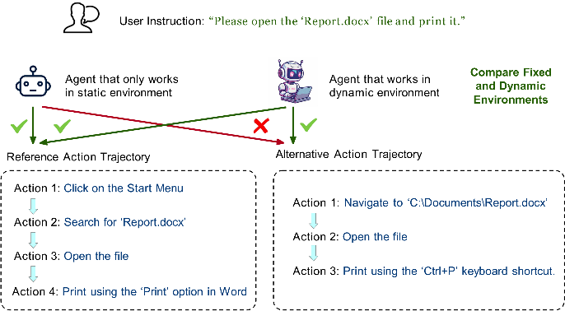
OSCAR: Static vs Dynamic evaluation
Static: match actions to reference (Mind2Web / AITW)
Dynamic: verify final OS state (OSWorld / AndroidWorld)
OSCAR targets the dynamic setting
Source: OSCAR static vs dynamic evaluation figure.
Notes:
Before moving on, it is important compare static and dynamic evaluation.
In static evaluation, the agent is judged by how well its actions match a reference trajectory. That kind of evaluation is useful, but it assumes there is a preferred action path.
In contrast, dynamic evaluation focuses on whether the agent actually reaches the correct final OS state. This is the setting used in benchmarks such as OSWorld and AndroidWorld.
And this distinction matters a lot in practice. In real computer use, there may be multiple valid ways to complete the same task. An agent does not need to exactly follow a reference trajectory, as long as it successfully changes the system to the desired outcome.
This is also why dynamic execution-based evaluation is closer to real assistants.

Slide 24
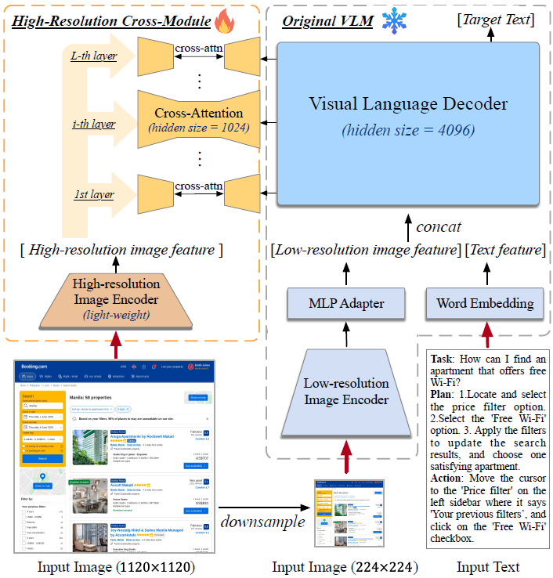
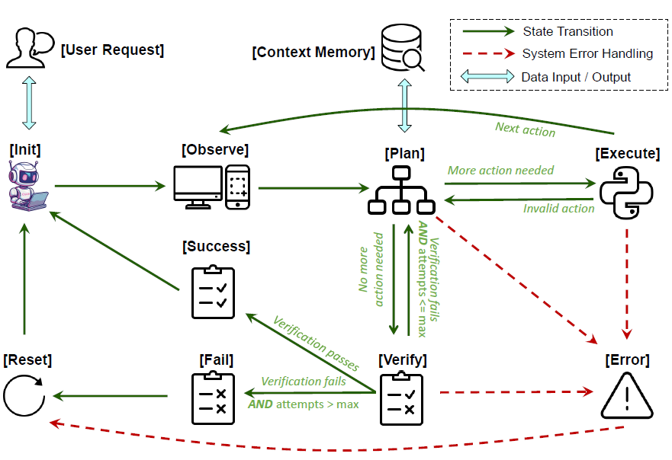

The research path (one story)
Benchmark
Perception
Control loops
OSWorld
CogAgent
OSCAR
Toward LLM-as-OS = measurable, perceptive, controllable
Notes:
Now summarize the whole research path. OSWorld gives us a realistic benchmark, so progress becomes measurable and we can see clearly where current agents fail. CogAgent shows that GUI grounding is a major bottleneck, the next question is perception. So CogAgent addresses this by improving GUI understanding, especially for high-resolution, text-rich interfaces. OSCAR adds state awareness, error handling, and closed-loop re-planning, so agents can operate more reliably in dynamic environments.
These works are not isolated pieces. Each of them fills in one missing layer of the stack: first measure, then perceive, next control.
And that is why they naturally compose into one path: toward LLM-as-OS that are measurable, perceptive, and controllable.

Slide 25
Runtime becomes the new security boundary
Identity
Execution
Agents run with real credentials, tokens, and account state.
They can trigger tools, code, UI actions, and file mutations.
Runtime becomes the security boundary
Agents execute actions with credentials
They ingest untrusted instructions + untrusted code
So isolation and identity governance are mandatory
Persistence
They accumulate memory, pairing, and automation state over time.
Source basis: security framing summarized in the provided report.
Notes:
But once we take the idea of LLM as OS seriously, a new question immediately appears: security. When an agent starts operating the computer in the real world, the runtime itself becomes the new security boundary.
Why? Because agents do not act in an abstract sandbox. They run with real identity — real credentials, real tokens, and real account state.
They also have real execution power. They can call tools, execute code, take UI actions, and modify files. Agents are no longer just models answering questions; they are becoming a form of privileged automation. If we want to deploy agentic OS safely, then isolation and identity governance must be built into the runtime from the start.

Slide 26
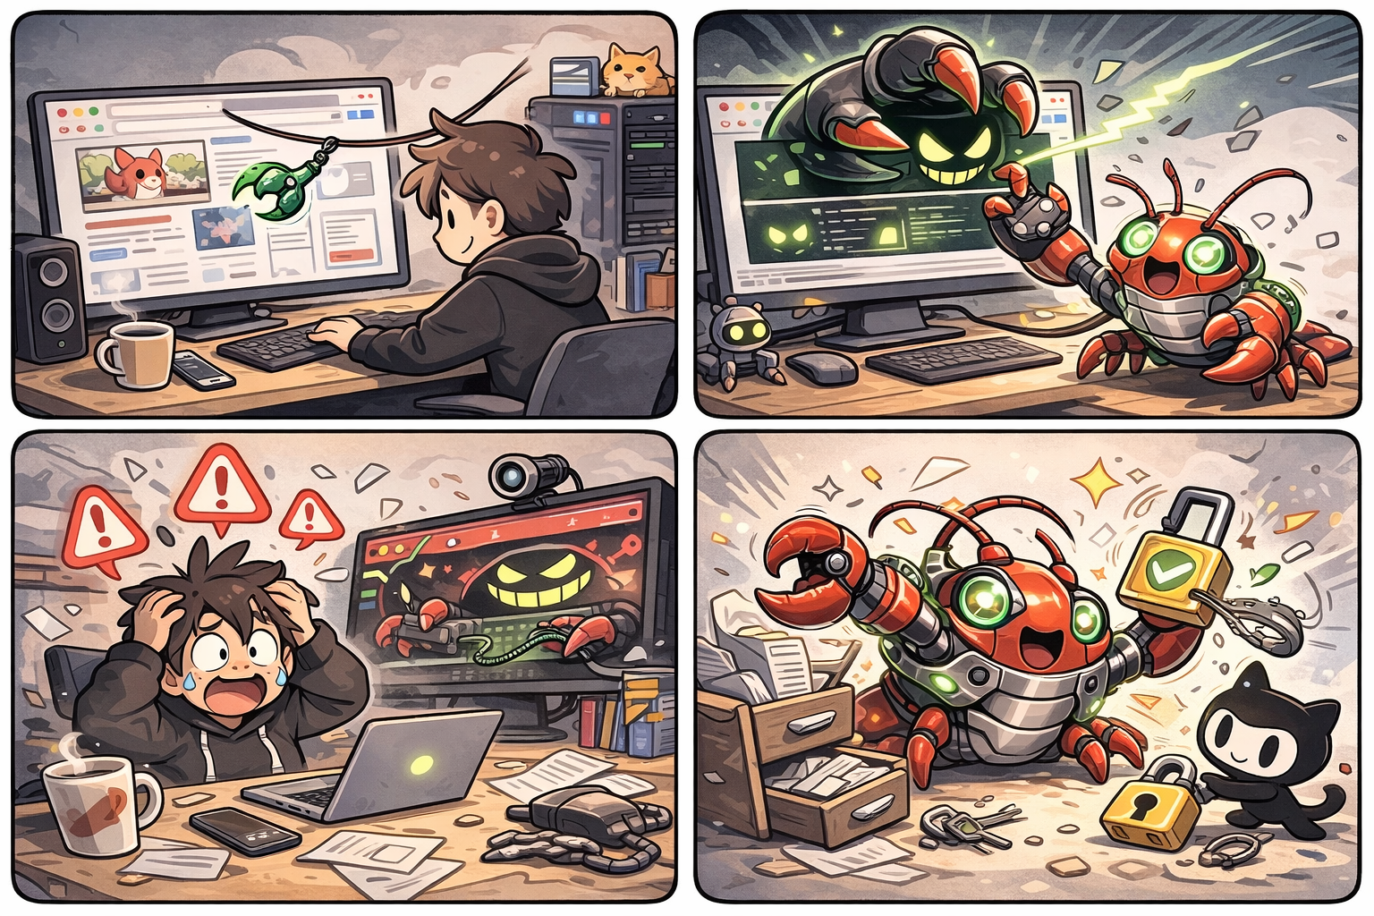
Oasis: ClawJacked (Feb 2026)
Notes:
Let me use ClawJacked as a security story.
Last month, The Security disclosed a dangerous bug in OpenClaw. The key issue was that a outer website could connect to the agent’s local gateway over localhost WebSocket and take over the agent.
The real risk moves into the runtime.
Anyone, anywhere, could be secretly accessing your computer. This is why we need to fundamentally rethink OS agent security.

Slide 27
Takeaways
1) OS history = abstraction layers for humans
2) LLM agents may form a new OS layer
3) OSWorld → CogAgent → OSCAR is a coherent path
4) Runtime security is the gating factor
Notes:
Here are the takeaways.
First, the history of operating systems is really the history of abstraction layers for humans.
Second, LLM agents may become the next OS layer, helping reduce workflow complexity.
Third, OSWorld, CogAgent, and OSCAR form one coherent path: from measurement, to perception, to control.
And finally, if we want to make this vision real, runtime security will be the gating factor.
So overall, the opportunity is exciting — but to make LLM-2-OS real, we need systems that are not only Executable, but also reliable and secure.

