Slide 1
PGO (Profile Guided Optimization) For Linux Kernel in Data Center 2026.03.10
Hui Li
School of Data Science
Chinese University of Hong Kong, Shenzhen

Slide 2
Outline
Introduction (3 min)
Background & Motivation (5 min)
Proposed Methods (15 min)
﻿Application-Specific OS (3 min)
﻿One Profile Fits All (3 min)
﻿PlugSched (4 min)
My Method (5 min)
Conclusions (2 min)
Q & A (5 min)

Slide 3
Outline
Introduction (3 min)
Background & Motivation (5 min)
Proposed Methods (15 min)
﻿Application-Specific OS (3 min)
﻿One Profile Fits All (3 min)
﻿PlugSched (4 min)
My Method (5 min)
Conclusions (2 min)
Q & A (5 min)

Slide 4
Introduction (1/2)
What are the special characteristics of OS in data center?
Running Environment: One or several large-scale applications running in each server
Features:
High Availability: Uninterrupted operation, with support for hot patching.
High Concurrency: Fine-grained resource scheduling of CPU, memory and network.
Automated Operation: Support batch deployment and automated operation & maintenance
Large-Scale Applications
User
Space
Glibc
System Call Interface
Progress Management
Virtual File System
Kernel
Space
Memory Management
Network Stack
Arch / Device Drivers
Hardware Platform
Figure 1: Overview of Server Architecture.

Slide 5
Introduction (2/2)
Why we need to optimize specific OS in data center?
Specific Tasks: Each type of application has different requirements for the operating system. Some emphasize memory management, while others stress rapid scheduling.
Limitations of General OS: Gernel OS cannot maximize a certain function required by a large-application.
What is the ideal OS for the data center?
Customization: Make specific applications running on it operate more efficiently.
Implementation types: Support automated maintenance and updates.
OS
Runing &Collecting
information
Update
Re-compile OS
Figure 2: The Ideal OS

Slide 6
Outline
Introduction (3 min)
Background & Motivation (5 min)
Proposed Methods (15 min)
﻿Application-Specific OS (3 min)
﻿One Profile Fits All (3 min)
﻿ PlugSched (4 min)
My Method (5 min)
Conclusions (2 min)
Q & A (5 min)

Slide 7
Background & Motivation (1/3)
Current Situation of Data Center:
High Cost Hardware: Most of the funds are used to improve the hardware of data centers.
Low Software Resource Utilization: The resources at the software level have not been utilized efficiently.
Complicated Deployment Process: Manual optimization of the source code is required for different applications resulting in high deployment costs.
Solutions:
Auto Optimization Method: Set up a feedback-based framework, enabling the program to automatically optimize the assembly code according to runtime information without changing the source code.

Slide 8
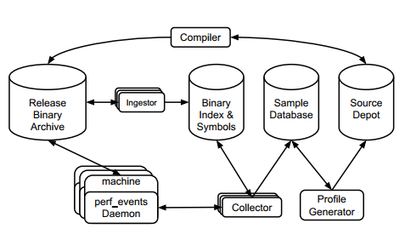
Background & Motivation (2/3)
Motivation in User Space:
﻿AutoFDO: ﻿Sample hardware performance monitors on production machines and use those profiles to guide optimization. It delivers a 10.5% speedup over non-FDO binaries.
JIT(Java): Dynamically compile frequently executed (hot) bytecode into native machine code at runtime, replacing slow bytecode interpretation for critical code paths.
Figure 3: AutoFDO System
Chen, Dehao, David Xinliang Li, and Tipp Moseley. "AutoFDO: Automatic feedback-directed optimization for warehouse-scale applications." Proceedings of the 2016 International Symposium on Code Generation and Optimization. 2016.

Slide 9
Background & Motivation (3/3)
Challenges:
Lack of Sampling Tools: Kernel mode has numerous restrictions and lacks the profiling tools available for collecting profile files in user mode.
Update Strategy: The operating system runs continuously, making it impossible to adopt a shutdown-based approach for OS updates.

Slide 10
Outline
Introduction (3 min)
Background & Motivation (5 min)
Proposed Methods (15 min)
﻿Application-Specific OS (3 min)
﻿One Profile Fits All (3 min)
﻿ PlugSched (4 min)
My Method (5 min)
Conclusions (2 min)
Q & A (5 min)

Slide 11
Application-Specific OS (1/3)
Observations:
Remarkable Success of PGO in User Space: PGO has achieved significant performance gains and wide adoption in the user mode for various applications, such as MySQL, Radis and Nginx.
Lack of PGO implementation in Kernel Space: The kernel mode lacks dedicated and practical profiling tools.
Motivation:
Leverage the PGO technology to compile a customized OS for each distinct server from a common source code.
Prof-gen
Compilation
Runing &
Generate
Prof file
Re-compile
Code
with Prof file
Figure 4: The Process of PGO
Apache
profile
Linux for
Apache
Linux kernel
source code
repository
GCC
MySQL
profile
Linux for
MySQL
Redis
profile
Linux for
Redis
Figure 5: Overview of Application-Specific OS.
Yuan, Pengfei, et al. "Building application-specific operating systems: a profile-guided approach." Science China Information Sciences 61.9 (2018): 092102.

Slide 12
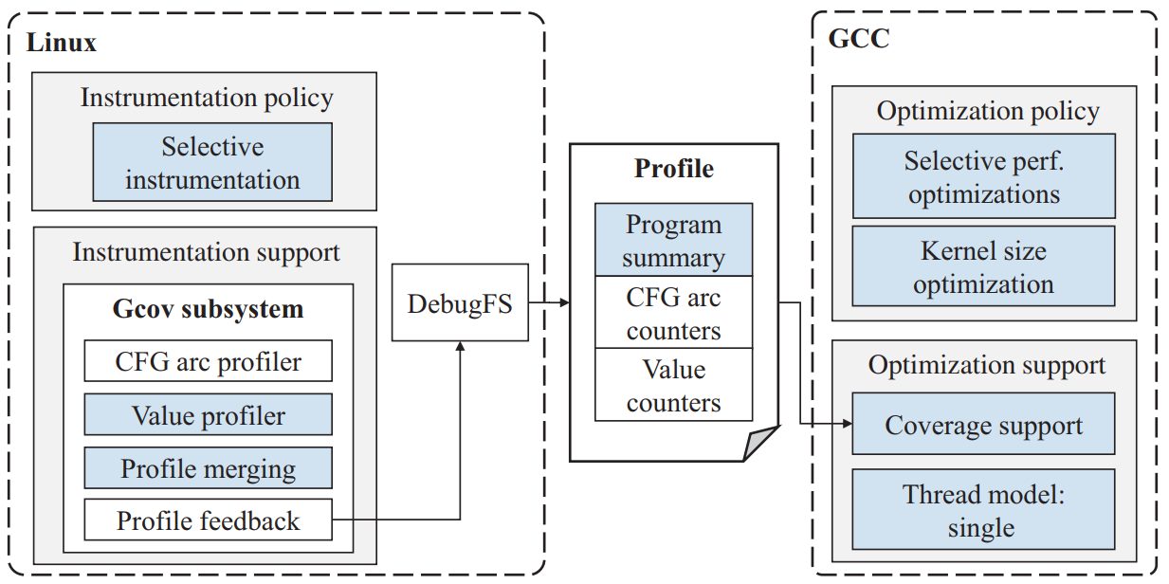
Application-Specific OS (2/3)
Implementation:
﻿Kernel Instrumentation:
Value Profiling: ﻿ Add profilers that are used in the instrumentation phase to gcov subsystem.
Disable TLS (﻿Thread-Local Storage)
﻿Selective Instrumentation
﻿Profile Collection: ﻿Write a utility program to help Calculate
GCC Modifications: ﻿Fix optimization problems and ﻿selective size optimization
Figure 6: System Architecture of Tarax.

Slide 13
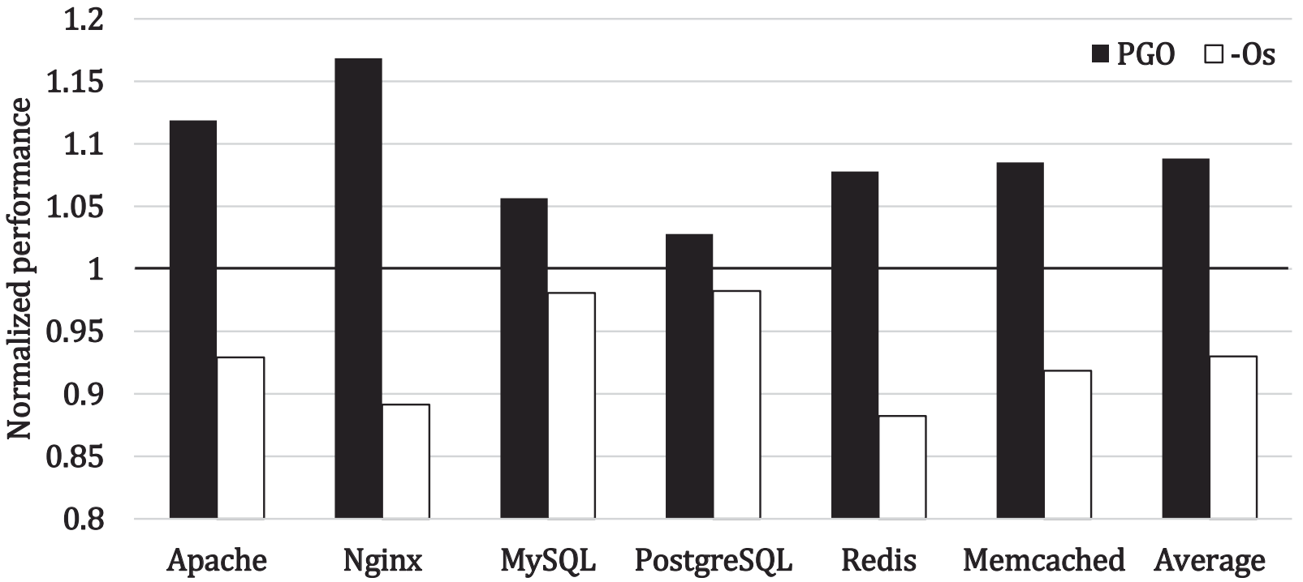
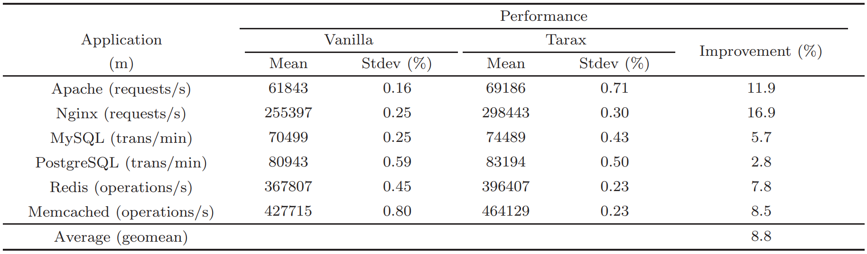
Application-Specific OS (3/3)
Results:
Conduct experiments on six popular server applications: Apache, Nginx, MySQL, PostgreSQL, Redis and Memcached.
Application performance improves by 8.8% on average (up to 16%)
Figure 7:Performance comparison: Tarax vs. kernel (-Os)
Table 1: ﻿Application performance on the vanilla kernel and the kernels optimized by Tarax

Slide 14
Outline
Introduction (3 min)
Background & Motivation (5 min)
Proposed Methods (15 min)
﻿Application-Specific OS (3 min)
﻿One Profile Fits All (3 min)
﻿PlugSched (4 min)
My Method (5 min)
Conclusions (2 min)
Q & A (5 min)

Slide 15
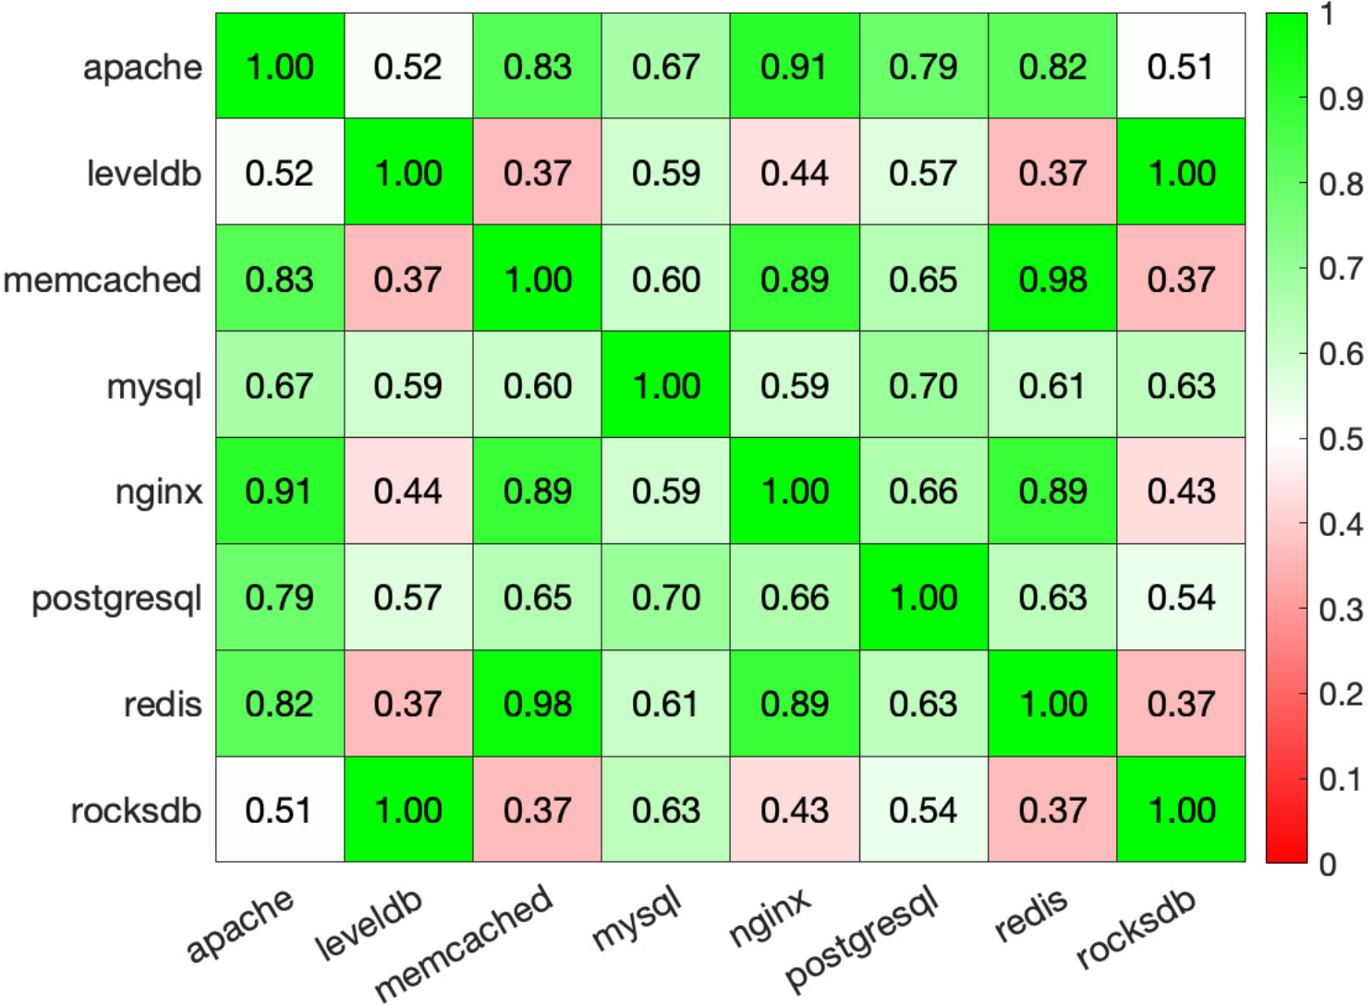
One Profile Fits All (1/3)
Observations:
Performance Bottleneck from Large Footprints: Instruction footprints, which far exceed the size of on-chip I-cache/I-TLB, leading to frequent misses.
High Misses in Kernel Space: 8 typical data center applications spend 43-74% of CPU cycles on kernel instructions; 61% of I-cache misses and 46% of I-TLB misses on average originate from the Linux kernel.
High Kernel Usage Similarity
Figure 8: ﻿Confusion matrix using cosine similarities for different data center applications based on the Linux kernel’s function execution frequencies, all other applications exhibit close similarity in their kernel function usage.
Ugur, Muhammed, et al. "One profile fits all: Profile-guided linux kernel optimizations for data center applications." ACM SIGOPS Operating Systems Review 56.1 (2022): 26-33.

Slide 16
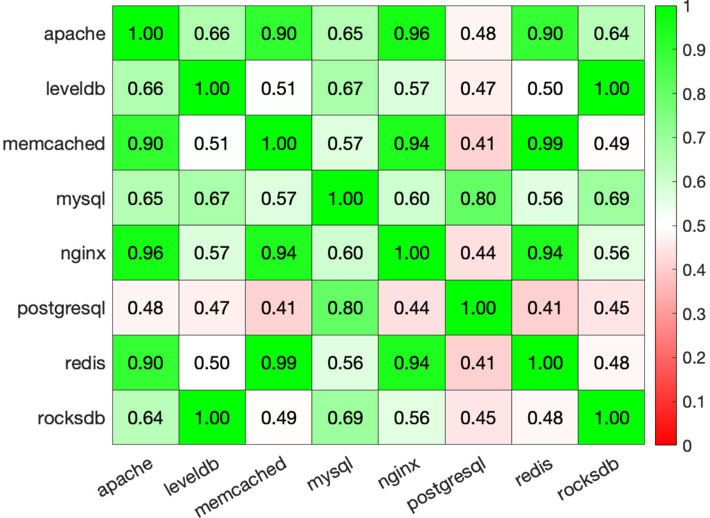
One Profile Fits All (2/3)
Observations:
Performance Bottleneck from Large Footprints: instruction footprints, which far exceed the size of on-chip I-cache/I-TLB, leading to frequent misses.
High Misses in Kernel Space: 8 typical data center applications spend 43-74% of CPU cycles on kernel instructions; 61% of I-cache misses and 46% of I-TLB misses on average originate from the Linux kernel.
High Kernel Usage Similarity
Figure 9: ﻿﻿Confusion matrix using cosine similarities in branch instructions for different data center applications.

Slide 17
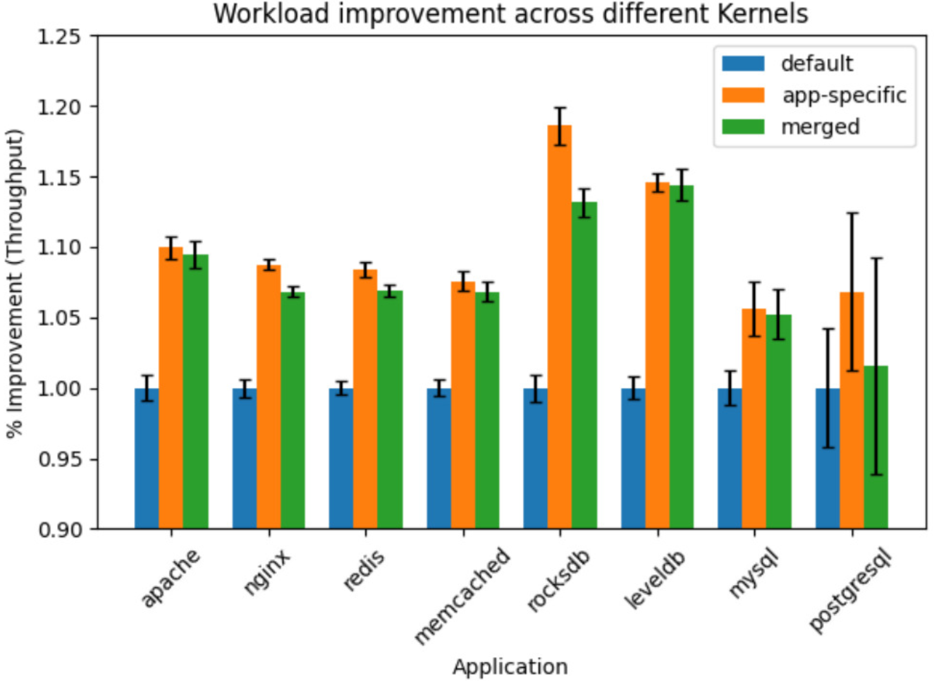
One Profile Fits All (3/3)
Motivations:
Limitations of Prior PGO Kernel: only focuses on application-specific customization and ignore generalization.
Feasibility of Universal Profile: High similarity in kernel usage across applications enables a universal kernel profile.
Method:
Merge of Profiles: Merge kernel execution profiles of all 8 applications with equal weights.
Results:
Achieve an average end-to-end speedup of 8.02%
Figure 10: ﻿﻿Comparison results between different kernels.

Slide 18
Outline
Introduction (3 min)
Background & Motivation (5 min)
Proposed Methods (15 min)
﻿Application-Specific OS (3 min)
﻿One Profile Fits All (3 min)
﻿PlugSched (4 min)
My Method (5 min)
Conclusions (2 min)
Q & A (5 min)

Slide 19
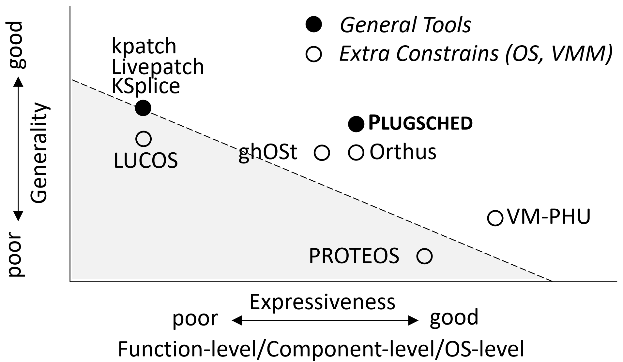
PlugSched (1/4)
Topic: Live Update of Linux Modules
Observations:
Limitations of Existing Live Update Techniques: Handle small code changes and lack data state migration support (Kpatch, Ksplice); component-level solutions (ghOSt) introduce extra context switch overhead.
Tight Kernel-Scheduler Coupling: The Linux scheduler has complex dependencies with other kernel subsystems (memory, time, cgroup) via hot paths.
Motivations:
Lack of Live Update Method for Linux Subsystem
Figure 11: ﻿﻿﻿Comparisons between potential solutions.
Ma, Teng, et al. "Efficient scheduler live update for linux kernel with modularization." Proceedings of the 28th ACM International Conference on Architectural Support for Programming Languages and Operating Systems, Volume 3. 2023.

Slide 20
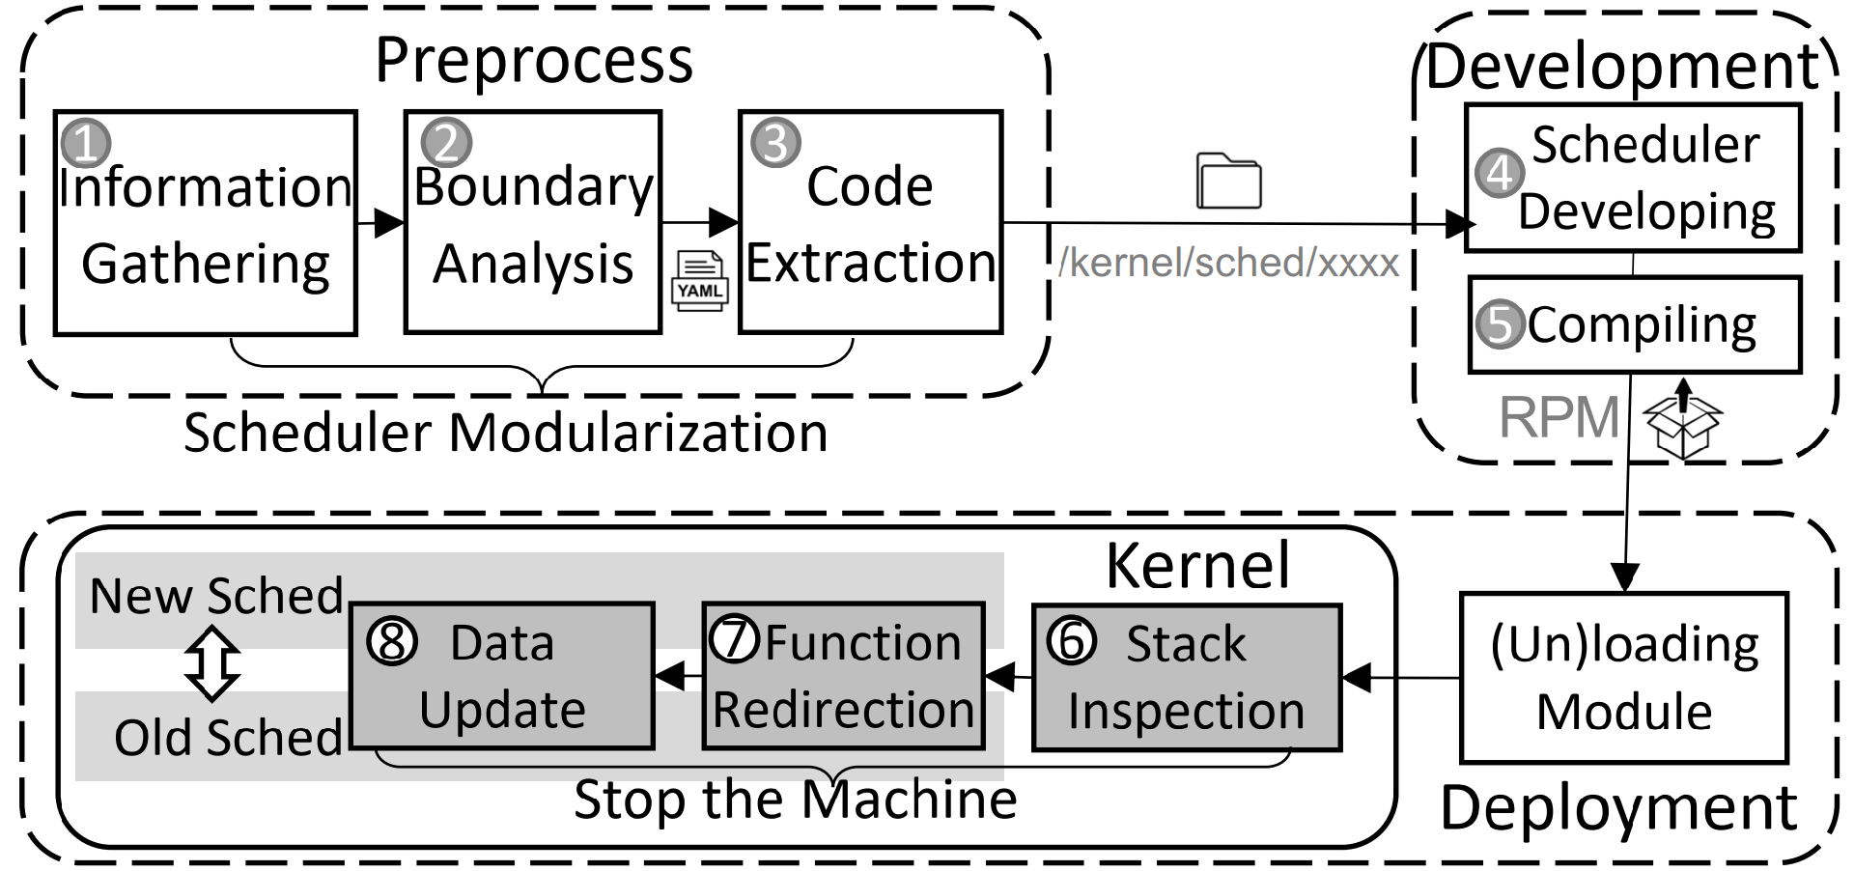
PlugSched (2/4)
Method:
System Design: Scheduler modularization (decouple scheduler from kernel as an independent module) and data rebuild (migrate state from old to new scheduler).
Scheduler Modularization: Extract scheduler code into an independent module directory.
Optimized Stack Inspection: Optimize stack inspection with multi-core parallelism and binary search.
Function Redirection: Replace original function prologues with JMP instructions for redirection.
Figure 12: ﻿The work flow of PlugSched.

Slide 21
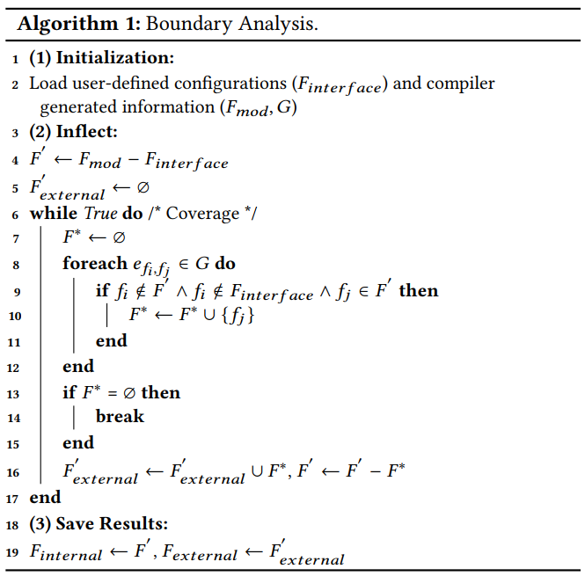
PlugSched (3/4)
Scheduler Modularization:
Adopt function boundary analysis to divide scheduler functions into interface / internal / external types and data into internal / external types.
Complete modularization via three steps:
Information gathering (GCC Plugin collects kernel call graph/function properties)
Boundary analysis (Algorithm 1 classifies functions via call graph traversal)
Code extraction (GCC Plugin reorganizes scheduler code into an independent module directory.
Notes:
The Boundary Analysis algorithm first loads user-defined scheduler interface functions, scheduler file functions and kernel call graph, then iteratively identifies external scheduler functions by checking call edges where callers are outside the scheduler module, and finally classifies the remaining scheduler functions as internal ones

Slide 22
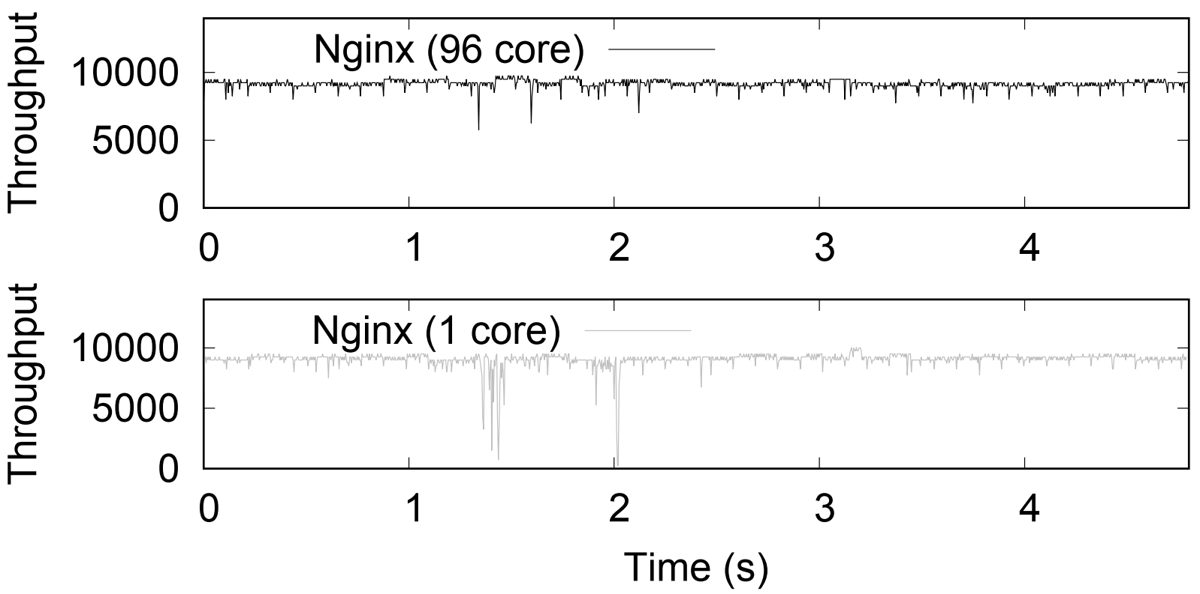
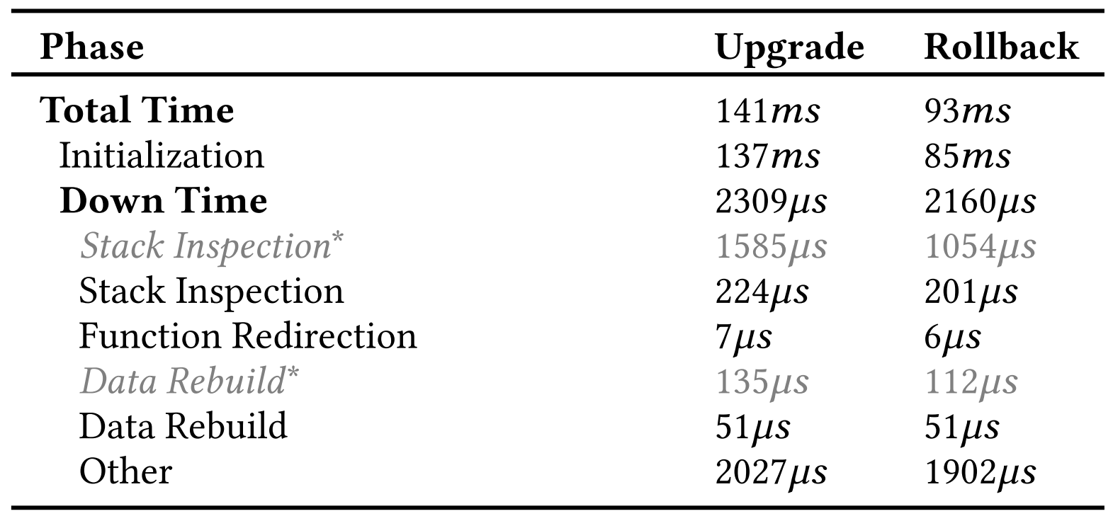
PlugSched (4/4)
Results:
Low Downtime: Plugsched achieves 2.1~2.6ms upgrade downtime and 1.8~2.5ms rollback downtime in experiments
Negligible Impact on Latency-Sensitive Workloads.
Figure 13: ﻿﻿﻿﻿The processing throughout of Nginx when we use PlugSched to update the scheduler
Table 2: ﻿﻿﻿﻿Breakdown of total time in PlugSched.

Slide 23
Outline
Introduction (3 min)
Background & Motivation (5 min)
Proposed Methods (15 min)
﻿Application-Specific OS (3 min)
﻿One Profile Fits All (3 min)
﻿PlugSched (4 min)
My Method (5 min)
Conclusions (2 min)
Q & A (5 min)

Slide 24
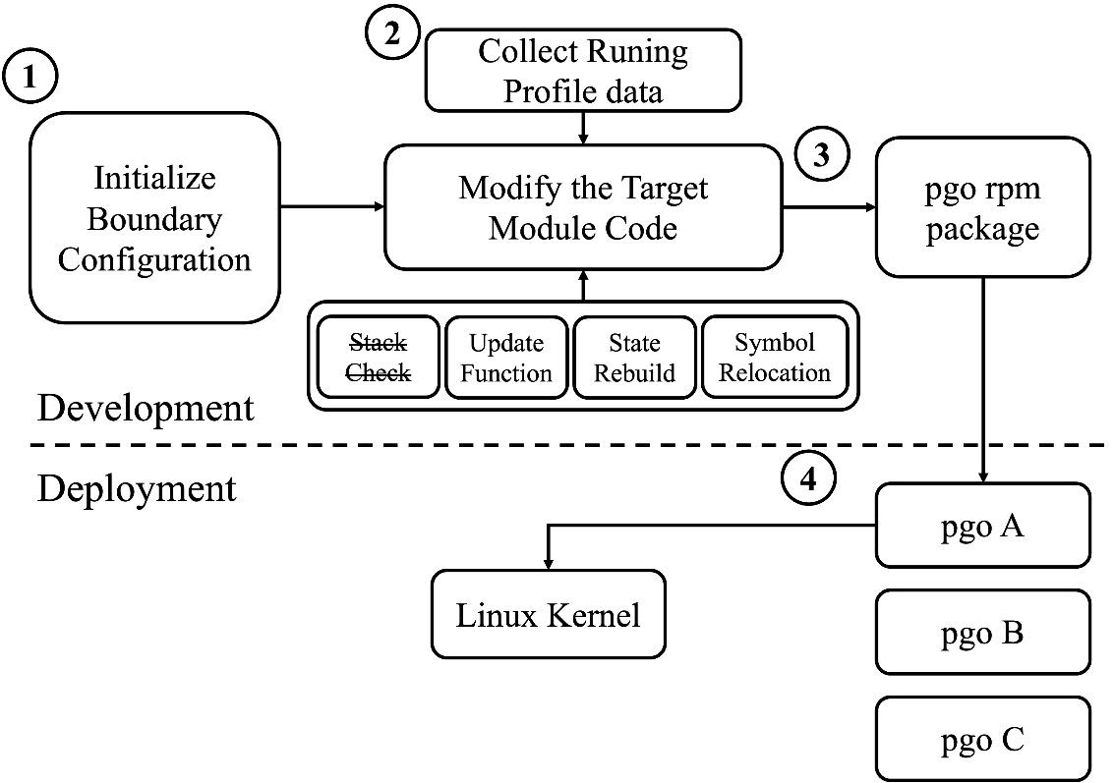
My Method (1/3)
Motivations:
Kernel PGO Deployment Limitation: Current PGO kernel adopt the whole-kernel update mode, relying on system shutdown/reboot for deployment without supporting hot dynamic updates.
Method:
Combine Plugsched with PGO to implement a hot-upgradable module acceleration solution for Linux kernel.
Figure 14: ﻿﻿﻿﻿ The work flow of PlugPGO

Slide 25
My Method (2/3)
Modifications:
Remove Data Restoration & Stack Check: Since all our data utilizes the system’s current data without creating new variables, data Restoration and stack check is not required.
Delayed Memory Release for Previous Modules: To ensure that no program runs in the abandoned code.
Figure 14: ﻿﻿﻿﻿ The work flow of PlugPGO

Slide 26
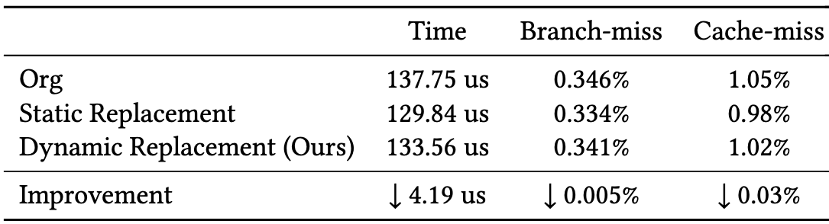
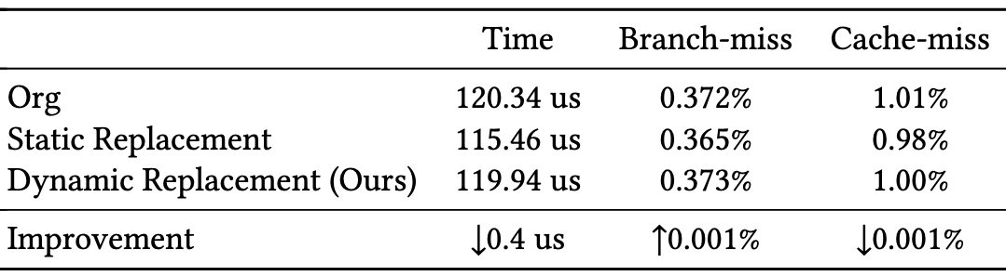
My Method (3/3)
Experiments:
Benchmark: Adopt the simplest UnixBench as the benchmark for evaluation.
Results: The performance of dynamic replacement, compared with that of static PGO, will lose part of the performance advantage.
Table 3: Swap Performance Comparison
Table 4: Pipe Performance Comparison

Slide 27
Outline
Introduction (3 min)
Background & Motivation (5 min)
Proposed Methods (15 min)
﻿Application-Specific OS (3 min)
﻿One Profile Fits All (3 min)
﻿PlugSched (4 min)
My Method (5 min)
Conclusions (2 min)
Q & A (5 min)

Slide 28
Conclusions (1/1)
Summary of PGO in Linux Kernel:
Specialized PGO Kernels Achieve Practical Efficacy: Dedicated PGO-optimized Linux kernels have been successfully adopted in production environments (e.g., Anolis, Euler).
Dynamic PGO Modules Remain Challenging: Balance the performance gains delivered by PGO against the potential performance losses incurred during module replacement.
Future Directions
Automated PGO Pipeline for Data Centers: Dynamically collect kernel execution profiles, generate targeted optimizations, and deploy updates via modular live update technologies.

Slide 29
Outline
Introduction (3 min)
Background & Motivation (5 min)
Proposed Methods (15 min)
﻿Application-Specific OS (3 min)
﻿One Profile Fits All (3 min)
﻿PlugSched (4 min)
My Method (5 min)
Conclusions (2 min)
Q & A (5 min)

