Slide 1
CSC4180 – Compiler Construction
Prof. Yeh-Ching Chung
School of Science and Engineering
Chinese University of Hong Kong, Shenzhen

Slide 2
Outline
3.1 Overview
3.2 Regular Expression
3.3 Finite Automata and Scanners
3.5 Practical Considerations
3.6 Translating Regular Expressions into Finite Automata
3.4 Using a Scanner Generator---LEX
Introduce in TA course: LEX introduction

Slide 3
Overview(1)
Formal notations for specifying the precise structure of tokens are necessary
Quoted string in Pascal
Can a string split across a line?
Is a null string allowed?
Is .1 or 10. ok?
the 1..10 problem
Scanner generators
tables
Programs
What formal notations to use?

Slide 4
Overview (2)
Lexical analyzer role
Produce a sequence of (tokens) for parser
Stripe out comments and whitespaces
Associate a line number with each error message
Expand macros
source
program
Lexical
Analyzer
token
Parser
to semantic
analysis
getNextToken
Symbol
Table

Slide 5
Outline
3.1 Over View
3.2 Regular Expression
3.3 Finite Automata and Scanners
3.5 Practical Considerations
3.6 Translating Regular Expressions into Finite Automata

Slide 6
Regular Expressions (1)
Tokens are built from symbols of a finite vocabulary.
We use regular expressions to define structures of tokens.
The sets of strings defined by regular expressions are termed regular sets
∅ is a regular expression denoting the empty set
λ or ε is a regular expression denoting the set that contains only the empty string
A string s is a regular expression denoting a set containing only s

Slide 7
Regular Expressions (2)
If A and B are regular expressions, so are
A | B (alternation)
A regular expression formed by A or B
AB or A•B (concatenation)
A regular expression formed by A followed by B
A* (Kleene closure)
A regular expression formed by zero or more repetitions of A
Examples
Let the set M= {a} ,N ={b, c}
M|N = {a, b, c}
(M|N)(M|N) = {aa, ab, ac, ba, bb, bc, ca, cb, cc}
M* = {ε, a, aa, aaa, …}
(M|N)* = ε, a, b, aa, ab, ac, ba, bb, bc, ca, cb, cc …}
M|M*N = {a, b, ab, ac, aab, aac, aaab, aaac,…}

Slide 8
Regular Expressions (3)
Some notational convenience
P+ == PP* (at least one)
Not(A) == V - A
Not(S) == V* - S
A^{K} == AA …A (k copies)
A? == Optional, zero or one occurrence of A
More examples
Let D = (0 | 1 | 2 | 3 | 4 | ... | 9 )
L = (A | B | ... | Z | a | b |... | z)
comment = -- not(EOL)* EOL ex: --hello12_34 \n
decimal = D+ · D+ ex: 123.456
ident = L (L | D | _)* ex: A1a5_6
comments = ##((#| l )not(#))* ## ex:###A435#3##
EOL==End Of Line
Not EOL
EOL

Slide 9
Outline
3.1 Over View
3.2 Regular Expression
3.3 Finite Automata and Scanners
3.5 Practical Considerations
3.6 Translating Regular Expressions into Finite Automata

Slide 10
Finite Automata and Scanners (1)
A finite automaton (FA) can be used to recognize the tokens specified by a regular expression
A FA consists of
A finite set of states S
A set of input symbols Σ (the input symbol alphabet)
A set of transitions (or moves) from one state to another, labeled with characters in V
A special start state s₀
A set of final, or accepting, states F
Two kinds of FA
Deterministic: next transition is unique
Non-deterministic: otherwise
FA = {S, Σ, s₀, F, move }
1
2
DFA
a
b
NFA
a
...
a
...

Slide 11
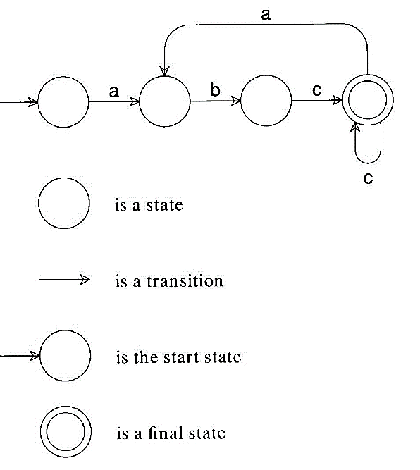
Finite Automata and Scanners (2)
A transition diagram
This machine accepts abccabc, but it rejects abcab.
This machine accepts (abc⁺)⁺.

Slide 12
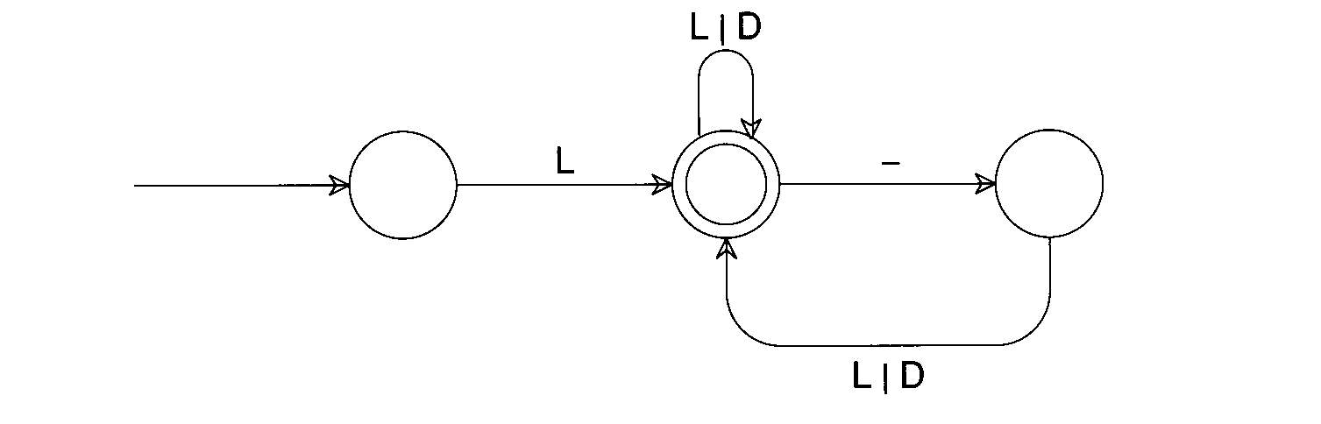
Finite Automata and Scanners (3)
Some Examples
(0|1)*0(0|1)(0|1)
ID = L(L|D)*(_(L|D)⁺)*
1
2
3
4
0,1 0
5
0,1

Slide 13
Finite Automata and Scanners(4)
Some Examples
(0|1)* 0 (0|1) (0|1)
ID = L (L|D)* (_(L|D)⁺)*
0 0,1 0,1
1
2
3
4
0,1 0
5
0,1

Slide 14
Finite Automata and Scanners (5)
A transition diagram
-
-
Eol
1
2
3
4
A transition table
Not(Eol)
state
character
-
Eol
a
b
...
1
2
2
3
3
3
4
3
3
3
4

Slide 15
Finite Automata and Scanners (6)
Any regular expression can be translated into a DFA that accepts the set of strings denoted by the regular expression
The transition can be done
Automatically by a scanner generator : LEX (TA course)
Manually by a programmer : Your homework #1 (3/13 publishes)

Slide 16
Finite Automata and Scanners (7)
/*
* Note: current_char is already set
* to the current input character.
*/
state = initial_state;
while (TRUE) {
next_state = T[state][current_char];
if (next_state == ERROR)
break;
state = next_state;
if (current_char == EOF)
break;
if (???)
???;
current_char = getchar();
}
if (is_final_state(state))
/* Return or process valid token. */
else
lexical_error(current_char);
-
-
Eol
1
2
3
4
Not(Eol)
if (current_char == '-') {
current_char = getchar();
if (current_char == '-') {
do
current_char = getchar();
while (current_char != '\n');
} else {
ungetc(current_char, stdin);
lexical_error(current_char);
}
}
else
lexical_error(current_char);
/* Return or process valid token. */
ungetc() -- lookahead

Slide 17
Outline
3.1 Overview
3.2 Regular Expression
3.3 Finite Automata and Scanners
3.5 Practical Considerations
3.6 Translating Regular Expressions into Finite Automata

Slide 18
Practical Consideration (1)
Reserved Words
Usually, all keywords are reserved in order to simplify parsing.
In Pascal, we could even write
begin
begin; end; end; begin;
end
if else then if = else;
The problem with reserved words is that they are too numerous.
COBOL has several hundreds of reserved words!

Slide 19
Practical Consideration(2)
Compiler Directives and Listing Source Lines
Compiler options e.g. optimization, profiling, etc.
handled by scanner or semantic routines
Complex pragmas are treated like other statements.
Source inclusion
e.g. #include in C
handled by preprocessor or scanner
Conditional compilation
e.g. #if, #endif in C
useful for creating program versions

Slide 20
Practical Consideration (3)
Entry of Identifiers into the Symbol Table
Who is responsible for entering symbols into symbol table?
Scanner?
Consider this example:
{ int abc;
…
{ int abc; }
}

Slide 21
Practical Consideration (4)
How to handle end-of-file?
Create a special EOF token.
EOF token is useful in a CFG
Multicharacter Lookahead
Blanks are not significant in Fortran
DO 10 I= 1,100
Beginning of a loop
DO 10 I = 1.100
An assignment statement DO10I=1.100
A Fortran scanner can determine whether the O is the last character of a DO token only after reading as far as the comma

Slide 22
Practical Consideration (5)
Multicharacter Lookahead (Cont’d)
In Ada and Pascal
To scan 10..100
There are three token
10
..
100
Two-character lookahead after the 10

Slide 23
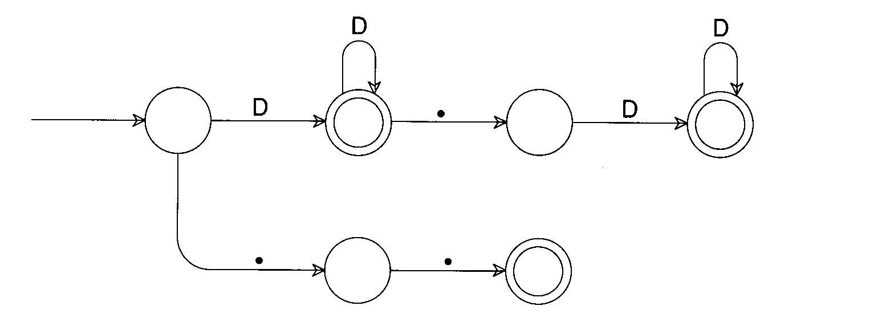
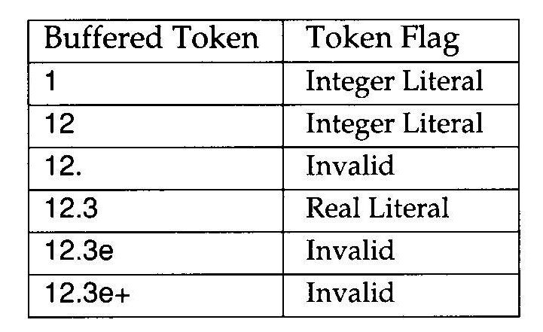
Practical Consideration(6)
Multicharacter Lookahead (Cont’d)
It is easy to build a scanner that can perform general backup.
If we reach a situation in which we are not in final state and cannot scan any more characters, backup is invoked.
Until we reach a prefix of the scanned characters flagged as a valid token

Slide 24
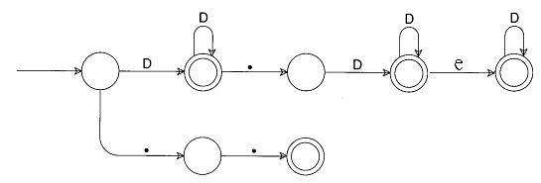
Practical Consideration (7)
1
Buffered Token Token Flag
1
Integer Literal

Slide 25
Practical Consideration (8)
2
1
Buffered Token Token Flag
1
2
Integer Literal

Slide 26
Practical Consideration(9)
2
1
.
Buffered Token Token Flag
1
2
.
Invalid

Slide 27
Practical Consideration (10)
2
1
3
.
Buffered Token Token Flag
1
2
.
3
Real Literal

Slide 28
Practical Consideration (11)
e
2
1
3
lexical_error break~
.
Buffered Token Token Flag
1
2
.
3
e
Invalid

Slide 29
Practical Consideration (12)
e
2
1
3
lexical_error break~!!!
.
Buffered Token Token Flag
1
2
.
3
e
+
Invalid
Do not compute !

