Slide 1
CSC4180 – Compiler Construction
Prof. Yeh-Ching Chung
School of Science and Engineering
Chinese University of Hong Kong, Shenzhen

Slide 2
Outlines
3.1 Overview
3.2 Regular Expressions
3.4 Finite Automata and Scanners
3.5 Using a Scanner Generator
3.7 Practical Considerations
3.8 Translating Regular Expressions into Finite Automata
3.9 Summary

Slide 3
Overview(1)
Formal notations
For specifying the precise structure of tokens are necessary
Quoted string in Pascal
Can a string split across a line?
Is a null string allowed?
Is .1 or 10. ok?
The 1..10 problem
Scanner generators
Tables, Programs
What formal notations to use?
Notes:
Quoted string in Pascal ➔ “ ” ’ “ String ” ’ ” ” , “ ” ” ” String “ ” ” ” ”
Can a string split across a line? ➔ “Hello \n
world “
Is a null string allowed? ➔ “ (我是空白)“
Is .1 or 10. ok?
the 1..10 problem ➔ 1. .10 (錯誤) ➔ 1 .. 10 (正確)

Slide 4
Overview(2)
Lexical analyzer (scanner) role
Produce a sequence of tokens for parser
Stripe out comments and whitespaces
Associate a line number with each error message
Expand macros
Lexical
Analyzer
token
Parser
Source program
to semantic analysis
getNextToken
Symbol
Table

Slide 5
Regular Expressions (1)
Tokens
Built from symbols of a finite vocabulary.
Structures of tokens
use regular expressions to define
Set Definition
The sets of strings defined by regular expressions are termed
∅ is a regular expression denoting the empty set
λ is a regular expression denoting the set that contains only the empty string
A string s is a regular expression denoting a set containing only s

Slide 6
Regular Expression (2)
If A and B are regular expressions, so are
A | B (alternation)
A regular expression formed by A or B
(a)|(b) = {a, b}
AB or A•B (concatenation)
A regular expression formed by A followed by B
(a)(b) = {ab}
A* (Kleene closure)
A regular expression formed by zero or more repetitions of A
a* = {λ, a, aa, aaa, …}
More Complex Example
(a|b|c)* = {λ, a, b, c, aa, ab, ac, ba, bb, bc, ca, cb, cc …}
Notes:
(a|b|c)* = (a|b,c)*

Slide 7
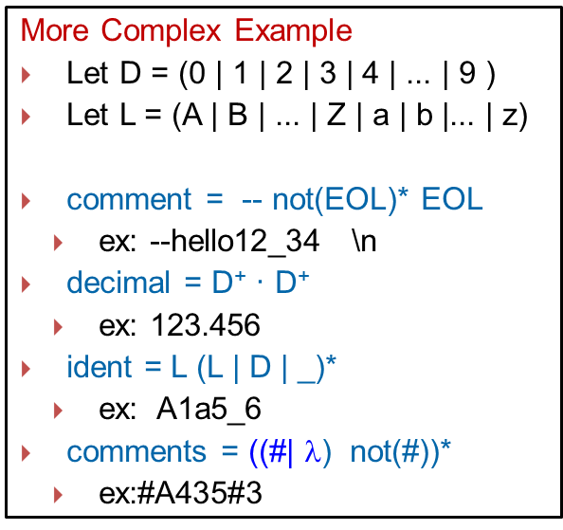
Regular Expression (3)
Some notational convenience
P⁺
PP* (at least one)
Not(A)
V – A
Not(S)
V* - S
A^{K}
AA …A (k copies)
A?
Optional, zero or one occurrence of A
More Complex Example
Let D = (0 | 1 | 2 | 3 | 4 | ... | 9 )
Let L = (A | B | ... | Z | a | b |... | z)
comment = -- not(EOL)* EOL
ex: --hello12_34 \n
decimal = D⁺ · D⁺
ex: 123.456
ident = L (L | D | _)*
ex: A1a5_6
comments = ((#| $\text{}$) not(#))*
ex:#A435#3

Slide 8
Regular Expressions (4)
Is regular expression as power as CFG?
{ [^{i} ]^{i} | i≥1}
Regular grammar
A→a
A→a
or
A→aB
A→Ba
Notes:
Answer : NO
aB : right grammar
Ba : left grammar

Slide 9
Finite Automata and Scanners (1)
Finite automaton (FA)
can be used to recognize the tokens specified by a regular expression
A FA consists of
A finite set of states S
A set of input symbols Σ (the input symbol alphabet)
A set of transitions (or moves) from one state to another, labeled with characters in V
A special start state s₀ (only one)
A set of final, or accepting, states F
FA = {S, Σ, s₀, F, move }

Slide 10
Finite Automata and Scanners (2)
is a state
is a transition
is the start state
is a final state
Example at next page….

Slide 11
Finite Automata and Scanners (3)
Example
A transition diagram
This machine accepts (abc⁺)⁺
(
a
b
c
)
⁺
⁺
a
a
b
c
c

Slide 12
Finite Automata and Scanners (4)
Other Example
(0|1)*0(0|1)(0|1)
0
0,1
0,1
1
2
3
4
0,1
0
5
0,1
(0|1)
*
0
(0|1)
(0|1)
Notes:
對一個state 有兩個input 兩個move 就叫做NFA

Slide 13


Finite Automata and Scanners (5)
Other Example
ID = L(L|D)*(_(L|D)⁺)*
A data structure can be translated for many REs or FAs
Final for two * symbol
L
(L|D)*
(_(L|D)⁺)*
L | D
L
-
What difference?
Answer : “_” by times
item 2 = item 3
L | D
Notes:
兩個不一樣的地方 在於 identify 的定義
ID = L(L|D)*(_(L|D)⁺)* to L(L|D)*(_(L|D)⁺)*
A data structure can be translated for many REs or FAs

Slide 14
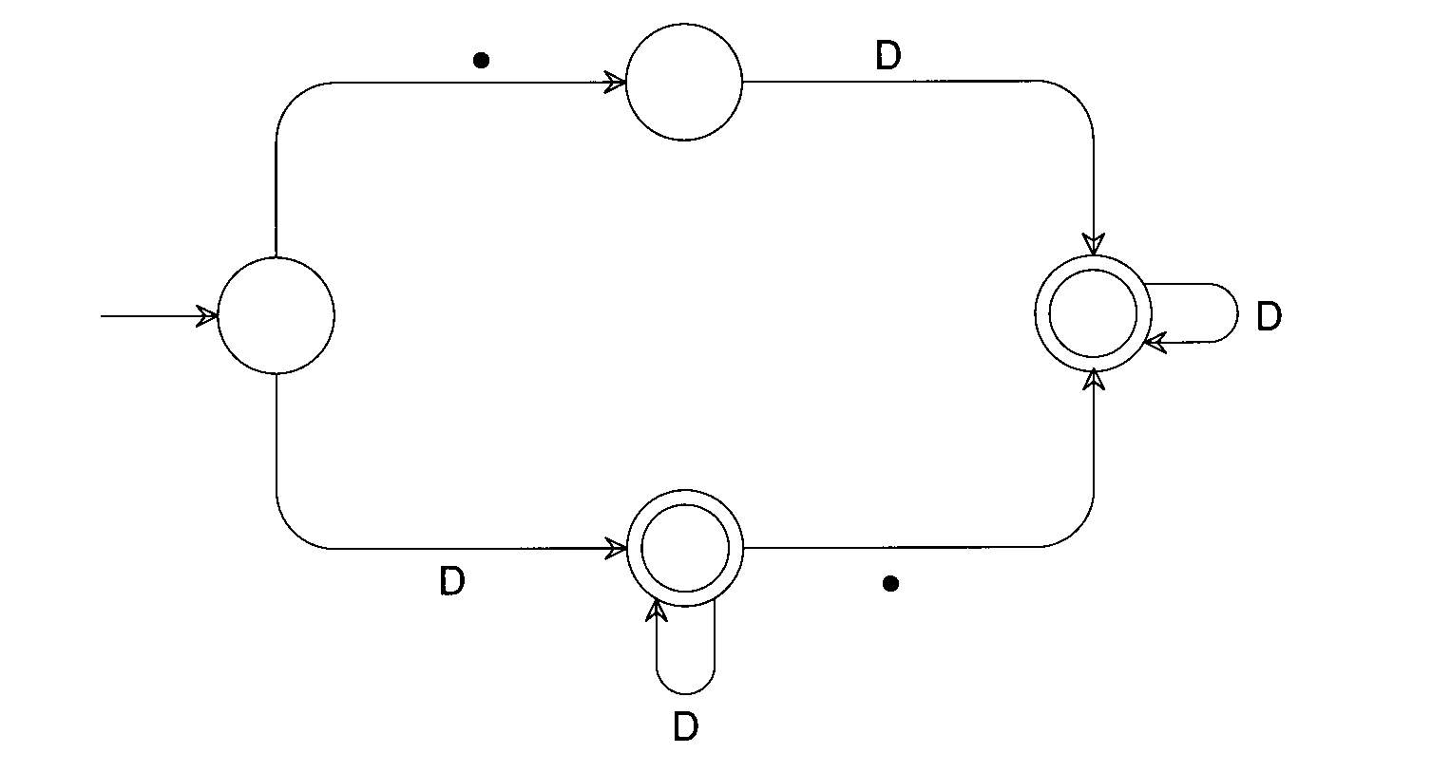
Finite Automata and Scanners (6)
Other Example
RealLit = (D⁺(λ |.))|(D*.D⁺)

Slide 15
Finite Automata and Scanners (7)
Two kinds of FA
Deterministic (DFA): Next transition is unique
Non-deterministic (NDFA): Otherwise
a
...
a
...
Which path we should select?

Slide 16
Finite Automata and Scanners (8)
A transition diagram
A transition table
Not(Eol)
/
/
Eol
1
2
3
4
State | Character
 | - | Eol | a | b | …
2
1
2
3
3
4
3
3
3
3
4

Slide 17
Finite Automata and Scanners (9)
Any regular expression
Can be translated into a DFA that accepts the set of strings denoted by the regular expression
The transition can be done
Automatically by a scanner generator : LEX (TA course)
Manually by a programmer
Coding the DFA in two form
Table-driven, commonly produced by a scanner generator
Explicit control, produced automatically or by hand

Slide 18
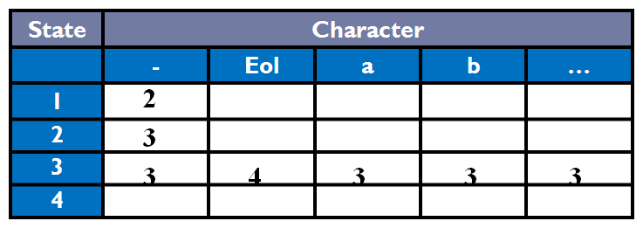
Finite Automata and Scanners (10)
Scanner Driver Interpreting a Transition Table
/* Note: CurrentChar is already set to the current input character. */
State = StartState;
while (TRUE) {
NextSate = T[State , CurrentChar];
if (NextSate == ERROR)
break;
State = NextState;
CurrentChar = getchar();
}
If(is_final_state(State))
/* Return or process valid token. */
else
lexical_error(CurrentChar);
Table-driven
Notes:
非有值則錯

Slide 19
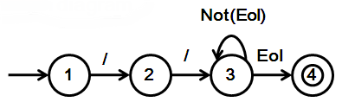
Finite Automata and Scanners (11)
Scanner with Fixed Token Definition
if (CurrentChar == ‘/') {
CurrentChar = getchar();
if (CurrentChar == ‘/') {
do {
CurrentChar = getchar();
} while (CurrentChar != '\n');
} else {
ungetc(CurrentChar, stdin);
lexical_error(CurrentChar);
}
}
else
lexical_error(CurrentChar);
/* Return or process valid token. */
Explicit control
Notes:
缺點 沒彈性 一改就全改了

Slide 20
Finite Automata and Scanners (12)
Transducer
We may perform some actions during state transition.
A scanner can be turned into a transducer by the appropriate insertion of actions based on state transitions

Slide 21
Using a Scanner Generator
Lex by TA….
21

Slide 22
Practical Considerations (1)
Reserved Words
Usually, all keywords are reserved in order to simplify parsing.
In Pascal, we could even write
begin
begin; end; end; begin;
end
if else then if = else;
The problem
with reserved words is that they are too numerous.
COBOL has several hundreds of reserved words!
ZEROS
ZERO
ZEROES
Notes:
ZEROS
ZERO
ZERO1S

Slide 23
Practical Considerations (2)
Compiler Directives and Listing Source Lines
Compiler options e.g. optimization, profiling, etc.
Handled by scanner or semantic routines
Complex pragmas are treated like other statements.
Source inclusion
e.g. #include in C
Handled by preprocessor or scanner
Conditional compilation
e.g. #if, #endif in C
Useful for creating program versions
Notes:
Directives : 不屬於語法的一部分 為了輔助compiler處理的動作

Slide 24
Practical Considerations (3)
Entry of Identifiers into the Symbol Table
Who is responsible for entering symbols into symbol table?
Scanner?
Consider this example:
{ int abc;
…
{ int abc; }
}
Notes:
用誰來做?
Parser去做
複雜的給semical routine (parser)
我們要決定要給parser哪些事情做 哪些功能

Slide 25
Practical Considerations (4)
How to handle end-of-file?
Create a special EOF token.
EOF token is useful in a CFG
Multicharacter Lookahead
Blanks are not significant in Fortran
DO 10 I = 1,100
Beginning of a loop
DO 10 I = 1.100
An assignment statement DO 10 I=1.100
A Fortran Scanner
Can determine whether the O is the last character of a DO token only after reading as far as the comma

Slide 26
Practical Considerations (5)
Multicharacter Lookahead (Cont’d)
In Ada and Pascal
To scan 10..100
There are three token
10
..
100
Two-character (..) lookahead after the 10
It is easy to build a scanner that can perform general backup.
If we reach a situation
In which we are not in final state and cannot scan any more characters, we extract characters from the right end of the buffer and queue them for rescanning until we reach a prefix of the scanned characters flagged as a valid token
Example at next page

Slide 27
Practical Considerations (6)
An FA That Scans Integer and Real Literals and the Subrange Operator
D
D
Buffered Token | Token Flag
1 | Integer Literal
12 | Integer Literal
12. | Invalid
12.3 | Real Literal
12.3e | Invalid
12.3e+ | Invalid
D
●
D
●
●
Detail Operation of each case at next page

Slide 28
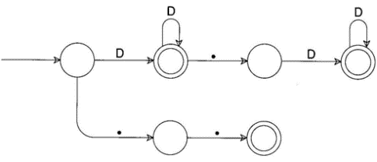
Practical Considerations (7)
An FA That Scans Integer and Real Literals and the Subrange Operator
Input string: 12.3e+q
D
Input Token
Buffered Token
Token Flag
1
1
Integer Literal

Slide 29
Practical Considerations (8)
An FA That Scans Integer and Real Literals and the Subrange Operator
Input string: 12.3e+q
D
D
Input Token
Buffered Token
Token Flag
1
2
1
2
Integer Literal

Slide 30
Practical Considerations (9)
An FA That Scans Integer and Real Literals and the Subrange Operator
Input string: 12.3e+q
D
D
●
Input Token
Buffered Token
Token Flag
1
2
.
1
2
.
Invalid

Slide 31
Practical Considerations (10)
An FA That Scans Integer and Real Literals and the Subrange Operator
Input string: 12.3e+q
D
D
●
D
Input Token
Buffered Token
Token Flag
1
2
.
3
1
2
.
3
Real Literal

Slide 32
Practical Considerations (11)
An FA That Scans Integer and Real Literals and the Subrange Operator
Input string: 12.3e+q
D
?
D
●
D
Backup is invoked!
Input Token
Buffered Token
Token Flag
1
2
.
3
e
1
2
.
3
e
Invalid

Slide 33
Practical Considerations (13)
cannot scan any more characters, and not in accept state
→ Backup is invoked !
Input string: 12.3e+q
D
?
?
D
●
D
Input Token
Buffered Token
Token Flag
1
2
.
3
e
⁺
1
2
.
3
e
⁺
Invalid

Slide 34
Outlines
3.1 Over View
3.2 Regular Expression
3.3 Finite Automata and Scanners
3.4 Using a Scanner Generator
3.5 Practical Considerations
3.6 Translating Regular Expressions into Finite Automata
Creating Deterministic Automata
Optimizing Finite Automata
3.7 Tracing Example
34

Slide 35
Translating Regular Expressions into Finite Automata (1)
Regular expressions are equivalent to FAs
The main job of a scanner generator
To transform a regular expression definition into an equivalent FA
Importance in NFA->DFA
A regular expression
Nondeterministic FA
Deterministic FA
minimize # of states
Optimized Deterministic FA

Slide 36
Translating Regular Expressions into Finite Automata (2)
We can transform any regular expression into an NFA with the following properties:
There is an unique final state
The final state has no successors
Every other state has at least one successors
Example : A Nondeterministic Finite Automaton (NFA)
Input : babb
Regular Expressions : (a|b)*abb
a
a
b
b
0
1
2
3
b
either one or two successors
Unique final state
Final S has no successor

Slide 37
Translating Regular Expressions into Finite Automata (3)
We need to review the definition of regular expression
Item 1: λ
It is a null string
Item 2: a
It is a character of the vocabulary
Item 3 : |
It is “or” operation.
Example : A|B
Item 4 : ●
It is the operation of catenation
Example : A ● B
Item 4 : *
It is the operation of repetition
Example : A*
More Example at Next Page

Slide 38
Translating Regular Expression into Finite Automata (4)
NFA : λ (null string)
NFA : a (1 string)
A character of the vocabulary
Processing Token
λ
λ
a
Processing Token
a

Slide 39
Translating Regular Expressions into Finite Automata (5)
NFA : A|B
Α
|
Processing Token
Β
NFA
For A
λ
λ
λ
NFA
For B
λ
Notes:
先A 在B

Slide 40
Translating Regular Expressions into Finite Automata (6)
NFA : A • B
Processing Token
Α
Β
●
λ
NFA
For A
λ
NFA
For B
Notes:
以課本為主 不對 扣分

Slide 41
Translating Regular Expressions into Finite Automata (7)
NFA : Α∗
Processing Token
Α
∗
λ
> 1 times
λ
NFA
For A
λ
λ
= 0 times

Slide 42
Translating Regular Expressions into Finite Automata (8)
Construct an NFA for Regular Expression 1*
01* | 1 ⇒ (0(1*)) |1
λ
λ
1
λ
Start
λ
1
*
Processing Token

Slide 43
Translating Regular Expressions into Finite Automata (9)
Construct an NFA for Regular Expression 01*
01*|1 ⇒ (0(1*)) |1
λ
Start
For Connection
λ
0
λ
λ
1
λ
λ
0
*
Processing Token
1

Slide 44
Translating Regular Expressions into Finite Automata (10)
Construct an NFA for Regular Expression 01*|1
01*+1 ⇒ (0(1*))+1
λ
λ
0
λ
λ
1
λ
λ
λ
λ
λ
1
λ
Start
0
*
Processing Token
1
|
1

Slide 45
Translating Regular Expressions into Finite Automata (11)
What’s problem about NFA?
Ans: It may be ambiguous that difficult to program!!!
A Nondeterministic Finite Automaton (NFA):(a|b)*abb
a
a
b
b
0
1
2
3
Start
b
Ambiguous!!!
Which one should we select?
Input : babb
Processing Token
b
a

Slide 46
Translating Regular Expressions into Finite Automata (12)
What’s problem about NFA?
Ans: It may be ambiguous that difficult to program!!!
A Deterministic Finite Automaton (DFA): b*abb
a
b
b
0
1
2
3
Start
b
No Ambiguous!!!
It have unique path!
Input : babb
Processing Token
b
a
b
b

Slide 47
Creating Deterministic Automata (1)
The transformation
From an NFA N to an equivalent DFA M works by what is sometimes called the subset construction
An Example for each step…
Initial NFA : 01*|1 ⇒ (0(1*)) |1
1
λ
8
1
9
λ
10
Start
λ
λ
λ
0
λ
λ
1
λ
2
3
4
5
6
7
λ
More Detail operation at next page…

Slide 48
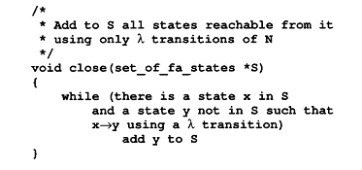
Creating Deterministic Automata (2)
Step 1
1
λ
8
1
9
λ
10
Start
λ
λ
λ
0
λ
λ
λ
2
3
4
5
1
6
7
λ
1. λ-closure(1) ={1, 2, 8}
2. λ-closure(2) ={2}
3. λ-closure(3) ={3 ,4 ,5 ,7 ,10}
4. λ-closure(4) ={4 ,5 ,7 ,10}
5. λ-closure(5) ={5}
6. λ-closure(6) ={5 ,6 ,7 ,10}
7. λ-closure(7) ={5, 7, 10}
8. λ-closure(8) ={8}
9. λ-closure(9) ={9 ,10}
10. λ-closure(10) ={10}
More Detail operation at next page…

Slide 49
Creating Deterministic Automata (2)
Step 1:
1
λ
8
1
9
λ
10
Start
λ
λ
λ
0
λ
λ
λ
2
3
4
5
1
6
7
λ
1. λ-closure(1) ={1, 2, 8}
2. λ-closure(2) ={2}
3. λ-closure(3) ={3 ,4 ,5 ,7 ,10}
4. λ-closure(4) ={4 ,5 ,7 ,10}
5. λ-closure(5) ={5}
6. λ-closure(6) ={5 ,6 ,7 ,10}
7. λ-closure(7) ={5, 7 ,10}
8. λ-closure(8) ={8}
9. λ-closure(9) ={9 ,10}
10. λ-closure(10) ={10}

Slide 50
Creating Deterministic Automata (2)
Step 1:
1
λ
8
1
λ
0
2
1. λ-closure(1) ={1, 2, 8}

Slide 51
Creating Deterministic Automata (2)
Step 1:
1
λ
8
1
9
λ
10
Start
λ
λ
λ
0
λ
λ
λ
2
3
4
5
1
6
7
λ
1. λ-closure(1) ={1, 2, 8}
2. λ-closure(2) ={2}
3. λ-closure(3) ={3 ,4 ,5 ,7 ,10}
4. λ-closure(4) ={4 ,5 ,7 ,10}
5. λ-closure(5) ={5}
6. λ-closure(6) ={5 ,6 ,7 ,10}
7. λ-closure(7) ={5, 7 ,10}
8. λ-closure(8) ={8}
9. λ-closure(9) ={9 ,10}
10. λ-closure(10) ={10}

Slide 52
Creating Deterministic Automata (2)
Step 1:
0
2
2. λ-closure(2) ={2}

Slide 53
Creating Deterministic Automata (2)
Step 1:
1
λ
8
1
9
λ
10
Start
λ
λ
λ
0
λ
λ
λ
2
3
4
5
1
6
7
λ
1. λ-closure(1) ={1, 2, 8}
2. λ-closure(2) ={2}
3. λ-closure(3) ={3 ,4 ,5 ,7 ,10}
4. λ-closure(4) ={4 ,5 ,7 ,10}
5. λ-closure(5) ={5}
6. λ-closure(6) ={5 ,6 ,7 ,10}
7. λ-closure(7) ={5, 7 ,10}
8. λ-closure(8) ={8}
9. λ-closure(9) ={9 ,10}
10. λ-closure(10) ={10}

Slide 54
Creating Deterministic Automata (2)
Step 1:
10
λ
λ
λ
3
4
5
1
7
λ
3. λ-closure(3) ={3 ,4 ,5 ,7 ,10}

Slide 55
Creating Deterministic Automata (2)
Step 1:
1
λ
8
1
9
λ
10
Start
λ
λ
λ
0
λ
λ
λ
2
3
4
5
1
6
7
λ
1. λ-closure(1) ={1, 2, 8}
2. λ-closure(2) ={2}
3. λ-closure(3) ={3 ,4 ,5 ,7 ,10}
4. λ-closure(4) ={4 ,5 ,7 ,10}
5. λ-closure(5) ={5}
6. λ-closure(6) ={5 ,6 ,7 ,10}
7. λ-closure(7) ={5, 7 ,10}
8. λ-closure(8) ={8}
9. λ-closure(9) ={9 ,10}
10. λ-closure(10) ={10}

Slide 56
Creating Deterministic Automata (2)
Step 1:
10
λ
λ
4
5
1
7
λ
4. λ-closure(4) ={4 ,5 ,7 ,10}

Slide 57
Creating Deterministic Automata (2)
Step 1:
1
λ
8
1
9
λ
10
Start
λ
λ
λ
0
λ
λ
λ
2
3
4
5
1
6
7
λ
1. λ-closure(1) ={1, 2, 8}
2. λ-closure(2) ={2}
3. λ-closure(3) ={3 ,4 ,5 ,7 ,10}
4. λ-closure(4) ={4 ,5 ,7 ,10}
5. λ-closure(5) ={5}
6. λ-closure(6) ={5 ,6 ,7 ,10}
7. λ-closure(7) ={5, 7 ,10}
8. λ-closure(8) ={8}
9. λ-closure(9) ={9 ,10}
10. λ-closure(10) ={10}

Slide 58
Creating Deterministic Automata (2)
Step 1:
5
1
5. λ-closure(5) ={5}

Slide 59
Creating Deterministic Automata (2)
Step 1:
1
λ
8
1
9
λ
10
Start
λ
λ
λ
0
λ
λ
λ
2
3
4
5
1
6
7
λ
1. λ-closure(1) ={1, 2, 8}
2. λ-closure(2) ={2}
3. λ-closure(3) ={3 ,4 ,5 ,7 ,10}
4. λ-closure(4) ={4 ,5 ,7 ,10}
5. λ-closure(5) ={5}
6. λ-closure(6) ={5 ,6 ,7 ,10}
7. λ-closure(7) ={5, 7 ,10}
8. λ-closure(8) ={8}
9. λ-closure(9) ={9 ,10}
10. λ-closure(10) ={10}

Slide 60
Creating Deterministic Automata (2)
Step 1:
10
λ
λ
5
6
λ
7
1
This point line not be computed!!
6. λ-closure(6) ={5 ,6 ,7 ,10}

Slide 61
Creating Deterministic Automata (2)
Step 1:
1
λ
8
1
9
λ
10
Start
λ
λ
λ
0
λ
λ
λ
2
3
4
5
1
6
7
λ
1. λ-closure(1) ={1, 2, 8}
2. λ-closure(2) ={2}
3. λ-closure(3) ={3 ,4 ,5 ,7 ,10}
4. λ-closure(4) ={4 ,5 ,7 ,10}
5. λ-closure(5) ={5}
6. λ-closure(6) ={5 ,6 ,7 ,10}
7. λ-closure(7) ={5, 7 ,10}
8. λ-closure(8) ={8}
9. λ-closure(9) ={9 ,10}
10. λ-closure(10) ={10}

Slide 62
Creating Deterministic Automata (2)
Step 1:
10
λ
λ
5
1
7
7. λ-closure(7) ={5, 7 ,10}

Slide 63
Creating Deterministic Automata (2)
Step 1:
1
λ
8
1
9
λ
10
Start
λ
λ
λ
0
λ
λ
λ
2
3
4
5
1
6
7
λ
1. λ-closure(1) ={1, 2, 8}
2. λ-closure(2) ={2}
3. λ-closure(3) ={3 ,4 ,5 ,7 ,10}
4. λ-closure(4) ={4 ,5 ,7 ,10}
5. λ-closure(5) ={5}
6. λ-closure(6) ={5 ,6 ,7 ,10}
7. λ-closure(7) ={5, 7 ,10}
8. λ-closure(8) ={8}
9. λ-closure(9) ={9 ,10}
10. λ-closure(10) ={10}

Slide 64
Creating Deterministic Automata (2)
Step 1:
8
1
8. λ-closure(8) ={8}

Slide 65
Creating Deterministic Automata (2)
Step 1:
1
λ
8
1
9
λ
10
Start
λ
λ
λ
0
λ
λ
λ
2
3
4
5
1
6
7
λ
1. λ-closure(1) ={1, 2, 8}
2. λ-closure(2) ={2}
3. λ-closure(3) ={3 ,4 ,5 ,7 ,10}
4. λ-closure(4) ={4 ,5 ,7 ,10}
5. λ-closure(5) ={5}
6. λ-closure(6) ={5 ,6 ,7 ,10}
7. λ-closure(7) ={5, 7 ,10}
8. λ-closure(8) ={8}
9. λ-closure(9) ={9 ,10}
10. λ-closure(10) ={10}

Slide 66
Creating Deterministic Automata (2)
Step 1:
9
λ
10
9. λ-closure(9) ={9 ,10}

Slide 67
Creating Deterministic Automata (2)
Step 1:
1
λ
8
1
9
λ
10
Start
λ
λ
λ
0
λ
λ
λ
2
3
4
5
1
6
7
λ
1. λ-closure(1) ={1, 2, 8}
2. λ-closure(2) ={2}
3. λ-closure(3) ={3 ,4 ,5 ,7 ,10}
4. λ-closure(4) ={4 ,5 ,7 ,10}
5. λ-closure(5) ={5}
6. λ-closure(6) ={5 ,6 ,7 ,10}
7. λ-closure(7) ={5, 7 ,10}
8. λ-closure(8) ={8}
9. λ-closure(9) ={9 ,10}
10. λ-closure(10) ={10}

Slide 68
Creating Deterministic Automata (2)
Step 1:
10
10. λ-closure(10) ={10}

Slide 69
Creating Deterministic Automata (2)
Step 1:
1
λ
8
1
9
λ
10
Start
λ
λ
λ
0
λ
λ
λ
2
3
4
5
1
6
7
λ
1. λ-closure(1) ={1, 2, 8}
2. λ-closure(2) ={2}
3. λ-closure(3) ={3 ,4 ,5 ,7 ,10}
4. λ-closure(4) ={4 ,5 ,7 ,10}
5. λ-closure(5) ={5}
6. λ-closure(6) ={5 ,6 ,7 ,10}
7. λ-closure(7) ={5, 7 ,10}
8. λ-closure(8) ={8}
9. λ-closure(9) ={9 ,10}
10. λ-closure(10) ={10}
Total closures, but…..

Slide 70
Creating Deterministic Automata (2)
Step 1:
1
λ
8
1
9
λ
10
Start
λ
λ
λ
0
λ
λ
λ
2
3
4
5
1
6
7
λ
1. λ-closure(1) ={1, 2, 8}
2. λ-closure(2) ={2}
3. λ-closure(3) ={3 ,4 ,5 ,7 ,10}
4. λ-closure(4) ={4 ,5 ,7 ,10}
5. λ-closure(5) ={5}
6. λ-closure(6) ={5 ,6 ,7 ,10}
7. λ-closure(7) ={5, 7 ,10}
8. λ-closure(8) ={8}
9. λ-closure(9) ={9 ,10}
10. λ-closure(10) ={10}
Delete Sub Set ...

Slide 71
Creating Deterministic Automata (2)
Step 1:
1
λ
8
1
9
λ
10
State 3
λ⁰ state 3
λ¹ state 4
λ² state 5,7
λ³ state 10
λ⁴ empty
Start
λ
λ
λ
0
λ
λ
λ
2
3
4
5
1
6
7
λ
1. λ-closure(1) ={1, 2, 8}
2. λ-closure(2) ={2}
3. λ-closure(3) ={3 ,4 ,5 ,7 ,10}
4. λ-closure(4) ={4 ,5 ,7 ,10}
5. λ-closure(5) ={5}
6. λ-closure(6) ={5 ,6 ,7 ,10}
7. λ-closure(7) ={7 ,10}
8. λ-closure(8) ={8}
9. λ-closure(9) ={9 ,10}
10. λ-closure(10) ={10}
Now Closures, No Sub Set ...

Slide 72
Creating Deterministic Automata (3)
Step 1:
The initial state of M is the set of states reachable from the initial state of N by λ-transitions
Usually called l-closure or ε-closure
Algorithm for example at upside

Slide 73
Creating Deterministic Automata (4)
Step 2:
To create the successor states
Take any state S of M and any character c, and compute S’s successor under c
S is identified with some set of N’s states, {n₁, n₂,…}
Find all possible successor states to {n₁, n₂,…} under c
Obtain a set {m₁, m₂,…}
T=close({m₁, m₂,…})
S
T
{n₁, n₂,…}
close({m₁, m₂,…})

Slide 74
Creating Deterministic Automata (5)
Step 2:
void make_deterministic( nondeterministic_fa N , deterministic *M)
{
set_of_fa_states T;
M->initial_state = SET_OF(N.initial_state) ;
close (& M->initial_state );
Add M-> initial_state to M->states;
while( states or transitions can be added)
{
choose S in M->states and c in Alphabet;
T=SET_OF (y in N . states SUCH THAT x->y under c for some x in S);
close(& T);
if(T not in M->states)
add T to M->states;
Add the transition to M->transitions:
S->T under c;
}
M->final_states = SET_OF(S in M->states
SUCH_THAT N.final_state in S);
Example at next page…

Slide 75
Creating Deterministic Automata (6)
Step 2:
First Re-Number for simplifying the work flow
1. λ-closure(1) ={1, 2, 8} ➔ A = {1, 2, 8}
3. λ-closure(3) ={3 ,4 ,5 ,7 ,10} ➔ B = {3 ,4 ,5 ,7 ,10}
6. λ-closure(6) ={5 ,6 ,7 ,10} ➔ C = {5 ,6 ,7 ,10}
9. λ-closure(9) ={9 ,10} ➔ D = {9, 10}
1
λ
8
1
9
λ
10
Start
λ
λ
λ
0
λ
λ
1
λ
2
3
4
5
1
6
7
λ
More Operation at next page ……

Slide 76
Creating Deterministic Automata (7)
1
λ
8
1
9
λ
10
Start
A : {1, 2, 8}
B : {3 ,4 ,5 ,7 ,10}
C : {5 ,6 ,7 ,10}
D : {9, 10}
λ
λ
λ
2
0
λ
λ
λ
3
4
5
1
6
7
1
λ
A
D
{1,2,8}
1
{9, 10}
Start
No
Out-Degree
0
1
B
C
{3 ,4 ,5 ,7 ,10}
1
{5 ,6 ,7 ,10}
Final
Notes:
dFinal many
Nfa many
DFA no empty

Slide 77
Creating Deterministic Automata (8)
Step 2:
void make_deterministic( nondeterministic_fa N , deterministic *M)
{
set_of_fa_states T;
M->initial_state = SET_OF(N.initial_state) ;
close (& M->initial_state );
Add M-> initial_state to M->states;
while( states or transitions can be added)
{
choose S in M->states and c in Alphabet;
T=SET_OF (y in N . states SUCH THAT x->y under c for some x in S);
close(& T);
if(T not in M->states)
add T to M->states;
Add the transition to M->transitions:
S->T under c;
}
M->final_states = SET_OF(S in M->states
SUCH_THAT N.final_state in S);
}
Example at next page…

Slide 78
Optimizing Finite Automata (1)
Minimize number of states
Every DFA has a unique smallest equivalent DFA
Given a DFA M, we use Transition Table to construct the equivalent minimal DFA.
Initially, we draw a transition table from DFA diagram.
State | Character
 | 0 | 1
A | B | D
B |  | C
C |  | C
D
DFA
A
1
D
Start
0
1
A: Start State
B,C,D: Final State
B
1
C
Table

Slide 79
Optimizing Finite Automata (2)
Minimize number of states
DFA
A
1
D
Start
A
1
D
New DFA
1
Start
0
B
1
C
0
B is equal C
1
B,C
State | Character
 | 0 | 1
A | B | D
B |  | C
C |  | C
D
Optimize
State | Character
 | 0 | 1
A | {B, C} | D
{B, C} |  | {B, C}
D
A: Start State
B,C,D: Final State
Special :
B can merge into C, Because the B and C are final state.
Notes:
A . B* | C
先

Slide 80
Additional
Simplifying rules (removing parentheses)
“*” has highest precedence and is left associative
Concatenation has the 2nd highest precedence and is left associative
“| “has lowest precedence and is left associative
E.g., (a)|((b)*(c)) == a|b*c

Slide 81
Outlines
3.1 Over View
3.2 Regular Expression
3.3 Finite Automata and Scanners
3.4 Using a Scanner Generator
3.5 Practical Considerations
3.6 Translating Regular Expressions into Finite Automata
3.7 Tracing Example

Slide 82
Tracing Example (1)
Review Steps of Scanner Generator
Importance in NFA->DFA
A regular expression
Nondeterministic FA
Deterministic FA
minimize # of states
Optimized Deterministic FA

Slide 83
Tracing Example (2)
Regular Expression
IF and IFA
if {return IF;}
[a - z] [a – z|0 - 9 ] * {return ID;}
[0 - 9] + {return NUM;}
. {error ();}
Notes:
先個別化
再用線連接起來

Slide 84
Tracing Example (3)
Translate from RE to NFA
A regular
expression
Deterministic
FA
Nondeterministic FA
minimize # of states
Optimized
Deterministic
FA

Slide 85
Tracing Example(4)
if {return IF;}
The NFA for a symbol i is:
start
i
1
2
The NFA for a symbol f is:
start
1
f
2
The NFA for the regular expression if is:
start
i
f
1
2
3
IF

Slide 86
Tracing Example (5)
[a-z] [a-z|0-9 ] * {return ID;}
λ
a-z
λ
start
a-z
2
3
4
1
0-9
λ
ID

Slide 87
Tracing Example (6)
[0 – 9]⁺ {return NUM;}
λ
start
0-9
0-9
1
2
3
4
5
λ
λ
NUM

Slide 88
Tracing Example (7)
λ
i
f
a-z
a-z
λ
1
2
3
1
2
3
4
0-9
ID
λ
IF
λ
1
0-9
0-9
2
3
4
λ
5
1
2
any but \n
λ
NUM
error

Slide 89
Tracing Example (8)
Translate from NFA to DFA
A regular
expression
Nondeterministic
FA
Deterministic
FA
minimize # of states
Optimized
Deterministic
FA

Slide 90
Tracing Example (9)
Full NFA Diagram
a-z
f
IF
λ
ID
2
3
4
a-z
λ
5
6
7
8
i
λ
0-9
λ
1
λ
λ
NUM
λ
9
0-9
0-9
14
any
character
15
10
11
12
λ
13
error
λ
Special case :Handle in Final

Slide 91
Tracing Example (10)
λ
a-z
f
IF
ID
2
3
4
a-z
λ
5
6
7
8
i
λ
0-9
λ
1
λ
λ
NUM
λ
9
0-9
0-9
14
any
character
15
10
11
12
13
λ
error
λ
1. λ-closure(1) ={ 1, 4, 9, 14}
6. λ-closure(8) ={ 6, 8}
2. λ-closure(2) ={ 2}
7. λ-closure(10) ={ 10, 11, 13}
3. λ-closure(3) ={ 3}
8. λ-closure(12) ={12, 13}
4. λ-closure(5) ={ 5, 6, 8}
9. λ-closure(13) ={11, 13}
5. λ-closure(7) ={ 7, 8}
10. λ-closure(15) ={15}

Slide 92
Tracing Example (11)
λ
a-z
f
IF
ID
2
3
4
a-z
λ
5
6
7
8
i
λ
0-9
λ
1
λ
λ
NUM
λ
9
0-9
0-9
14
any
character
15
10
11
12
13
λ
error
λ
DFA States = {1-4-9-14}
Now we need to compute:
a-h
5-6-8-15
move(1-4-9-14,a-h) =
{5,15}
1-4-9-14
λ-closure({5,15}) =
{5,6,8,15}

Slide 93
Tracing Example (12)
λ
a-z
f
IF
2
3
4
a-z
λ
5
6
7
8
i
λ
0-9
λ
1
λ
λ
λ
9
0-9
0-9
14
any
character
15
10
11
12
13
λ
error
DFA States = {1-4-9-14}
move(1-4-9-14, i) =
{2,5,15}
a-h
5-6-8-15
λ-closure({2,5,15}) =
{2,5,6,8,15}
1-4-9-14
i
2-5-6-8-15

Slide 94
Tracing Example (13)
a-z
f
IF
λ
ID
2
3
4
a-z
λ
5
6
7
8
i
λ
0-9
λ
1
λ
λ
NUM
λ
9
0-9
0-9
14
any
character
15
10
11
12
13
λ
error
DFA States = {1-4-9-14}
move(1-4-9-14, j-z) =
{5,15}
a-h
5-6-8-15
j-z
λ-closure({5,15}) =
{5,6,8,15}
1-4-9-14
i
2-5-6-8-15

Slide 95
Tracing Example (14)
λ
a-z
f
IF
ID
2
3
4
a-z
λ
5
6
7
8
i
λ
0-9
λ
1
λ
λ
NUM
λ
9
0-9
0-9
14
any
character
15
10
11
12
13
λ
error
λ
DFA States = {1-4-9-14}
move(1-4-9-14, 0-9) =
{10,15}
10-11-13-15
a-h
5-6-8-15
j-z
λ-closure({10,15}) =
{10,11,13,15}
0-9
1-4-9-14
i
2-5-6-8-15

Slide 96
Tracing Example (15)
λ
IF
a-z
ID
2
f
3
a-z
4
5
6
7
λ
8
i
λ
0-9
λ
1
λ
λ
NUM
λ
any
character
9
0-9
0-9
14
15
10
11
12
λ
13
error
λ
DFA States = {1-4-9-14}
move(1-4-9-14, other) =
{15}
10-11-13-15
a-h
5-6-8-15
j-z
λ-closure({15}) =
{15}
0-9
1-4-9-14
i
2-5-6-8-15
other
96
15

Slide 97
Tracing Example (16)
IF
a-z
f
ID
2
3
a-z
λ
λ
4
5
6
7
8
i
λ
0-9
λ
1
λ
λ
NUM
λ
9
0-9
0-9
14
any
character
15
10
11
12
13
λ
error
DFA states = {1-4-9-14}
λ
10-11-13-15
a-h
5-6-8-15
j-z
The analysis for 1-4-9-14 is complete. We mark it and pick another state in the DFA to analysis. (Practice)
0-9
1-4-9-14
i
2-5-6-8-15
other
15

Slide 98
Tracing Example (17)
ID
a-e, g-z, 0-9
2-5-6-8-15
f
IF
i
3-6-7-8
ID
a-z,0-9
ID
a-h
5-6-8-15
1-4-9-14
a-z,0-9
6-7-8
j-z
0-9
NUM
NUM
a-z,0-9
0-9
11-12-13
10-11-13-15
other
error
0-9
15

Slide 99
Tracing Example (18)
Minimize DFA
A regular
expression
Nondeterministic
FA
Deterministic
FA
minimize # of states
Optimized
Deterministic
FA

Slide 100
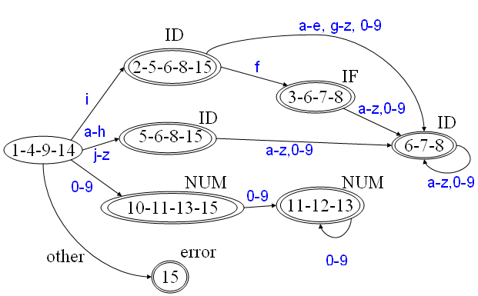
Tracing Example (19)
Transition Table
DFA
State | character
 | 0-9 | a-e | f | g-h | i | j-z | other
A | D | C | C | C | B | C | E
B | G | G | F | G | G | G | -
C | G | G | G | G | G | G | -
D | H | - | - | - | - | - | -
E | - | - | - | - | - | - | -
F | G | G | G | G | G | G | -
G | G | G | G | G | G | G | -
H | H | - | - | - | - | - | -
B
F
C
A
G
D
H
E

Slide 101
Tracing Example (20)
DFA
B
F
A
C
G
Transition Table
H
D
State | character
 | 0-9 | a-e | f | g-h | i | j-z | other
A | D | C | C | C | B | C | E
B | G | G | F | G | G | G | -
C | G | G | G | G | G | G | -
D | H | - | - | - | - | - | -
E | - | - | - | - | - | - | -
F | G | G | G | G | G | G | -
G | G | G | G | G | G | G | -
H | H | - | - | - | - | - | -
E
New Transition Table-1
State | character
 | 0-9 | a-e | f | g-h | i | j-z | other
A | D | C | C | C | B | C | E
B | C | C | C | C | C | C | -
C | C | C | C | C | C | C | -
D | D | - | - | - | - | - | -
E | - | - | - | - | - | - | -

Slide 102
Tracing Example (21)
DFA
B
F
C
A
G
D
H
New Transition Table-1
E
State | character
 | 0-9 | a-e | f | g-h | i | j-z | other
A | D | C | C | C | B | C | E
B | C | C | C | C | C | C | -
C | C | C | C | C | C | C | -
D | D | - | - | - | - | - | -
E | - | - | - | - | - | - | -
New Transition Table-2
State | character
 | 0-9 | a-e | f | g-h | i | j-z | other
A | D | B | B | B | B | B | E
B | B | B | B | B | B | B | -
D | D | - | - | - | - | - | -
E | - | - | - | - | - | - | -

Slide 103
Tracing Example (22)
New Transition Table-2
DFA
State | character
 | 0-9 | a-e | f | g-h | i | j-z | other
A | D | B | B | B | B | B | E
B | B | B | B | B | B | B | -
D | D | - | - | - | - | - | -
E | - | - | - | - | - | - | -
New DFA
B
F
IF
f
C
i
A
G
B
D
H
a-z
a-z,0-9
ID
E
A
B=C=F=G
D=H
NUM
0-9
D
0-9
other
error
E

Slide 104
Chapter 3 End
Any Question?

Slide 105
Quiz: What is the optimized DFA for 1⁺?

Slide 106
1*= 1 . 1⁺ (Can use this method)
λ
1
A
B
{1,2}
1
{3,4,2}
1
λ
2
1
3
λ
4
Start
1. λ-closure(1) ={1, 2}
2. λ-closure(2) ={2}
3. λ-closure(3) ={3 ,4 ,2}
4. λ-closure(4) ={4 ,2}
State | Character
 | 0 | 1
A |  | B
B |  | B
1. λ-closure(1) ={1, 2} ➔ A
3. λ-closure(3) ={3 ,4 ,2} ➔ B
1
Can Not Optimized, (Merge)
For A is Start State, B is Final State!
A
1
B

