Slide 1
CSC4180 – Compiler Construction
Prof. Yeh-Ching Chung
School of Data Science
Chinese University of Hong Kong, Shenzhen

Slide 2
Outline
6.0 Introduction
6.1 Shift-Reduce Parsers
6.2 LR Parsers
6.3 LR(1) Parsing
6.4 SLR(1)Parsing
6.5 LALR(1)
6.6 Calling Semantic Routines in Shift-Reduce Parsers
6.7 Using a Parser Generator (TA course)
6.8 Optimizing Parse Tables
6.9 Practical LR(1) Parsers
6.10 Properties of LR Parsing
6.11 LL(1) or LAlR(1) , That is the question
6.12 Other Shift-Reduce Technique

Slide 3
LR(1) Parsing (1)
An LR(1) configuration, or item is of the form
A→X₁X₂…X_{i} • X_{i+1} … X_{j}, l where l ∈ V_{t}∪{λ}
The look ahead component l represents a possible look-ahead after the entire right-hand side has been matched
The λ appears as look-ahead only for the augmenting production because there is no look-ahead after the end-marker
We use the following notation to represent the set of LR(1) configurations that shared the same dotted production
A→X₁X₂…X_{i} • X_{i+1} … X_{j}, {l₁…l_{m}}
={A→X₁X₂…X_{i} • X_{i+1} … X_{j}, l₁} ∪
{A→X₁X₂…X_{i} • X_{i+1} … X_{j}, l₂} ∪
…
{A→X₁X₂…X_{i} • X_{i+1} … X_{j}, l_{m}}
3
3

Slide 4
LR(1) Parsing (2)
LR(1)
There are many more distinct LR(1) configurations than LR(0) configurations.
In fact, the major difficulty with LR(1) parsers is not their power but rather finding ways to represent them in storage-efficient ways.
Parsing begins with the configuration : closure1({S→ • α $, {λ}})
Configuration_set closure1 (configuration_set s)
{
configuration_set s’ = s ;
do
{
if( B →δ • A ρ, l ∈ s’ for A ∈ V_{n} )
{
/*
* Predict productions with A as the left-hand side.
* Possible lookaheads are First(ρl )
*/
Add all configurations of the form
A → • γ, u where u ∈First(ρl ) to s’
}
} while (more new configurations can be added) ;
return s’;
}
for grammar G₂ :
1. S→E$
2.E→E+T
3.E→T
4.T →id
5.T →(E)
closure1(S→ • E$, λ}) = { S → • E$,{λ}
E → • E+T,{$+}
E → • T,{$+}
T → • id,{$+}
T → • (E),{$+} }

Slide 5
LR(1) Parsing (3)
Tracing Example
for grammar G₂ :
1. S→E$
2.E→E+T
3.E→T
4.T →id
5.T →(E)
closure1(S→ • E$, λ})
S → • E$,{λ}
E → • E+T,{$}
E → • T,{$}
E → • E+T,{+}
E → • T,{+}
closure1(S→ • E$, λ})=
{ S → • E$,{λ}
E → • E+T,{$+}
E → • T,{$+}
T → • id,{$+}
T → • (E),{$+} }
T → • id,{$}
T → • (E),{$}
T → • id,{+}
T → • (E),{+}

Slide 6
LR(1) Parsing (4)
Given an LR(1) configuration set s
We compute its successor, s', under a symbol X
go_to1(s,X)
Configuration_set goto1 (configuration_set s , symbol x)
{
S_{b} = Ø ;
for (each configuration c ∈ s)
if( c is of the form A → βx • γ, l)
//In goto0 if( each configuration c ∈ s)
Add A → βx • γ, l to s_{b} ;
/*
* That is, we advance the • past the symbol X,
* if possible. Configurations not having a
* dot preceding an X are not included in s_{b .}
*/
/* Add new predictions to s_{b} via closure1. */
return closure1(s_{b}) ;
}

Slide 7
LR(1) Parsing (5)
LR(1)
We can build a finite automata that is analogue of the LR(0) CFSM
LR(1) FSM, LR(1) machine
The relationship between CFSM and LR(1) macine
By merging LR(1) machine’s configuration sets, we can obtain CFSM
Tracing Example:
for grammar G₃ :
1. S → E $
2. E → E + T
3. E → T
4. T → T * P
5. T → P
6. P → id
7. P → ( E )
void_build_LR1(void)
{
Create the Start State of FSM; Label it with s₀
Put s₀ into an initially empty set , S.
while (S is nonempty) {
Remove a configuration set s from S;
/* Consider both terminals and non-terminals */
for ( X in Symbols) {
if(go_to1(s,X) does not label a FSM state) {
Create a new FSM state and label it with go_to1(s , X) into S;
Put go_to1(s , X) into S;
}
Create a transition under X from the state s
labels to the state go_to1 (s , X) labels;
} } }

Slide 8
state 0
S → • E$ ,{λ}
E → • E+T,{$+}
E → • T ,{$+}
T → • T*P ,{$+*}
T → • P ,{$+*}
P → • id ,{$+*}
P → • (E) ,{$+*}
E
P
id
T
(

Slide 9
state 0
S → • E$ ,{λ}
E → • E+T,{$+}
E → • T ,{$+}
T → • T*P ,{$+*}
T → • P ,{$+*}
P → • id ,{$+*}
P → • (E) ,{$+*}
state 1
S → E • $ ,{λ}
E → E •+T,{$+}
E
P
id
T
(

Slide 10
state 0
S → • E$ ,{λ}
E → • E+T,{$+}
E → • T ,{$+}
T → • T*P ,{$+*}
T → • P ,{$+*}
P → • id ,{$+*}
P → • (E) ,{$+*}
state 1
S → E • $ ,{λ}
E → E •+T,{$+}
state 2 //Accept
S → E $ • ,{λ}
E
$
P
id
T
(

Slide 11
state 0
S → • E$ ,{λ}
E → • E+T,{$+}
E → • T ,{$+}
T → • T*P ,{$+*}
T → • P ,{$+*}
P → • id ,{$+*}
P → • (E) ,{$+*}
state 1
S → E • $ ,{λ}
E → E •+T,{$+}
state 2 //Accept
S → E $ • ,{λ}
E
$
P
+
state 3
E → E+ • T,{$+}
T → • T*P ,{$+*}
T → • P ,{$+*}
P → • id ,{$+*}
P → • (E) ,{$+*}
P
id
T
(
T
id
(

Slide 12
state 0
S → • E$ ,{λ}
E → • E+T,{$+}
E → • T ,{$+}
T → • T*P ,{$+*}
T → • P ,{$+*}
P → • id ,{$+*}
P → • (E) ,{$+*}
state 1
S → E • $ ,{λ}
E → E •+T,{$+}
state 2 //Accept
S → E $ • ,{λ}
E
$
P
+
state 3
E → E+ • T,{$+}
T → • T*P ,{$+*}
T → • P ,{$+*}
P → • id ,{$+*}
P → • (E) ,{$+*}
state 4
T → P • ,{$+*}
id
P
T
(
T
id
(

Slide 13
state 0
S → • E$ ,{λ}
E → • E+T,{$+}
E → • T ,{$+}
T → • T*P ,{$+*}
T → • P ,{$+*}
P → • id ,{$+*}
P → • (E) ,{$+*}
state 1
S → E • $ ,{λ}
E → E •+T,{$+}
state 2 //Accept
S → E $ • ,{λ}
E
$
P
+
state 3
E → E+ • T,{$+}
T → • T*P ,{$+*}
T → • P ,{$+*}
P → • id ,{$+*}
P → • (E) ,{$+*}
state 4
T → P • ,{$+*}
P
id
state 5
P → id • ,{$+*}
T
(
id
T
(

Slide 14
state 0
S → • E$ ,{λ}
E → • E+T,{$+}
E → • T ,{$+}
T → • T*P ,{$+*}
T → • P ,{$+*}
P → • id ,{$+*}
P → • (E) ,{$+*}
state 1
S → E • $ ,{λ}
E → E •+T,{$+}
state 2 //Accept
S → E $ • ,{λ}
E
$
P
+
state 3
E → E+ • T,{$+}
T → • T*P ,{$+*}
T → • P ,{$+*}
P → • id ,{$+*}
P → • (E) ,{$+*}
state 4
T → P • ,{$+*}
P
id
state 5
P → id • ,{$+*}
T
(
id
T
state 6
P → (• E) ,{$+*}
E → • E+T,{)+}
E → • T ,{)+}
T → • T*P ,{)+*}
T → • P ,{)+*}
P → • id ,{)+*}
P → • (E) ,{)+*}
(
T
E
(
id
P

Slide 15
state 0
S → • E$ ,{λ}
E → • E+T,{$+}
E → • T ,{$+}
T → • T*P ,{$+*}
T → • P ,{$+*}
P → • id ,{$+*}
P → • (E) ,{$+*}
state 1
S → E • $ ,{λ}
E → E •+T,{$+}
state 2 //Accept
S → E $ • ,{λ}
E
$
P
+
state 3
E → E+ • T,{$+}
T → • T*P ,{$+*}
T → • P ,{$+*}
P → • id ,{$+*}
P → • (E) ,{$+*}
state 4
T → P • ,{$+*}
P
id
state 5
P → id • ,{$+*}
T
(
id
T
state 7
E → T • ,{$+}
T → T • *P,{$+*}
state 6
P → (• E) ,{$+*}
E → • E+T,{)+}
E → • T ,{)+}
T → • T*P ,{)+*}
T → • P ,{)+*}
P → • id ,{)+*}
P → • (E) ,{)+*}
(
T
E
*
(
id
P

Slide 16
state 0
S → • E$ ,{λ}
E → • E+T,{$+}
E → • T ,{$+}
T → • T*P ,{$+*}
T → • P ,{$+*}
P → • id ,{$+*}
P → • (E) ,{$+*}
state 1
S → E • $ ,{λ}
E → E •+T,{$+}
state 2 //Accept
S → E $ • ,{λ}
E
$
P
+
state 3
E → E+ • T,{$+}
T → • T*P ,{$+*}
T → • P ,{$+*}
P → • id ,{$+*}
P → • (E) ,{$+*}
state 4
T → P • ,{$+*}
P
id
state 5
P → id • ,{$+*}
T
(
id
T
state 7
E → T • ,{$+}
T → T • *P,{$+*}
state 6
P → (• E) ,{$+*}
E → • E+T,{)+}
E → • T ,{)+}
T → • T*P ,{)+*}
T → • P ,{)+*}
P → • id ,{)+*}
P → • (E) ,{)+*}
id
(
*
T
E
state 8
T → T* • P,{$+*}
P → • id ,{$+*}
P → • (E) ,{$+*}
(
(
id
P
P

Slide 17
state 0
S → • E$ ,{λ}
E → • E+T,{$+}
E → • T ,{$+}
T → • T*P ,{$+*}
T → • P ,{$+*}
P → • id ,{$+*}
P → • (E) ,{$+*}
state 1
S → E • $ ,{λ}
E → E •+T,{$+}
state 2 //Accept
S → E $ • ,{λ}
E
$
P
+
state 3
E → E+ • T,{$+}
T → • T*P ,{$+*}
T → • P ,{$+*}
P → • id ,{$+*}
P → • (E) ,{$+*}
state 4
T → P • ,{$+*}
P
id
state 5
P → id • ,{$+*}
T
(
id
T
state 7
E → T • ,{$+}
T → T • *P,{$+*}
state 6
P → (• E) ,{$+*}
E → • E+T,{)+}
E → • T ,{)+}
T → • T*P ,{)+*}
T → • P ,{)+*}
P → • id ,{)+*}
P → • (E) ,{)+*}
id
(
*
T
E
state 8
T → T* • P,{$+*}
P → • id ,{$+*}
P → • (E) ,{$+*}
(
(
id
P
P
state 9
T → T* P •,{$+*}

Slide 18
state 0
S → • E$ ,{λ}
E → • E+T,{$+}
E → • T ,{$+}
T → • T*P ,{$+*}
T → • P ,{$+*}
P → • id ,{$+*}
P → • (E) ,{$+*}
state 1
S → E • $ ,{λ}
E → E •+T,{$+}
state 2 //Accept
S → E $ • ,{λ}
E
$
P
+
state 3
E → E+ • T,{$+}
T → • T*P ,{$+*}
T → • P ,{$+*}
P → • id ,{$+*}
P → • (E) ,{$+*}
state 4
T → P • ,{$+*}
P
id
state 5
P → id • ,{$+*}
T
(
id
T
state 7
E → T • ,{$+}
T → T • *P,{$+*}
state 6
P → (• E) ,{$+*}
E → • E+T,{)+}
E → • T ,{)+}
T → • T*P ,{)+*}
T → • P ,{)+*}
P → • id ,{)+*}
P → • (E) ,{)+*}
id
(
*
T
E
state 8
T → T* • P,{$+*}
P → • id ,{$+*}
P → • (E) ,{$+*}
(
(
P
P
state 9
T → T* P •,{$+*}
id
state 10
P → id • ,{)+*}

Slide 19
state 0
S → • E$ ,{λ}
E → • E+T,{$+}
E → • T ,{$+}
T → • T*P ,{$+*}
T → • P ,{$+*}
P → • id ,{$+*}
P → • (E) ,{$+*}
state 1
S → E • $ ,{λ}
E → E •+T,{$+}
state 2 //Accept
S → E $ • ,{λ}
E
$
P
+
state 3
E → E+ • T,{$+}
T → • T*P ,{$+*}
T → • P ,{$+*}
P → • id ,{$+*}
P → • (E) ,{$+*}
state 4
T → P • ,{$+*}
P
id
state 5
P → id • ,{$+*}
T
(
id
T
state 7
E → T • ,{$+}
T → T • *P,{$+*}
state 6
P → (• E) ,{$+*}
E → • E+T,{)+}
E → • T ,{)+}
T → • T*P ,{)+*}
T → • P ,{)+*}
P → • id ,{)+*}
P → • (E) ,{)+*}
id
(
state 11
E → E+ T •,{$+}
T → T • *P,{$+*}
*
T
E
*
state 8
T → T* • P,{$+*}
P → • id ,{$+*}
P → • (E) ,{$+*}
State 8
(
(
P
P
state 9
T → T* P •,{$+*}
id
state 10
P → id • ,{)+*}

Slide 20
state 0
S → • E$ ,{λ}
E → • E+T,{$+}
E → • T ,{$+}
T → • T*P ,{$+*}
T → • P ,{$+*}
P → • id ,{$+*}
P → • (E) ,{$+*}
state 1
S → E • $ ,{λ}
E → E •+T,{$+}
state 2 //Accept
S → E $ • ,{λ}
E
$
P
+
state 3
E → E+ • T,{$+}
T → • T*P ,{$+*}
T → • P ,{$+*}
P → • id ,{$+*}
P → • (E) ,{$+*}
state 4
T → P • ,{$+*}
P
id
state 5
P → id • ,{$+*}
T
(
id
T
state 7
E → T • ,{$+}
T → T • *P,{$+*}
state 6
P → (• E) ,{$+*}
E → • E+T,{)+}
E → • T ,{)+}
T → • T*P ,{)+*}
T → • P ,{)+*}
P → • id ,{)+*}
P → • (E) ,{)+*}
id
(
state 11
E → E+ T •,{$+}
T → T • *P,{$+*}
*
T
*
state 8
T → T* • P,{$+*}
P → • id ,{$+*}
P → • (E) ,{$+*}
State 8
(
E
state 12
P → (E •) ,{$+*}
E → E • +T,{)+}
(
P
P
)
+
state 9
T → T* P •,{$+*}
id
state 10
P → id • ,{)+*}

Slide 21
state 0
S → • E$ ,{λ}
E → • E+T,{$+}
E → • T ,{$+}
T → • T*P ,{$+*}
T → • P ,{$+*}
P → • id ,{$+*}
P → • (E) ,{$+*}
state 1
S → E • $ ,{λ}
E → E •+T,{$+}
state 2 //Accept
S → E $ • ,{λ}
E
$
P
+
state 3
E → E+ • T,{$+}
T → • T*P ,{$+*}
T → • P ,{$+*}
P → • id ,{$+*}
P → • (E) ,{$+*}
state 4
T → P • ,{$+*}
P
id
state 5
P → id • ,{$+*}
T
(
id
T
state 7
E → T • ,{$+}
T → T • *P,{$+*}
state 6
P → (• E) ,{$+*}
E → • E+T,{)+}
E → • T ,{)+}
T → • T*P ,{)+*}
T → • P ,{)+*}
P → • id ,{)+*}
P → • (E) ,{)+*}
id
(
state 11
E → E+ T •,{$+}
T → T • *P,{$+*}
*
T
*
state 8
T → T* • P,{$+*}
P → • id ,{$+*}
P → • (E) ,{$+*}
State 8
(
E
state 12
P → (E •) ,{$+*}
E → E • +T,{)+}
(
P
+
P
)
state 9
T → T* P •,{$+*}
id
state 13
P → (E ) • ,{$+*}
state 10
P → id • ,{)+*}

Slide 22
state 0
S → • E$ ,{λ}
E → • E+T,{$+}
E → • T ,{$+}
T → • T*P ,{$+*}
T → • P ,{$+*}
P → • id ,{$+*}
P → • (E) ,{$+*}
state 1
S → E • $ ,{λ}
E → E •+T,{$+}
state 2 //Accept
S → E $ • ,{λ}
E
$
P
+
state 3
E → E+ • T,{$+}
T → • T*P ,{$+*}
T → • P ,{$+*}
P → • id ,{$+*}
P → • (E) ,{$+*}
state 4
T → P • ,{$+*}
P
id
state 5
P → id • ,{$+*}
T
(
id
T
state 7
E → T • ,{$+}
T → T • *P,{$+*}
state 6
P → (• E) ,{$+*}
E → • E+T,{)+}
E → • T ,{)+}
T → • T*P ,{)+*}
T → • P ,{)+*}
P → • id ,{)+*}
P → • (E) ,{)+*}
id
(
state 11
E → E+ T •,{$+}
T → T • *P,{$+*}
*
T
*
state 8
T → T* • P,{$+*}
P → • id ,{$+*}
P → • (E) ,{$+*}
State 8
(
E
state 12
P → (E •) ,{$+*}
E → E • +T,{)+}
(
+
P
)
state 9
T → T* P •,{$+*}
id
state 13
P → (E ) • ,{$+*}
P
state 14
T → P • ,{)+*}
state 10
P → id • ,{)+*}

Slide 23
state 0
S → • E$ ,{λ}
E → • E+T,{$+}
E → • T ,{$+}
T → • T*P ,{$+*}
T → • P ,{$+*}
P → • id ,{$+*}
P → • (E) ,{$+*}
state 1
S → E • $ ,{λ}
E → E •+T,{$+}
state 2 //Accept
S → E $ • ,{λ}
E
$
P
+
state 3
E → E+ • T,{$+}
T → • T*P ,{$+*}
T → • P ,{$+*}
P → • id ,{$+*}
P → • (E) ,{$+*}
state 4
T → P • ,{$+*}
P
id
state 5
P → id • ,{$+*}
T
(
id
T
state 7
E → T • ,{$+}
T → T • *P,{$+*}
state 6
P → (• E) ,{$+*}
E → • E+T,{)+}
E → • T ,{)+}
T → • T*P ,{)+*}
T → • P ,{)+*}
P → • id ,{)+*}
P → • (E) ,{)+*}
id
(
state 11
E → E+ T •,{$+}
T → T • *P,{$+*}
*
T
*
state 8
T → T* • P,{$+*}
P → • id ,{$+*}
P → • (E) ,{$+*}
State 8
(
E
state 12
P → (E •) ,{$+*}
E → E • +T,{)+}
(
+
P
state 18
P → (• E) ,{)+*}
E → • E+T,{)+}
E → • T ,{)+}
T → • T*P ,{)+*}
T → • P ,{)+*}
P → • id ,{)+*}
P → • (E) ,{)+*}
(
)
state 9
T → T* P •,{$+*}
id
state 13
P → (E ) • ,{$+*}
P
id
state 14
T → P • ,{)+*}
state 10
P → id • ,{)+*}
P
E
T

Slide 24
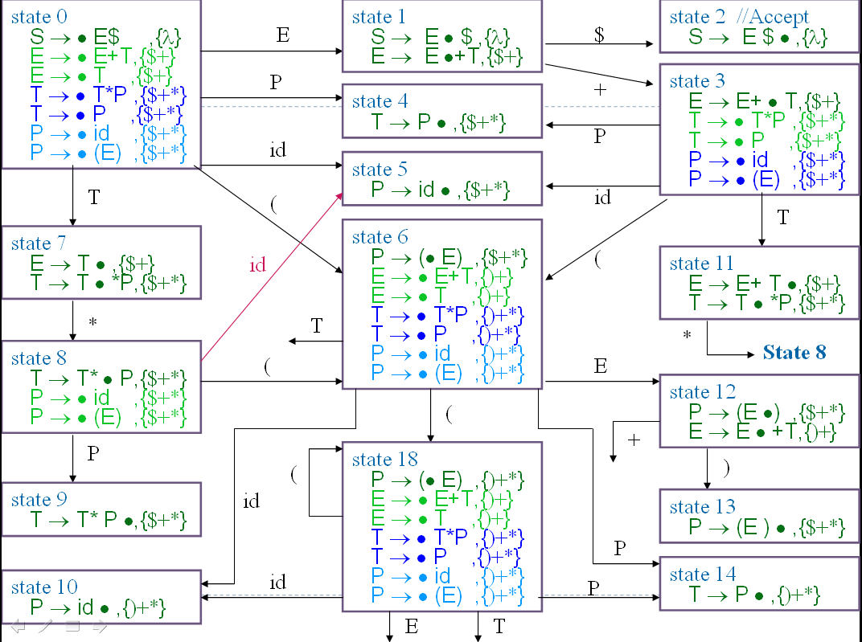
LR(1) Parsing (16)
state 16
P → (E• ) ,{)+*}
E → E •+T,{)+}
E
state 18
P → (• E) ,{)+*}
E → • E+T,{)+}
E → • T ,{)+}
T → • T*P ,{)+*}
T → • P ,{)+*}
P → • id ,{)+*}
P → • (E) ,{)+*}
T
(
+
(
P
id
State 14
State 10

Slide 25
LR(1) Parsing (17)
state 16
P → (E• ) ,{)+*}
E → E •+T,{)+}
E
state 18
P → (• E) ,{)+*}
E → • E+T,{)+}
E → • T ,{)+}
T → • T*P ,{)+*}
T → • P ,{)+*}
P → • id ,{)+*}
P → • (E) ,{)+*}
T
+
(
(
state 15
P → (E ) • ,{)+*}
P
id
State 14
State 10

Slide 26
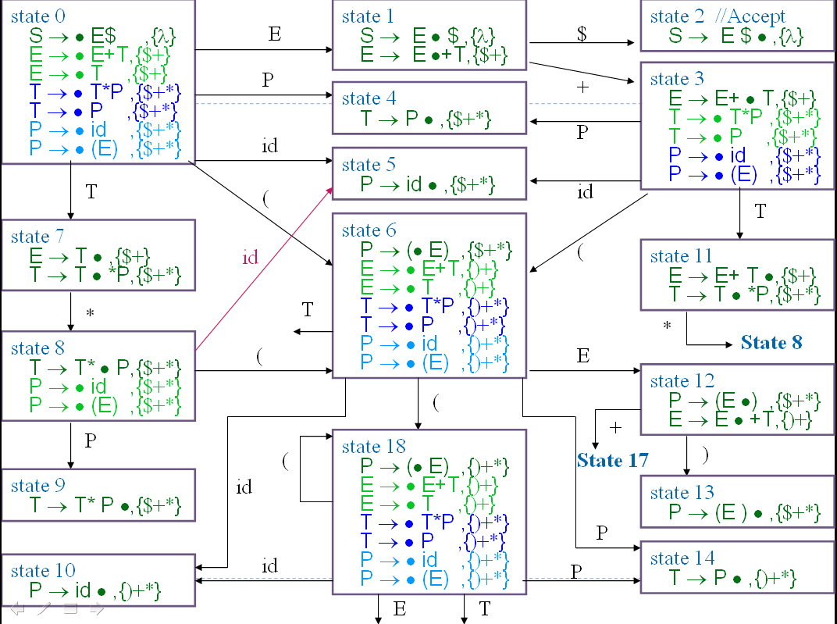
LR(1) Parsing (18)
state 16
P → (E• ) ,{)+*}
E → E •+T,{)+}
E
state 18
P → (• E) ,{)+*}
E → • E+T,{)+}
E → • T ,{)+}
T → • T*P ,{)+*}
T → • P ,{)+*}
P → • id ,{)+*}
P → • (E) ,{)+*}
T
(
(
state 15
P → (E ) • ,{)+*}
(
P
id
+
state 17
E → E +•T,{)+}
T → • T*P ,{)+*}
T → • P ,{)+*}
P → • id ,{)+*}
P → • (E) ,{)+*}
P
State 14
State 10
id
T

Slide 27
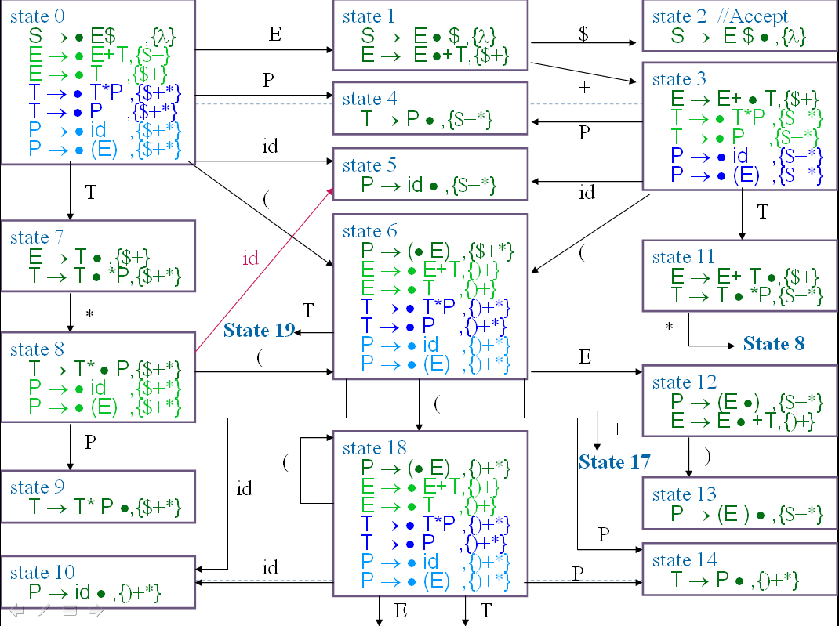
LR(1) Parsing (19)
state 16
P → (E• ) ,{)+*}
E → E •+T,{)+}
E
state 18
P → (• E) ,{)+*}
E → • E+T,{)+}
E → • T ,{)+}
T → • T*P ,{)+*}
T → • P ,{)+*}
P → • id ,{)+*}
P → • (E) ,{)+*}
T
state 19
E → T • ,{)+}
T → T • *P ,{)+*}
(
*
(
state 15
P → (E ) • ,{)+*}
(
P
id
+
state 17
E → E +•T,{)+}
T → • T*P ,{)+*}
T → • P ,{)+*}
P → • id ,{)+*}
P → • (E) ,{)+*}
P
State 14
State 10
id
T

Slide 28
LR(1) Parsing (20)
state 16
P → (E• ) ,{)+*}
E → E •+T,{)+}
E
state 18
P → (• E) ,{)+*}
E → • E+T,{)+}
E → • T ,{)+}
T → • T*P ,{)+*}
T → • P ,{)+*}
P → • id ,{)+*}
P → • (E) ,{)+*}
T
state 19
E → T • ,{)+}
T → T • *P ,{)+*}
(
*
(
state 15
P → (E ) • ,{)+*}
(
P
id
+
state 17
E → E +•T,{)+}
T → • T*P ,{)+*}
T → • P ,{)+*}
P → • id ,{)+*}
P → • (E) ,{)+*}
P
State 14
State 10
id
T
state 20
E → E +T•,{)+}
T → T • *P ,{)+*}
*

Slide 29
LR(1) Parsing (21)
state 16
P → (E• ) ,{)+*}
E → E •+T,{)+}
E
state 18
P → (• E) ,{)+*}
E → • E+T,{)+}
E → • T ,{)+}
T → • T*P ,{)+*}
T → • P ,{)+*}
P → • id ,{)+*}
P → • (E) ,{)+*}
T
state 19
E → T • ,{)+}
T → T • *P ,{)+*}
(
*
(
(
state 15
P → (E ) • ,{)+*}
state 21
T → T * • P,{)+*}
P → • id ,{)+*}
P → • (E) ,{)+*}
(
P
id
+
state 17
E → E +•T,{)+}
T → • T*P ,{)+*}
T → • P ,{)+*}
P → • id ,{)+*}
P → • (E) ,{)+*}
P
*
id
P
State 14
State 10
id
T
state 20
E → E +T•,{)+}
T → T • *P ,{)+*}

Slide 30
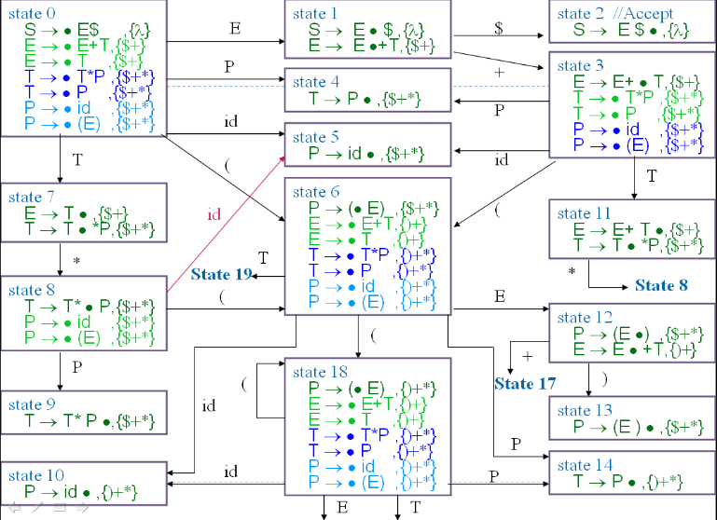
LR(1) Parsing (22)
state 16
P → (E• ) ,{)+*}
E → E •+T,{)+}
E
state 18
P → (• E) ,{)+*}
E → • E+T,{)+}
E → • T ,{)+}
T → • T*P ,{)+*}
T → • P ,{)+*}
P → • id ,{)+*}
P → • (E) ,{)+*}
T
state 19
E → T • ,{)+}
T → T • *P ,{)+*}
(
*
(
(
state 15
P → (E ) • ,{)+*}
state 21
T → T * • P,{)+*}
P → • id ,{)+*}
P → • (E) ,{)+*}
(
P
id
+
state 17
E → E +•T,{)+}
T → • T*P ,{)+*}
T → • P ,{)+*}
P → • id ,{)+*}
P → • (E) ,{)+*}
P
*
id
P
State 14
State 10
id
state 22
T → T * P •,{)+*}
T
state 20
E → E +T•,{)+}
T → T • *P ,{)+*}

Slide 31
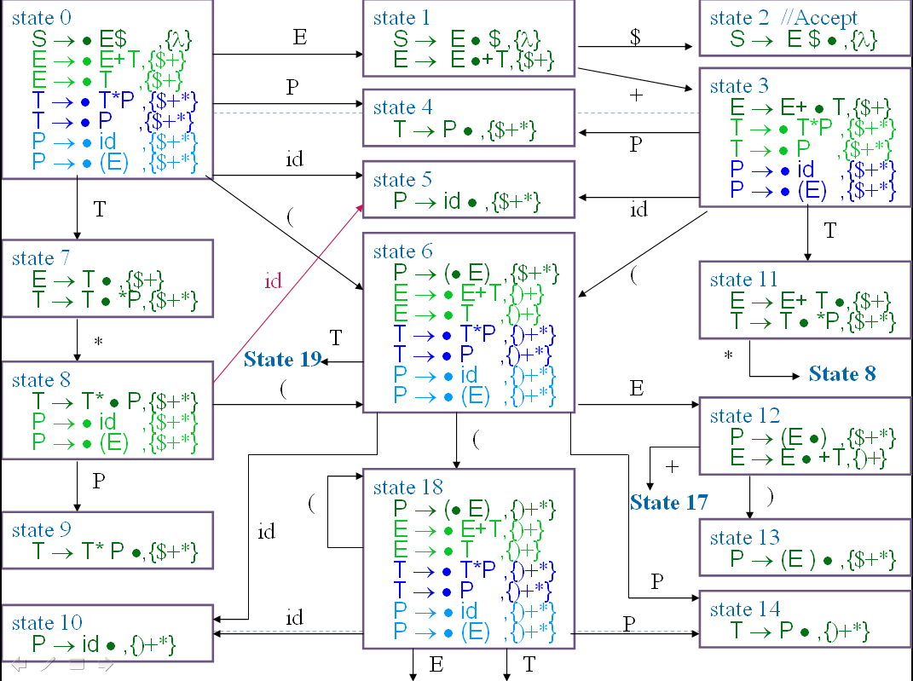
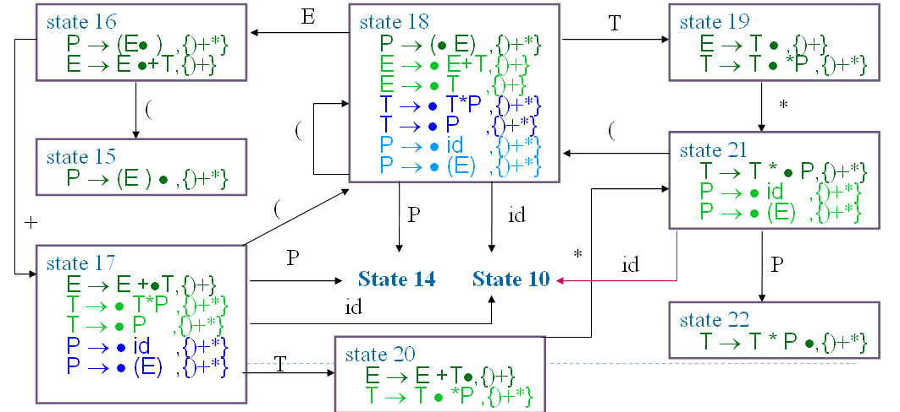
LR(1) Parsing (23)
LR(1)
The go_to table used to drive an LR(1) is extracted directly from the LR(1) machine
The algorithm to generate “go_to” table is same that we discuss in LR(0)

Slide 32
LR(1) Parsing (24)
LR(1)
Action table is extracted directly from the configuration sets of the LR(1) machine
A projection function, P
P : S₁×V_{t}→2^{Q}
S₁ be the set of LR(1) machine states
P(s,a)={Reduce_{i} | B→ρ •,a∈ s and production i is B→ρ } ∪ (if A→ α• aβ,b ∈ s Then {Shift} Else ∅)

Slide 33
LR(1) Parsing (25)
LR(1)
G is LR(1) if and only if
∀s∈ S₁ ∀a∈ V_{t} |P(s,a)|≤1
If G is LR(1), the action table is trivially extracted from P
P(s,$)={Shift} ⇒ action[s][$]=Accept
P(s,a)={Shift}, a≠$ ⇒ action[s][a]=Shift
P(s,a)={Reduce_{i}}, ⇒ action[s][a]=Reduce_{i}
P(s,a)=∅ ⇒ action[s][a]=Error

Slide 34
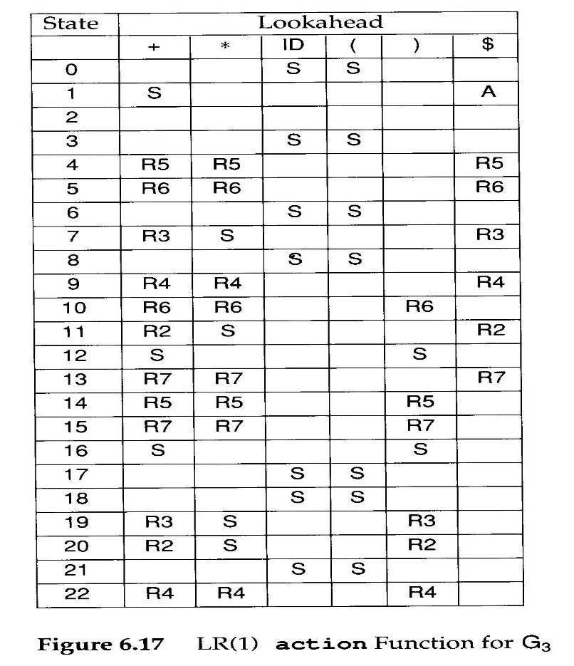
LR(1) Parsing (26)
Example: state 7
Reduce when look-ahead $+
Shift when look-ahead *

Slide 35
Look-
State
ahead
0
1
2
3
4
5
6
7
8
9
10
11
12
13
14
15
16
17
18
19
20
21
22
+
S3
R5
R6
R3
R4
R6
R2
S17
R7
R5
R7
S17
R3
R2
R4
*
R5
R6
S8
R4
R6
S8
R7
R5
R7
S21
S21
R4
id
S5
S5
S10
S5
S10
S10
S10
(
S6
S6
S18
S6
S18
S18
S18
)
R6
S13
R5
R7
S15
R3
R2
R4
$
A
R5
R6
R3
R4
R2
R7
S
E
S1
S12
S16
T
S7
S11
S19
S20
S19

Slide 36
Compare G₃ action in LR(0) and LR(1) - 1
LR(0)
LR(1)
for grammar G₃ :
1. S → E $
2. E → E + T
3. E → T
4. T → T * P
5. T → P
6. P → id
7. P → ( E )
state 7
E → T •
T → T • *P
state 7
E → T • ,{$+}
T → T • *P,{$+*}
LR(0)
ambiguous

Slide 37
Compare G₃ action in LR(0) and LR(1) - 2
for grammar G₃ :
1. S → E $
2. E → E + T
3. E → T
4. T → T * P
5. T → P
6. P → id
7. P → ( E )
Look-
State
ahead
0
1
2
3
4
5
6
7
8
9
10
11
12
13
14
15
16
17
18
19
20
21
22
+
S3
R5
R6
R3
R4
R6
R2
S17
R7
R5
R7
S17
R3
R2
R4
*
R5
R6
S8
R4
R6
S8
R7
R5
R7
S21
S21
R4
id
S5
S5
S10
S5
S10
S10
S10
(
S6
S6
S18
S6
S18
S18
S18
)
R6
S13
R5
R7
S15
R3
R2
R4
$
A
R5
R6
R3
R4
R2
R7
S
E
S1
S12
S16
T
S7
S11
S19
S20
S19

Slide 38
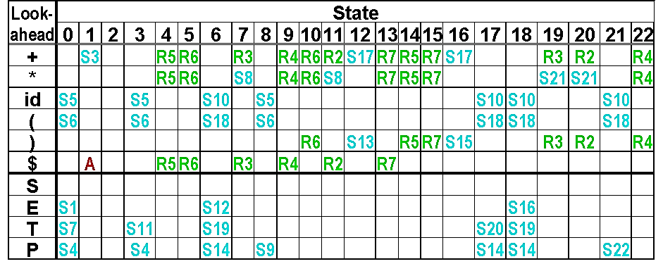
Initial :(id+id)$
shift (
step1:0 (id+id)$
Tree:
(

Slide 39
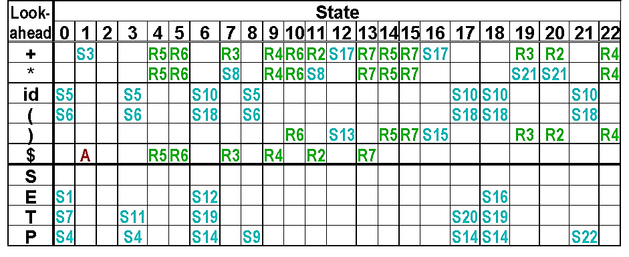
Initial :(id+id)$
step2:0 6 id+id)$
shift id
Tree:
(
id

Slide 40
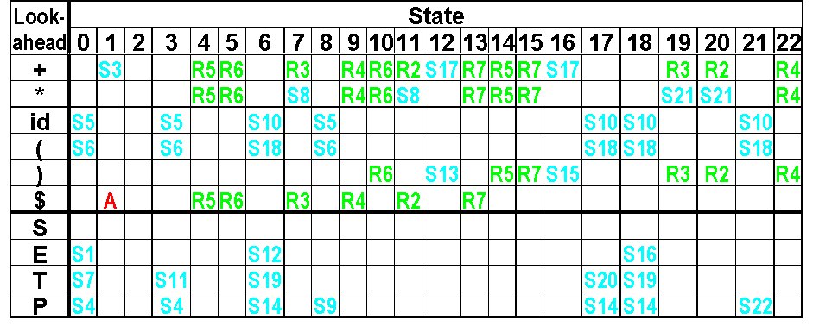
Initial :(id+id)$
step3:0 6 10 +id)$
Reduce 6
Shift
Tree:
(
P
id

Slide 41
Initial :(id+id)$
step4:0 6 14 +id)$
Reduce 5
Shift T
Tree:
(
T
P
id

Slide 42
Initial :(id+id)$
Reduce 3
step5:0 6 19 +id)$
Shit E
Tree:
(
E
T
P
id

Slide 43
Initial :(id+id)$
step6:0 6 12 +id)$
Shift +
Tree:
(
E
+
T
P
id

Slide 44
Initial :(id+id)$
step7:0 6 12 17 id)$
shift id
Tree:
(
E
+
id
T
P
id

Slide 45
Initial :(id+id)$
10
Reduce 6
step8:0 6 12 17 )$
Shift P
Tree:
(
E
+
P
T
id
P
id

Slide 46
Initial :(id+id)$
14
Reduce 5
step9:0 6 12 17 )$
Shift T
Tree:
(
E
+
T
T
P
P
id
id

Slide 47
Initial :(id+id)$
Reduce 2
17
20
Shift E
step10:0 6 )$
12
Tree:
(
E
E
+
T
T
P
P
id
id

Slide 48
Initial :(id+id)$
)
step11:0 6 12 $
Shift ）
Tree:
(
E
)
E
+
T
T
P
P
id
id

Slide 49
Initial :(id+id)$
6
step12:0 $
12
13
Shift P
Reduce 7
Tree:
P
(
E
)
E
+
T
T
P
P
id
id

Slide 50
Initial :(id+id)$
4
Reduce 5
step13:0 $
Shift T
Tree:
T
P
(
E
)
E
+
T
T
P
P
id
id

Slide 51
Initial :(id+id)$
Reduce 3
step14:0 $
Shift E
7
E
Tree:
T
P
(
E
)
E
+
T
T
P
P
id
id

Slide 52
Initial :(id+id)$
step15:0 1 $ Accept
E
Tree:
T
P
(
E
)
E
+
T
T
P
P
id
id

Slide 53
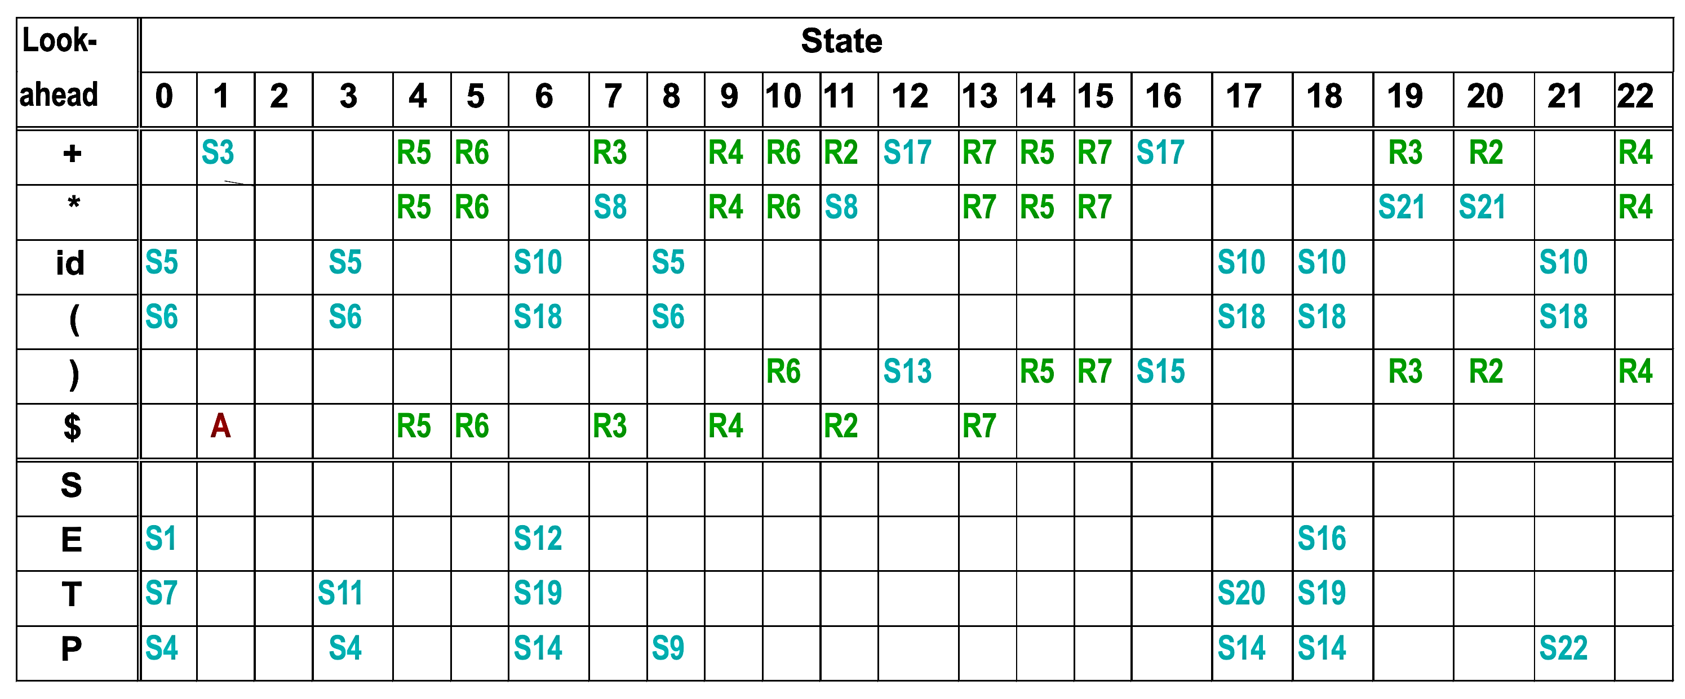
Summary (1)
for grammar G₃ :
1. S → E $
2. E → E + T
3. E → T
4. T → T * P
5. T → P
6. P → id
7. P → ( E )
Initial :(id+id)$
Step | State | Next Token | Operation | Rule | Current Grammar
1 | 0 | ( | shift | s6 | (.id+id)$
2 | 6 | id | shift | s10 | (id.+id)$
3 | 10 | + | reduce | r6 | (.P+id)$
4 | 6 | P | shift | s14 | (P.+id)$
5 | 14 | + | reduce | r5 | (.T+id)$
6 | 6 | T | shift | s19 | (T.+id)$
7 | 19 | + | reduce | r3 | (.E+id)$
8 | 6 | E | shift | s12 | (E.+id)$
9 | 12 | + | shift | s17 | (E+.id)$
10 | 17 | id | shift | s10 | (E+id.)$
11 | 10 | ) | reduce | r6 | (E+.P)$

Slide 54
Summary (2)
for grammar G₃ :
1. S → E $
2. E → E + T
3. E → T
4. T → T * P
5. T → P
6. P → id
7. P → ( E )
Initial :(id+id)$
Step | State | Next Token | Operation | Rule | Current Grammar
12 | 17 | P | shift | s14 | (E+P.)$
13 | 14 | ) | reduce | r5 | (E+.T)$
14 | 17 | T | shift | r20 | (E+T.)$
15 | 20 | ) | reduce | r2 | (.E)$
16 | 6 | E | shift | s12 | (E.)$
17 | 12 | ) | shift | s13 | (E).$
18 | 13 | $ | reduce | r7 | .P$
19 | 0 | P | shift | s4 | P.$
20 | 4 | $ | reduce | r5 | .E$
21 | 0 | E | shift | s1 | E.$
22 | 1 | $ | accept | r1 | S

