Slide 1
CSC4180 – Compiler Construction
Prof. Yeh-Ching Chung
School of Data Science
Chinese University of Hong Kong, Shenzhen

Slide 2
Outline
6.0 Introduction
6.1 Shift-Reduce Parsers
6.2 LR Parsers
6.3 LR(1) Parsing
6.4 SLR(1)Parsing
6.5 LALR(1)
6.6 Calling Semantic Routines in Shift-Reduce Parsers
6.7 Using a Parser Generator (TA course)
6.8 Optimizing Parse Tables
6.9 Practical LR(1) Parsers
6.10 Properties of LR Parsing
6.11 LL(1) or LAlR(1) , That is the question
6.12 Other Shift-Reduce Technique
2

Slide 3
SLR(1) Parsing (1)
LR(1) parsers
are the most powerful case of shift-reduce parsers, using a single look-ahead
LR(1) grammars exist for virtually all programming languages
LR(1)’s problem is that the LR(1) machine contains so many states that the go_to and action tables become prohibitively large
In reaction to the space inefficiency of LR(1) tables
computer scientists have devised parsing techniques that are almost as powerful as LR(1) but that require far smaller tables
One is to start with the CFSM, and then add look-ahead after the CFSM is build
SLR(1)
The other approach to reducing LR(1)’s space inefficiencies is to merger inessential LR(1) states
LALR(1)

Slide 4
SLR(1) Parsing (2)
SLR(1) stands for Simple LR(1)
One-symbol look-ahead
Look-aheads are not built directly into configurations but rather are added after the LR(0) configuration sets are built
An SLR(1) parser will perform a reduce action for configuration B→ ρ • if the look-ahead symbol is in the set Follow(B)
The SLR(1) projection function, from CFSM states,
P : S₀×V_{t}→2^{Q}
P(s,a)={Reduce_{i} | B→ρ •, a∈ Follow(B) and production i is B→ρ } ∪
(if A→ α• aβ ∈ s for a∈ V_{t} Then {Shift} Else ∅)

Slide 5
SLR(1) Parsing (3)
G is SLR(1) if and only if
∀s∈ S₀ ∀a∈ V_{t} |P(s,a)|≤1
If G is SLR(1), the action table is trivially extracted from P
P(s,$)={Shift} ⇒ action[s][$]=Accept
P(s,a)={Shift}, a≠$ ⇒ action[s][a]=Shift
P(s,a)={Reduce_{i}}, ⇒ action[s][a]=Reduce_{i}
P(s,a)=∅ ⇒ action[s][a]=Error
Clearly SLR(1) is a proper superset of LR(0)

Slide 6
SLR(1) Parsing (4)
Consider G₃
It is LR(1) but not LR(0)
What are the follow-sets in G₃?
Consider G₃ :
1. S → E $
2. E → E + T
3. E → T
4. T → T * P
5. T → P
6. P → id
7. P → ( E )
Follow(S) = {λ},
Follow(E) = {+)$},
Follow(T) = {+*)$},
Follow(P) = {+*)$}

Slide 7
state 0
S → • E$
E → • E+T
E → • T
T → • T*P
T → • P
P → • id
P → • (E)
E
P
id
T
(
Follow(S) = {λ},
Follow(E) = {+)$},
Follow(T) = {+*)$},
Follow(P) = {+*)$}

Slide 8
state 0
S → • E$
E → • E+T
E → • T
T → • T*P
T → • P
P → • id
P → • (E)
state 1
S → E • $
E → E •+T
E
$
P
+
id
T
(
Follow(S) = {λ},
Follow(E) = {+)$},
Follow(T) = {+*)$},
Follow(P) = {+*)$}

Slide 9
state 0
S → • E$
E → • E+T
E → • T
T → • T*P
T → • P
P → • id
P → • (E)
state 1
S → E • $
E → E •+T
state 2 //Accept
S → E $ •
E
$
P
+
id
T
(
Follow(S) = {λ},
Follow(E) = {+)$},
Follow(T) = {+*)$},
Follow(P) = {+*)$}
9

Slide 10
state 0
S → • E$
E → • E+T
E → • T
T → • T*P
T → • P
P → • id
P → • (E)
state 1
S → E • $
E → E •+T
state 2 //Accept
S → E $ •
E
$
P
+
state 3
E → E+ • T
T → • T*P
T → • P
P → • id
P → • (E)
P
id
T
(
id
T
(
Follow(S) = {λ},
Follow(E) = {+)$},
Follow(T) = {+*)$},
Follow(P) = {+*)$}

Slide 11
state 0
S → • E$
E → • E+T
E → • T
T → • T*P
T → • P
P → • id
P → • (E)
state 1
S → E • $
E → E •+T
state 2 //Accept
S → E $ •
E
$
P
P
+
state 3
E → E+ • T
T → • T*P
T → • P
P → • id
P → • (E)
state 4
T → P •
P
id
T
(
id
T
(
Follow(S) = {λ},
Follow(E) = {+)$},
Follow(T) = {+*)$},
Follow(P) = {+*)$}

Slide 12
state 0
S → • E$
E → • E+T
E → • T
T → • T*P
T → • P
P → • id
P → • (E)
state 1
S → E • $
E → E •+T
state 2 //Accept
S → E $ •
E
$
P
P
+
state 3
E → E+ • T
T → • T*P
T → • P
P → • id
P → • (E)
state 4
T → P •
P
id
state 5
P → id •
T
(
id
T
(
Follow(S) = {λ},
Follow(E) = {+)$},
Follow(T) = {+*)$},
Follow(P) = {+*)$}

Slide 13
state 0
S → • E$
E → • E+T
E → • T
T → • T*P
T → • P
P → • id
P → • (E)
state 1
S → E • $
E → E •+T
state 2 //Accept
S → E $ •
E
$
P
P
+
state 3
E → E+ • T
T → • T*P
T → • P
P → • id
P → • (E)
state 4
T → P •
P
id
state 5
P → id •
T
(
id
T
id
(
state 6
P → (• E)
E → • E+T
E → • T
T → • T*P
T → • P
P → • id
P → • (E)
T
E
(
P
Follow(S) = {λ},
Follow(E) = {+)$},
State 4
Follow(T) = {+*)$},
Follow(P) = {+*)$}

Slide 14
state 0
S → • E$
E → • E+T
E → • T
T → • T*P
T → • P
P → • id
P → • (E)
state 1
S → E • $
E → E •+T
state 2 //Accept
S → E $ •
E
$
P
P
+
state 3
E → E+ • T
T → • T*P
T → • P
P → • id
P → • (E)
state 4
T → P •
P
id
state 5
P → id •
T
(
id
T
state 7
E → T •
T → T • *P
id
(
state 6
P → (• E)
E → • E+T
E → • T
T → • T*P
T → • P
P → • id
P → • (E)
*
T
E
(
P
Follow(S) = {λ},
Follow(E) = {+)$},
State 4
Follow(T) = {+*)$},
Follow(P) = {+*)$}

Slide 15
state 0
S → • E$
E → • E+T
E → • T
T → • T*P
T → • P
P → • id
P → • (E)
state 1
S → E • $
E → E •+T
state 2 //Accept
S → E $ •
E
$
P
P
+
state 3
E → E+ • T
T → • T*P
T → • P
P → • id
P → • (E)
state 4
T → P •
P
id
state 5
P → id •
T
(
id
T
state 7
E → T •
T → T • *P
id
id
(
state 6
P → (• E)
E → • E+T
E → • T
T → • T*P
T → • P
P → • id
P → • (E)
*
T
state 8
T → T* • P
P → • id
P → • (E)
(
E
P
(
P
Follow(S) = {λ},
Follow(E) = {+)$},
State 4
Follow(T) = {+*)$},
Follow(P) = {+*)$}

Slide 16
state 0
S → • E$
E → • E+T
E → • T
T → • T*P
T → • P
P → • id
P → • (E)
state 1
S → E • $
E → E •+T
state 2 //Accept
S → E $ •
E
$
P
P
+
state 3
E → E+ • T
T → • T*P
T → • P
P → • id
P → • (E)
state 4
T → P •
P
id
state 5
P → id •
T
(
id
T
state 7
E → T •
T → T • *P
id
id
(
state 6
P → (• E)
E → • E+T
E → • T
T → • T*P
T → • P
P → • id
P → • (E)
*
T
state 8
T → T* • P
P → • id
P → • (E)
(
E
P
(
P
state 9
T → T* P •
Follow(S) = {λ},
Follow(E) = {+)$},
State 4
Follow(T) = {+*)$},
Follow(P) = {+*)$}

Slide 17
state 0
S → • E$
E → • E+T
E → • T
T → • T*P
T → • P
P → • id
P → • (E)
state 1
S → E • $
E → E •+T
state 2 //Accept
S → E $ •
E
$
P
P
+
state 3
E → E+ • T
T → • T*P
T → • P
P → • id
P → • (E)
state 4
T → P •
P
id
state 5
P → id •
T
(
id
T
state 7
E → T •
T → T • *P
id
id
(
state 11
E → E+ T •
T → T • *P
state 6
P → (• E)
E → • E+T
E → • T
T → • T*P
T → • P
P → • id
P → • (E)
*
T
*
state 8
T → T* • P
P → • id
P → • (E)
State 8
(
E
P
(
P
state 9
T → T* P •
Follow(S) = {λ},
Follow(E) = {+)$},
State 4
Follow(T) = {+*)$},
Follow(P) = {+*)$}

Slide 18
state 0
S → • E$
E → • E+T
E → • T
T → • T*P
T → • P
P → • id
P → • (E)
state 1
S → E • $
E → E •+T
state 2 //Accept
S → E $ •
E
$
P
P
+
state 3
E → E+ • T
T → • T*P
T → • P
P → • id
P → • (E)
state 4
T → P •
P
id
state 5
P → id •
T
(
id
T
state 7
E → T •
T → T • *P
id
id
(
state 11
E → E+ T •
T → T • *P
state 6
P → (• E)
E → • E+T
E → • T
T → • T*P
T → • P
P → • id
P → • (E)
*
T
*
state 8
T → T* • P
P → • id
P → • (E)
State 8
(
E
state 12
P → (E •)
E → E • +T
P
(
)
+
P
state 9
T → T* P •
Follow(S) = {λ},
Follow(E) = {+)$},
State 3
Follow(T) = {+*)$},
State 4
Follow(P) = {+*)$}

Slide 19
state 0
S → • E$
E → • E+T
E → • T
T → • T*P
T → • P
P → • id
P → • (E)
state 1
S → E • $
E → E •+T
state 2 //Accept
S → E $ •
E
$
P
P
+
state 3
E → E+ • T
T → • T*P
T → • P
P → • id
P → • (E)
state 4
T → P •
P
id
state 5
P → id •
T
(
id
T
state 7
E → T •
T → T • *P
id
id
(
state 11
E → E+ T •
T → T • *P
state 6
P → (• E)
E → • E+T
E → •T
T → • T*P
T → • P
P → • id
P → • (E)
*
T
*
state 8
T → T* • P
P → • id
P → • (E)
State 8
(
E
state 12
P → (E •)
E → E • +T
P
(
)
+
P
state 9
T → T* P •
Follow(S) = {λ},
State 3
Follow(E) = {+)$},
State 4
Follow(T) = {+*)$},
state 10
P → (E) •
Follow(P) = {+*)$}

Slide 20
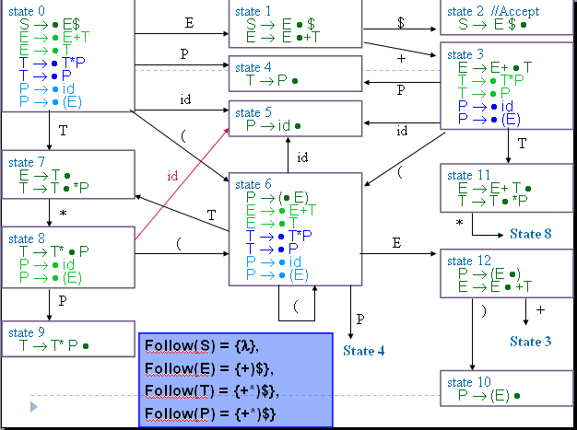
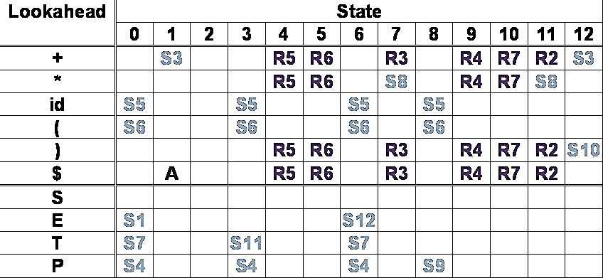
SLR(1) Parsing (5)
SLR(1) action table

Slide 21
SLR(1) Parsing (6)
Limitations of the SLR(1) Technique
The use of follow sets to estimate the look-aheads that predict reduce actions is less precise than using the exact look-aheads incorporated into LR(1) configurations
Example in next page

Slide 22
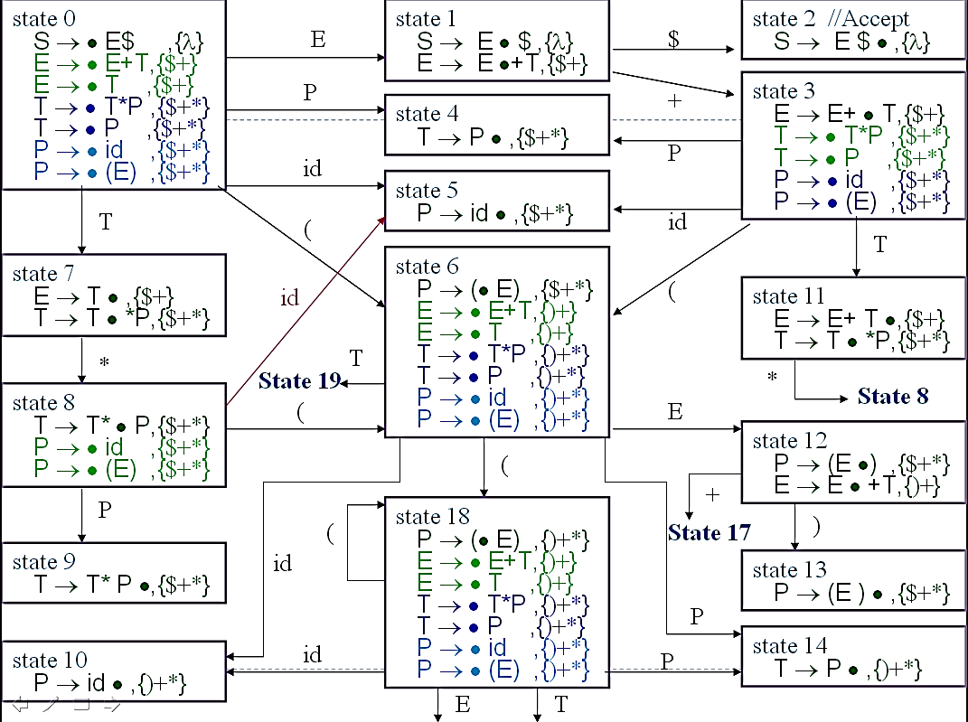
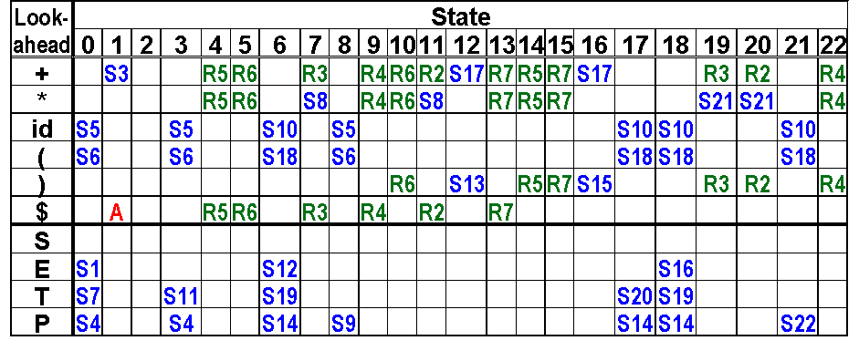
Compare LR(1) & SLR(1) -1
Consider G₃ :
1. S → E $
2. E → E + T
3. E → T
4. T → T * P
5. T → P
6. P → id
7. P → ( E )
Consider Input: id )
Step1:0 id) shift 5
Step2:05 ) Error
LR(1)

Slide 23
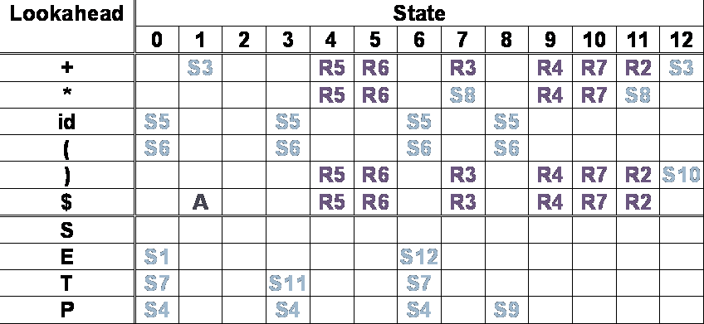

Compare LR(1) & SLR(1) - 2
Consider Input: id )
Consider G₃ :
1. S → E $
2. E → E + T
3. E → T
4. T → T * P
5. T → P
6. P → id
7. P → ( E )
Step1:0 id) shift 5
Step2:05 ) Reduce 6
Step3:04 ) Reduce 5
Step4:07 ) Reduce 3
Step5:01 ) Error
SLR(1)

Slide 24
Outline
6.0 Introduction
6.1 Shift-Reduce Parsers
6.2 LR Parsers
6.3 LR(1) Parsing
6.4 SLR(1)Parsing
6.5 LALR(1)
6.6 Calling Semantic Routines in Shift-Reduce Parsers
6.7 Using a Parser Generator (TA course)
6.8 Optimizing Parse Tables
6.9 Practical LR(1) Parsers
6.10 Properties of LR Parsing
6.11 LL(1) or LAlR(1) , That is the question
6.12 Other Shift-Reduce Technique

Slide 25
LALR(1) - 1
LALR(1) parsers
Can be built by first constructing an LR(1) parser and then merging states
An LALR(1) parser is an LR(1) parser in which all states that differ only in the look-ahead components of the configurations are merged
LALR is an acronym for Look Ahead LR
The core of the right two configurations is the same, but with different look-ahead sets
state 3
E → E+ • T,{$+}
T → • T*P ,{$+*}
T → • P ,{$+*}
P → • id ,{$+*}
P → • (E) ,{$+*}
Cognate(s′)={c|c∈s, core(s)=s′}
state 3
E → E+ • T,{)$+}
T → • T*P ,{)$+*}
T → • P ,{)$+*}
P → • id ,{)$+*}
P → • (E) ,{)$+*}
Core s’
E → E+ • T
T → • T*P
T → • P
P → • id
P → • (E)
state 17
E → E +•T,{)+}
T → • T*P ,{)+*}
T → • P ,{)+*}
P → • id ,{)+*}
P → • (E) ,{)+*}

Slide 26
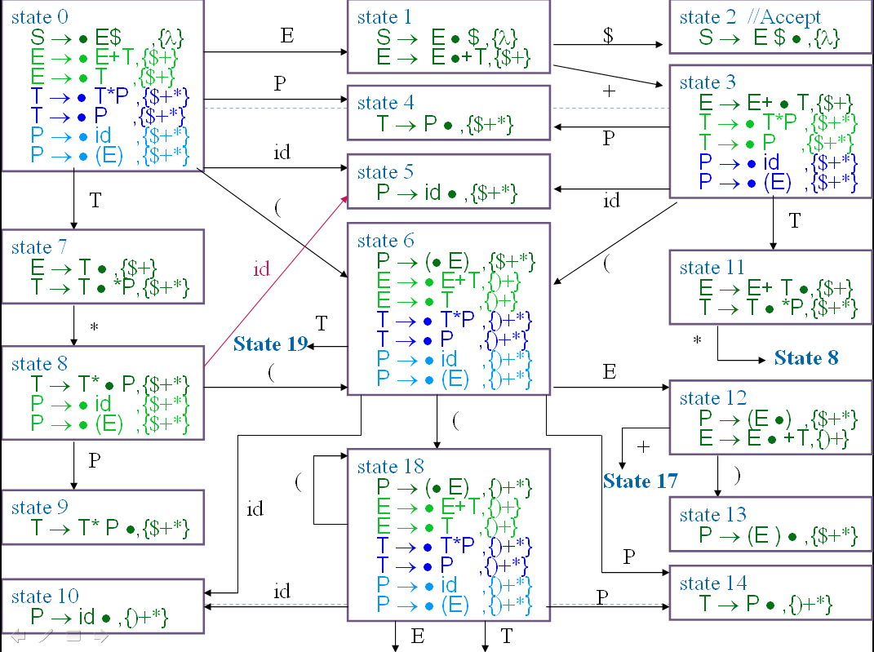
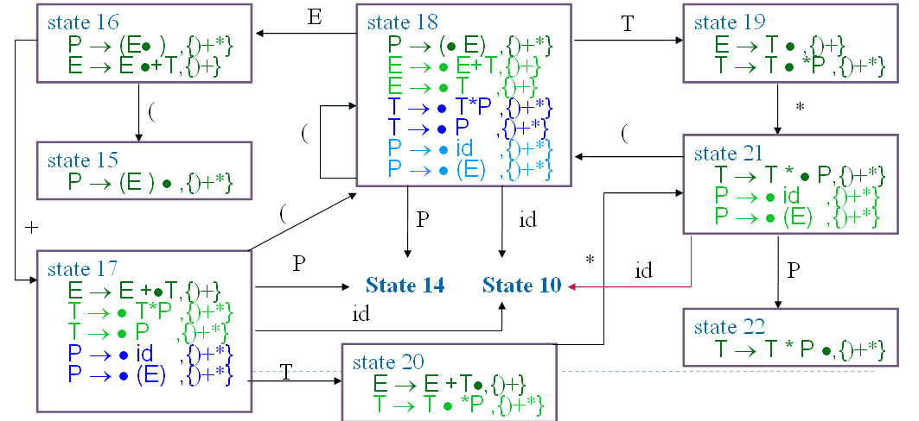
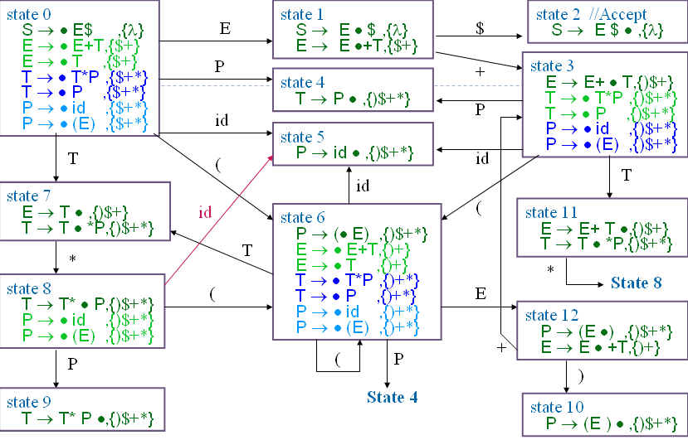
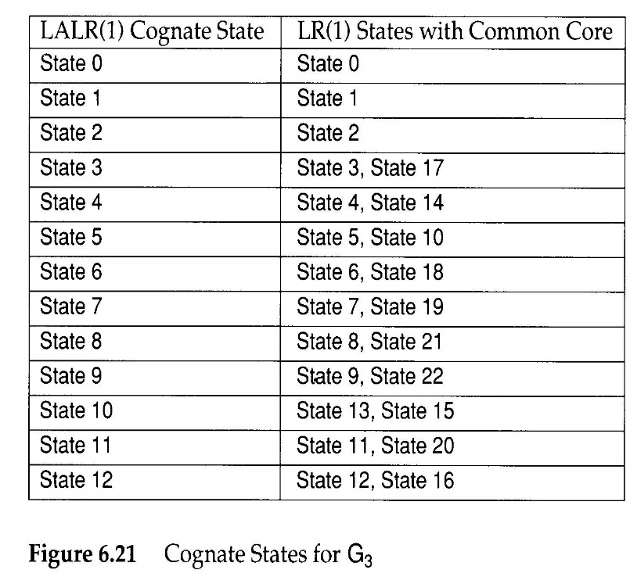
LR(1) G₃ diagram
LALR(1) G₃ diagram

Slide 27
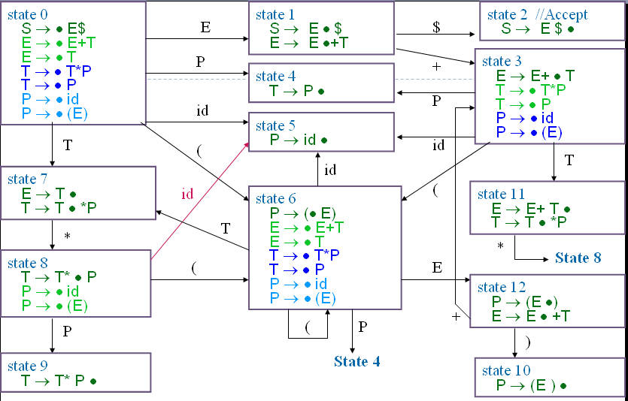
LALR(1) - 3
Follow(S) = {λ},
Follow(E) = {+)$},
Follow(T) = {+*)$},
Follow(P) = {+*)$}
SLR(1) G₃ diagram
LALR(1) G₃ diagram
Compare SLR(1) & LALR(1)
The behavior whether action or goto using SLR(1) or LALR(1) in G₃ is the same
Example:
Compare state 7 and state10
in SLR(1) and LALR(1).
Are they all the same?
When are they different???

Slide 28
LALR(1) - 4
The CFSM state is transformed into its LALR(1) Cognate
P : S₀×V_{t}→2^{Q}
P(s,a)={Reduce_{i} | B→ρ •,a∈ Cognate(s) and production i is B→ρ } ∪
(if A→ α• aβ ∈ s Then {Shift} Else ∅)
G is LALR(1) if and only if
∀s∈ S₀ ∀a∈ V_{t} |P(s,a)|≤1
If G is LALR(1), the action table is trivially extracted from P
P(s,$)={Shift} ⇒ action[s][$]=Accept
P(s,a)={Shift}, a≠$ ⇒ action[s][a]=Shift
P(s,a)={Reduce_{i}}, ⇒ action[s][a]=Reduce_{i}
P(s,a)=∅ ⇒ action[s][a]=Error

Slide 29
LALR(1) - 5
For Grammar 5:
Assume that statements are separated by ; The grammar is not SLR(1) because
; ∈ Follow(<stmt>) and
; ∈ Follow(<var>), since <expr>→<var>
grammar G₅ :
…..
<prog>→ <stmt>;{<stmt>;}
<stmt>→ID
<stmt>→<var>:=<expr>
<var> →ID
<var> →ID[<expr>]
<expr>→<var>
state 0
……
<prog>→ •<stmt>;{<stmt>;}
<stmt>→ •ID
<stmt>→ •<var>:=<expr>
<var> → •ID
<var> → •ID[<expr>]
<expr>→ •<var>
State 1
<stmt>→ ID •
<var> → ID •
<var> → ID •[<expr>]
id
Reduce-reduce conflict

Slide 30
LALR(1) - 6
However, in LALR(1),
If we use <var> → ID, the next symbol must be :=
so action[ 1, := ] = reduce(<var> → ID)
action[ 1, ; ] = reduce(<stmt> → ID)
action[ 1,[ ] = shift
There is no conflict
state 0
……
<prog>→ •<stmt>;{<stmt>;} ,{$ ;}
<stmt>→ •ID, {$ ;}
<stmt>→ •<var>:=<expr> ,{$ ; :=}
<var> → •ID, {$ ; :=}
<var> → •ID[<expr>] ,{$ ; := [ }
<expr>→ •<var>
state 1
<stmt>→ ID •, {$ ;}
<var> → ID •, {$ ; :=}
<var> → ID •[<expr>] ,{$ ; := [ }
id

Slide 31
LALR(1) - 7
A common technique
Translate an LALR(1) grammar into SLR(1) form is to introduce a new non-terminal whose global (I.e. SLR) look-aheads are more nearly corresponding to LALR’s exact look-aheads
Follow(<lhs>) = {:=}
Grammar G₅ :
……
<prog>→ <stmt>;{<stmt>;}
<stmt>→ ID
<stmt>→ <lhs>:=<expr>
<lhs> → ID
<lhs> → ID[<expr>]
<var> → ID
<var> → ID[<expr>]
<expr>→ <var>
Grammar G₅ :
……
<prog>→ <stmt>;{<stmt>;}
<stmt>→ ID
<stmt>→ <var>:=<expr>
<var> → ID
<var> → ID[<expr>]
<expr>→ <var>

Slide 32
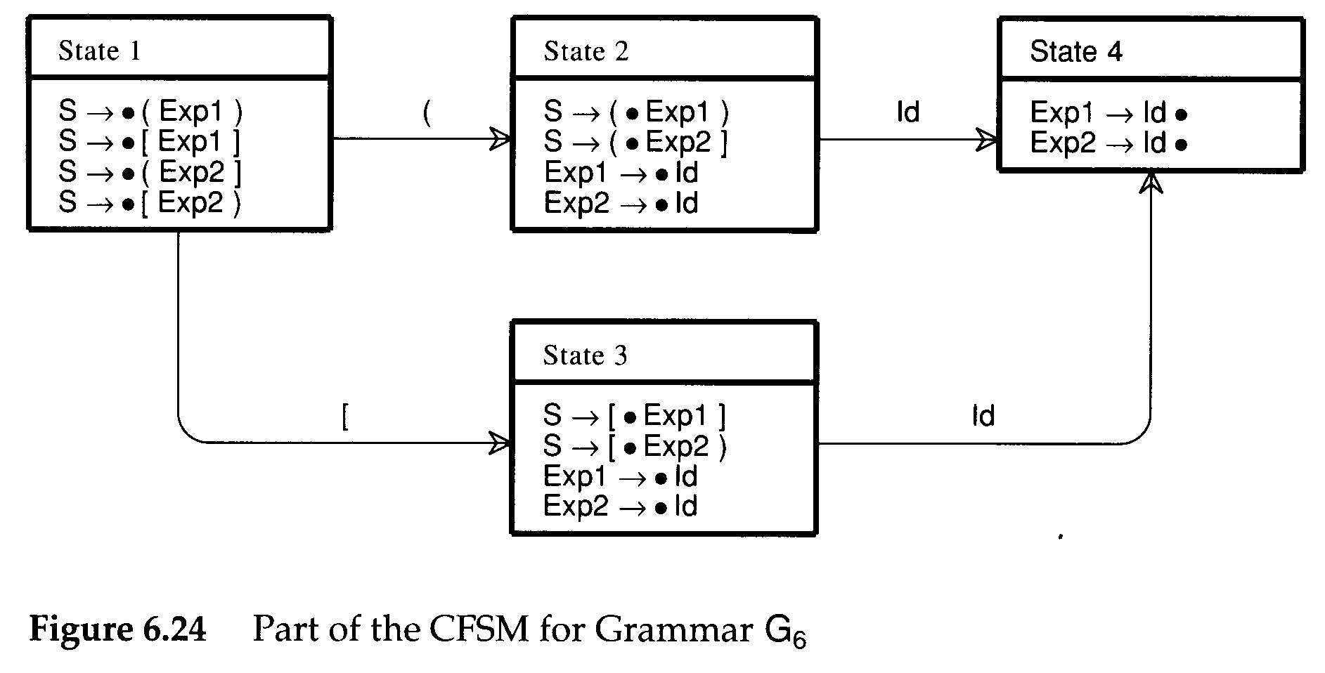
LALR(1) - 8
Both SLR(1) and LALR(1) build CFSM
Does the case ever occur in which action table can’t work?
At times, it is the CFSM itself that is at fault
A different expression non-terminal is used to allow error or warning diagnostics
grammar G₆ :
S→ (Exp1)
S→ [Exp1]
S→ (Exp2]
S→ [Exp2)
<Exp1>→ID
<Exp2>→ID
In state4 , after reduce, we do not know what state should be the next state
In LR(1) , state4 will split into two states and have a solution

Slide 33
Build LALR(1) Parser (1)
In the definition of LALR(1)
An LR(1) machine is first built, and then its states are merged to form an automaton identical in structure to the CFSM
May be quite inefficient
An alternative is to build the CFSM first
Then LALR(1) look-aheads are “propagated” from configuration to configuration
Propagate links
Case 1: One configuration is created from another in a previous state via a shift operation
Case 2: One configuration is created as the result of a closure or prediction operation on another configuration
A→ α•Xγ , L₁
A→ αX• γ , L₂
B→ β•Aγ , L₁ A→ •α , L₂
L₂={ x|x∈First(γ t) and t ∈L₁ }

Slide 34
Build LALR(1) Parser (2)
Step 1
After the CFSM is built, we can create all the necessary propagate links to transmit look-aheads from one configuration to another
Step 2
Spontaneous look-aheads are determined
By including in L₂, for configuration A→•α, L₂, all spontaneous look-aheads induced by configurations of the form B → β • Aγ, L₁
These are simply the non-λ values of First(γ)
Step 3
Then, propagate look-aheads via the propagate links
While (stack is not empty)
{
Pop top item, assign its components to (s,c,L)
if ( configuration c in state s has any propagate links)
{
Try, in turn, to add L to the look-ahead set of each configuration so linked.
for (each configuration c’ in state s’ to which L is added)
Push(s’,c’,L) onto the stack
}
}

Slide 35
Build LALR(1) Parser (3)
grammar G₆ :
S→ Opts $
Opts→ Opt Opt
Opt→ ID
Build CFSM
state 1
S → • Opts$
Opts → • Opt Opt
Opt → • ID
state 4
Opts → Opt • Opt
Opt → • ID
Opt
state 6
Opts → Opt Opt •
Opt
Opts
ID
ID
state 2
S → Opts • $
state 5
Opt → ID •
$
state 3
S → Opts $ •

Slide 36
Build LALR(1) Parser (4)
grammar G₆ :
S→ Opts $
Opts→ Opt Opt
Opt→ ID
Build initial Lookahead
state 1
S → • Opts$ ,{}
Opts → • Opt Opt,
Opt → • ID ,
state 4
Opts → Opt • Opt
Opt → • ID
Opt
state 6
Opts → Opt Opt •
Opt
Stack:
(s1,c1,{ })
Opts
ID
ID
state 2
S → Opts • $
state 5
Opt → ID •
$
state 3
S → Opts $ •

Slide 37
Build LALR(1) Parser (5)
grammar G₆ :
S→ Opts $
Opts→ Opt Opt
Opt→ ID
state 1
S → • Opts$ ,{}
Opts → • Opt Opt
Opt → • ID
state 4
Opts → Opt • Opt
Opt → • ID
Opt
state 6
Opts → Opt Opt •
Opt
,{$}
Opts
ID
ID
Step1
pop (s1, c1, {})
add $ to c1 in s2 (case1)
push(s2,c1,$)
add $ to c2 in s1 (case2)
push(s1, c2, $)
state 2
S → Opts • $
,{$}
state 5
Opt → ID •
$
state 3
S → Opts $ •
Top
Stack:
(s1,c2,$)
(s2,c1,$)
(s1,c1,{ })
A→ α•Xγ , L₁
A→ αX• γ , L₂
buttom
B→ β•Aγ , L₁ A→ •α , L₂
L₂={ x|x∈First(γ t) and t ∈L₁ }

Slide 38
Build LALR(1) Parser (6)
grammar G₆ :
S→ Opts $
Opts→ Opt Opt
Opt→ ID
state 1
S → • Opts$ ,{}
Opts → • Opt Opt ,{$}
Opt → • ID
state 4
Opts → Opt • Opt
Opt → • ID
Opt
, {ID}
, {ID}
Opts
ID
ID
Opt
Step2
pop (s1,c2,$)
add ID to c1 in s4 (case1)
push (s4,c1,ID)
add ID to c3 in s1 (case2)
push (s1,c3,ID)
state 2
S → Opts • $ , {$}
state 5
Opt → ID •
$
state 3
S → Opts $ •
state 6
Opts → Opt Opt •
Stack:
(s1,c3,ID)
(s4,c1,ID)
(s2,c1,$)
Top
A→ α•Xγ , L₁
A→ αX• γ , L₂
(s1,c2,$)
B→ β•Aγ , L₁ A→ •α , L₂
buttom
L₂={ x|x∈First(γ t) and t ∈L₁ }

Slide 39
Build LALR(1) Parser (7)
grammar G₆ :
S→ Opts $
Opts→ Opt Opt
Opt→ ID
state 1
S → • Opts$ ,{}
Opts → • Opt Opt ,{$}
Opt → • ID, {ID}
state 4
Opts → Opt • Opt, {ID}
Opt → • ID
Opt
Opts
ID
ID
Opt
state 2
S → Opts • $ , {$}
state 5
Opt → ID •
, {ID}
Step3
pop (s1, c3, ID)
add ID to c1 in s5 (case1)
push (s5, c1, ID)
$
state 3
S → Opts $ •
state 6
Opts → Opt Opt •
Top
Stack:
(s5,c1,ID)
(s4,c1,ID)
(s2,c1,$)
A→ α•Xγ , L₁
A→ αX• γ , L₂
(s1,c3,ID)
buttom

Slide 40
Build LALR(1) Parser (8)
grammar G₆ :
S→ Opts $
Opts→ Opt Opt
Opt→ ID
state 1
S → • Opts$ ,{}
Opts → • Opt Opt ,{$}
Opt → • ID, {ID}
state 4
Opts → Opt • Opt, {ID}
Opt → • ID
Opt
Opts
ID
ID
Opt
state 2
S → Opts • $ , {$}
state 5
Opt → ID • , {ID}
$
Step4
pop (s5,c1,ID)
state 3
S → Opts $ •
state 6
Opts → Opt Opt •
Top
Stack:
(s5,c1,ID)
(s4,c1,ID)
(s2,c1,$)
buttom

Slide 41
Build LALR(1) Parser (9)
state 1
S → • Opts$ ,{}
Opts → • Opt Opt ,{$}
Opt → • ID, {ID}
state 4
Opts → Opt • Opt, {ID}
Opt → • ID
grammar G₆ :
S→ Opts $
Opts→ Opt Opt
Opt→ ID
Opt
, {ID}
Opts
ID
ID
Opt
Step5
pop (s4,c1,ID)
add ID to c1 in s6 (case1)
push(s6, c1, ID)
add ID to c2 in s4 (case2)
push(s4, c2, ID)
state 2
S → Opts • $ , {$}
state 5
Opt → ID • {ID}
$
state 3
S → Opts $ •
state 6
Opts → Opt Opt •
, {ID}
Top
Stack:
(s4,c2,ID)
(s6,c1,ID)
(s2,c1,$)
A→ α•Xγ , L₁
A→ αX• γ , L₂
(s4,c1,ID)
B→ β•Aγ , L₁ A→ •α , L₂
buttom
L₂={ x|x∈First(γ t) and t ∈L₁ }

Slide 42
Build LALR(1) Parser (10)
grammar G₆ :
S→ Opts $
Opts→ Opt Opt
Opt→ ID
state 1
S → • Opts$ ,{}
Opts → • Opt Opt ,{$}
Opt → • ID, {ID}
state 4
Opts → Opt • Opt, {ID}
Opt → • ID , {ID}
Opt
Opts
ID
ID
Opt
state 2
S → Opts • $ , {$}
Step 6
pop (s4,c2,ID)
add ID to c1 in s5 (case1)
push(s5,c1,ID)
state 5
Opt → ID •
, {ID}
$
state 3
S → Opts $ •
state 6
Opts → Opt Opt • , {ID}
Stack:
(s5,c1,ID)
(s6,c1,ID)
(s2,c1,$)
Top
A→ α•Xγ , L₁
A→ αX• γ , L₂
(s4,c2,ID)
buttom

Slide 43
Build LALR(1) Parser (11)
grammar G₆ :
S→ Opts $
Opts→ Opt Opt
Opt→ ID
state 1
S → • Opts$ ,{}
Opts → • Opt Opt ,{$}
Opt → • ID, {ID}
state 4
Opts → Opt • Opt, {ID}
Opt → • ID , {ID}
Opt
Opts
ID
ID
Opt
state 2
S → Opts • $ , {$}
state 5
Opt → ID • , {ID}
$
Step 7
pop (s5,c1,ID)
state 3
S → Opts $ •
state 6
Opts → Opt Opt • , {ID}
Stack:
(s5,c1,ID)
(s6,c1,ID)
(s2,c1,$)
Top
buttom

Slide 44
Build LALR(1) Parser (12)
grammar G₆ :
S→ Opts $
Opts→ Opt Opt
Opt→ ID
state 1
S → • Opts$ ,{}
Opts → • Opt Opt ,{$}
Opt → • ID, {ID}
state 4
Opts → Opt • Opt, {ID}
Opt → • ID , {ID}
Opt
Opts
ID
ID
Opt
state 2
S → Opts • $ , {$}
state 5
Opt → ID • , {ID}
$
Step 8
pop (s6,c1,ID)
state 3
S → Opts $ •
state 6
Opts → Opt Opt • , {ID}
Stack:
(s6,c1,ID)
(s2,c1,$)
Top
buttom

Slide 45
Build LALR(1) Parser (13)
grammar G₆ :
S→ Opts $
Opts→ Opt Opt
Opt→ ID
state 1
S → • Opts$ ,{}
Opts → • Opt Opt ,{$}
Opt → • ID, {ID}
state 4
Opts → Opt • Opt, {ID}
Opt → • ID , {ID}
Opt
Opts
ID
ID
Opt
state 2
S → Opts • $ , {$}
state 5
Opt → ID • , {ID}
$
Step9
pop (s2,c1,$)
add $ in c1 of s3 (case1)
push (s3, c1, $)
state 3
S → Opts $ •
, {$}
state 6
Opts → Opt Opt • , {ID}
Top
Stack:
(s3,c1,$)
A→ α•Xγ , L₁
A→ αX• γ , L₂
(s2,c1,$)
buttom

Slide 46
Build LALR(1) Parser (14)
grammar G₆ :
S→ Opts $
Opts→ Opt Opt
Opt→ ID
state 1
S → • Opts$ ,{}
Opts → • Opt Opt ,{$}
Opt → • ID, {ID}
state 4
Opts → Opt • Opt, {ID}
Opt → • ID , {ID}
Opt
Opts
ID
ID
Opt
state 2
S → Opts • $ , {$}
state 5
Opt → ID • , {ID}
$
Step10
pop (s3,c1,$)
state 3
S → Opts $ • , {$}
state 6
Opts → Opt Opt • , {ID}
Top
Stack:
(s3,c1,$)
buttom

Slide 47
Build LALR(1) Parser (15)
A number of LALR(1) parsers
Generators use look-ahead propagation to compute the parser action table
LALR-Gen uses the propagation algorithm
YACC examines each state repeatedly

Slide 48
Outline
6.0 Introduction
6.1 Shift-Reduce Parsers
6.2 LR Parsers
6.3 LR(1) Parsing
6.4 SLR(1)Parsing
6.5 LALR(1)
6.6 Calling Semantic Routines in Shift-Reduce Parsers
6.7 Using a Parser Generator (TA course)
6.8 Optimizing Parse Tables
6.9 Practical LR(1) Parsers
6.10 Properties of LR Parsing
6.11 LL(1) or LAlR(1) , That is the question
6.12 Other Shift-Reduce Technique

Slide 49
Calling Semantic Routines in Shift-Reduce Parsers (1)
Shift-reduce parsers
Can normally handle larger classes of grammars than LL(1) parsers, which is a major reason for their popularity
Are not predictive
We cannot always be sure what production is being recognized until its entire right-hand side has been matched
The semantic routines can be invoked only after a production is recognized and reduced
Action symbols only at the extreme right end of a right-hand side

Slide 50
Calling Semantic Routines in Shift-Reduce Parsers (2)
Two common tricks
are known that allow more flexible placement of semantic routine calls
For example,
<stmt>→if <expr> then <stmts> else <stmts> end if
We need to call semantic routines after the conditional expression else and end if are matched
Solution: create new non-terminals that generate λ
<stmt>→if <expr> <test cond>
then <stmts> <process then part>
else <stmts> end if
<test cond>→λ
<process then part>→λ

Slide 51
Calling Semantic Routines in Shift-Reduce Parsers (3)
If the right-hand sides differ in the semantic routines that are to be called
The parser will be unable to correctly determine which routines to invoke
Ambiguity will manifest. For example,
<stmt>→if <expr> <test cond1>
then <stmts> <process then part>
else <stmts> end if;
<stmt>→if <expr> <test cond2>
then <stmts> <process then part>
else <stmts> end if;
<test cond1>→λ
<test cond2>→λ
<process then part>→λ

Slide 52
Calling Semantic Routines in Shift-Reduce Parsers (4)
An alternative to the use of λ–generating non-terminals
is to break a production into a number of pieces, with the breaks placed where semantic routines are required
<stmt>→<if head><then part><else part>
<if head>→if <expr>
<then part>→then <stmts>
<else part>→then <stmts> end if;
This approach can make productions harder to read but has the advantage that no λ–generating are needed

Slide 53
Outline
53
6.0 Introduction
6.1 Shift-Reduce Parsers
6.2 LR Parsers
6.3 LR(1) Parsing
6.4 SLR(1)Parsing
6.5 LALR(1)
6.6 Calling Semantic Routines in Shift-Reduce Parsers
6.7 Using a Parser Generator (TA course)
6.8 Optimizing Parse Tables
6.9 Practical LR(1) Parsers
6.10 Properties of LR Parsing
6.11 LL(1) or LALR(1) , That is the question
6.12 Other Shift-Reduce Technique

Slide 54
Optimizing Parse Tables (1)
Step1: Merge Action table and Go-to table
Action table
Goto table

Slide 55
Optimizing Parse Tables (2)
The goto-action table after merging

Slide 56
Optimizing Parse Tables (3)
Single Reduce State
The state always simply reduce
Because of always reducing , can we simplify using another display?

Slide 57
Optimizing Parse Tables (4)
Step2: Eliminate all single reduce states.
Replaced with a special marker--- L-prefix
Example
Shift to state4 would be replaced by the entry L5
Make only one possible reduction in a state, we need not ever go to that state
Cancel this column
Replace S4 by L5
L5
L5
L5

Slide 58
Optimizing Parse Tables (5)

Slide 59
Shift-Reduce Parsers
void shift_reduce_driver(void)
{
/* Push the Start State, S₀,
* onto an empty parse stack. */
push(S₀);
while (TRUE) { /* forever */
/* Let S be the top parse stack state;
* let T be the current input token.*/
switch (action[S][T]) {
case ERROR:
announce_syntax_error();
break;
case ACCEPT:
/* The input has been correctly * parsed. */
clean_up_and_finish();
return;
case SHIFT:
push(go_to[S][T]);
scanner(&T);
/* Get next token. */
break;
case REDUCE_{i}:
/* Assume i-th production is
* X → Y₁ ⋅ ⋅ ⋅ Y_{m}.
* Remove states corresponding to
* the RHS of the production. */
pop(m);
/* S' is the new stack top. */
push(go_to[S'][X]);
break;
case L_{i}:
/* Assume i-th production is
* X → Y₁ ⋅ ⋅ ⋅ Y_{m}.
* Remove states corresponding to
* the RHS of the production. */
pop(m-1);
/* S' is the new stack top. */
T = X;
break;
}
}
}

Slide 60
Example (1)
Input:(id+id)$
for grammar G₃ :
1. S → E $
2. E → E + T
3. E → T
4. T → T * P
5. T → P
6. P → id
7. P → ( E )

Slide 61
Example (2)
for grammar G₃ :
1. S → E $
2. E → E + T
3. E → T
4. T → T * P
5. T → P
6. P → id
7. P → ( E )
Initial :(id+id)$
case SHIFT:
push(go_to[S][T]);
scanner(&T);
/* Get next token. */
break;
step1:0
6
(
id+id)$
shift (
Tree:
(

Slide 62
Example (3)
Initial :(id+id)$
for grammar G₃ :
1. S → E $
2. E → E + T
3. E → T
4. T → T * P
5. T → P
6. P → id
7. P → ( E )
case L_{i}:
/* Assume i-th production is
* X → Y₁ ⋅ ⋅ ⋅ Y_{m}.
* Remove states corresponding to
* the RHS of the production. */
pop(m-1);
/* S' is the new stack top. */
T = X;
break;
step2:0 6 id+id)$
L6
Tree:
P
(
id

Slide 63
Example (4)
for grammar G₃ :
1. S → E $
2. E → E + T
3. E → T
4. T → T * P
5. T → P
6. P → id
7. P → ( E )
case L_{i}:
/* Assume i-th production is
* X → Y₁ ⋅ ⋅ ⋅ Y_{m}.
* Remove states corresponding to
* the RHS of the production. */
pop(m-1);
/* S' is the new stack top. */
T = X;
break;
Initial :(id+id)$
step2:0 6 id+id)$
L5
Tree:
T
P
(
id

Slide 64
Example (5)
for grammar G₃ :
1. S → E $
2. E → E + T
3. E → T
4. T → T * P
5. T → P
6. P → id
7. P → ( E )
case SHIFT:
push(go_to[S][T]);
scanner(&T);
/* Get next token. */
break;
Initial :(id+id)$
step4:0 6
7
id
+id)$
shift id
Tree:
(
T
P
id

Slide 65
Example (6)
for grammar G₃ :
1. S → E $
2. E → E + T
3. E → T
4. T → T * P
5. T → P
6. P → id
7. P → ( E )
case REDUCE_{i}:
/* Assume i-th production is
* X → Y₁ ⋅ ⋅ ⋅ Y_{m}.
* Remove states corresponding to
* the RHS of the production. */
pop(m);
/* S' is the new stack top. */
push(go_to[S'][X]);
break;
Initial :(id+id)$
step5:0 6
12
+
id)$
Reduce 3
7
Tree:
E
(
T
P
id

Slide 66
Example (7)
Initial :(id+id)$
for grammar G₃ :
1. S → E $
2. E → E + T
3. E → T
4. T → T * P
5. T → P
6. P → id
7. P → ( E )
case SHIFT:
push(go_to[S][T]);
scanner(&T);
/* Get next token. */
break;
step6:0 6 12
3
+
id)$
shift +
Tree:
(
E
+
T
P
id

Slide 67
Example (8)
for grammar G₃ :
1. S → E $
2. E → E + T
3. E → T
4. T → T * P
5. T → P
6. P → id
7. P → ( E )
case L_{i}:
/* Assume i-th production is
* X → Y₁ ⋅ ⋅ ⋅ Y_{m}.
* Remove states corresponding to
* the RHS of the production. */
pop(m-1);
/* S' is the new stack top. */
T = X;
break;
Initial :(id+id)$
step7:0 6 12 3
id
)$
L6
Tree:
(
E
+
P
T
id
P
id

Slide 68
Example (9)
Initial :(id+id)$
for grammar G₃ :
1. S → E $
2. E → E + T
3. E → T
4. T → T * P
5. T → P
6. P → id
7. P → ( E )
case L_{i}:
/* Assume i-th production is
* X → Y₁ ⋅ ⋅ ⋅ Y_{m}.
* Remove states corresponding to
* the RHS of the production. */
pop(m-1);
/* S' is the new stack top. */
T = X;
break;
step8:0 6 12 3
id
)$
L5
Tree:
(
E
+
T
T
P
P
id
id

Slide 69
Example (10)
for grammar G₃ :
1. S → E $
2. E → E + T
3. E → T
4. T → T * P
5. T → P
6. P → id
7. P → ( E )
Initial :(id+id)$
case SHIFT:
push(go_to[S][T]);
scanner(&T);
/* Get next token. */
break;
11
id
)$
Shift id
step9:0 6 12 3
Tree:
(
E
+
T
T
P
P
id
id

Slide 70
Example (11)
for grammar G₃ :
1. S → E $
2. E → E + T
3. E → T
4. T → T * P
5. T → P
6. P → id
7. P → ( E )
case REDUCE_{i}:
/* Assume i-th production is
* X → Y₁ ⋅ ⋅ ⋅ Y_{m}.
* Remove states corresponding to
* the RHS of the production. */
pop(m);
/* S' is the new stack top. */
push(go_to[S'][X]);
break;
Initial :(id+id)$
step10:0 6
12
3
11
)$
Reduce 2
Tree:
E
(
E
+
T
T
P
P
id
id

Slide 71
Example (12)
for grammar G₃ :
1. S → E $
2. E → E + T
3. E → T
4. T → T * P
5. T → P
6. P → id
7. P → ( E )
case SHIFT:
push(go_to[S][T]);
scanner(&T);
/* Get next token. */
break;
Initial :(id+id)$
step11:0 6
12
)
$
Shift ）
Tree:
(
E
)
E
+
T
T
P
P
id
id

Slide 72
Example (13)
for grammar G₃ :
1. S → E $
2. E → E + T
3. E → T
4. T → T * P
5. T → P
6. P → id
7. P → ( E )
case L_{i}:
/* Assume i-th production is
* X → Y₁ ⋅ ⋅ ⋅ Y_{m}.
* Remove states corresponding to
* the RHS of the production. */
pop(m-1);
/* S' is the new stack top. */
T = X;
break;
Initial :(id+id)$
step11:0 $
6
12
L7
Tree:
P
(
E
)
E
+
T
T
P
P
id
id

Slide 73
Example (14)
Initial :(id+id)$
for grammar G₃ :
1. S → E $
2. E → E + T
3. E → T
4. T → T * P
5. T → P
6. P → id
7. P → ( E )
case L_{i}:
/* Assume i-th production is
* X → Y₁ ⋅ ⋅ ⋅ Y_{m}.
* Remove states corresponding to
* the RHS of the production. */
pop(m-1);
/* S' is the new stack top. */
T = X;
break;
step12:0 $
L5
T
Tree:
P
(
E
)
E
+
T
T
P
P
id
id

Slide 74
Example (15)
Initial :(id+id)$
for grammar G₃ :
1. S → E $
2. E → E + T
3. E → T
4. T → T * P
5. T → P
6. P → id
7. P → ( E )
case SHIFT:
push(go_to[S][T]);
scanner(&T);
/* Get next token. */
break;
step13:0
7
$
S7
Tree:
T
P
(
E
)
E
+
T
T
P
P
id
id

Slide 75
Example (16)
for grammar G₃ :
1. S → E $
2. E → E + T
3. E → T
4. T → T * P
5. T → P
6. P → id
7. P → ( E )
case REDUCE_{i}:
/* Assume i-th production is
* X → Y₁ ⋅ ⋅ ⋅ Y_{m}.
* Remove states corresponding to
* the RHS of the production. */
pop(m);
/* S' is the new stack top. */
push(go_to[S'][X]);
break;
Initial :(id+id)$
step14:0
1
Reduce 3
7
$
E
Tree:
T
P
(
E
)
E
+
T
T
P
P
id
id

Slide 76
Example (17)
for grammar G₃ :
1. S → E $
2. E → E + T
3. E → T
4. T → T * P
5. T → P
6. P → id
7. P → ( E )
Initial :(id+id)$
case ACCEPT:
/* The input has been correctly
parsed. */
clean_up_and_finish();
return;
step15:0 1 $
Accept
E
Tree:
T
P
(
E
)
E
+
T
T
P
P
id
id

Slide 77
LL(1) or LALR(1) , That is the question (1)
Power --
LR(1) grammar
LALR(1) grammar
SLR(1) grammar
LR(0) grammar
LALR(1) is the most commonly used bottom-up parsing method

Slide 78
LL(1) or LALR(1) , That is the question (2)
Two most popular parsing methods

