Slide 1
A Layered GPU Scheduling Architecture for Iterative Generative Workloads
Qinke Ni
School of Data Science
Chinese University of Hong Kong, Shenzhen
Notes:
Hello everyone, and thank you for being here. Today, I will be presenting on the topic: A Layered GPU Scheduling Architecture for Iterative Generative Workloads.
This presentation focuses on a very pressing issue in today's AI landscape. With the rapid adoption of TTS, diffusion models, and Large Language Models for both inference and training, the GPU is no longer just a raw compute engine—it has become a highly complex shared system requiring precise scheduling.
My core thesis today is that for iterative generative workloads, GPU scheduling cannot solely focus on 'utilization'; it must elevate 'tail latency' to an equally critical position. Because of this, the problem cannot be solved by a single mechanism. Instead, we must break it down and understand it as a layered systems problem. Let's dive in.

Slide 2
Outline
Introduction
Related Work
Preliminaries
Proposed Methods
Performance Evaluation
Conclusions
Notes:
Here is a brief outline of my talk.

Slide 3
Outline
Introduction
Related Work
Preliminaries
Proposed Methods
Performance Evaluation
Conclusions

Slide 4
Introduction
Objective
Modern generative AI workloads include TTS, diffusion, and LLM inference/training.
These workloads are iterative, latency-sensitive, and bursty.
GPU scheduling must optimize not only utilization, but also tail latency.
Why this is hard
A request is not a single compact kernel stream.
Execution unfolds as multiple steps with synchronization and changing parallelism.
The scheduler must react to fine-grained phase changes
Notes:
Let's begin by defining the problem. Modern generative AI workloads—like LLM inference, diffusion, and TTS—share a few common characteristics: they are highly iterative, extremely latency-sensitive, and their traffic is often bursty.
Because of this, the goal of GPU scheduling is no longer just to 'keep the GPU busy.' It must optimize for high utilization while strictly protecting tail latency.
The difficulty lies in the fact that an AI request is not a single, compact stream of kernels. Instead, its execution unfolds in multiple phases—such as prefill, decode, and communication—with changing parallelism and frequent synchronizations. Therefore, the scheduler must react to fine-grained phase changes, rather than just making decisions at the request or job level.

Slide 5
Introduction
The core conflict
Spatial sharing improves utilization, but creates interference
Temporal sharing improves isolation, but suffers from long preemption delay
Closed-source GPUs do not provide fast proactive preemption
Consequence
Long kernels directly translate into long waiting time for urgent requests
No single default sharing primitive can satisfy both efficiency and strict latency goals
Utilization ↔ Tail Latency Tradeoff
Notes:
This brings us to the core conflict in current GPU scheduling. If we use spatial sharing, multiple tasks can execute concurrently, which generally yields higher utilization. However, they compete for shared cache, memory bandwidth, and execution units, leading to unpredictable interference.
If we use temporal sharing, we achieve strong isolation. But the fatal flaw here is that closed-source GPUs lack fast, proactive preemption. Urgent requests often have to wait for long-running kernels to naturally finish, translating directly into unacceptable preemption delays.
So, we face a strict trade-off: Spatial sharing is efficient but unstable; Temporal sharing is stable but too slow to react. No single default sharing primitive can satisfy both high efficiency and strict latency goals.

Slide 6
Introduction
Main thesis
GPU scheduling for iterative generative workloads is a layered systems problem
Three Layers
Entrance control → KRYPTON
Execution abstraction → LithOS
Emergency preemption → Hummingbird
Main idea of this talk
These three systems are complementary rather than competing
Together they form a practical closed-loop scheduling stack
Question
What existing OS methods can improve utilization while protecting tail latency?
Notes:
This leads to the central argument of my presentation: GPU scheduling for iterative generative workloads is fundamentally a layered systems problem.
We break this down into three distinct layers:
Entrance Control — handled by KRYPTON, which manages compatibility, tenant isolation, and cluster admission.
Execution Abstraction — handled by LithOS, which pushes the scheduling granularity from coarse kernels down to the execution unit level.
Emergency Preemption — handled by Hummingbird, which guarantees microsecond-level response when a bursty, high-priority task arrives.
The main idea of this talk is that these three systems are complementary. Together, they form a practical, closed-loop scheduling stack that answers three questions: Who gets to enter the GPU? How do they run efficiently once inside? And how do they yield during emergencies?

Slide 7
Outline
Introduction
Related Work
Preliminaries
Proposed Methods
Performance Evaluation
Conclusions
Notes:
The next part is related work.

Slide 8
Related Work
GPU spatial sharing & virtualization
NVIDIA MPS: concurrent kernel execution through GPU context sharing [1]
MIG: hardware-supported GPU partitioning with stronger isolation [2]
KRYPTON (USENIX ATC ’ 25) : kernel-space GPU interception; IGPU abstraction with MIG and time slicing [3]
GPU scheduling & fine-grained execution control
Salus (MLSys ’ 20): fine-grained GPU sharing for deep learning workloads [4]
REEF (OSDI ’ 22): microsecond-scale preemption and controlled concurrent execution for GPU-accelerated DNN inference [5]
LithOS (SOSP ’ 25): TPC-level scheduling, kernel atomization, and hardware right-sizing [6]
Preemption, tail latency & urgent-task protection
Chimera (ASPLOS ’ 15): collaborative GPU preemption; controlled multitasking [7]
Tanasia et al. (ISCA ’ 14): hardware support for preemptive GPU multiprogramming [8]
Hummingbird(arXiv ’26): split-kernel scheduling and bubble harvesting for strict SLOs [9]
[1] NVIDIA. Multi-Process Service (MPS). NVIDIA Documentation.
[2] NVIDIA. Multi-Instance GPU (MIG). NVIDIA Documentation.
[3] Zhang, Shulai, et al. "Efficient {Performance-Aware}{GPU} Sharing with Compatibility and Isolation through Kernel Space Interception." 2025 USENIX Annual Technical Conference (USENIX ATC 25). 2025.
[4] Yu, Peifeng, and Mosharaf Chowdhury. "Fine-grained GPU sharing primitives for deep learning applications." Proceedings of Machine Learning and Systems 2 (2020): 98-111.
[5] Han, Mingcong, et al. "Microsecond-scale preemption for concurrent {GPU-accelerated}{DNN} inferences." 16th USENIX Symposium on Operating Systems Design and Implementation (OSDI 22). 2022.
[6] Coppock, Patrick H., et al. "LithOS: An operating system for efficient machine learning on GPUs." Proceedings of the ACM SIGOPS 31st Symposium on Operating Systems Principles. 2025.
[7] Park, Jason Jong Kyu, Yongjun Park, and Scott Mahlke. "Chimera: Collaborative preemption for multitasking on a shared GPU." ACM SIGARCH Computer Architecture News43.1 (2015): 593-606.
[8] Tanasic, Ivan, et al. "Enabling preemptive multiprogramming on GPUs." ACM SIGARCH Computer Architecture News 42.3 (2014): 193-204.
[9] Hu, Tiancheng, et al. "Hummingbird: SLO-Oriented GPU Preemption at Microsecond-scale." arXiv preprint arXiv:2601.04071 (2026).
Notes:
Before diving into our methods, let's briefly review the related work, which can be grouped into three categories.
First, GPU spatial sharing and virtualization, such as NVIDIA's MPS and MIG. MPS allows concurrency but has weak isolation; MIG provides strong hardware isolation but with rigid, inflexible partitions. KRYPTON improves on this by intercepting commands in the kernel space, creating an 'Isolated GPU' (IGPU) abstraction.
Second, fine-grained execution control, seen in works like Salus and REEF. LithOS takes this a step further by scheduling at the TPC (Texture Processing Cluster) level and introducing kernel atomization.
Third, preemption and urgent-task protection. This is where Hummingbird shines. Instead of optimizing average utilization, it focuses on yielding closed-source GPUs at the microsecond scale using split-kernel scheduling and bubble harvesting

Slide 9
Outline
Introduction
Related Work
Preliminaries
Proposed Methods
Performance Evaluation
Conclusions
Notes:
The next part is Preliminaries.

Slide 10
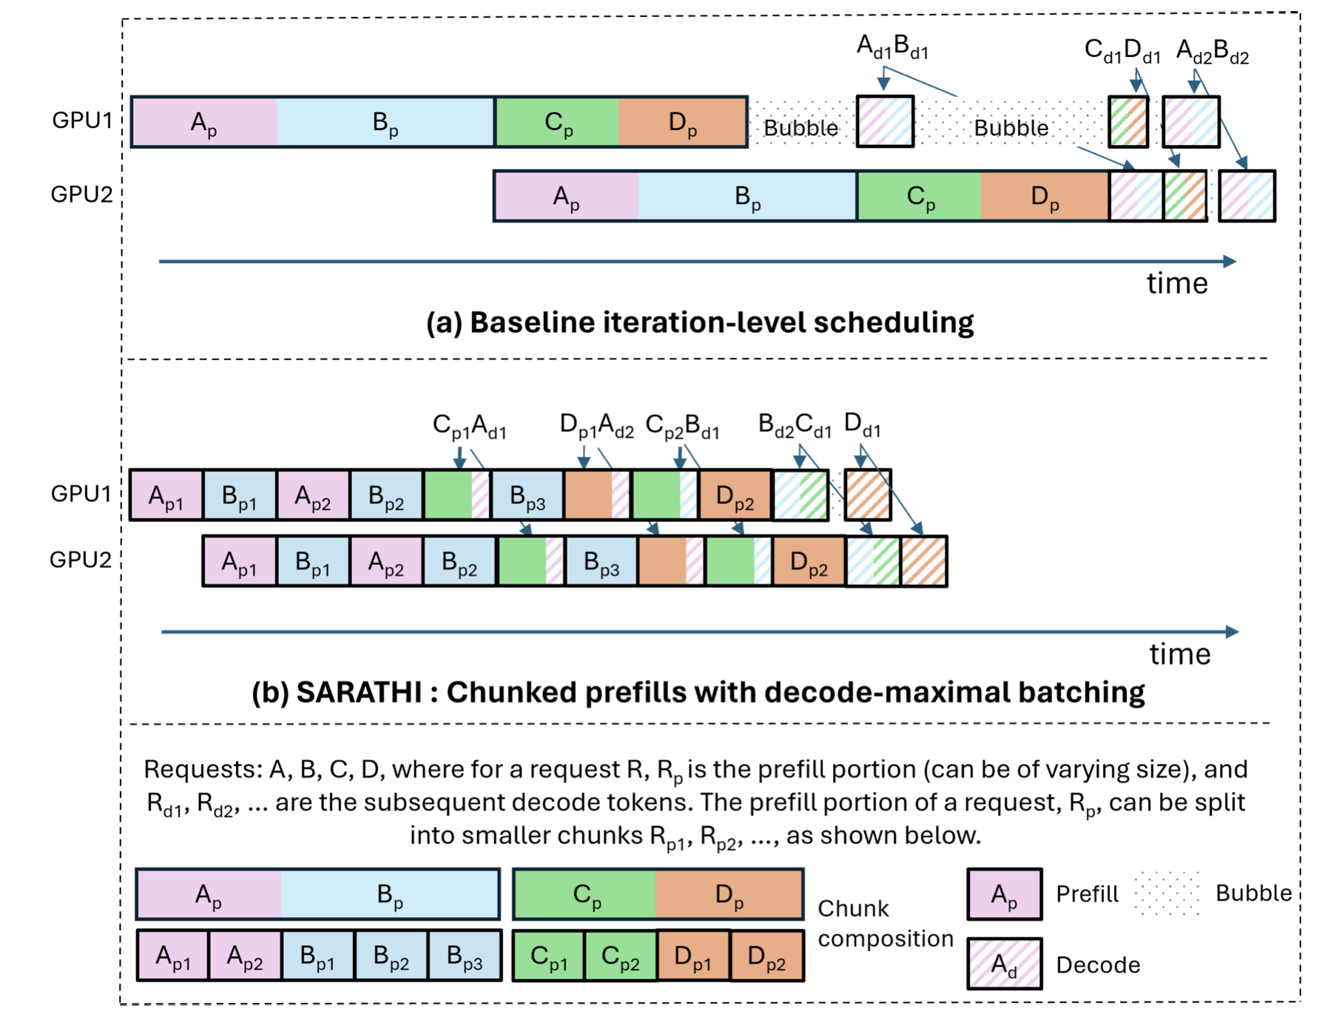
Preliminaries
Iterative generative workloads as a scheduling target
Each request unfolds over multiple iterative steps
Workload behavior changes within a single request
Synchronization and communication create bubbles and stalls
Scheduling must reason at finer-than-request granularity
Fig.1: Example two-stage pipeline parallel schedule.
Notes:
Now, let's look at why generative workloads specifically demand a new approach. Iterative generative workloads are inherently 'hard to schedule.' As shown in the pipeline parallel example on the right, a single request unfolds over multiple iterative steps.
During these steps—such as between prefill and decode, or during inter-GPU communication—we see frequent 'bubbles' and stalls. The key insight here is that the problem isn't just about assigning a GPU to a request; it's about understanding and exploiting these microsecond-scale gaps within the request's execution phases. Therefore, scheduling must reason at a granularity much finer than the request level.

Slide 11
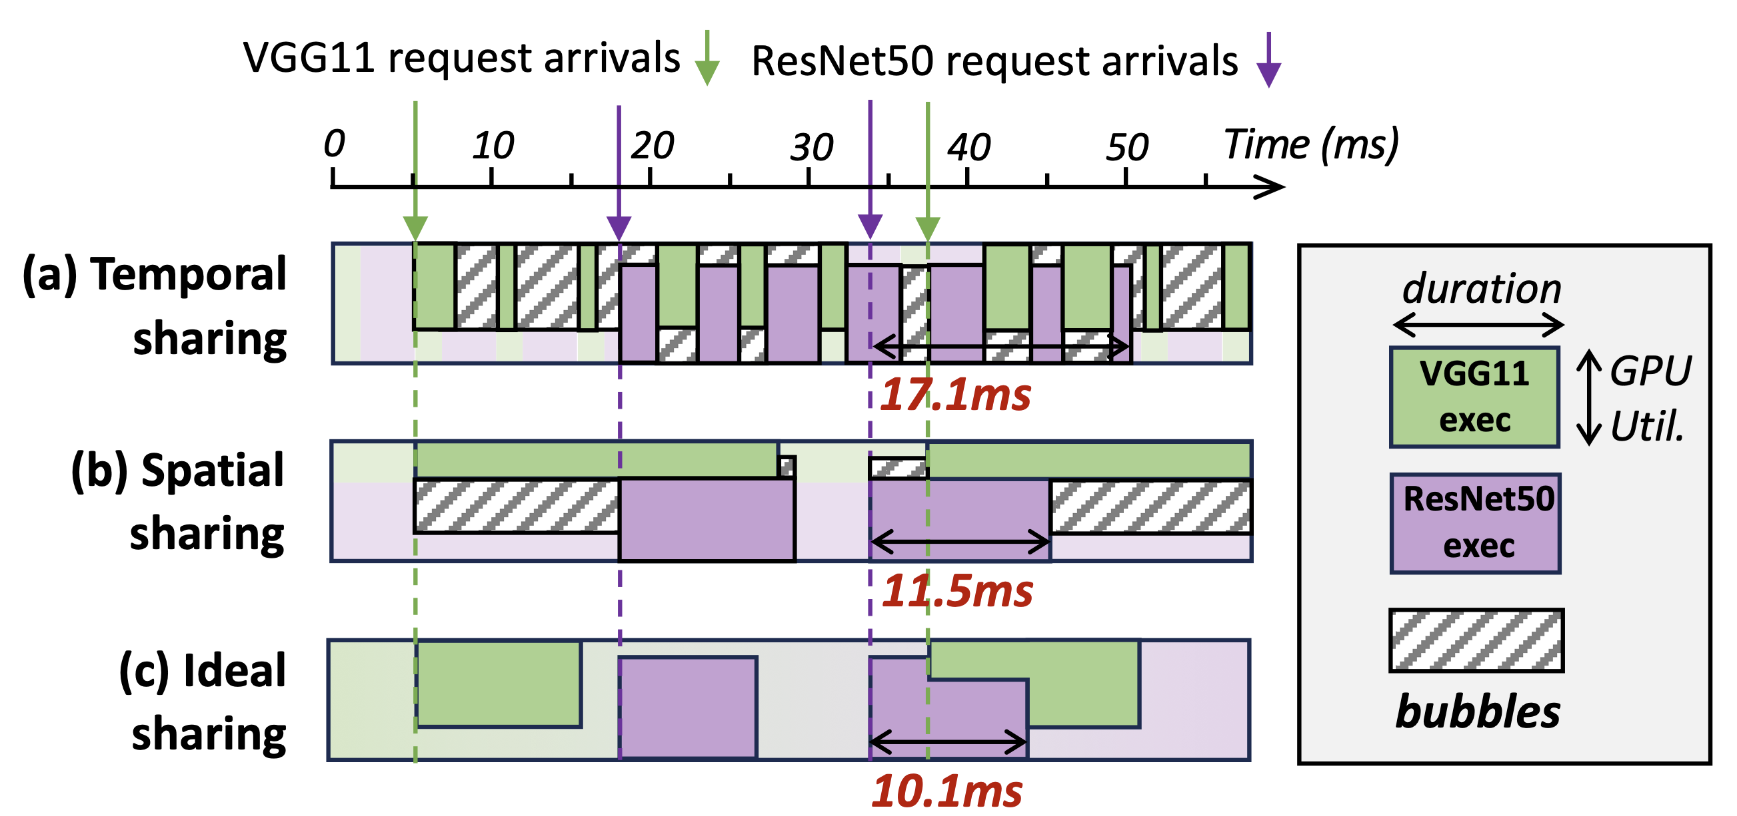
Preliminaries
Why default GPU sharing fails
Coarse kernel-level control is too rigid
Long kernels cause head-of-line blocking
Shared memory hierarchy causes interference
Lack of fast preemption hurts urgent tasks
One-sentence takeaway
Current GPU scheduling granularity mismatches the dynamics of generative AI workloads
Fig.2: An example of handling two applications’ requests
on an Nvidia A100 GPU with a real-world trace.
Notes:
To put it bluntly: default GPU sharing fails because its control granularity is simply too coarse. When a scheduler can only control execution at the kernel level, a long-running kernel will cause head-of-line blocking. If we allow concurrent execution, the shared memory hierarchy causes interference. And the lack of fast preemption severely hurts urgent tasks.
As the trace in the figure shows, neither default spatial nor temporal sharing can perfectly handle real-world request arrivals. The one-sentence takeaway is: Current GPU scheduling granularity fundamentally mismatches the highly dynamic nature of generative AI workloads.

Slide 12
Preliminaries
Why existing GPU sharing mechanisms are insufficient
Temporal sharing
Strong isolation between jobs
But urgent requests may wait for long-running kernels to finish
Preemption delay directly hurts tail latency
Spatial Sharing
Higher utilization through concurrent execution
But shared cache, memory bandwidth, and execution units introduce interference
SLOs become hard to guarantee under colocation
Key challenge
Generative workloads need both: high utilization in normal cases and fast reaction to urgent requests in bad cases
Notes:
To summarize the limitations of existing mechanisms: Temporal sharing provides strong isolation, but preemption delays directly hurt the tail latency of urgent requests. Spatial sharing improves utilization via concurrency, but shared resource contention makes it nearly impossible to guarantee Strict Service Level Objectives (SLOs).
The key challenge we must solve is that generative workloads demand a 'best of both worlds' scenario: High utilization during normal execution, and lightning-fast reaction times when urgent requests arrive.

Slide 13
Outline
Introduction
Related Work
Preliminaries
Proposed Methods
Performance Evaluation
Conclusions
Notes:
The next part is Proposed Methods.

Slide 14
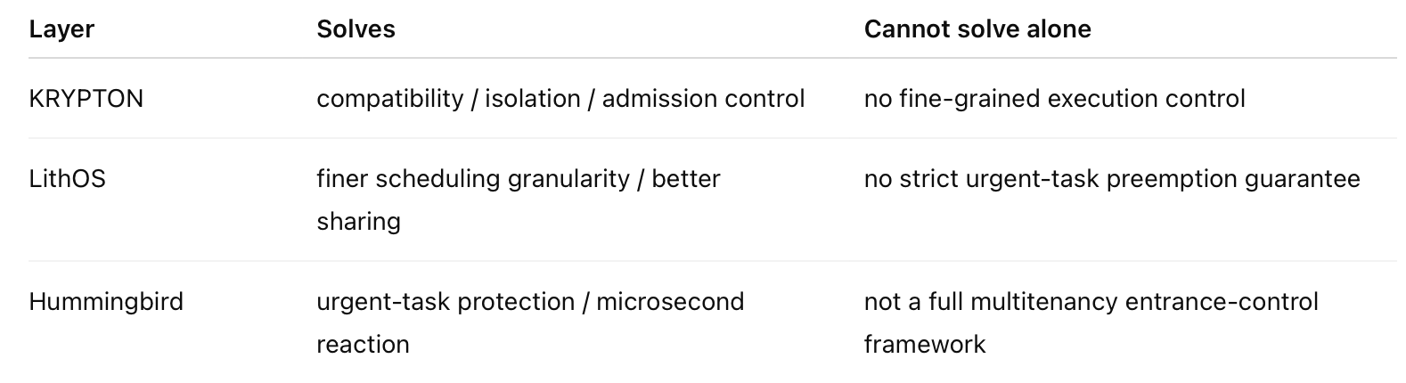
Proposed Methods - Overview
Architecture
Entrance control → KRYPTON
Execution abstraction → LithOS
Emergency preemption → Hummingbird
Design Goal
Deployability
Efficiency
Strict tail-latency protection
These methods are complementary at the design level, not a single integrated implementation.
Fig.3: Comparison of these Methods
Notes:
Now, we move to the core of the presentation: the proposed layered architecture. As mentioned, we approach this through three layers: KRYPTON for entrance control, LithOS for execution abstraction, and Hummingbird for emergency preemption.
Each system targets specific design goals: deployability in real-world software stacks, execution efficiency, and strict tail-latency protection. As the table shows, none of these methods can solve the entire problem alone. They are complementary at the design level.

Slide 15
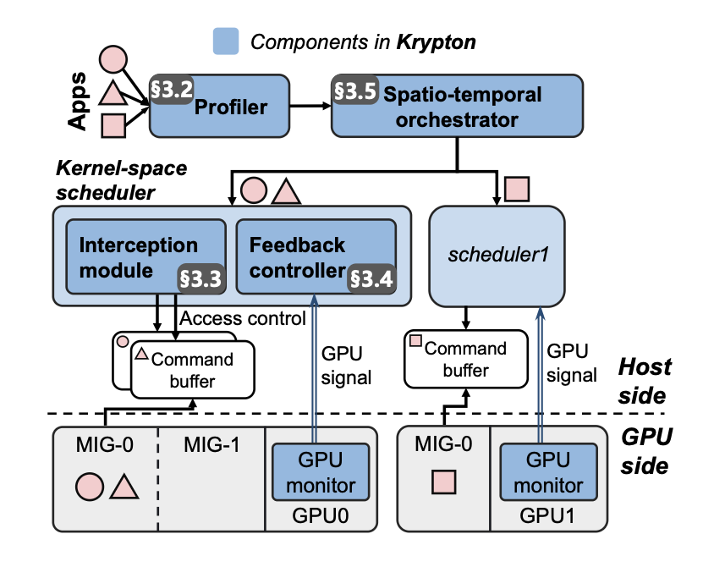
Proposed Methods - KRYPTON
What KRYPTON does
Intercepts GPU management in kernel space
Exposes isolated virtual GPU objects (IGPUs)
Combines MIG and time slicing
Avoids brittle user-space API remoting
What problem it solves
Compatibility across heterogeneous software stacks
Tenant isolation
Performance control at cluster entrance
Limitation
strong at entrance control, but not enough for fine-grained in-flight scheduling
Fig.4: The overview of KRYPTON
Notes:
Let's look at the first layer: KRYPTON. KRYPTON's core innovation is intercepting GPU management in the kernel space rather than relying on fragile user-space API remoting.
This brings two immediate benefits: First, incredible compatibility across diverse, heterogeneous software stacks and runtimes. Second, strong tenant isolation. KRYPTON exposes Isolated Virtual GPU objects (IGPUs) by intelligently combining MIG hardware partitioning with time slicing.
It excels at entrance control and cluster-level performance management. However, its limitation is that it is primarily an admission control solution; it is not designed for fine-grained, in-flight scheduling once the kernels are executing.

Slide 16
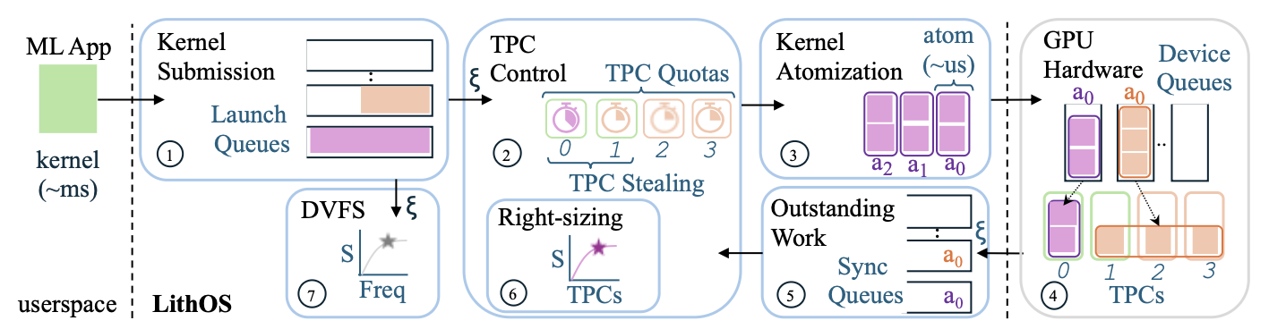
Proposed Methods - LithOS
What LithOS does
Replaces coarse kernel-level control with TPC-level scheduling
Introduces kernel atomization
Supports fine-grained spatial sharing
Enables hardware right-sizing and power management
What problem it solves
Head-of-line blocking under coarse scheduling
Over-provisioned GPU allocation
Inefficient multitenancy and energy waste
Limitation
requires execution abstraction changes, deployability may depend on stack assumptions
Fig.5: LithOS operations overview
Notes:
To handle that in-flight execution, we introduce our second layer: LithOS. LithOS shifts the scheduling paradigm from coarse kernel-level control down to TPC-level scheduling.
Its major breakthrough is kernel atomization. A massive, monolithic kernel is hard to preempt and causes head-of-line blocking. LithOS transparently splits these into smaller 'schedulable atoms,' allowing resources to be reallocated mid-execution. Furthermore, LithOS performs hardware right-sizing—dynamically determining exactly how many TPCs a kernel actually needs—and implements fine-grained power management.
LithOS solves head-of-line blocking and energy waste. Its main trade-off is that it requires deeper changes to the execution abstraction, meaning deployability depends on certain stack assumptions.

Slide 17
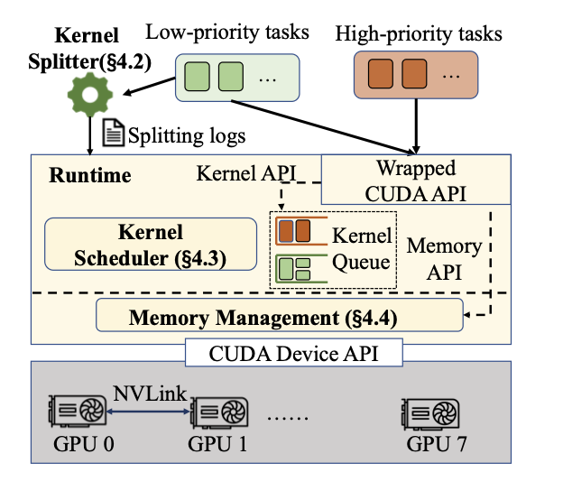
Proposed Methods - Hummingbird
What Hummingbird does
Converts best-effort kernels into split kernels
Harvests bubbles during execution
Uses hierarchical memory offloading
Forces low-priority work to yield within microseconds
What problem it solves
Millisecond-scale preemption delay
Poor SLO attainment for urgent requests
Throughput loss under exclusive execution
Limitation
focuses on urgent-task protection, not overall cluster admission
Fig.6: Design overview of Hummingbird
Notes:
The final layer targets the most acute problem: How do we get out of the way fast on closed-source GPUs? This is Hummingbird.
Hummingbird converts best-effort, low-priority kernels into split kernels (controlled block-level execution). Instead of waiting milliseconds for a kernel to finish, Hummingbird creates preemption boundaries at the microsecond scale.
It utilizes a crucial observation: generative workloads generate massive amounts of 'bubbles' (idle GPU time slices) during synchronization and communication. Hummingbird harvests these bubbles to run low-priority tasks, and uses hierarchical NVLink memory offloading to prevent memory contention. It guarantees strict SLOs for high-priority tasks while keeping throughput high. Its scope, however, is purely urgent-task protection, not overall cluster admission.

Slide 18
Outline
Introduction
Related Work
Preliminaries
Proposed Methods
Performance Evaluation
Conclusions
Notes:
The next part is Performance Evaluation

Slide 19
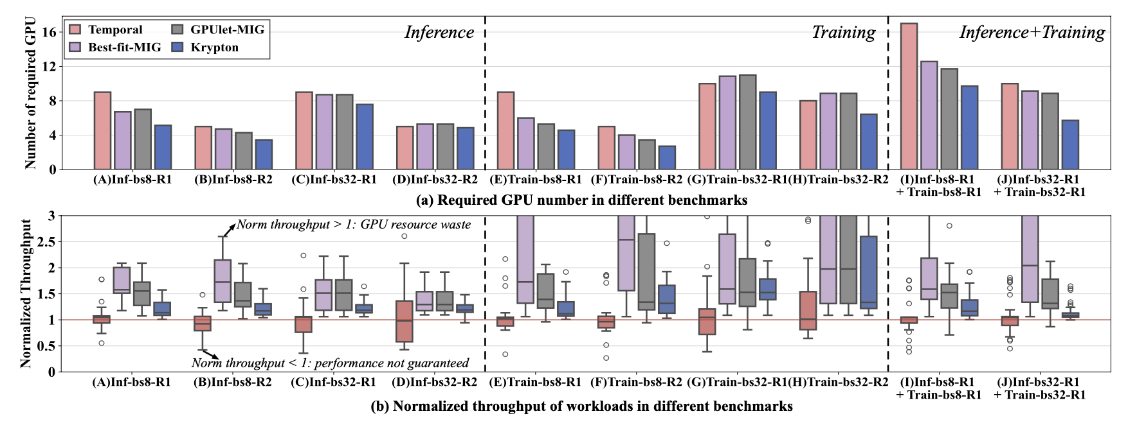
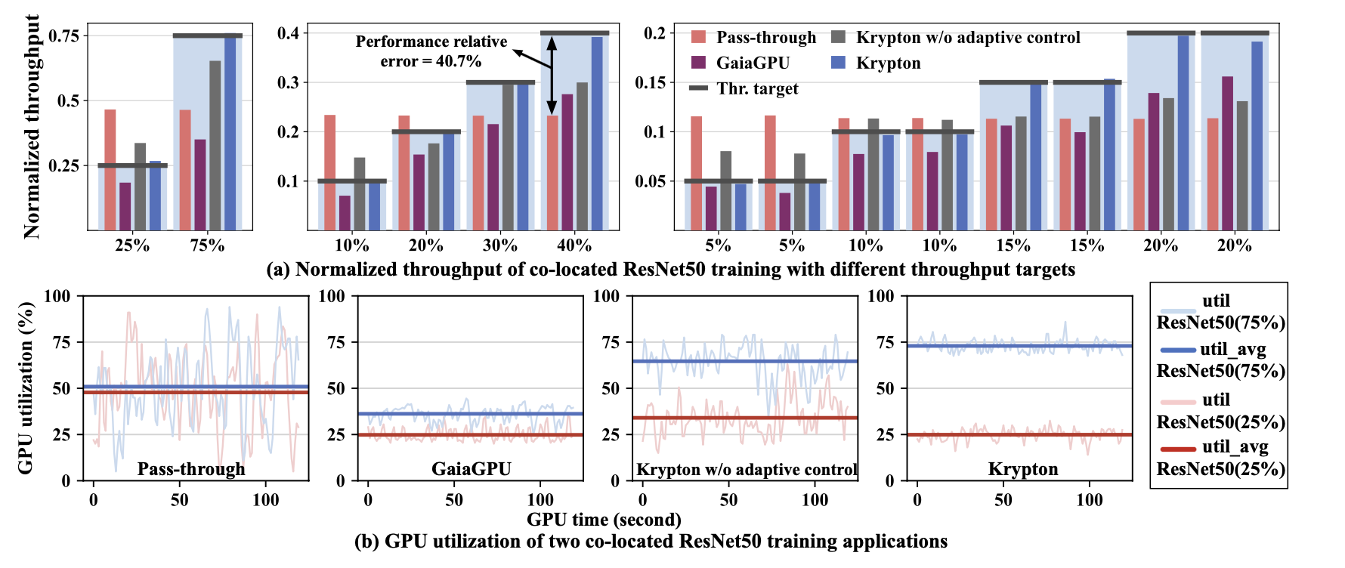
Performance Evaluation - KRYPTON
Main results
Reduces required GPU fleet by 32.1%
Average throughput relative error with feedback: 0.9%
Average latency QoS violation rate: 1.23%
Validated in production deployment for over 1 year
Fig.7: Comparison between KRYPTON and other methods in reducing GPU number and promising performance.
Fig.8: Comparison of different methods in promising the performance target of ResNet50 training applications.
Notes:
Now, let's look at the evaluation results, starting with our first layer: KRYPTON.
As you can see from the core results on this slide, KRYPTON demonstrates massive real-world impact at the cluster level. If you direct your attention to Figure 7 on the left, we compared KRYPTON against other SOTA methods in terms of the number of GPUs required to guarantee performance. By utilizing its fine-grained spatio-temporal orchestration, KRYPTON actively reduces GPU fragmentation. As a result, it reduces the required GPU fleet by 32.1% compared to baseline methods. This is a huge win for cluster efficiency.
But efficiency cannot come at the cost of stability. Figure 8 on the right illustrates how KRYPTON behaves under dynamic loads compared to pass-through or simple user-space API remoting. Thanks to its kernel-space feedback controller, KRYPTON dynamically adjusts time slices to combat interference. This keeps the average throughput relative error to a mere 0.9%, and the latency QoS violation rate at just 1.23%.
Most importantly, KRYPTON is not just a simulator or a lab prototype—it has been deployed and validated in a production environment for over a year. The true value of KRYPTON is that it takes GPU sharing from a fragile academic concept and hardens it into reliable, production-grade entrance infrastructure.

Slide 20
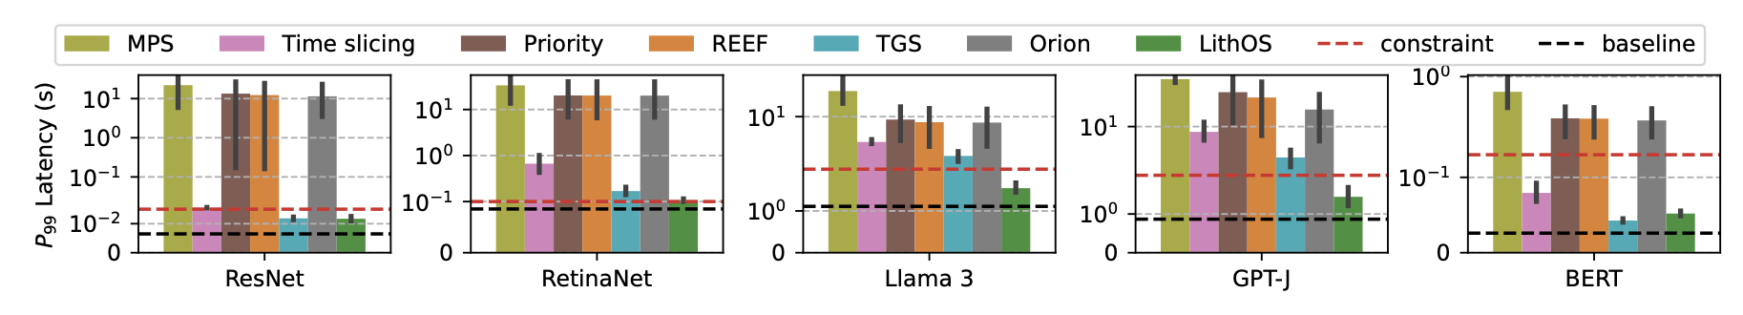
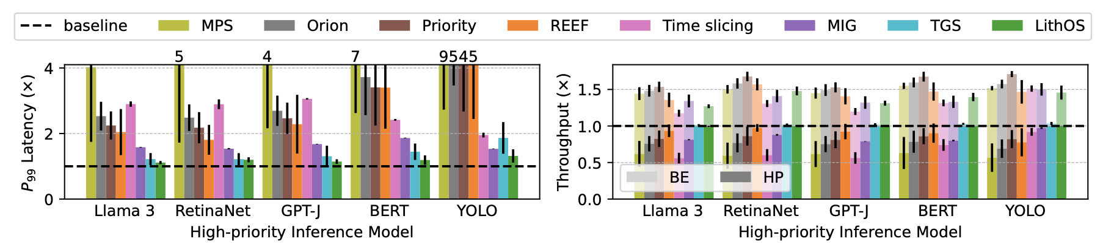
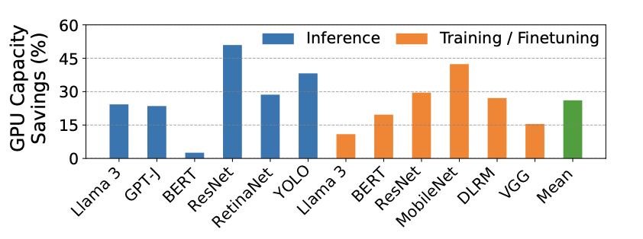
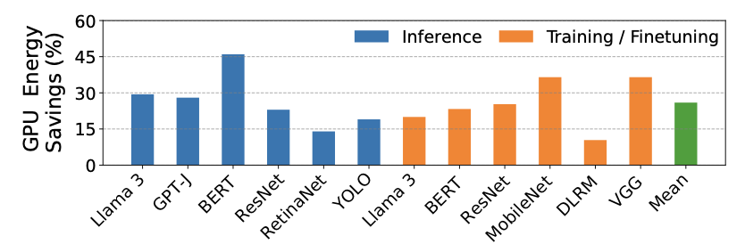
Performance Evaluation - LithOS
Inference-only multitenancy:
13× lower P99 latency vs. MPS
4× lower P99 latency vs. best prior baseline
1.3× aggregate goodput improvement
Hybrid inference-training multitenancy
4.7× lower P99 latency vs. MPS
1.35× aggregate throughput
Right-sizing and power management
26% average GPU capacity savings
26% average GPU energy savings
Fig.9: Inference stacking multitenancy: HP A tail latencies by model.
Fig.10: Hybrid multitenancy: (a) 𝑃99 service latency and (b) aggregate throughput.
Fig.11 Hardware right-sizing GPU capacity savings.
Fig.12 Power management GPU energy savings.
Notes:
Moving down to the execution layer, we evaluate LithOS.
Let's first look at the inference-only multitenancy scenario shown in the charts. LithOS lowers P99 tail latency by a staggering 13x compared to NVIDIA’s default MPS, and 4x compared to the best prior baselines. At the same time, it improves aggregate goodput by 1.3x. In the hybrid inference-training scenario (Figure 10), it lowers P99 latency by 4.7x versus MPS and boosts aggregate throughput by 1.35x.
Why do we see this massive leap? Because LithOS breaks away from rigid kernel-level scheduling. By introducing TPC-level scheduling and kernel atomization, it effectively eliminates the head-of-line blocking that plagues existing systems.
But LithOS goes beyond just making scheduling faster; it acts as a true Operating System managing hardware resources. As shown in Figure 11 and 12, it introduces two powerful system-level optimizations: First, Hardware Right-sizing: By dynamically figuring out that a kernel doesn't need the entire GPU to reach peak performance, it frees up resources, saving an average of 26% in GPU capacity. Second, Transparent Power Management: By scaling frequency based on workload characteristics—without needing offline profiling—it yields 26% in energy savings.
LithOS proves that bringing OS-level abstractions to GPUs fundamentally improves both capacity and energy efficiency.

Slide 21
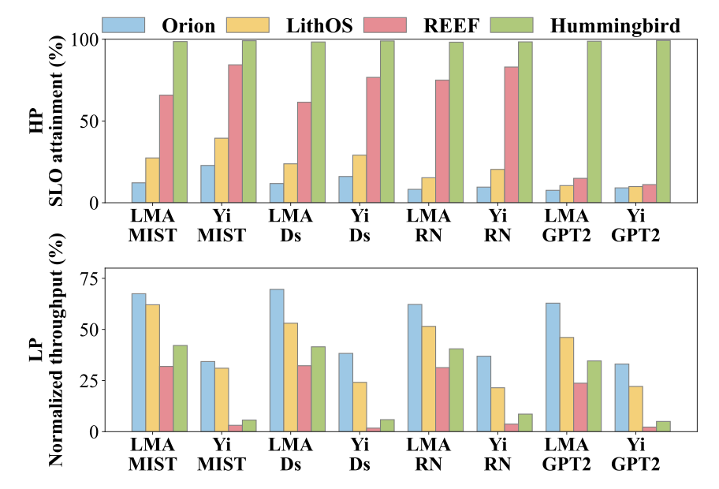
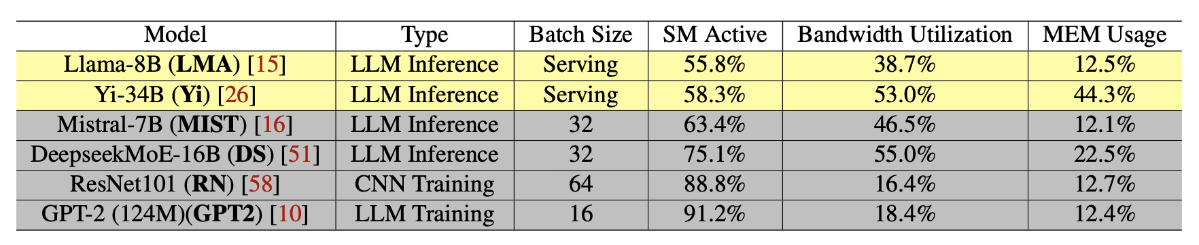
Performance Evaluation - Hummingbird
Main results:
9.7× higher HP-task SLO attainment over spatial-sharing baselines
3.5× higher HP-task SLO attainment over temporal-sharing baselines
Nearly 99% SLO attainment across scenarios
2.4× higher low-priority throughput than REEF overall
Maximum preemption delay capped at about 400 µs
Fig.13: (a) SLO attainment of high-priority tasks; (b)
Throughput of low-priority tasks. The results are normalized to executing low-priority tasks exclusively.
Fig.14: Evaluation applications. SM active ratio and bandwidth utilization indicate the average SM activity and bandwidth usage during a request (inference) or an epoch (training). Memory usage represents the task’s required ratio to total GPU memory. Yellow rows denote high-priority tasks, and grey rows denote low-priority tasks.
Notes:
Finally, we evaluate Hummingbird, which answers our most critical question: How well can we protect strict SLOs during sudden bursts on closed-source GPUs?
As shown in Figure 13(a), Hummingbird’s ability to protect high-priority tasks is exceptional. Compared to spatial-sharing baselines—which suffer from severe memory interference—Hummingbird achieves 9.7x higher SLO attainment. Compared to temporal sharing baselines like REEF—which suffer from long preemption delays—it is 3.5x higher. Across all evaluated scenarios, Hummingbird consistently maintains nearly 99% SLO attainment.
But here is the most crucial part: look at Figure 13(b). Hummingbird does not achieve these strict SLOs by simply killing or starving the background low-priority tasks. Compared to REEF, Hummingbird actually delivers 2.4x higher low-priority throughput.
How does it achieve this 'best of both worlds' result? First, by converting kernels into split-kernels, Hummingbird forces preemption boundaries, capping the maximum preemption delay at roughly 400 microseconds. It doesn't wait passively; it yields actively. Second, it utilizes bubble harvesting. Instead of leaving the GPU idle during host-device synchronization or communication phases of the high-priority task, Hummingbird sneaks in microsecond-scale low-priority work. It completely bypasses the preemption limitations of closed-source hardware, maximizing throughput without sacrificing tail latency.

Slide 22
Outline
Introduction
Related Work
Preliminaries
Proposed Methods
Performance Evaluation
Conclusions
Notes:
The next part is Conclusions.

Slide 23
Conclusions and Future Work
Remarks
Iterative generative workloads shift GPU scheduling toward tail-latency control
Contributions
KRYPTON: entrance control via isolated virtual GPU construction
LithOS: execution abstraction via TPC scheduling and kernel atoms
Hummingbird: emergency preemption via microsecond-scale yielding
Takeaway
GPU scheduling for modern generative AI is a layered systems problem
Future Work
Unified implementation across all three layers
Cross-layer policy optimization
Deployment on heterogeneous GPU clusters
Notes:
To conclude: The rise of iterative generative workloads has fundamentally shifted the focus of GPU scheduling from pure 'utilization' toward strict tail-latency control.
We have shown that this is a layered problem:
KRYPTON provides entrance control via isolated virtual GPU construction.
LithOS provides execution abstraction through TPC scheduling and kernel atomization.
Hummingbird provides emergency preemption via microsecond-scale yielding.
The main takeaway is that GPU scheduling for modern generative AI is no longer a single-point optimization—it is a layered systems problem.
For future work, the next logical steps are to build a unified implementation that integrates all three layers natively, develop cross-layer scheduling policies, and deploy this architecture across heterogeneous GPU clusters.

Slide 24
Q & A
Notes:
That concludes my presentation. Thank you all for your time and attention. I welcome any questions, feedback, or critiques. I'd be particularly interested in discussing whether these three layers can be truly unified in the future, how we can push for even finer-grained control on closed-source GPUs, or how these ideas translate to your own real-world LLM serving stacks. Thank you. I am now open to questions.

