Slide 1
Memory-Efficient Large Model Training: From ZeRo to ZeRO-Infinity 2026.03.19
Wentao Ge
School of Data Science
Chinese University of Hong Kong, Shenzhen
Notes:
Good afternoon everyone, I am wentao Ge and today I am gonna present Memory-Efficient Large Model Training: From ZeRo to ZeRO-Infinity

Slide 2
Outline
Introduction (3 min)
Background & Motivation (5 min)
Proposed Methods (15 min)
ZeRO: Memory Optimizations Toward Training Trillion Parameter Models (5 min)
ZeRO-Offload: Democratizing Billion-Scale Model Training (5 min)
ZeRO-Infinity: Breaking the GPU Memory Wall for
Extreme Scale Deep Learning (5 min)
Conclusions (2 min)
Q & A (5 min)
Notes:
So my presentation consists of 5 parts, I will first go through the introduction and the background then I wiil elaborate these three papers and go into a conclusion

Slide 3
Outline
Introduction (3 min)
Background & Motivation (5 min)
Proposed Methods (15 min)
ZeRO: Memory Optimizations Toward Training Trillion Parameter Models (5 min)
ZeRO-Offload: Democratizing Billion-Scale Model Training (5 min)
ZeRO-Infinity: Breaking the GPU Memory Wall for
Extreme Scale Deep Learning (5 min)
Conclusions (2 min)
Q & A (5 min)
Notes:
Now lets start with the introduction

Slide 4
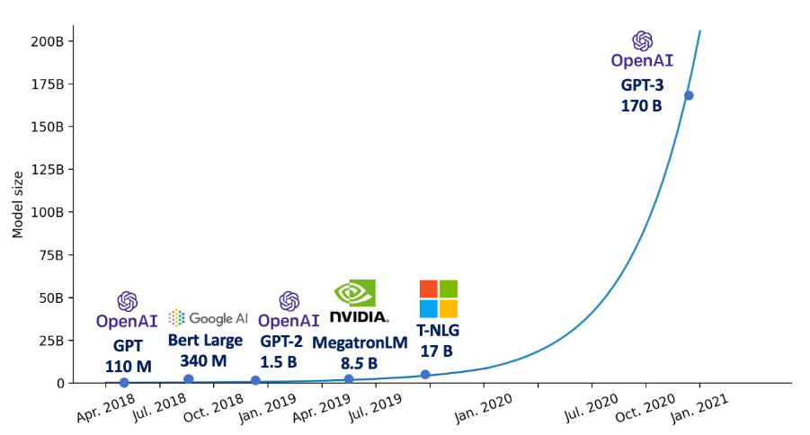
Introduction (1/3)
The size of large deep learning models continue to grow rapidly.
Model scaling often brings strong performance gains.
Hardware memory scaling severely lags behind.
Model size increases by 1000x.
GPU VRAM grows only linearly (16GB —>32GB —> 80GB).
Notes:
In recent years, deep learning models—especially transformer-based large language models—have grown dramatically, moving from million level model size to billion model size. One of the main reasons for this qualitative change is the increase in model size often offers better performance.
While these massive models deliver stunning breakthroughs, they bring a critical pain point: hardware evolution simply cannot keep up. Model sizes have grown thousands of times over, but GPU memory—like what we see when we try to allocate tensors in PyTorch—only grows linearly. This discrepancy has led us to hit a massive 'Memory Wall.'

Slide 5
Introduction (2/3)
Existing solutions help scale training, but they also have important limitations.
Data parallelism (DP) wastes memory through replication.
Pipeline parallelism (PP) and model parallelism (MP) can support larger models, but introduces high communication overhead and pipeline bubbles.
Existing methods cannot simultaneously achieve:
high memory efficiency
high training efficiency
low engineering complexity
Notes:
Faced with this memory wall, traditional parallel training methods leave us in a dilemma. The most common approach, Data Parallelism, is highly compute-efficient but incredibly wasteful when it comes to memory as every single GPU replicates the exact same model states, including weights, gradients, and optimizer states. The redundancy is huge. Model and pipeline parallelism can support larger models, but they introduces massive communication overhead and pipeline bubbles, making it difficult to scale.. Early offloading methods can use CPU memory, but they often suffer from data transfer overhead. So existing solutions could not fully balance memory efficiency, speed, and usability.

Slide 6
Introduction (3/3)
The main question is: How can we break the GPU memory wall for large-scale model training without sacrificing efficiency or requiring complex model refactoring?
The Zero Redundancy Optimizer (ZeRO) series provides a progressive answer:
ZeRO: remove memory redundancy across data-parallel workers
ZeRO-Offload: extend training memory from GPU to GPU + CPU
ZeRO-Infinity: further extend memory to GPU + CPU + NVMe
Notes:
This brings us to the main question: how can we break the GPU memory wall without significantly hurting training efficiency and without forcing researchers to redesign their models? The three works I am going to present today provide a progressive solution. So in the first work, the authors proposed The Zero, which first removes memory redundancy in data parallel training. In the second work called ZeRO-Offload, the authors brings CPU memory and CPU computation into the training system. Finally, the work ZeRO-Infinity extends the idea to a full hierarchical memory system across GPU, CPU, and NVMe

Slide 7
Outline
Introduction (3 min)
Background (5 min)
Proposed Methods (15 min)
ZeRO: Memory Optimizations Toward Training Trillion Parameter Models (5 min)
ZeRO-Offload: Democratizing Billion-Scale Model Training (5 min)
ZeRO-Infinity: Breaking the GPU Memory Wall for
Extreme Scale Deep Learning (5 min)
Conclusions (2 min)
Q & A (5 min)

Slide 8
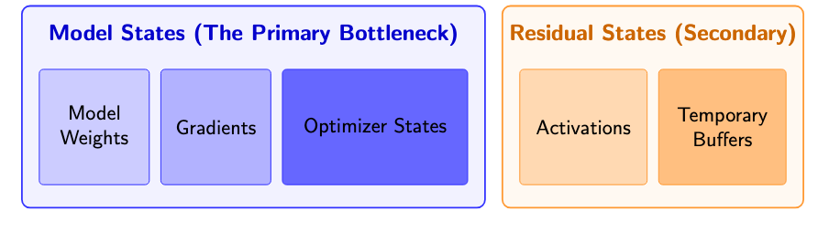
Background (1/5)
Where does the memory go during training?
Notes:
Before we fix the memory problem, we need to understand where the memory actually goes. During large-scale training, GPU memory is divided into two main categories. The biggest cost is 'Model States.' This includes the model weights, the gradients from backpropagation, and also, the optimizer states. The second category is 'Residual States,' which includes activations and temporary buffers. While activations take up space, we already have mature techniques like Activation Checkpointing to handle them. Therefore, the ZeRO family primarily targets the massive footprint of Model States.

Slide 9
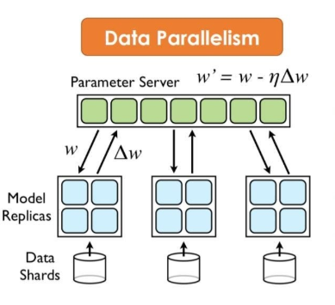
Background: Data Parallelism (2/5)
Standard data parallelism:
Excellent compute efficiency
Terrible memory efficiency
DP Mechanism
Every GPU holds a 100% exact replica of the model (W ).
Gradients (∇W ) are synchronized via AllReduce.
Notes:
Historically, the default solution for scaling out is standard Data Parallelism. DP is excellent for scaling compute, but it is terrible for memory efficiency. In standard DP, every single GPU holds a complete, one-hundred-percent replica of the entire model weights, gradients, and optimizer states. The GPUs only split the data batches and synchronize gradients via All-Reduce. The fatal flaw here is obvious: if your model requires 100 Gigabytes of memory just to load, a standard 32 Gigabyte GPU will crash with an 'Out of Memory' error immediately. In this scenario, it doesn't matter if you have ten GPUs or a thousand GPUs; DP is completely useless.

Slide 10
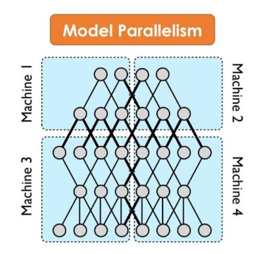
Background: Model Parallelism (3/5)
Model Parallelism (MP):
Splits individual layers across multiple GPUs.
Problem:
Requires massive, fine-grained communication for every pass.
Confined to high-bandwidth links (e.g., NVLink).
Notes:
To fit models that exceed a single GPU's memory, the community turned to Model Parallelism. Tensor-level Model Parallelism slices individual layers across multiple GPUs. While it saves memory, it requires massive, fine-grained communication for every single forward and backward pass. Because of this, it is strictly confined to GPUs connected by high-speed links like NVLink, and as a result, MP becomes much less efficient across nodes because communication bandwidth drops sharply outside NVLink domains.

Slide 11
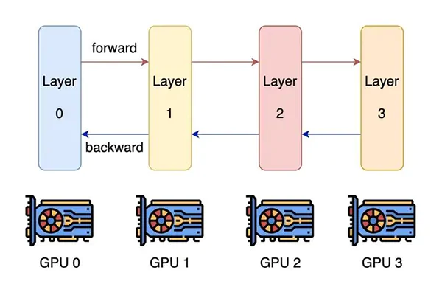
Background: Pipeline Parallelism (4/5)
Pipeline Parallelism (PP):
Splits the model layer-by-layer across GPUs.
Problem: Introduces “Pipeline Bubbles” and highly complex scheduling logic.
Notes:
Another solution is pipeline parallelism. Pipeline Parallelism tries a different approach by placing different layers on different GPUs. However, this introduces 'Pipeline Bubbles,' which are periods where GPUs sit entirely idle waiting for data from the previous stage. So both MP and PP complicate the code and reduce compute efficiency."

Slide 12
Background: Early Heterogeneous Training (5/5)
Use cheaper, abundant CPU RAM to store parts of the model.
Pre-ZeRO Limitations:
PCIe bandwidth bottleneck
Synchronous blocking
Notes:
Researchers also looked at heterogeneous training, which use the cheaper, abundant CPU RAM to help store the model. But before ZeRO, these attempts largely failed. The primary bottleneck is the PCIe bus, which is significantly slower than the GPU's native memory. Also, early systems implemented synchronous data transfers, meaning the ultra-fast GPU had to stop and wait while data was copied back and forth from the CPU. This caused GPU utilization to decrease, making the training process unacceptably slow.

Slide 13
Outline
Introduction (3 min)
Background (5 min)
Proposed Methods (15 min)
ZeRO: Memory Optimizations Toward Training Trillion Parameter Models (5 min)
ZeRO-Offload: Democratizing Billion-Scale Model Training (5 min)
ZeRO-Infinity: Breaking the GPU Memory Wall for
Extreme Scale Deep Learning (5 min)
Conclusions (2 min)
Q & A (5 min)
Notes:
So now we come to the methods that the three paper proposed

Slide 14
Outline
Introduction (3 min)
Background (5 min)
Proposed Methods (15 min)
ZeRO: Memory Optimizations Toward Training Trillion Parameter Models (5 min)
ZeRO-Offload: Democratizing Billion-Scale Model Training (5 min)
ZeRO-Infinity: Breaking the GPU Memory Wall for
Extreme Scale Deep Learning (5 min)
Conclusions (2 min)
Q & A (5 min)
Notes:
let’s start with the first paper, which is ZeRO: Memory Optimizations Toward Training Trillion Parameter Models

Slide 15
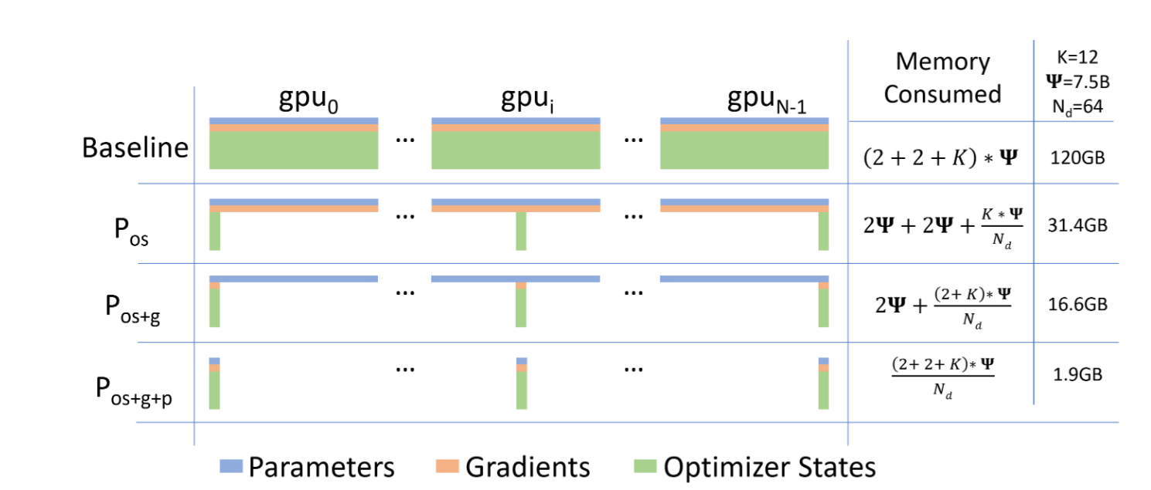
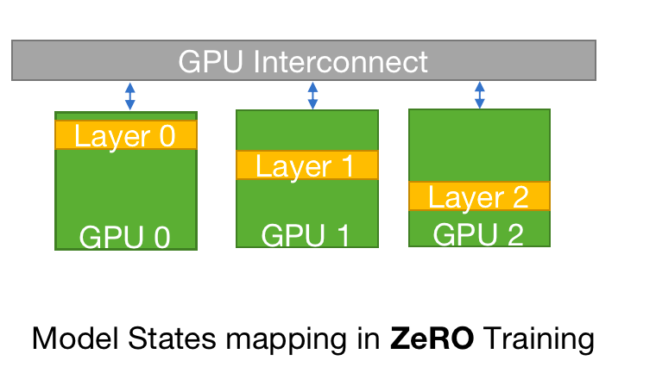
ZeRO (1/6)
Zero Redundancy Optimizer (ZeRO)
ZeRO-DP: aimed at reducing the memory footprint of the model states
ZeRO-R: targeted towards reducing the residual memory consumption
Core Philosophy: Achieve the memory efficiency of MP while maintaining the compute efficiency of DP.
Strategy: Partition model states into mutually exclusive slices.
Notes:
In this paper, the authors proposed the zero redundancy optimizer, which is zero for short. ZeRO has two sets of optimizations: which is zero-dp and zero-r. ZeRO-DP aimed at reducing the memory footprint of the model states, while ZeRO-R targeted towards reducing the residual memory consumption. And we will focus on the zero-dp part, which addresses the dominant memory bottleneck. The core philosophy of ZeRO is simple: stop replicating and start partitioning. ZeRO aims to preserve the memory efficiency of Model Parallelism while keeping the compute and communication efficiency of Data Parallelism. Instead of every GPU holding a hundred percent of the model states, ZeRO chops these states into mutually exclusive pieces and distributes them across the cluster.

Slide 16
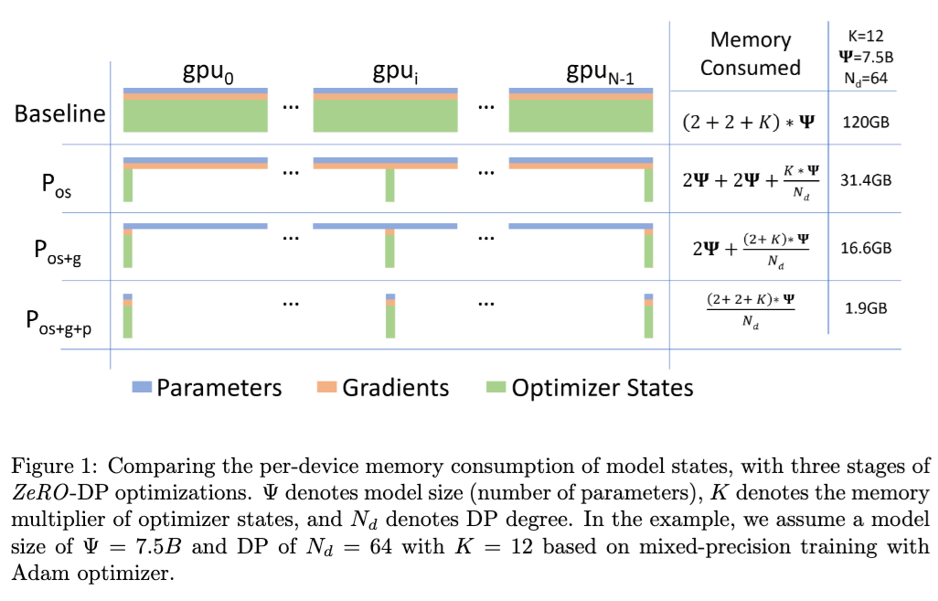
ZeRO (2/6)
Three stages of ZeRO-DP:
P_{os}: Optimizer State Partitioning
P_{g}: Gradient Partitioning
P_{p}: Parameter Partitioning
Notes:
The authors introduce ZeRO-DP through three progressive stages, which are partitioning optimizer states, then gradients, and finally, the parameters themselves. Let's look at how each stage reclaims memory.

Slide 17
ZeRO (3/6)
ZeRO Stage 1 (P_{os}): Optimizer State Partitioning
Divide optimizer states into N equal partitions (N = number of GPUs).
Each GPU only updates its assigned fraction of the parameters.
Memory footprint for optimizer states drops by a factor of N.
Notes:
Stage 1 targets the optimizer states. In modern mixed-precision training, an optimizer like Adam needs to hold 32-bit master weights, momentum, and variance. This consumes up to 12 bytes per parameter. ZeRO Stage 1 takes these optimizer states and divides them equally across all N GPUs in the cluster. Now, each GPU is only responsible for updating its specific slice of the model. By doing this, the memory footprint for optimizer states immediately drops by a factor of N.

Slide 18
ZeRO (4/6)
ZeRO Stage 2 (P_{g}): Gradient Partitioning
If GPU i only updates partition i of the optimizer states, it only needs partition i of the gradients.
Replace traditional AllReduce with a ReduceScatter operation during the backward pass.
Gradients are reduced only to the GPU responsible for that partition. Other GPUs instantly free that memory.
Notes:
Stage 2 is gradient partitioning. In this stage, If a GPU is only responsible for updating a specific fraction of the optimizer states, it doesn't need to hold the entire gradient tensor. It only needs the gradients corresponding to its assigned partition. ZeRO Stage 2 implements this by replacing the traditional All-Reduce communication with a Reduce-Scatter operation during the backward pass. As soon as a gradient slice is computed and reduced to its designated GPU, the other GPUs immediately free that memory. When combined with Stage 1, ZeRO Stage 2 reduces the total memory consumption by up to 8 times.

Slide 19
ZeRO (5/6)
ZeRO Stage 3 (P_{p}): Parameter Partitioning
GPUs discard the full model and only store their partition of the weights.
Dynamic Fetching: When a layer is needed for forward/backward pass, GPUs use AllGather to fetch the full weights.
Immediate Release: Once the computation for that layer is done, the gathered weights are instantly discarded.
Notes:
Finally, Stage 3 tackles the model weights. In this stage, GPUs no longer store the entire model. They only keep their assigned partition of the weights. And we compute the forward and backward passes through dynamic fetching. Right before computing a specific layer, the GPUs use an All-Gather operation to reconstruct the full weights for that layer. Once the computation for that layer is done, the gathered weights are instantly discarded. With Stage 3, the entire memory footprint of the model is distributed. If you add more GPUs, your memory capacity scales linearly.

Slide 20
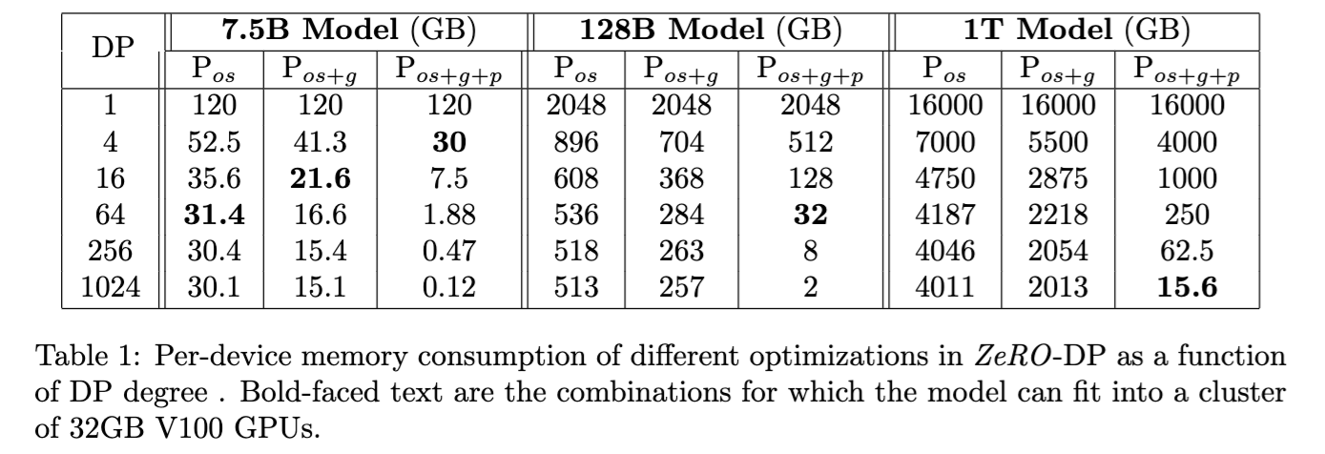
ZeRO (6/6)
Memory benefits of ZeRO:
P_{os}, P_{os+g}, and P_{os+g+p} reduces the memory consumption on model states by up to 4 times, 8 times, and N times respectively.
Notes:
Now let’s see how zero really works in practice. The three phases of partitioning on optimizer state, gradient, and parameter reduces the memory consumption of each data parallel process on model states by up to 4 times, 8 times , and N times respectively. This table shows the model-state memory consumption of a few example models under the 3 stages of ZeRO-DP optimizations for varying DP degree. Without ZeRO, the memory consumption is equal to the first row in the table, regardless of the DP degree. Note that , with N = 64, ZeRO can train models with up to 7.5B, 14B, and 128B parameters using three stages, respectively. When N = 1024, ZeRO with all of its optimizations enabled (Pos+g+p)
could train models with 1 Trillion parameters! Without ZeRO, the largest model DP alone can run has less than 1.5 Billion parameters.

Slide 21
Outline
Introduction (3 min)
Background (5 min)
Proposed Methods (15 min)
ZeRO: Memory Optimizations Toward Training Trillion Parameter Models (5 min)
ZeRO-Offload: Democratizing Billion-Scale Model Training (5 min)
ZeRO-Infinity: Breaking the GPU Memory Wall for
Extreme Scale Deep Learning (5 min)
Conclusions (2 min)
Q & A (5 min)
Notes:
Okay now we move to the second paper, which is zero-Offload: Democratizing Billion-Scale Model Training

Slide 22
ZeRO-Offload (1/5)
Motivations:
The limitation of ZeRO: Still strictly bounded by the aggregate GPU memory of the cluster.
Hardware reality: CPU RAM is significantly cheaper and vastly larger than GPU HBM (Terabytes vs. Gigabytes).
Core question: Can we train 10-Billion parameter models on a single GPU by leveraging cheap CPU memory?
Notes:
So, in the previous work, ZeRO gave us a way to scale, but it still has the limitation that it requires massive GPU clusters for large model training. But if we look at a standard server, CPU memory is significantly cheaper and larger than GPU memory. The core vision of ZeRO-Offload is democratization: Can we leverage this abundant CPU memory to train a 10-Billion parameter model on a single GPU?

Slide 23
ZeRO-Offload (2/5)
Core strategy: Offload optimizer states to CPU and execute optimizer computation on CPU
GPU is responsible for forward and backward passes.
CPU is responsibile for optimizer updates and norm calculations.
Notes:
To make this work, ZeRO-Offload doesn't just blindly move data; it relies on an optimal division of labor. We know the forward and backward passes are highly compute-intensive, so they must stay on the GPU. However, the optimizer step—like updating Adam states—involves very little computation but consumes a massive amount of memory. Therefore, the core strategy is to offload all the fp32 master weights and optimizer states to the CPU RAM, while keeping the heavy matrix multiplications on the GPU.

Slide 24
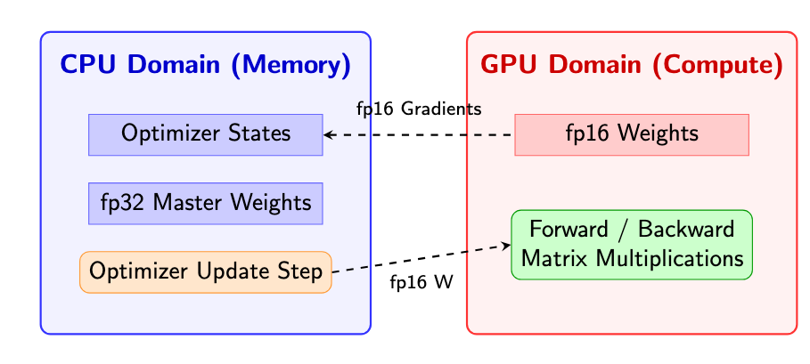
ZeRO-Offload (3/5)
Offload goal:
Limit CPU computation
Minimize communication volume
Maximize memory savings
Optimal strategy:
CPU stores the fp32 model states along with the fp16 gradients and computes the parameter updates.
GPU keeps the fp16 parameters and do the forward and backward computations.
Notes:
As there are many offload strategies between GPU and CPU, so the authors aim to find a unique and optimal offload strategy that limit CPU computation, minimize communication volume, and maximize memory savings. As a result, they propose the ZeRO-Offload. Zero-offload allocates all the fp32 model states along with the fp16 gradients on the CPU memory, and it also computes the parameter updates on CPU. The fp16 parameters are kept on GPU and the forward and backward computations are also done on GPU.

Slide 25
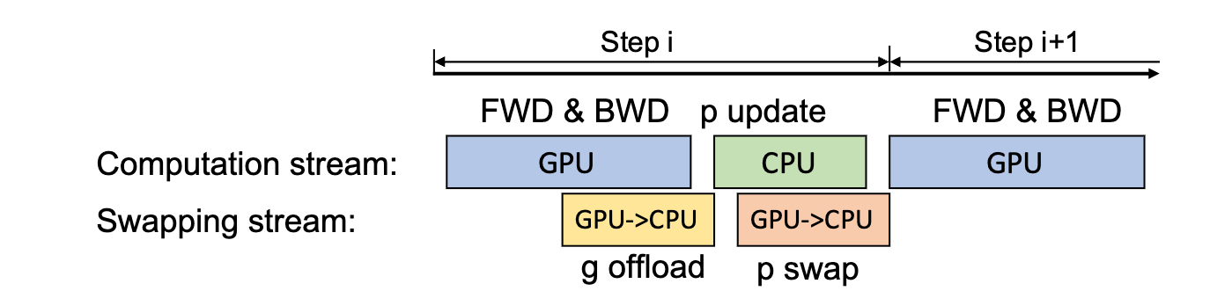
ZeRO-Offload (4/5)
ZeRO-Offload schedule (Single GPU):
Compute: GPU calculates fp16 gradients via backpropagation.
Transfer (Offload): Gradients are instantly pushed to CPU RAM.
Update: CPU reads the fp32 optimizer states, applies the gradients, and updates the fp32 master weights.
Transfer (Return): CPU converts the new weights to fp16 and sends them back to the GPU for the next step.Optimal strategy:
Notes:
Here is the detailed schedule of zero-offload on a single GPU. In Step one: the GPU computes the fp16 gradients. Step two: these gradients are instantly offloaded to the CPU. and Step three: the CPU takes over, reads its fp32 optimizer states, and updates the master weights. Finally, step four: the CPU casts these updated weights back to fp16 and returns them to the GPU.

Slide 26
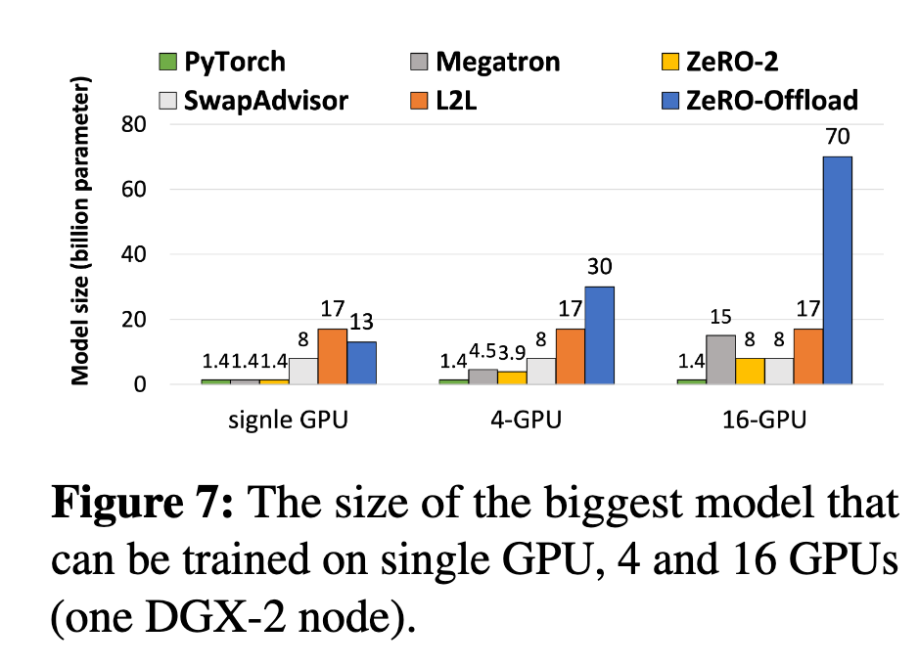
ZeRO-Offload (5/5)
ZeRO-Offload Performance (Single GPU):
Enables ~10x larger models on a single GPU
Makes 10B-scale training feasible with limited GPU resources
Performance overhead is relatively modest compared with naive offloading
Notes:
In evaluation, ZeRO-Offload can train a 10x larger model on a single GPU, while keeping performance relatively modest. More importantly, it makes much larger models trainable on very limited GPU resources, including single-GPU settings. This is why the paper emphasizes democratizing billion-scale model training.

Slide 27
Outline
Introduction (3 min)
Background (5 min)
Proposed Methods (15 min)
ZeRO: Memory Optimizations Toward Training Trillion Parameter Models (5 min)
ZeRO-Offload: Democratizing Billion-Scale Model Training (5 min)
ZeRO-Infinity: Breaking the GPU Memory Wall for
Extreme Scale Deep Learning (5 min)
Conclusions (2 min)
Q & A (5 min)
Notes:
So here comes to the final chapter of the ZeRO family, ZeRO-Infinity: Breaking the GPU Memory Wall for Extreme Scale Deep Learning

Slide 28
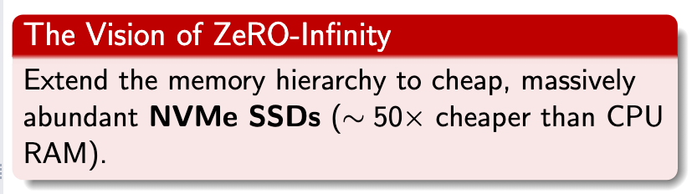
ZeRO-Infinity (1/4)
Why ZeRO-Offload is not enough?
The Trillion-Parameter Ambition:
Models are scaling beyond 100 Billion to 1 Trillion+ parameters.
The CPU RAM Wall:
A 1-Trillion parameter model requires tens of terabytes of memory just for states.
Scaling CPU RAM to that size is physically difficult and prohibitively expensive.
Notes:
ZeRO-Infinity starts from a stronger version of the same problem. ZeRO and ZeRO-Offload already reduce memory pressure, but model sizes are growing so fast that aggregate GPU memory is still becoming the bottleneck. This paper shows that even with the SOTA 3D parallelism, fitting a trillion-parameter model already requires hundreds of GPUs. Buying that much CPU RAM is incredibly expensive and sometimes physically impossible for a single node. The vision of ZeRO-Infinity is to break this final memory wall by extending the hierarchy one step further—to NVMe Solid State Drives, which are about 50 times cheaper than CPU RAM and offer virtually infinite capacity.

Slide 29
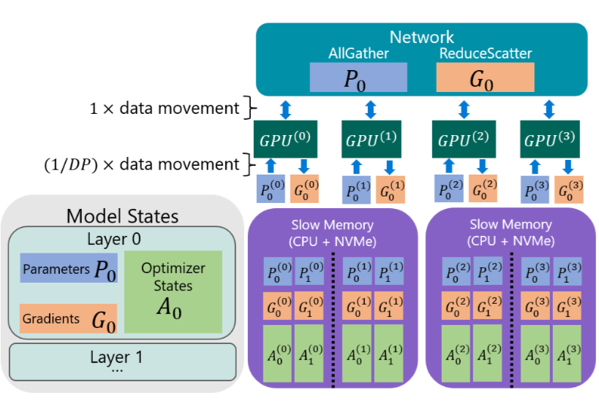
ZeRO-Infinity (2/4)
The ZeRO-Infinity Design:
Infinity Offload Engine
Partitioned model states can live in GPU, CPU, or NVMe memory.
Supports CPU offload for activations。
Memory-Centric Tiling
Break a very large operator into smaller tiles.
Execute tiles sequentially.
Allow extremely large layers without requiring model parallelism.
Notes:
So now let’s look at the design of ZeRO-infinity. The core of ZeRO-Infinity is the infinity offload engine. Unlike earlier ZeRO methods, it can place partitioned model states not only on GPU or CPU, but also on NVMe. This extends the effective memory pool dramatically. But the paper also identifies another problem: sometimes even a single large layer cannot fit in GPU memory. To solve that, ZeRO-Infinity introduces memory-centric tiling, which decomposes a large operator into smaller tiles and runs them sequentially.

Slide 30
ZeRO-Infinity (3/4)
Efficiency Optimization of ZeRO-Infinity
Bandwidth-centric partitioning
Leverage aggregate PCIe / NVMe bandwidth across devices
Overlap-centric design
Overlap:
GPU compute
GPU-GPU communication
CPU-GPU transfer
NVMe-CPU transfer
Dynamic prefetching
Fetch parameters before they are consumed
Notes:
ZeRO-Infinity stays practical because it is designed around bandwidth and overlap. The paper introduces three optimizations that allow ZeRO-Infinity to achieve excellent efficiency. The first is bandwidth-centric partitioning, it use aggregate bandwidth across the system. The second optimization is an overlap-centric design that lets GPU compute, GPU communication, CPU-GPU transfer, and NVMe-CPU transfer proceed in parallel. And last, A dynamic prefetcher moves parameters before they are needed, which hides much of the IO cost behind computation.

Slide 31
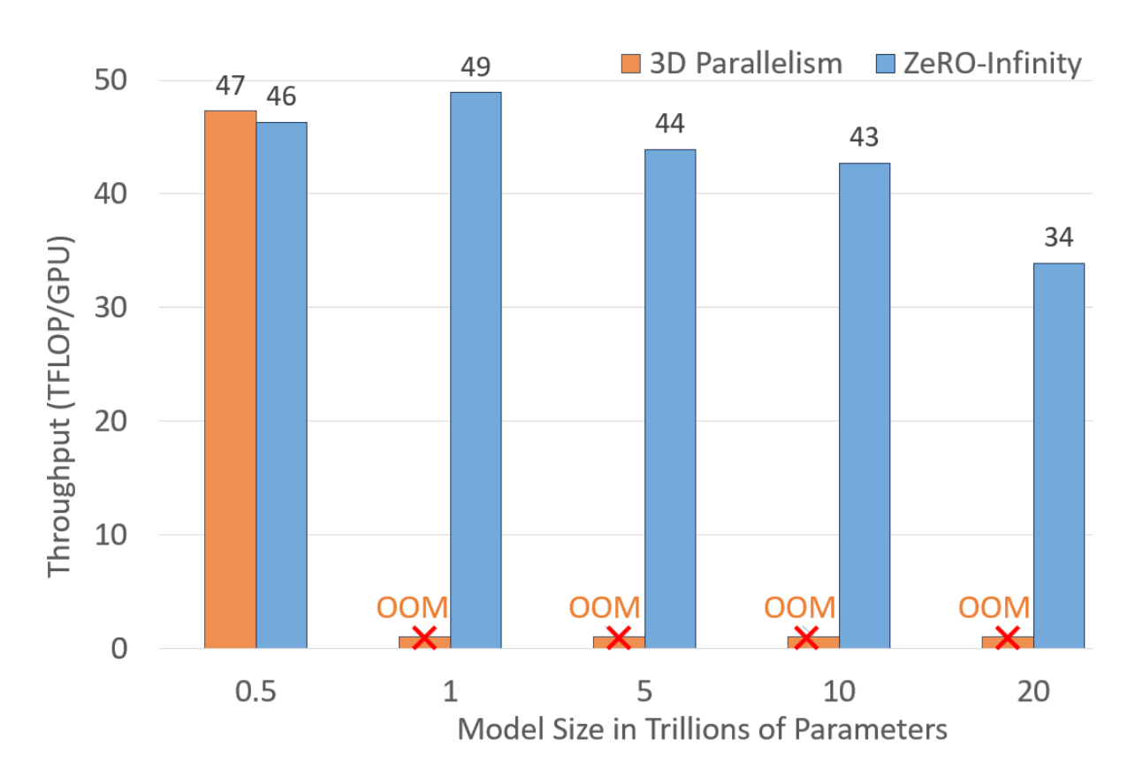
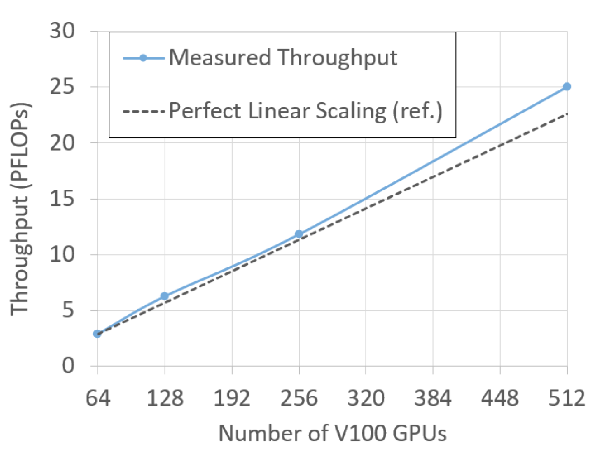
ZeRO-Infinity (4/4)
Evaluation
50x larger model scale than 3D parallelism
32T+ vs. ~650B
On 512 GPUs:
Trains up to 20T
Up to 49 TFLOPS/GPU
Super-linear scaling for a 1T model from 64 → 512 GPUs
On a single DGX-2 node:
Trains up to 1T without model parallelism
>40 TFLOPS/GPU up to 100B
Notes:
In evaluation, ZeRO-Infinity shows both scale and practicality. It pushes model scale from around 650 billion with 3D parallelism to over 32 trillion parameters, which is about a 50-times jump. On 512 GPUs it trains up to 20-trillion-parameter models with strong throughput, and it also shows super-linear scaling for a 1T model as more nodes contribute more aggregate bandwidth, and CPU compute. Finally, in the single-node setting, it can train up to 1T without model parallelism, which is the most compelling accessibility result.

Slide 32
Outline
Introduction (3 min)
Background (5 min)
Proposed Methods (15 min)
ZeRO: Memory Optimizations Toward Training Trillion Parameter Models (5 min)
ZeRO-Offload: Democratizing Billion-Scale Model Training (5 min)
ZeRO-Infinity: Breaking the GPU Memory Wall for
Extreme Scale Deep Learning (5 min)
Conclusions (2 min)
Q & A (5 min)
Notes:
So now lets come to the conclusion parts

Slide 33
Conclusions (1/2)
 | Core Question | Main Solution | Memory Scope
ZeRO | How to remove redundancy in DP? | Partition model states across GPUs | GPU
ZeRO-Offload | How to train larger models with few GPUs? | Offload states and optimizer compute to CPU | GPU + CPU
ZeRO-Infinity | How to go beyond aggregate GPU memory? | Use GPU + CPU + NVMe with hierarchical scheduling | GPU + CPU + NVMe
Notes:
These three papers form a clear progression. ZeRO focuses on eliminating memory redundancy in data parallel training. ZeRO-Offload extends the usable memory pool by bringing CPU memory and CPU computation into the training system. ZeRO-Infinity goes one step further by treating GPU, CPU, and NVMe as a unified hierarchical memory system. So the evolution is from partitioning, to offloading, to full hierarchical memory orchestration.

Slide 34
Conclusions (2/2)
Key takeaways
Large-model training is limited not only by compute, but also by memory organization.
Efficient training requires reducing redundancy and coordinating heterogeneous memory.
System design can greatly improve both model scale and accessibility.
Impact of the ZeRO series
Enables training from 100B+ scale to trillion-scale and beyond
Reduces dependence on complex model refactoring
Makes large-model training more accessible to researchers with limited hardware
Notes:
The main takeaway is that large-model training is not only a compute problem, but also a memory systems problem. The ZeRO series shows that by carefully organizing model states across devices and storage tiers, we can significantly increase trainable model scale without forcing users to completely rewrite their models. In this sense, the impact of the ZeRO series is not just higher scale, but also better usability and broader accessibility of large-model training.

Slide 35
Thanks for Listening !

