Slide 1
Three-Layer System Stack for Spoken Dialogue System 2026.03.24
Huan Liao
School of Data Science
Chinese University of Hong Kong, Shenzhen
Notes:
Good afternoon everyone, I am Huan Liao and today I Today, I will present my report: 'Three-Layer System Stack for Spoken Dialogue Systems.’
I will discuss how we can use Operating System principles to build better Spoken Dialogue System.

Slide 2
Outline
Introduction (3 min)
Background & Motivation (5 min)
Proposed Methods (15 min)
[Programming] SpeechGPT: The Unified Instruction Set Architecture (5 min)
[Workload] LSLM: Language Model Can Listen While Speaking (5 min)
[Runtime] Moshi: A speech-text foundation model for real-time dialogue (5 min)
Conclusions (2 min)
Q & A (5 min)
Notes:
Here is the outline for today. First, I’ll cover the background and why we need a 'System' perspective.
Then, I will introduce my 3-layer stack: Programming, Workload, and Runtime.
Finally, I will conclude with some highlights.

Slide 3
Outline
Introduction (3 min)
Background & Motivation (5 min)
Proposed Methods (15 min)
SpeechGPT: The Unified Instruction Set Architecture (5 min)
LSLM: Language Model Can Listen While Speaking (5 min)
Moshi: A speech-text foundation model for real-time dialogue (5 min)
Conclusions (2 min)
Q & A (5 min)
Notes:
Now lets start with the introduction

Slide 4


Introduction (1/3)
What is Spoken Dialogue System?
Real-time interaction
Interrupt anytime (Full-duplex)
Personalized voice
Applications of Spoken Dialogue Systems
Voice assistants: Siri, Doubao
AI tutors: Duolingo
AI Copilots: GPT-4o, Gemini
Notes:
"First, what is a Spoken Dialogue System (SDS)? You probably use them every day, like Siri or Doubao.
A good system needs to support Real-time interaction, and allow you to interrupt anytime. This is called Full-duplex interaction.”
Now, let’s take a quick look at an example video.”

Slide 5
Introduction (2/3)
The Evolution of Spoken Dialogue System
Speech-to-speech
Low-latency (~200ms)
Always-on interaction
Listen while speaking
Turn-taking & interruption
More
Interactive
Speech + text unified
Better semantic understanding
More
Integrated
More
Real-time
ASR(speech recognition) → LLM → TTS(speech generation)
Turn-based interaction
High latency
Pipeline Era
Multimodal Integration
Full-Duplex Modeling
Real-Time Streaming
2022
2023
2024
2025-2026
Notes:
The Spoken Dialogue System technology has changed a lot. Before 2022, we used the 'Pipeline Era.’
This was like ASR then LLM then TTS. It was very slow. Now, in 2025 and beyond, we are in the 'Real-time Streaming' era, where models are much more integrated and faster."

Slide 6



Introduction (3/3)
How to build an dialogue system? (From an OS perspective):
Layer 3: Runtime
How fast can we respond?
Moshi: real-time asynchronous runtime
Layer 2: Workloads
Who speaks? When?
LSLM: state-driven workload management
Layer 1: Programming
What is the data?
SpeechGPT: unified instruction sets
Notes:
So, How do we build a dialogue system, from an operating system perspective?
We can break this problem into three layers.
First, Layer 1 — Programming. This is about: what is the data? With SpeechGPT, speech is treated as a unified instruction format, so the model can directly understand audio as input.
And Second Layer is Workloads. This is about: who speaks, and when? LSLM introduces state-driven workload management, which controls turn-taking in a more flexible way.
Finally, Layer 3 — Runtime. This is about: how fast can we respond? Moshi provides a real-time asynchronous runtime, enabling low-latency, continuous interaction.

Slide 7
Outline
Introduction (3 min)
Background (5 min)
Proposed Methods (15 min)
SpeechGPT: The Unified Instruction Set Architecture (5 min)
LSLM: Language Model Can Listen While Speaking (5 min)
Moshi: a speech-text foundation model for real-time dialogue (5 min)
Conclusions (2 min)
Q & A (5 min)

Slide 8



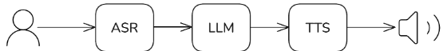
Background (1/4)
Traditional systems are modular:
ASR (Frontend)
LLM (Kernel)
TTS (Backend)
The Device Driver.
Transcribes raw audio frames into discrete tokens.
The CPU/Logic Unit.
Executes reasoning and state management.
The Output Buffer.
Renders binary data back into analog waveforms.
ASR: Auto-Speech Recognition
TTS: Text-to-Speech Generation
Notes:
Traditional systems are modular.
ASR works like a device driver. It converts audio into text.
The LLM is like the CPU. It handles reasoning.
TTS is like the output buffer .It converts text back to speech.
But this modular design also brings problems.

Slide 9
Background: Challenges in Spoken System (2/4)
Bottlenecks in Traditional Spoken Dialogue System:
Modality Gap → speech/text mismatch [Programming]
No Interaction Control → turn-taking conflicts (说话轮次冲突) [Workload]
Synchronous I/O → high latency [Runtime]
Traditional systems cannot simultaneously achieve:
Low Latency：Real-time response、Streaming interaction、No pipeline delay
Full Duplex：Listen + speak together、User interruption handling
Notes:
There are three main bottlenecks.
First, modality gap. Speech and text are not aligned.
Second, no interaction control. This causes turn-taking conflicts.
Third, synchronous I/O. This leads to high latency.
Because of these problems, current systems cannot achieve both low latency and full-duplex interaction at the same time.”

Slide 10
Background: System-Level Bottlenecks (3/4)
Token Explosion & Memory Wall
Density: Audio tokens are 10∼100× denser than text.
Bottleneck: Massive sequences cause KV Cache explosion, hitting GPU memory limits and throttling long-form dialogue.
Modality Gap & IPC Overhead
Fragmentation: Cascaded ASR-LLM-TTS pipelines act as isolated processes.
Bottleneck: Modular handovers incur "IPC-like" latency and severe loss of paralinguistic info (style, emotion).
I/O Blocking & Scheduling Conflict
Latency: Synchronous "Listen-then-Speak" patterns cause high response lag.
Bottleneck : Lack of a scheduler leads to interruption (Barge-in “用户打断”) failures and overlapping speech chaos.
Notes:
“From a system view, the problems are even deeper.
First, token explosion. Audio tokens are much denser than text. This causes memory issues.
Second, modality gap. Different modules act like isolated processes.
Third, I/O blocking. The system cannot listen and speak at the same time.”

Slide 11
Background (4/4)
The main question is: How to design an OS-like dialogue system: unified data, controlled interaction, and real-time response?
Decompose the problem into three system layers:
SpeechGPT : Unify speech + text as shared tokens [Programming]
LSLM : State-driven scheduling for turn-taking [Workload]
Moshi : Asynchronous runtime for full-duplex [Runtime]
Notes:
This brings us to the main question: How to design an OS-like dialogue system: unified data, controlled interaction, and real-time response?
We divide the solution into three system layers.
SpeechGPT handles data representation. LSLM handles interaction control. Moshi handles runtime execution.”

Slide 12
Outline
Introduction (3 min)
Background (5 min)
Proposed Methods (15 min)
SpeechGPT: The Unified Instruction Set Architecture (5 min)
LSLM: Language Model Can Listen While Speaking (5 min)
Moshi: a speech-text foundation model for real-time dialogue (5 min)
Conclusions (2 min)
Q & A (5 min)
Notes:
So now we come to the methods that the three paper proposed

Slide 13
Outline
Introduction (3 min)
Background (5 min)
Proposed Methods (15 min)
SpeechGPT: The Unified Instruction Set Architecture (5 min)
LSLM: Language Model Can Listen While Speaking (5 min)
Moshi: a speech-text foundation model for real-time dialogue (5 min)
Conclusions (2 min)
Q & A (5 min)
Notes:
let’s start with the first paper SpeechGPT

Slide 14
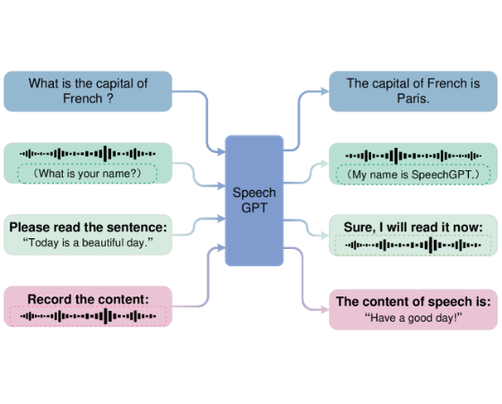
SpeechGPT: Unified ISA (1/6)
Limitations of Traditional Methods
Cascade processing (ASR–LLM–TTS)
Cannot understand and generate speech jointly
Continuous speech not compatible with LLM tokens
SpeechGPT: Key Highlights
No Translation Layer: No ASR/TTS bottlenecks
Unified Representation (ISA-like): Speech tokens enter the LLM vocabulary
Native Instructions: Speech as programmable input
Figure 1: SpeechGPT’s capabilities to tackle multiple cross-modal tasks.
Notes:
Traditional methods use pipelines. They cannot understand and generate speech together. Also, speech is not compatible with LLM tokens.
SpeechGPT solves this by removing the pipeline. It puts speech tokens directly into the LLM.
So speech becomes a native input to the model.”
ISA：Instruction Set Architecture【用户输入/上层软件 → ISA 接口 → 底层硬件处理器（CPU/计算核心）】
ISA defines how a system understands instructions.
Similarly, SpeechGPT defines how an LLM understands speech.”

Slide 15
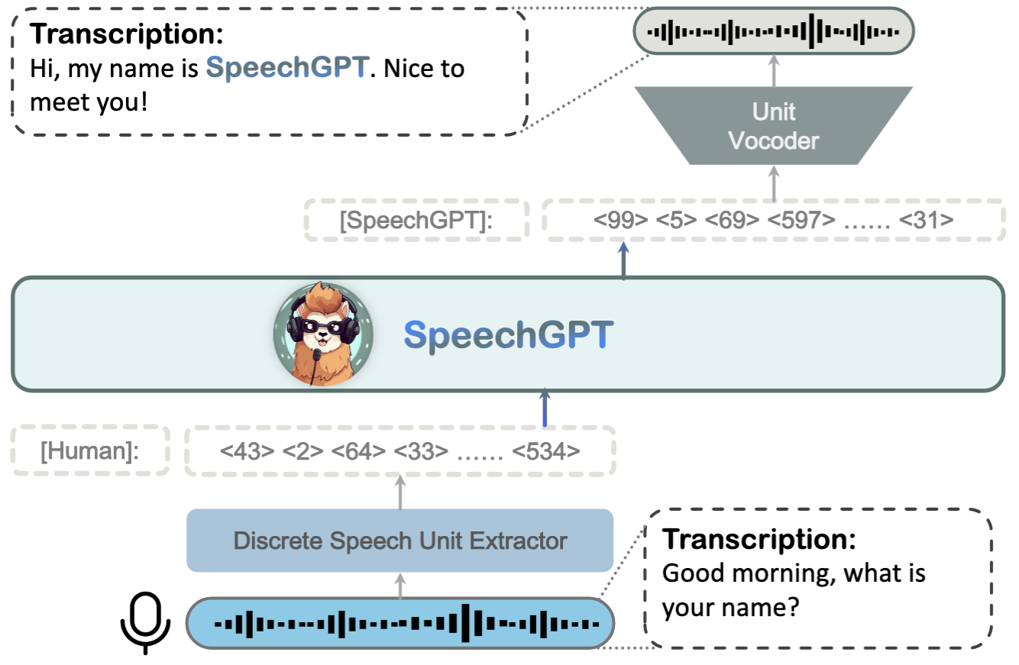
SpeechGPT: Unified ISA (2/6)
Mapping the Data Path:
Audio Frontend: HuBERT/Whisper encodes raw signals into dense vectors.
Modality Quantization: k-means clustering maps vectors to discrete "Speech Units".
Unified Tokenizer: Merges Speech Units with SentencePiece text tokens.
LLM Backbone: Processes fused instructions via standard Transformer blocks.
Figure 2: An illustration of SpeechGPT model structure
Notes:
The key idea is to convert speech into discrete tokens.
First, audio is encoded into vectors. Then, these vectors are mapped into discrete units.
Finally, these units are combined with text tokens.
This creates a unified token space for the model.

Slide 16
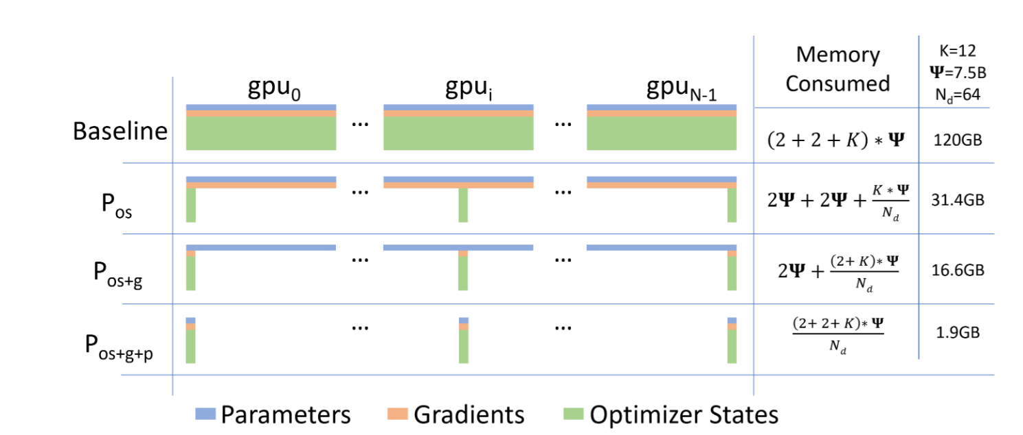
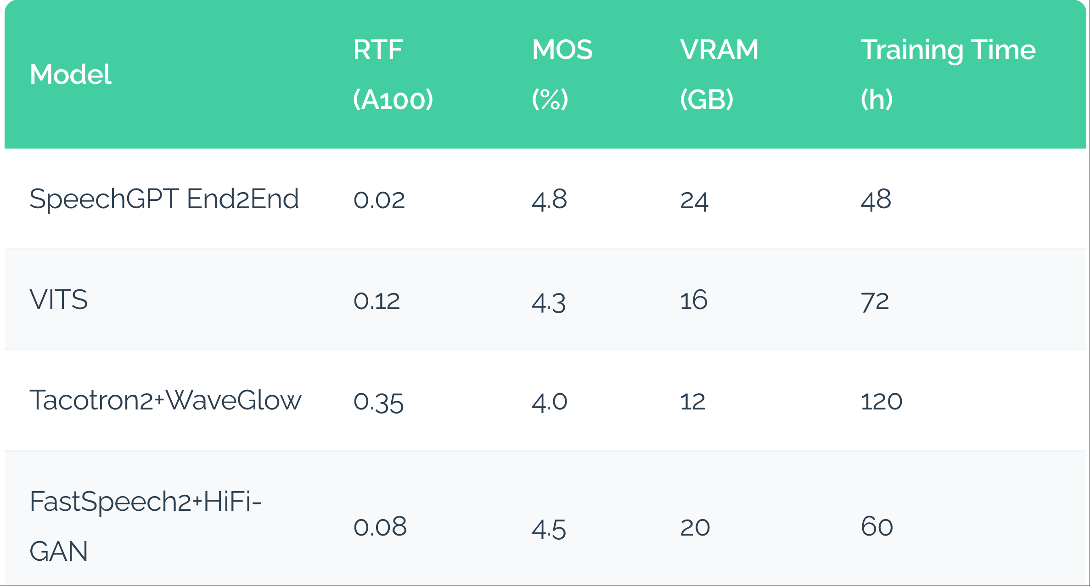
SpeechGPT: Unified ISA (3/6)
Training Stage
Stage 1: Modality-adaptive pretraining Learn speech understanding via discrete units
Stage 2: Cross-modal instruction tuning Improve speech–text alignment with SpeechInstruct
Stage 3: Chain-of-Modality tuning (LoRA) Efficient fine-tuning for better alignment
Evaluation
Low latency (RTF = 0.02)
High speech quality (MOS = 4.8)
Efficient training & resources: Moderate VRAM (24GB), shorter training time (48h)
Notes:
SpeechGPT uses three training stages.
First, it learns speech using discrete units. Second, it aligns speech and text with instruction tuning. Third, it further improves alignment with efficient fine-tuning.
In evaluation, SpeechGPT shows strong performance with low latency, with RTF 0.02. It also achieves high quality, with MOS 4.8. And it is efficient in both memory and training time.
So overall, it balances speed, quality, and efficiency.”

Slide 17
SpeechGPT: Unified ISA (4/6)
System Impact:
Reduced Context Switching
Zero-shot Generalization
Acoustic Robustness
Eliminating module IPC reduces overhead and prevents data corruption.
Text-learned skills transfer to speech via intrinsic alignment.
Direct tokenization is more robust to noise than text-intermediate buffers.
Notes:
This brings several benefits.
First, less overhead from module switching. Second, better generalization. Third, more robustness to noise.”

Slide 18
SpeechGPT: Unified ISA (5/6)
Limitation:
Missing Prosody
CoM Bottleneck
Contextual Wall
Unable to generate responses with specific emotional tones or prosodic variations.
Requires text generation before producing speech.
increasing response latency.
Struggles with multi-turn dialogue due to severe context length constraints, limiting the "memory" of the interaction history.
Notes:
However, SpeechGPT still has limitations.
It cannot model emotion well. It depends on text before speech generation. And it has difficulty handling long conversations.

Slide 19
SpeechGPT (6/6)
Programming Efficiency
ISA
By defining a Unified ISA, SpeechGPT reduces semantic translation overhead and enables "Speech Native" programming for conversational agents.
Result: A more coherent, instruction-following dialogue core.
Cross-modal LLM
Notes:
SpeechGPT introduces a unified interface for speech and text.
This reduces translation overhead and enables more natural speech interaction.
As a result, it builds a more coherent and instruction-following dialogue system.

Slide 20
Outline
Introduction (3 min)
Background (5 min)
Proposed Methods (15 min)
SpeechGPT: The Unified Instruction Set Architecture (5 min)
LSLM: Language Model Can Listen While Speaking (5 min)
Moshi: a speech-text foundation model for real-time dialogue (5 min)
Conclusions (2 min)
Q & A (5 min)
Notes:
Okay now we move to the second paper, which is LSLM: Language Model Can Listen While Speaking

Slide 21
LSLM: State Scheduling (1/6)
Motivation: From SpeechGPT to LSLM
Half-Duplex Limitation: Cannot listen while speaking
No Interruption Handling: No interruption (barge-in) handling
Latency issue: Sequential pipeline, not real-time
Core Question
Can we design a full-duplex dialogue system with real-time interaction?
Notes:
SpeechGPT face many limitation：it cannot listen and speak at the same time. It cannot handle interruption. And it is not real-time.
So the question is: Can we design a full-duplex dialogue system with real-time interaction?

Slide 22
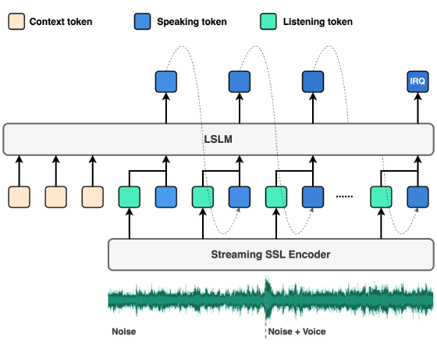
LSLM: State Scheduling (2/6)
LSLM: State-Driven Scheduler
From sequential turns → concurrent interaction
State tokens (Listen / Speak) act as a scheduler
Predict next state for reactive dialogue
Notes:
LSLM introduces state-driven scheduling.
It uses state tokens like ‘listen’ and ‘speak’. These act like a scheduler in an OS.
The model predicts the next state and controls the interaction flow.

Slide 23
LSLM: State Scheduling (3/6)
The Scheduling Challenge
Parallelism Conflict
Context Thrashing
Determining when to “pre-empt 抢占" a response when user talking mid-sentence (Barge-in 用户打断).
Efficiently updating the history buffer as multiple audio streams overlap during interaction.
Notes:
But scheduling is not easy.
The system must decide when to stop speaking if the user interrupts
It also needs to manage overlapping audio streams.”

Slide 24
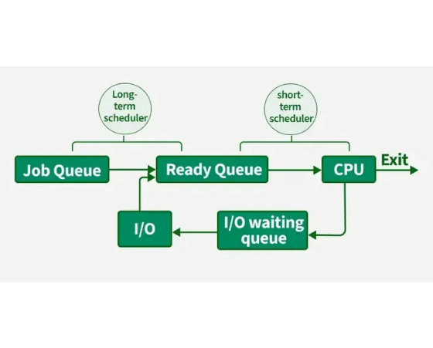
LSLM: State Scheduling (4/6)
States as Process Units
Input processing mode (User stream active).
Internal state (KV Cache update, no output).
Output generation mode (Model stream active).
Immediate pre-emption of current task.
Notes:
Each state represents a process.
Input state, internal state, output state. The system can switch between them.
This allows flexible interaction.”

Slide 25
LSLM: State Scheduling (5/6)
LSLM State Transitions
Current State | Event | Target State | System Action
SPEAK | User Input Detected | INTERRUPT | Flush Output Buffer, Update Cache
LISTEN | Silence Detected | THINK | Trigger Generation Kernel
THINK | Response Ready | SPEAK | Streaming Audio I/O
Notes:
LSLM models dialogue as a state machine.
The system switches between listen, think, and speak.
For example, If the user speaks while the system is in SPEAK mode, it triggers an INTERRUPT. The system immediately flushes the output buffer and updates the cache to prepare for new input.
When the user stops talking (Silence Detected), the system moves from LISTEN to THINK. This triggers the generation kernel to process a response
Once the Response is Ready, the system transitions from THINK back to SPEAK, using streaming audio I/O for real-time interaction.
This allows flexible and responsive interaction.”

Slide 26
LSLM: State Scheduling (6/6)
Workload Orchestration
FSM
LSLM provides the logic for Turn-taking Parallelism. It ensures the system knows when to listen, when to response, and how to recover from task interruptions.
Result: A robust, natural conversational flow.
Problem: Latency
State Management
Notes:
This state mechanism works like a scheduler.
It decides when to listen, when to respond,and how to handle interruptions.
As a result, the system achieves a more natural and robust conversational flow.”
But it still has a problem: latency.”

Slide 27
Outline
Introduction (3 min)
Background (5 min)
Proposed Methods (15 min)
SpeechGPT: The Unified Instruction Set Architecture (5 min)
LSLM: Language Model Can Listen While Speaking (5 min)
Moshi: a speech-text foundation model for real-time dialogue (5 min)
Conclusions (2 min)
Q & A (5 min)
Notes:
So here comes to the final chapter，Moshi: a speech-text foundation model for real-time dialogue

Slide 28
Moshi: Runtime Engine (1/5)
Why SpeechGPT/LSLM is not enough?
Full-duplex interaction, but high latency
Concurrent control, but slow execution
I/O bottleneck, not truly real-time
Moshi Solution:
Dual-stream (user + agent)
Non-blocking, parallel execution
Sub-200ms real-time dialogue
Notes:
SpeechGPT and LSLM improves control, but it is still not fast enough.
The system still has I/O bottlenecks and cannot achieve real-time performance
Moshi solves this with a dual-stream design.
It processes user and system audio at the same time. This allows true parallel execution.

Slide 29
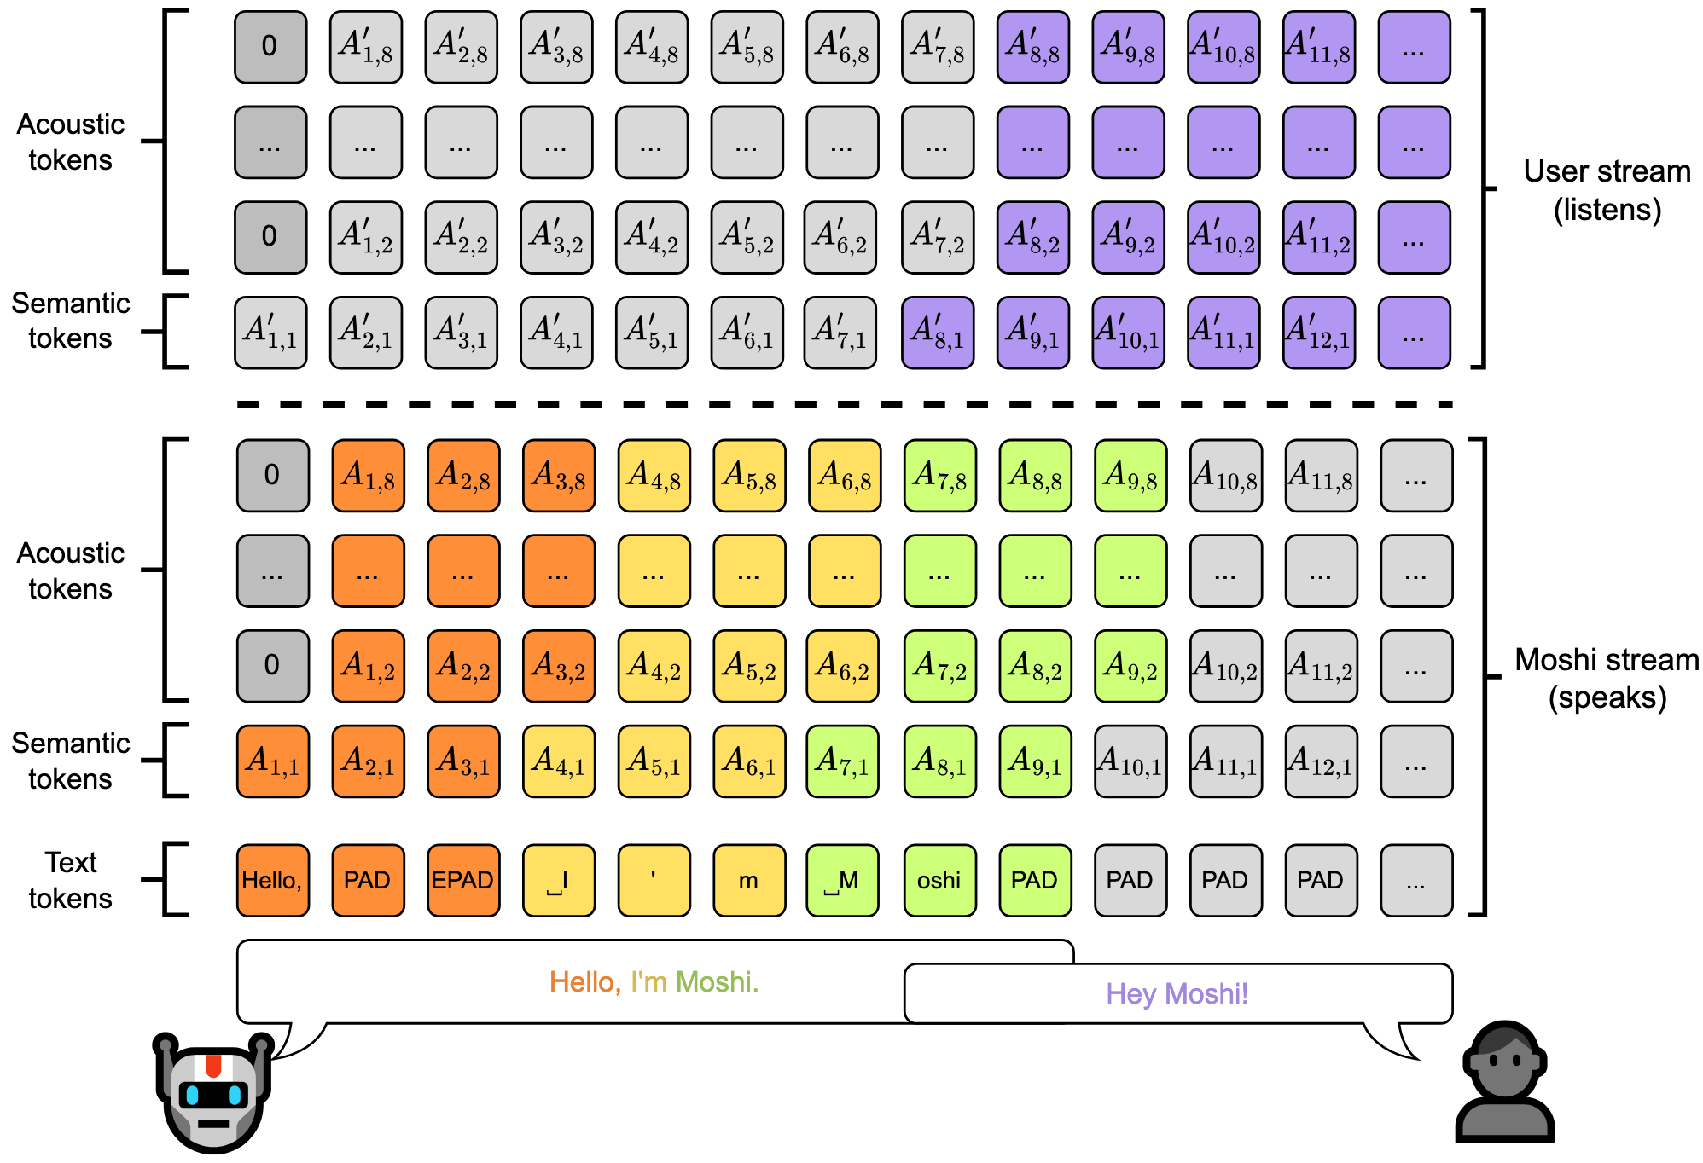
Moshi: Runtime Engine (2/5)
Dual-Stream Design:
Simultaneous decoding of User Audio and encoding of Agent Audio in a single forward pass.
Non-blocking I/O
The system continues listening even while generating, ensuring zero-latency awareness of user feedback.
Figure 2: Representation of the joint sequence modeled by Moshi.
Notes:
To be specific, Moshi uses a dual-stream design.
It processes user audio and system audio at the same time, within a single forward pass.
This means the model can listen and speak simultaneously.
Another key idea is non-blocking I/O.
The system keeps listening even while generating speech,
so it can immediately react to user feedback.
This avoids the delay caused by traditional systems that process input and output step by step

Slide 30
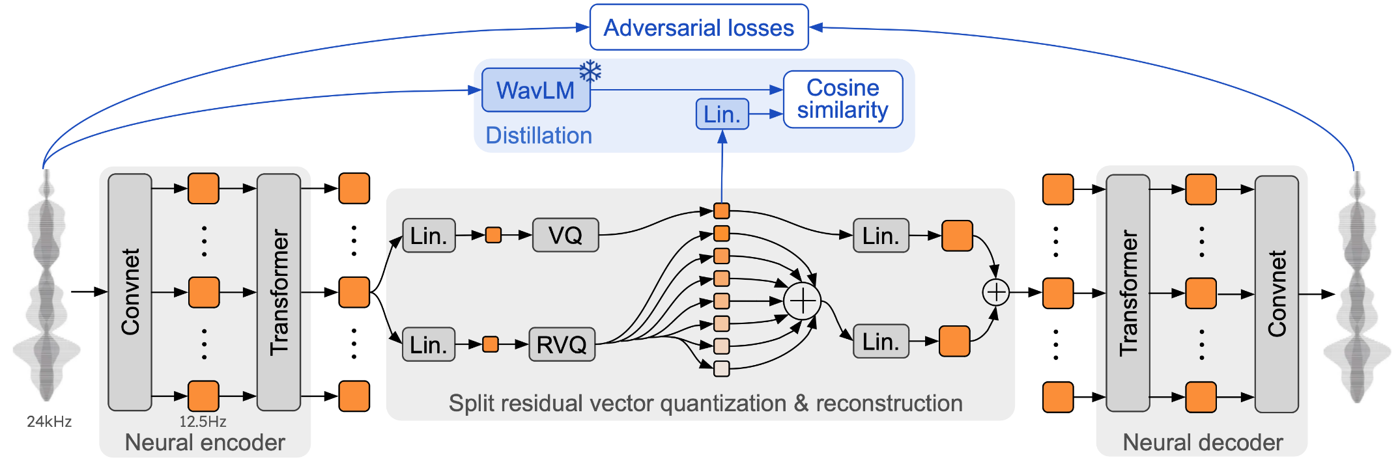
Moshi: Runtime Engine (3/5)
Mimi: Neural Audio Codec
Efficient I/O Compression
Mimi acts as the Device Driver for audio. It compresses speech into a high-frequency (12.5Hz) bitstream with minimal latency.
By reducing the bitrate while preserving quality, it solves the "Memory Bandwidth Wall" of high-resolution audio processing.
Figure 2: Architecture and training of Mimi.
Notes:
It also uses a neural codec called Mimi.
This compresses audio efficiently and reduces memory usage.
So the system can handle high-speed audio streams

Slide 31
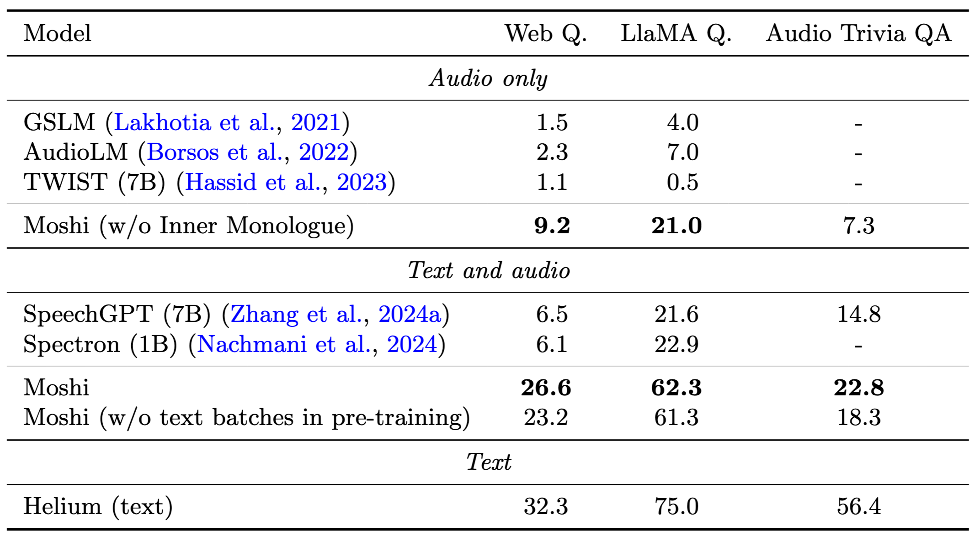
Moshi: Runtime Engine (4/5)
Evaluation
Throughput efficiency:
Inner Monologue ×3 accuracy (16→17 tokens/step)
Latency advantage:
Streaming inference (no full-text blocking)
Memory efficiency:
Joint semantic + acoustic tokens (single model)
System performance:
Outperforms SpeechGPT & Spectron across Spoken QA Test-set
Notes:
In experiments, Moshi shows strong results.
First, Moshi improves accuracy by about three times with Inner Monologue, Second, it supports streaming inference, so there is no blocking delay.
Third, it uses a single model to handle both semantic and acoustic tokens, which improves memory efficiency.
Finally, Moshi outperforms SpeechGPT and Spectron across Q&A testset.”

Slide 32
Moshi: Runtime Engine (5/5)
Runtime Excellence
Moshi proves that Asynchronous Runtime is the key to immersion. By optimizing the audio driver (Mimi) and the execution kernel (Helio), it enables true full-duplex dialogue.
Result: Fluid, human-like verbal interaction.
Async Runtime
160ms Median Latency
Notes:
Most importantly, Moshi achieves real-time performance.
Around 160 milliseconds latency.
This enables smooth, human-like interaction.

Slide 33
Outline
Introduction (3 min)
Background (5 min)
Proposed Methods (15 min)
SpeechGPT: The Unified Instruction Set Architecture (5 min)
LSLM: Language Model Can Listen While Speaking (5 min)
Moshi: a speech-text foundation model for real-time dialogue (5 min)
Conclusions (2 min)
Q & A (5 min)
Notes:
So now lets come to the conclusion parts

Slide 34
Conclusions (1/2)
System Layer | Work | Core Question | OS Analogy | System Implementation
Layer 1: Programming | SpeechGPT | What is the data? | Unified ISA | Unified Representation: Maps speech tokens as native opcodes, enabling unified modality addressing
Layer 2: Workloads | LSLM | Who speaks? When? | FSM / Process States | State-driven Scheduling: State tokens (Listen/Speak) drive an FSM for preemptive turn-taking
Layer 3: Runtime | Moshi | How fast to respond? | Real-time Kernel | Dual-stream Execution: Parallel dual streams bypass blocking I/O, enabling sub-500ms real-time response
Notes:
In summary, we present a three-layer system.
SpeechGPT unifies data. LSLM controls interaction. Moshi enables real-time execution.
Together, they form a complete system for spoken dialogue.
To summarize, we organize the system into three layers.
In Layer 1, SpeechGPT focuses on data representation. It answers the question: what is the data? By using a unified representation, speech and text are processed in the same space.
In Layer 2, LSLM handles interaction control. It answers: who speaks and when? With state-driven scheduling, the system can manage turn-taking and interruptions.
In Layer 3, Moshi focuses on runtime execution. It answers: how fast can we respond? With a dual-stream design, it enables real-time, non-blocking interaction.
Together, these three layers form a complete system design.”

Slide 35
Conclusions (2/2)
Highlights
From cascaded pipelines → unified architecture
From isolated modules → shared representation & control
From blocking execution → real-time, OS-like dialogue system
Conlusion
Spoken Dialogue Systems are becoming the "User-facing OS" of the future. By applying classic computer system principles—efficient I/O, robust scheduling, and unified programming models—we are finally crossing the uncanny valley of human-computer conversation.
Notes:
Overall, we see a clear system evolution.
From cascaded pipelines to a unified architecture.
From isolated modules to shared representation and control.
And from blocking execution to real-time, OS-like dialogue systems.
In conclusion, spoken dialogue systems are becoming the user-facing operating system of the future.
By improving I/O, scheduling, and system design, we are moving closer to natural human conversation.”

Slide 36
Thanks for Listening !
Notes:
Thank you for listening. I’m happy to take questions.

