Slide 1
The Breakthrough Journey of Streaming Real-Time Speech Generation
Zihao Fang
School of Data Science
Chinese University of Hong Kong, Shenzhen

Slide 2
Outline
Introduction (3 min)
Related Work & Background (5 min)
Proposed Methods (15 min)
VALL-E (5 min)
CosyVoice2 (5 min)
vLLM/PagedAttention (5 min)
Conclusions (2 min)
Q & A (5 min)

Slide 3
Outline
Introduction (3 min)
Related Work & Background (5 min)
Proposed Methods (15 min)
VALL-E (5 min)
CosyVoice2 (5 min)
vLLM/PagedAttention (5 min)
Conclusions (2 min)
Q & A (5 min)

Slide 4
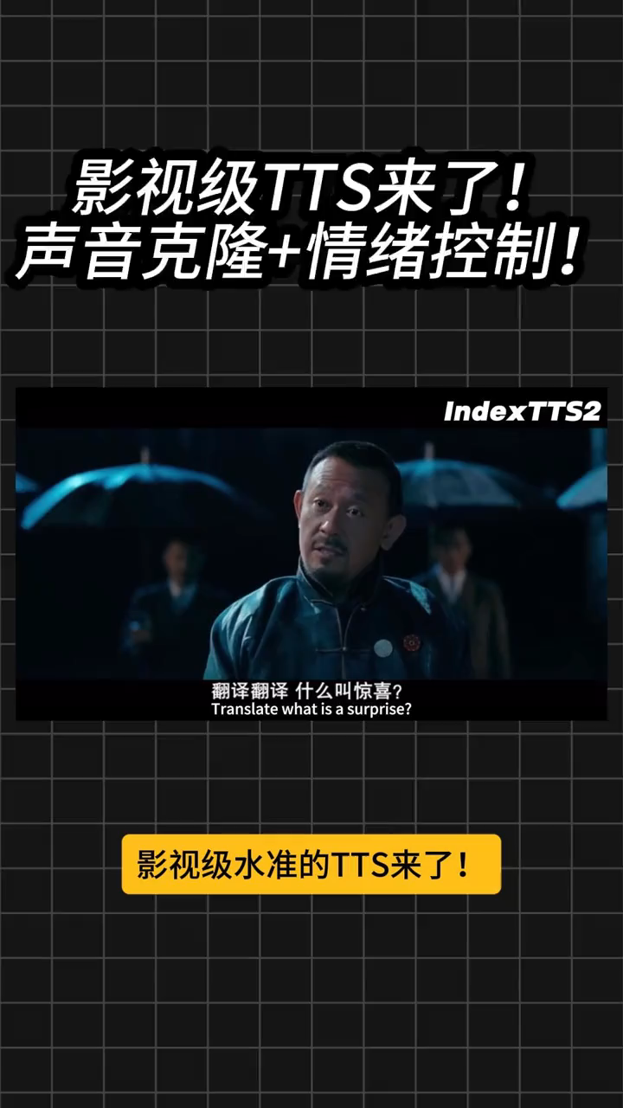
Introduction – Speech Generation (1/3)
What is Speech Generation / Text-to-Speech (TTS)?
A task of generating natural sounding speech given text input.
Can be extended to have a single model that generates speech
for multiple speakers and multiple languages.
Applications of TTS
Video dubbing / voice over
Underlying support for voice assistants (e.g., Siri)
Notes:
What is tts

Slide 5
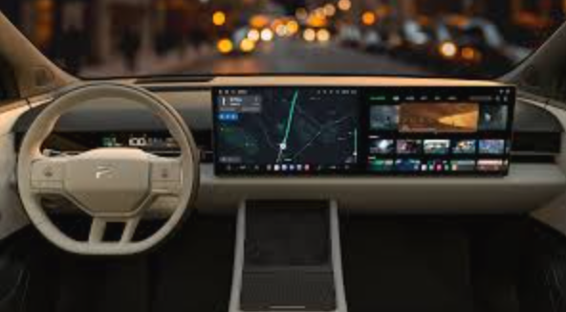


Introduction – Speech Generation (2/3)
Mission-Critical Application Requirements
Intelligent Cockpit
Excessive latency leads to
potential safety hazards.
Virtual Live Streaming
Every 100ms increase in latency
leads to a more than 10% rise
in user hang-up rate.
End-to-End
Large Model Conversation
Seamless collaboration with
streaming text output from LLMs.
Notes:
Why do we need low-latency real-time tts

Slide 6

Introduction – Speech Generation (3/3)
Three Core Challenges of Streaming Real-Time TTS
Fundamental Barrier to Native Streaming
Traditional TTS is built on continuous mel-spectrogram modeling.
Performance Degradation in Streaming Scenarios
Traditional TTS has extremely weak context modeling capability.
Performance Bottleneck for Deployment
The parameter scale of large-model TTS continues to grow.

Slide 7
Outline
Introduction (3 min)
Related Work & Background (5 min)
Proposed Methods & Performance Evaluation (15 min)
VALL-E (5 min)
CosyVoice2 (5 min)
vLLM/PagedAttention (5 min)
Conclusions (2 min)
Q & A (5 min)

Slide 8
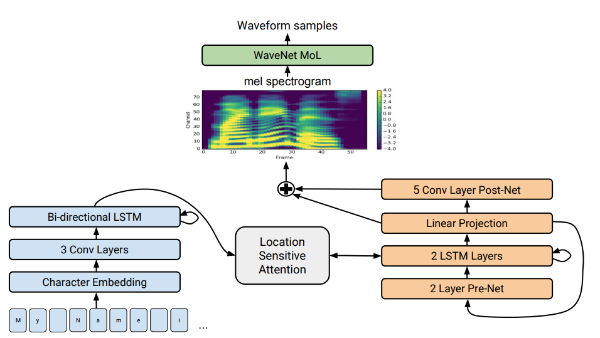
Related Work (1/3) - Parametric TTS
Parametric TTS (Representative: Tacotron 2),
Two-stage architecture (acoustic model + vocoder)
Bidirectional autoregressive modeling of continuous mel-spectrogram
Requires full text input

Slide 9
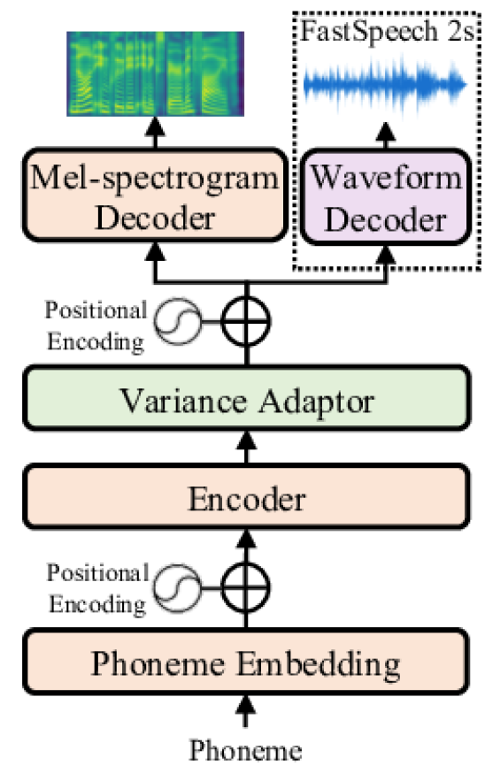
Related Work (2/3) - E2E Non-AR TTS
E2E Non-AR TTS (Representative: FastSpeech 2)
Accelerates inference speed, but still relies on global text information for duration prediction.
Forced streaming splitting is prone to prosody errors and pronunciation distortion.
Core Common Limitation:
All traditional architectures are designed for full-segment generation, with no native streaming inference capability.

Slide 10
Background (3/3) - Limitations
Modeling Level: Strong inter-frame dependency of continuous mel-spectrogram, non-autoregressive architecture cannot achieve chunk-by-chunk incremental generation.
Architecture Level: Siloed design of text frontend - acoustic model - vocoder, multi-module cascade leads to latency accumulation, and chunk-by-chunk streaming processing is prone to error propagation.
Inference Level: Static VRAM allocation mechanism cannot adapt to the dynamic length of streaming requests, resulting in massive VRAM fragmentation, drastic latency fluctuations under high concurrency, and failure to meet commercial SLA requirements.

Slide 11
Outline
Introduction (3 min)
Related Work & Background (5 min)
Proposed Methods (15 min)
VALL-E (5 min)
CosyVoice2 (5 min)
vLLM/PagedAttention (5 min)
Conclusions (2 min)
Q & A (5 min)

Slide 12
Outline
Introduction (3 min)
Related Work & Background (5 min)
Proposed Methods (15 min)
VALL-E (5 min)
CosyVoice2 (5 min)
vLLM/PagedAttention (5 min)
Conclusions (2 min)
Q & A (5 min)

Slide 13

VALL-E (1/5)
Construction of Native Streaming Modeling Capability
Core Design Idea:
Break continuous feature into discrete tokens
Adapt to the mature autoregressive generation logic of large language models.

Slide 14
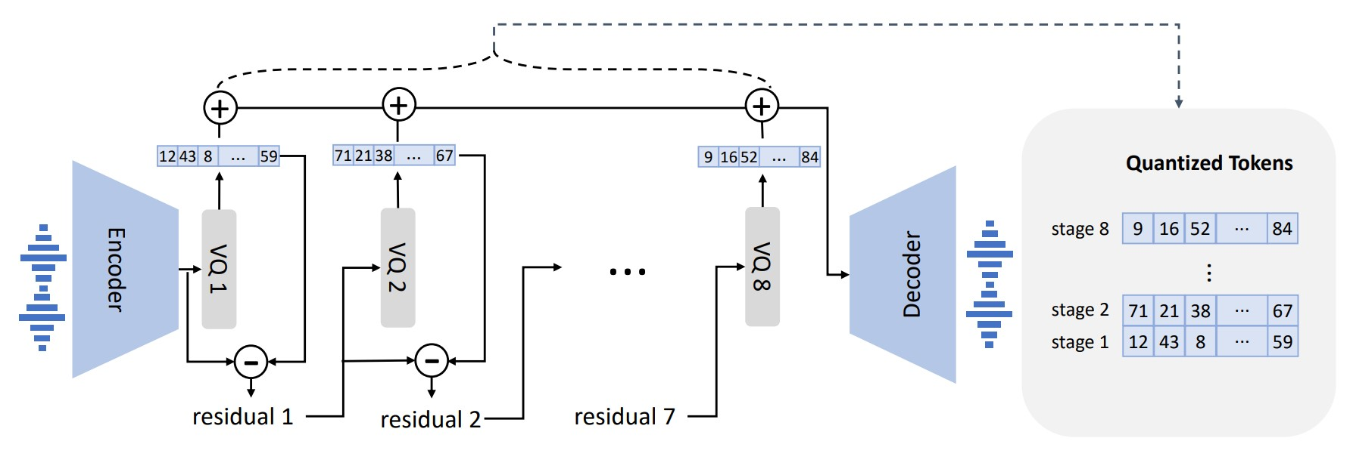
VALL-E (2/5)
Technical Implementation Details
Convert continuous signals into discrete token via audio codec.

Slide 15
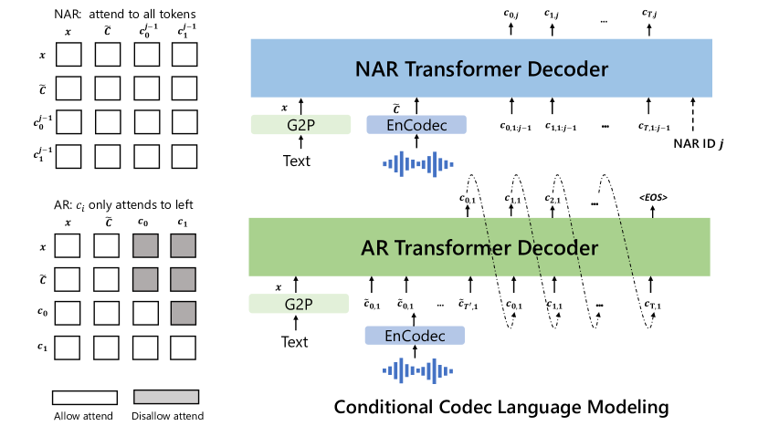
VALL-E (3/5)
Technical Implementation Details
Adopt an autoregressive (AR) modeling approach, generating subsequent acoustic tokens token by token conditioned on historical text and speech tokens.

Slide 16
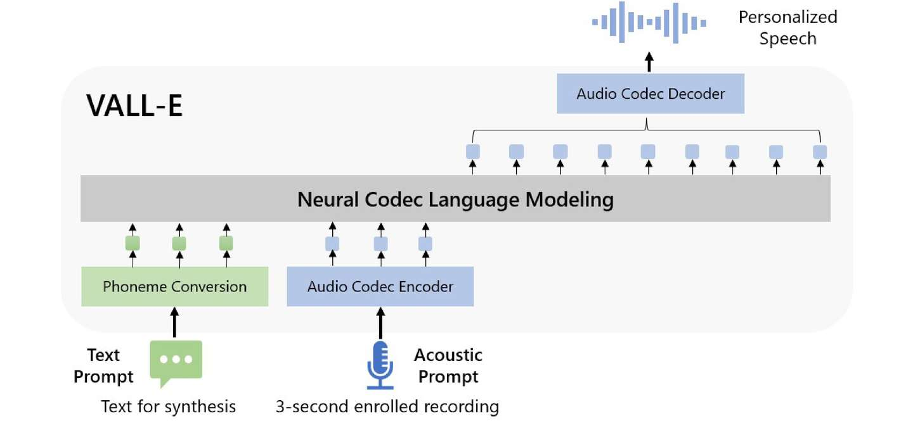
VALL-E (4/5)
Technical Implementation Details
End-to-end pipeline:
text input → token generation → audio decoding
no multi-module cascade error.
Notes:
Core Difference from Traditional Architectures: Shift from "one-time modeling of full text" to "token-by-token incremental generation", natively compatible with streaming inference logic by design.

Slide 17
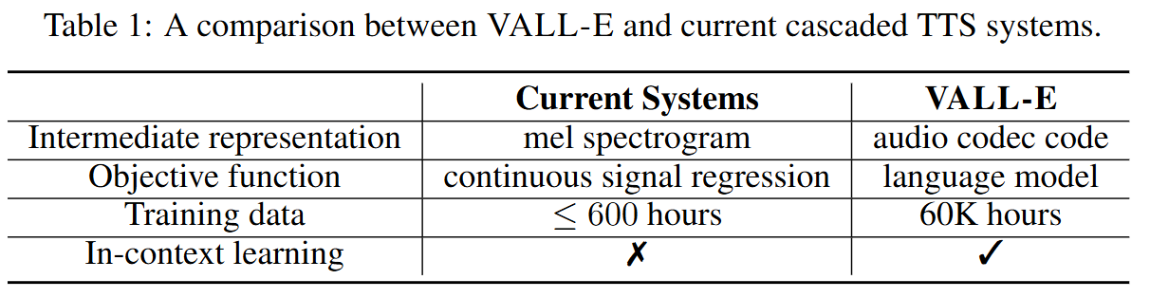
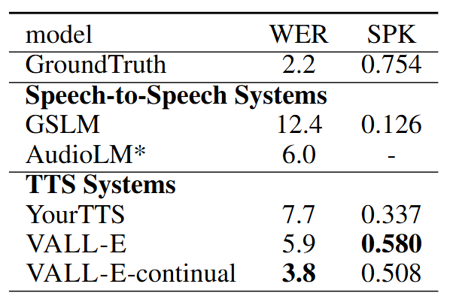
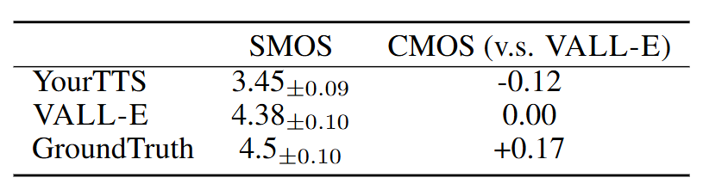
VALL-E (5/5)
Evaluation

Slide 18
Outline
Introduction (3 min)
Related Work & Background (5 min)
Proposed Methods (15 min)
VALL-E (5 min)
CosyVoice2 (5 min)
vLLM/PagedAttention (5 min)
Conclusions (2 min)
Q & A (5 min)

Slide 19
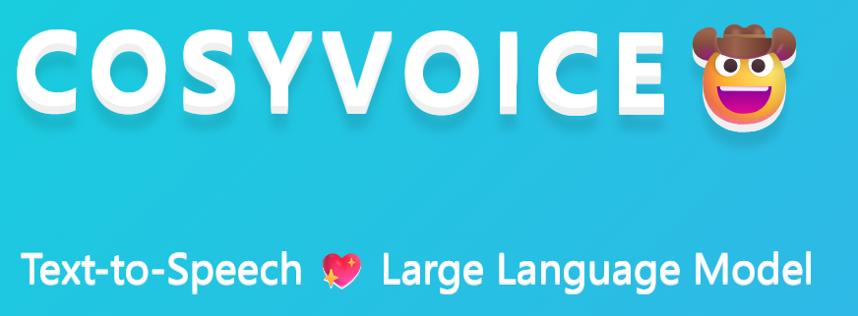
CosyVoice2 (1/6)
LLM-Based Unified Architecture for Streaming Context Modeling Upgrade
Core Design Idea:
Fully introduce LLMs into speech generation.
Unified multimodal tokens.
Powerful context capability of large language models.

Slide 20
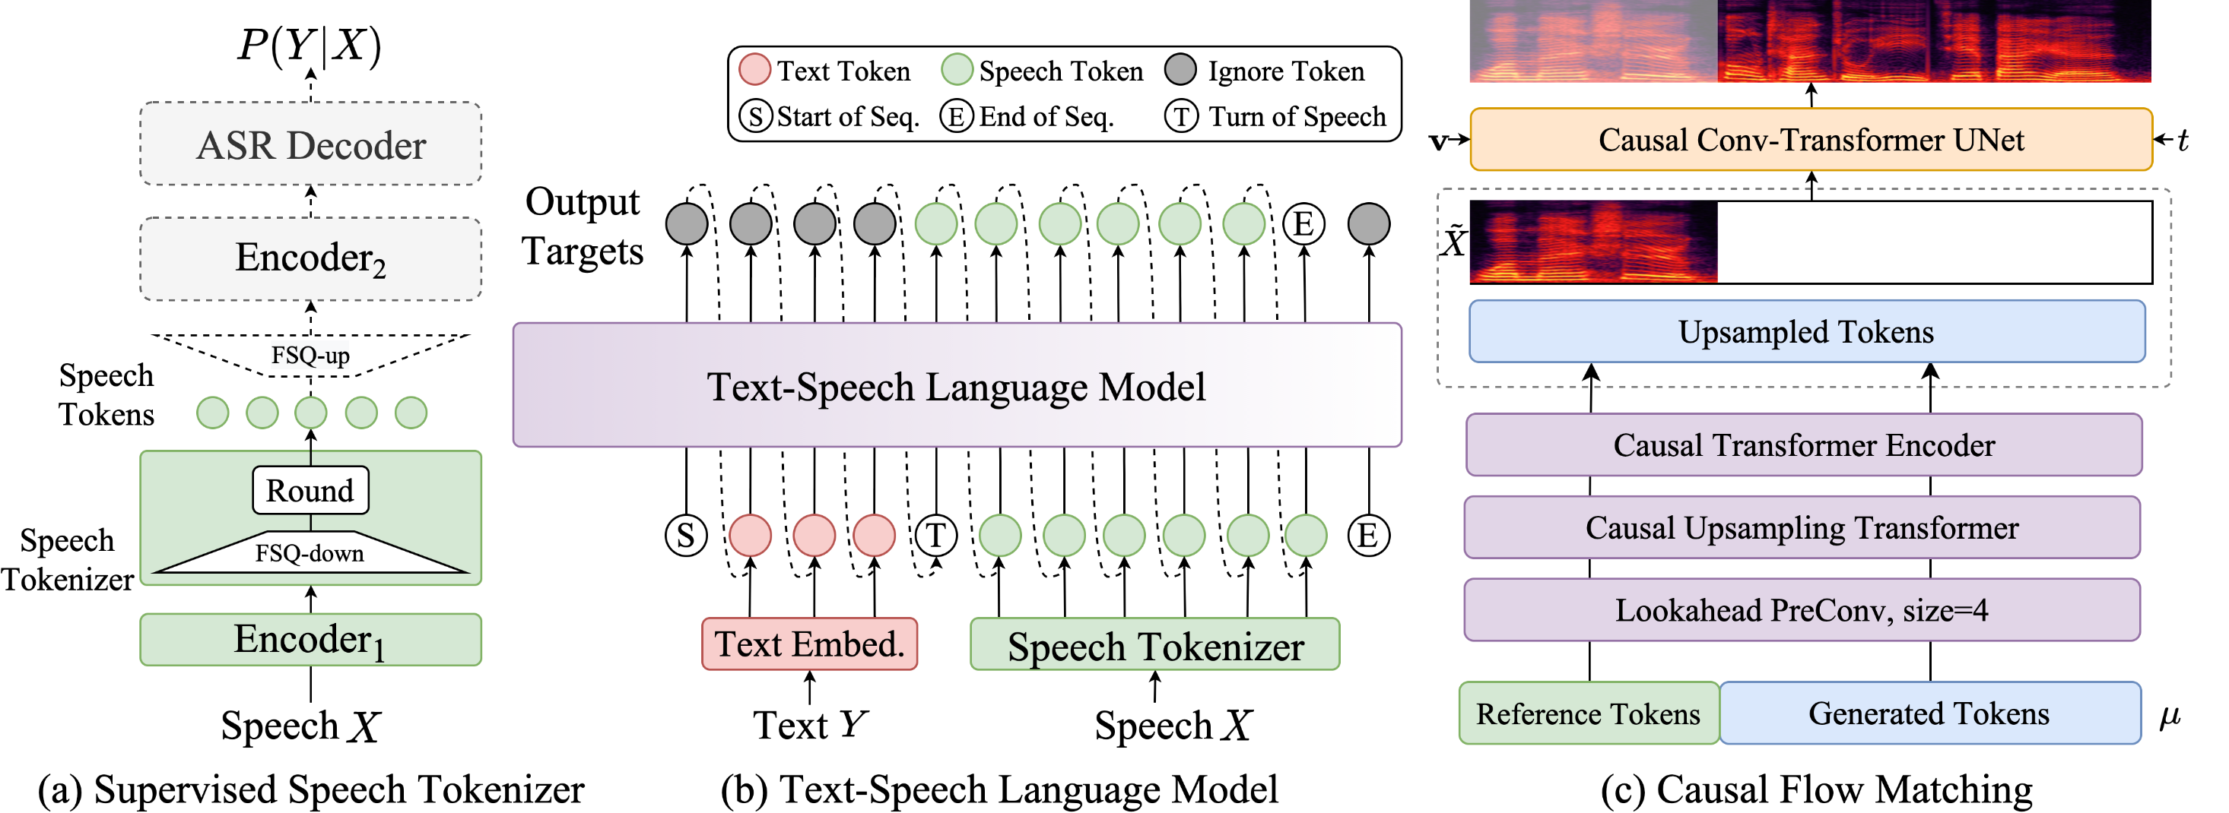
CosyVoice2 (2/6)

Slide 21
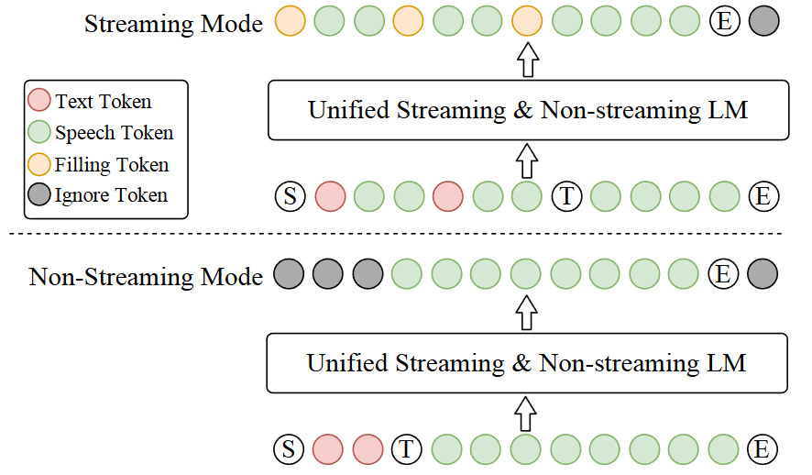
CosyVoice2 (3/6)
Technical Implementation Details:
Unified Representation Space:
Convert different tokens into a unified token sequence understandable by LLMs.
Notes:
Unified Representation Space: Convert text tokens, acoustic tokens, speaker characteristics, emotion control tokens, and language identifiers into a unified token sequence understandable by LLMs.

Slide 22
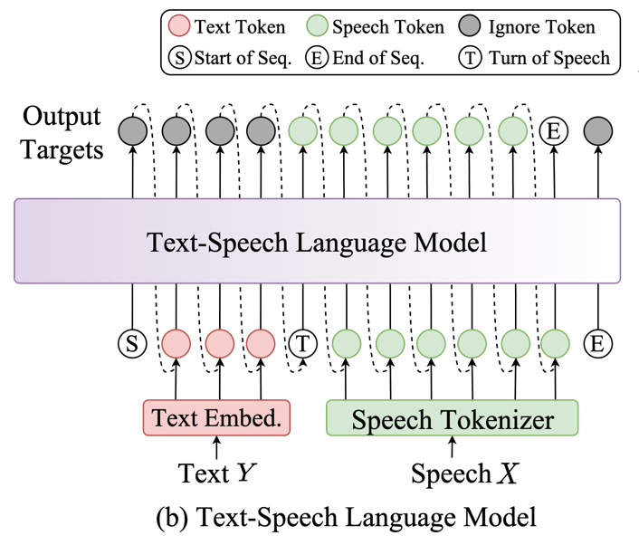
CosyVoice2 (4/6)
Technical Implementation Details:
Single LLM End-to-End Generation
Complete the full pipeline from text understanding, context modeling, emotion control to speech generation with a single large language model, breaking the siloed architecture of traditional TTS.
Notes:
Complete the full pipeline from text understanding, context modeling, emotion control to speech generation with a single large language model, breaking the siloed architecture of traditional TTS.

Slide 23
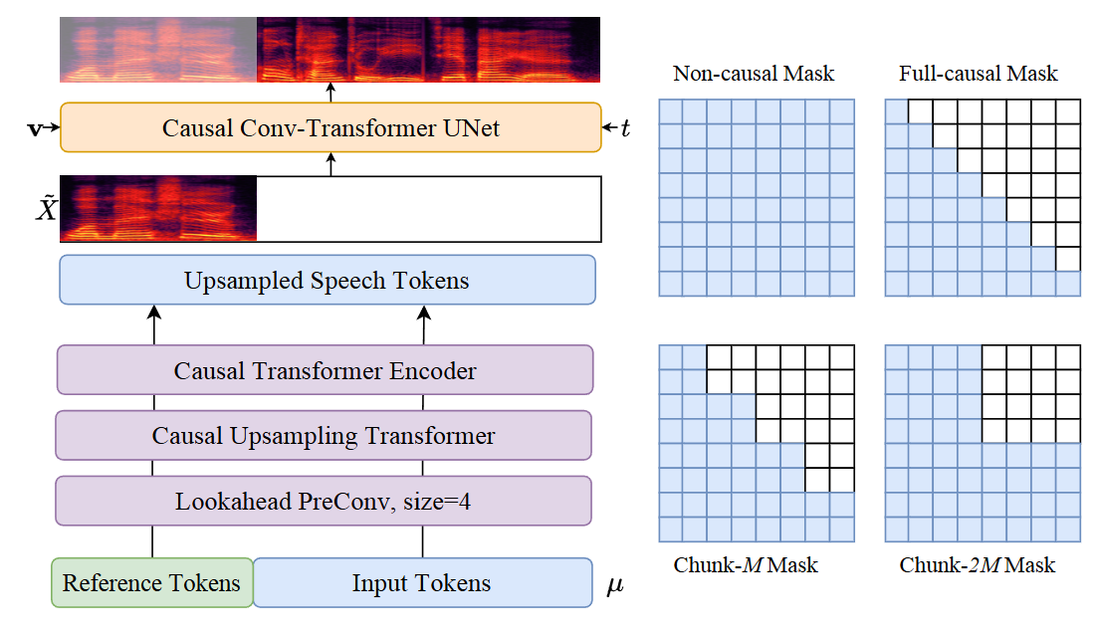
CosyVoice2 (5/6)
Technical Implementation Details:
Streaming Context Prediction Mechanism:
Dynamically predict subsequent text based on preceding context, solving the problems of polyphonic character mispronunciation and incorrect sentence breaks in streaming scenarios.
Core Advantage:
Long context understanding capability, perfectly adapted to streaming scenarios.

Slide 24
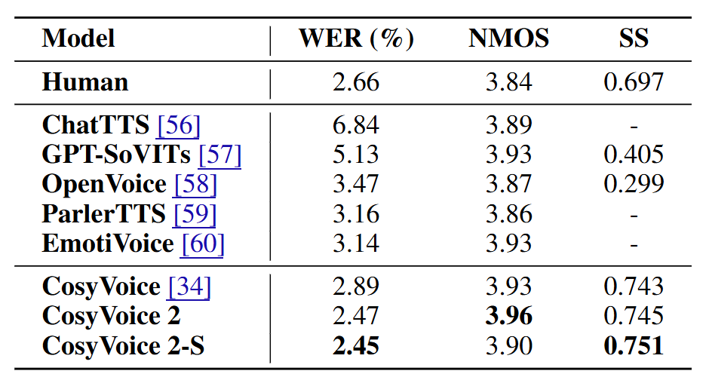
CosyVoice2 (6/6)
Evaluation
MOS approaching the level of human recording.
Support ultra-long context consistency maintenance
Natively support end-to-end real-time conversation

Slide 25
Outline
Introduction (3 min)
Related Work & Background (5 min)
Proposed Methods (15 min)
VALL-E (5 min)
CosyVoice2 (5 min)
vLLM/PagedAttention (5 min)
Conclusions (2 min)
Q & A (5 min)

Slide 26
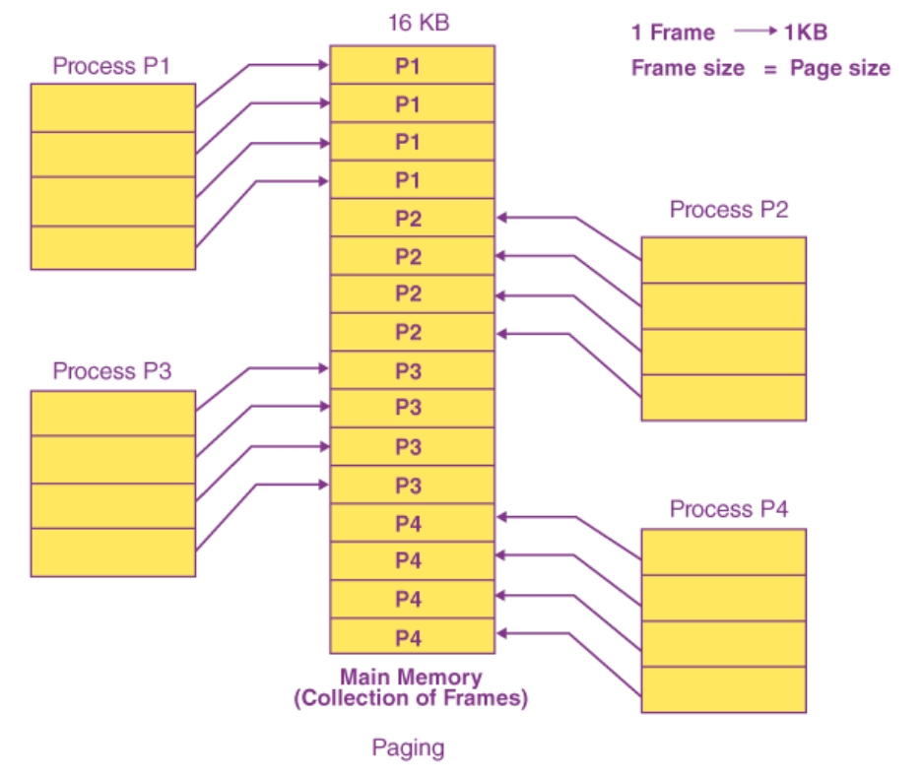
vLLM/PagedAttention (1/6)

Slide 27
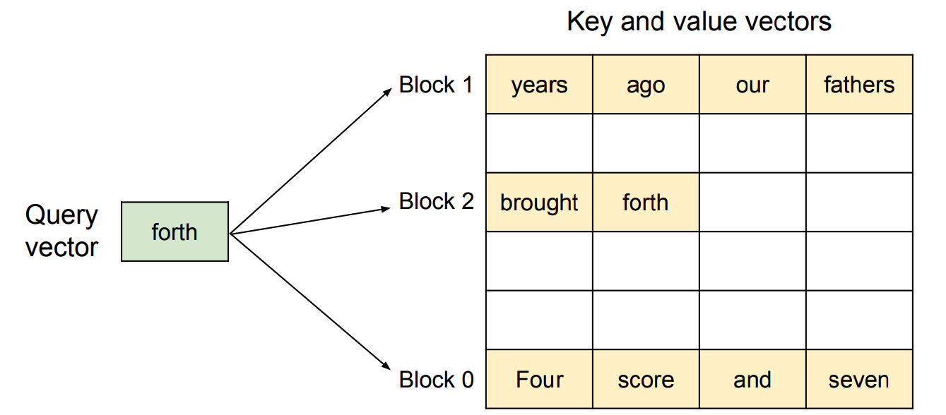
vLLM/PagedAttention (2/6)
OS-Level Memory Management for Streaming Optimization
Core Design Idea:
Replicate the core logic of virtual memory paging in operating systems, and solve the pain point of KV cache management efficiency for large model streaming inference from the OS bottom layer.

Slide 28
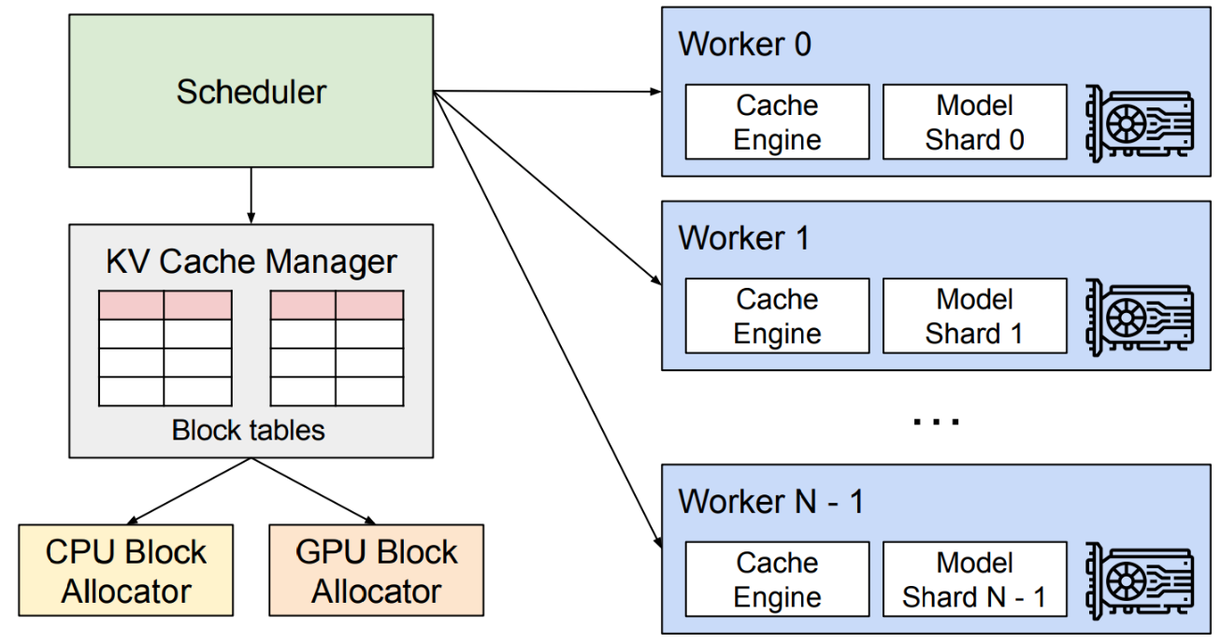
vLLM/PagedAttention (3/6)
Technical Implementation Details:
Core Mechanism of PagedAttention: Split KV cache into fixed-size "pages", manage non-contiguous VRAM space through page tables, and completely eliminate VRAM fragmentation caused by dynamic streaming requests.

Slide 29
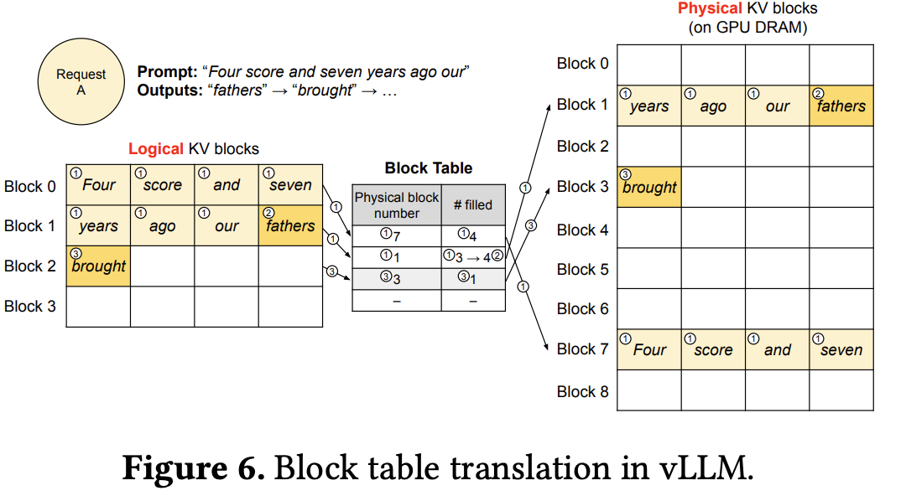
vLLM/PagedAttention (4/6)
Technical Implementation Details:
Core Difference from Traditional Mechanisms: Shift from "continuous static VRAM allocation" to "non-contiguous dynamic paging management", fully adapted to the dynamic length characteristics of streaming requests.

Slide 30
vLLM/PagedAttention (5/6)
Technical Implementation Details:
Continuous Batching Mechanism: Insert new requests in the gaps between generation steps without waiting for the full generation of a request to complete, maximizing GPU computing power utilization.

Slide 31
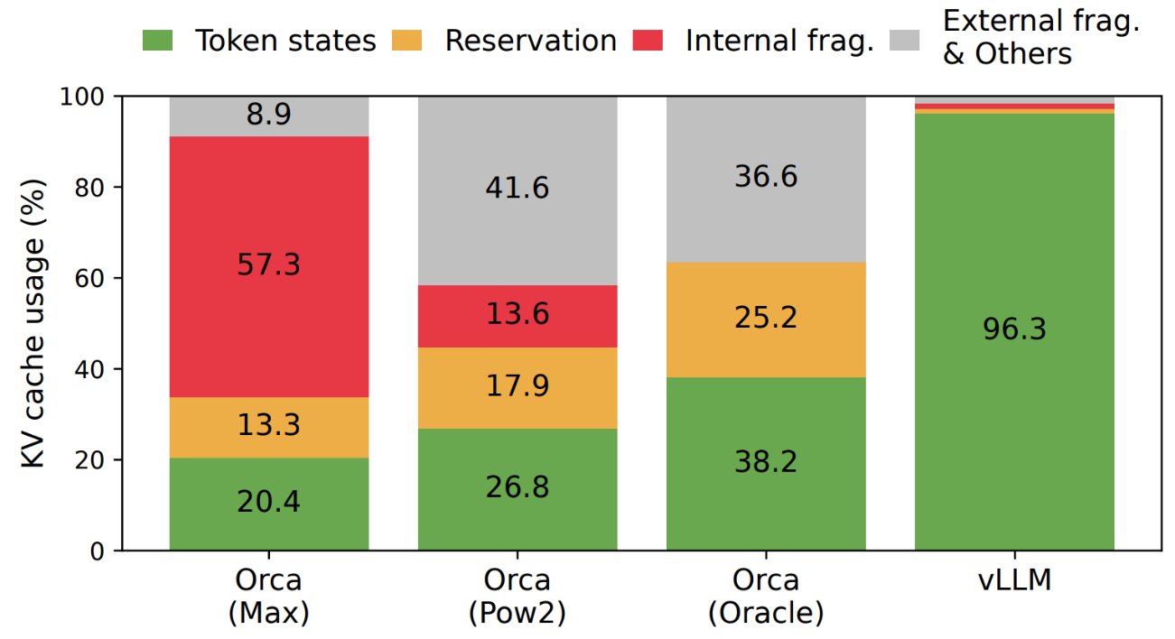
vLLM/PagedAttention (6/6)
Evaluation
Core Problem Solved: Complete the final mile of large-scale commercial deployment of streaming TTS, and meet the commercial requirements of high concurrency, low latency and low cost.

Slide 32
Outline
Introduction (3 min)
Related Work & Background (5 min)
Proposed Methods (15 min)
VALL-E (5 min)
CosyVoice2 (5 min)
vLLM/PagedAttention (5 min)
Conclusions (2 min)
Q & A (5 min)

Slide 33
Conclusions
Discrete speech representation and autoregressive modeling are the core foundation of streaming real-time TTS.
The introduction of LLMs is a key breakthrough to achieve high-naturalness conversation in streaming scenarios.
OS-level system optimization at the bottom layer is the core guarantee for the technology to move from the laboratory to commercial use.

Slide 34
Outline
Introduction (3 min)
Related Work & Background(5 min)
Proposed Methods & Performance Evaluation (15 min)
VALL-E (5 min)
CosyVoice2 (5 min)
vLLM/PagedAttention (5 min)
Conclusions (2 min)
Q & A (5 min)

