Slide 1
CSC4180 – Compiler Construction
Prof. Yeh-Ching Chung
School of Data Science
Chinese University of Hong Kong, Shenzhen

Slide 2
Class Information
Instructor
Dr. Yeh-Ching Chung (ychung@cuhk.edu.hk)
Course TA
刘宇轩
Lectures
Tuesday 13:30pm – 14:50pm TA 201
Thursday 13:30pm – 14:50pm TA 201
Tutorials
1 session (TA will announce the time and classrooms)
WeChat Group
CSC4180 Spring 2025
Online Platform
Blackboard (https://bb.cuhk.edu.cn)
Website
http://www.cs.nthu.edu.tw/~ychung/syllabus/CSC4180-2025-Spring.htm

Slide 3
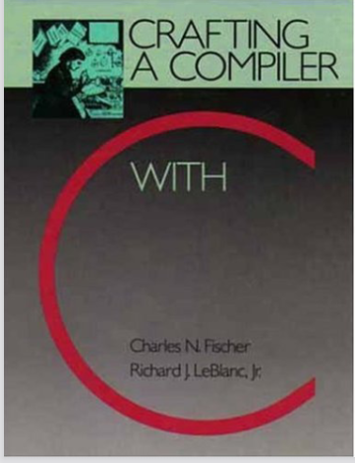
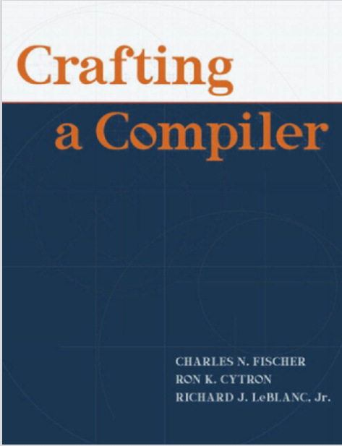
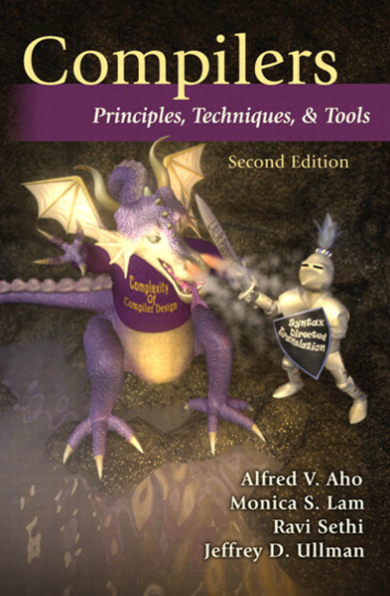
Textbook & Reference
(Textbook)
Crafting a Compiler with C
C. Fisher and R. Leblanc, 1991
(Textbook)
Crafting a Compiler
C. Fisher, Ron K. Cytron, and
R. Leblanc, 2010
(Reference)
Compilers, Principles, Techniques, and Tools,
A. Aho, R. Sethi, J. Ullmman, 2007

Slide 4
Course Syllabus (1)
Goals
Understand the components of compilers and the theories behind them
Design a simplified C compiler
Contents
Introduction
A Simple Compiler
Scanning - Theory and Practice
Grammar and Parsing
Top-Down Parsing
Bottom-Up Parsing
Syntax-Directed Translation
Symbol Table and Declaration Processing
Semantics Analysis
Code Generation

Slide 5
Course Syllabus (2)
Source Program
Tokens
Syntactic
Scanner
Parser
Semantic
Routines
(Character Stream)
Structure
Intermediate
Representation
Symbol and
Attribute
Tables
Optimizer
(Used By All Phases of The Compiler)
Code
Generator
Target Machine Code

Slide 6
Course Assessment
Class participation (5%)
Programming Projects (70%)
Final Exam (25%)
If you need to apply for a leave for the roll call, send an email to me beforehand
If you are sick (at the hospital) and cannot attend the final exam, obtain a medical diagnostic record and email it to me no later than three days after your absence
Students are responsible for keeping track of their marks

Slide 7
Learning Outcome
Upon completing this course, students will be able to
Understand the theories of scanner and parser
Understand the contents of code generation
Use Lex and Yacc to design a scanner and a parser
Design a simplified C compiler

Slide 8
Academic Honesty
Zero Tolerance
Plagiarism, cheating, misconduct in test/exam will be reported to the School for handing.
Consequences
Zero marks for the concerned assignments/test/exam/whole course, reviewable demerits, non-reviewable demerits, suspension of study, dismissal from University.
University Policy to Academic Honesty
https://registry.cuhk.edu.cn/en/page/30

