Slide 1
CSC4180 – Compiler Construction
Prof. Yeh-Ching Chung
School of Data Science
Chinese University of Hong Kong, Shenzhen

Slide 2
Outline
2.1 The Structure of a Micro Compiler
2.2 A Micro Scanner
2.3 The Syntax of Micro
2.4 Recursive Descent Parsing
2.5 Translating Micro
2

Slide 3
The Structure of a Micro compiler (1)
Micro - A very simple language
Only integers
No declarations
Variables consist of A..Z, 0..9
At most 32 characters long
Comments begin with “--” and end with end-of-line.
Three kinds of statements:
assignments, e.g., a := b + c
read(list of ids), e.g., read(a, b)
write(list of exps), e.g., Begin, end, read, and write are reserved words.
Tokens may not extend to the following line.
(a+b)
3

Slide 4
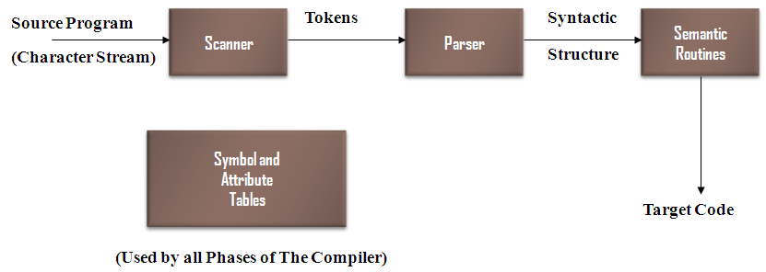
The Structure of a Micro compiler (2)
One-pass type, no explicit intermediate representations used
The interface
Parser is the main routine.
Parser calls scanner to get the next token.
Parser calls semantic routines at appropriate times.
Semantic routines produce output in assembly language.
A simple symbol table is used by the semantic routines.

Slide 5
Outlines
2.1 The Structure of a Micro Compiler
2.2 A Micro Scanner
2.3 The Syntax of Micro
2.4 Recursive Descent Parsing
2.5 Translating Micro
5

Slide 6
A Micro Scanner (1)
The Micro Scanner
will be a function of no arguments that returns token values
There are 14 tokens.
typedef enum token_types {
BEGIN, END, READ, WRITE, ID, INTLITERAL,
LPAREN, RPAREN, SEMICOLON, COMMA, ASSIGNOP,PLUOP, MINUSOP, SCANEOF
} token;
Extern token scanner(void);

Slide 7
A Micro Scanner (2)
The Micro Scanner
Returns the longest string that constitutes a token, e.g., in
abcdef
ab, abc, abcdef are all valid tokens.
The scanner will return the longest one, e.g.,
abcdef

Slide 8
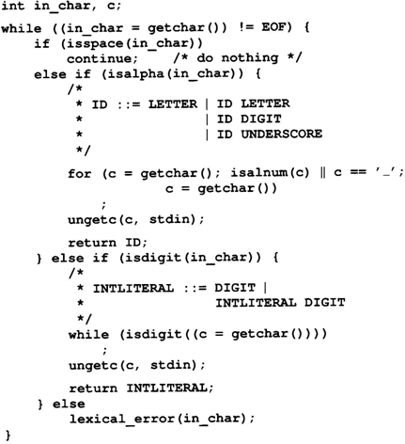
A Micro Scanner (3)
The Micro Scanner
Continue:
skip one iteration
getchar() , isspace(),
isalpha(), isalnum(),
isdigital()
ungetc():
push back one character

Slide 9
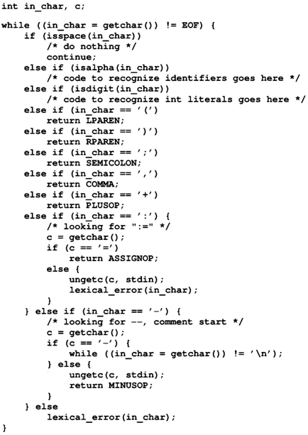
A Micro Scanner (4)
The Micro Scanner
Continue:
skip one iteration
getchar() , isspace(),
isalpha(), isalnum(),
isdigital()
ungetc():
push back one character

Slide 10
A Micro Scanner (5)
The Micro Scanner
How to handle RESERVED words?
Reserved words are similar to identifiers.
Two approaches
Use a separate table of reserved words
Put all reserved words into symbol table initially.

Slide 11
A Micro Scanner (6)
The Micro Scanner
Provision for saving the characters of a token as they are scanned
token_buffer
buffer_char()
clear_buffer()
check_reserved()
Handle end of file
feof(stdin)

Slide 12
Outline
2.1 The Structure of a Micro Compiler
2.2 A Micro Scanner
2.3 The Syntax of Micro
2.4 Recursive Descent Parsing
2.5 Translating Micro
12

Slide 13
The Syntax of Micro (1)
The Syntax of Micro
Micro's syntax is defined by a context-free grammar (CFG)
CFG is also called BNF (Backus-Naur Form) grammar
CFG consists of a set of production rules,
A→B C D… Z
LHS
must be a single nonterminal
RHS
consists 0 or more terminals or nonterminals

Slide 14
The Syntax of Micro (2)
Two kinds of symbols
Nonterminals
Delimited by “<“ and “>”
Represent syntactic structures
Terminals
Represent tokens
E.g.
<program> → begin <statement list> end
Start or goal symbol
λ : empty or null string
E.g.
<statement list> → <statement><statement tail>
<statement tail> → λ
<statement tail> → <statement><statement tail>

Slide 15
The Syntax of Micro (3)
Extended BNF: some abbreviations
Optional: [ ] 0 or 1
<stmt> → if <exp> then <stmt>
<stmt> → if <exp> then <stmt> else <stmt>
<stmt> → if <exp> then <stmt> [ else <stmt> ]
Repetition: { } 0 or more
<stmt list> → <stmt> <tail>
<tail> → λ
<tail> → <stmt> <tail>
<stmt list> → <stmt> { <stmt> }

Slide 16
The Syntax of Micro (4)
Extended BNF: some abbreviations
Alternative: |
<stmt> → <assign>
<stmt> → <if stmt>
<stmt> → <assign> | <if stmt>
Extended BNF == BNF
Either can be transformed to the other.
Extended BNF is more compact and readable

Slide 17
The Syntax of Micro (5)
Extended CFG Defining Micro
<program> → begin <statement list> end
<statement list> → <statement> { <statement> }
<statement> → ID := <expression> ;
<statement> → read ( <id list> ) ;
<statement> → write ( <expr list> ) ;
<id list> → ID { , ID }
<expr list> → <expression> { , <expression> }
<expression> → <primary> { <add op> <primary> }
<primary> → ( <expression> )
<primary> → ID
<primary> → INTLITERAL
<add op> → +
<add op> → -
<system goal> → <program> SCANEOF

Slide 18
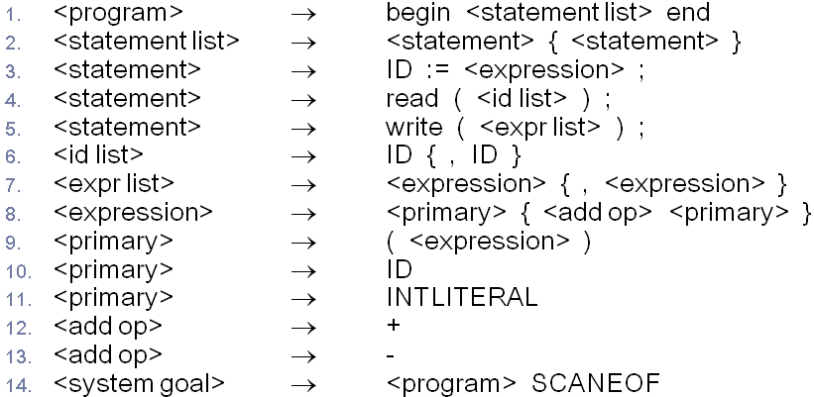
The Syntax of Micro (6)
begin ID := ID + ( INTLITERAL - ID ) ; end
<system goal> (Apply rule 14)
<program> SCANEOF (Apply rule 1)
begin <statement list> end SCANEOF (Apply rule 2)
begin <statement> { <statement> } end SCANEOF (Apply rule 3)
begin ID := <expression> ; { <statement> } end SCANEOF (Apply rule 8)
begin ID := <primary> { <add op> <primary> }; { <statement> } end SCANEOF (Apply rule 10)
begin ID := ID {<add op> <primary> }; { <statement> } end SCANEOF (Apply rule 12)
begin ID := ID + <primary>; { <statement> } end SCANEOF (Apply rule 9)
begin ID := ID + ( <expression> ) ;{ <statement> } end SCANEOF (Apply rule 8)
begin ID := ID + ( <primary> { <add op> <primary> } ) ; { <statement> } end SCANEOF (Apply rule 11)
begin ID := ID + ( INTLITERAL <add op> <primary> ); { <statement> } end SCANEOF (Apply rule 13)
begin ID := ID + (NTLITERAL - <primary> ); { <statement> } end SCANEOF (Apply rule 10)
begin ID := ID + ( INTLITERAL - ID); { <statement> } end SCANEOF
begin ID := ID + ( INTLITERAL - ID ) ; end SCANEOF

Slide 19
The Syntax of Micro (7)
A CFG
Defines a language, which is a set of sequences of tokens
Syntax errors & semantic errors
A:=‘X’+True;
Associativity
A-B-C
Operator precedence
A+B*C

Slide 20
The Syntax of Micro (8)
A grammar fragment
Defines such a precedence relationship
<expression> → <factor> {<add op><factor>}
<factor>→ <primary> {<mult op><primary>}
<primary>→(< expression >)
<primary>→ID
<primary>→INTLITERAL
<expression>
<factor>
<primary>
<mult op>
<primary>
(
<expression>
)
*
ID
<expression>
<factor>
<add op>
<factor>
<factor>
<add op>
<factor>
<primary>
+
<primary>
<mult op>
<primary>
<primary>
+
<primary>
ID
ID
*
ID
ID
ID
Derivation Tree for A+B*C
Derivation Tree for (A+B)*C

Slide 21
Outline
2.1 The Structure of a Micro Compiler
2.2 A Micro Scanner
2.3 The Syntax of Micro
2.4 Recursive Descent Parsing
2.5 Translating Micro
21

Slide 22
Recursive Descent Parsing (1)
There are many parsing techniques.
Recursive descent is one of the simplest parsing techniques
Basic idea (1)
Each nonterminal has a parsing procedure
For symbol on the RHS : a sequence of matching
To Match a nonterminal A
Call the parsing procedure of A
To match a terminal symbol t
Call match(t)
match(t) calls the scanner to get the next token. If is it t, everything is correct. If it is not t, we have found a syntax error.

Slide 23
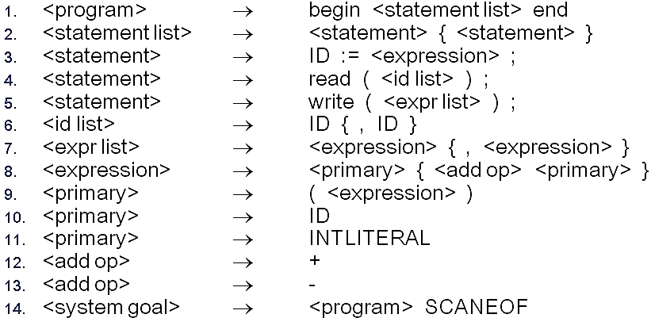
Recursive Descent Parsing (2)
Basic idea (2)
If a nonterminal has several productions,
Choose an appropriate one based on the next input token.
Parser is started by invoking system_goal().
void system_goal(void)
{
/* <system goal> ::=
<program> SCANEOF */
program();
match(SCANEOF);
}

Slide 24
Recursive Descent Parsing (3)
void program(void)
void program(void)
{
/* <program> ::=
BEGIN <statement list> END */
match(BEGIN)
statement_list();
match(END);
}

Slide 25
Recursive Descent Parsing (4)
void statement_list(void)
void statement_list(void)
{
/* <statement list> ::=
<statement> { <statement> } */
statement();
while (TRUE) {
switch (next_token()) {
case ID:
case READ:
case WRITE:
statement();
break;
default:
return;
}
}
}
Process {<statement>} did not show up case
next_token()
a function that returns the next token. It does not call scanner(void).

Slide 26
Recursive Descent Parsing (5)
void statement(void)
void statement(void) {
token tok = next_token();
switch (tok) {
case ID:
/* <statement> ::= ID := <expression> ; */
match(ID); match(ASSIGNOP);
expression(); match(SEMICOLON);
break;
case READ:
/* <statement> ::= READ ( <id list> ) ; */
match(READ); match(LPAREN);
id_list(); match(RPAREN); match(SEMICOLON);
break;
case WRITE:
/* <statement> ::= WRITE (<expr list>) ; */
match(WRITE); match(LPAREN);
expr_list(); match(RPAREN);
match(SEMICOLON);
break;
default:
syntax_error(tok);
break;
}
}
<statement>
Would appear at least once

Slide 27
Recursive Descent Parsing (6)
void id_list(void)
void id_list(void)
{
/* <id list> ::= ID { , ID } */
match(ID);
while (next_token() == COMMA) {
match(COMMA);
match(ID);
}
}

Slide 28
Recursive Descent Parsing (7)
void expression(void)
void expression(void)
{
/* <expression> ::=
<primary> { <add op> <primary> } */
token t;
primary();
for (t = next_token(); t == PLUSOP || t == MINUSOP; t = next_token()) {
add_op();
primary();
}
}

Slide 29
Recursive Descent Parsing (8)
void expr_list(void)
void expr_list(void)
{
/* <expr list> ::=
<expression> { , <expression> } */
expression();
while (next_token() == COMMA) {
match(COMMA);
expression();
}
}

Slide 30
Recursive Descent Parsing (9)
void add_op(void)
void add_op(void)
{
/* <addop> ::= PLUSOP I MINUSOP */
token tok = next_token();
if (tok == PLUSOP || tok ==MINUSOP)
match(tok);
else
syntax_error(tok);
}

Slide 31
Recursive Descent Parsing (10)
void primary(void)
void primary(void)
{
token tok = next_token();
switch (tok) {
case LPAREN:
/* <primary> ::= ( <expression> ) */
match(LPAREN); expression();
match(RPAREN);
break;
case ID:
/* <primary> ::= ID */
match(ID);
break;
case INTLITERAL:
/* <primary> ::= INTLITERAL */
match(INTLITERAL);
break;
default:
syntax_error(tok);
break;
}
}

Slide 32
Outline
2.1 The Structure of a Micro Compiler
2.2 A Micro Scanner
2.3 The Syntax of Micro
2.4 Recursive Descent Parsing
2.5 Translating Micro
32

Slide 33
Translating Micro (1)
Target language: 3-addr code (quadruple)
OP A, B, C
Note that we did not worry about registers at this time
Temporaries: Sometimes we need to hold temporary values
E.g. A+B+C
ADD A,B,TEMP&1
ADD TEMP&1,C,TEMP&2

Slide 34
Translating Micro (2)
Action Symbols
The bulk of a translation is done by semantic routines
Action symbols can be added to a grammar to specify when semantic processing should take place
Be placed anywhere in the RHS of a production
translated into procedure call in the parsing procedures
#add corresponds to a semantic routine named add()
No impact on the languages recognized by a parser driven by a CFG

Slide 35
Translating Micro (3)
Grammar for Mirco with Action Symbols
<program> → #start begin <statement list> end
<statement list> → <statement> { <statement> }
<statement> → <ident> := <expression> #assign ;
<statement> → read ( <id list> ) ;
<statement> → write ( <expr list> ) ;
<id list> → <ident> #read_id { , <ident> #read_id }
<expr list> → <expression> #write_expr { , <expression> #write_expr }
<expression> → <primary> { <add op> <primary> #gen_infix }
<primary> → ( <expression> )
<primary> → <ident>
<primary> → INTLITERAL #process_literal
<add op> → + #process_op
<add op> → - #process_op
<ident> → ID #process_id
<system goal> → <program> SCANEOF #finish

Slide 36
Semantic Information (1)
Semantic routines need certain information to do their work
These information is stored in semantic records
Each kind of grammar symbol has a semantic record
#define MAXIDLEN 33
typedef char string[MAXIDLEN];
/* for operators */
typedef struct operator {
enum op { PLUS, MINUS } operator;
} op_rec;
/* for <primary> and <expression> */
enum expr { IDEXPR, LITERALEXPR, TEMPEXPR };
typedef struct expression {
enum expr kind;
union {
string name; /* for IDEXPR, TEMPEXPR */
int val; /* for LITERALEXPR */
};
} expr_rec;
semantic records for Micro Symbols

Slide 37
Semantic Information (2)
Parsing procedure
<expression> → <primary> {<add op> <primary> #gen_infix}
void expression (expr_rec *result)
{
expr_rec left_operand, right_operand;
op_rec op;
/* <expression> ::= <primary>
{ <add op> <primary> #gen_infix }*/
primary( &left_operand)
while (next_token() == PLUSOP || next_token() == MINUSOP) {
add_op( &op);
primary( &right_operand);
left_operand = gen_infix(left_operand,
op, right_operand);
}
*result = left_operand;
}
void expression(void)
{
token t;
/* <expression> ::= <primary>
{ <add op> <primary> } */
primary();
for (t = next_token(); t == PLUSOP || t == MINUSOP; t = next_token()) {
add_op();
primary();
}
}
Old parsing procedure ( P. 37 )
New parsing procedure which involved semantic routines

Slide 38
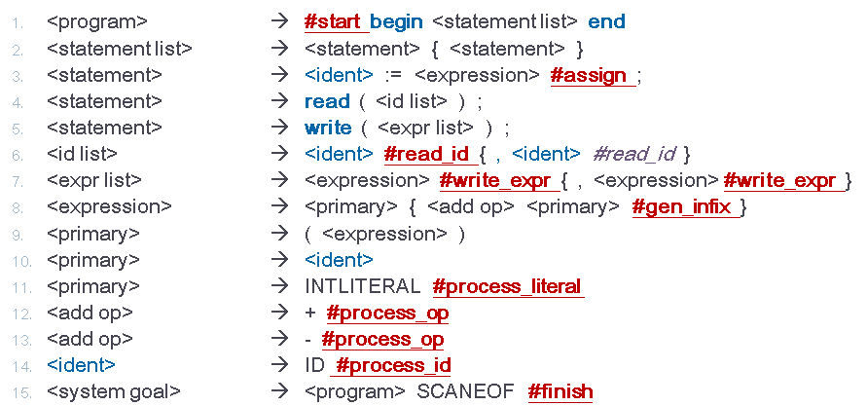
Semantic Information (3)
Subroutines for symbol table
Symbol table
Is s in the symbol ?
extern int lookup(string s);
/* Put s unconditionally into symbol table. */
extern void enter(string s);
void check_id(string s)
{
if (! lookup(s)) { enter(s);
generate("Declare", s, "Integer“," ");
}
}

Slide 39
Semantic Information (4)
Subroutines for temporaries
Temporaries
char *get_temp(void) {
/* max temporary allocated so far*/
static int max_temp = 0;
static char tempname[MAXIDLEN];
max_temp++;
sprintf(tempname, "Temp&%d",
max_temp);
check_id(tempname);
return tempname;
}

Slide 40
Semantic Information (5)
Subroutines
start
void start(void)
{
/* Semantic initializations, none needed. */
}

Slide 41
Semantic Information (6)
Subroutines
assign
void assign(expr_rec target, expr_rec source)
{
/* Generate code for assignment. */
generate("Store", extract(source), target.name, "");
}

Slide 42
Semantic Information (7)
Subroutines
read_id
void read_id(expr_rec in_var)
{
/* Generate code for read. */
generate("Read", in_var.name,"Integer", "");
}

Slide 43
Semantic Information (8)
Subroutines
write_expr
void write_expr(expr_rec out_expr)
{
/* Generate code for write. */
generate("Write", extract(out_expr),"Integer", "");
}

Slide 44
Semantic Information (9)
Subroutines
gen_infix
expr_rec gen_infix(expr_rec e1, op_rec op, expr_rec e2)
{
/* Generate code for infix operation.
* Get result temp and set up semantic
* record for result. */
expr_rec e_rec;
/* An expr_rec with temp variant set. */
e_rec.kind = TEMPEXPR;
strcpy(e_rec.name, get_temp());
generate(extract(op), extract(e1),extract(e2), e_rec.name);
return e_rec;
}

Slide 45
Semantic Information (10)
Subroutines
process_literal
expr_rec process_literal(void)
{
/* Convert literal to a numeric representation
and build semantic record. */
expr_rec t;
t.kind = LITERALEXPR;
(void) sscanf(token_buffer, “%d",&t.val);
return t;
}

Slide 46
Semantic Information (11)
Subroutines
process_op
op_rec process_op(void)
{
/* Produce operator descriptor. */
op_rec o;
if (current_token == PLUSOP)
o.operator = PLUS;
else
o.operator = MINUS;
return o;
}

Slide 47
Semantic Information (12)
Subroutines
process_id
expr_rec process_id(void)
{
/* Declare ID and build a corresponding semantic record. */
expr_rec t;
check_id(token_buffer);
t.kind = IDEXPR;
strcpy(t.name, token_buffer);
return t;
}

Slide 48
Semantic Information (13)
Subroutines
finish
void finish(void)
{
/* Generate code to finish program. */
generate("Halt", "", "");
}

Slide 49
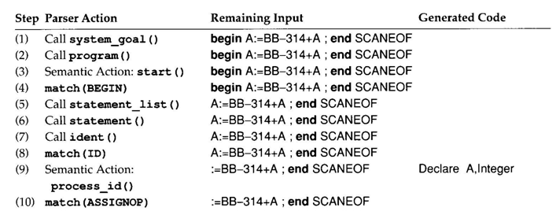
Tracing Example (1)

Slide 50
Tracing Example (2)

Slide 51
Tracing Example (3)

Slide 52
Tracing Example (4)

Slide 53
Tracing Example (5)

Slide 54
Tracing Example (6)

Slide 55
Tracing Example (7)

Slide 56
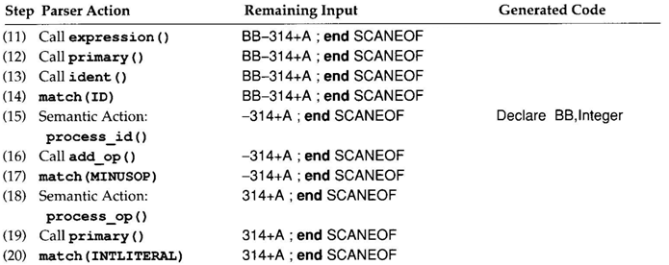
Tracing Example (8)

Slide 57
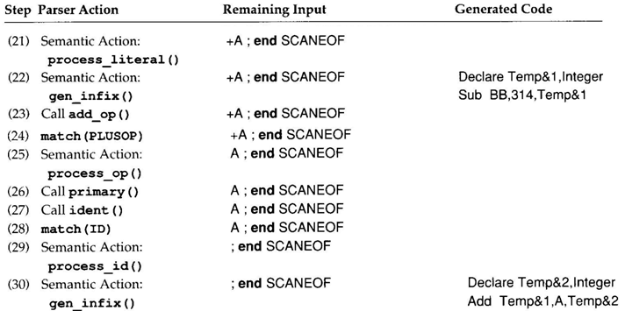
Tracing Example (9)

Slide 58
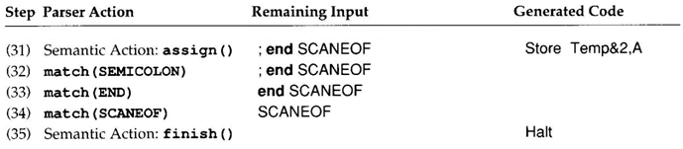
Tracing Example (10)

Slide 59
Any Questions?

