Slide 1
CSC4180 – Compiler Construction
Prof. Yeh-Ching Chung
School of Data Science
Chinese University of Hong Kong, Shenzhen

Slide 2
Outlines
Symbol Tables
Construct a symbol table
Block-structured language and scope
Basic implementation techniques
Advanced features
Declaration Processing
Variable and type declarations
Function declarations
Type Checking

Slide 3
Symbol Table
A database of the declared names
Attributes associated with a name
Class: type, variable, function, label
Type: int, float, double, array, boolean, struct
Scope
Memory address (for code gen)
Access attributes (for code gen)
Attributes are collected when a name is declared
Attributes are checked when the names are used in statements

Slide 4
Variable Declaration (1)
Function_decl
Type
ID
Para_list
Block
Decl_list
Stmt_list
Symbol
table
Semantic check
Storage
allocation,
Offset computing

Slide 5
Variable Declaration (2)
An example
Int f (float h1, float h2, float h3)
void g(int a)
{
int w,x;
{
float, x,z[100][10];
f(x,w,z);
}
}
Symbol number | Symbol name | Attributes
1 | f | Int function (float, float, float)
2 | g | void function (int)
3 | w | int
4 | x | int
5 | x | float
6 | z | float; array; two dimensional; 1000w
7 | a | int

Slide 6
Static Scoping
Programming languages use scopes to confine a symbol in region
Scopes may be nested
A name is usually associated with its closest containing scope
Variables, types, functions may be declared in a scope
A name usually can be declared only once in a scope (overloading is an exception)
C is a flat language in that it does not allow functions to be declared in another function. (Pascal, ML allow this)

Slide 7
A Symbol Table Interface
OpenScope()
Open a new scope
CloseScope()
Close the current scope, and revert to a previous scope
EnterSymbol(name, type)
Enter the newly declared name into the symbol table for the current scope with the type info
RetriveSymbol(name)
DeclaredLocally(name)?

Slide 8
Block Structured Languages and Scopes
Visibility rules
At any point in the text of a program, the accessible names are those that are declared in the current scope and in all other open scopes
If a name is declared in more than one open scope, then a reference to the name is resolved to the innermost declaration
New declarations can be made only in the current scope

Slide 9
Scope Rules Example (1)
A
Open scope
B
Open scope
You are here
C
Closed scope
D
Current scope
E

Slide 10
Scope Rules Example (2)
1 Closed
2 Closed
You are here
3 Open
4 Closed
5 Current
6 Closed
7 Closed

Slide 11
Scope Rules in C
Global variables, local variables, formal parameters
Example:
int i, j, k;
int f1(int a, int j)
{
float k;
while (a < 1)
{ int k;
i= j + k; }
}
Scope 0 → i, j, k
Scope 1 → a, j, k
Scope 2 → k
Which scope is f1 in?

Slide 12
Symbol Table Organization (1)
A single symbol table implementation
The pair <name, scope #> should be unique
To close a scope is more expensive
A
i, j, k
i(2)
j(1)
i(1)
B
i, l, m
k(2)
k(1)
C
i, k, n
n(2)
Q: where are B’s names (i, l, m)?

Slide 13
Symbol Table Organization (2)
Multiple Symbol Table Implementation
Push a new table when a new scope is entered
Pop a symbol table when a scope is closed
i, k, n
A
i, j, k
i, j, k
B
Each scope has its own table
i, l, m
C
i, k, n
Scope Stack

Slide 14
Many Small Table vs. One Big Table
Many small table | One Big Table
Simpler | More complicated (how to locate all names in a scope)
Slower search (for global or undefined variables) | Faster search
Less efficient storage usage (no sharing among small tables) | Efficient storage usage (but needs to store scope #)
Hash table or search trees | Hash table only
Good for keeping symbol tables of closed scopes | Good for 1-pass compilers (entries may be discarded after a scope is closed)

Slide 15
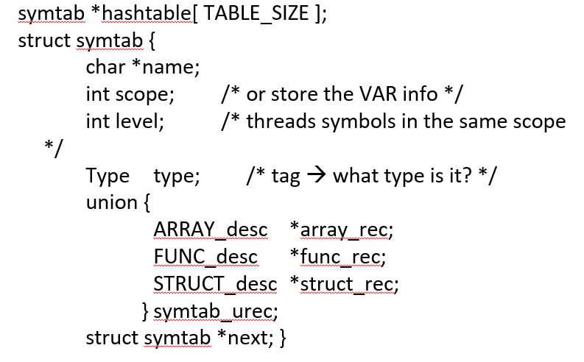
Symbol Table Example (1)

Slide 16
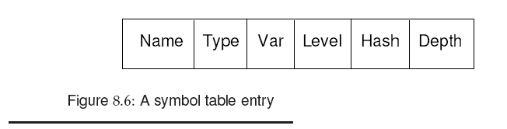
Symbol Table Example (2)
symtab *hashtable[ TABLE_SIZE ];
struct symtab {
char *name;
int scope; /* or store the VAR info */
int level; /* threads symbols in the same scope */
Type type; /* tag → what type is it? */
union {
ARRAY_desc *array_rec;
FUNC_desc *func_rec;
STRUCT_desc *struct_rec;
} symtab_urec;
struct symtab *next; }

Slide 17
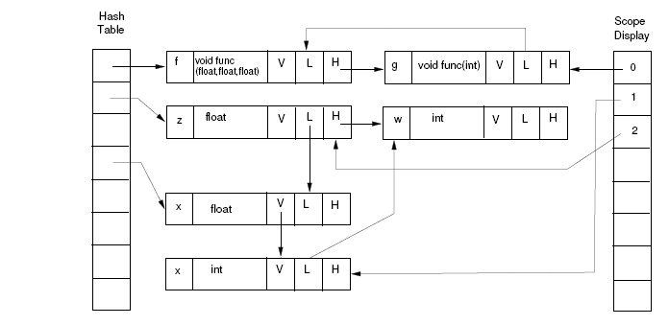
Symbol Table Example (3)
A symbol table entry

Slide 18
Basic Implementation Techniques
Unordered list
Ordered list
Binary search
Binary search tree
Hash tables
Constant time search
Most commonly used
Conflicts resolution: chaining is commonly used
What is a good Hash function ?
In early years, V % P, P is a prime number, e.g. 31,61,127,257,509,1021,…

Slide 19
Quick Review
Symbol table implementation
Scope handling
Unified big table
Multiple private small tables
Basic table organization
Scalable table organization

Slide 20
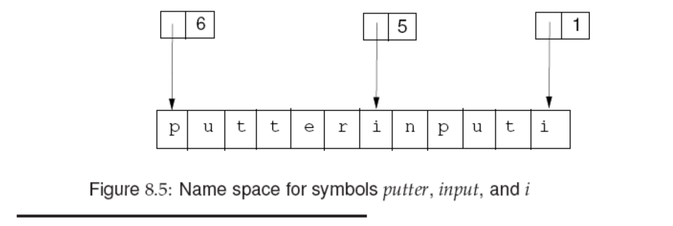
Name Space
Should we store the identifier’s name in the symbol table?
Name length differ significantly, space is wasted if space of max size is reserved
Solution
Store the identifiers in a name space, and store the index and its length in the symbol table.

Slide 21
Segmented Name Space Index
Segmented name space
String table can be a collection of fixed size string segments, dynamically allocated
Index length
Selector = index div slength
Offset = index mod slength
slength is the length of each seqment
seg 0
seg 1
length
selector
name
offset
seg n

Slide 22
Semantic Record in Parser.y Layout
%{
C declarations
%}
Yacc/Bison declarations
%%
Grammar rules (including action routines)
%%
Additional C code

Slide 23
Parser.y Layout
%union {
int num;
char* lexeme; …}
%token <lexeme> ID
%token <num> const
%type <num> expr term
%%
expr : expr ‘+’ term
%%
int eval (char c, int a,b) {}

Slide 24
Setup Token Attributes (1)
Step 1, define the %union in parser.y
Step 2, modify the lexer.l to pass token attributes to the parser
In lexer.l, insert code as follows:
Name Space?
{ID} {yylval.lexeme = strdup(yytext); return ID; }
{int_constant} {yylval.value = atoi(yytext); …}
But constants can be integer constants, float point constants, and string constants.
How to handle constants other than integers ?

Slide 25
Setup Token Attributes (2)
Example
%union {
char* lexeme;
Const_Type *const_rec;
TYPE type; /* general semantic rec type */
int intval; /* evaluate const exp */
List *list; /* handle all lists */
ArrayInfo *arr_info;
VarRef *var_ref;
…. }
Token attribute type
%token <lexeme> ID
%token <const_rec> CONST
Typedef struct {
C_type ctype;
Union {
int intval;
double fval;
char *sc; } const_u;
} Const_Type;

Slide 26
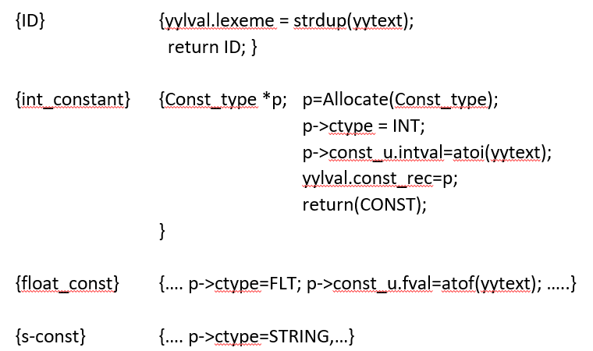
Setup Token Attributes (3)
In lexer.l, insert code as follows

Slide 27
Scope Implementation in 1-Pass
funct_decl → type ID ( param_list ) { block }
Inserting actions:
funct_decl → type ID ( {scope++;}
param_list )
{EnterSymbolparam($5);
EnterSymbolfunc($1,$2,$5);}
{ block } {scope--}
Stmt → ( block )
stmt → ( {scope++;} block ) {scope--;}
1
2
3
4
5
6
Scope = 0

Slide 28
Extensions
Fields and Records
Struct A {
int a, b;
float c;
double d;
char e;
}
Two possible implementations
Allocate a symbol table for each struct
Each struct is assigned a unique number.
Each field name is stored in the global table associated with its struct number

Slide 29
Scope of Struct Type
Struct S {
Struct T
{ int a;
int b; } x;
double z1, z2, z3;
Struct T y;
}
Struct T xyz;
Struct S {
Struct S next;
int a;…}
Struct S {
Struct S {int a;int b;} x;…
Struct S {
int a;
Struct S *next;…
illegal!
illegal!
OK in C!
But not in C++
Innermost containing block
OK!

Slide 30
Handling Array Declaration in 1-Pass
Var_list : id
| Var_list ‘,’ id
| id dim_decl
| Var_list ‘,’ id dim_decl
Adding action routines:
Var_list : Var_list ‘,’ id dim_decl
{ addtype($3, scope, current_type, $4);}
| id dim_decl
{ addtype($1, scope, current_type, $2);}
dim_decl : ‘ [‘ cexpr ‘]’ | dim_decl ‘[‘ cexpr ‘]’ {get dim info}
cexpr means constant expressions
For each array declaration, we need to record the number of dimensions and the size of each dimension.
A[3x5+6]
cexpr

Slide 31
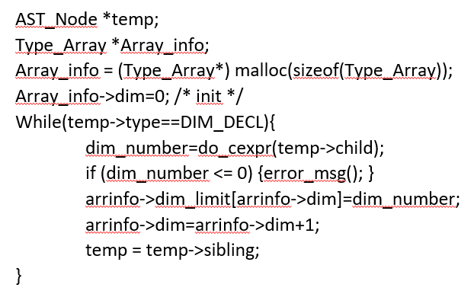
Handle Array Declarations in AST
Var_list : id dim_decl
| Var_list ‘,’ id dim_decl
Attributes collection during AST tree walk

Slide 32
Attribute Collection in Parser (1)
Example: Array Declaration
%type <num> cexpr
%type <dim_rec> dim_decl
dim_decl : ‘[‘ cexpr ‘]’
{$$->n =1; $$->dimsize[0]=$2}
| dim_decl ‘[‘ cexpr ‘]’
{$$->n = i = $1->n +1; $$->dimsize[i]=$2}
cexpr : cexpr ‘+’ cexpr {$$ = $1 + $3}
| cexpr ‘*’ cexpr {$$ = $1 * $3}

Slide 33
Attribute Collection in Parser (2)
dim_decl : ‘[‘ cexpr ‘]’
{$$->n =1; $$->dimsize[0]=$2}
| dim_decl ‘[‘ cexpr ‘]’
{$$->n = i = $1->n +1; $$->dimsize[i]=$2}
float ABC [100][200][30];
[
dim_decl
{1, [100]}
ID
ABC
float

Slide 34
Attribute Collection in Parser (3)
dim_decl : ‘[‘ cexpr ‘]’
{$$->n =1; $$->dimsize[0]=$2}
| dim_decl ‘[‘ cexpr ‘]’
{$$->n = i = $1->n +1; $$->dimsize[i]=$2}
float ABC [100][200][30];
[
[
dim_decl
{1, [100]}
dim_decl
{2, [100,200]}
ID
ABC
ID
ABC
float
float

Slide 35
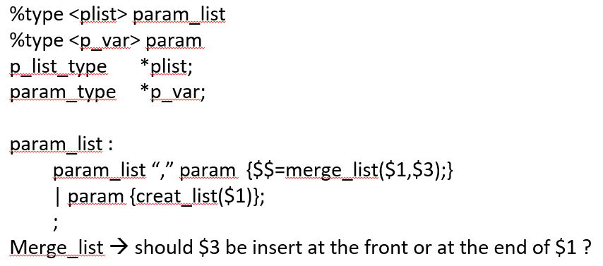
Building a List (e.g. parameters)

Slide 36
Overloading
Same symbols may mean more than one thing
In Pascal, the same identifier can denote the name of a function and its return value f := f(0,1) + 1;
f on the left-hand side denotes the return variable
f on the right-hand side denote the function call
In Ada, the name of a procedure, function, operator can be overloaded
The symbol table must provide all the possible meanings of a name
The key is to link together all possible definitions

Slide 37
Forward References (1)
Handling forward references
There is a risk that a forward reference to a name may be resolved to a non-local definition
Example:
type T = integer;
procedure foo;
type P = ^T;
T = real;
P should be a pointer to real, but it is easy to incorrectly interpret P as a pointer to integer

Slide 38
Forward References (2)
The above problem can be resolved by chaining together all references to a pointer to type T until the end of the type section is reached
All type names can then be looked up and resolved
Forward references to labels in goto statemetns can also be resolved in a similar way
Once the label address is known, we can back filled the branch/jump instruction
In Pascal, labels must be declared before they can be defined
If unrestricted forward references are allowed, the only way to handle them is to make more than one pass over the program

Slide 39
Type Checking
Type checking makes sure the source program follows semantic rules
Examples of type checking
An object is defined exactly once
An operator is applied to compatible operands
De-referencing is applied only to a pointer
Indexing is done only on array objects
Function is called with the correct number and type of arguments

Slide 40
Static and Dynamic Type Checking
Static type check
Type checking done at compile time
Dynamic type check
Type checking done at run time
Runtime objects have tags
A strongly typed language eliminates the need for dynamic checking of types
Some type checking can only be performed at runtime
Array index for array [0..255] of integer

Slide 41
Type Checking of Expressions (AST)
CheckExpr (AST_Node* exprnode)
{
AST_node* leftop = exprNode->child;
AST_node* rightop = leftop->rightSibling;
if (leftop->datatype != rightop->datatype)
Error….
}
But how do we know the type of each sub-expression ?
a) recursive traverse down
b) bottom up traverse to compute synthesized attributes

Slide 42
Type Conversion
Implicit type conversions called coercions
In assignments
In expression evaluation
In parameter passing
In function return
Coercion is often a symptom of weak typing
Explicit type conversions are performed by programmers such as type casting

Slide 43
Type Expression
Integer is a basic type
Array (1..100) of integer is a type expression
Struct { integer a; float b;} is a type expression
Integer is a type expression
int f(integer a; float b;} is a type expression
struct S { integer a[100][200];
float *b;
struct { integer a; float c;} d;
}
is a type expression

Slide 44
Equivalence of Type Expressions (1)
Name Equivalence
Two variables have the same type if they have the same associated type expressions
Structural Equivalence
Two variables have the same type if their associated type expressions are structurally equivalent, i.e., two type expressions are either the same basic type, or are formed by applying the same constructor to structurally equivalent types

Slide 45
Equivalence of Type Expressions (2)
A, B : array (1..100) of integer;
C, D : array (1..100) of integer;
A and B are of the same type, C and D are of the same type, but the two types A and C may be incompatible
Ada, Pascal, Modula-2 are using this name equivalence rule
Algol68 uses structural equivalence rule, so A,B,C,D are equivalent
C uses name equivalence for structs and unions, and structural equivalence for arrays

Slide 46
Equivalence of Type Expressions (3)
A, B : array (1..100) of integer;
C, D : array (1..100) of integer;
A and B are of the same type, C and D are of the same type, but the two types may be incompatible.
Question:
The two type expressions are actually identical. Why is A not compatible with C?
Answer:
They are not the same name (implicit name for type expression)

Slide 47
Equivalence of Type Expressions (4)
Modern languages tend to use name equivalence rules, because
Type comparison is just a comparison of pointers
Programmers can get full benefit of type checking
Useful for type-inferred aliasing analysis – less possible aliasing
It is hard (time consuming) to implement structural equivalence

Slide 48
C Type Equivalence Test (1)
Char *p, *q;
Short j;
Short int k;
Int a[100], b[200], c[100];
Int d[]; /* as in function parameter list or extern */
The types of p and q are the same?
The types of j and k are the same?
The types of a and b are different?
The types of a and c are the same?
The types of a and d are the same?
T
F
T
T
F

Slide 49
C Type Equivalence Test (2)
Struct {int a,b;} x, y;
Struct S {int a,b;} w;
Typedef Struct S T1,T2;
Struct S u;
T1 z;
T2 zz;
Q1: x, y and w are compatible T or F
Q2: z, zz and u are compatible T or F
F
T

Slide 50
C Type Equivalence Test (3)
Struct {int a,b;} x, y;
Struct S {int a,b;} w;
Typedef int A[3];
A B[10];
Int C[10][3];
x = w;
C = B;
No
No

Slide 51
Implicit Conversion of Constants
Assume that X is an array of float
In the following For loop
for (I=0; I< n; I++)
X(I) = 1;
the compiler can automatically convert it to float point constant with no runtime cvt operations
for (I=0; I< n; I++)
X(I) = 1.0;
This speeds up the loop by 9 times
(some machines are slower on fp-int conversions)

Slide 52
Overloading (1)
An overloaded symbol is one that has different meanings depending on its context
Arithmetic operators +, -, *, and /
The key to handle overloaded names in the symbol table is to link together all possible definitions
Overloading is resolved when a unique meaning can be determined
function “+” (x,y: complex) return complex
function “+” (x,y: integer ) return complex
function “+” (x,y: integer ) return integer
x, y: complex then x+y is not ambiguous
but what if x and y are integers?

Slide 53
Overloading (2)
function “+” (x,y: complex) return complex
function “+” (x,y: integer ) return complex
function “+” (x,y: integer ) return integer
R = A + B + C what is the type of R if A, B, C are integer?
R = (A+B) + (C+D) what are the types for (A+B) and (C+D) if
A,B,C,D are integer?
Ada requires a complete expression to have a unique type
We can use the unique type information to narrow down the type choices for each subexpression

Slide 54
Type Inferred Aliasing Analysis
{
a = f(x);
*p = b;
c = a + c;
}
Can we reuse a ?
Can we schedule the load of c ahead of the store of *p?
Register Allocation
Code Scheduling
Yes, if data type of *p is different from a and c

Slide 55
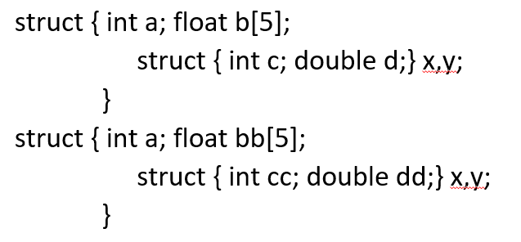
How to Tell if Two Type Expressions Are Identical (1)
Are these two type expressions identical?
They are structural equivalent, not name equivalent

Slide 56
How to Tell if Two Type Expressions Are Identical (2)
If structural equivalence is used?
A fast encoding would fail to tell if they are equivalent
A more expensive recursive algorithm must be used
struct { int a; float b[5];
struct { int c; struct {.. Int k[3] …} w;} x, y;}
struct { int a; float bb[5];
struct { int cc; struct {.. Int k[4] …} z;} x, y;}

Slide 57
Efficient Test for Structural Inequivalence
Type expressions can be encoded as an integer value. A simple integer comparison can tell structural inequivalence immediately
Basic types: boolean: 0, char 1, integer 2, real 3
Type constructors: pointer 1, array 2, freturns 3
Type expressions
char 0 0 0 1
freturn(char) 0 0 3 1
pointer(freturn(char)) 0 1 3 1
array(pointer(freturn(char))) 2 1 3 1

Slide 58
How to Tell If Two Expressions Are Identical
x = (A+B*C);
…….
y = (A + B*C);
Are these two expressions identical?
Do they generate the same value?

Slide 59
DAG for Expressions
A Directed Acyclic Graph (DAG) for an expression identifies the common sub-expressions (CSE) in the expression
For expression A+(B*C) + (B*C*A) - B
Tree
DAG
-
-
+
B
+
+
*
*
+
A
*
*
A
*
A
B
C
B
C
B
C

Slide 60
Value Numbering (1)
Suppose each node is stored in an array, and is referenced by its index (called value number)
The signature of an operator node be a triple <op,l,r> consisting of its label op, left child l, and right child, r.
Search the array for a node m with <op,l,r>, if found, return m, else create a new node.
1
2
3
4
5
id | Pointer to symtab
num | 10
+ | 1 | 2
:= | 1 | 3
…
I := I+10

Slide 61
Value Numbering (2)
An efficient way to search for <op, l, r> is to use hashing
All nodes are kept in k lists, called buckets
A hash function compute the number of bucket from the signature <op, l, r>.

Slide 62
Example
(A+B*C) – D *(A+B*C)
Assume A,B,C are stored in entry 4,5,6.
B*C is stored in entry 15
A+B*C is in entry 16
when the 2nd A+B*C is processed, we will search for <*,5,6> first, then <+,4,15>
15 <*,5,6>
16 <+,4,15>

