Slide 1
Introduction to Compilers
編譯器理論與實作
  Wei Chung Hsu
  徐慰中
Department of Computer Science and Information Engineering

Slide 2






Course Information
My Compiler Background:
  Compiler (code scheduler) development for Cray XMP/YMP, Cray-2, and Cray-3 supercomputers.
  Tech lead of Hewlett-Packard CLL lab, for the optimizing compilers of HP-7200, HP-8000 processors
  Compiler architect for Intel/HP Itanium (IA-64) Merced and McKinley processors
  Binary Translation/Optimization for Itanium, Sun SPARC, x86, MIPS and ARM processors
  Finalizer for HSAIL (HSA Intermediate Language)
  RDC Specialized Compiler
  ITRI AI Compilers
Department of Computer Science and Engineering

Slide 3

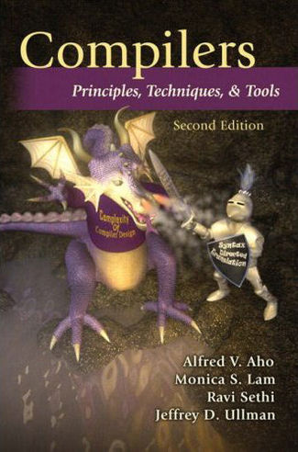
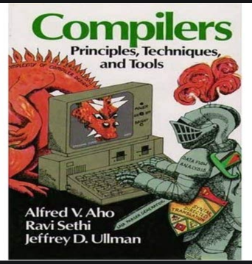
  Text Book:
  C.N. Fischer, R.K. Cytron, and R.J. LeBlanc, Jr.,
  "Crafting a Compiler", 2010
  Reference book:
  A.V. Aho, M. Lam, R. Sethi, and J.D. Ullman “Compilers: Principles, Techniques and Tools”
  the Dragon book, 2nd edition, 2007
  (1st edition was in 1986)
  Instructor Office Hours:
    Thursday 10-12, room 313
  email address: hsuwc@csie.ntu.edu.tw
  TA: 塗大為 (b07902024@ntu.edu.tw)
Department of Computer Science and Engineering
Notes:
CNF Chomsky Normal Form
Red dragon turned into purple, and with a pair of wings
Becomes even more scary!

Slide 4
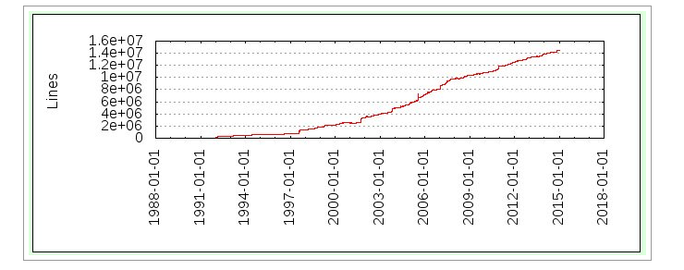
GCC (4.9) Soars Past 14.5 M Lines Of Code
(latest GCC 10.1, 13.6M LOC)
System Software Dragons
Linux kernel (4.1) is over 22M Lines Of Code
(latest Linux 5.8, 27.4M LOC)
Department of Computer Science and Engineering
Notes:
If you lack of SW development experience, you need to get help – open source SW community, senior students, TA,…
GCC is now 10.1 (2020/09) Linux 5.8 (2020/09)
LLVM is about 1.6M

Slide 5

Grading:
    Homework and Compiler Implementation: 40%
    Midterm Exam: 20% (take-home)
    Final Exam: 20% (in-class)
    Peer evaluation (x%)
    Quizzes and Class Participation (y%)
Compiler Implementation Projects
    Two compilers: a simple one and a baby dragon
    Team of two
    In C or C++
    Details: visit the class website (Ceiba)
Department of Computer Science and Engineering
Notes:
Exams are open books/open notes/open google
Compile a high level language to RISC-V code

Slide 6
Introduction to Compilers 課綱
Week 1 | 9/17 | 1) Course Organization, 2) Chapter 1: Introduction
Week 2 | 9/24 | 1) Chapter 2: A Simple Compiler (Homework: A Simple AC-to-DC Compiler)
Week 3 | 10/1 | Holiday
Week 4 | 10/8 | Chapter 3: Scanner
Week 5 | 10/15 | Quiz1 (Chapter 1-3) (HW A C–/RISC-V Compiler CheckPoint#1: A Scanner) Chapter 4: Grammar and Parsing
Week 6 | 10/22 | Chapter 5: Top-Down Parsing
Week 7 | 10/29 | Chapter 6: Bottom-up Parsing (HW CheckPoint#2: A Parser) Quiz2 (Chapter 4-6)
Week 8 | 11/5 | Chapter 7: Syntax Directed Translation (HW CheckPoint#3: A Type Checker)
Week 9 | 11/12 | Midterm Exam (Take Home) Chapter 12: Runtime Support
Week 10 | 11/19 | Chapter 8: Declaration Processing and Symbol Table
Week 11 | 11/26 | Chapter 9: Semantic Analysis
Week 12 | 12/3 | Code Generation for RISC-V (HW CheckPoint#4: Code Generation I)
Week 13 | 12/10 | Code Generation for Data Accesses and Simple Register Allocation
Week 14 | 12/17 | Code Generation for Control Structures (HW CheckPoint#5: Code Generation II)
Week 15 | 12/24 | Code Generation for Arrays, Procedure Calls
Week 16 | 12/31 | Basic Code Optimizations: CSE, Register Allocation, and Code Scheduling
Week 17 | 1/7 | Advanced Optimization: Parallelization, GPGPU optimization, Vectorization, Memory Hierarchy related optimization, DNN optimization…
Department of Computer Science and Engineering

Slide 7
Introduction to Compilers課綱
Introduction and Overview of a Simple compiler
Week 1 | 9/17 | Introduction
Week 2 | 9/24
Week 3 | 10/1 | Chapter 3: Scanner
Week 4 | 10/8 | Quiz1 (Chapter 1-3) (Project: A C– Compiler CheckPoint#1: A Scanner) Chapter 4: Grammar and Parsing
Week 5 | 10/15 | Chapter 5: Top-Down Parsing
Week 6 | 10/22 | Chapter 6: Bottom-up Parsing (CheckPoint#2: A Parser) Quiz2 (Chapter 4-6)
Week 7 | 10/29
Week 8 | 11/5 | Chapter 7: Syntax Directed Translation (CheckPoint#3: A Type Checker)
Week 9 | 11/12 | Chapter 12: Runtime Support
Week 10 | 11/19 | Chapter 8: Declaration Processing and Symbol Table
Week 11 | 11/26 | Chapter 9: Semantic Analysis
Week 12 | 2/3 | Code Generation for ARMV8 (CheckPoint#4: Code Generation I)
Week 13 | 12/10 | Code Generation for Data Accesses and Simple Register Allocation
Week 14 | 12/17 | Code Generation for Control Structures (CheckPoint#5: Code Generation II)
Week 15 | 12/24 | Basic Code Optimizations: CSE, Register Allocation, and Code Scheduling
Week 16 | 12/31 | Advanced Optimization: Parallelization, GPGPU optimization
Week 17 | 1/7 | Advanced Optimization: Vectorization, Memory Hierarchy related optimization, …
Scanner
Parser
Type Checker (Semantic Analyzer)
Code Generation
Compiler Optimizations
Department of Computer Science and Engineering
Notes:
If you only like to know the rough concept of a compiler, you may quit after two weeks

Slide 8

Ch 1: Introduction
What is a compiler? (original meaning)
  A compiler reads a program written in the source language and translate it into an equivalent program in machine language.
Source
Program
(in high level lang.)
Compiler
Machine Language (or object code)
Automatic translation +
optimization
Error messages
Department of Computer Science and Engineering
Notes:
ML: Machine Language

Slide 9
  Fallacy: Code in assembly language to obtain the highest performance
  Modern compilers are very sophisticated, and can generate code competitive to hand crafted code.
  Compilers are very patient in conduct register allocation and code scheduling. Such optimizations by hand are error prone.
  To achieve highest performance, an assembly coder must have a deep understanding of the underlying processor architecture. The compiler code generators usually have the best knowledge of the processor architecture.
  Productivity, maintainability, portability, ease of debugging, code reusability all favor High Level Languages
  Scalability
Department of Computer Science and Engineering
Notes:
HLL is for Sissy, real man coded in assembly

Slide 10
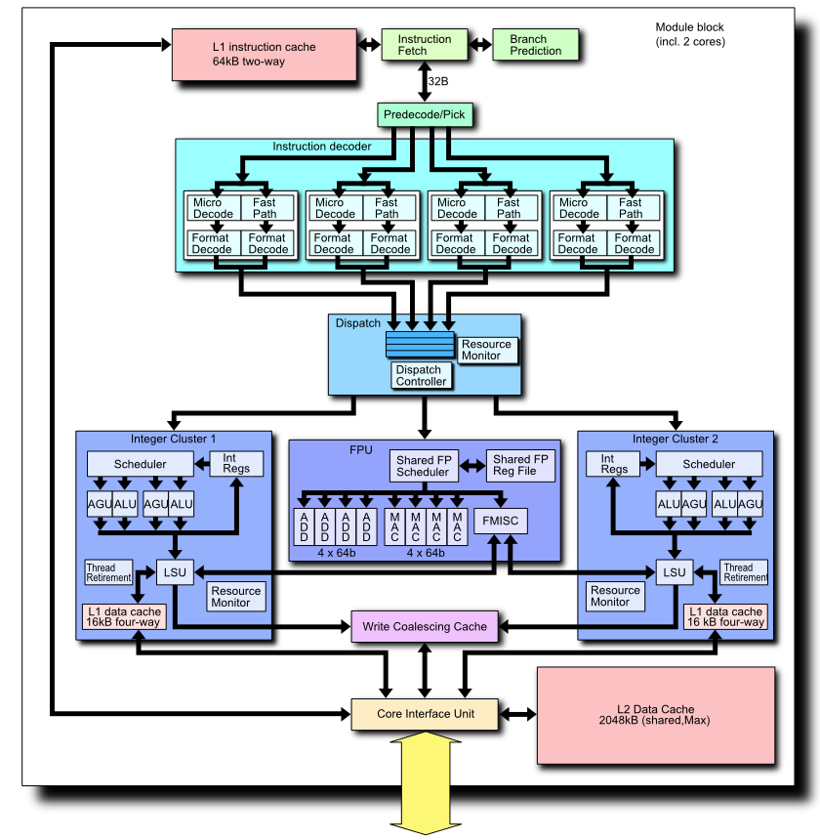
Micro-architectures are getting increasingly more complex, writing assembly code to obtain high performance is no longer a manageable task.
Micro-architectures are company IP, for example, Intel would not give out all details of x86 micro-architectures.
For dynamic, OOO processors, it is hard for a programmer to know how to write a high performance code. Should leave this job to compiler/experts.
Department of Computer Science and Engineering

Slide 11
SIMD/
SMP
Micro-architectures are getting increasingly more complex, writing assembly code to obtain high performance is no longer a manageable task.
Micro-architectures are company IP, for example, Intel would not give out all details of x86 micro-architectures.
For dynamic, OOO processors, it is hard for a programmer to know how to write a high performance code. Should leave this job to compiler/experts.
DSP
NPU/VPU
AI acc
GPU
HSA
FPGA
VHDL to RTL
/Silicon compiler
Department of Computer Science and Engineering
Notes:
iPhone11 A13 is a typical heterogeneous computing system: BigLittle CPU 2X, 4x, GPU, 8core NPU

Slide 12
What Do Compilers Do?
Source language:
  High-level programming languages,
  Text-formatting languages, (e.g. LaTex)
  Logic-level specification languages (e.g. HDL)
  Application binaries (e.g. x86/ARM)
  DataBase Query Languages
  AI/ML programming platforms
Target language:
  Machine Languages, Other high-level PL,
  Typesetting commands,
  VLSI layout
  Cross ISAs (for app migration)
  DataBase Access Methods (or MapReduce)
  AI/ML Accelerator code
  Compiler technology can be broadly applied
Department of Computer Science and Engineering
Notes:
Compiler is important automation Tool (DAC Design Automation)
My UofM compiler class, 23/35 students were hired by MS
Synopsys used to be an EDA company, now very actively recruit compiler students

Slide 13
What is a compiler? (broader meaning)
  A compiler reads a program written in a source language and translate it into an equivalent program in target language.
Compiler
Source
program
Target
Program
Error messages
Compiler is just an Automatic Tool for
Translation and Optimization
Department of Computer Science and Engineering
Notes:
In the past, traditional compiler jobs are not many, but are secure and highly paid.
23/25 students from my class hired by MS, mostly in their compiler team.
Now, you might think no compiler jobs in Taiwan, only MediaTek/Andes may want compiler workers.
To my surprise, Synopsis recruit almost all my MS students in the last two years.

Slide 14
  Compiler technology can be broadly applied
  Silicon Compiler
  Query Compiler
  Source-to-Source Compilers
  Rewriter
  Compiler Compiler
Department of Computer Science and Engineering
Notes:
Compiler is important automation Tool (DAC Design Automation)
Synopsys used to be an EDA company, now very actively recruit compiler students

Slide 15
  Silicon Compiler
  Takes VHDL/Verilog specifications and automatically generates an IC.
  Query Compiler
  Translates SQL queries into relational algebra, and optimized execution plans.
  Source-to-Source Compiler
  e.g. Parallelizer (C to C+OpenMP), Fortran2C
  Rewriter
  e.g. x86 binary editor, executable optimizer
  Compiler Compiler
  Programming tools that create scanner, parser, and code generator from some formal descriptions of a PL and machine
Department of Computer Science and Engineering
Notes:
Compiler is important automation Tool (DAC Design Automation)
Synopsys used to be an EDA company, now very actively recruit compiler students

Slide 16
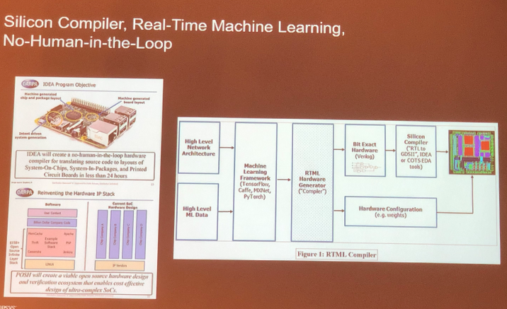
DARPA’s new Vision
Intelligent Design of Electronic Assets (IDEA) program and the
Posh Open Source Hardware (POSH) program enable full automation and apply machine intelligence. The key here is the silicon compiler.
Department of Computer Science and Engineering
Notes:
DARPA: Defense Advanced Research Project Agency
Open Source Hardware (e.g. RISC-V)
A good opportunity for TSMC, one issue is that most libraries TSMC has may not be open source, so there are IP issues

Slide 17
Why Study Compilers?
Influences on programming language design (see section 1.6)
Influences on computer design (see section 1.7)
Compiling techniques are useful for software development
  Parsing techniques are often used
  Learn practical data structures and algorithms
  Basis for many tools such as text formatters, structure editors, silicon compilers, design verification tools, security enforcement…
So you may write more efficient code
  Writing a compiler requires an understanding of almost many important CS subfields
Department of Computer Science and Information Engineering

Slide 18
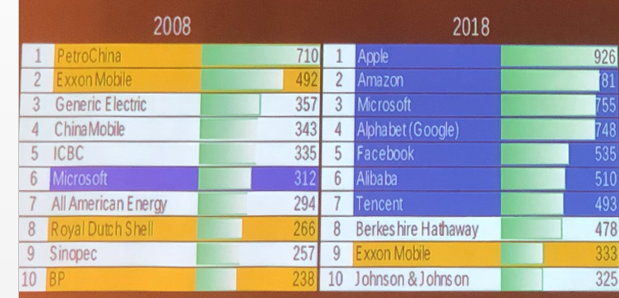
Most Valuable Company from 2008 to 2018
LLVM/Clang
TVM
MS Visual
TensorFlow/XLA
GLOW
  All 5 top companies have invested on compiler efforts
Department of Computer Science and Engineering

Slide 19

2020:
FAANG: Facebook, Apple, Amazon, Netflix, Google
LLVM/Clang
TVM
MS Visual
TensorFlow/XLA
GLOW
Latest:
FATMAAN: FAANG + Tesla, MicroSoft
Department of Computer Science and Engineering

Slide 20
Why Study Compilers?
Influences on programming language design (see section 1.6)
Influences on computer design (see section 1.7)
Compiling techniques are useful for software development
  Parsing techniques are often used
  Learn practical data structures and algorithms
  Basis for many tools such as text formatters, structure editors, silicon compilers, design verification tools,…
So you may write more efficient code
  Writing a compiler requires an understanding of almost many important CS subfields
Requirements for a successful language
Easy to compile
Has a quality compiler on a wide variety of machines
Better code will be generated
Fewer compiler bugs
Compiler is smaller, faster, reliable
Good diagnostic messages and development tools
Department of Computer Science and Information Engineering

Slide 21
Why Study Compilers?
Influences on programming language design (see section 1.6)
Influences on computer design (see section 1.7)
Compiling techniques are useful for software development
  Parsing techniques are often used
  Learn practical data structures and algorithms
  Basis for many tools such as text formatters, structure editors, silicon compilers, design verification tools,…
So you may write more efficient code
  Writing a compiler requires an understanding of almost many important CS subfields
Many machines failed because they are hard to compile/optimize for:
Intel 860
IBM cell
Cray-2
Department of Computer Science and Information Engineering

Slide 22
Why Study Compilers?
Influences on programming language design (see section 1.6)
Influences on computer design (see section 1.7)
Compiling techniques are useful for software development
  Parsing techniques are often used
  Learn practical data structures and algorithms
  Basis for many tools such as text formatters, structure editors, silicon compilers, design verification tools, security enforcement, …
So you may write more efficient code
  Writing a compiler requires an understanding of almost many important CS subfields
programming, data structures and algorithms, automata and formal language, system programming, computer organization.
Department of Computer Science and Information Engineering
Notes:
Wish you are well prepared for this course

Slide 23
Trendy Computer Technologies
Artificial Intelligence/ML/DL
Blockchain
Big Data
Computer Security
Cloud Computing
Heterogeneous Computing
Department of Computer Science and Information Engineering
Notes:
引領風騷2-3 years
For such techniues to reach a critical mass, compilers are needed!

Slide 24
Trendy Computer Technologies
Artificial Intelligence/ML/DL
NNVM/TVM, nGraph, Glow, XLA, DLVM
Blockchain
EVM JIT (Ethereum Virtual Machine)
Big Data
Query Languages to Hadoop and Map/Reduce
Computer Security
CFI (Control Flow Integrity)
Heterogeneous Computing
HSA Finalizer and Runtime
Cloud Computing (Virtualization)
compiling / optimizations are often the key to success
Department of Computer Science and Information Engineering
Notes:
EVM/JIT can impropve performance by 2.5x

Slide 25
Analysis and Synthesis
Two parts to translation/compilation
  Analysis: This part breaks up the source program into pieces for syntax and semantic analysis, e.g. parsing.
  The analysis portion is widely used in many tools.
  Synthesis: This part constructs the desired target program, e.g. code generation.
  The synthesis portion can be very complex, such as the optimizer.
Department of Computer Science and Engineering

Slide 26
Interpreter and Compiler
Interpreter: executes programs without explicitly performing target code generation.
Interpretation often involves large overhead
Interpretation avoids a complex synthesis part.
Interpreter
Output
Source
program
Data
Department of Computer Science and Engineering
Notes:
Interpreter half translation (half breed)

Slide 27
Why Interpretation
  A higher degree of machine independence: high portability.
  Dynamic execution: modification or addition to user programs are allowed (e.g. for interactive debugging).
  Dynamic data type: type of objects may change at runtime (e.g. Javascript)
  Easier to write an interpreter – no synthesis part.
  Better diagnostics: more source text information available
Department of Computer Science and Engineering
Notes:
Interpretation easy to customize
Traditional model: print and distribute
New model: distribute then print

Slide 28
Hybrid Translation
Source program
JIT
Translator
Virtual
Machine
Intermediate
Code (bytecode)
Output
Input
Compilation
(javac)
Interpretation
(JVM)
Compilation
(JIT)
Example: A Java Virtual Machine with a JIT
Department of Computer Science and Engineering

Slide 29
  Fallacy: Compilation is always static
  Runtime compilation is increasingly more popular, consider Java JIT, MS .net, Graphics rendering, GPGPU code generation, …
  Runtime compilation allows for more portable applications. (compile then distribute vs. distribute then compile)
  Runtime compilation enables more machine dependent code optimizations.
  Runtime compilation enables adaptive systems (e.g. dispatching OpenCL kernels to a more suitable device)
Department of Computer Science and Engineering
Notes:
Compile time is static
Runtime is dynamic
Compile and distribute vs distribute and compile
Think about news paper – print then distribute, but todays become more like distribute and print
(cache size/issue width/Superscalr or OOO/SIMD lanes/SIMD register length/HSA/ )

Slide 30
Structure of a Compiler
Analysis
Lexical analysis (Linear Analysis) : stream of characters are grouped into tokens
Syntax analysis (Hierarchical Analysis): tokens are grouped hierarchically with collective meaning
Semantic Analysis: ensure the components of a program fit together (type, scope, ..)
Synthesis
Code Generation and Optimization
Department of Computer Science and Engineering
Notes:
Token 單詞
Whether the collection and connection of tokens are syntactically correct or meaningful.

Slide 31
Source
Program
Scanner
Tokens
Parser
Syntactic
Semantic
Routines
(Character
Stream)
Structure
Intermediate
Representation
Symbol and
Attribute
Tables
Optimizer
(Used by all
Phases of
The Compiler)
Code
Generator
The structure of a Syntax-Directed Compiler
Target Machine
Code
Department of Computer Science and Engineering
Department of Computer Science and Engineering
Notes:
GCC Gimple
LLVM IR
Both are three address code

Slide 32
  Syntax-Directed Translation
  Translation actions attached to each rule of grammar.
  Parsing is the driver of compilation
  Once a construct is recognized by a grammar rule, a sequence of actions are taken to perform semantic checks, code generation.
  Ideal for single pass compiler design
  In our compiler, parsing, semantic analysis and code generation are separate passes.
Department of Computer Science and Engineering

Slide 33
Lexical Analysis Example
Pay := Base + Rate* 160
Lexical analysis:
characters are grouped into seven tokens:
Pay, Base, Rate are identifiers
:= is assignment symbol
+ and * are operators
160 is a number
Error example:
pay := base + rat@e*160
pay := base + rat^^e*160
→ this error (^^) will be propagated to syntax analysis and reported as a syntax error
Department of Computer Science and Engineering

Slide 34
Syntax Analysis Example
Pay := Base + Rate* 160
The seven tokens are grouped into a parse tree
Assignment stmt
identifier
expression
:=
pay
expression
expression
+
identifier
*
base
Rate
160
Department of Computer Science and Engineering

Slide 35
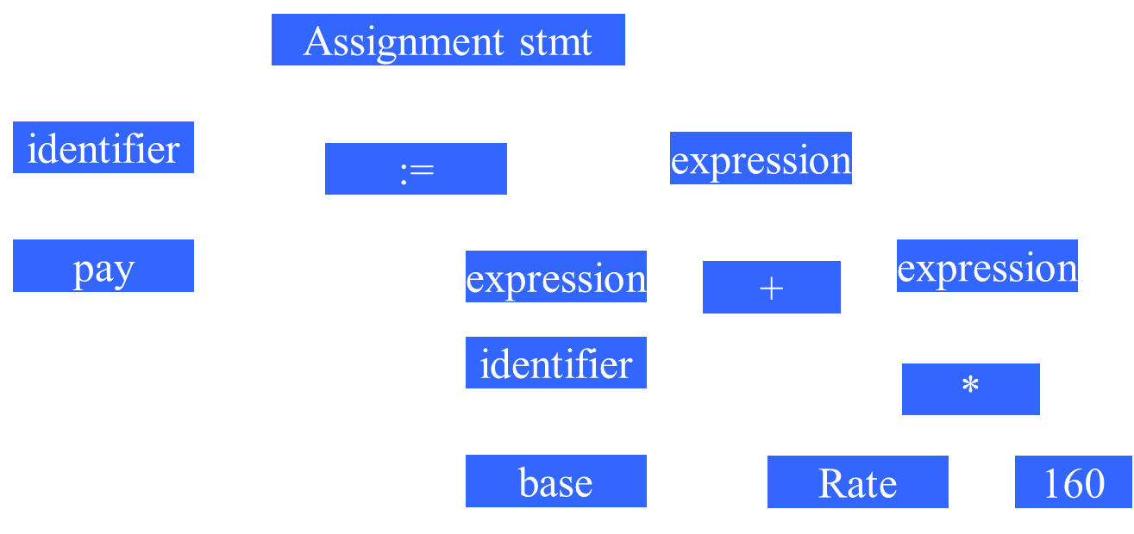
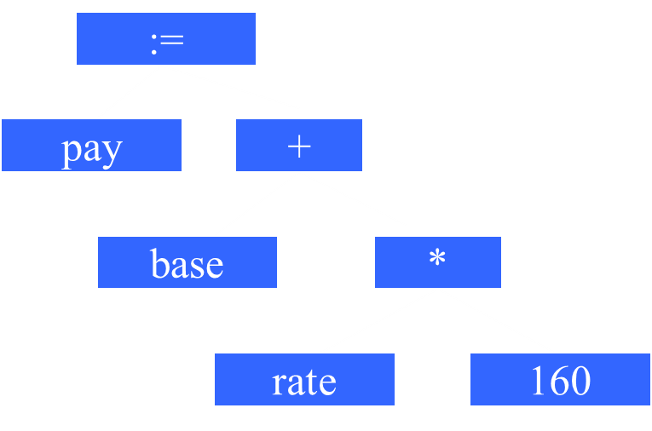
Transform a Parse Tree to a Syntax Tree
Syntax Tree
(also called
Abstract Syntax Tree
AST)
Parse Tree
Department of Computer Science and Engineering

Slide 36
Semantic Analysis Example
Pay := Base + Rate* 160
Checks for semantic errors and gathers type information for code generation.
:=
:=
pay
+
pay
+
base
*
base
*
rate
Int-to-real
rate
160
160
Department of Computer Science and Engineering

Slide 37
The Phases of a Compiler
Source Program
Analysis
Lexical
Syntax
Semantic
IR code gen
Optimizer
Synthesis
Target code gen
Target Program
Department of Computer Science and Engineering

Slide 38
The Phases of a Compiler
Source Program
Lexical
Symbol
Table
manager
Syntax
Error
handler
and
recovery
Semantic
IR code gen
Optimizer
資料庫
Target code gen
監察院?
Target Program
Department of Computer Science and Engineering

Slide 39
The Phases of a Compiler
Source Program
Lexical
Symbol
Table
manager
Syntax
Error
handler
and
recovery
Semantic
IR code gen
Optimizer
Target code gen
Is increasingly more important
Target code Optimizer
Department of Computer Science and Engineering

Slide 40
Source Program
Pay := base + rate * 60
Id1 := Id2 + Id3 * 60
lexical
:=
+
syntax
id1
*
id2
:=
id3
60
semantic
+
id1
*
id2
id3
inttoreal
IR code gen
temp1 = inttoreal(60) temp2 = id3* temp1 temp3 = id2+ temp2 id1 = temp3
60
temp1 = id3* 60.0
id1 = id2+temp1
optimizer
movf id3, fr2;
movf id2, fr1
mulf #60.0, fr2
addf fr2,fr1
movf fr1, id1
target code gen
Target Program
Department of Computer Science and Engineering

Slide 41

Grouping of Compiler Phases
Front end
  Consist of those phases that depend on the source language but largely independent of the target machine.
Back end
  Consist of those phases that are usually target machine dependent such as optimization and code generation.
Department of Computer Science and Engineering

Slide 42
Common Back-end Compiling System
Fortran
C/C++
Pascal
Cobol
Common IR
(e.g. LLVM bc, GCC GENERIC/GIMPLE)
Optimizer
Target Machine Code Gen
Department of Computer Science and Engineering

Slide 43
Retargetable Compiler
C compiler Front-End
IR Code Generation
Machine Independent Optimization
Code gen for
MIPS
Code gen for
IA32
Code gen for
SPARC
Code gen for
PowerPC
Department of Computer Science and Engineering

Slide 44
Without IR
C front-end
X86 backend
Fortran
front-end
ARM backend
Basic
front-end
PPC backend
Pascal
front-end
SPARC backend

Slide 45
With IR
C front-end
X86 backend
Fortran
front-end
ARM backend
IR
Basic
front-end
PPC backend
Pascal
front-end
SPARC backend

Slide 46
LLVM Compiler Infrastructure
Clang
(C/C++/Objective-C)
X86 backend
dragonegg
(GCC tool chain)
(Fortran/Ada/OpenMP/…)
ARM backend
LLVM IR
Others
(Java, C#, Haskell, Ruby, Python, Rust,…)
PPC backend
SPARC backend
LLBT
( Arm, x86, …)

Slide 47
LLVM Compiler Infrastructure
Clang
(C/C++/Objective-C)
X86 backend
dragonegg
(GCC tool chain)
(Fortran/Ada/OpenMP/…)
ARM backend
LLVM
IR
Ind
Opt
Others
(Java, C#, Haskell, Ruby, Python, Rust,…)
PPC backend
SPARC backend
LLBT
( Arm, x86, …)
Notes:
How to quickly port GCC tools to LLVM: IR to IR translation

Slide 48
Quick Overview
What are the two main functions of translation?
  Analysis and Synthesis
What are major work involved in analysis?
  Lexical, Syntax and Semantics analysis
What are the typical phases in a compilation?
  lexical,syntax,semantics,IR-CG,optimization,TargetCG
What phases belong to FE (Front-End)
  Analysis + IR
What phases belong to BE (Back-End)
  Target Code Gen + Machine dependent optimization
How is a JVM/JIT different from an ordinary compiler
  JIT compiles ByteCode (VISA) into native code at runtime
Department of Computer Science and Information Engineering

Slide 49
Compiler and AI
Compiler is AI, it has high intelligence:
  It can correct your syntax errors, ensure correct semantics
  It is an expert in generating highly efficient machine code (e.g. ICC)
Compiler is the key to “SDE” – Software Defined Everything. Retargeting a software for different devices enables SDE.
Machine Learning (ML and DL) need domain specific compilers (such as XLA from Google, TVM from UW and Amazon) to increase performance
Compilers need AI/ML to be more intelligent
  Deep learning to discover most suitable optimizations
  Efficient and effective retargeting to various devices
  Resource allocation and management for heterogeneous systems
  Automate the compiler generation
Department of Computer Science and Information Engineering

Slide 50
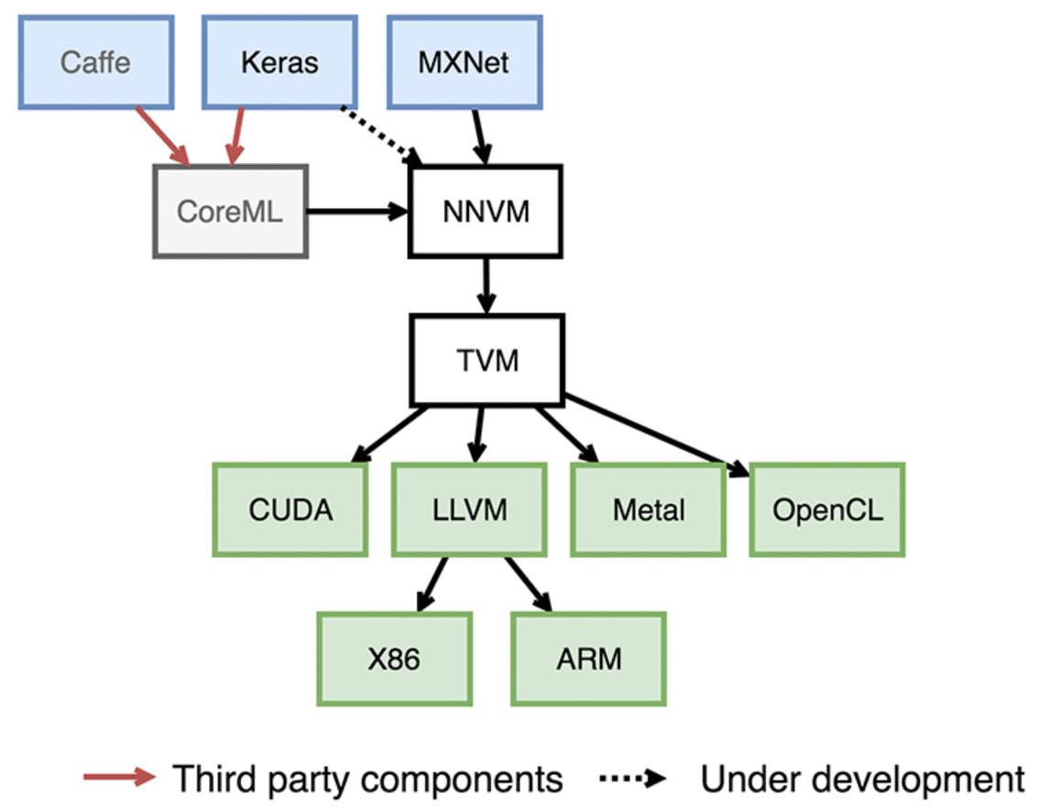
NNVM Compiled Execution Model
Computation Graph IR
Tensor IR
Memory opt, op fusion, kernel merge
Notes:
The goal of NNVM is to represent workloads from different frameworks into standardized computation graphs and then translate these high-level graphs into execution graphs. The computation graph, which is presented in a framework-agnostic format, is inspired from the layer definition in Keras and tensor operators from numpy.
NNVM also ships with routines, called Pass by following the LLVM convention, to manipulate these graphs. These routines either add new attributes into the graph to execute them or modify graphs to improve efficiency.
TVM, which originates from Halide, implements the operators used in computation graphs and optimizes them for target backend hardware. Unlike NNVM, it provides a hardware-independent, domain-specific language to simplify the operator implementation in the tensor index level. TVM also offers scheduling primitives, such as multi-threading, tiling, and caching, to optimize the computation to fully utilize the hardware resources. These schedules are hardware-dependent and can either be hand-coded or it is possible to search optimized schema automatically.

Slide 51
Different AI Compiler Terms
nGraph
Glow
NNVM
XLA
Computational Graph (HLO)
Symbolic Representation
opt
Tensor IR (op level)
nGraph
IR
Linear
Algebra
Node
Tensor
IR
HLO
IR
opt
Lowered Linear Algebra op
Low-level
IR
LIR (Low-Level IR)
LIR (Low-Level IR)
LIR (Low-Level IR)
LIR (Low-Level IR)
LIR (Low-Level IR)
LIR (Low-Level IR)
LLVM IR
LIR (Low-Level IR)
LIR (Low-Level IR)
LLVM IR
LIR (Low-Level IR)
LIR (Low-Level IR)
GPU, FPGA, X86,ARM
GPU, FPGA, X86,ARM
TPU

Slide 52

A Short History of Compiler Construction
1945—1960 Code Generation
How to generate code for a given machine
The goal was to match the efficiency of assembly coding.
1960—1975 Parsing
Many new languages came out. Automatic parsing became more important.
1975—present Code Optimization
ILP: RISC and Post-RISC machines.
Vectorization: SIMD(SSE, GPGPU) Parallelization: Multiprocessors (SMP, MPP)
Heterogeneous Computing: Cuda, OpenCL, HSA
AI / ML / DNN: TPU, VPU, NPU, Eyeriss, Tetris, DCNN
Department of Computer Science and Engineering
Notes:
Google TPU
Intel VPU
MIT DCNN
Stanford Tetris
UCLA DCNN
Intel Movidius is custom built to inference deep neural networks for images, It is powered by Intel Movidius Vision processing Unit which is custom built for Computer Vision.
Intel FPGA alco comes with OPENVINO. OpenCL runtime driver (FPGA RTE for OpenCL) comes with the OpenVINO installation.

Slide 53
A Short History of Compiler Construction
1945—1960 Code Generation
How to generate code for a given machine
The goal was to match the efficiency of assembly coding.
1960—1975 Parsing
Many new languages came out. Automatic parsing
became more important.
1975—present Code Optimization
ILP: RISC and Post-RISC machines.
Vectorization: SIMD(SSE, GPGPU)
Parallelization: Multiprocessors (SMP, MPP)
Heterogeneous Computing: Cuda, OpenCL,HSA
Present to 2050 AI and Compilers
Department of Computer Science and Engineering

Slide 54
Syntax and Semantics
A complete definition of a PL includes specification of its syntax (structure) and semantics (meaning)
Syntax
Syntax is usually defined by CFG (context free grammar)
e.g. A := B+C; is legal, A:=B+; is not.
CFG example:
<exp> → <exp> + identifier
B+C, A+D, A+B+C, … are valid expressions
Semantics
Many important language features such as type
compatibility and scoping rules are context-sensitive.
e.g. A:=B+C; is legal when all variables are declared, are not boolean or structure type, and are type compatible
Department of Computer Science and Engineering

Slide 55
Static Semantics
Static semantics provide a set of rules which syntactically legal programs are actually valid, such as type rules.
e.g.
all identifiers are declared
operator and operands are type compatible
procedures are called with the proper parameters
Attribute grammars are a popular method of formally specifying static semantics.
e.g.
Exp1→Exp2+Term (Exp2.type == numeric && Term.type==numeric).
Department of Computer Science and Engineering

Slide 56
Imprecise Semantics Challenges
Example:
In Pascal, a logical expression
(I <> 0) and (K div I > 10)
is not well-defined – because it is not defined whether the and operator should be treated as ordinary binary operator (both expressions {I<>0} and {K div I} should be evaluated first) or like a short-circuit operator (i.e. expression {K div I} should not be evaluated if I==0).
Why short-circuit is not always a preferred
implementation here ?
Department of Computer Science and Engineering

Slide 57
Another Example:
In Java, all functions must return via a return expr statement.
The following function is illegal:
public static int subr(int b) {
if (b!=0) return b+100; }
How about the following?
public static int subr(int b) {
if (b!=0) return b+100;
else if (10*b == 0) return 1; }
Department of Computer Science and Information Engineering

Slide 58
Compiler Constructions Tools
First Fortran compiler took 18 person-years. Now with compiler construction tools, you may build a simple compiler in one semester.
Translator writing tools:
  Scanner generator
  Parser generator
  Symbol table manager
  Attribute grammar evaluator
  Automatic code generator
  Data flow analyzer generator
Compiler - Compiler
Department of Computer Science and Engineering

Slide 59
Puzzle and Practice
nVidia bought ARM. So ARM is also USA technology now. Both x86 and ARM are under USA control, so China must rely on RISC-V to avoid CPU control from USA.
Q: How to create the first C compiler on the RISC-V machine?
Requirements:
1) the compiler must generates RISC-V code
2) the compiler must run on RISC-V machines
Department of Computer Science and Engineering

Slide 60
Q: How to create the first C compiler on the Itanium machine?
a) Write a C compiler in C, compiled it on RISC-V machines using GCC.
b) Write a C compiler in RISC-V machine code
c) Develop a Cross-compiler on x86 PC and use it to compile itself into C/RISC-V.
d) Leave it to MicroSoft or Google
Department of Computer Science and Engineering

Slide 61
Cross-Compilation
A C Compiler
Written in C
Generates
RISC-V code
GCC compiler
on PC
Step 1
A C Compiler
Gen RISC-V code
Runs on x86
C Compiler
Gen RISC-V code
Runs on RISC-V
Step 2
Department of Computer Science and Engineering

Slide 62
Cross-Compilation and Bootstrapping
Quiz: How to create the first C compiler on the new RISC-V machine if no cross-compilers to be used?
Department of Computer Science and Engineering

Slide 63
Answer: Bootstrapping.
A subset of C is selected (e.g. C--) and a simple compiler is written in RISC-V assembly code, called this compiler C0.
Rewrite this subset compiler using the subset (C--), compile it with C0, get a new compiler called C1.
Write a more complete set of C in C--, compiled with C1, get a new compiler C2
Repeat the process until a complete C compiler is done
Department of Computer Science and Engineering

Slide 64
Summary
What is a compiler
Why is compiling technique important
Three phases of analysis
Phases of a compiler
Grouping of phases
Compiler construction tools
Department of Computer Science and Engineering

