Slide 1
Chapter 5
Top-Down Parsing
Department of Computer Science

Slide 2
Left-most derivation
  denoted by ⇒_{lm} , ⇒+ _{lm} , ⇒∗ _{lm}
example of leftmost derivation of b(c+c)
E→Prefix(E)
E→c Tail
Prefix→b
Prefix→λ
Tail→+Ε
Tail→ λ
E⇒ _{lm} Prefix(E)
⇒ _{lm} b(E)
⇒ _{lm} b(c Tail)
⇒ _{lm} b(c+E)
⇒ _{lm} b(c+c Tail)
⇒ _{lm} b(c+c)
G₀
Top-down parsing is to come up with a leftmost derivation.
Department of Computer Science

Slide 3
Input buffer
Parse
Stack
LL Parsing Driver
LL Parsing Table
Department of Computer Science

Slide 4
1 E→Prefix(E)
2 E→c Tail
3 Prefix→b
4 Prefix→λ
5 Tail→+Ε
6 Tail→ λ
  b(c+c)
Parse
Stack
LL Parsing Driver
 | b | c | ( | ) | +
E | 1 | 2 | 1
Prefix | 3 |  | 4
Tail |  |  |  | 6 | 5
LL Parsing Table
Department of Computer Science

Slide 5
1 E→Prefix(E)
2 E→c Tail
3 Prefix→b
4 Prefix→λ
5 Tail→+Ε
6 Tail→ λ
  b(c+c)
E
LL Parsing Driver
 | b | c | ( | ) | +
E | 1 | 2 | 1
Prefix | 3 |  | 4
Tail |  |  |  | 6 | 5
LL Parsing Table
Department of Computer Science

Slide 6
1 E→Prefix(E)
2 E→c Tail
3 Prefix→b
4 Prefix→λ
5 Tail→+Ε
6 Tail→ λ
  b(c+c)
Prefix
(
LL Parsing Driver
E
)
 | b | c | ( | ) | +
E | 1 | 2 | 1
Prefix | 3 |  | 4
Tail |  |  |  | 6 | 5
LL Parsing Table
Department of Computer Science

Slide 7
1 E→Prefix(E)
2 E→c Tail
3 Prefix→b
4 Prefix→λ
5 Tail→+Ε
6 Tail→ λ
  b(c+c)
b
(
LL Parsing Driver
E
)
 | b | c | ( | ) | +
E | 1 | 2 | 1
Prefix | 3 |  | 4
Tail |  |  |  | 6 | 5
LL Parsing Table
Department of Computer Science

Slide 8
1 E→Prefix(E)
2 E→c Tail
3 Prefix→b
4 Prefix→λ
5 Tail→+Ε
6 Tail→ λ
  c+c)
E
)
LL Parsing Driver
 | b | c | ( | ) | +
E | 1 | 2 | 1
Prefix | 3 |  | 4
Tail |  |  |  | 6 | 5
LL Parsing Table
Department of Computer Science

Slide 9
1 E→Prefix(E)
2 E→c Tail
3 Prefix→b
4 Prefix→λ
5 Tail→+Ε
6 Tail→ λ
  c+c)
c
Tail
LL Parsing Driver
)
 | b | c | ( | ) | +
E | 1 | 2 | 1
Prefix | 3 |  | 4
Tail |  |  |  | 6 | 5
LL Parsing Table
Department of Computer Science

Slide 10
1 E→Prefix(E)
2 E→c Tail
3 Prefix→b
4 Prefix→λ
5 Tail→+Ε
6 Tail→ λ
  +c)
Tail
)
LL Parsing Driver
 | b | c | ( | ) | +
E | 1 | 2 | 1
Prefix | 3 |  | 4
Tail |  |  |  | 6 | 5
LL Parsing Table
Department of Computer Science

Slide 11
1 E→Prefix(E)
2 E→c Tail
3 Prefix→b
4 Prefix→λ
5 Tail→+Ε
6 Tail→ λ
  +c)
+
E
LL Parsing Driver
)
 | b | c | ( | ) | +
E | 1 | 2 | 1
Prefix | 3 |  | 4
Tail |  |  |  | 6 | 5
LL Parsing Table
Department of Computer Science

Slide 12
1 E→Prefix(E)
2 E→c Tail
3 Prefix→b
4 Prefix→λ
5 Tail→+Ε
6 Tail→ λ
  c)
E
)
LL Parsing Driver
 | b | c | ( | ) | +
E | 1 | 2 | 1
Prefix | 3 |  | 4
Tail |  |  |  | 6 | 5
LL Parsing Table
Department of Computer Science

Slide 13
1 E→Prefix(E)
2 E→c Tail
3 Prefix→b
4 Prefix→λ
5 Tail→+Ε
6 Tail→ λ
  c)
c
Tail
LL Parsing Driver
)
 | b | c | ( | ) | +
E | 1 | 2 | 1
Prefix | 3 |  | 4
Tail |  |  |  | 6 | 5
LL Parsing Table
Department of Computer Science

Slide 14
1 E→Prefix(E)
2 E→c Tail
3 Prefix→b
4 Prefix→λ
5 Tail→+Ε
6 Tail→ λ
  )
Tail
)
LL Parsing Driver
 | b | c | ( | ) | +
E | 1 | 2 | 1
Prefix | 3 |  | 4
Tail |  |  |  | 6 | 5
LL Parsing Table
Department of Computer Science

Slide 15
1 E→Prefix(E)
2 E→c Tail
3 Prefix→b
4 Prefix→λ
5 Tail→+Ε
6 Tail→ λ
  )
)
LL Parsing Driver
 | b | c | ( | ) | +
E | 1 | 2 | 1
Prefix | 3 |  | 4
Tail |  |  |  | 6 | 5
LL Parsing Table
Department of Computer Science

Slide 16
1 E→Prefix(E)
2 E→c Tail
3 Prefix→b
4 Prefix→λ
5 Tail→+Ε
6 Tail→ λ
Stack
Empty
Parsing
Complete
!!
LL Parsing Driver
 | b | c | ( | ) | +
E | 1 | 2 | 1
Prefix | 3 |  | 4
Tail |  |  |  | 6 | 5
LL Parsing Table
Department of Computer Science

Slide 17
The LL(k) Predict Function
Given the productions
  A→α₁
  A→α₂
  …
  A→α_{n}
During a (leftmost) derivation
  … A … ⇒ … α₁ … or
  … α₂ … or
  … α_{n} …
Deciding which production to match
  Using k lookahead symbols
Department of Computer Science

Slide 18
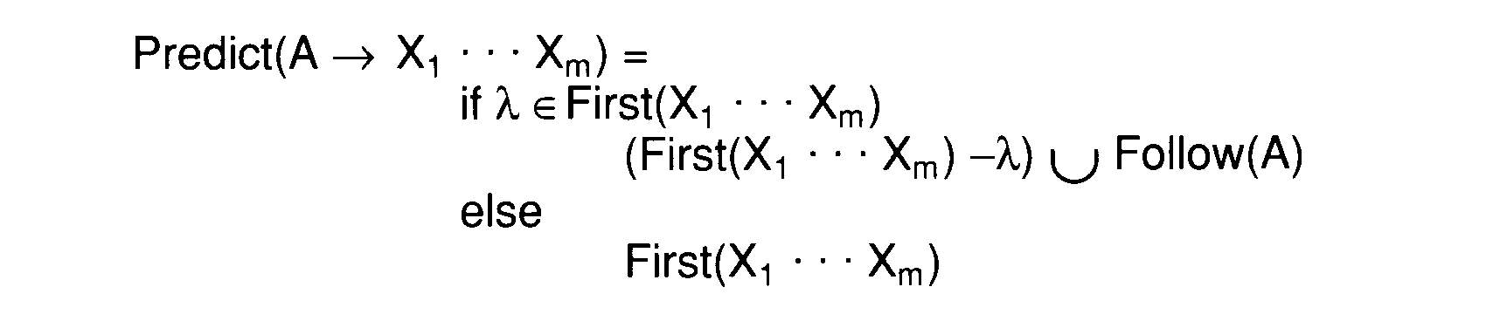

The LL(1) Predict Function
The limitation of LL(1)
  LL(1) contains exactly those grammars that have disjoint predict sets for productions that share a common left-hand side
Department of Computer Science

Slide 19
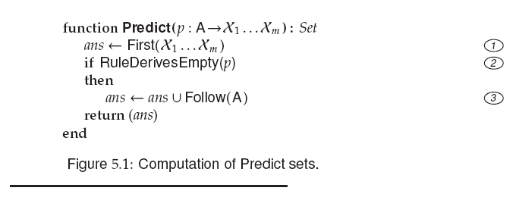

Slide 20
The LL(1) Parse Table
An LL(1) parse table
  T:V_{n} x V_{t} → P∪{Error}
The definition of T
  T[ A ][ t ]=A→X_{1…}X_{m} if t ∈ Prediction( A→X_{1…}X_{m} );
  T[ A ][ t ]=Error otherwise
Department of Computer Science

Slide 21
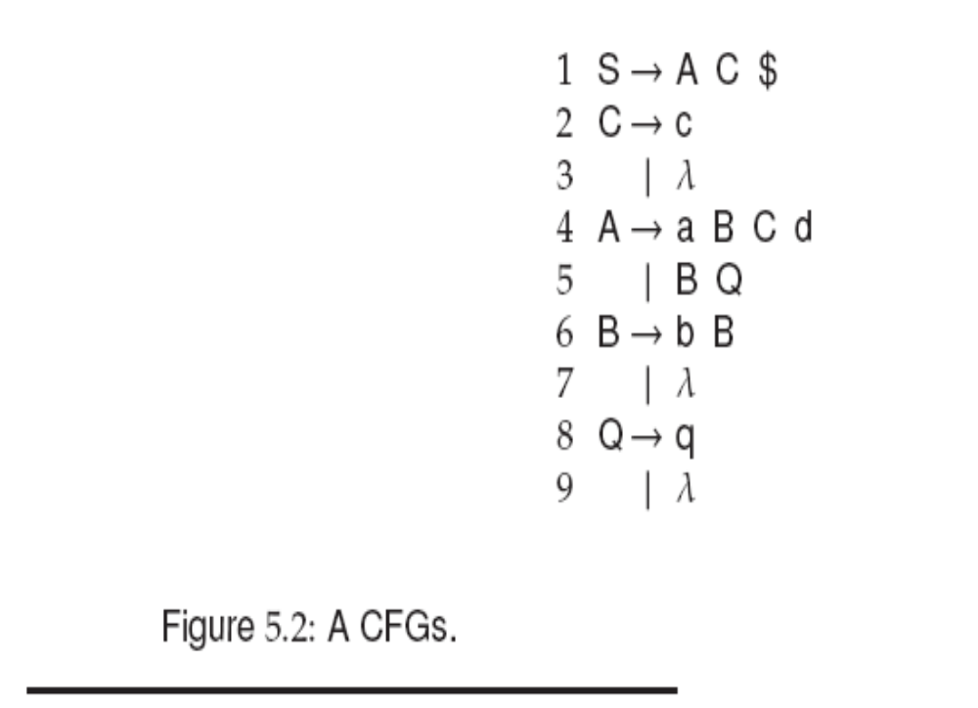

Slide 22
Example:
FIRST(AC)
compute FIRST(A)
{a, FIRST(BQ)}
{a,b,FIRST(Q)}
{a,b,q, λ}
{a,b,q} + FIRST(C)
{a,b,q}+{c, λ}
{a,b,q,c, λ} + {$}
{a,b,q,c,$}

Slide 23
Predict Set
{a,b,q,c,$}
{c}
{a}
{b}
{q}
{c,$}

Slide 24
Predict Set
{a,b,q,c,$}
{c}
{$,d}
{a}
{b,q,c,$}
{b}
{q,c,d,$}
{q}
{c,$}

Slide 25
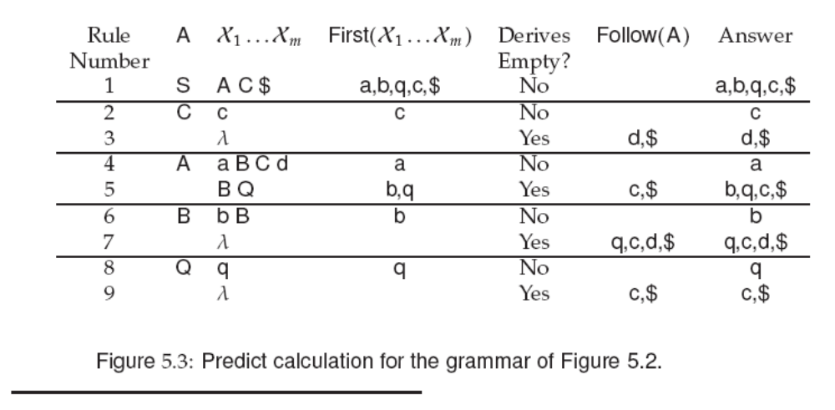

Slide 26
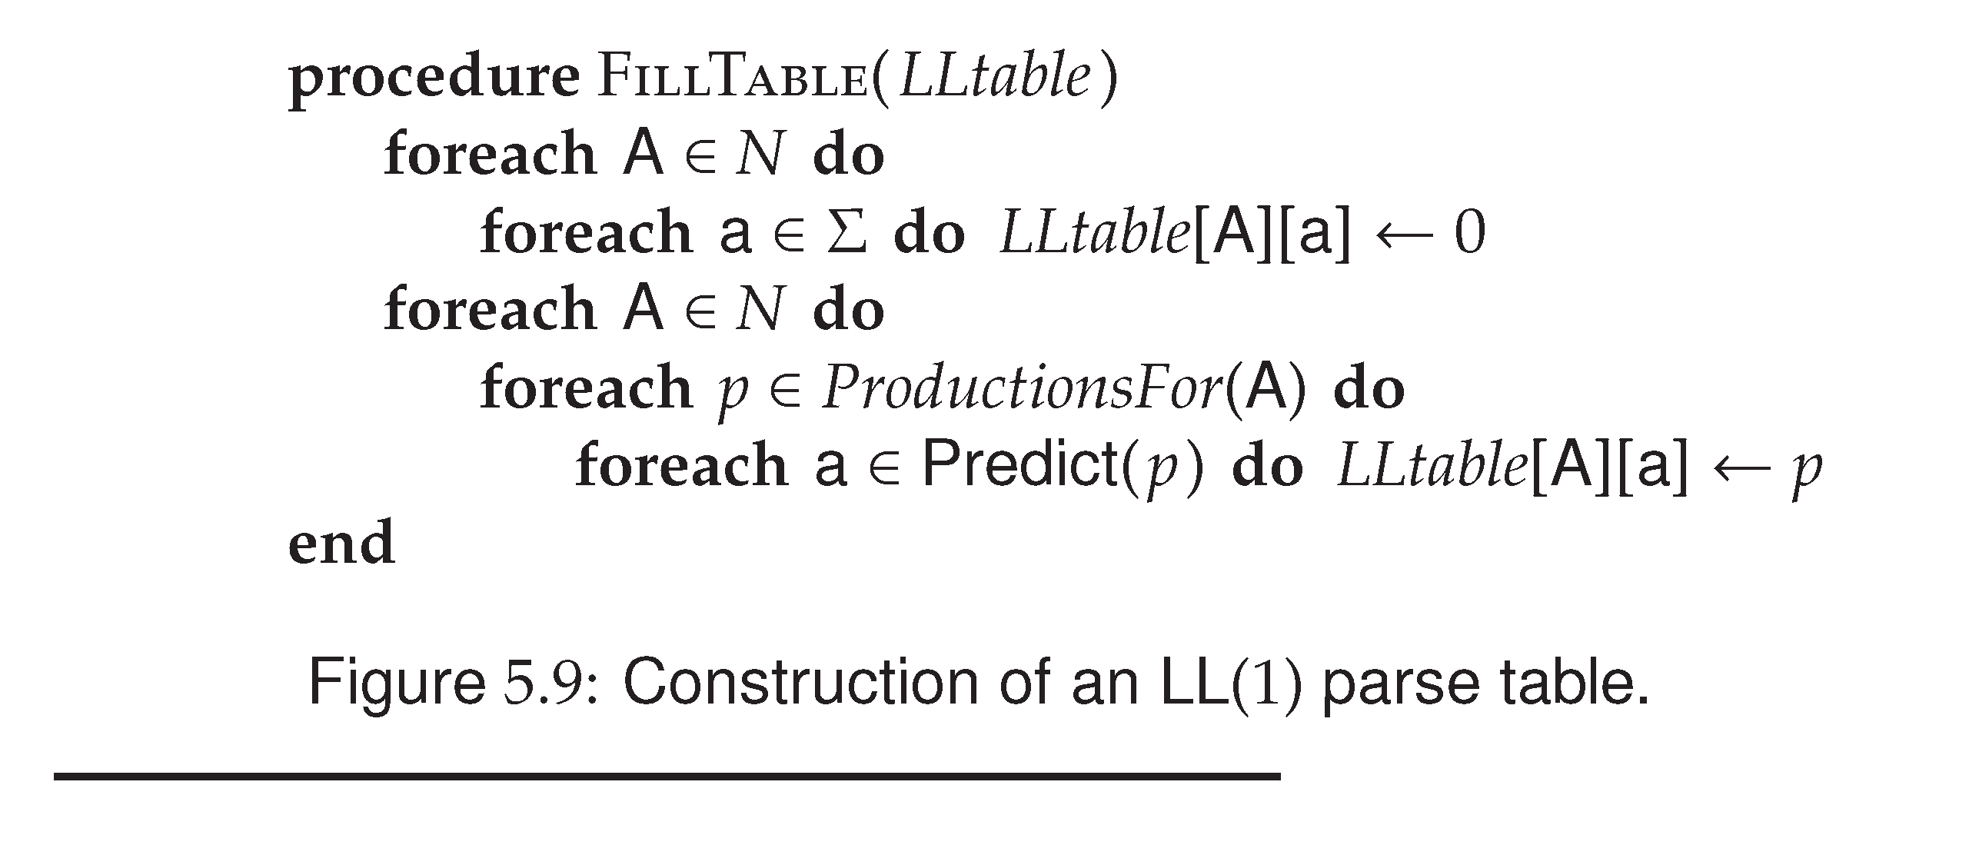
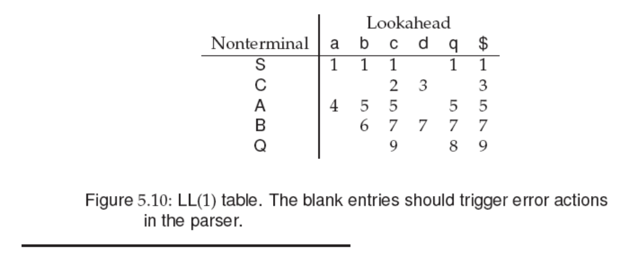

Slide 27

Building Recursive Descent Parsers from LL(1) Tables
Similar to the implementation of a scanner, there are two kinds of parsers
  Build in
    The parsing decisions recorded in LL(1) tables can be hardwired into the parsing procedures used by recursive descent parsers
  Table-driven
Department of Computer Science

Slide 28
An LL(1) Parser Driver
Rather than using the LL(1) table to build parsing procedures, it is possible to use the table in conjunction with a driver program to form an LL(1) parser
Smaller and faster than a corresponding recursive descent parser
Changing a grammar and building a new parser is easy
  New LL(1) driver are computed and substituted for the old tables
Department of Computer Science

Slide 29
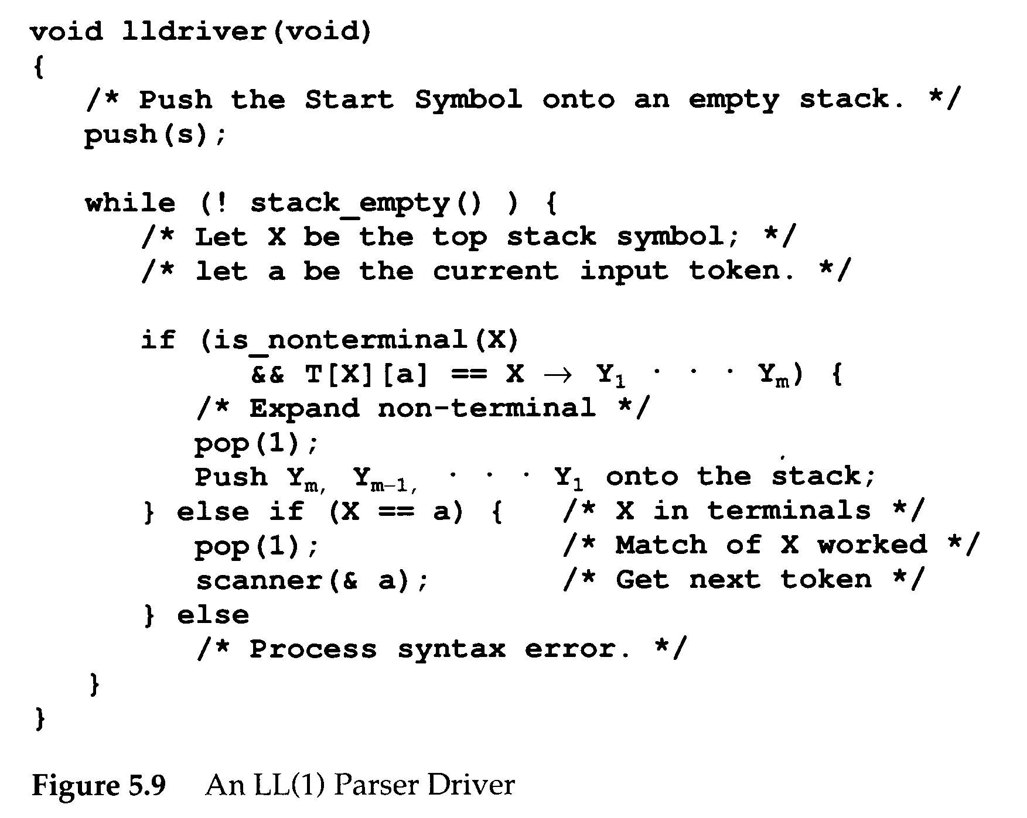
a
B
A
c
D
A→aBcD
03/24/2008
Department of Computer Science

Slide 30
LL(1) Action Symbols
During parsing, the appearance of an action symbol in a production will serve to initiate the corresponding semantic action – a call to the corresponding semantic routine.
ID := <expression> #gen_assign ;
match(ID);
match(ASSIGN);
exp();
gen_assign();
match(semicolon);
Department of Computer Science

Slide 31
LL(1) Action Symbols
The semantic routine calls pass no explicit parameters
  Necessary parameters are transmitted through a semantic stack
  Semantic stack ≠ parse stack
Semantic stack is a stack of semantic records.
Action symbols are pushed to the parse stack
Department of Computer Science

Slide 32
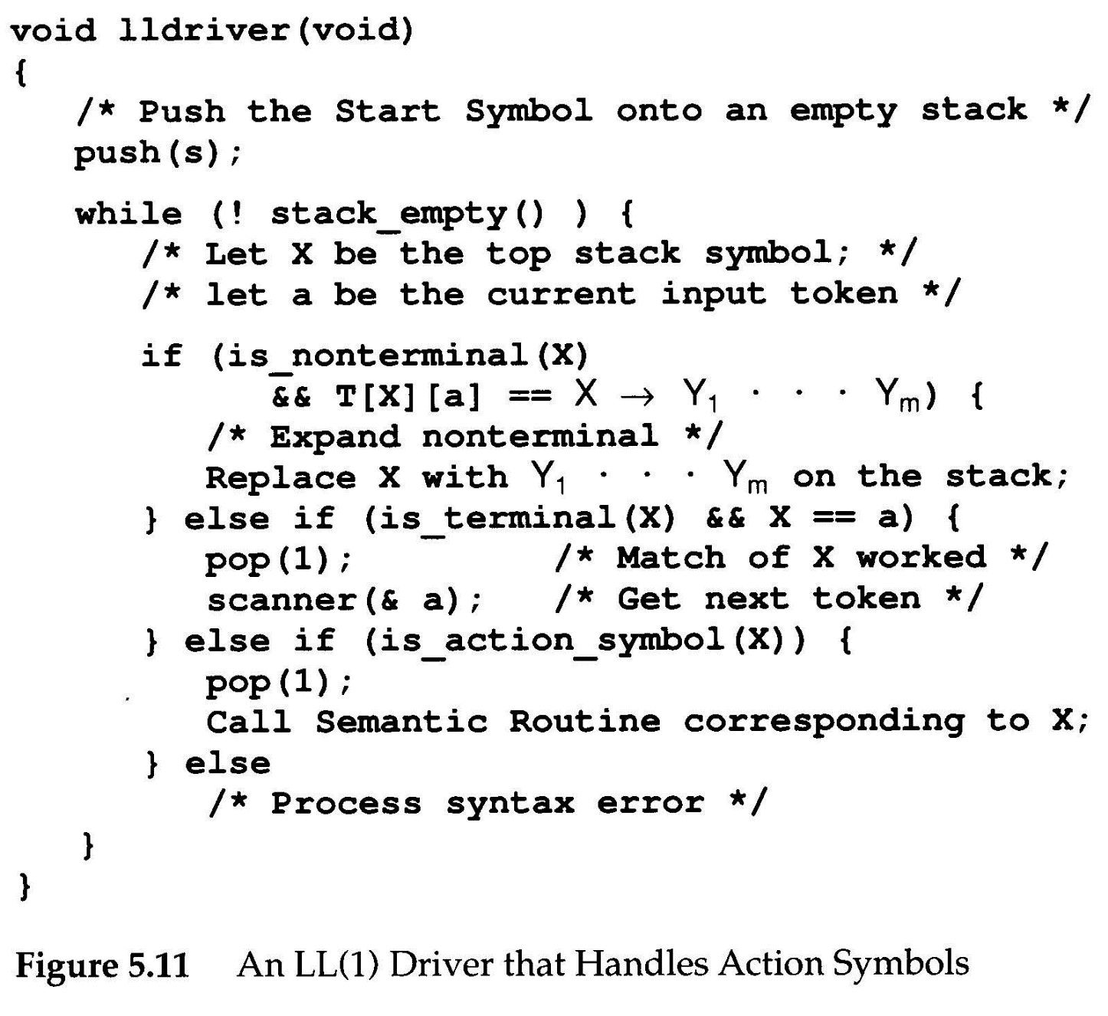
Department of Computer Science

Slide 33
Making Grammars LL(1)
Not all grammars are LL(1). However, some non-LL(1) grammars can be made LL(1) by simple modifications.
When a grammar is not LL(1) ?
This is called a conflict, which means we do not know which production to use when <stmt> is on stack top and ID is the next input token.
ID
<stmt>
2,5
Department of Computer Science

Slide 34
Making Grammars LL(1)
Major LL(1) prediction conflicts
  Common prefixes
  Left recursion
Common prefixes
<stmt> → if <exp> then <stmt>
<stmt> → if <exp> then <stmt> else <stmt>
Solution: left factoring
03/24/2008
Department of Computer Science

Slide 35
Making Grammars LL(1)
Grammars with left-recursive production can never be LL(1)
  A → A β
  Why? A will be the top stack symbol, and hence the same production would be predicted forever
Department of Computer Science

Slide 36
FAQ
How is First(A→P) different from Predict(A→P)?
Why do we need the stack for LL Parsing?
  Recursion
How is First(A) different from First(A→P)?
Department of Computer Science

Slide 37
Making Grammars LL(1)
Other transformations may be needed
  No common prefixes, no left recursion, but conflicts still exist.
1 <stmt> → <label> <unlabeled stmt>
2 <label> → ID :
3 <label> → λ
4 <unlabeled stmt> → ID := <exp> ;
A: B := C ;
B := C ;
ID
2,3
LL(2) will work
<label>
Department of Computer Science

Slide 38
Making Grammars LL(1)
<stmt> → ID <suffix>
<suffix> → : <unlabeled stmt>
<suffix> → := <exp> ;
<unlabeled stmt> → ID := <exp> ;
Example
A: B := C ;
B := C ;
Department of Computer Science

Slide 39
Dangling else
<stmt> → if <expr> then stmt
<stmt> → if <expr> then stmt else stmt
<stmt> → while ( <expr> ) stmt
<stmt> → for ( expr; expr; expr) stmt
<stmt> → if <expr> then stmt V
<V> → else stmt
→ λ
Department of Computer Science

Slide 40
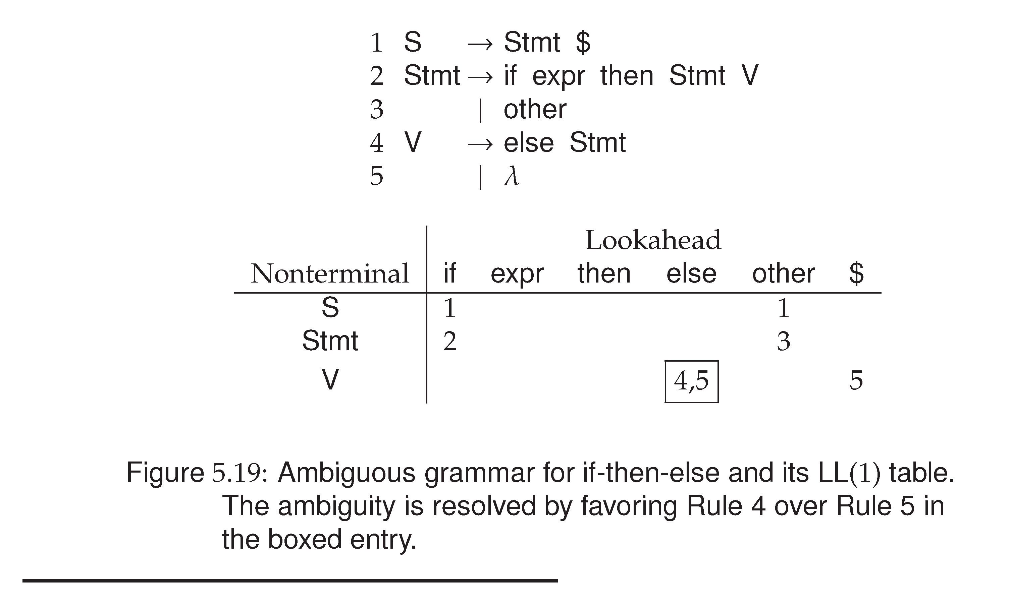
Left factoring may
fail to solve the
problem !
e.g. after left factoring,
the dangling IF’s
problem remains…
Notes:
When else is the lookahead symbol, the top-down parser may choose to expand with else Stmt, or decide to take
The lamda production, and therefore, parsing would fail.

Slide 41
The If-Then-Else Problem in LL(1)
Solution: conflicts + special rules
In Figure 5.19, T[V, else] = 4 and 5
We can enforce that T[V, else] = 4th rule.
This essentially forces “else “ to be matched with the nearest unpaired “ if “.
Department of Computer Science

Slide 42
The If-Then-Else Problem in LL(1)
If all if statements are terminated with an end if, or some equivalent symbol, the problem disappears.
    S → if S E
    S → Other
    E → else S end if
    E → end if
An alternative solution
  Change the language
Department of Computer Science

