Slide 1
CSC6032 – Advanced Operating Systems
Peer-to-Peer Systems
Prof. Yeh-Ching Chung
School of Data Science
Chinese University of Hong Kong, Shenzhen

Slide 2
Outline
What is P2P Network
Overlay Network Centralization
Network Structure
Unstructured Architectures
Structured Architectures

Slide 3
A Basic Definition of P2P
The exchange of data (documents, MP3s, voice) between two “peers” that can act as both the client and the server
A basic example
  The typical telephone call
Both “peers” act as producers (by talking) and as consumers

Slide 4
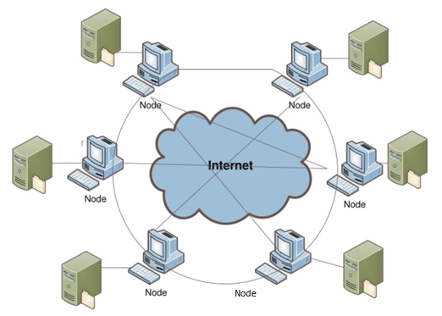
Definition of P2P Network
A P2P network is a distributed network composed of a large number of distributed, heterogeneous, autonomous, and highly dynamic peers in which participants share a part of their own resources such as processing power, storage capacity, software, and file contents.
The participants in the P2P network can act as a server and a client at the same time.
They are accessible by other nodes directly, without passing intermediary entities.

Slide 5
Peer-to-Peer Architecture
Although in purest form peer-to-peer overlay networks are supposed to be totally decentralized, in practice this is not always true, and systems with various degrees of centralization are encountered.
They are identified into the following three categories:
  Purely decentralized architectures
  Hybrid decentralized architectures
  Partially Centralized architectures

Slide 6
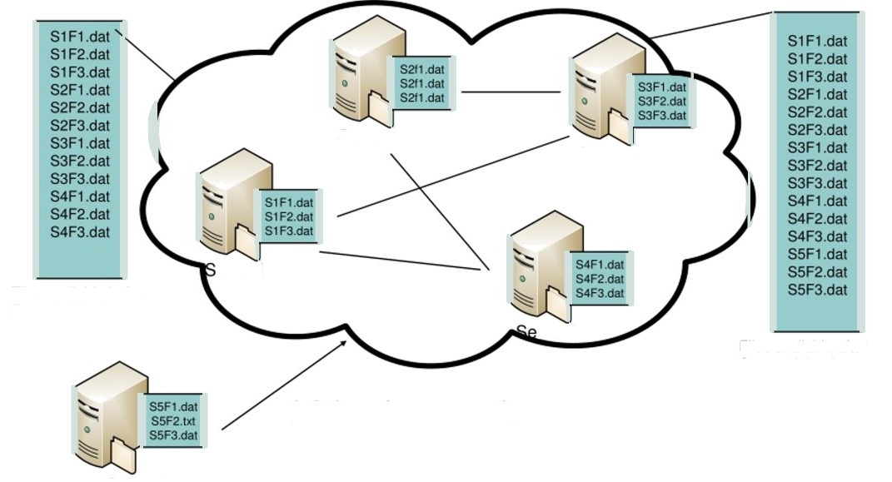
  Purely Decentralized Architecture (1)
Join the network

Slide 7
  Purely Decentralized Architectures (2)
Gnutella – A pure decentralized peer-to-peer networking
  Applications connect to peer applications
  Decentralized method of searching for files each application instance serves to
  Store selected files route queries (file searches) from and to its neighboring peers respond to queries (serve file) if file stored locally
How it works
  Searching by flooding: If you don't have the file you want, query 7 of your partners. If they don't have it, they contact 7 of their partners, for a maximum hop count of 10. Requests are flooded, but there is no tree structure. No looping but packets may be received twice.

Slide 8
  Purely Decentralized Architectures (3)
Advantages
  Inherently fault-tolerant, since there is no central point of failure and the loss of a peer or even a number of peers can easily be compensated.
  Have a greater degree of autonomous control over their data and resources
Disadvantages
  Slow discovery time
  No guarantee about quality of services

Slide 9
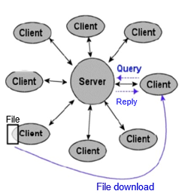
  Hybrid Decentralized Architectures (1)
Clients send requests for files to the server
The server searches for matches in its index, returning a list of users that hold the matching file.
The user then opens direct connections with one or more of the peers that hold the requested file, and downloads it

Slide 10
  Hybrid Decentralized Architectures (2)
Napster - Application-level, client-server protocol over point to­ point TCP, centralized system
Retrieval - Four steps
  Connect to Napster server
  Upload your list of files (push) to server.
  Give server keywords to search the full list with
  Select "best" of correct answers. (pings)
Centralized server: single logical point of failure, can load balance among servers using DNS rotation, potential for congestion
No security: passwords in plain text, no authentication,
No anonymity

Slide 11
  Hybrid Decentralized Architectures (3)
Advantages
  Easy to implement
  Locate files quickly and efficiently
Disadvantages
  Vulnerable to censorship, legal action, surveillance, malicious attack, and technical failure
  Considered inherently unscalable as they are bound to be limitations to the size of the server database and its capacity to respond to queries.

Slide 12
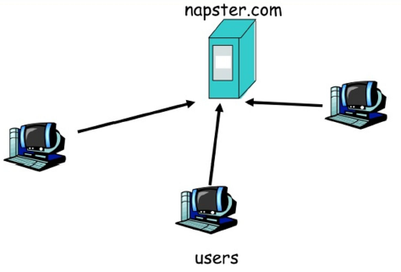
  Hybrid Decentralized Architectures (4)
Example - Napster
Step 1: File list is uploaded

Slide 13
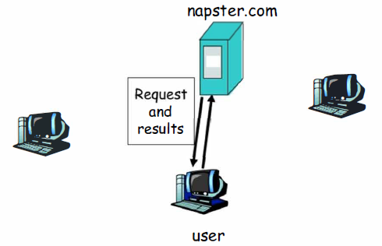
  Hybrid Decentralized Architectures (5)
Example - Napster
Step 2. User requests search on server

Slide 14
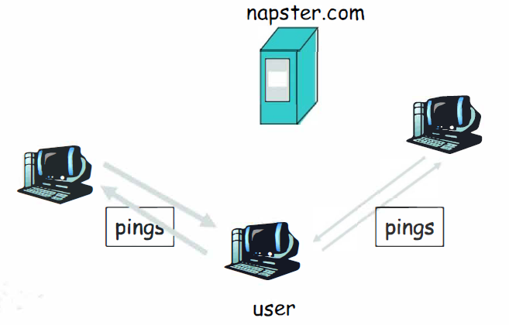
  Hybrid Decentralized Architectures (6)
Example - Napster
Step 3. User pings hosts that apparently have data and look for best transfer rate

Slide 15
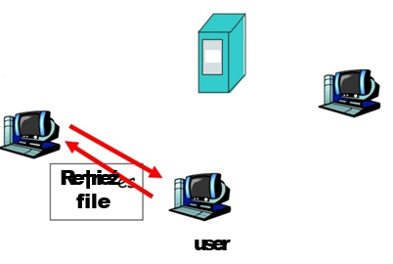
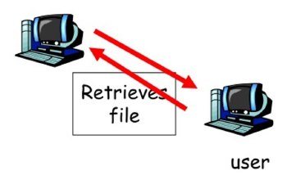
  Hybrid Decentralized Architectures (7)
Example - Napster
napster.com
Step 4. User retrieve file

Slide 16
  Hybrid Decentralized Architectures (8)
Advantages
  Easy to Implement
  Locate files quickly and efficiently
Disadvantages
  Vulnerable to censorship, legal action, surveillance, malicious attack, and technical failure
  Considered inherently unscalable as they are bound to be limitations to the size of the server database and its capacity to respond to queries index the files shared by peers connected to them, and proxy search requests on behalf of these peers.

Slide 17
Partially Centralized Architectures
Use the concept of supernodes
  Nodes that are dynamically assigned the task of servicing a small subpart of the peer network by indexing and caching files contained therein
Peers are automatically elected to become supernodes if they have sufficient bandwidth and processing power
Supernodes index the files shared by peers connected to them, and proxy search requests on behalf of these peers
All queries are therefore initially directed to supernodes
.

Slide 18
Partially Centralized Systems (1)
Kazaa and Morpheus are two similar partially centralized systems which use the concept of “SuperNodes".
In Morpheus a central server provides new peers with a list of one or more Supernodes with which they can connect. SuperNodes index the files shared by peers connected to them, and proxy search requests on behalf of these peers. Queries are therefore sent to SuperNodes, not to other peers.
Recent version of the Gnutella protocol.
  A mechanism for dynamically selecting supernodes organizes the Gnutella network into an interconnection of superpeers (as they are referred to) and client nodes.
  When a node with enough CPU power joins the network, it immediately becomes a superpeer and establishes connections with other superpeers, forming a flat unstructured network of superpeers.
  If it establishes a minimum required number of connections to client nodes within a specified time, it remains a superpeer. Otherwise it turns into a regular client node.

Slide 19
Partially Centralized Systems (2)
Advantages
  In comparison with purely decentralized systems, discovery time and the traffic on messages exchanging between nodes are reduced
  In comparison with Hybrid Decentralized Systems, workload on central server are reduced, but with slower information discovery
  The inherent heterogeneity of peer-to-peer networks is taken advantage of and exploited
  no unique point of failure
    If one or more supernodes go down, the nodes connected to them can open new connections with other supernodes, and the network will continue to operate.
    Peers can become supernodes themselves even when all supernodes go down

Slide 20
Discovery Mechanisms for P2P Systems
Distributed peer-to-peer systems often require a discovery mechanism to locate specific data within the system.
P2P systems have evolved from first generation centralized structures to second generation flooding-based and then third generation systems based on distributed hash tables:
  Centralized indexes and repositories
  Flooding broadcast of queries
  Routing Model

Slide 21
Centralized Indexes and Repositories
Used in hybrid system
Peers of the community connect to a centralized directory servers, which store all information regarding location and usage of resources
A central directory server maintains
  An index with meta data (file name, time of creation etc.) of all files in the network
  A table of registered user connection information (IP addresses, connection speeds etc.)
  A table listing the files that each user holds and shares in the network

Slide 22
Flooding Broadcast of Queries
Simple and robust
  No state maintenance needed
  High tolerance to node failures
Elective and of low latency
  Always find the shortest/fastest routing paths
Fundamental Operation for
  Broadcasting in distributed system
  P2P communications

Slide 23
Problems of Flooding
Loops in Gnutella networks
Caused by redundant links
Result in endless message routing
Current solution by Gnutella
Detect and discard redundant messages
Limit TTL(time-to-live) of messages
Unnecessary traffic is till too much
The redundant links are still there

Slide 24
Routing Model
Adds structure to the way information about resources are stored using distributed hash table
Provides a mapping between the resource identifier and location
Reduces the number of p2p hops that must be taken to locate a resource

Slide 25
Chord (1)
Provides peer-to-peer hash lookup service
  Lookup(key) for IP address
  Chord does not store the data
Efficient: O(Log N) messages per lookup
  N is the total number of servers
  Scalable: O(Log N)
Robust: Survives massive changes in membership

Slide 26
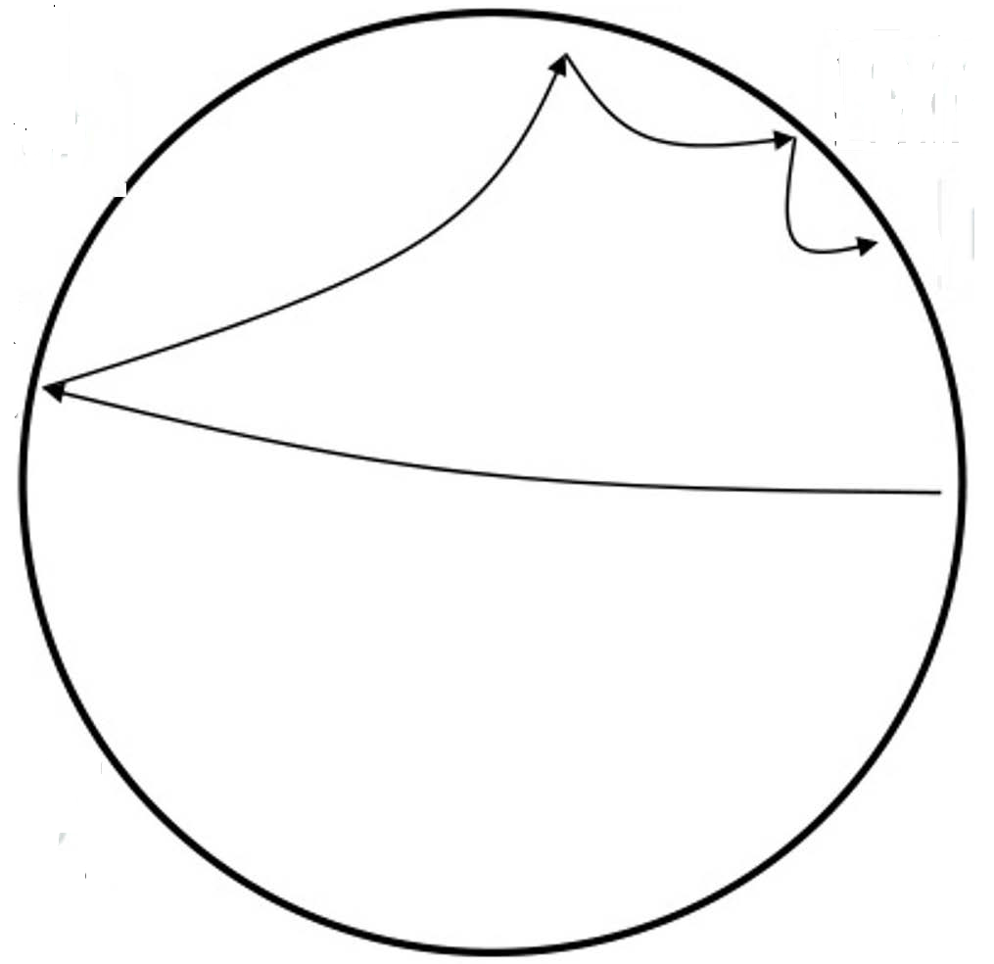
Chord (2)
Chord: Lookup mechanism
N5
N110
N10
N20
K19
N99
N32
Lookup(K19)
N80
N60

Slide 27
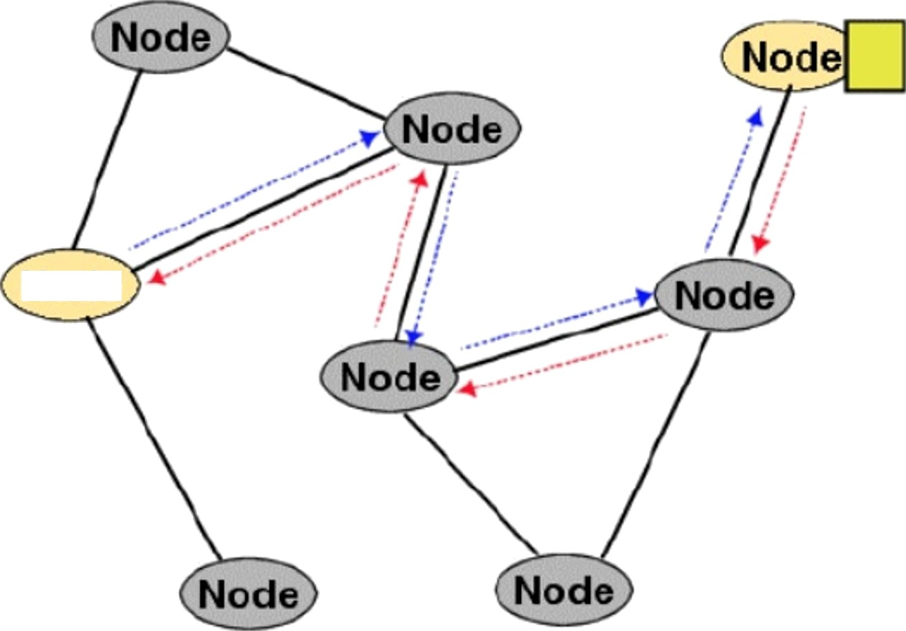
Freenet
The query is forwarded from node to node using the routing table, until it reaches the node which has the requested data.
The replay is passed back to the original node following the reverse path.
Node

Slide 28
Pastry
Completely decentralized, scalable, and self-organizing; it automatically adapts to the arrival, departure and failure of nodes.
Seeks to minimize the distance messages travel, according to a scalar proximity metric like the number of IP routing hops.
In a Pastry network
  Each node has a unique id, nodeld.
  Presented with a message & a key, Pastry node efficiently routes the message to the node with a nodeld that is numerically closest to the key.

Slide 29
CAN (Content Addressable Network)
The network is created in a tree-like form
Each node is associated to one in the upper level an to a group in the lower level.
The network is create in a tree-like form.
Each node is associated to one in the upper level an to a group in the lower level
A query travels from the uppermost level down through the network until a match is found or until it reaches the lowermost level.
For its query model, scalability is an issue

Slide 30
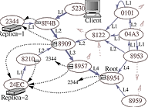
Tapestry (1)
Self-administered, self-organized, location independent, scalable, fault-tolerant
Each node has a neighbor map table with neighbor information.

Slide 31
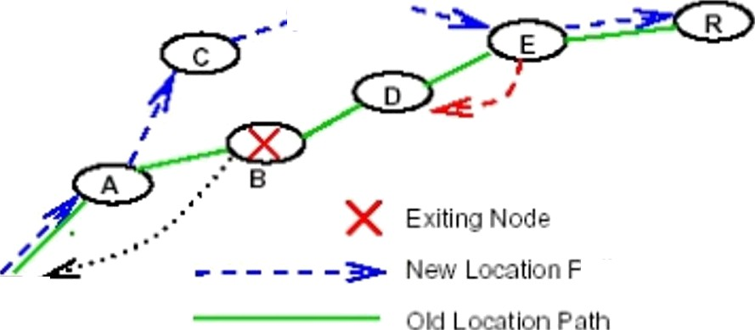
Tapestry (2)
The system is able to adapt to network changes because it algorithms are dynamic. This also provides for Fault-handling

Slide 32
Tapestry (3)
The placement of content (files) is completely unrelated to the overlay topology.
In an unstructured network, content typically needs to be located. Searching mechanisms range from brute force methods such as flooding the network with propagating queries in a breadth-first or depth-first manner until the desired content is located, to more sophisticated and resource-preserving strategies that include the use of random walks and routing indices. The searching mechanisms employed in unstructured networks have obvious implications, particularly in regards to matters of availability, scalability, and persistence.

Slide 33
Tapestry (4)
Unstructured systems are generally more appropriate for accommodating highly transient node populations.
Some representative examples of unstructured systems are Napster, Publius, Gnutella, Kazaa and Freehaven, et.

Slide 34
Consider Structured P2P Systems (1)
In structured networks the overlay topology is tightly controlled and files (or pointers to them) are placed at precisely specified locations.
    These systems essentially provide a mapping between content (e.g. file identifier) and location (e.g. node address), in the form of a distributed routing table, so that queries can be efficiently routed to the node with the desired content.
Structured systems offer a scalable solution for exact-match queries, i.e. queries in which the exact identifier of the requested data object is known (as compared to keyword queries). Using exact-match queries as a substrate for keyword queries remains an open research problem for distributed environments

Slide 35
Consider Structured P2P Systems (2)
A disadvantage of structured systems is that it is hard to maintain the structure required for efficiently routing messages in the face of a very transient node population, in which nodes are joining and leaving at a high rate.
Typical examples of structured systems include Chord, CAN, Tapestry, etc.

Slide 36
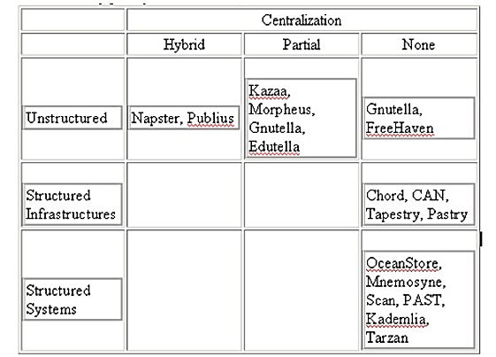
Conclusion
The table below shows a classification of peer-to-peer content distribution systems and location and routing infrastructures in terms of their Network structure, with some typical examples

Slide 37
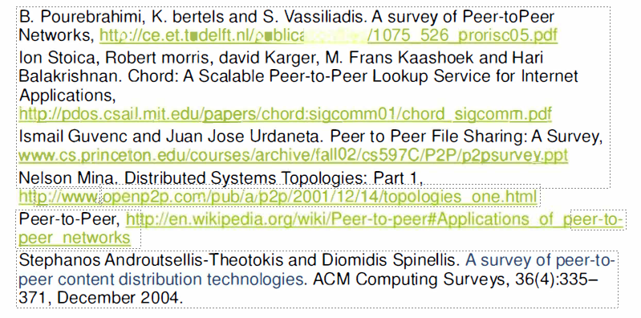
References
The table below shows a classification of peer-to-peer content distribution systems and location and routing infrastructures in terms of their Network structure, with some typical examples

Slide 38
Q & A

