Slide 1

GPU Virtualization in Cloud Gaming
Harvesting idle GPU cycles without dropping a frame
PilotFish · ATC ’22
Combo · SoCC ’23
CoCG · IPDPS ’24
ZHANG Wenqian · 225040483
School of Data Science, CUHK-Shenzhen · CSC6103 Virtualization Techniques · Nov 5, 2026

Slide 2
Outline
01
04
Introduction
Combo (SoCC ’23)
key question & cloud gaming
spatial sharing
02
05
Background & Related Work
CoCG (IPDPS ’24)
GPU sharing · prior work
stage-level co-location
03
06
PilotFish (ATC ’22)
Discussion & Conclusions
temporal sharing
comparison · open problems

Slide 3

GPU Virtualization in Cloud Gaming
Introduction
Background & Related Work
PilotFish (ATC ’22)
Combo (SoCC ’23)
CoCG (IPDPS ’24)
Discussion & Conclusions
01
Red Dead Redemption 2 — test game of PilotFish [1]

Slide 4
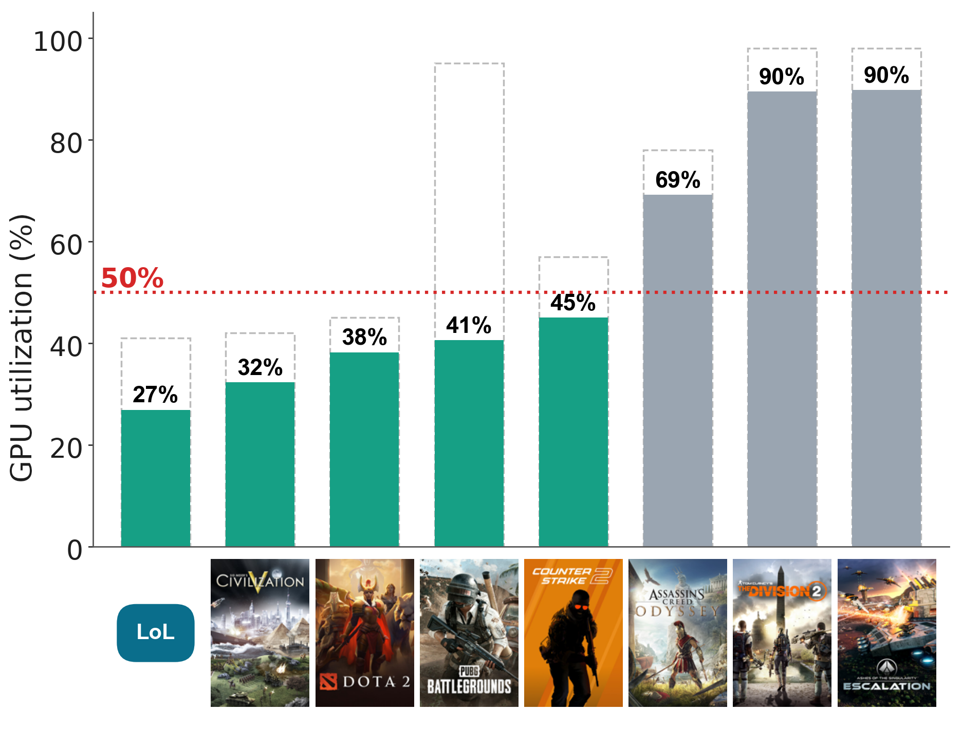
The Problem & Our Key Question
Observation: 5 of 8 games use < 50% of the GPU (1 player : 1 GPU)
KEY QUESTION
How can we share the GPU to harvest its idle time — without dropping a single frame?
Figure 1. GPU utilization at 1080p / 60 FPS on RTX 2060 (data: PilotFish [1]).

Slide 5




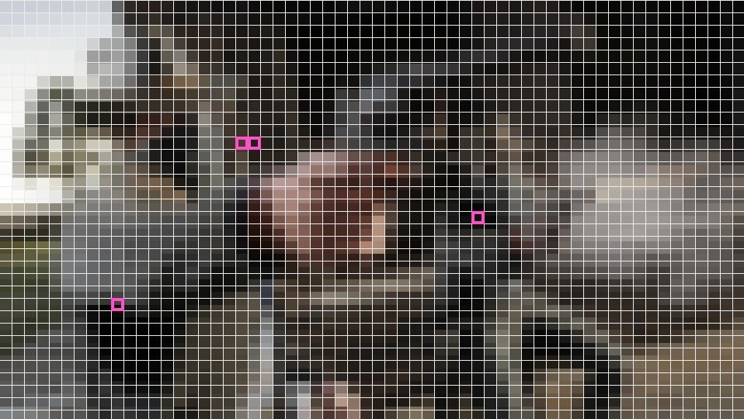
What is Cloud Gaming?
Cloud server (datacenter)
Thin client
Game logic
CPU
Draw calls
DirectX / Vulkan
Rendering
GPU
Encoding
GPU · NVENC
video
decode & display only
scene + player input
geometry & materials
full frame, every 16.67 ms
H.264 / HEVC macroblocks
TV · phone · PC
· browser
input
same frame, 4 steps →
both GPU stages: the critical, most expensive resource
100 %
Any device
16.67 ms
of the game runs in the cloud
client only decodes video
per frame at 60 FPS — every frame

Slide 6

GPU Virtualization in Cloud Gaming
Introduction
Background & Related Work
PilotFish (ATC ’22)
Combo (SoCC ’23)
CoCG (IPDPS ’24)
Discussion & Conclusions
02
Assassin’s Creed Odyssey — 69 % average GPU utilization [1]

Slide 7
How Can a GPU Be Shared?
API Remoting
Pass-through
Mediated Pass-through
HW Partitioning
Kernel-level Sharing
VM
VM
VM
GPU timeline
slice
slice
API calls
A
B
A
B
A
B
GPU
whole GPU
slice
slice
time →
vCUDA, VirGL
most cloud-gaming VMs
gVirt, NVIDIA vGPU
SR-IOV, NVIDIA MIG
CUDA MPS, streams
software
1 VM : 1 GPU
time slices
static split
dynamic
coarse · isolation first
fine-grained · utilization first
All of them are frame-agnostic — the three papers add a frame-QoS-aware scheduler on top.

Slide 8
Related Work: From Isolation to Co-location
2014
2014
2016
2020
VGRIS
vGASA
Baymax
MIG
SLA-aware VM graphics
FPS-aware scheduling
QoS-aware sharing
hardware partitioning
2014
2015
2019
gVirt
dJay
GAugur
mediated pass-through
tune quality, pack games
predict interference
This talk (2022–24):
PilotFish ’22 · game + DL, temporal
Combo ’23 · game + DL, spatial
CoCG ’24 · game + game, stages

Slide 9
Roadmap: Three Ways to Harvest Idle GPU
Temporal sharing
PilotFish ’22
Spatial sharing
Combo ’23
Stage-level co-location
CoCG ’24
SM
SM
SM
SM
load
battle
explore
game
game
SM
SM
SM
SM
lobby
load
fight
time → green = DL kernels
blue = game · orange = AI job
game A / game B: peaks interleave
fill gaps between frames
co-run inside the GPU
interleave game stages
Same goal: more work per GPU, zero FPS loss

Slide 10

GPU Virtualization in Cloud Gaming
Introduction
Background & Related Work
PilotFish (ATC ’22)
Combo (SoCC ’23)
CoCG (IPDPS ’24)
Discussion & Conclusions
03
HITMAN 3 — test game of PilotFish [1]

Slide 11


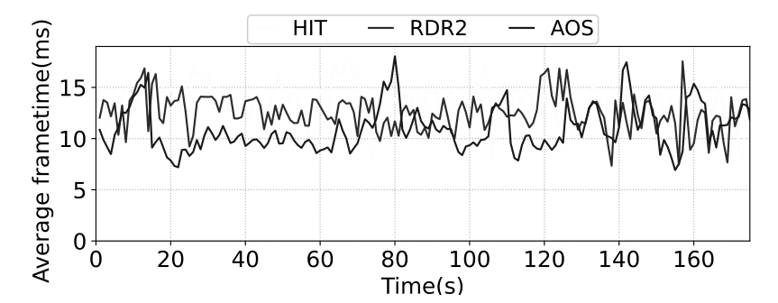

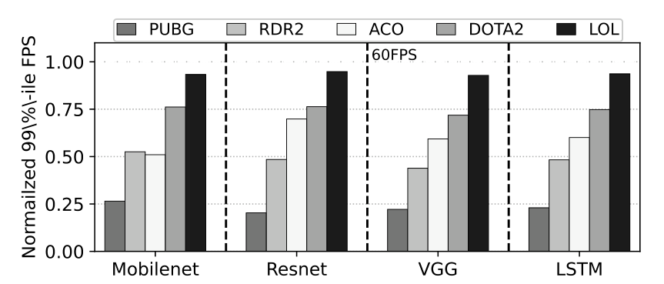
PilotFish – Why Not Game + Game?
Paper 1 · ATC ’22
+
20 FPS
RDR2 drops from 60
Figure 2. Game frame time fluctuates. [1]
+
DL
training
ResNet
VGG
LSTM
< 1 ms
stable, predictable kernels
Figure 3. Naive game + DL: 99%-ile FPS still drops. [1]
Idea: know when each frame ends and how long each DL kernel runs → fill the gap exactly.

Slide 12
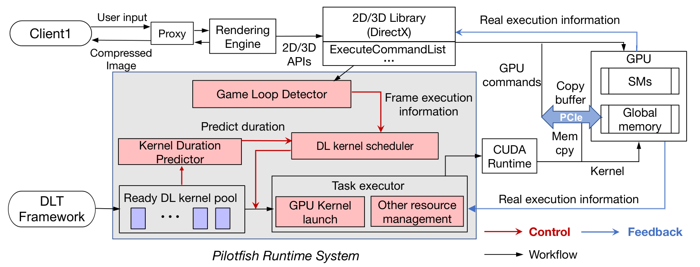
PilotFish – System Architecture
Paper 1 · ATC ’22
Figure 4. PilotFish overall design (Fig. 8). [1]
1
Game Loop Detector
2
Duration Predictor
3
DL Kernel Scheduler
4
Task Executor
hook ExecuteCommandList → frame start / end
offline profile → DL kernel times
pick kernels that fit the free slice
launch · preempt · resume + CPU/PCIe/IO isolation

Slide 13

PilotFish – Fitting DL Kernels into a Frame
Paper 1 · ATC ’22
render frame i
k1
k2
k3
k4
k5
waits
free =
QoS − last render
free time slice
deadline 16.67 ms
① Know the frame
② Fit the kernels
③ Fail safely
API hook
predict & pack
kill in 0.7 ms
< 1 µs / frame
hard / soft guarantee
resume in 30–69 ms

Slide 14
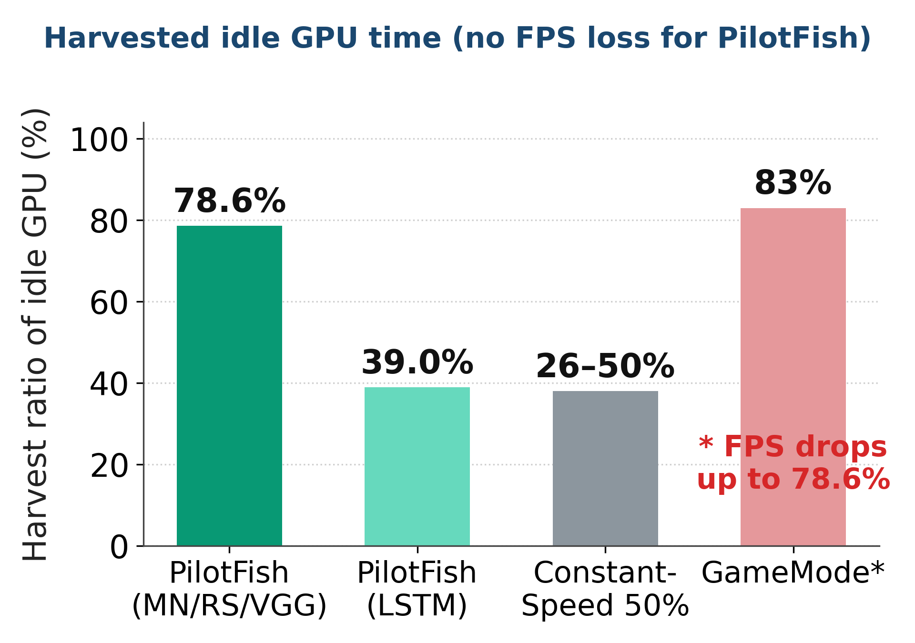
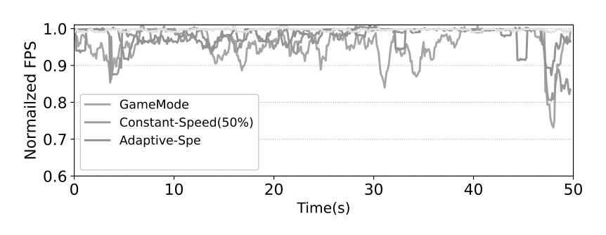
PilotFish – Results
Paper 1 · ATC ’22
85.1 %
78.6 %
≈ 0
40→81 %
idle GPU time harvested (max)
harvested on average
FPS loss for the game
cluster GPU util. (sim.)
Testbed · RTX 2060
Red Dead Redemption 2
HITMAN 3
Shadow of the Tomb Raider
Figure 6. FPS over time: PilotFish stays at target. [1]
F1 2021
Limit: only one workload on the GPU at a time.
Ashes of the Singularity
+ DL training jobs
MobileNet · ResNet
VGG · LSTM
Figure 5. Harvest ratio vs. baselines (data from [1]).

Slide 15

GPU Virtualization in Cloud Gaming
Introduction
Background & Related Work
PilotFish (ATC ’22)
Combo (SoCC ’23)
CoCG (IPDPS ’24)
Discussion & Conclusions
04
The Ascent — ray-traced test game of Combo [2]

Slide 16
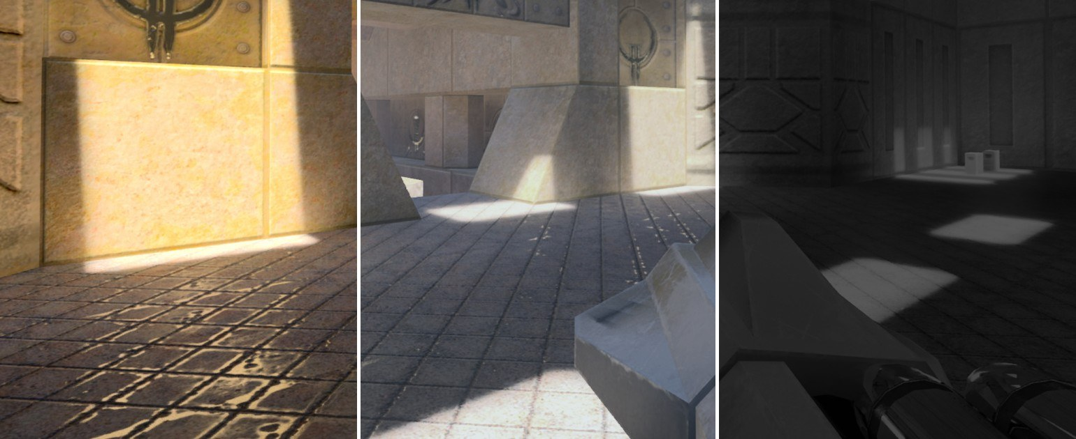
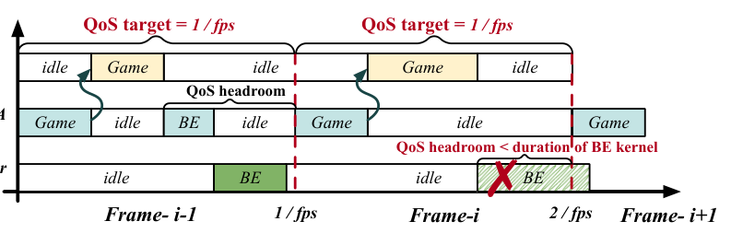
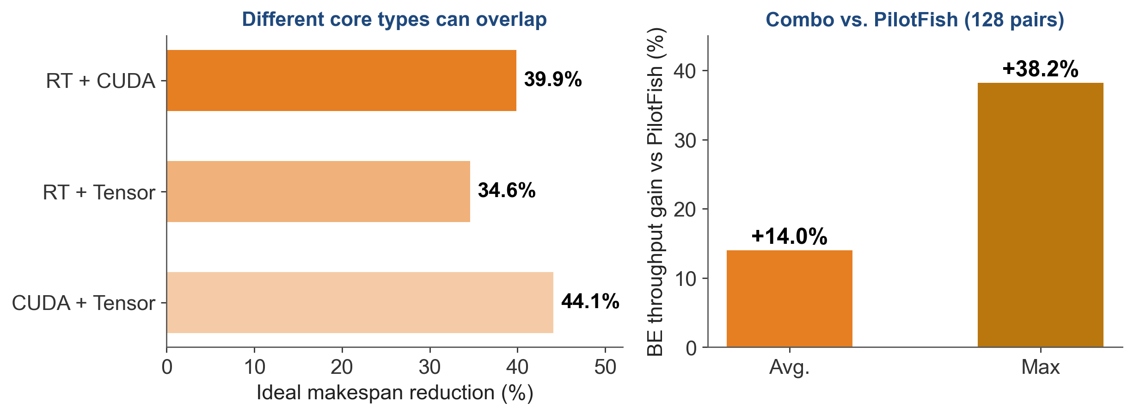
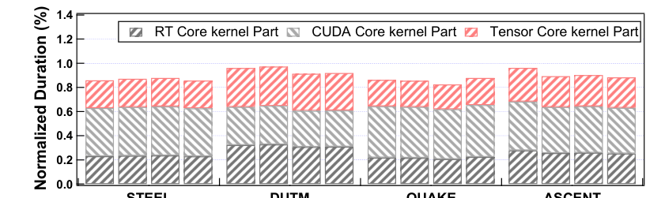
Combo – Idle Cores Inside the GPU
Paper 2 · SoCC ’23
Quake II RTX — test game [2]
RT cores
ray tracing
CUDA cores
shading
Tensor cores
idle
Figure 8. Temporal sharing: a long BE kernel cannot fit the gap. [2]
Figure 7. Per-frame time on RT / CUDA / Tensor cores. [2]
Figure 9. Potential and achieved gains (data from [2]).

Slide 17
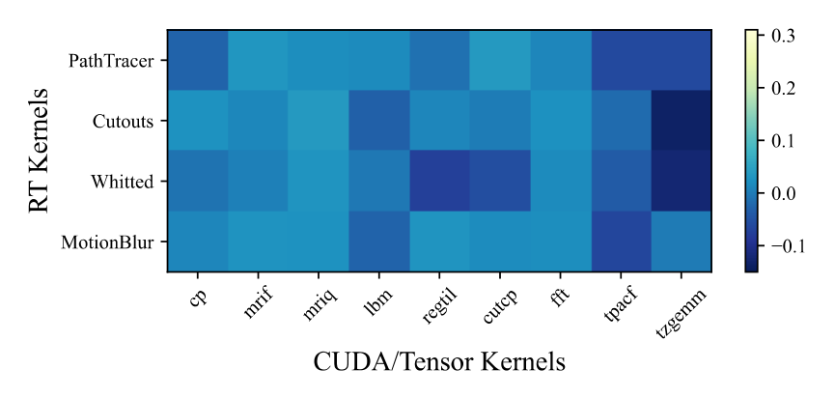
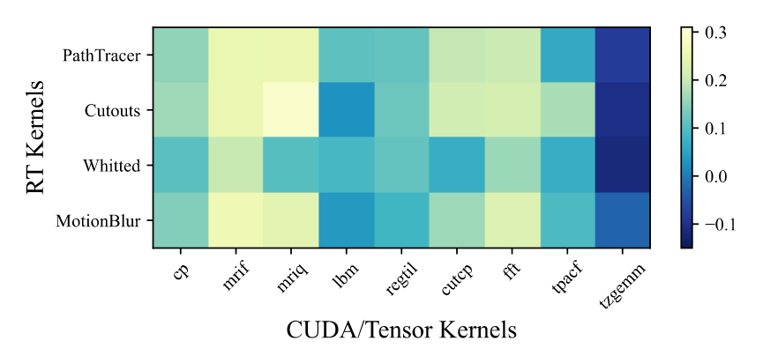
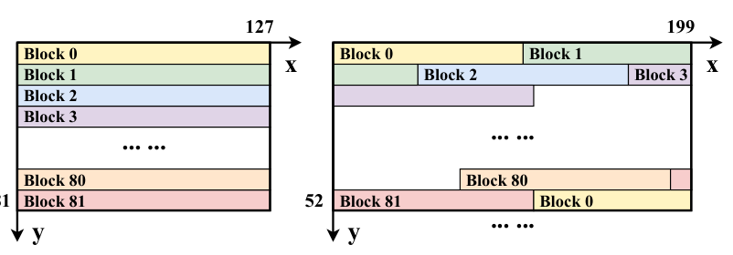
Combo – Taking Control of the SMs
Paper 2 · SoCC ’23
Figure 12. Persistent thread blocks. [2]
Figure 10. Naive co-run: gain ≈ 0. [2]
Figure 11. With PTB: up to +25.9 %. [2]
Problem
Solution
first kernel floods all SMs
no control over which SM
Persistent Thread Block: #SM blocks loop
SM-bounding: exit if %smid not mine

Slide 18
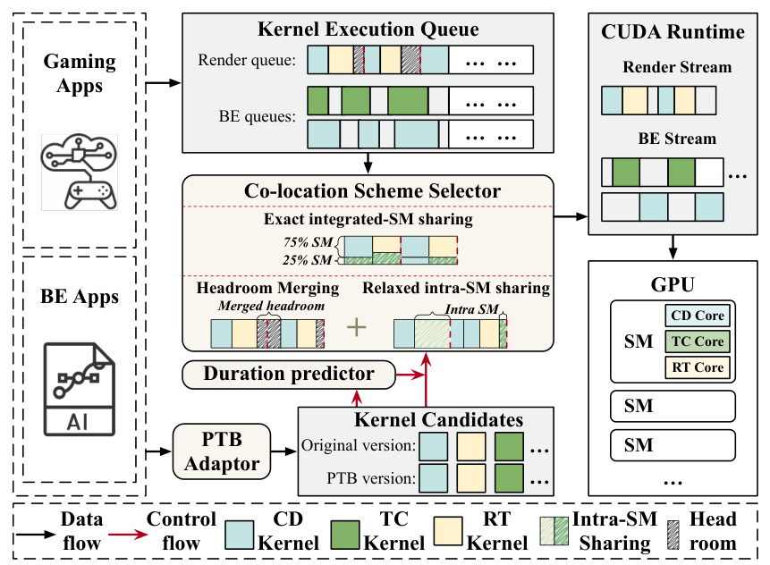
Combo – System Overview
Paper 2 · SoCC ’23
1
PTB Adaptor
rewrite AI kernels
2
Duration Predictor
render time vs. #SMs
3
Scheme Selector
pick sharing mode
4
Headroom Merging
merge small gaps
5
CUDA Runtime
SM-bounded streams
Figure 13. Combo architecture. [2]

Slide 19
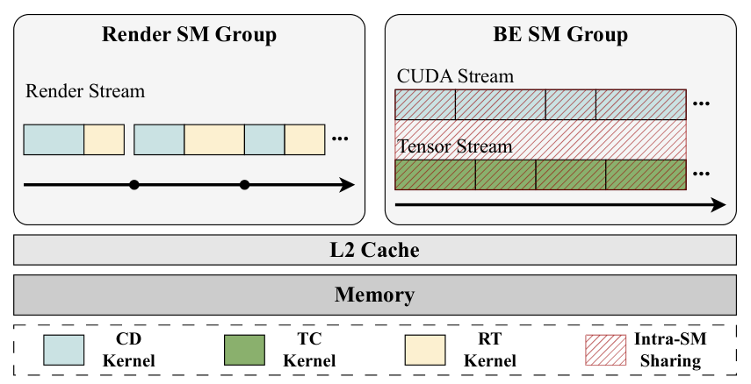
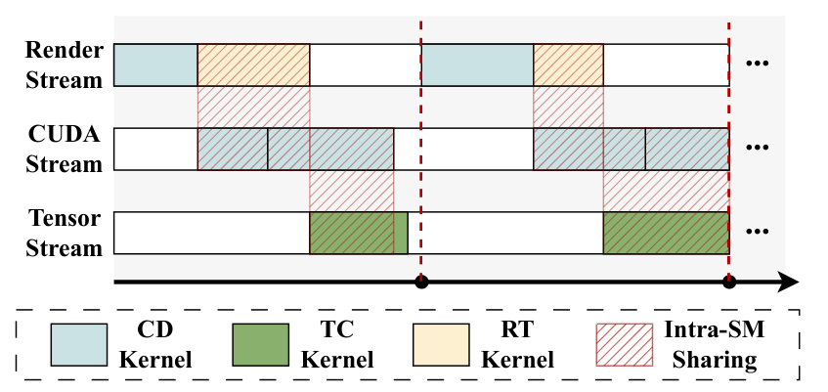
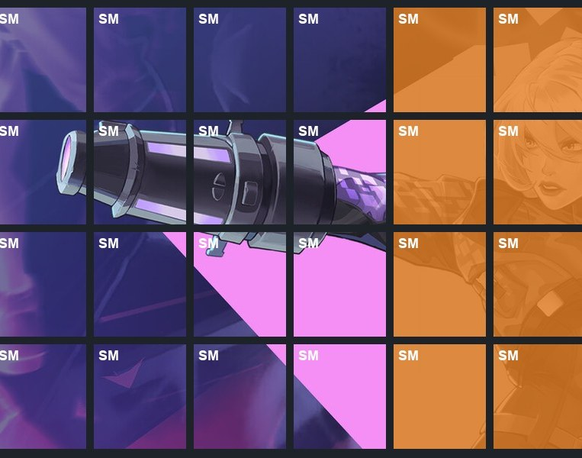
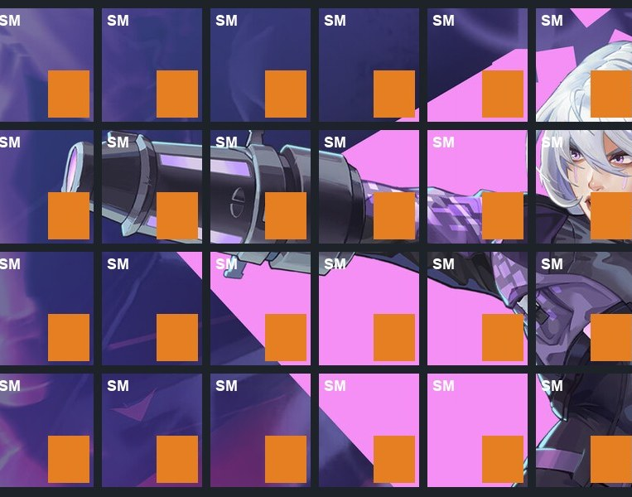
Combo – Two Adaptive Sharing Modes
Paper 2 · SoCC ’23
Figure 14. Split SMs between game and AI job. [2]
Figure 15. Share all SMs, different core types. [2]
Stable load
switch
when
load Δ
> 10%
Fluctuating load
fewest SMs for the game
1.45×
share every SM
1.16×
throughput
throughput

Slide 20
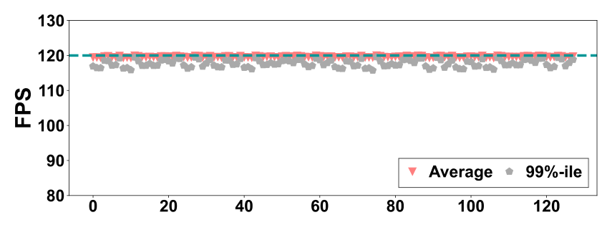
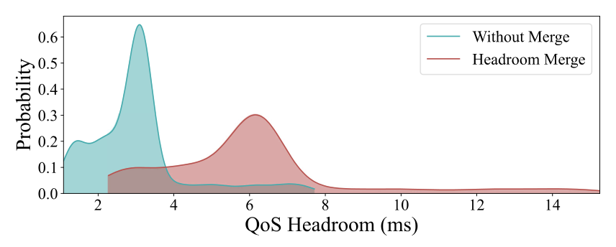
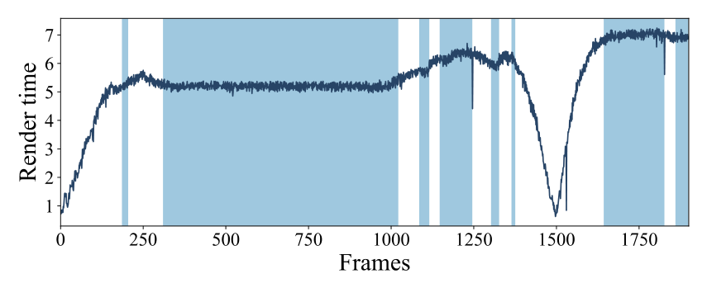
Combo – Results
Paper 2 · SoCC ’23
+14.0 %
+38.2 %
> 117
0.18 ms
vs PilotFish (avg.)
vs PilotFish (max.)
99%-ile FPS @ 120 target
scheduling overhead
Figure 16. FPS stays at 120. [2]
Figure 17. Headroom merging: bigger gaps. [2]
Figure 18. Mode switching tracks load. [2]
Testbed · RTX 3090
Severed Steel
Deliver Us The Moon
Quake II RTX
The Ascent
BE jobs
ResNet50
VGG16
Inception
DenseNet

Slide 21

GPU Virtualization in Cloud Gaming
Introduction
Background & Related Work
PilotFish (ATC ’22)
Combo (SoCC ’23)
CoCG (IPDPS ’24)
Discussion & Conclusions
05
Contra — test game of CoCG [3]

Slide 22
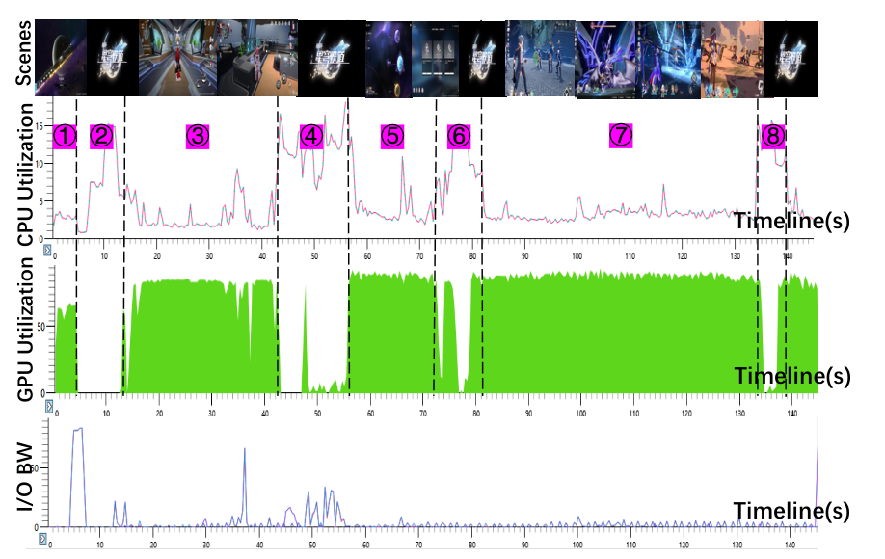



CoCG – Games Have Stages
Paper 3 · IPDPS ’24
One game, many stages (Devil May Cry 5)
Loading
low GPU, high I/O
Battle
GPU peak
Explore
medium load
Figure 19. Honkai: Star Rail — resource use per scene. [3]
Idea: pair games so their peaks never overlap; stretch loading screens as a buffer.

Slide 23
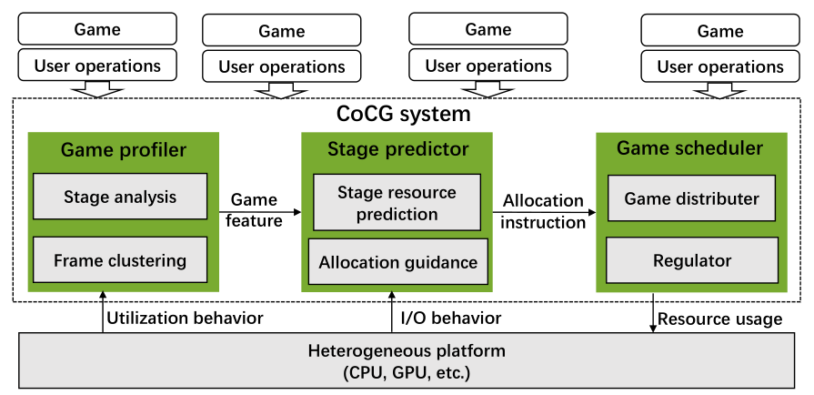
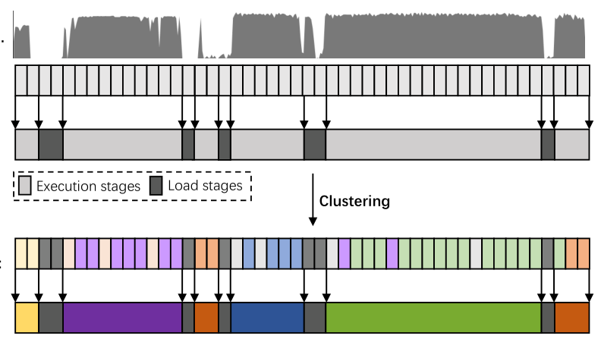
CoCG – Profile → Predict → Schedule
Paper 3 · IPDPS ’24
Figure 20. CoCG system overview. [3]
Figure 21. 5-second slices → K-means clusters → stages. [3]
1. Profile
2. Predict
3. Schedule
K-means
DTC / RF / GBDT
pair & regulate
find stages
> 92 % accuracy
extend loading

Slide 24
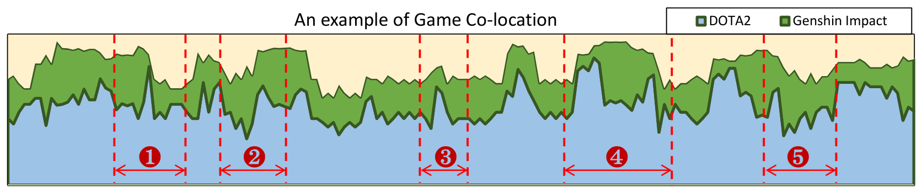
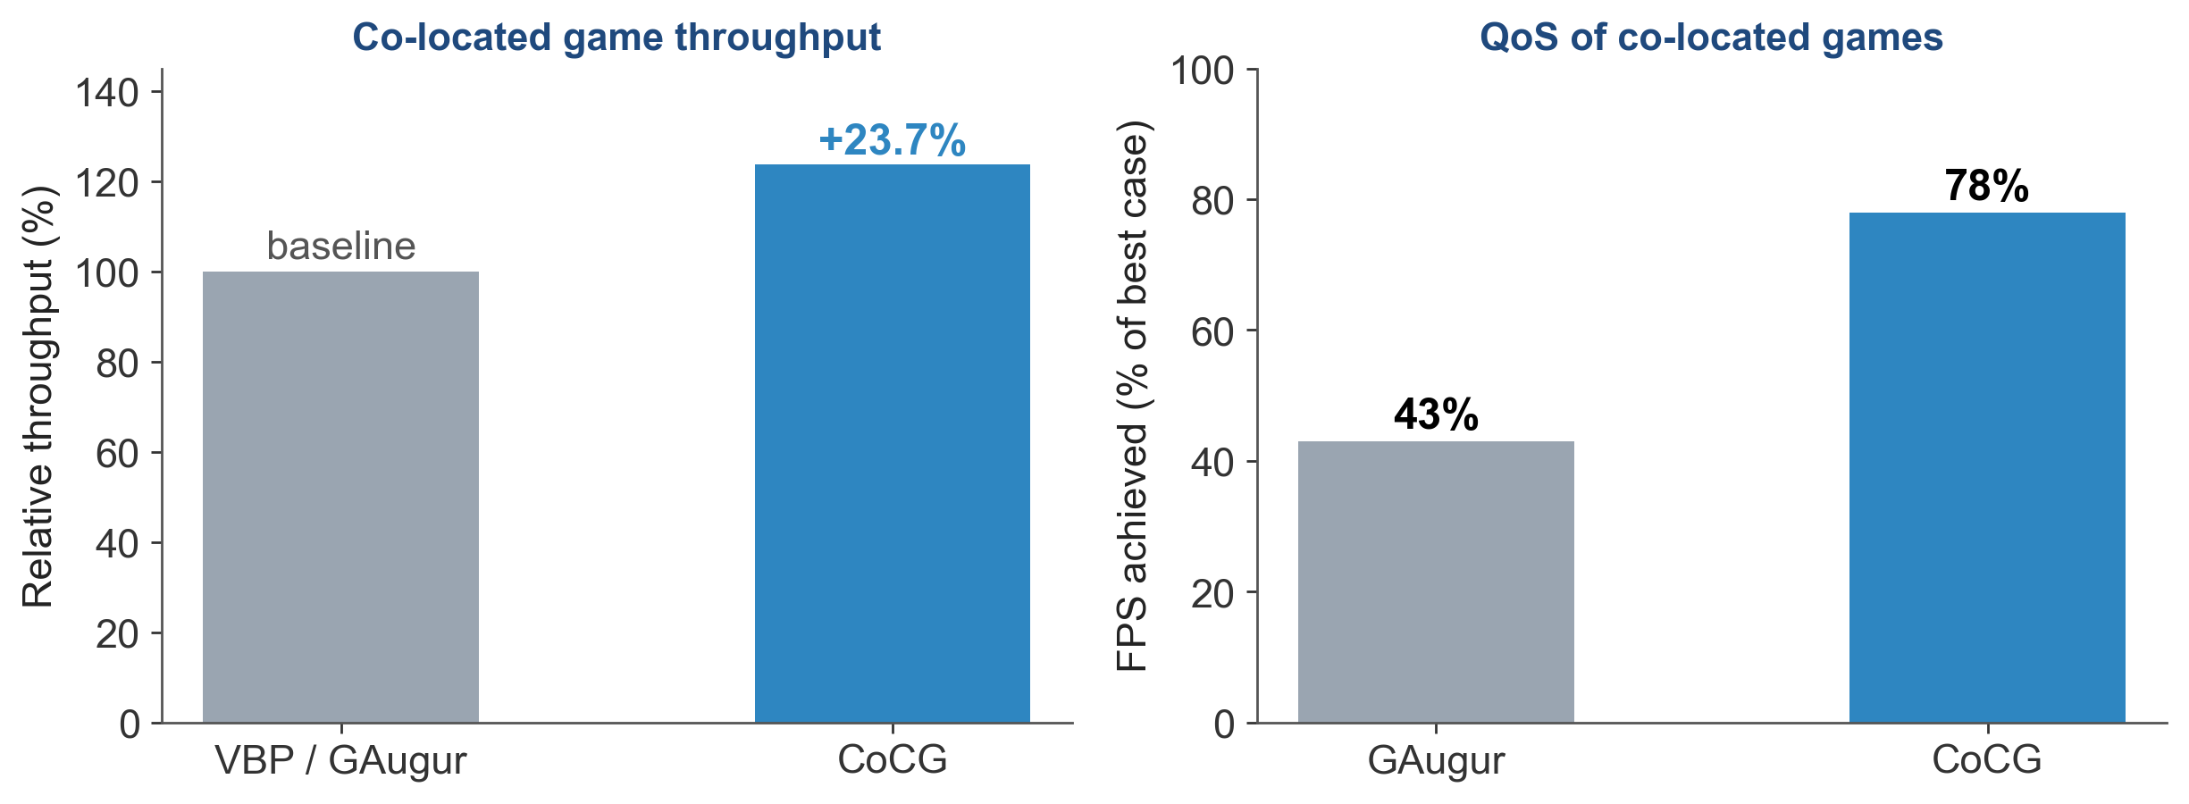

CoCG – Results
Paper 3 · IPDPS ’24
+23.7 %
17.5 %
78 % vs 43 %
3–13 s
throughput vs VBP / GAugur
resources saved (avg.)
of best FPS (vs GAugur)
prediction, hidden in loading
Figure 22. DOTA2 + Genshin Impact co-located (total ≤ 95 %). [3]
Figure 23. Throughput and QoS (data from [3]).
+
Genshin Impact
loading +15 s
peaks never overlap
one GPU, total load ≤ 95 %
DOTA 2

Slide 25

GPU Virtualization in Cloud Gaming
Introduction
Background & Related Work
PilotFish (ATC ’22)
Combo (SoCC ’23)
CoCG (IPDPS ’24)
Discussion & Conclusions
06
PUBG — 41 % average but 95 % peak GPU [1]

Slide 26
Comparison of the Three Works
 | PilotFish ’22 | Combo ’23 | CoCG ’24
Shares GPU with | AI training | AI training / CUDA | other games
Dimension | time | space (SMs, cores) | game stages
Granularity | < 1 ms kernel | per frame, per SM | ≥ 5 s stage
Sees the game via | DirectX hook | render-time model | ML stage predictor
Headline | 85 % idle harvested | +14 % vs PilotFish | +23.7 % throughput
Weak spot | DirectX 12 only | OptiX apps only | coarse control

Slide 27
My Analysis: Design Space & Open Problems
Portability
CoCG ’24
game + game · stages
open:
frame-level
game + game
DirectX / CUDA / NVIDIA only
game
Isolation
shared SMs → side channels
PilotFish ’22
time
Hypervisor
vGPU / MIG that know frames
AI
Combo ’23
space
LLM co-runners
two deadlines on one GPU
granularity: coarse (stage) → fine (kernel / SM)

Slide 28
Conclusions
PilotFish
time
know the frame → harvest 85 % of idle GPU
Combo
space
go spatial → +14 % over temporal
CoCG
stages
interleave stages → +23.7 % throughput
Take-away: cloud-gaming GPU virtualization must be QoS-aware — it has to understand frames, SMs and game stages.

Slide 29

Q & A
Thank you!
Questions & discussion are welcome
PilotFish · time
Combo · space
CoCG · stages

