Slide 1
Virtualization Techniques
Prof. Yeh-Ching Chung
School of Data Science
Chinese University of Hong Kong, Shenzhen

Slide 2
Outline
Introduction
Related Work
Preliminaries
Proposed Methods
Performance Evaluation
Conclusions

Slide 3
Virtualization Techniques
Introduction
Related Work
Preliminaries
Proposed Methods
Performance Evaluation
Conclusions

Slide 4
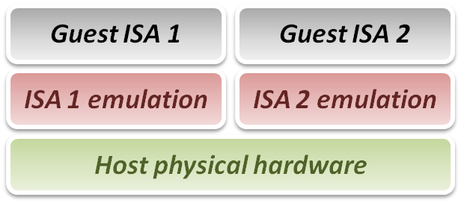
Introduction - Emulation Technique (1)
Why do we talk about emulation
In fact, virtualization technique can be treated as a special case of emulation technique.
Many virtualization techniques were developed in or inherited from emulation technique.
Goal of emulation
Provide a method for enabling a (sub)system to present the same interface and characteristics as another.

Slide 5
Introduction - Emulation Technique (2)
Three emulation implementations
Interpretation
Emulator interprets only one instruction at a time.
Static Binary Translation
Emulator translates a block of guest binary at a time and further optimizes for repeated instruction executions.
Dynamic Binary Translation
This is a hybrid approach of emulator, which mix two approaches above.
Design challenges and issues
Register mapping problem
Performance improvement

Slide 6
Introduction - Virtual Machine
A virtual machine (VM) is a software implementation of a machine (i.e. a computer) that executes programs like a physical machine, i.e., add Virtualizing Software to a Host platform and support Guest process or system

Slide 7
Virtualization Techniques
Introduction
Related Work
Preliminaries
Proposed Methods
Performance Evaluation
Conclusions

