Slide 1
Networking
Chapter 12

Slide 2
Distributed Capabilities
Communications architectures
  Software that supports a group of networked computers
Network operating system
  Each computer has its own private operating system
Distributed operating system
  Common operating system shared by a network of computers

Slide 3
The Need for a Protocol Architecture
Computer communications
  Exchange of information between computers for the purpose of cooperative action
Computer network
  When tow or more computers are interconnected via a communication network

Slide 4
Two Concepts
Protocol
  Used for communication between entities in different systems
Protocol architecture
  Broken into subtasks, each of which is implemented separately

Slide 5
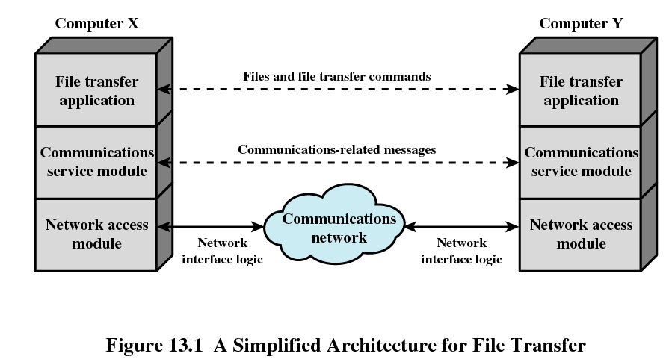
File Transfer

Slide 6
The TCP/IP Protocol Architecture
Protocol suite
Five relatively independent layers
  Physical
  Network access
  Internet
  Host-to-host, or transport
  Application

Slide 7
Physical Layer
Specifying
  the characteristics of the transmission medium
  Nature of the signals
  Data rate

Slide 8
Network Access Layer
Concerned with the exchange of data between an end system and the network
Different standards
  Circuit switching
  Packet switching (frame relay)
  LANs (Ethernet)

Slide 9
Internet Layer
Procedures for data to traverse different networks
Implemented in the end systems and routers

Slide 10
Transport Layer
Ensures all data arrives at the destination and in the order sent
TCP

Slide 11
Application Layer
Supports various user application
Example: file transfer

Slide 12
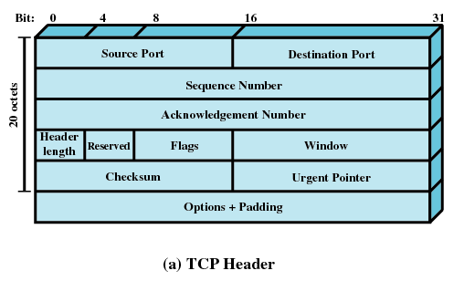
TCP Header

Slide 13
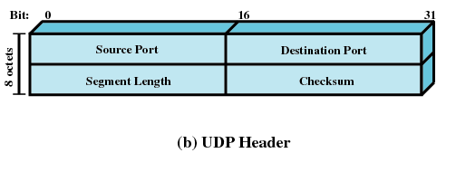
UDP

Slide 14
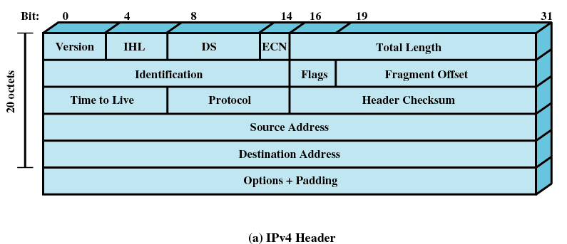
IP

Slide 15
IPv6
Provides enhancements over existing IP
Designed to accommodate higher speeds of a mix of data streams, graphic and video
Provides more addresses
Includes 128-bits for addresses
  IP uses 32-bit address

Slide 16
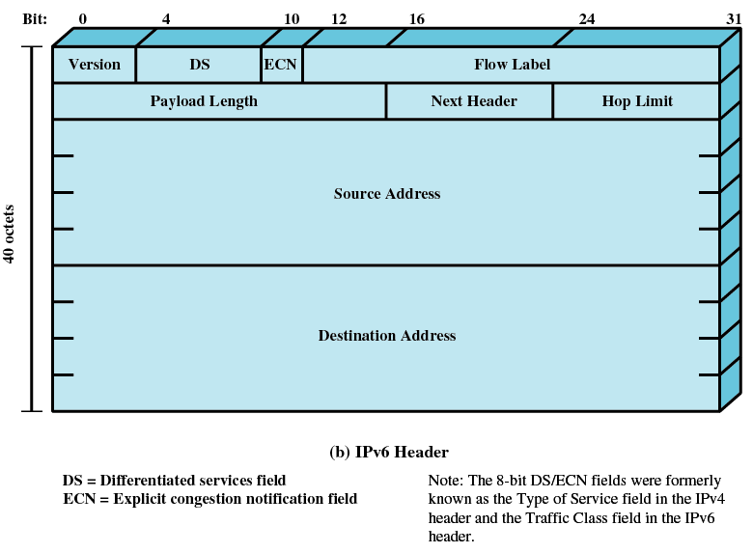
IPv6

Slide 17
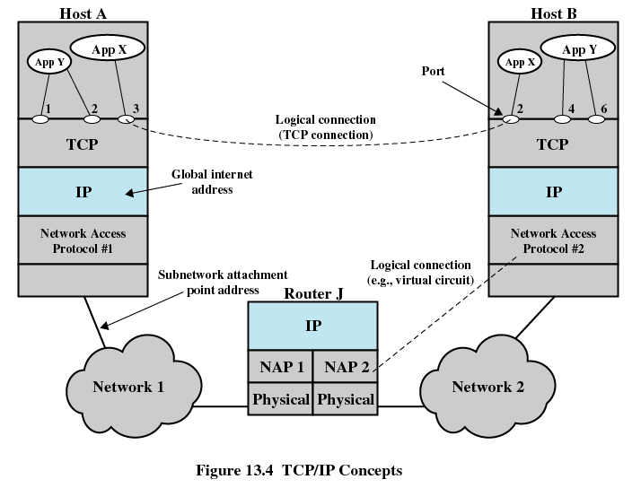
TCP/IP Concepts

Slide 18
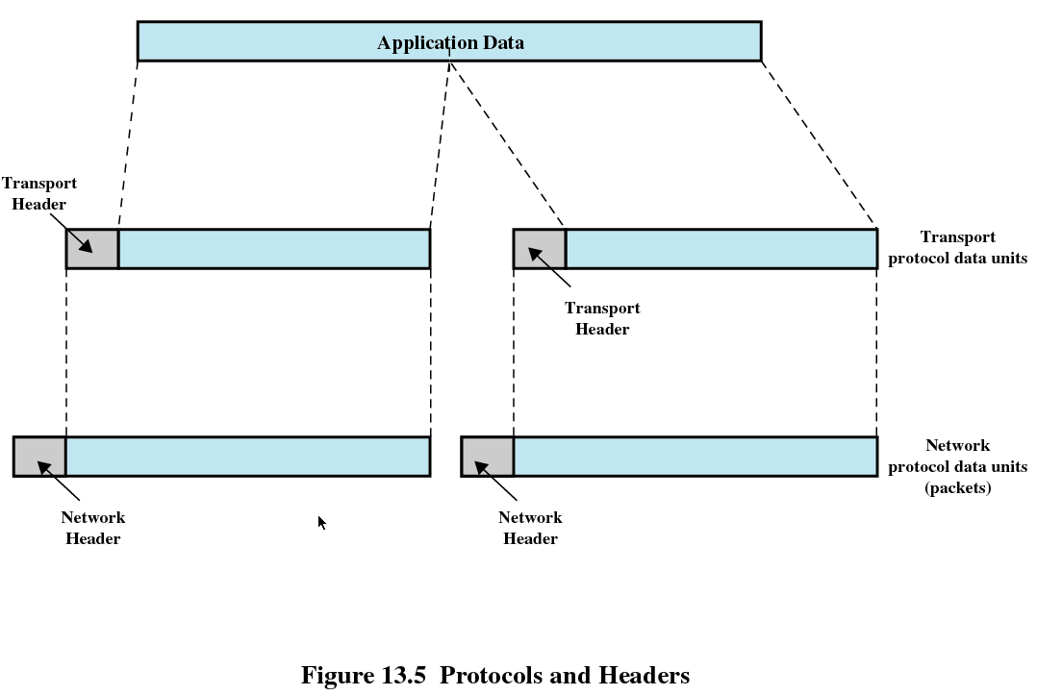
Protocols and Headers

Slide 19
Items in the Header
Destination network address
Facilities requests
  Example: priority

Slide 20
TCP.IP Applications
Simple Mail Transfer Protocol (SMTP)
File Transfer Protocol
TELNET

Slide 21
Sockets
Enable communication between a client and server
Concatenation of a port value and an IP address form a socket

Slide 22
Two Types of Sockets
Stream sockets
  Use TCP
  Reliable data transfer
Datagram sockets
  Use UDP
  Delivery is not guaranteed

Slide 23
Socket Setup
socket() command
Three parameters
  Protocol family is always PF_INET for TCP/IP
  Type specifies whether stream or datagram
  Protocol specifies either TCP or UDP

Slide 24
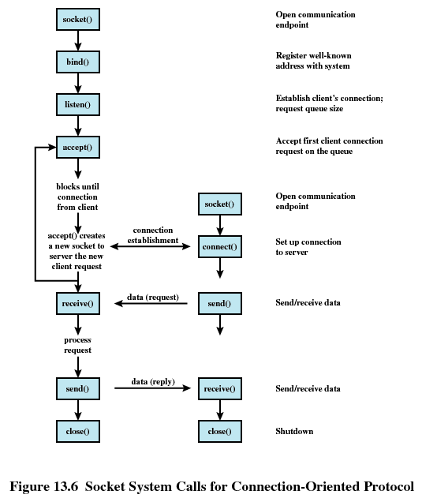

Slide 25
