Slide 1
CSC6032 – Advanced Operating Systems
RIOT
Prof. Yeh-Ching Chung
School of Data Science
Chinese University of Hong Kong, Shenzhen

Slide 2
Outline
Introduction
Technical Overview
RIOT in Action

Slide 3
What is RIOT
Operating system for microcontrollers
  Microkernel architecture ⇒ require very low resources
  Real-time and multi-threaded
  Comes with in-house networking stacks
Open-source: https://github.com/RIOT-OS/RIOT
  Free software platform
  World-wide community of developers
Easy to use and reuse
  Standard programming in C
  Standard tooling
  API is independent from the hardware

Slide 4
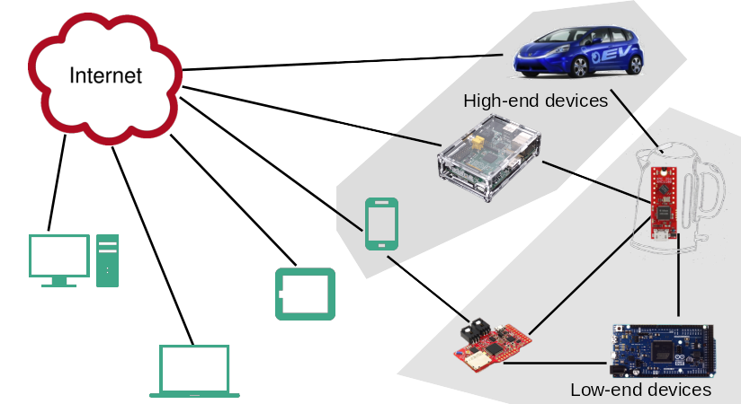
RTOS in IoT
RIOT is designed for low-end devices (kB RAM, MHz, mW )

Slide 5
History of the Project (1)
Inria, FU Berlin, and HAW founded RIOT in 2013
  Stemed from a French-German research project
  Kernel evolved from FireKernel
The community today
  So far, +200 different contributors to the master branch
  Academics: Berkeley, UCLA, MIT, AIT, TZI, etc
  Industrial: Cisco, Samsung, ImgTec, Fujitsu, Thalès
  SME: Zolertia, OTAKeys, Mesotic, Eistec, We-sens
  Member of the EdgeXFoundry initiative
  Kernel evolved from FireKernel

Slide 6
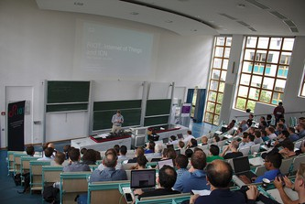

History of the Project (2)
Annual RIOT Summit: https://summit.riot-os.org

Slide 7
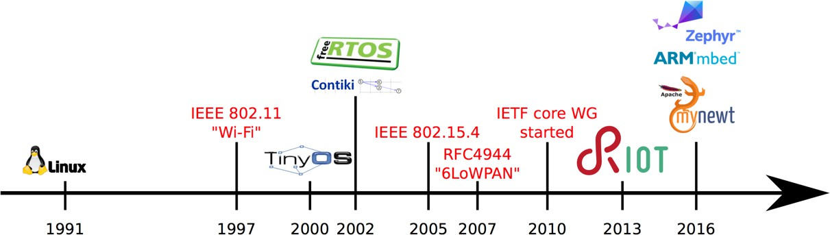
Competitors
Requires less memory & adapts to a wider range of architectures
Fosters an open-source philosophy
More akin to Linux provides more integrated high-level functionalities
Reference: O. Hahm et al. "Operating Systems for Low-End Devices in the Internet of Things: A survey," IEEE Internet of ThingsJournal, 2016.

Slide 8


The RIOT Philosophy & Community
RIOT is free-software, licensed under LGPLv2.1
The community takes inspiration from Linux
Use standards whenever possible (C-ANSI, standard tools, standard protocols, standard procedures)
Follow POSIX standards
Avoid code duplication, easy to program, increase portability, modularity
Vendor & Technology independence
Decisions and orientations are taken by a grass-root community

Slide 9
Ecosystem & Community Processes
Standard tooling and build system: Makefiles, OpenOCD, GDB
Distributed and fast CI, Murdock: https://ci.riot-os.org
⇒ Build and run all test/example applications
⇒ Static tests (Cppcheck, Coccinelle, etc)
Online documentation ⇒ https://doc.riot-os.org
In-depth code reviews
Stable release every 3 months: . (ex: 2018.07, 2018.10, etc)

Slide 10
Outline
Introduction
Technical Overview
RIOT in Action

Slide 11
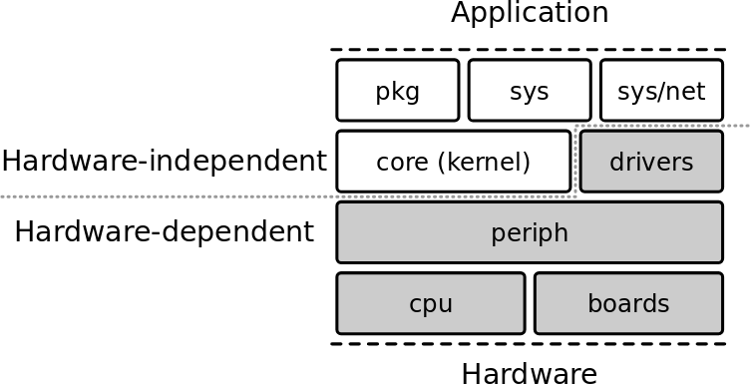
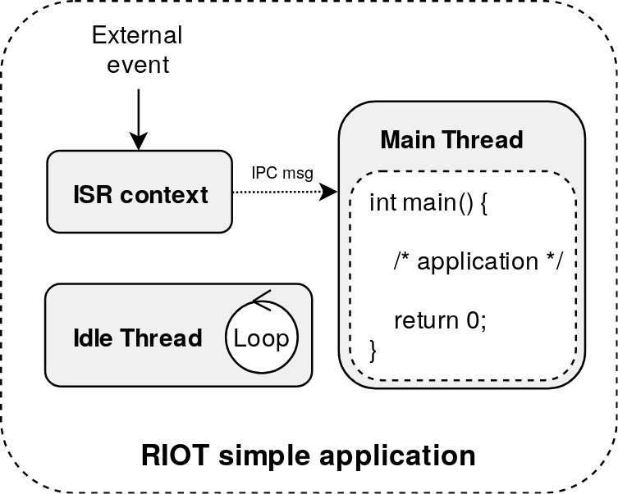
OS Characteristics
Micro-kernel based architecture: modular approach
Small footprint
  2.8KB RAM, 3.2KB ROM on 32-bit Cortex-M
Real-time scheduler
⇒ fixed priorities preemption with O(1) operations
⇒ Tickless scheduler
Multithreading and IPC
  Separate thread contexts with separate thread memory stack
  Minimal thread control block (TCB) Thread synchronization using mutexes, semaphores and messaging

Slide 12
Multi-Threading
With 2 threads
  The main thread running the main function
  The idle thread
    Lowest priority
    ⇒ fallback thread when all other threads are blocked or terminated
    Switches the system to low-power mode
The ISR context handles external events and notifies

Slide 13
Hardware Abstraction Layer
Divided in 3 blocks: boards, cpus, drivers
CPUs are organized as follows:
  Architecture (ARM) > family (stm32) > type (stm32l4) > model (stm32l476rg)
Generic API for cpu peripherals (gpio, uart, spi, pwm, etc)
⇒ same API for all architectures
Only based on vendor header files (CMSIS) ⇒ implementation from scratch ⇒ less code duplication, more efficient, more work
One application ⇒ one board ⇒ one cpu model

Slide 14
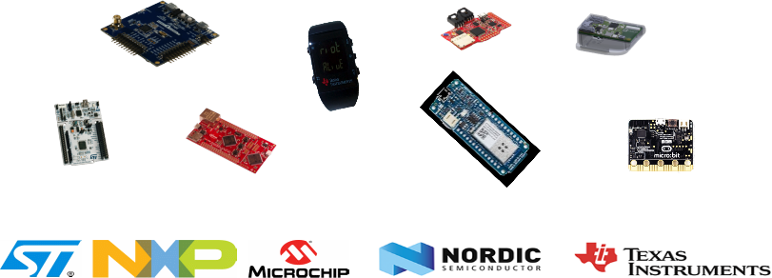
Hardware Support Review
Hardware abstraction layer
  Support 8/16/32 bit, ARM, AVR, MIPS CPUs
  Supported vendors: Microchip, NXP, STMicroelectronics, Nordic, TI, ESP, RISC-V, etc.
Large list of sensors and actuators supported (drivers)
Native board – Run RIOT as process on your computer
+100 boards supported

Slide 15
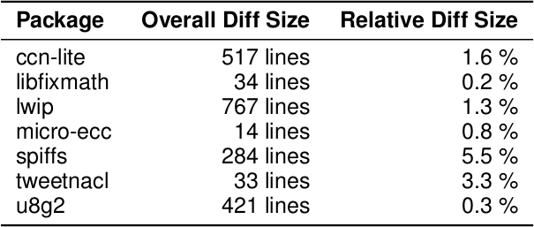
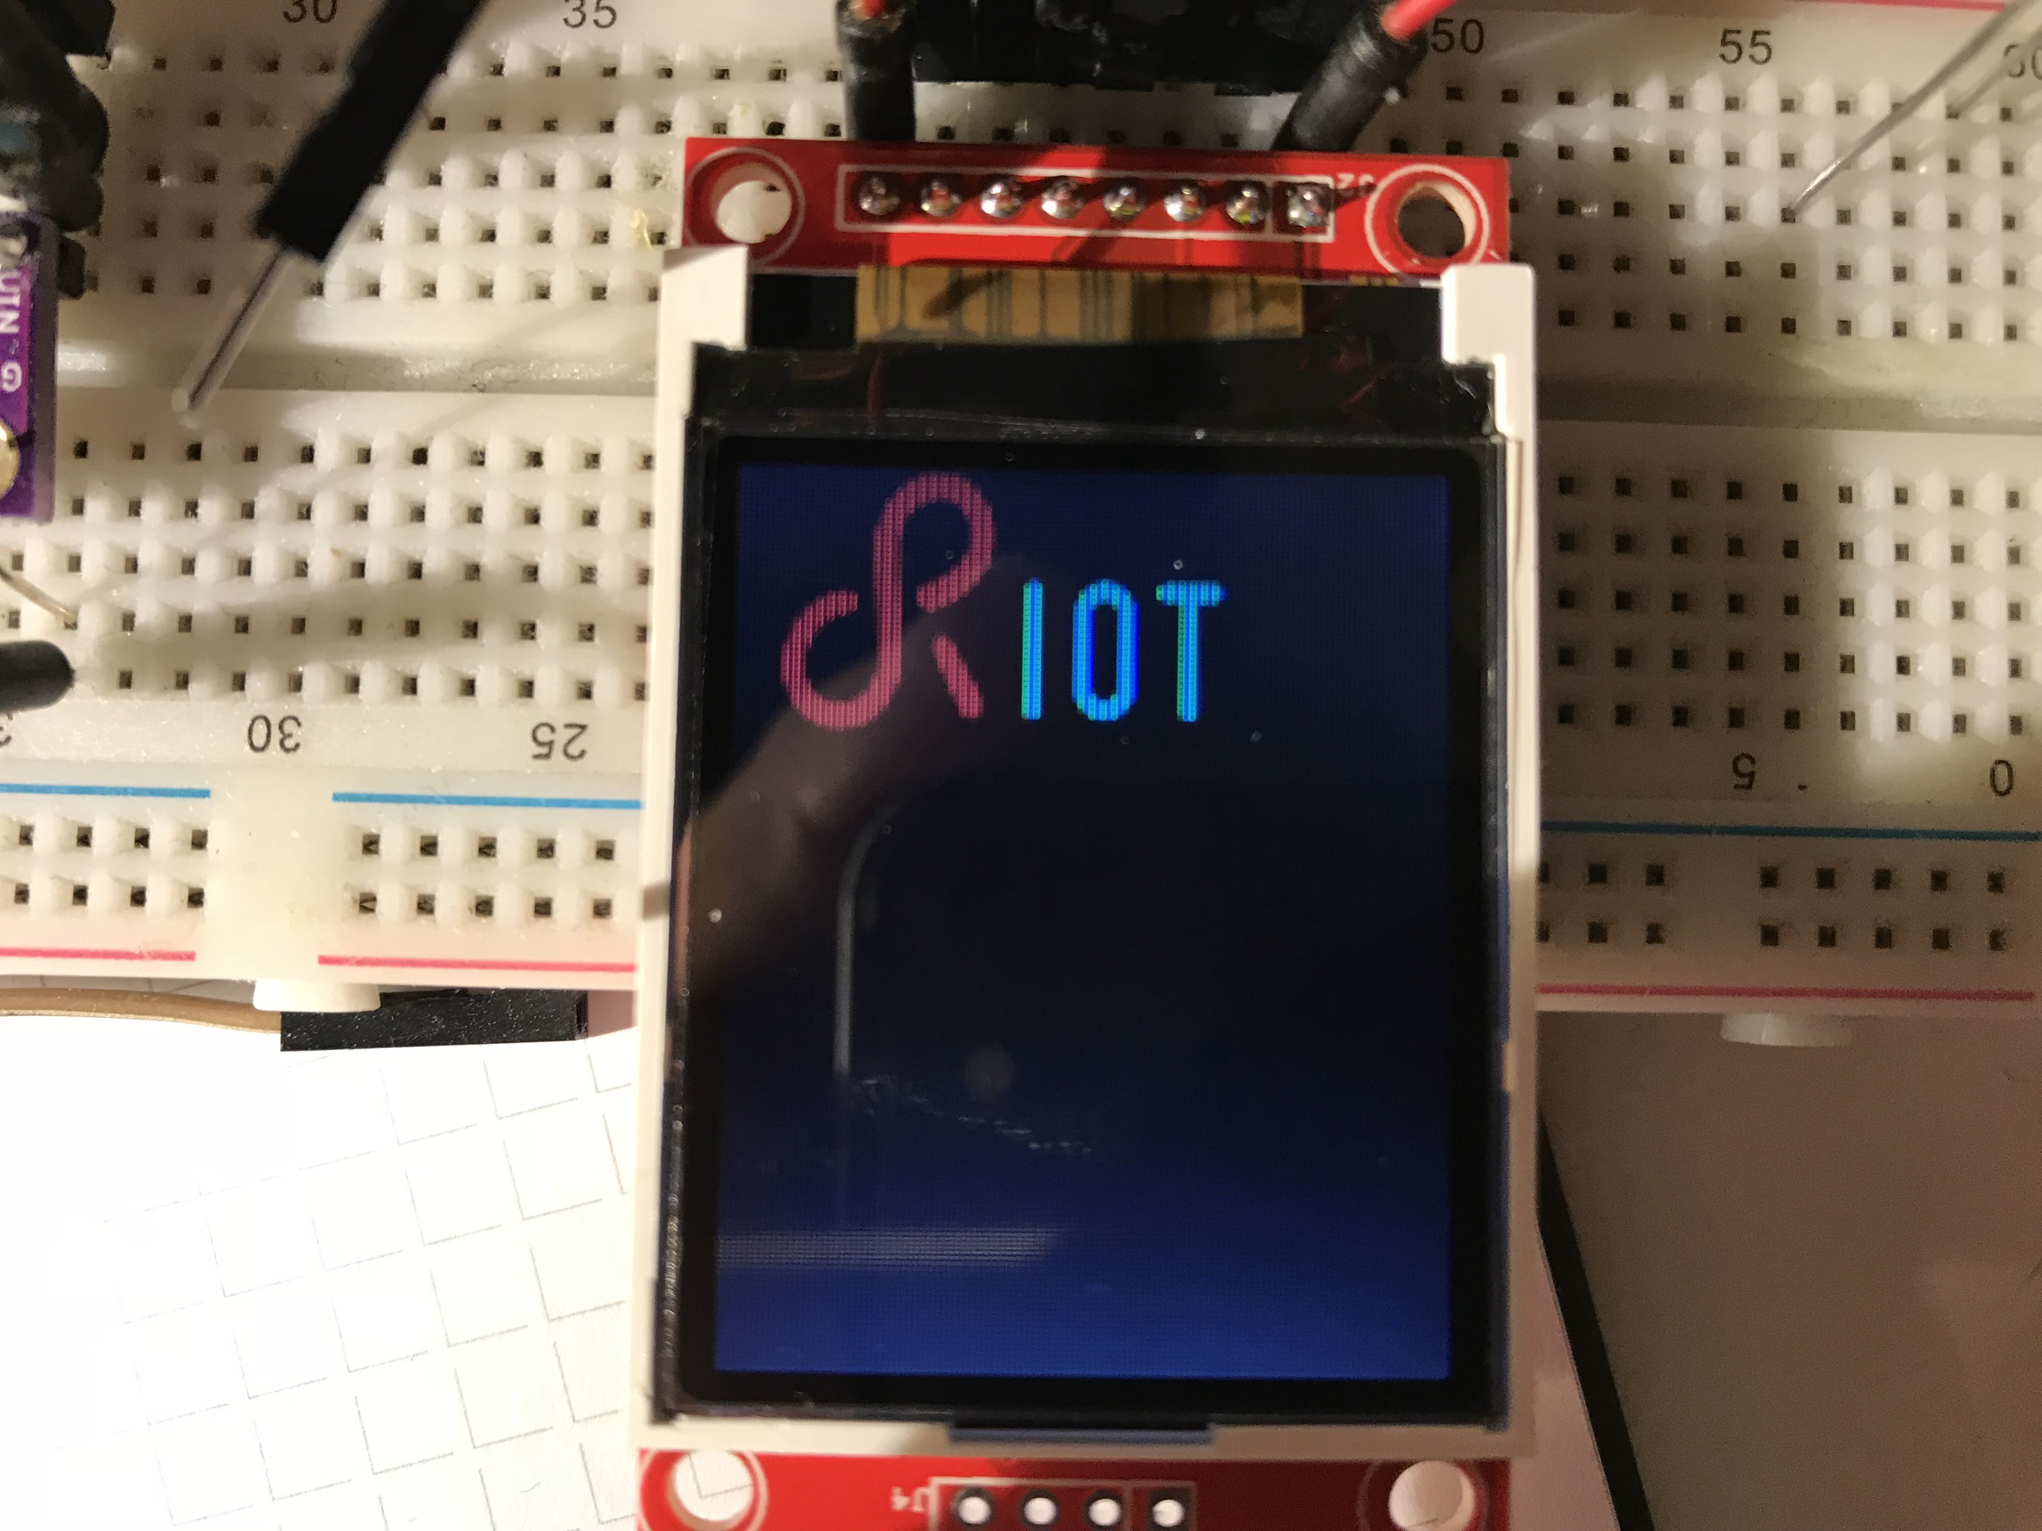
A Modular OS
Features are provided as modules ⇒ only built what’s required
  System libraries : xtimer, shell, crypto, etc.
Sensor and actuators
Display drivers, filesystems, etc.
Embedded interpretors: Javascript, Micropython, LUA
High-level network protocols: CoAP, MQTT-SN, etc.
External packages

Slide 16
Useful System Libraries (1)
Features are provided as modules ⇒ only built what’s required
  System libraries : xtimer, shell, crypto, etc.
Sensor and actuators
Display drivers, filesystems, etc.
Embedded interpretors: Javascript, Micropython, LUA
High-level network protocols: CoAP, MQTT-SN, etc.
External packages

Slide 17
Useful System Libraries (2)
Xtimer
  High-level timer subsystem that provides full abstraction from the hardware timer
  Can set callbacks, put a thread to sleep, etc
Shell
  Provides interactive command line interface
  Useful for interactive debugging or examples
Others:
  crypto, fmt, math, etc

Slide 18
External Packages
RIOT can be extended with external packages
Integrated (and eventually patched) on-the-fly while building an application
Easy to add: just requires 2 Makefiles
Example of packages: lwIP, Openthread, lvgl, loramac, etc

Slide 19

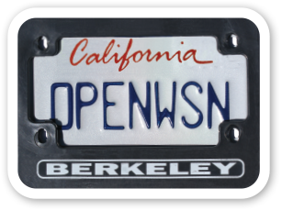
Network Stacks
IP oriented stacks ⇒ designed for Ethernet, WiFi, 802.15.4 networks
  GNRC : The in-house 802.15.4/6LowPAN/IPv6 stack of RIOT
  Thread: 802.15.4 IPv6 stack provided by the ThreadGroup
  OpenWSN (experimental): a deterministic MAC layer implementing the IEEE 802.15.4e TSCH protocol
  Other IPv6 stacks:
    lwIP: full-featured network stack designed for low memory consumption
    emb6: A fork of Contiki network stack that can be used without protothreads

Slide 20



Other Network Support
In-house Controller Area Network (CAN)
BLE stack support: NimBLE
LoRaWAN stack ⇒ Compliant with LoRaWAN 1.0.2
SigFax support for ATA8520e modulesExample of packages: lwIP, Openthread, lvgl, loramac, etc

Slide 21

Other Important Features
Full featured USB stack (CDC-ACM, CDC-ECM, etc
Standard and secure software update implementation
https://datatracker.ietf.org/wg/suit/about/
NB-IoT support
More advanced configuration with Kconfig

Slide 22
Outline
Introduction
Technical Overview
RIOT in Action

Slide 23
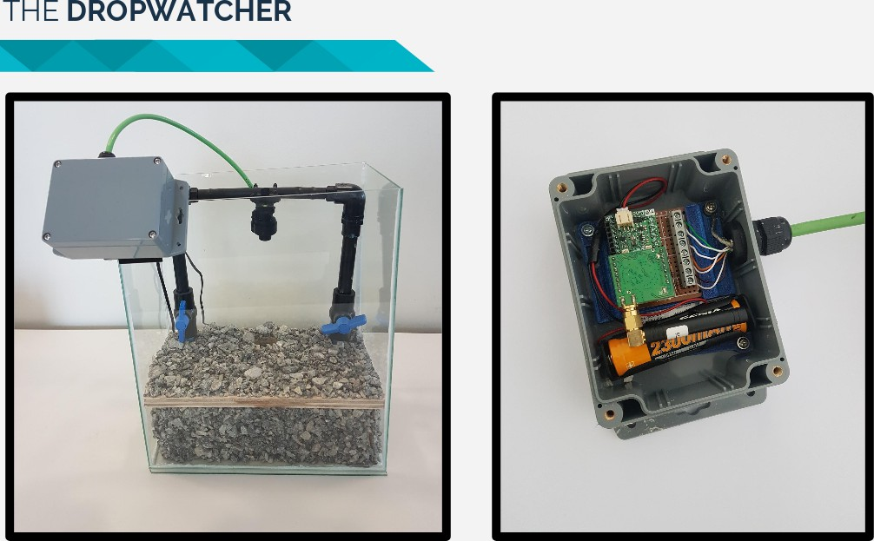
IoT Deployments Using RIOT (1)
Telefonica Chile –LoRa devices in a mine
More information

Slide 24
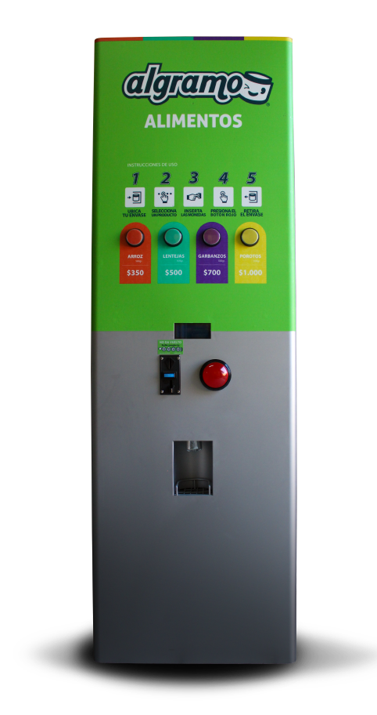
IoT Deployments Using RIOT (2)
Algramo – Automatic cereal dispenser
More information

Slide 25
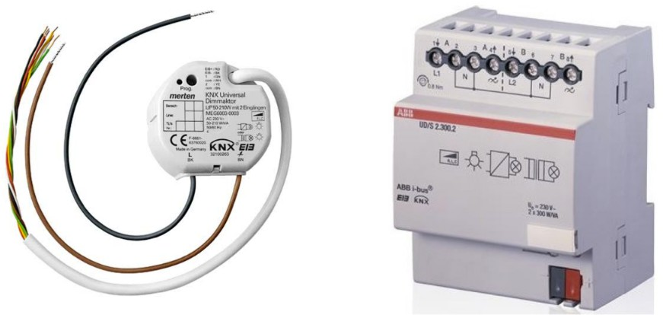
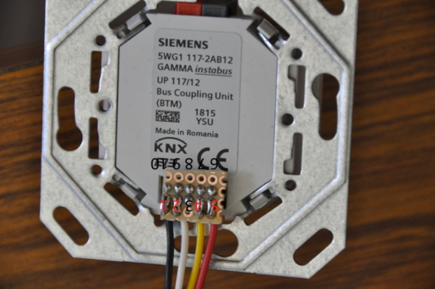
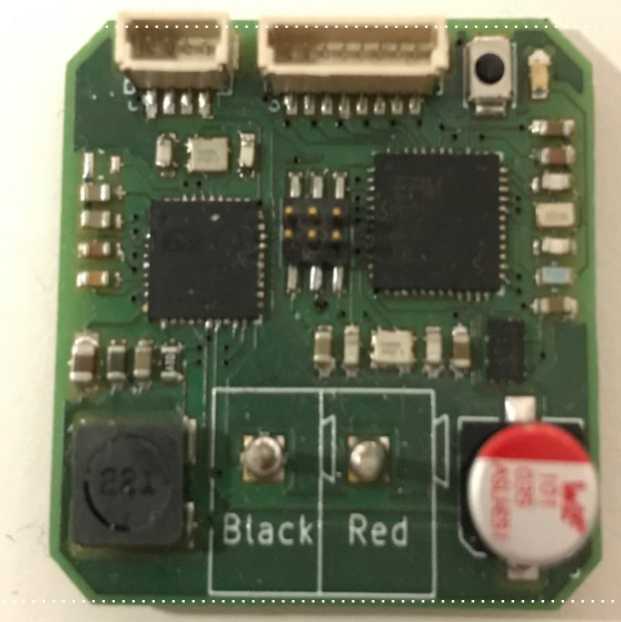
IoT Deployments Using RIOT (3)
Home automation using KNX
More information

Slide 26
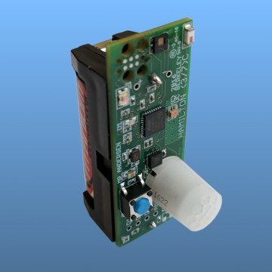
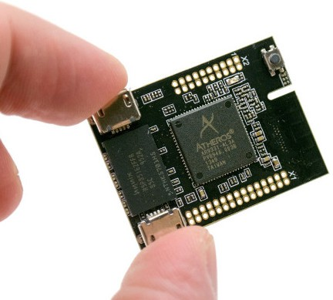
IoT Products & Services Using RIOT
Environment monitoring: Hamilton IoT (USA), Unwired Devices (Russia)
On-Board diagnostics for connected cars: OTAKeys (Continental)
Design Office: Eistec (Sweeden), Mesotic (France)

Slide 27

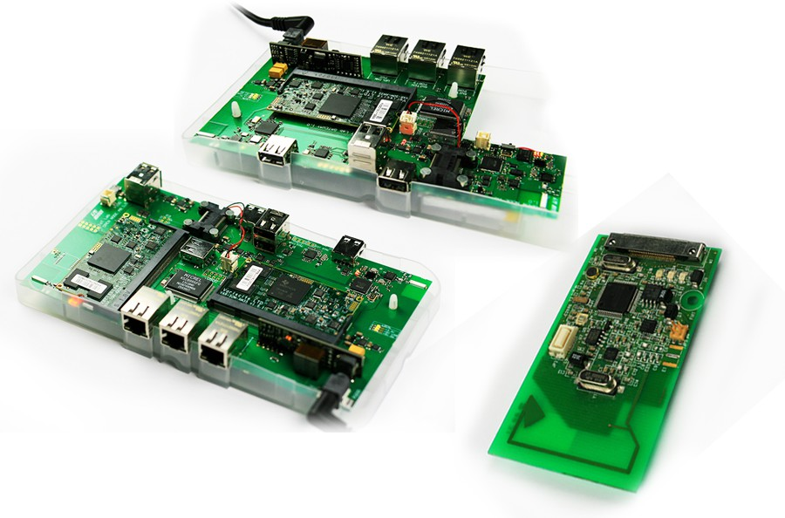
RIOT on FIT/IoT-LAB Large Scale Testbed
IoT-LAB (https://www.iot-lab.info) is a large scale experimentation testbed
Can be used for testing wireless communication networks on small devices
Can be used for learning IoT programming and communication protocols
Can be used for testing software platforms on heterogeneous hardware

Slide 28
Learn RIOT
RIOT Tutorials https://github.com/RIOT-OS/Tutorials
RIOT online course https://github.com/riot-os/riot-course

Slide 29
Summary
Generalities on RIOT: history, community, users
A technical overview
  OS characteristics
  OS characteristics
  Libraries
  Network stack
  Import external libraries via packages
The RIOT ecosystem: standard tools, CI, documentation Companies using RIOT

Slide 30
Q & A

