Slide 1
Lecture Two
Introduction to Network Operating Systems
Dr. Tarfa Yaseen Hamed Department of Networks
College of Computer Science and Mathematics University of Mosul
2025

Slide 2
What is an Operating System?
Definition: An OS is system software that manages hardware and software resources.
Types: Standalone OS (e.g., Windows, Linux) vs. Network OS (e.g., Windows Server, Linux-based NOS).

Slide 3
What is a Network Operating System?
A NOS is an OS designed to manage network resources.
Enables multiple computers to communicate and share resources.
Examples: Windows Server, Linux (Ubuntu Server, Red Hat), Cisco IOS.

Slide 4
NOS vs. Standalone OS
A NOS is users and
optimized for managing multiple network resources, making it
essential for businesses, data centers, and enterprise environments, whereas standalone OS are better suited for personal computing.

Slide 5
NOS vs. Standalone OS (cont.)
Feature | Standalone OS | Network OS
User Focus | Single user | Multi-user, multi-device
Resource Management | Local resources | Network resources
Security | Local security policies | Centralized security policies
Examples | Windows 11, macOS | Windows Server, Linux Server

Slide 6
Key Functions of NOS
Network Resource Management
Multi-user Access & Authentication
Security & Data Protection
Remote Access
Network Communication & Routing
Performance Monitoring & Optimization

Slide 7
Architecture of a NOS
Client-Server Model: Centralized control with client machines.
Peer-to-Peer Model: Decentralized with equal devices.

Slide 8


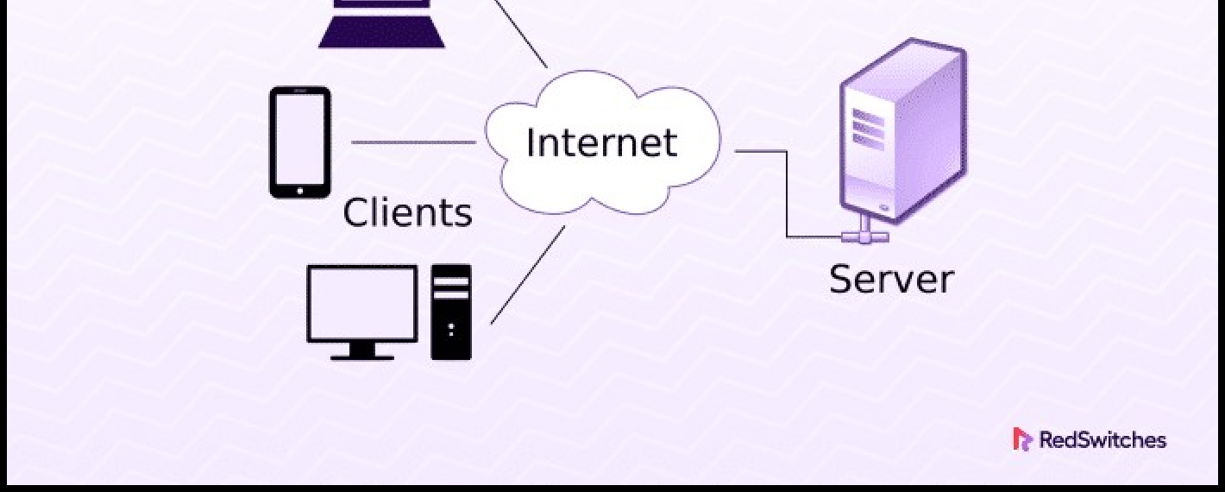
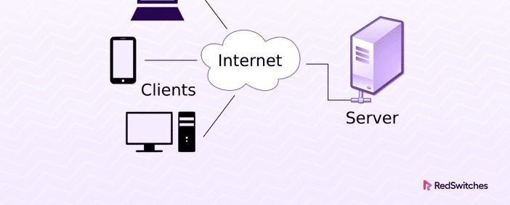
Client-Server Model

Slide 9
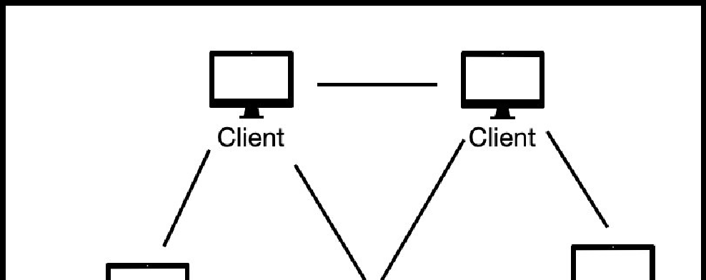
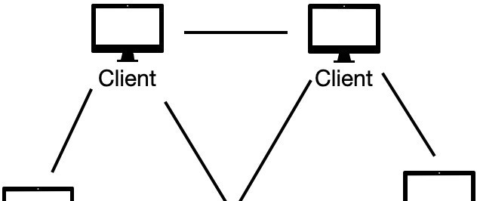
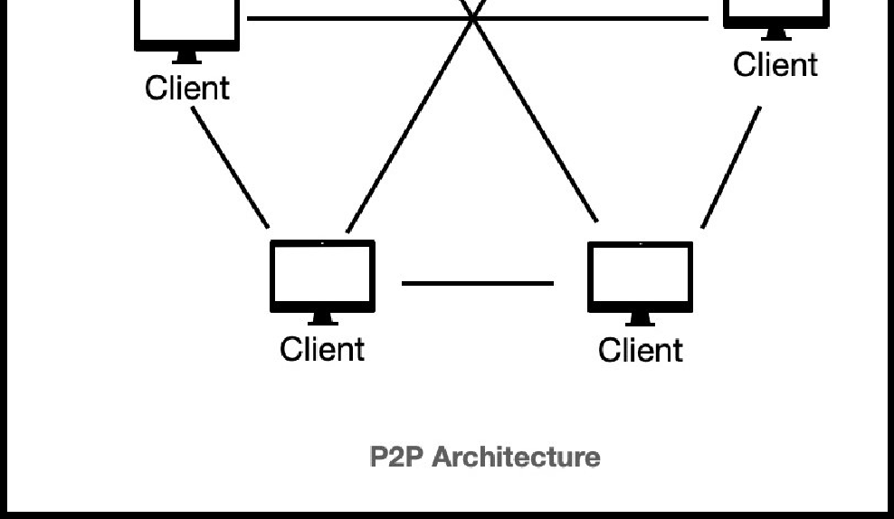
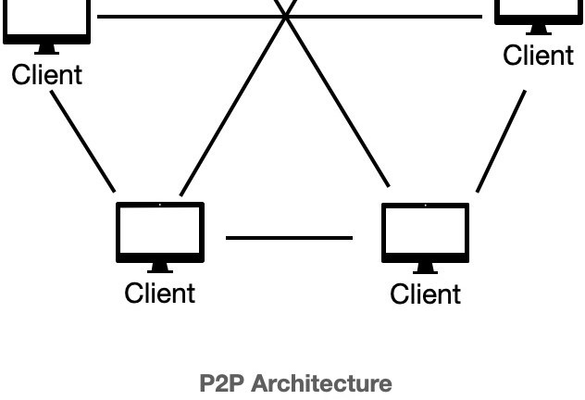
Peer-to-Peer Model

Slide 10
Examples of NOS
Microsoft Windows Server: Enterprise- grade server OS
Linux-based NOS: Ubuntu Server, Red Hat Enterprise Linux
Unix-based NOS: Solaris, FreeBSD
Cisco IOS: Used in networking devices
10

Slide 11
Network Resource Management
File and Print Sharing: Manages shared access to files and printers across the network, ensuring users have appropriate permissions.
User and Group Management: Allows administrators to create, modify, and manage user accounts and group policies to control access and security.
Disk Quotas and Storage
Management:
Monitors and prevent excessive
allocates storage
resources to
usage and ensure optimal
performance.
11

Slide 12
Network Resource Management (cont.)
Resource Allocation & Load Balancing:
Distributes network resources efficiently to prevent bottlenecks and maintain system performance.
Peripheral Device Management: Controls and monitors network-attached devices such as scanners, printers, and external storage.

Slide 13
User Management in NOS
Authentication (Usernames, Passwords, Multi-factor Authentication)
Authorization (Permissions, Access Control Lists)
User Roles and Policies

Slide 14
Security Features in NOS
Firewalls & Intrusion Detection
Encryption (TLS, SSL)
VPN & Remote Access Security
Role-based access control

Slide 15
Remote Access in NOS
Remote Desktop Protocol (RDP)
Secure Shell (SSH)
Virtual Private Networks (VPNs)
Web-based access portals

Slide 16
Remote Desktop Protocol (RDP)
RDP is a protocol developed by Microsoft that allows users to remotely access and control a computer running Windows.
It provides a graphical user interface (GUI) so you can see the desktop of the remote machine and interact with it as if you were sitting in front of it.

Slide 17
Secure Shell (SSH)
A cryptographic network protocol that allows secure remote login and other secure network services over an unsecured network.
It provides confidentiality, integrity, and authentication.

Slide 18
Virtual Private Networks (VPNs)
A Virtual Private Network (VPN) extends a private network across a public network, such as the Internet.
It enables users to send and receive data across shared or public networks as if their computing devices were directly connected to the private network.
In a NOS context, a VPN allows secure access to network resources from remote locations.

Slide 19
Web-based access portals
Web-based access portals provide a single point of
entry for users to access various applications, resources, and information through a web browser.
They offer a centralized and user-friendly interface, simplifying access and improving productivity.
In a (NOS) context, these portals
access to network resources and tools.
often provide
administrative

Slide 20
Network Communication & Protocols
TCP/IP model
Network Protocols (DHCP, DNS, FTP, SMTP, HTTP/HTTPS)
Packet Switching & Routing
Internet Printing Protocol (IPP)
⁻ Enables remote printing over networks or the internet.
⁻ Uses HTTP/HTTPS for communication.
⁻ Supports encryption, authentication, and print job management.
⁻ Commonly used in enterprise printing and CUPS (Common Unix Printing System).
20

Slide 21
Performance Monitoring in NOS
Network Traffic Analysis
Resource Utilization Monitoring
Load Balancing & Fault Tolerance

Slide 22
Windows Server Overview
Features: Active Directory, IIS, Hyper-V
Common Uses: Enterprise Networks, Cloud Services

Slide 23
Linux-Based NOS Overview
Features: Open-source, Secure, Flexible
Common Uses: Web Servers, Data Centers

Slide 24
Case Study – Enterprise Network Setup
A large organization with multiple departments using Windows Server and Linux-based NOS.
Centralized authentication using Active Directory.
Challenges faced:
₋ Scalability: Managing increasing users and network traffic.
₋ Security Risks: Ensuring data protection against cyber threats.
₋ Interoperability: Integrating different operating systems and applications.
₋ Maintenance & Downtime: Ensuring continuous network availability and quick recovery from failures.

Slide 25
Case Study – Enterprise Network Setup (cont.)
Solutions and best practices for overcoming these challenges.
A large organization with multiple departments using Windows Server and Linux-based NOS.
Centralized authentication using Active Directory.

Slide 26
Future Trends in NOS
Cloud-based NOS solutions: Enhancing scalability and reducing infrastructure costs for businesses.
AI & Machine
Learning in network management: Improving automation,
security, and predictive maintenance.
Edge Computing
&
IoT Integration:
Allowing faster processing
and real-time
decision-making for IT professionals managing large-scale networks.

