Slide 1


Slide 2
Introduction to multitasking in Small
Embedded Systems
Most embedded real-time applications include a mix of both hard and soft real-time requirements.
Soft real-time requirements
  State a time deadline, but breaching the deadline
would not render the system useless.
    E.g., responding to keystrokes too slowly
Hard real-time requirements
  State a time deadline, but breaching the deadline would result in absolute failure of the system.
    E.g.1a driver's airbag would be useless if it responded to crash event too slowly.

Slide 3
FreeRTOS
FreeRTOS is a real-time kernel/scheduler on top of which MCU applications can be built to meet their hard real-time requirements.
  Allows MCU applications be organized as a collection of independent threads of execution.
  Decides which thread should be executed by examining the priority assigned to each thread.
    Assume a single core MCU, where only a single thread can be executing at one time.

Slide 4
The simplest case of task priority
assignments
Assign higher priorities (lower priorities) to threads that implement hard real-time (soft real-time) requirements
— As a result, hard real-time threads are always executed ahead of soft real-time threads.
But, priority assignment decision are not always that simple.
In general, task prioritization can help ensure an application meet its processing deadline.

Slide 5

note about terminology
In FreeRTOS, each thread of execution is
called a ‘task’.
s

Slide 6
Why use a real-time kernel
For a simple system, many well-established techniques can provide an appropriate solution without the use of a kernel.
For a more complex embedded application, a kernel would be preferable.
But where the crossover point occurs will always
be subjective.
Besides ensuring an application meets its processing deadline, a kernel can bring other less obvious benefits.

Slide 7
Benefits of using real-time kernel
Abstracting away timing information
  Kernel is responsible for execution timing and provides a time-related API to the application. This allows the application code to be simpler and the overall code size be smaller.
Maintainability/Extensibility
  Abstracting away timing details results in fewer interdependencies between modules and allows sw to evolve in a predictable way.
  Application performance is less susceptible to changes in the underlying
hardware.
Modularity
  Tasks are independent modules, each of which has a well-defined purpose.
Team development
  Tasks have well-defined interfaces, allowing easier development by
teams

Slide 8
Benefits of using real-time kernel
Easier testing
  Tasks are independent modules with clean interfaces, they can be tested in isolation.
Idle time utilization
  The idle task is created automatically when the kernel is started. It executes whenever there are no application tasks to run.
  Be used to measure spare processing capacity, perform background checks, or simply place the process into a low-power mode.
Flexible interrupt handling
  Interrupt handlers can be kept very short by deferring most
of the required processing to handler tasks.

Slide 9
Standard FreeRTOS features
Pre-emptive or co-operative operation
Very flexible task priority assignment
Queues
Binary/Counting / Recursive semaphores
Mutexes
Tick/Idle hook functions
Stack overflow checking
Trace hook macros
Interrupt nesting

Slide 10
Outline
Task Management
Queue Management
Interrupt Management
Resource Management
Memory Management
Trouble Shooting

Slide 11
TASK MANAGEMENT

Slide 12
. Introduction and scope
Main topics to be covered
  How FreeRTOS allocates processing time to each task within an application
  How FreeRTOS chooses which task should execute at any given time
  How the relative priority of each task añects system behavior
  The states that a task can exist in.

Slide 13
More specific topics
How to implement tasks
How to create one or more instances of a task
How to use the task parameter
How to change the priority of a task that has
already been created.
How to delete a task.
How to implement periodic processing.
When the idle task will execute and how it can
be used.

Slide 14
1.2 Task functions
Tasks are implemented as C functions.
  Special: Its prototype must return void and take a void pointer parameter as the following
void ATaskFunction (void *pvParameters);
Each task is a small program in its own right.
  Has an entry point
  Normally runs forever within an infinite loop
  Does not exit

Slide 15
Special features of task function
FreeRTOS task
  Must not contain a ’return’ statement
  Must not be allowed to execute past the end of the function
  If a task is no longer required, it should be explicitly deleted.
  Be used to create any number of tasks
    Each created task is a separate execution instance with its own stack, and its own copy of any automatic variables defined within the task itself.

Slide 16




Tbo JFBBE paz=•••Mr paaaert Lo b2uz nas&1Xzlobo fl tuocLLon 1o4Łezbias tbaL
Łba LmiJc to bo dsleLwl La LWz eal1tag \Łb£W LaaŁ: •/

Slide 17
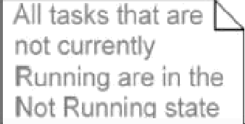

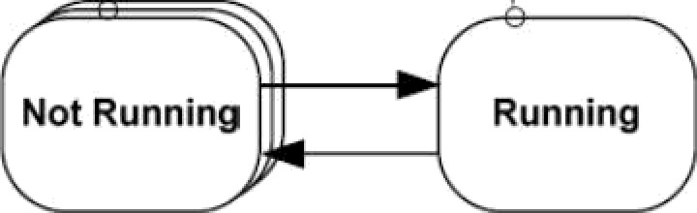
. To level tas states
A task can exist in one of two states: Running
and Not Running
Running state the processor is
executing its code.
Not Running state the task is dormant, its status having been saved ready
for resuming execution the next time
Not Running
Running
Scheduler is the only entity that can switch a task in and out a running state.

Slide 18
.4 Creating Tasks
xTaskCreate() API function
  the most fundamental component in a multitasking
system
    Probably the most complex of all API functions
portBASE_TYPE xTaskCreate(
RdTASK_CODE pvTaSkCode,
const signed char unsigned short void
” consf pcName,
usStackDepth,
*RVParameters,
unsigned portBASE_TYPE uxPriority, xTaskHandle ”pxCreatedTask

Slide 19
All parameters
pvTaskCode
  a pointer to the function (just the function name)
that implements the task.
pcName
  A descriptive name for the task. It is not used by FreeRTOS, but a debugging aid.
  configMAX TASK NAME LEN: the application defined constant that defines the maximum length a task name can task including the NULL terminator.

Slide 20
usStackDepth
  Each task has its own unique stack that is allocated by the kernel to the task when the task is created.
  The value specifies the number of words the task stack can hold.
    E.g., Cortex-M3 stack is 32 bits wide, if usStackDepth is passed in as 100, 400 bytes of stack space will be allocated (100*4 bytes)
Size of the stack used by the idle task is defined
by configMlNlMAL STACK SIZE.
  Adjustable w.r.t. applications

Slide 21
pvParameters
  The value assigned to pvParameters will be the values passed into the task.
uxPriority
  defines the priority at which the task will execute.
  Priorities can be assigned from 0, which is the lowest priority, to (configMAX PRIOIRTIES-1), which is the highest priority.
  Passing a value above (configMAX PRIOIRTIES -
1 will result in the priority being capped the
maximum legitimate value.

Slide 22
pxCreatedTask
  pass out a handle to the created tas+1then be used to refer the created task in API calls.
    E.g., change the task priority or delete the task
  Be set to NULL if no use for the task handle
Two possible return values
  pdTRUE : task has been created successfully.
  errCOULD NOT ALLOCATE REQUIRED MEMORY
    Task has not been created as there is insufficient heap memory available for FreeRTOS to allocate enough RAM to hold the task data structures and stack.

Slide 23
Example Creating tasks
To demonstrate the steps of creating two tasks then starting the tasks executing.
  Tasks simply print out a string periodically, using a crude null loop to create the periodic delay.
  Both tasks are created at the same priority and are identical except for the string they print out.

Slide 24
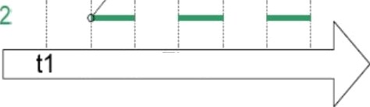
Execution pattern of two Example 1 tasks
At tirre t1 Task enters the Running state ard exec Yes uiilil ti i o i2
At Anne t2 Task 2 enters the Running see ard executes uni! time t3 - at which po‹nt Task‹ re-enters the Running stale
Task 1
Task
t2 t3 Time
Both tasks are rapidly entering and exiting the
Running state.
Only one task can exist in the Running state at any one time.

Slide 25
Example 2 Using the task parameter
The two tasks in Example 1 are almost identical, the only di0erence between them being the text string they print out.
  Remove such duplication by creating two instances of a single task implementation vTaskFunction.
    Each created instance will execute independently under
the control of the FreeRTOS scheduler.
  The task parameter can then be used to pass into each task the string that it should print out.

Slide 26
First define a char string pcTextForTask 1
static const char *pcTextForTask1 = “Task 1 is running.\n”;
Then, in main(void) function, change
xTaskCreate( vTask1 , "Task 1", 2401NULL, 1, NULL );
to
xTaskCreate( vTaskFunction, "Task 1", 240, (void*)pcTextForTask1, 1, NULL );
Create a task function vTaskFunction(void * pvParameters) char *pcTaskName;
pcTaskName —— (char *) pvParameters;

Slide 27
.5 Task priorities
uxPriority parameter of xTaskCreate() assigns an initial priority to the task being created.
  It can be changed after the scheduler has been started by using vTaskPrioritySet() API function
configMAX RPIORITIES in FreeRTOSConfig.h
  Maximum number of priorities
  Higher this value, more RAM consumed
  Range: [0(low), configMAX-PRIORITIES-1(high)]
  Any number of tasks can share the same priority

Slide 28
To select the next task to run, the scheduler itself
must execute at the end of each time slice.
  Use a periodic interrupt called the tick (interrupt).
  Effectively set the length of time slice by the tick interrupt frequency -- configTlCK RATE HZ in FreeRTOSConfig.h
configTlCK RATE HZ
  If it is 100(Hz), the time slice will be 10 ms.
  API always calls specify time in tick interrupts (ticks)
portTlCK RATE MS
  Convert time delays from milliseconds into the number of tick interrupts.

Slide 29
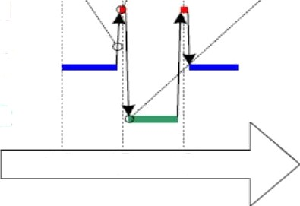
kernel runs ‹n ticI‹ interrupt to select next task
Tick interrupt OscUrs
Newly selected task runs when
the ticA i‹›terrupt completes
Kernel
Task 1
Task 2
t1 t2 t3
When kernel itself is running, the arrows in the above figure show the sequence of execution from task interrupt, then from interrupt back to a next task.

Slide 30
Example . Experimenting with priorities
Scheduler always ensures that the highest priority task is able to run is the task selected to enter the Running state.
  In Example 1 and 2, two tasks have been created at the same priority, so both entered and exited the Running state in turn.
  In this example, the second task is set at priority
2.

Slide 31
In main() function, change
xTaskCreate( vTaskFunction, "Task 2", 240, (void*)pcTextForTask2, 1, NULL );
To
xTaskCreate( vTaskFunction, "Task 2", 240,
(void*)pcTextForTask2, 2, NULL );

Slide 32
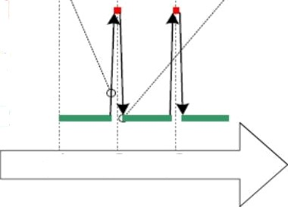
I he scheduler runs in the tick interrupt
Tick interrupt occurs
but selects the same task Task 2 is
always in the Running state and Task 1 is
always in the Not Running state
Kernel
Task 1
Task 7
t1 t2 t3
The scheduler always selects the highest priority
task that is able to run.
  Task 2 has a higher priority than Task 1; so Task 2 is
the only task to ever enter the Running state.
  Task 1 is to be ‘starved’ of processing time of Task 2.

Slide 33
‘Continuous processing’ task
So far, the created tasks always have work to perform and have never had to wait for anything
  Always able to enter the Running state.
This type of task has limited usefulness as they can only be created at the very lowest priority.
  If they run at any other priority, they will tasks of lower priority ever running at all.
Solution: Event-driven tasks

Slide 34
1.6 Expanding the ‘Not Running’ state
An event-driven task
  has work to perform only after the occurrence of the event that triggers it
  Is not able enter the Running state before that event has
occurred.
The scheduler selects the highest priority task that is
able to run.
High priority tasks not being able to run means that the
scheduler cannot select them, and
  Must select a lower priority task that is able to run.
Using event-driven tasks means that
  tasks can be created at different priorities without the highest priority tasks starving all the lower priority tasks.

Slide 35
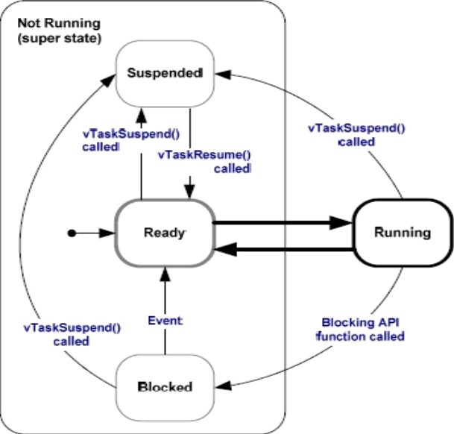
Full task state machine
39

Slide 36
Blocked state
Tasks enter this state to wait for two types of events
  Temporal (time-related) events: the event being either a
delay expiring, or an absolute time being reached.
    A task enter the Blocked state to wait for 10ms to pass
  Synchronization events: where the events originate from another task or interrupt
    A task enter the Blocked state to wait for data to arrive on a
queue.
  Can block on a synchronization event with a timeout, effectively block on both types of event simultaneously.
    A task waits for a maximum of 10ms for data to arrive on a queue. It leaves the Blocked state if either data arrives within 1 Oms or 1 Oms pass with no data arriving.

Slide 37
Suspended state
Tasks in this state are not available to the scheduler.
  The only way into this state is through a call to the vTaskSuspend() API function
  The only way out this state is through a call to the vTaskResume() or vTaskResumeFromlSR() API functions

Slide 38
Ready state
Tasks that are in the ‘Not Running’ state but are not Blocked or Suspended are said to be in the Ready state.
— They are able to run, and therefore ‘ready’ to run, but are not currently in the Running state.

Slide 39
Example 4 Using the Block state to create a delay
All tasks in the previous examples have been periodic
  They have delayed for a period and printed out their string before delay once more, and so on.
  Delayed generated using a null loop
    the task effectively polled an incrementing loop counter
until it reached a fixed value.

Slide 40
Disadvantages to any form of polling
  While executing the null loop, the task remains in the Ready state, ‘starving’ the other task of any processing time.
  During polling, the task does not really have any work to do, but it still uses maximum processing time and so wastes processor cycles.
This example corrects this behavior by
  replacing the polling null loop with a call to vTaskDelay() API function.
  setting INCLUDE vTaskDelay to 1 in FreeRTOSConfig.h

Slide 41
vTaskDelay() API function
Place the calling task into the Blocked state for a fixed number of tick interrupts.
— The Blocked state task does not use any processing time, so processing time is consumed only when there is work to be done.
void vTaskDeIay(portTickType xTicksToDelay);
xTicksToDelay: the number of ticks that the calling task should remain in the Blocked state before being transitioned back into the Ready state.
E.g, if a task called vTaskDeIay(100) while the tick count was 10,000, it enters the Blocked state immediately and remains there until the tick count is 10,100.

Slide 42
In void vTaskFunction(yoid *pvParameters)
Change a NULL loop
for( ul 0; ul < mainDELAY LOOP_COUNT; uI++ ) { }
To
vTaskDeIay(250 / portTlCK RATE MS);
II a period of 250ms is being specified.
Although two tasks are being created at different priorities, both will now run.

Slide 43

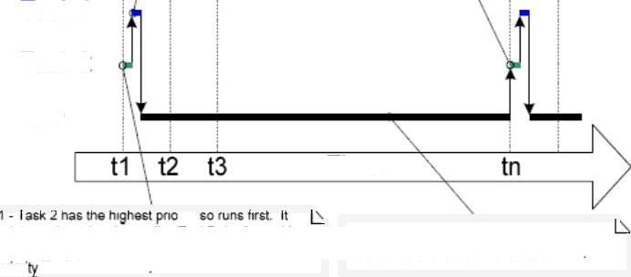
4 - Men the 4e•ay expires the schedu6r moves th tasks back into the reaoy state. where both exwuie again beware orce again calling vTask0elay() causing new TO fe+nor ze Blowed site Task I execues
Grst ao 1 has the higher pn ty .
2 - Task ! pnnts oat its sung, then i\ icat
enters be Blocked state by ca\iing
vTssrDelay/).
Task 1
Task 2 Idle
Time
parts out its stnng them calls vTaskDelayt) - and in so doing ente's the Blocked state oermittfng the lever pnon Task 1 to execite
z - At this po'nt both applicator !asks are in
« Bluuked sMe - su lhe IN.s ask Iu‹is
Each time the tasks leave the Blocked state they execute for a fraction of a tick period before re-entering the Blocked state.
— Most of the time no application tasks are able to run and, so, no tasks can be selected to enter the Running state. The idle task will run to ensure there is always at least one
task that is able to run.

Slide 44
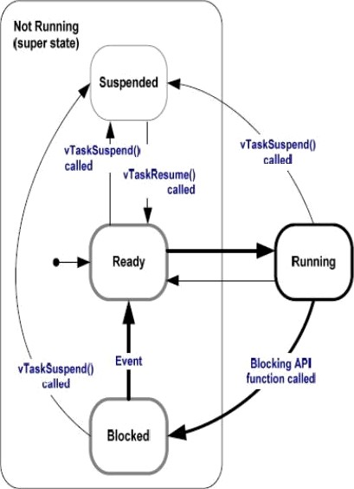
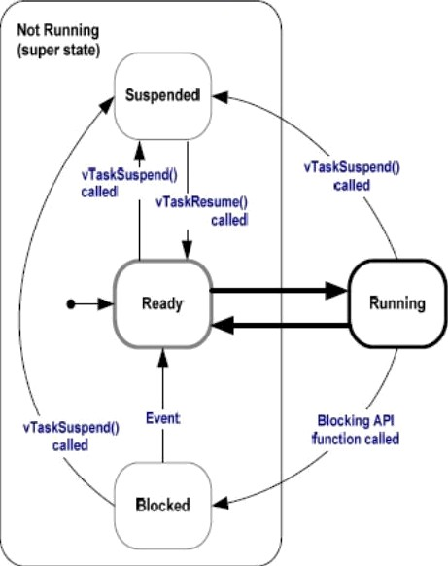
Bold lines indicate the state transitions performed by the tasks in Example 4

Slide 45
vTaskDelayUntil() API Function
Parameters to vTaskDelayUntil()
  specify the exact tick count value at which the calling task should be moved from the Blocked state into the Ready state.
  Be used when a fixed execution period is required.
    The time at which the calling task is unblocked is absolute, rather than relative to when the function was called (as vTaskDelay())
void vTaskDelayUntil(
portTickType *pxPreviousWakeTime, portTickType xTimelncrement);
49

Slide 46
vTaskDelayUntil() prototype
pxPreviousWakeTime
  Assume that vTaskDelayUtil() is being used to implement a task that executes periodically and with a fixed frequency.
  Holds the time at which the task left the Blocked
state.
  Be used as a reference point to compute the time at which the task next leaves the Blocked state.
  The variable pointed by pxPreviousWakeTime is updated automatically, not be modified by application code, other than when the variable is first initialized.
46

Slide 47
xTimelncrement
  Assume that vTaskDelayUtil() is being used to implement a task that executes periodically and with a fixed frequency — set by xTimelncrement.
  Be specified in ‘ticks’. The constant
portTlCK RATE MS can be used to convert ms
to ticks.

Slide 48
Example 5 Converting the example tasks to use vTaskDelayUntil()
Two tasks created in Example 4 are periodic tasks.
vTaskDelay() does not ensure that the frequency at which they run is fixed,
— as the time at which the tasks leave the Blocked state is relative to when they call vTaskDelay().

Slide 49
In void vTaskFunction(yoid *pvParameters)
Change
vTaskDeIay(250 / portTlCK RATE MS);
// a period of 250ms is being specified.
To
vTaskDelayUntil( &xLastWakeTime, (vTaskDeIay(250 / portTlCK RATE MS));
/*xLastWakeTime is initialized with the current tick count before entering the infinite loop. This is the only time it is written to explicitly. */
xLastWakeTime xTaskGetTickCount();
/*It is then updated within vTaskDelayUntil(); automatically */

Slide 50
Example 6 Combining blocking and non-blocking tasks
Two tasks are created at priority 1.
  Always be either the Ready or the Running state
as never making any API function calls.
  Tasks of this nature are called continuous processing tasks they always have work to do.
A Third task is created at priority 2.
  Periodically prints out a string by using vTaskDelayUntil() to place itself into the Blocked state between each print iteration.

Slide 51
void vContinuousProcessingTask(void * pvParameters) (
char *pcTaskName;
pcTaskName = (char *) pvParameters; for (;;){ vPrintString(pcTaskName);
for( ul = 0; ul < Oxfff; uI++ ) ( }
void vPeriodicTask(void * pvParameters) ( portTickType xLastWakeTime; xLastWakeTime = xTaskGetTickCount();
for (;;){ vPrintString(“Periodic task is running\n"); vTaskDeIayUntiI(&xLastWakeTime,
(10/portTlCK RATE MS));

Slide 52
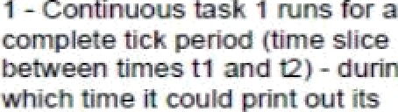
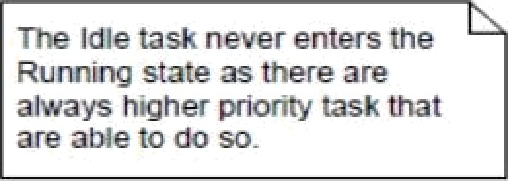





so¥tg exac0y onco bettaa cagng vTacgDeiaytJntgUas mm sz
tin Bitched stata.
kttetzufx - &amg wtdcti time 0 cou¥s print M m t¥nes.
Continuous 1
Continuous 2
Idle
t1 t2 t3 Time t

Slide 53
1.7 Idle Task and the Idle task hook
An idle task is automatically created by the scheduler when vTaskStartScheduleif) is called.
  Does very little more than site in a loop
  Has the lowest possible priority (zero), to ensure it never prevents a higher priority application task from entering the Running state
  Be transitioned out of the Running state as soon as a higher priority task enters the Ready state

Slide 54
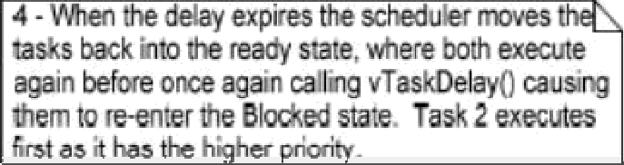
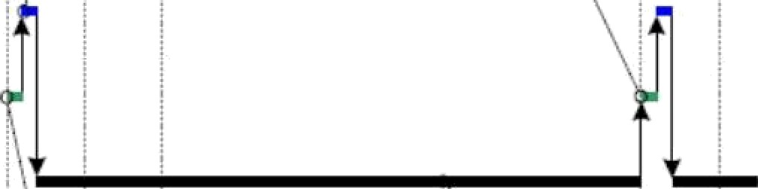
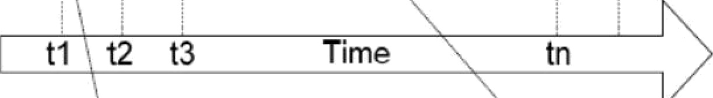
4 - Seri the 4eiay empires the scheduler moves th asks back into the reaay some, where bob execute again before once again calling vTask0elayt› causing
sts T s 1 p¿
Beye e s e
t g e i
b I g
Task 1
Task 2
Idle
fret as 1 has the h›ghor pnofity
’’
t1 t2 t3
Time
tn
*,
h1ip T k 2 h
u n
h
r o
r t
e iTask tsd n
pop
his i bo
o as
k
doing t h B s te e e
Bi
TbLsori 1 o ute
The Idle task is immediately swapped out to allow Task 2 to execute at the instant Task 2 leaves the Blocked state.
— Task 2 pre—empts the idle task automatically.

Slide 55
Idle Task Hook Functions
Add application specific functionality directly into the idle task by the use of an idle hook
— A function called automatically by the idle task once per iteration of the idle task loop
Common uses for the Idle task hook
  Executing low priority, background, or continuous
processing
  Measuring the amount of spare processing capacity
  Placing the processor into a low power mode, providing an automatic method of saving power whenever no application processing to be performed.

Slide 56
Limitations on the implementation of Idle Task Hook Functions
Rules idle task hook functions must adhere to
  Must never attempt to block or suspend.
  If the application uses vTaskDelete(), the Idle task hook must always return to its caller within a reasonable time period.
    Idle task is responsible for cleaning up kernel resources after a task has been deleted.
    If the idle task remains permanently in the Idle hook function, this clean-up cannot occur.
Idle task hook functions have the name and
prototype as
void vAppIicationIdIeHook(void);
S6

Slide 57
Example 7 Defining an idle task hook function
Set configUSE IDLE HOOK to 1
Add following function
unsigned long ulldleCycleCount = OUL;
/* must be called this name, take no parameters and return void. */
void vApplicationldleHook (void) {
uIIdIeCycIeCount++;
In vTaskFunction(), change
vPrintString(pcTaskName) TO vPrintStringAndNumber(pcTaskName, uIIdIeCycIeCount);
57

Slide 58
1.8 Change the priority of a task
vTaskPrioritySet(xTaskHandIe pxTask, unsigned portBASE TYPE uxNewPriority);
  Be used to change the priority of any task after the scheduler has been started.
  Available if INCLUDE vTaskPrioritySet is set 1.
Two parameters
  pxTask: Handle of the task whose priority is being modified. A task can change its own priority by passing NULL in place of a valid task handle.
  uxNewPriority: the priority to be set.

Slide 59
unsigned portBASE TYPE uxTaskPriorityGet(xTaskHandle pxTask);
  Be used to query the priority of a task
  Available if INCLUDE vTaskPriorityGet is set 1
  pxTask: Handle of the task whose priority is being modified. A task can query its own priority by passing NULL in place of a valid task handle.
  Returned value: the priority currently assigned to the task being queried

Slide 60
Example Changing task priorities
Demonstrate the scheduler always selects the highest Ready state task to run
— by using the vTaskPrioritySet() API function to change the priority of two tasks relative to each other.
Two tasks are created at two different
priorities.
  Neither task makes any API function calls that
cause it to enter the Blocked state,
    So both are in either Ready or Running state.
    So the task with highest priority will always be the task selected by the scheduler to be in Running state

Slide 61
Expected Behavior of Example
Task 1 is created with the highest priority to be guaranteed to run first. Task 1 prints out a couple of strings before raising the priority of Task 2 to above its own priority.
Task2 starts to run as it has the highest relative
priority.
Task 2 prints out a message before setting its own priority back to below that of Task 1.
Task 1 is once again the highest priority task, so it starts to run and forcing Task 2 back into the Ready state.

Slide 62
Declare a global variable to hold the handle of Task 2.
xTaskHandle xTask2Handle;
In main() function, create two tasks
xTaskCreate(vTask1, “Task 1”, 240,
NULL, 2, NULL);
xTaskCreate(vTask2, “Task 2”, 240,
NULL, 1, &xTask2HandIe);

Slide 63
Change vTask1 by initialization unsigned portBASE TYPE uxPriority; uxPriority = uxTaskPriorityGet(NULL);
And adding to the infinite loop
vTaskPrioritySet(xTaskHandI1, (uxPriority+1));
Change vTask2 by initialization unsigned portBASE TYPE uxPriority; uxPriority = uxTaskPriorityGet(NULL);
And adding to the infinite loop
vTaskPrioritySet(NULL, (uxPriority-2));

Slide 64

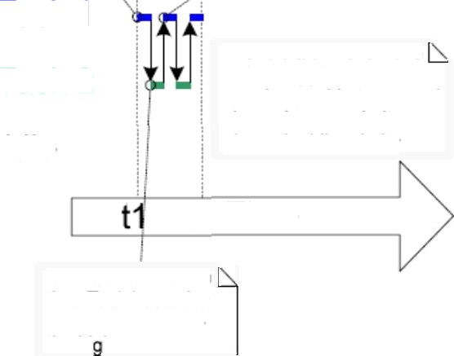
Task execution sequence
3 - Task1 runs aqa n when Task2 lowers its own priority back to being below the Task1 priority and so on
1 - Task1 runs first as it has the highest priority
Task 1
The Idle task never runs as both application tasks are always able to run and always have a priority above the idle priority
Task 2
Idle
t2 Time
2 - Task2 runs each time Task1 sets the Task2 priority to be
the hi hest
69

Slide 65
1.9 Deleting a task
Deleted tasks no longer exist and cannot enter the Running state again.
Idle task is responsible to automatically free memory allocated by kernel to tasks that have been deleted.
— Remember if applications use vTaskDelete(), do not completely starve the idle task of all processing time.
Note: any memory or other resource that the application task allocates itself must by be freed explicitly by the application code.

Slide 66
vTaskDelete() API function
Function prototype
void vTaskDeIete(xTaskHandIe pxTaskToDelete);
— pxTaskToDelete: Handle of the task that is to be deleted. A task can delete itself by passing NULL in place of valid task handle.
Available only when INCLUDE vTaskDelete set 1

Slide 67
Example Deleting tasks (Behavior)
Task 1 is created by main() with priority 1. When it runs, it creates Task 2 at priority 2. Task 2 as the highest priority task starts to execute immediately.
Task 2 does nothing but delete itself by passing NULL or its own task handle.
When Task 2 has been deleted, Task 1 is again the highest priority task, so continues executing —at which point it calls vTaskDelay() to block lor a short period.
The idle task executes while Task 1 is in the blocked state and frees the memory that was allocated to the now deleted Task 2.
5. When Task 1 leaves the blocked state it again becomes the highest priority Ready state task and preempts the Idle task. Then, start from Step1 again.
4.
6

Slide 68
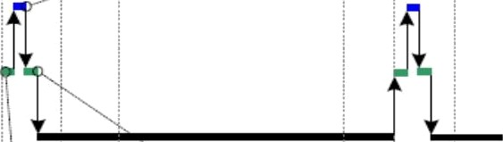


Execution sequence
2 - Task 2 does nothing other than delete itself, allowing execution to return to Task 1
Task 2
Task 1
Idle
I.
t1 t2
time tn
3 - Task 1 calls vTaskDelay(). allowing the idle task to run untfl the delay time expires. and the whole sequence repeats.
1 - Task 1 runs and creates Task 2. Task 2 starts io run immediately as It has the higher prionty.

Slide 69
Memory Management
Does not permit memory to be freed once it has been allocated.
Subdivide a single array into smaller blocks. Total size of the array (heap) is set by configTOTAL HEAP SIZE
xPortGetFreeHeapSize() returns the total amount of heap space that remains unallocated.

Slide 70
Heap 2.c
Allow previously allocated blocks to be freed.
Does not combine adjacent free blocks into a
single large block.

Slide 71


Slide 72
Summary —
Prioritized pre-emptive scheduling
  Examples illustrate how and when FreeRTOS selects which task should be in the Running state.
    Each task is assigned a priority.
    Each task can exist in one of several states.
    Only one task can exist in the Running state at any
one time.
    The scheduler always selects the highest priority Ready state task to enter the Running state.

Slide 73
Fixed priority Pre-emptive scheduling
Fixed priority
  Each task is assigned a priority that is not altered by the kernel itself (only tasks can change priorities)
Pre-emptive
  A task entering the Ready state or having its priority altered will always pre-empt the Running state task, if the Running state task has a lower priority.

Slide 74
Tasks in the Blocked state
Tasks can wait in the Blocked state for an event and are automatically moved back to the Ready state when the event occurs.
Temporal events
  Occur at a particular time, e.g. a block time expires.
  Generally be used to implement periodic or timeout behavior.
Synchronization events
  Occur when a task or ISR sends info to a queue or to one of the many types of semaphore.
  Generally be used to signal asynchronous activity,
such as data arriving at a peripheral.
79

Slide 75
Execution pattern with pre-emption points highlighted
Event for Task 1 occur at : t11
Task2 is released at : t1, t6, t9
Event for Task 3 occur at: t3, t5, t9, t12

Slide 76
Idle task
  The idle task is running at the lowest priority, so get pre-empted every time a higher priority task enters the Ready state
    E.g., at times t3,t5,t9.

Slide 77
Task 3
  An event-driven task
    Execute with a low priority, but above the Idle task priority.
  It spends most of its time in the Blocked state waiting for the event of interest, transitioning from Blocked to Ready state each time the event occurs.
    All FreeRTOS inter-task communication mechanisms (queues, semaphores, etc.) can be used to signal events and unblock tasks in this way.
  Event occur at t3, t5, and also between t9 and t12.
    The events occurring at t3 and t5 are processed immediately
as it is the highest priority task that is able to run.
    The event occurring somewhere between t9 and t12 is not processed as until t12 as until then Task 1 and 2 are still running. They enter Blocked state at t12, mahing Tash 3 the highest priority Ready state task.
7B

Slide 78
Task 2
  A periodic task that executes at a priority above Task 3, but below Task1. The period interval means Task 2 wants to execute at t1, t6 and t9.
    At t6, Task 3 is in Running state, but task 2 has the higher relative priority so preempts Task 3 and start to run immediately.
    At t7, Task 2 completes its processing and reenters the Blocked state, at which point Task 3 can re-enter the Running state to complete its processing.
    At t8, Task 3 blocks itself.

Slide 79
Task 1
  Also an event-driven task.
  Execute with the highest priority of all, so can preempt any other task in the system.
  The only Task 1 event shown occurs at t10, at which time Task 1 pre-empts Task 2.
  Only after Task 1 has re-entered the Blocked at t11, Task 2 can complete its processing.

Slide 80
2. Selecting Task Priorities
Task that implement hard real-time functions are assigned priorities above those that implement soft real-time functions.
Must also take execution times and processor utilization into account to ensure the entire application will never miss a hard real-time deadline.
— Rate monotonic scheduling

Slide 81
Rate monotonic scheduling (RMS)
A common priority assignment technique which assigns each task a unique priority according to tasks periodic execution rate.
  Highest priority is assigned to the task that has the highest frequency of periodic execution.
  Lowest priority is assigned to the task that has the lowest frequency of periodic execution.
  Can maximize the schedulability of the entire application.
  But runtime variations, and the fact that not all tasks are in any way periodic, make absolute calculations a complex process.

Slide 82
3. Co-operative scheduling
In a pure co-operative scheduler, a context
switch occur only when
  the Running state task enters the Blocked state
  Or, the Running state task explicitly calls
taskYlELD().
Tasks will never be pre-empted and tasks of equal priority will not automatically share processing time.
  Results in a less responsive system.

Slide 83
Co-operative scheduling
A hybrid scheme, it is possible that ISRs are used to explicitly cause a context switch. It
—allows synchronization events to cause pre-
emption, but not temporal events.
  results in a pre-emptive system without time
slicing.
  is desirable due to its efficiency gains and is a common scheduler configuration.

