Slide 1
Chapter 3
Scanning - Theory and Practice
Prof Chung.

Slide 2
Outlines
3.1 Overview
3.2 Regular Expression
3.3 Finite Automata and Scanners
3.4 Using a Scanner Generator
  LEX --- Introduce in TA course: LEX introduction
3.5 Practical Considerations
3.6 Translating Regular Expressions into Finite Automata

Slide 3
Outlines
3.1 Overview
3.2 Regular Expression
3.3 Finite Automata and Scanners
3.4 Using a Scanner Generator
3.5 Practical Considerations
3.6 Translating Regular Expressions into Finite Automata

Slide 4
Overview(1)
Formal notations
  For specifying the precise structure of tokens are necessary
  Quoted string in Pascal
  Can a string split across a line?
  Is a null string allowed?
  Is .1 or 10. ok?
  the 1..10 problem
Scanner generators
  Tables, Programs
What formal notations to use?

Slide 5
Overview(2)
Lexical analyzer role
  Produce a sequence of (tokens) for parser
  Stripe out comments and whitespaces
  Associate a line number with each error message
  Expand macros
source
program
Lexical
Analyzer
token
Parser
to semantic
analysis
getNextToken
Symbol
Table

Slide 6
Outlines
3.1 Overview
3.2 Regular Expression
3.3 Finite Automata and Scanners
3.5 Practical Considerations
3.4 Using a Scanner Generator
3.6 Translating Regular Expressions into Finite Automata

Slide 7
Regular Expression (1)
Tokens
  built from symbols of a finite vocabulary.
Structures of tokens
  use regular expressions to define
Set Definition
  The sets of strings defined by regular expressions are termed
  ∅ is a regular expression denoting the empty set
  λ is a regular expression
  denoting the set that contains only the empty string
  A string s is a regular expression denoting a set containing only s

Slide 8
Regular Expression (2)
if A and B are regular expressions, so are
  A | B (alternation)
    A regular expression formed by A or B
    (a)|(b) = {a, b}
  AB or A•B (concatenation)
    A regular expression formed by A followed by B
    (a)(b) = {ab}
  A* (Kleene closure)
    A regular expression formed by zero or more repetitions of A
    a* = {ε, a, aa, aaa, …}
More Complex Example
(a|b,c)* = {ε, a, b, c, aa, ab, ac, ba, bb, bc, ca, cb, cc …}

Slide 9
Regular Expression (3)
Some notational convenience
  P+
    PP* (at least one)
  Not(A)
    V - A
  Not(S)
    V* - S
  A^{K}
    AA …A (k copies)
  A?
    Optional, zero or one occurrence of A
More Complex Example
Let D = (0 | 1 | 2 | 3 | 4 | ... | 9 )
Let L = (A | B | ... | Z | a | b |... | z)
comment = -- not(EOL)* EOL
  ex: --hello12_34 \n
decimal = D+ · D+
  ex: 123.456
ident = L (L | D | _)*
  ex: A1a5_6
comments = ##((#| l )not(#))* ##
  ex:###A435#3##

Slide 10
Regular Expression (4)
  Is regular expression as power as CFG?
  { [^{i}]^{i} | i≥1}

Slide 11
Outlines
3.1 Overview
3.2 Regular Expression
3.3 Finite Automata and Scanners
3.4 Using a Scanner Generator
3.5 Practical Considerations
3.6 Translating Regular Expressions into Finite Automata

Slide 12
Finite Automata and Scanners (1)
Finite automaton (FA)
  can be used to recognize the tokens specified by a regular expression
A FA consists of
  A finite set of states S
  A set of input symbols Σ (the input symbol alphabet)
  A set of transitions (or moves) from one state to another,
  labeled with characters in V
  A special start state s₀
  A set of final, or accepting, states F
FA = {S, Σ, s₀, F, move }

Slide 13
Finite Automata and Scanners (2)
is a state
is a transition
is the start state
is a final state
Example at next page….

Slide 14
Finite Automata and Scanners (3)
Example
  A transition diagram
    This machine accepts abccabc, but it rejects abcab.
    This machine accepts (abc+)+
(
a
b
c
)
⁺
⁺
a
a
b
c
c

Slide 15
Finite Automata and Scanners (4)
Other Example
  (0|1)*0(0|1)(0|1)
0
0,1
0,1
1
2
3
4
0,1
0
5
0,1
(0|1)
*
0
(0|1)
(0|1)

Slide 16
Finite Automata and Scanners (5)
Other Example
  ID = L(L|D)*(_(L|D)+)*
L | D
L
-
Final for two * symbol
L | D
L
(L|D)*
(_(L|D)+)*

Slide 17
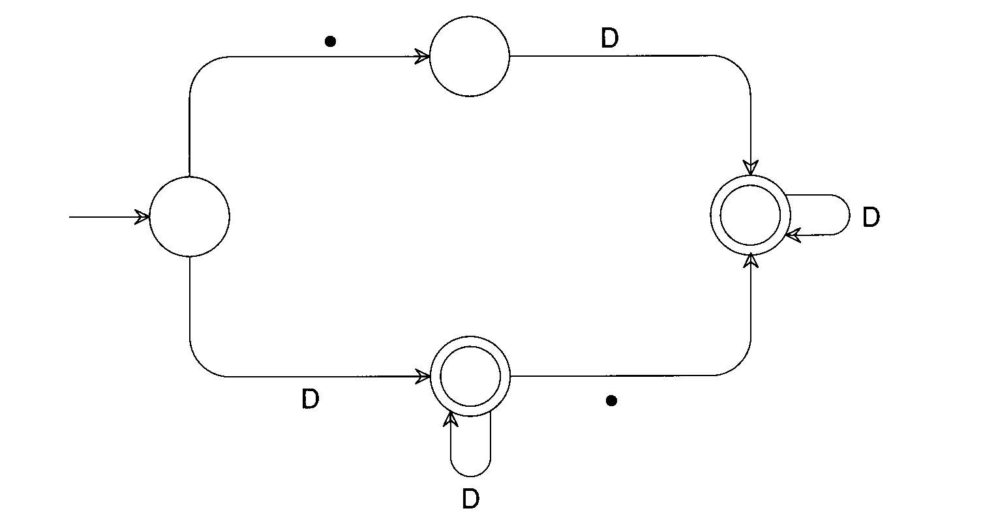
Finite Automata and Scanners (6)
Other Example
  RealLit = (D+(λ|.))|(D*.D+)

Slide 18
Finite Automata and Scanners (7)
Two kinds of FA:
  Deterministic: next transition is unique
  Non-deterministic: otherwise
a
...
a
...
Which path we should select?

Slide 19
Finite Automata and Scanners (8)
A transition diagram
A transition table
Not(Eol)
-
-
Eol
1
2
3
4
State | Character
 | - | Eol | a | b | …
2
1
2
3
3
3
4
3
3
3
4

Slide 20
Finite Automata and Scanners (9)
Any regular expression
  can be translated into a DFA
  that accepts the set of strings denoted by the regular expression
The transition can be done
  Automatically by a scanner generator : LEX (TA course)
  Manually by a programmer : Your homework #1 (3/18 publishes)

Slide 21
Finite Automata and Scanners (10)
Scanner Driver Interpreting a Transition Table
/* Note: current_char is already set to the current input character. */
state = initial_state;
while (TRUE) {
next_state = T[state][current_char];
if (next_state == ERROR)
break;
state = next_state;
if (current_char == EOF)
break;
current_char = getchar();
}
If(is_final_state(state))
/* Return or process valid token. */
else
lexical_error(current_char);

Slide 22
Finite Automata and Scanners (11)
Scanner with Fixed Token Definition
if (current_char == '-') {
current_char = getchar();
if (current_char == '-') {
do {
current_char = getchar();
} `while (current_char != '\n');
} else {
ungetc(current_char, stdin);
lexical_error(current_char);
}
}
else
lexical_error(current_char);
/* Return or process valid token. */

Slide 23
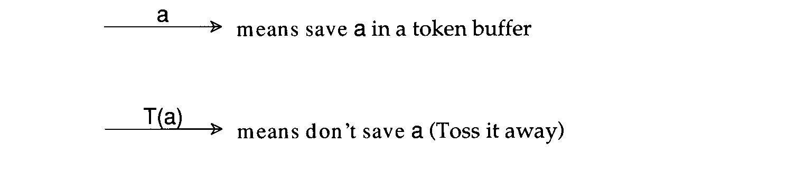
Finite Automata and Scanners (12)
Transducer
  We may perform some actions during state transition.

Slide 24
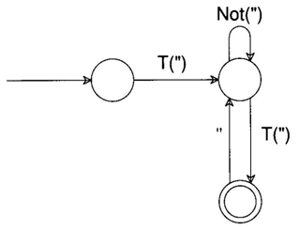
Finite Automata and Scanners (13)
Other Example
  be given by quoted strings,
  according to the regular expression ("(Not(")|"")*")
  A corresponding transducer might be
  The input """Hi""" would produce output "Hi"

Slide 25
Outlines
3.1 Overview
3.2 Regular Expression
3.3 Finite Automata and Scanners
3.4 Using a Scanner Generator
3.5 Practical Considerations
3.6 Translating Regular Expressions into Finite Automata

Slide 26
Using a Scanner Generator
By Ta….

Slide 27
Outlines
3.1 Overview
3.2 Regular Expression
3.3 Finite Automata and Scanners
3.4 Using a Scanner Generator
3.5 Practical Considerations
3.6 Translating Regular Expressions into Finite Automata

Slide 28
Practical Considerations (1)
Reserved Words
    Usually, all keywords are reserved in order to simplify parsing.
    In Pascal, we could even write
    begin
    begin; end; end; begin;
    end
    if else then if = else;
    The problem
    with reserved words is that they are too numerous.
    COBOL has several hundreds of reserved words!

Slide 29
Practical Considerations (2)
Compiler Directives and Listing Source Lines
  Compiler options e.g. optimization, profiling, etc.
    handled by scanner or semantic routines
    Complex pragmas are treated like other statements.
  Source inclusion
    e.g. #include in C
    handled by preprocessor or scanner
  Conditional compilation
    e.g. #if, #endif in C
    useful for creating program versions

Slide 30
Practical Considerations (3)
Entry of Identifiers into the Symbol Table
    Who is responsible for entering symbols into symbol table?
  Scanner?
  Consider this example:
    { int abc;
    …
    { int abc; }
    }

Slide 31
Practical Considerations (4)
How to handle end-of-file?
    Create a special EOF token.
    EOF token is useful in a CFG
Multicharacter Lookahead
    Blanks are not significant in Fortran
    DO 10 I= 1,100
      Beginning of a loop
    DO 10 I = 1.100
      An assignment statement DO10I=1.100
    A Fortran scanner
      can determine whether the O is the last character of a DO token only after reading as far as the comma

Slide 32
Practical Considerations (5)
Multicharacter Lookahead (Cont’d)
    In Ada and Pascal
  To scan 10..100
    There are three token
      10
      ..
      100
    Two-character lookahead after the 10
  It is easy to build a scanner that can perform general backup.
  If we reach a situation
    in which we are not in final state and
    cannot scan any more characters, backup is invoked.
      Until we reach a prefix of the scanned characters flagged as a valid token
Example at next page

Slide 33
Practical Considerations (6)
An FA That Scans Integer and Real Literals and the Subrange Operator
D
D
D
●
D
Buffered Token | Token Flag
1 | Integer Literal
12 | Integer Literal
12. | Invalid
12.3 | Real Literal
12.3e | Invalid
12.3e+ | Invalid
●
●
Detail Operation of each case at next page

Slide 34
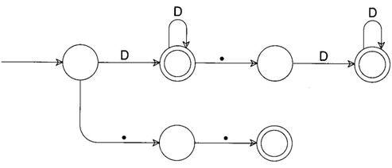
Practical Considerations (7)
An FA That Scans Integer and Real Literals and the Subrange Operator
D
Input Token
Buffered Token
Token Flag
1
1
Integer Literal

Slide 35
Practical Considerations (8)
An FA That Scans Integer and Real Literals and the Subrange Operator
D
D
Input Token
Buffered Token
Token Flag
1
2
1
2
Integer Literal

Slide 36
Practical Considerations (9)
An FA That Scans Integer and Real Literals and the Subrange Operator
D
D
●
Input Token
Buffered Token
Token Flag
1
2
.
1
2
.
Invalid

Slide 37
Practical Considerations (10)
An FA That Scans Integer and Real Literals and the Subrange Operator
D
D
●
D
Input Token
Buffered Token
Token Flag
1
2
.
3
1
2
.
3
Real Literal

Slide 38
Practical Considerations (11)
An FA That Scans Integer and Real Literals and the Subrange Operator
D
?
D
●
D
Input Token
Buffered Token
Token Flag
1
2
.
3
e
1
2
.
3
e
Invalid

Slide 39
Practical Considerations (12)
An FA That Scans Integer and Real Literals and the Subrange Operator
D
?
?
D
●
D
Input Token
Buffered Token
Token Flag
1
2
.
3
e
+
1
2
.
3
e
+
Invalid

Slide 40
Chapter 3 End
Any Question?

