Slide 1
Outline
6.0 Introduction
6.1 Shift-Reduce Parsers
6.2 LR Parsers
6.3 LR(1) Parsing
6.4 SLR(1)Parsing
6.5 LALR(1)
6.6 Calling Semantic Routines in Shift-Reduce Parsers
6.7 Using a Parser Generator (TA course)
6.8 Optimizing Parse Tables
6.9 Practical LR(1) Parsers
6.10 Properties of LR Parsing
6.11 LL(1) or LAlR(1) , That is the question
6.12 Other Shift-Reduce Technique

Slide 2
LR(1) Parsing (1)
An LR(1) configuration, or item is of the form
  A→X₁X₂…X_{i} • X_{i+1} … X_{j}, l where l ∈ V_{t}∪{λ}
    The look ahead component l represents a possible look-ahead
    after the entire right-hand side has been matched
    The λ appears as look-ahead only for the augmenting production
    because there is no look-ahead after the end-marker
We use the following notation to represent the set of LR(1) configurations that shared the same dotted production
  A→X₁X₂…X_{i} • X_{i+1} … X_{j}, {l₁…l_{m}}
  ={A→X₁X₂…X_{i} • X_{i+1} … X_{j}, l₁} ∪
  {A→X₁X₂…X_{i} • X_{i+1} … X_{j}, l₂} ∪
  …
  {A→X₁X₂…X_{i} • X_{i+1} … X_{j}, l_{m}}

Slide 3
LR(1) Parsing (2)
LR(1)
  There are many more distinct LR(1) configurations than LR(0) configurations.
  In fact, the major difficulty with LR(1) parsers is not their power
  but rather finding ways to represent them in storage-efficient ways.
  Parsing begins with the configuration : closure1({S→ • α $, {λ}})
Configuration_set closure1 (configuration_set s)
{
configuration_set s’ = s ;
do
{
if( B →δ • A ρ, l ∈ s’ for A ∈ V_{n} )
{
/*
* Predict productions with A as the left-hand side.
* Possible lookaheads are First(ρl )
*/
Add all configurations of the form
A → • γ, u where u ∈First(ρl ) to s’
}
} while (more new configurations can be added) ;
return s’;
}
for grammar G₂ :
1. S→E$
2.E→E+T
3.E→T
4.T →id
5.T →(E)
closure1(S→ • E$, λ})
= { S → • E$,{λ}
E → • E+T,{$+}
E → • T,{$+}
T → • id,{$+}
T → • (E),{$+} }

Slide 4
LR(1) Parsing (3)
for grammar G₂ :
1. S→E$
2.E→E+T
3.E→T
4.T →id
5.T →(E)
Tracing Example
closure1(S→ • E$, λ})
S → • E$,{λ}
E → • E+T,{$}
E → • T,{$}
E → • E+T,{+}
E → • T,{+}
closure1(S→ • E$, λ})=
{ S → • E$,{λ}
E → • E+T,{$+}
E → • T,{$+}
T → • id,{$+}
T → • (E),{$+} }
T → • id,{$}
T → • (E),{$}
T → • id,{+}
T → • (E),{+}

Slide 5
LR(1) Parsing (4)
Given an LR(1) configuration set s
  We compute its successor, s', under a symbol X
  go_to1(s,X)
Configuration_set goto1 (configuration_set s , symbol x)
{
S_{b} = Ø ;
for (each configuration c ∈ s)
if( c is of the form A → βx • γ, l)
//In goto0 if( each configuration c ∈ s)
Add A → βx • γ, l to s_{b} ;
/*
* That is, we advance the • past the symbol X,
* if possible. Configurations not having a
* dot preceding an X are not included in s_{b .}
*/
/* Add new predictions to s_{b} via closure1. */
return closure1(s_{b}) ;
}

Slide 6
LR(1) Parsing (5)
LR(1)
  We can build a finite automata that is analogue of the LR(0) CFSM
    LR(1) FSM, LR(1) machine
  The relationship between CFSM and LR(1) macine
    By merging LR(1) machine’s configuration sets, we can obtain CFSM
void_build_LR1(void)
{
Create the Start State of FSM; Label it with s₀
Put s₀ into an initially empty set , S.
while (S is nonempty) {
Remove a configuration set s from S;
/* Consider both terminals and non-terminals */
for ( X in Symbols) {
if(go_to1(s,X) does not label a FSM state) {
Create a new FSM state and label it with go_to1(s , X) into S;
Put go_to1(s , X) into S;
}
Create a transition under X from the state s
labels to the state go_to1 (s , X) labels;
} } }
Tracing Example:
for grammar G₃ :
  1. S → E $
  2. E → E + T
  3. E → T
  4. T → T * P
  5. T → P
  6. P → id
  7. P → ( E )

Slide 7
state 0
S → • E$ ,{λ}
E → • E+T,{$+}
E → • T ,{$+}
T → • T*P ,{$+*}
T → • P ,{$+*}
P → • id ,{$+*}
P → • (E) ,{$+*}
E
P
id
T
(

Slide 8
state 0
S → • E$ ,{λ}
E → • E+T,{$+}
E → • T ,{$+}
T → • T*P ,{$+*}
T → • P ,{$+*}
P → • id ,{$+*}
P → • (E) ,{$+*}
state 1
S → E • $ ,{λ}
E → E •+T,{$+}
E
P
id
T
(

Slide 9
state 0
S → • E$ ,{λ}
E → • E+T,{$+}
E → • T ,{$+}
T → • T*P ,{$+*}
T → • P ,{$+*}
P → • id ,{$+*}
P → • (E) ,{$+*}
state 1
S → E • $ ,{λ}
E → E •+T,{$+}
state 2 //Accept
S → E $ • ,{λ}
E
$
P
id
T
(

Slide 10
state 0
S → • E$ ,{λ}
E → • E+T,{$+}
E → • T ,{$+}
T → • T*P ,{$+*}
T → • P ,{$+*}
P → • id ,{$+*}
P → • (E) ,{$+*}
state 1
S → E • $ ,{λ}
E → E •+T,{$+}
state 2 //Accept
S → E $ • ,{λ}
E
$
P
+
state 3
E → E+ • T,{$+}
T → • T*P ,{$+*}
T → • P ,{$+*}
P → • id ,{$+*}
P → • (E) ,{$+*}
P
id
T
(
T
id
(

Slide 11
state 0
S → • E$ ,{λ}
E → • E+T,{$+}
E → • T ,{$+}
T → • T*P ,{$+*}
T → • P ,{$+*}
P → • id ,{$+*}
P → • (E) ,{$+*}
state 1
S → E • $ ,{λ}
E → E •+T,{$+}
state 2 //Accept
S → E $ • ,{λ}
E
$
P
+
state 3
E → E+ • T,{$+}
T → • T*P ,{$+*}
T → • P ,{$+*}
P → • id ,{$+*}
P → • (E) ,{$+*}
state 4
T → P • ,{$+*}
id
P
T
(
T
id
(

Slide 12
state 0
S → • E$ ,{λ}
E → • E+T,{$+}
E → • T ,{$+}
T → • T*P ,{$+*}
T → • P ,{$+*}
P → • id ,{$+*}
P → • (E) ,{$+*}
state 1
S → E • $ ,{λ}
E → E •+T,{$+}
state 2 //Accept
S → E $ • ,{λ}
E
$
P
+
state 3
E → E+ • T,{$+}
T → • T*P ,{$+*}
T → • P ,{$+*}
P → • id ,{$+*}
P → • (E) ,{$+*}
state 4
T → P • ,{$+*}
P
id
state 5
P → id • ,{$+*}
T
(
id
T
(

Slide 13
state 0
S → • E$ ,{λ}
E → • E+T,{$+}
E → • T ,{$+}
T → • T*P ,{$+*}
T → • P ,{$+*}
P → • id ,{$+*}
P → • (E) ,{$+*}
state 1
S → E • $ ,{λ}
E → E •+T,{$+}
state 2 //Accept
S → E $ • ,{λ}
E
$
P
+
state 3
E → E+ • T,{$+}
T → • T*P ,{$+*}
T → • P ,{$+*}
P → • id ,{$+*}
P → • (E) ,{$+*}
state 4
T → P • ,{$+*}
P
id
state 5
P → id • ,{$+*}
T
(
id
T
state 6
P → (• E) ,{$+*}
E → • E+T,{)+}
E → • T ,{)+}
T → • T*P ,{)+*}
T → • P ,{)+*}
P → • id ,{)+*}
P → • (E) ,{)+*}
(
T
E
Be careful of look-ahead !!
(
id
P

Slide 14
state 0
S → • E$ ,{λ}
E → • E+T,{$+}
E → • T ,{$+}
T → • T*P ,{$+*}
T → • P ,{$+*}
P → • id ,{$+*}
P → • (E) ,{$+*}
state 1
S → E • $ ,{λ}
E → E •+T,{$+}
state 2 //Accept
S → E $ • ,{λ}
E
$
P
+
state 3
E → E+ • T,{$+}
T → • T*P ,{$+*}
T → • P ,{$+*}
P → • id ,{$+*}
P → • (E) ,{$+*}
state 4
T → P • ,{$+*}
P
id
state 5
P → id • ,{$+*}
T
(
id
T
state 7
E → T • ,{$+}
T → T • *P,{$+*}
state 6
P → (• E) ,{$+*}
E → • E+T,{)+}
E → • T ,{)+}
T → • T*P ,{)+*}
T → • P ,{)+*}
P → • id ,{)+*}
P → • (E) ,{)+*}
(
T
E
*
(
id
P

Slide 15
state 0
S → • E$ ,{λ}
E → • E+T,{$+}
E → • T ,{$+}
T → • T*P ,{$+*}
T → • P ,{$+*}
P → • id ,{$+*}
P → • (E) ,{$+*}
state 1
S → E • $ ,{λ}
E → E •+T,{$+}
state 2 //Accept
S → E $ • ,{λ}
E
$
P
+
state 3
E → E+ • T,{$+}
T → • T*P ,{$+*}
T → • P ,{$+*}
P → • id ,{$+*}
P → • (E) ,{$+*}
state 4
T → P • ,{$+*}
P
id
state 5
P → id • ,{$+*}
T
(
id
T
state 7
E → T • ,{$+}
T → T • *P,{$+*}
state 6
P → (• E) ,{$+*}
E → • E+T,{)+}
E → • T ,{)+}
T → • T*P ,{)+*}
T → • P ,{)+*}
P → • id ,{)+*}
P → • (E) ,{)+*}
id
(
*
T
E
state 8
T → T* • P,{$+*}
P → • id ,{$+*}
P → • (E) ,{$+*}
(
(
id
P
P

Slide 16
state 0
S → • E$ ,{λ}
E → • E+T,{$+}
E → • T ,{$+}
T → • T*P ,{$+*}
T → • P ,{$+*}
P → • id ,{$+*}
P → • (E) ,{$+*}
state 1
S → E • $ ,{λ}
E → E •+T,{$+}
state 2 //Accept
S → E $ • ,{λ}
E
$
P
+
state 3
E → E+ • T,{$+}
T → • T*P ,{$+*}
T → • P ,{$+*}
P → • id ,{$+*}
P → • (E) ,{$+*}
state 4
T → P • ,{$+*}
P
id
state 5
P → id • ,{$+*}
T
(
id
T
state 7
E → T • ,{$+}
T → T • *P,{$+*}
state 6
P → (• E) ,{$+*}
E → • E+T,{)+}
E → • T ,{)+}
T → • T*P ,{)+*}
T → • P ,{)+*}
P → • id ,{)+*}
P → • (E) ,{)+*}
id
(
*
T
E
state 8
T → T* • P,{$+*}
P → • id ,{$+*}
P → • (E) ,{$+*}
(
(
id
P
P
state 9
T → T* P •,{$+*}

Slide 17
state 0
S → • E$ ,{λ}
E → • E+T,{$+}
E → • T ,{$+}
T → • T*P ,{$+*}
T → • P ,{$+*}
P → • id ,{$+*}
P → • (E) ,{$+*}
state 1
S → E • $ ,{λ}
E → E •+T,{$+}
state 2 //Accept
S → E $ • ,{λ}
E
$
P
+
state 3
E → E+ • T,{$+}
T → • T*P ,{$+*}
T → • P ,{$+*}
P → • id ,{$+*}
P → • (E) ,{$+*}
state 4
T → P • ,{$+*}
P
id
state 5
P → id • ,{$+*}
T
(
id
T
state 7
E → T • ,{$+}
T → T • *P,{$+*}
state 6
P → (• E) ,{$+*}
E → • E+T,{)+}
E → • T ,{)+}
T → • T*P ,{)+*}
T → • P ,{)+*}
P → • id ,{)+*}
P → • (E) ,{)+*}
id
(
*
T
E
state 8
T → T* • P,{$+*}
P → • id ,{$+*}
P → • (E) ,{$+*}
(
(
P
P
state 9
T → T* P •,{$+*}
id
state 10
P → id • ,{)+*}

Slide 18
state 0
S → • E$ ,{λ}
E → • E+T,{$+}
E → • T ,{$+}
T → • T*P ,{$+*}
T → • P ,{$+*}
P → • id ,{$+*}
P → • (E) ,{$+*}
state 1
S → E • $ ,{λ}
E → E •+T,{$+}
state 2 //Accept
S → E $ • ,{λ}
E
$
P
+
state 3
E → E+ • T,{$+}
T → • T*P ,{$+*}
T → • P ,{$+*}
P → • id ,{$+*}
P → • (E) ,{$+*}
state 4
T → P • ,{$+*}
P
id
state 5
P → id • ,{$+*}
T
(
id
T
state 7
E → T • ,{$+}
T → T • *P,{$+*}
state 6
P → (• E) ,{$+*}
E → • E+T,{)+}
E → • T ,{)+}
T → • T*P ,{)+*}
T → • P ,{)+*}
P → • id ,{)+*}
P → • (E) ,{)+*}
id
(
state 11
E → E+ T •,{$+}
T → T • *P,{$+*}
*
T
E
*
state 8
T → T* • P,{$+*}
P → • id ,{$+*}
P → • (E) ,{$+*}
State 8
(
(
P
P
state 9
T → T* P •,{$+*}
id
state 10
P → id • ,{)+*}

Slide 19
state 0
S → • E$ ,{λ}
E → • E+T,{$+}
E → • T ,{$+}
T → • T*P ,{$+*}
T → • P ,{$+*}
P → • id ,{$+*}
P → • (E) ,{$+*}
state 1
S → E • $ ,{λ}
E → E •+T,{$+}
state 2 //Accept
S → E $ • ,{λ}
E
$
P
+
state 3
E → E+ • T,{$+}
T → • T*P ,{$+*}
T → • P ,{$+*}
P → • id ,{$+*}
P → • (E) ,{$+*}
state 4
T → P • ,{$+*}
P
id
state 5
P → id • ,{$+*}
T
(
id
T
state 7
E → T • ,{$+}
T → T • *P,{$+*}
state 6
P → (• E) ,{$+*}
E → • E+T,{)+}
E → • T ,{)+}
T → • T*P ,{)+*}
T → • P ,{)+*}
P → • id ,{)+*}
P → • (E) ,{)+*}
id
(
state 11
E → E+ T •,{$+}
T → T • *P,{$+*}
*
T
*
state 8
T → T* • P,{$+*}
P → • id ,{$+*}
P → • (E) ,{$+*}
State 8
(
E
state 12
P → (E •) ,{$+*}
E → E • +T,{)+}
(
P
P
)
+
state 9
T → T* P •,{$+*}
id
state 10
P → id • ,{)+*}

Slide 20
state 0
S → • E$ ,{λ}
E → • E+T,{$+}
E → • T ,{$+}
T → • T*P ,{$+*}
T → • P ,{$+*}
P → • id ,{$+*}
P → • (E) ,{$+*}
state 1
S → E • $ ,{λ}
E → E •+T,{$+}
state 2 //Accept
S → E $ • ,{λ}
E
$
P
+
state 3
E → E+ • T,{$+}
T → • T*P ,{$+*}
T → • P ,{$+*}
P → • id ,{$+*}
P → • (E) ,{$+*}
state 4
T → P • ,{$+*}
P
id
state 5
P → id • ,{$+*}
T
(
id
T
state 7
E → T • ,{$+}
T → T • *P,{$+*}
state 6
P → (• E) ,{$+*}
E → • E+T,{)+}
E → • T ,{)+}
T → • T*P ,{)+*}
T → • P ,{)+*}
P → • id ,{)+*}
P → • (E) ,{)+*}
id
(
state 11
E → E+ T •,{$+}
T → T • *P,{$+*}
*
T
*
state 8
T → T* • P,{$+*}
P → • id ,{$+*}
P → • (E) ,{$+*}
State 8
(
E
state 12
P → (E •) ,{$+*}
E → E • +T,{)+}
(
P
+
P
)
state 9
T → T* P •,{$+*}
id
state 13
P → (E ) • ,{$+*}
state 10
P → id • ,{)+*}

Slide 21
state 0
S → • E$ ,{λ}
E → • E+T,{$+}
E → • T ,{$+}
T → • T*P ,{$+*}
T → • P ,{$+*}
P → • id ,{$+*}
P → • (E) ,{$+*}
state 1
S → E • $ ,{λ}
E → E •+T,{$+}
state 2 //Accept
S → E $ • ,{λ}
E
$
P
+
state 3
E → E+ • T,{$+}
T → • T*P ,{$+*}
T → • P ,{$+*}
P → • id ,{$+*}
P → • (E) ,{$+*}
state 4
T → P • ,{$+*}
P
id
state 5
P → id • ,{$+*}
T
(
id
T
state 7
E → T • ,{$+}
T → T • *P,{$+*}
state 6
P → (• E) ,{$+*}
E → • E+T,{)+}
E → • T ,{)+}
T → • T*P ,{)+*}
T → • P ,{)+*}
P → • id ,{)+*}
P → • (E) ,{)+*}
id
(
state 11
E → E+ T •,{$+}
T → T • *P,{$+*}
*
T
*
state 8
T → T* • P,{$+*}
P → • id ,{$+*}
P → • (E) ,{$+*}
State 8
(
E
state 12
P → (E •) ,{$+*}
E → E • +T,{)+}
(
+
P
)
state 9
T → T* P •,{$+*}
id
state 13
P → (E ) • ,{$+*}
P
state 14
T → P • ,{)+*}
state 10
P → id • ,{)+*}

Slide 22
state 0
S → • E$ ,{λ}
E → • E+T,{$+}
E → • T ,{$+}
T → • T*P ,{$+*}
T → • P ,{$+*}
P → • id ,{$+*}
P → • (E) ,{$+*}
state 1
S → E • $ ,{λ}
E → E •+T,{$+}
state 2 //Accept
S → E $ • ,{λ}
E
$
P
+
state 3
E → E+ • T,{$+}
T → • T*P ,{$+*}
T → • P ,{$+*}
P → • id ,{$+*}
P → • (E) ,{$+*}
state 4
T → P • ,{$+*}
P
id
state 5
P → id • ,{$+*}
T
(
id
T
state 7
E → T • ,{$+}
T → T • *P,{$+*}
state 6
P → (• E) ,{$+*}
E → • E+T,{)+}
E → • T ,{)+}
T → • T*P ,{)+*}
T → • P ,{)+*}
P → • id ,{)+*}
P → • (E) ,{)+*}
id
(
state 11
E → E+ T •,{$+}
T → T • *P,{$+*}
*
T
*
state 8
T → T* • P,{$+*}
P → • id ,{$+*}
P → • (E) ,{$+*}
State 8
(
E
state 12
P → (E •) ,{$+*}
E → E • +T,{)+}
(
+
P
state 18
P → (• E) ,{)+*}
E → • E+T,{)+}
E → • T ,{)+}
T → • T*P ,{)+*}
T → • P ,{)+*}
P → • id ,{)+*}
P → • (E) ,{)+*}
(
)
state 9
T → T* P •,{$+*}
id
state 13
P → (E ) • ,{$+*}
P
id
state 14
T → P • ,{)+*}
state 10
P → id • ,{)+*}
P
E
T

Slide 23
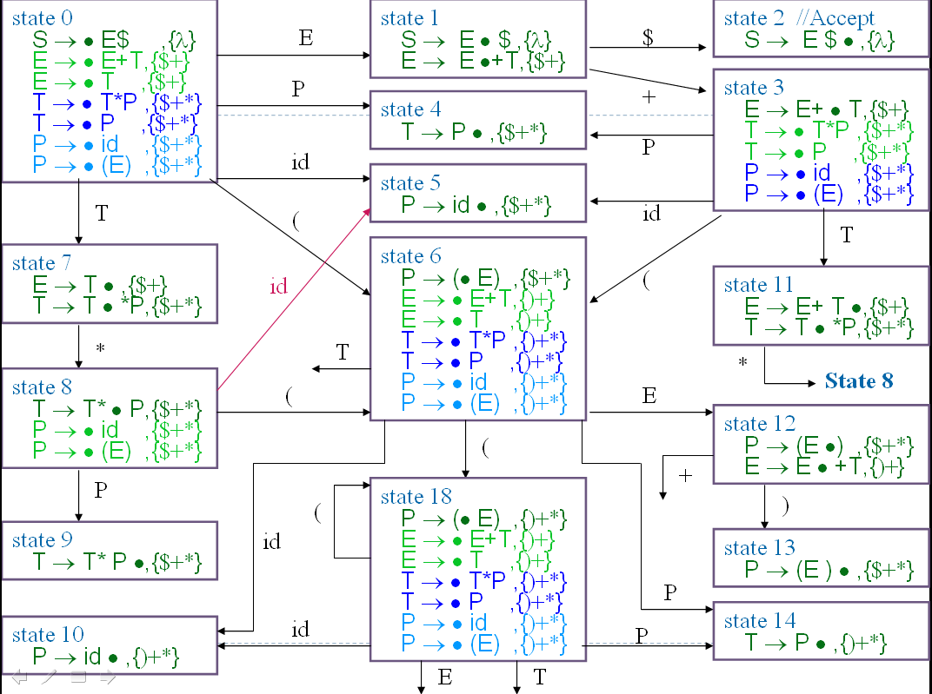
LR(1) Parsing (16)
state 16
P → (E• ) ,{)+*}
E → E •+T,{)+}
E
state 18
P → (• E) ,{)+*}
E → • E+T,{)+}
E → • T ,{)+}
T → • T*P ,{)+*}
T → • P ,{)+*}
P → • id ,{)+*}
P → • (E) ,{)+*}
T
(
+
(
P
id
State 14
State 10

Slide 24
LR(1) Parsing (17)
state 16
P → (E• ) ,{)+*}
E → E •+T,{)+}
E
state 18
P → (• E) ,{)+*}
E → • E+T,{)+}
E → • T ,{)+}
T → • T*P ,{)+*}
T → • P ,{)+*}
P → • id ,{)+*}
P → • (E) ,{)+*}
T
+
(
(
state 15
P → (E ) • ,{)+*}
P
id
State 14
State 10

Slide 25
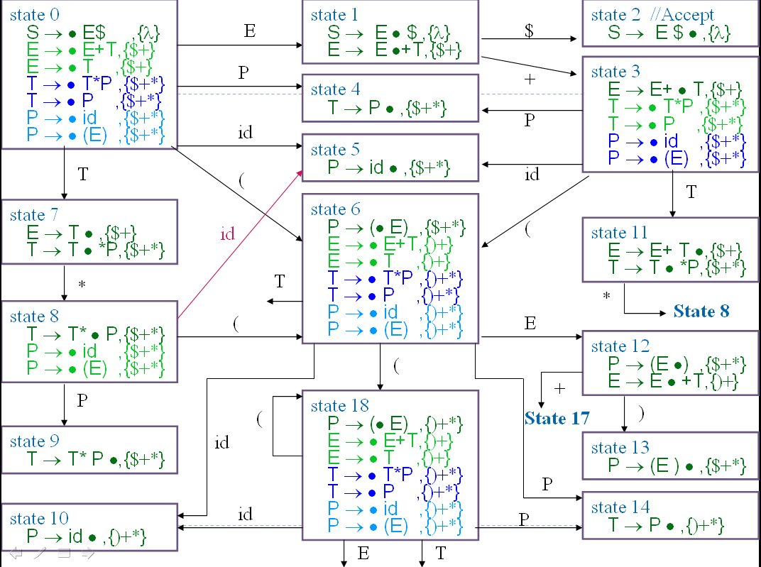
LR(1) Parsing (18)
Renew state 12
->+ to state 17
state 16
P → (E• ) ,{)+*}
E → E •+T,{)+}
E
state 18
P → (• E) ,{)+*}
E → • E+T,{)+}
E → • T ,{)+}
T → • T*P ,{)+*}
T → • P ,{)+*}
P → • id ,{)+*}
P → • (E) ,{)+*}
T
(
(
state 15
P → (E ) • ,{)+*}
(
P
id
+
state 17
E → E +•T,{)+}
T → • T*P ,{)+*}
T → • P ,{)+*}
P → • id ,{)+*}
P → • (E) ,{)+*}
P
State 14
State 10
id
T

Slide 26
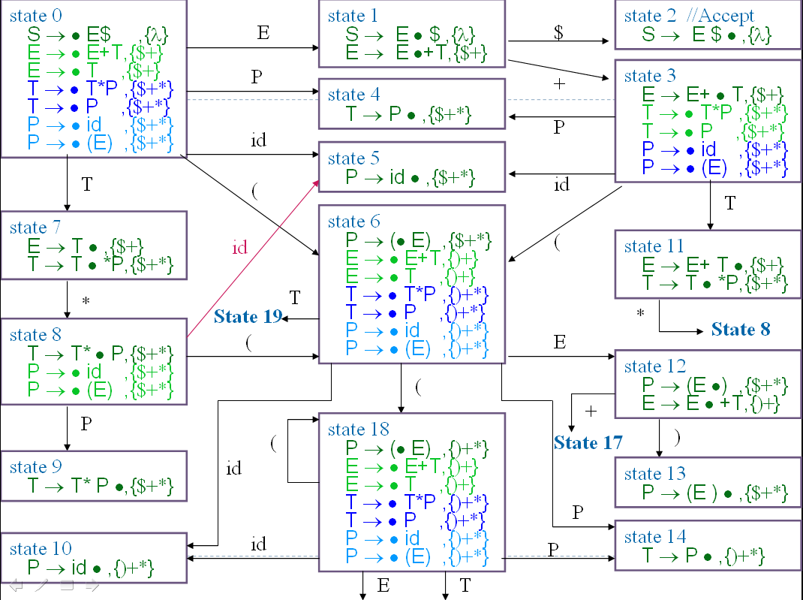
LR(1) Parsing (19)
Renew state 6
->T to state 19
state 16
P → (E• ) ,{)+*}
E → E •+T,{)+}
E
state 18
P → (• E) ,{)+*}
E → • E+T,{)+}
E → • T ,{)+}
T → • T*P ,{)+*}
T → • P ,{)+*}
P → • id ,{)+*}
P → • (E) ,{)+*}
T
state 19
E → T • ,{)+}
T → T • *P ,{)+*}
(
*
(
state 15
P → (E ) • ,{)+*}
(
P
id
+
state 17
E → E +•T,{)+}
T → • T*P ,{)+*}
T → • P ,{)+*}
P → • id ,{)+*}
P → • (E) ,{)+*}
P
State 14
State 10
id
T

Slide 27
LR(1) Parsing (20)
state 16
P → (E• ) ,{)+*}
E → E •+T,{)+}
E
state 18
P → (• E) ,{)+*}
E → • E+T,{)+}
E → • T ,{)+}
T → • T*P ,{)+*}
T → • P ,{)+*}
P → • id ,{)+*}
P → • (E) ,{)+*}
T
state 19
E → T • ,{)+}
T → T • *P ,{)+*}
(
*
(
state 15
P → (E ) • ,{)+*}
(
P
id
+
state 17
E → E +•T,{)+}
T → • T*P ,{)+*}
T → • P ,{)+*}
P → • id ,{)+*}
P → • (E) ,{)+*}
P
State 14
State 10
id
T
state 20
E → E +T•,{)+}
T → T • *P ,{)+*}
*

Slide 28
LR(1) Parsing (21)
state 16
P → (E• ) ,{)+*}
E → E •+T,{)+}
E
state 18
P → (• E) ,{)+*}
E → • E+T,{)+}
E → • T ,{)+}
T → • T*P ,{)+*}
T → • P ,{)+*}
P → • id ,{)+*}
P → • (E) ,{)+*}
T
state 19
E → T • ,{)+}
T → T • *P ,{)+*}
(
*
(
(
state 15
P → (E ) • ,{)+*}
state 21
T → T * • P,{)+*}
P → • id ,{)+*}
P → • (E) ,{)+*}
(
P
id
+
state 17
E → E +•T,{)+}
T → • T*P ,{)+*}
T → • P ,{)+*}
P → • id ,{)+*}
P → • (E) ,{)+*}
P
*
id
P
State 14
State 10
id
T
state 20
E → E +T•,{)+}
T → T • *P ,{)+*}

Slide 29
LR(1) Parsing (22)
state 16
P → (E• ) ,{)+*}
E → E •+T,{)+}
E
state 18
P → (• E) ,{)+*}
E → • E+T,{)+}
E → • T ,{)+}
T → • T*P ,{)+*}
T → • P ,{)+*}
P → • id ,{)+*}
P → • (E) ,{)+*}
T
state 19
E → T • ,{)+}
T → T • *P ,{)+*}
(
*
(
(
state 15
P → (E ) • ,{)+*}
state 21
T → T * • P,{)+*}
P → • id ,{)+*}
P → • (E) ,{)+*}
(
P
id
+
state 17
E → E +•T,{)+}
T → • T*P ,{)+*}
T → • P ,{)+*}
P → • id ,{)+*}
P → • (E) ,{)+*}
P
*
id
P
State 14
State 10
id
state 22
T → T * P •,{)+*}
T
state 20
E → E +T•,{)+}
T → T • *P ,{)+*}

Slide 30
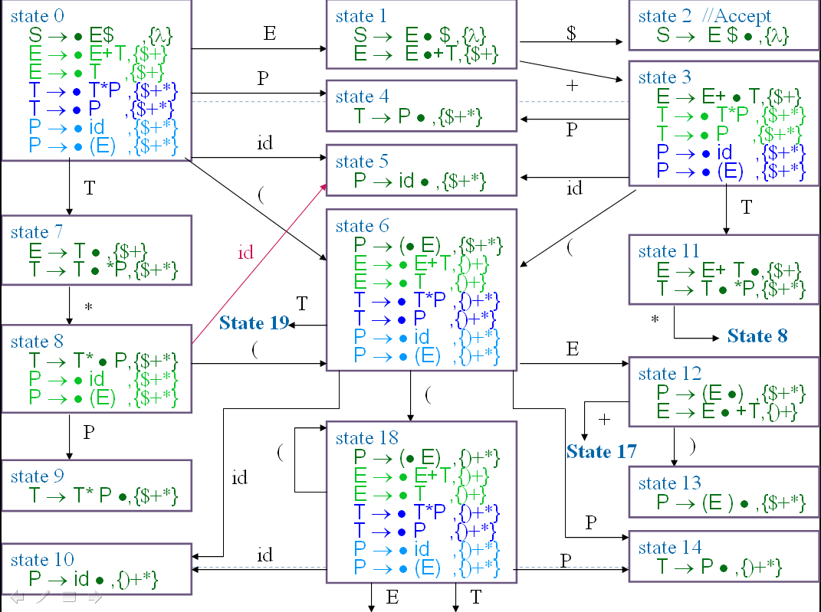
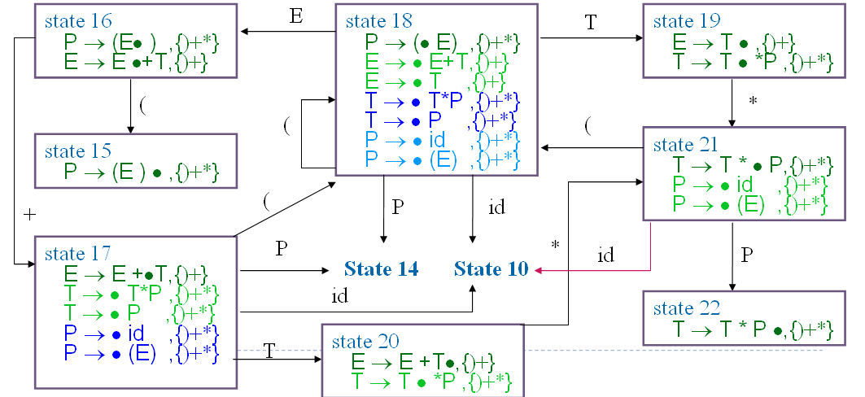
LR(1) Parsing (23)
LR(1)
  The go_to table used to drive an LR(1) is extracted directly from the LR(1) machine
  The algorithm
  to generate “go_to” table is same that we discuss in LR(0)

Slide 31
LR(1) Parsing (24)
LR(1)
  Action table is extracted directly from the configur-ation sets of the LR(1) machine
  A projection function, P
    P : S₁×V_{t}→2^{Q}
      S₁ be the set of LR(1) machine states
  P(s,a)=
  {Reduce_{i} | B→ρ •,a∈ s
  and production i is B→ρ } ∪
  (if A→ α• aβ,b ∈ s Then {Shift} Else ∅)

Slide 32
LR(1) Parsing (25)
LR(1)
  G is LR(1) if and only if
    ∀s∈ S₁ ∀a∈ V_{t} |P(s,a)|≤1
  If G is LR(1), the action table is trivially extracted from P
    P(s,$)={Shift} ⇒ action[s][$]=Accept
    P(s,a)={Shift}, a≠$ ⇒ action[s][a]=Shift
    P(s,a)={Reduce_{i}}, ⇒ action[s][a]=Reduce_{i}
    P(s,a)=∅ ⇒ action[s][a]=Error

Slide 33
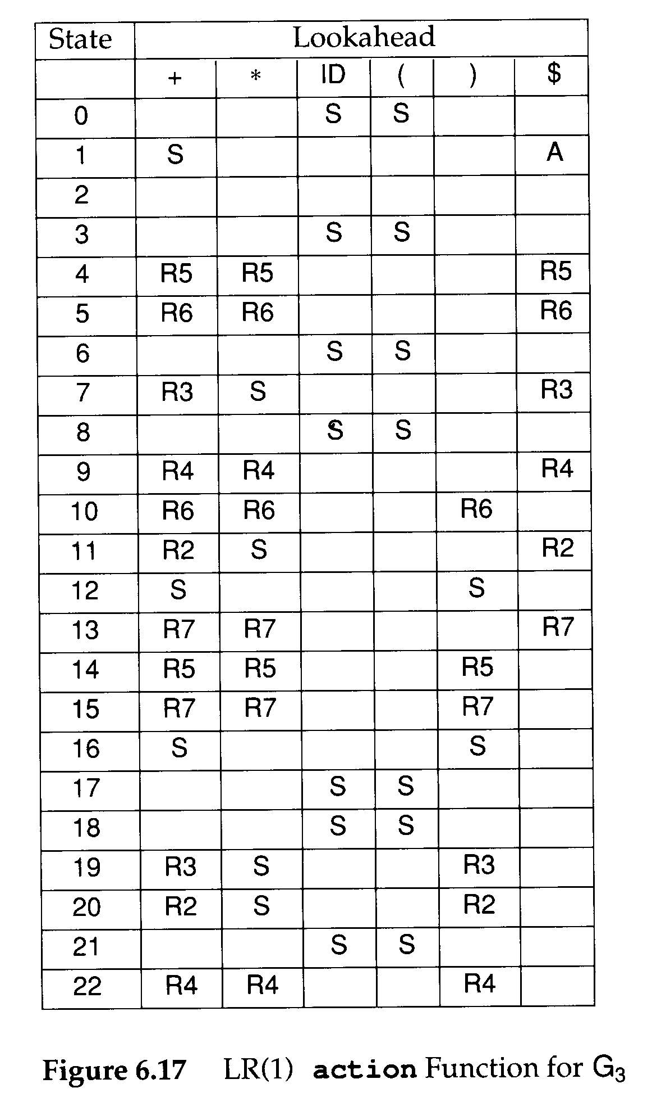
LR(1) Parsing (26)
  P(s,a)= {Reduce_{i} | B→ρ •,a∈ s
  and production i is B→ρ } ∪
  (if A→ α• aβ,b ∈ s Then {Shift} Else ∅)
Example:
state 7
Reduce when look-ahead $+
Shift when look-ahead *

Slide 34
Look-
State
ahead
0
1
2
3
4
5
6
7
8
9
10
11
12
13
14
15
16
17
18
19
20
21
22
+
S3
R5
R6
R3
R4
R6
R2
S17
R7
R5
R7
S17
R3
R2
R4
*
R5
R6
S8
R4
R6
S8
R7
R5
R7
S21
S21
R4
id
S5
S5
S10
S5
S10
S10
S10
(
S6
S6
S18
S6
S18
S18
S18
)
R6
S13
R5
R7
S15
R3
R2
R4
$
A
R5
R6
R3
R4
R2
R7
S
E
S1
S12
S16
T
S7
S11
S19
S20
S19

Slide 35
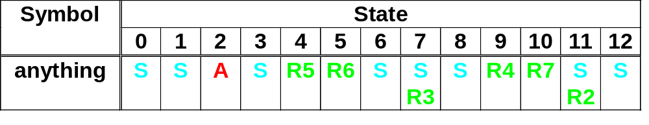
Combare G₃ action in LR(0) and LR(1)
for grammar G₃ :
  1. S → E $
  2. E → E + T
  3. E → T
  4. T → T * P
  5. T → P
  6. P → id
  7. P → ( E )
Look-
State
ahead
0
1
2
3
4
5
6
7
8
9
10
11
12
13
14
15
16
17
18
19
20
21
22
+
S3
R5
R6
R3
R4
R6
R2
S17
R7
R5
R7
S17
R3
R2
R4
*
R5
R6
S8
R4
R6
S8
R7
R5
R7
S21
S21
R4
id
S5
S5
S10
S5
S10
S10
S10
(
S6
S6
S18
S6
S18
S18
S18
)
R6
S13
R5
R7
S15
R3
R2
R4
$
A
R5
R6
R3
R4
R2
R7
S
E
S1
S12
S16
T
S7
S11
S19
S20
S19

Slide 36
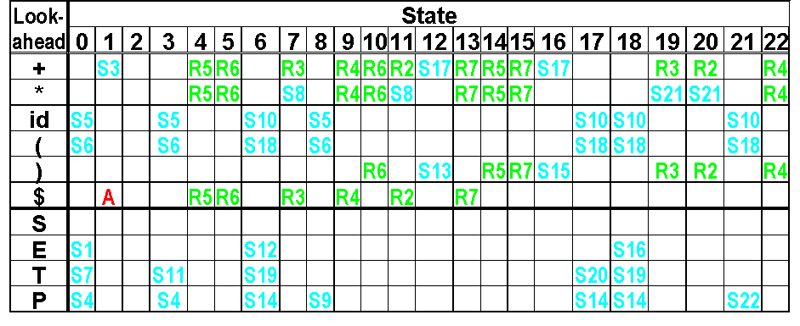
Initial :(id+id)$
step1:0 (id+id)$ shift (
Tree:
(

Slide 37
Initial :(id+id)$
step2:0 6 id+id)$ shift id
Tree:
(
id

Slide 38
Initial :(id+id)$
step3:0 6 10 +id)$ Reduce 6
Tree:
(
P
id

Slide 39
Initial :(id+id)$
step4:0 6 14 +id)$ Reduce 5
Tree:
(
T
P
id

Slide 40
Initial :(id+id)$
step5:0 6 19 +id)$ Reduce 3
Tree:
(
E
T
P
id

Slide 41
Initial :(id+id)$
step6:0 6 12 +id)$ shift +
Tree:
(
E
+
T
P
id

Slide 42
Initial :(id+id)$
step7:0 6 12 17 id)$ shift id
Tree:
(
E
+
id
T
P
id

Slide 43
Initial :(id+id)$
step8:0 6 12 17 10 )$ Reduce 6
Tree:
(
E
+
P
T
id
P
id

Slide 44
Initial :(id+id)$
step9:0 6 12 17 14 )$ Reduce 5
Tree:
(
E
+
T
T
P
P
id
id

Slide 45
Initial :(id+id)$
step10:0 6 12 17 20 )$ Reduce 2
Tree:
(
E
E
+
T
T
P
P
id
id

Slide 46
Initial :(id+id)$
step11:0 6 12 )$ Shift 13
Tree:
(
E
)
E
+
T
T
P
P
id
id

Slide 47
Initial :(id+id)$
step12:0 6 12 13 $ Reduce 7
Tree:
P
(
E
)
E
+
T
T
P
P
id
id

Slide 48
Initial :(id+id)$
step13:0 4 $ Reduce 7
Tree:
T
P
(
E
)
E
+
T
T
P
P
id
id

Slide 49
Initial :(id+id)$
step14:0 7 $ Reduce 3
E
Tree:
T
P
(
E
)
E
+
T
T
P
P
id
id

Slide 50
Initial :(id+id)$
step15:0 1 $ Accept
E
Tree:
T
P
(
E
)
E
+
T
T
P
P
id
id

