Slide 1
Outline
6.0 Introduction
6.1 Shift-Reduce Parsers
6.2 LR Parsers
6.3 LR(1) Parsing
6.4 SLR(1)Parsing
6.5 LALR(1)
6.6 Calling Semantic Routines in Shift-Reduce Parsers
6.7 Using a Parser Generator (TA course)
6.8 Optimizing Parse Tables
6.9 Practical LR(1) Parsers
6.10 Properties of LR Parsing
6.11 LL(1) or LAlR(1) , That is the question
6.12 Other Shift-Reduce Technique

Slide 2
SLR(1) Parsing (1)
LR(1) parsers
  are the most powerful case of shift-reduce parsers, using a single look-ahead
    LR(1) grammars exist for virtually all programming languages
    LR(1)’s problem is that the LR(1) machine contains so many states that the go_to and action tables become prohibitively large
In reaction to the space inefficiency of LR(1) tables
  computer scientists have devised parsing techniques that are almost as powerful as LR(1) but that require far smaller tables
    One is to start with the CFSM, and then add look-ahead after the CFSM is build
      SLR(1)
    The other approach to reducing LR(1)’s space inefficiencies is to merger inessential LR(1) states
      LALR(1)

Slide 3
SLR(1) Parsing (2)
SLR(1) stands for Simple LR(1)
  One-symbol look-ahead
  Look-aheads are not built directly into configurations but rather are added after the LR(0) configuration sets are built
  An SLR(1) parser will perform a reduce action for configuration B→ ρ • if the look-ahead symbol is in the set Follow(B)
The SLR(1) projection function, from CFSM states,
  P : S₀×V_{t}→2^{Q}
  P(s,a)={Reduce_{i} | B→ρ •,a∈ Follow(B) and production i is B→ρ } ∪ (if A→ α• aβ ∈ s for a∈ V_{t} Then {Shift} Else ∅)

Slide 4
SLR(1) Parsing (3)
G is SLR(1) if and only if
  ∀s∈ S₀ ∀a∈ V_{t} |P(s,a)|≤1
If G is SLR(1), the action table is trivially extracted from P
  P(s,$)={Shift} ⇒ action[s][$]=Accept
  P(s,a)={Shift}, a≠$ ⇒ action[s][a]=Shift
  P(s,a)={Reduce_{i}}, ⇒ action[s][a]=Reduce_{i}
  P(s,a)=∅ ⇒ action[s][a]=Error
Clearly SLR(1) is a proper superset of LR(0)

Slide 5
SLR(1) Parsing (4)
Consider G₃
  It is LR(1) but not LR(0)
  What’re follow-sets in G₃?
Consider G₃ :
  1. S → E $
  2. E → E + T
  3. E → T
  4. T → T * P
  5. T → P
  6. P → id
  7. P → ( E )
Follow(S) = {λ},
Follow(E) = {+)$},
Follow(T) = {+*)$},
Follow(P) = {+*)$}

Slide 6
state 0
S → • E$
E → • E+T
E → • T
T → • T*P
T → • P
P → • id
P → • (E)
E
P
id
T
(
Follow(S) = {λ},
Follow(E) = {+)$},
Follow(T) = {+*)$},
Follow(P) = {+*)$}

Slide 7
state 0
S → • E$
E → • E+T
E → • T
T → • T*P
T → • P
P → • id
P → • (E)
state 1
S → E • $
E → E •+T
E
$
P
+
id
T
(
Follow(S) = {λ},
Follow(E) = {+)$},
Follow(T) = {+*)$},
Follow(P) = {+*)$}

Slide 8
state 0
S → • E$
E → • E+T
E → • T
T → • T*P
T → • P
P → • id
P → • (E)
state 1
S → E • $
E → E •+T
state 2 //Accept
S → E $ •
E
$
P
+
id
T
(
Follow(S) = {λ},
Follow(E) = {+)$},
Follow(T) = {+*)$},
Follow(P) = {+*)$}

Slide 9
state 0
S → • E$
E → • E+T
E → • T
T → • T*P
T → • P
P → • id
P → • (E)
state 1
S → E • $
E → E •+T
state 2 //Accept
S → E $ •
E
$
P
+
state 3
E → E+ • T
T → • T*P
T → • P
P → • id
P → • (E)
P
id
T
(
id
T
(
Follow(S) = {λ},
Follow(E) = {+)$},
Follow(T) = {+*)$},
Follow(P) = {+*)$}

Slide 10
state 0
S → • E$
E → • E+T
E → • T
T → • T*P
T → • P
P → • id
P → • (E)
state 1
S → E • $
E → E •+T
state 2 //Accept
S → E $ •
E
$
P
P
+
state 3
E → E+ • T
T → • T*P
T → • P
P → • id
P → • (E)
state 4
T → P •
P
id
T
(
id
T
(
Follow(S) = {λ},
Follow(E) = {+)$},
Follow(T) = {+*)$},
Follow(P) = {+*)$}

Slide 11
state 0
S → • E$
E → • E+T
E → • T
T → • T*P
T → • P
P → • id
P → • (E)
state 1
S → E • $
E → E •+T
state 2 //Accept
S → E $ •
E
$
P
P
+
state 3
E → E+ • T
T → • T*P
T → • P
P → • id
P → • (E)
state 4
T → P •
P
id
state 5
P → id •
T
(
id
T
(
Follow(S) = {λ},
Follow(E) = {+)$},
Follow(T) = {+*)$},
Follow(P) = {+*)$}

Slide 12
state 0
S → • E$
E → • E+T
E → • T
T → • T*P
T → • P
P → • id
P → • (E)
state 1
S → E • $
E → E •+T
state 2 //Accept
S → E $ •
E
$
P
P
+
state 3
E → E+ • T
T → • T*P
T → • P
P → • id
P → • (E)
state 4
T → P •
P
id
state 5
P → id •
T
(
id
T
id
(
state 6
P → (• E)
E → • E+T
E → • T
T → • T*P
T → • P
P → • id
P → • (E)
T
E
(
P
Follow(S) = {λ},
State 4
Follow(E) = {+)$},
Follow(T) = {+*)$},
Follow(P) = {+*)$}

Slide 13
state 0
S → • E$
E → • E+T
E → • T
T → • T*P
T → • P
P → • id
P → • (E)
state 1
S → E • $
E → E •+T
state 2 //Accept
S → E $ •
E
$
P
P
+
state 3
E → E+ • T
T → • T*P
T → • P
P → • id
P → • (E)
state 4
T → P •
P
id
state 5
P → id •
T
(
id
T
state 7
E → T •
T → T • *P
id
(
state 6
P → (• E)
E → • E+T
E → • T
T → • T*P
T → • P
P → • id
P → • (E)
*
T
E
(
P
Follow(S) = {λ},
State 4
Follow(E) = {+)$},
Follow(T) = {+*)$},
Follow(P) = {+*)$}

Slide 14
state 0
S → • E$
E → • E+T
E → • T
T → • T*P
T → • P
P → • id
P → • (E)
state 1
S → E • $
E → E •+T
state 2 //Accept
S → E $ •
E
$
P
P
+
state 3
E → E+ • T
T → • T*P
T → • P
P → • id
P → • (E)
state 4
T → P •
P
id
state 5
P → id •
T
(
id
T
state 7
E → T •
T → T • *P
id
id
(
state 6
P → (• E)
E → • E+T
E → • T
T → • T*P
T → • P
P → • id
P → • (E)
*
T
state 8
T → T* • P
P → • id
P → • (E)
(
E
P
(
P
Follow(S) = {λ},
State 4
Follow(E) = {+)$},
Follow(T) = {+*)$},
Follow(P) = {+*)$}

Slide 15
state 0
S → • E$
E → • E+T
E → • T
T → • T*P
T → • P
P → • id
P → • (E)
state 1
S → E • $
E → E •+T
state 2 //Accept
S → E $ •
E
$
P
P
+
state 3
E → E+ • T
T → • T*P
T → • P
P → • id
P → • (E)
state 4
T → P •
P
id
state 5
P → id •
T
(
id
T
state 7
E → T •
T → T • *P
id
id
(
state 6
P → (• E)
E → • E+T
E → • T
T → • T*P
T → • P
P → • id
P → • (E)
*
T
state 8
T → T* • P
P → • id
P → • (E)
(
E
P
(
P
state 9
T → T* P •
Follow(S) = {λ},
State 4
Follow(E) = {+)$},
Follow(T) = {+*)$},
Follow(P) = {+*)$}

Slide 16
state 0
S → • E$
E → • E+T
E → • T
T → • T*P
T → • P
P → • id
P → • (E)
state 1
S → E • $
E → E •+T
state 2 //Accept
S → E $ •
E
$
P
P
+
state 3
E → E+ • T
T → • T*P
T → • P
P → • id
P → • (E)
state 4
T → P •
P
id
state 5
P → id •
T
(
id
T
state 7
E → T •
T → T • *P
id
id
(
state 11
E → E+ T •
T → T • *P
state 6
P → (• E)
E → • E+T
E → • T
T → • T*P
T → • P
P → • id
P → • (E)
*
T
*
state 8
T → T* • P
P → • id
P → • (E)
State 8
(
E
P
(
P
state 9
T → T* P •
Follow(S) = {λ},
State 4
Follow(E) = {+)$},
Follow(T) = {+*)$},
Follow(P) = {+*)$}

Slide 17
state 0
S → • E$
E → • E+T
E → • T
T → • T*P
T → • P
P → • id
P → • (E)
state 1
S → E • $
E → E •+T
state 2 //Accept
S → E $ •
E
$
P
P
+
state 3
E → E+ • T
T → • T*P
T → • P
P → • id
P → • (E)
state 4
T → P •
P
id
state 5
P → id •
T
(
id
T
state 7
E → T •
T → T • *P
id
id
(
state 11
E → E+ T •
T → T • *P
state 6
P → (• E)
E → • E+T
E → • T
T → • T*P
T → • P
P → • id
P → • (E)
*
T
*
state 8
T → T* • P
P → • id
P → • (E)
State 8
(
E
state 12
P → (E •)
E → E • +T
P
(
)
+
P
state 9
T → T* P •
Follow(S) = {λ},
State 3
State 4
Follow(E) = {+)$},
Follow(T) = {+*)$},
Follow(P) = {+*)$}

Slide 18
state 0
S → • E$
E → • E+T
E → • T
T → • T*P
T → • P
P → • id
P → • (E)
state 1
S → E • $
E → E •+T
state 2 //Accept
S → E $ •
E
$
P
P
+
state 3
E → E+ • T
T → • T*P
T → • P
P → • id
P → • (E)
state 4
T → P •
P
id
state 5
P → id •
T
(
id
T
state 7
E → T •
T → T • *P
id
id
(
state 11
E → E+ T •
T → T • *P
state 6
P → (• E)
E → • E+T
E → •T
T → • T*P
T → • P
P → • id
P → • (E)
*
T
*
state 8
T → T* • P
P → • id
P → • (E)
State 8
(
E
state 12
P → (E •)
E → E • +T
P
(
)
+
P
state 9
T → T* P •
Follow(S) = {λ},
State 3
State 4
Follow(E) = {+)$},
Follow(T) = {+*)$},
state 10
P → (E) •
Follow(P) = {+*)$}

Slide 19
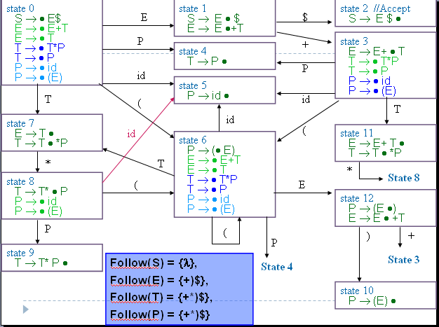
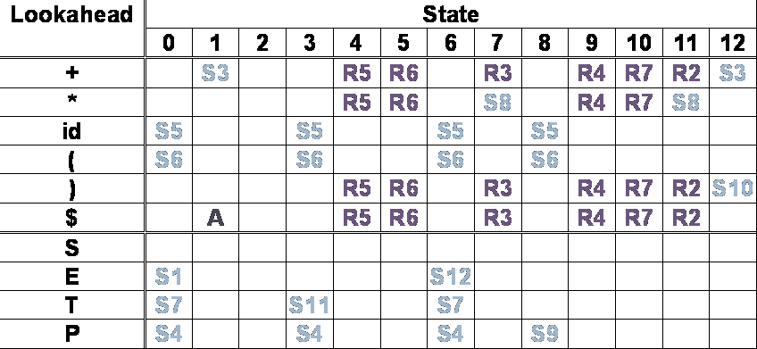
SLR(1) Parsing (5)
SLR(1) action table

Slide 20
SLR(1) Parsing (6)
Limitations of the SLR(1) Technique
  The use of Follow sets to estimate the look-aheads that predict reduce actions is less precise than using the exact look-aheads incorporated into LR(1) configurations
  Example in next page

Slide 21
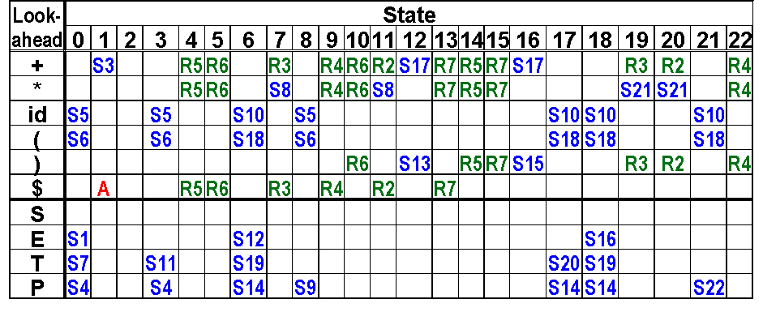
Compare
LR(1)&
SLR(1)
Consider G₃ :
  1. S → E $
  2. E → E + T
  3. E → T
  4. T → T * P
  5. T → P
  6. P → id
  7. P → ( E )
Consider Input: id )
LR(1)
LR(1)
Step1:0 id) shift 5
Step2:05 ) Error
The performance of detecting errors
SLR(1)
Step1:0 id) shift 5
Step2:05 ) Reduce 6
Step3:04 ) Reduce 5
Step4:07 ) Reduce 3
Step5:01 ) Error
SLR(1)

Slide 22
Outline
6.0 Introduction
6.1 Shift-Reduce Parsers
6.2 LR Parsers
6.3 LR(1) Parsing
6.4 SLR(1)Parsing
6.5 LALR(1)
6.6 Calling Semantic Routines in Shift-Reduce Parsers
6.7 Using a Parser Generator (TA course)
6.8 Optimizing Parse Tables
6.9 Practical LR(1) Parsers
6.10 Properties of LR Parsing
6.11 LL(1) or LAlR(1) , That is the question
6.12 Other Shift-Reduce Technique

Slide 23
LALR(1) (1)
LALR(1) parsers
  can be built by first constructing an LR(1) parser and then merging states
    An LALR(1) parser is an LR(1) parser in which all states that differ only in the look-ahead components of the configurations are merged
    LALR is an acronym for Look Ahead LR
The core of the above two configurations is the same. Example: LR(1)- state3,state17
state 3
E → E+ • T,{$+}
T → • T*P ,{$+*}
T → • P ,{$+*}
P → • id ,{$+*}
P → • (E) ,{$+*}
Cognate(s′)={c|c∈s, core(s)=s′}
state 3
E → E+ • T,{)$+}
T → • T*P ,{)$+*}
T → • P ,{)$+*}
P → • id ,{)$+*}
P → • (E) ,{)$+*}
Core s’
E → E+ • T
T → • T*P
T → • P
P → • id
P → • (E)
state 17
E → E +•T,{)+}
T → • T*P ,{)+*}
T → • P ,{)+*}
P → • id ,{)+*}
P → • (E) ,{)+*}

Slide 24
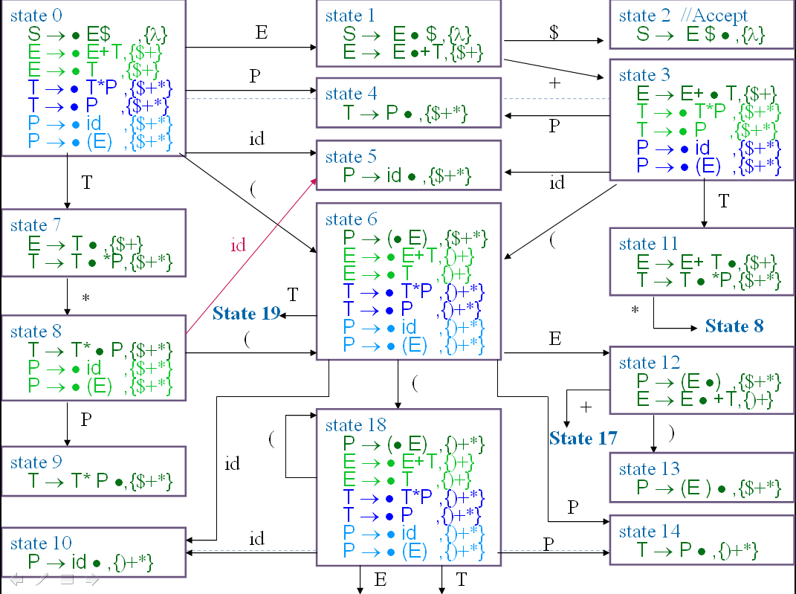
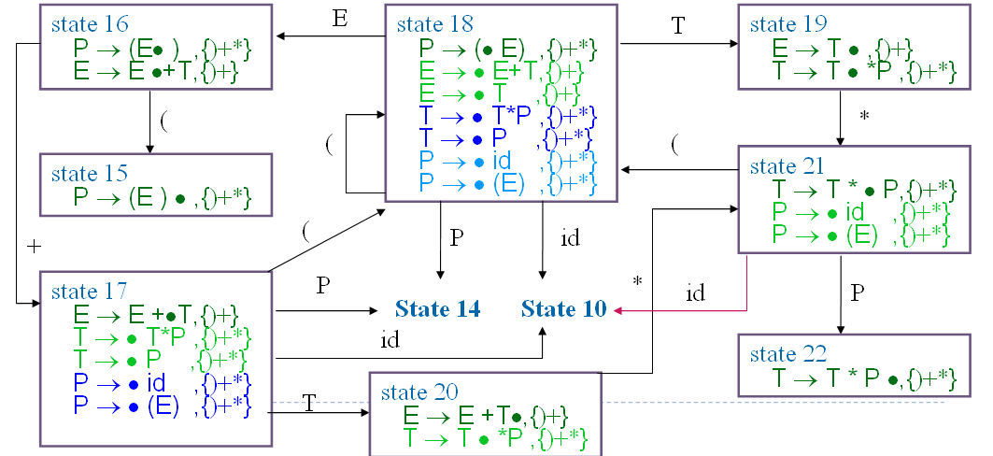
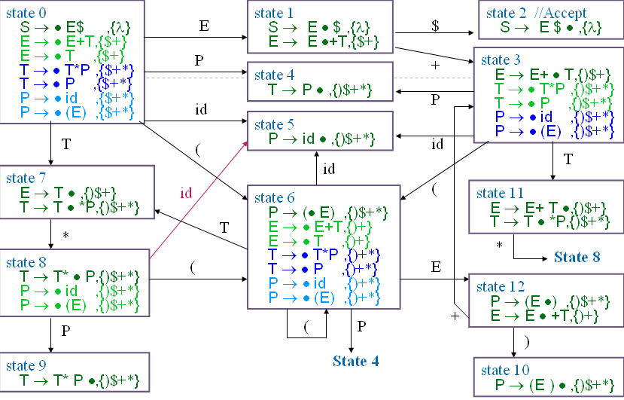
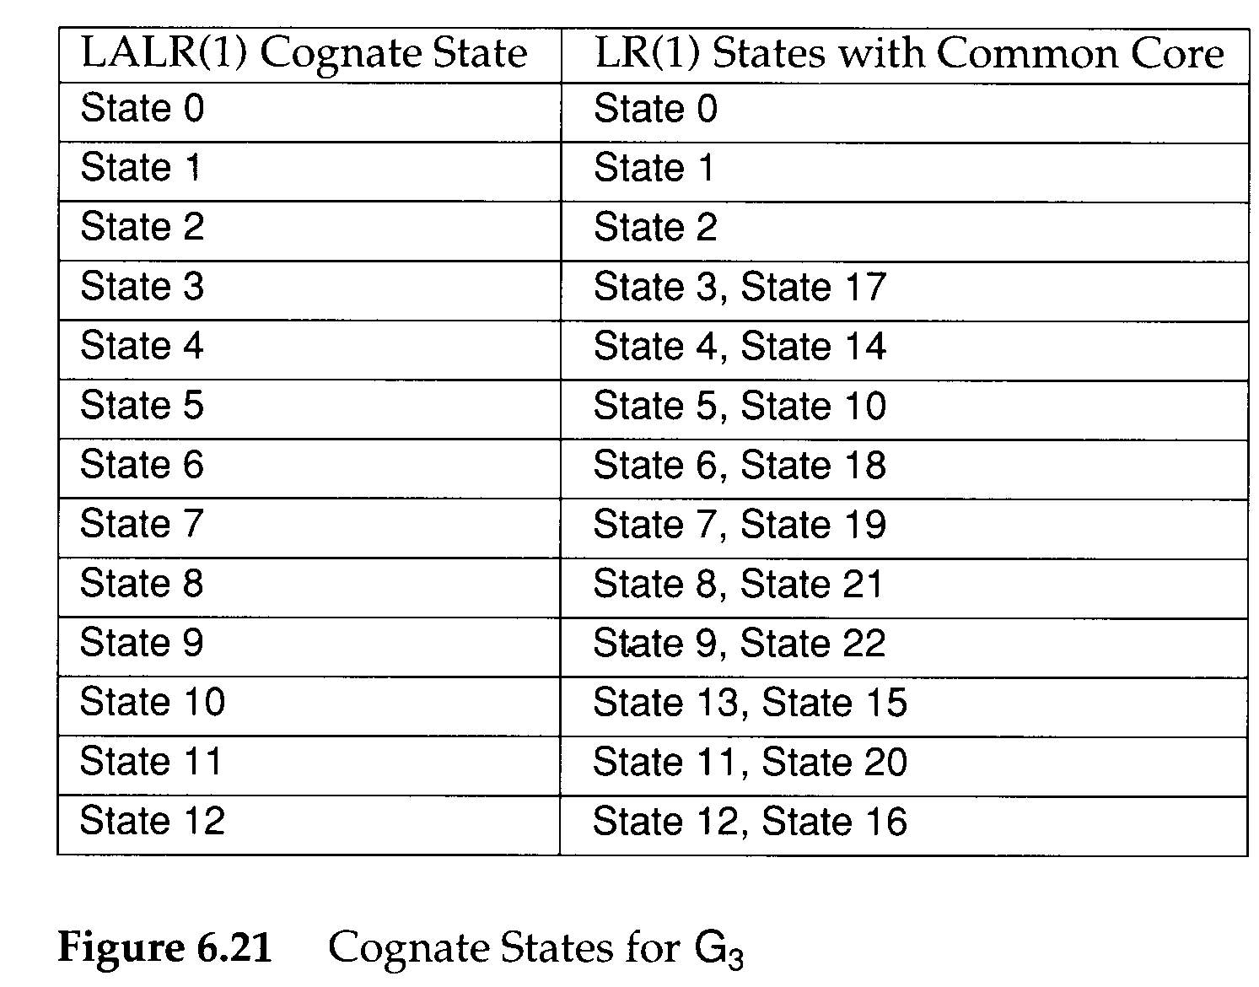
LR(1) G₃ diagram
LALR(1) G₃ diagram

Slide 25
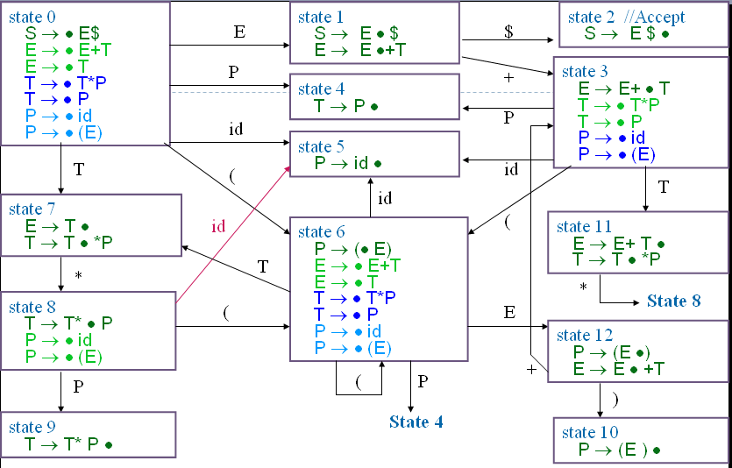
Follow(S) = {λ},
Follow(E) = {+)$},
Follow(T) = {+*)$},
SLR(1) G₃ diagram (CFSM)
Follow(P) = {+*)$}
Compare SLR(1) & LALR(1)
It’s same behavior whether action or goto using SLR(1) or LALR(1) in G₃
Example:
Compare state 7and state10
in SLR(1) andLALR(1).
Are they all same?
When’s different???
LALR(1) G₃ diagram

Slide 26
LALR(1) (4)
The CFSM state is transformed into its LALR(1) Cognate
  P : S₀×V_{t}→2^{Q}
  P(s,a)={Reduce_{i} | B→ρ •,a∈ Cognate(s) and production i is B→ρ } ∪
  (if A→ α• aβ ∈ s Then {Shift} Else ∅)
G is LALR(1) if and only if
  ∀s∈ S₀ ∀a∈ V_{t} |P(s,a)|≤1
If G is LALR(1), the action table is trivially extracted from P
  P(s,$)={Shift} ⇒ action[s][$]=Accept
  P(s,a)={Shift}, a≠$ ⇒ action[s][a]=Shift
  P(s,a)={Reduce_{i}}, ⇒ action[s][a]=Reduce_{i}
  P(s,a)=∅ ⇒ action[s][a]=Error

Slide 27
LALR(1) (5)
grammar G₅ :
…..
<prog>→ <stmt>;{<stmt>;}
<stmt>→ID
<stmt>→<var>:=<expr>
<var> →ID
<var> →ID[<expr>]
<expr>→<var>
For Grammar 5:
Assume statements are separated by ;’s,
the grammar is not SLR(1) because
  ; ∈ Follow(<stmt>) and
  ; ∈ Follow(<var>), since <expr>→<var>
state 0
……
<prog>→ •<stmt>;{<stmt>;}
<stmt>→ •ID
<stmt>→ •<var>:=<expr>
<var> → •ID
<var> → •ID[<expr>]
<expr>→ •<var>
id
state 1
<stmt>→ ID •
<var> → ID •
<var> → ID •[<expr>]
Reduce-reduce conflict

Slide 28
LALR(1) (6)
state 0
……
<prog>→ •<stmt>;{<stmt>;} ,{$ ;}
<stmt>→ •ID ,{$ ;}
<stmt>→ •<var>:=<expr> ,{$ ; :=}
<var> → •ID,{$ ; :=}
<var> → •ID[<expr>] ,{$ ; := [ }
<expr>→ •<var>
id
state 1
<stmt>→ ID • ,{$ ;}
<var> → ID • ,{$ ; :=}
<var> → ID •[<expr>] ,{$ ; := [ }
However, in LALR(1),
  if we use <var> → ID the next symbol must be :=
    so action[ 1, := ] = reduce(<var> → ID)
    action[ 1, ; ] = reduce(<stmt> → ID)
    action[ 1,[ ] = shift
There is no conflict.

Slide 29
LALR(1) (7)
A common technique
  to put an LALR(1) grammar into SLR(1) form is to introduce a new non-terminal whose global (I.e. SLR) look-aheads more nearly correspond to LALR’s exact look-aheads
  Follow(<lhs>) = {:=}
grammar G₅ :
……
<prog>→ <stmt>;{<stmt>;}
<stmt>→ ID
<stmt>→ <var>:=<expr>
<var> → ID
<var> → ID[<expr>]
<expr>→ <var>
grammar G₅ :
……
<prog>→ <stmt>;{<stmt>;}
<stmt>→ ID
<stmt>→ <lhs>:=<expr>
<lhs> → ID
<lhs> → ID[<expr>]
<var> → ID
<var> → ID[<expr>]
<expr>→ <var>

Slide 30
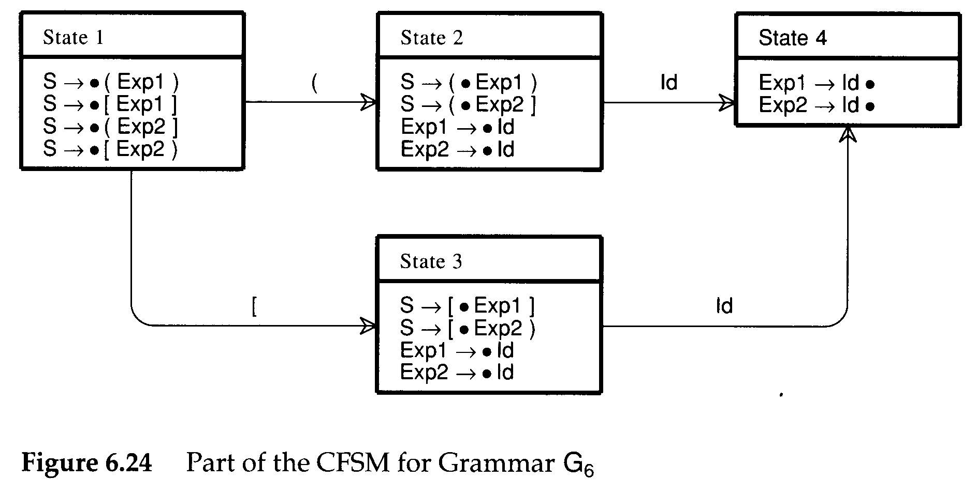
LALR(1) (8)
grammar G₆ :
S→ (Exp1)
S→ [Exp1]
S→ (Exp2]
S→ [Exp2)
<Exp1>→ID
<Exp2>→ID
Both SLR(1) and LALR(1) are both built CFSM
  Does the case ever occur in which action table
  can’t work?
At times, it is the CFSM itself that is at fault.
A different expression non-terminal is used to allow error or warning diagnostics
In state4 , after reduce, we do not know what state should be the next state
In LR(1) , state4 will split into two states and have a solution.

Slide 31
Building LALR(1) Parsers (1)
In the definition of LALR(1)
  An LR(1) machine is first built, and then its states are merged to form an automaton identical in structure to the CFSM
    May be quite inefficient
  An alternative is to build the CFSM first.
    Then LALR(1) look-aheads are “propagated” from configuration to configuration
Propagate links:
  Case 1: one configuration is created from another in a previous state via a shift operation
  Case 2: one configuration is created as the result of a closure or prediction operation on another configuration
A→ α•Xγ , L₁
A→ αX• γ , L₂
B→ β•Aγ , L₁
A→ •α , L₂
L₂={ x|x∈First(γ t) and t ∈L₁ }

Slide 32
Building LALR(1) Parsers(2)
Step 1:
  After the CFSM is built, we can create all the necessary propagate links to transmit look-aheads from one configuration to another (case1)
Step 2:
  spontaneous look-aheads are determined (case2)
    By including in L₂, for configuration A→•α,L₂, all spontaneous look-aheads induced by configurations of the form B → β • Aγ,L₁
      These are simply the non-λ values of First(γ)
Step 3:
  Then, propagate look-aheads via the propagate links
While (stack is not empty)
{
pop top items , assign its components to (s,c,L)
if ( configuration c in state s has any propagate links)
{
Try, in turn, to add L to the look-ahead set of each
configuration so linked.
for (each configuration c’ in state s’ to which L is added)
Push(s’,c’,L) onto the stack
} }

Slide 33
Building LALR(1) Parsers(3)
state 1
S → • Opts$
Opts → • Opt Opt
Opt → • ID
state 4
Opts → Opt • Opt
Opt → • ID
Opt
state 6
Opts → Opt Opt •
Opt
grammar G₆ :
S→ Opts $
Opts→ Opt Opt
Opt→ ID
Opts
ID
ID
state 2
S → Opts • $
state 5
Opt → ID •
$
state 3
S → Opts $ •
Build CFSM
state 1
S → • Opts$ ,{}
Opts → • Opt Opt,
Opt → • ID ,
state 4
Opts → Opt • Opt
Opt → • ID
Opt
state 6
Opts → Opt Opt •
Opt
Stack:
(s1,c1,{ })
Opts
ID
ID
state 2
S → Opts • $
state 5
Opt → ID •
$
state 3
S → Opts $ •
Build initial Lookahead

Slide 34
Building LALR(1) Parsers(4)
state 1
S → • Opts$ ,{}
Opts → • Opt Opt ,{$}
Opt → • ID
state 4
Opts → Opt • Opt
Opt → • ID
Opt
state 6
Opts → Opt Opt •
Opt
Opts
ID
ID
state 2
S → Opts • $ , {$}
state 5
Opt → ID •
$
Step1
pop (s1, c1, {})
add $ to c1 in s2 (case1)
push(s2,c1,$)
add $ to c2 in s1 (case2)
push(s1, c2, $)
state 3
S → Opts $ •
Top
Stack:
(s1,c2,$)
(s2,c1,$)
buttom

Slide 35

Building LALR(1) Parsers(5)
state 1
S → • Opts$ ,{}
Opts → • Opt Opt ,{$}
Opt → • ID, {ID}
state 4
Opts → Opt • Opt, {ID}
Opt → • ID
Opt
Opts
ID
ID
Opt
state 2
S → Opts • $ , {$}
state 5
Opt → ID •
$
Step2
pop (s1,c2,$)
add ID to c1 in s4 (case1)
push (s4,c1,ID)
add ID to c3 in s1 (case2)
push (s1,c3,ID)
state 3
S → Opts $ •
state 6
Opts → Opt Opt •
Stack:
(s1,c3,ID)
(s4,c1,ID)
(s2,c1,$)
Top
buttom

Slide 36
Building LALR(1) Parsers(6)
state 1
S → • Opts$ ,{}
Opts → • Opt Opt ,{$}
Opt → • ID, {ID}
state 4
Opts → Opt • Opt, {ID}
Opt → • ID
Opt
Opts
ID
ID
Opt
state 2
S → Opts • $ , {$}
state 5
Opt → ID • , {ID}
$
Step3
pop (s1, c3, ID)
add ID to c1 in s5(case1)
push (s5, c1, ID)
state 3
S → Opts $ •
state 6
Opts → Opt Opt •
Top
Stack:
(s5,c1,ID)
(s4,c1,ID)
(s2,c1,$)
buttom

Slide 37
state 1
S → • Opts$ ,{}
Opts → • Opt Opt ,{$}
Opt → • ID, {ID}
state 4
Opts → Opt • Opt, {ID}
Opt → • ID
Opt
Opts
ID
ID
Opt
state 2
S → Opts • $ , {$}
state 5
Opt → ID • , {ID}
$
Step4
pop (s5,c1,ID)
state 3
S → Opts $ •
state 6
Opts → Opt Opt •
Top
Stack:
(s4,c1,ID)
(s2,c1,$)
buttom

Slide 38
state 1
S → • Opts$ ,{}
Opts → • Opt Opt ,{$}
Opt → • ID, {ID}
state 4
Opts → Opt • Opt, {ID}
Opt → • ID , , {ID}
Opt
Opts
ID
ID
Opt
state 2
S → Opts • $ , {$}
state 5
Opt → ID • , {ID}
$
Step5
pop (s4,c1,ID)
add ID to c1 in s6 (case1)
push(s6, c1, ID)
add ID to c2 in s4 (case2)
push(s4, c2, ID)
state 3
S → Opts $ •
state 6
Opts → Opt Opt • , {ID}
Top
Stack:
(s6,c1,ID)
(s4,c2,ID)
(s2,c1,$)
buttom

Slide 39
state 1
S → • Opts$ ,{}
Opts → • Opt Opt ,{$}
Opt → • ID, {ID}
state 4
Opts → Opt • Opt, {ID}
Opt → • ID , {ID}
Opt
Opts
ID
ID
Opt
state 2
S → Opts • $ , {$}
state 5
Opt → ID • , {ID}
$
Step6
pop (s6,c1,ID)
state 3
S → Opts $ •
state 6
Opts → Opt Opt • , {ID}
Top
Stack:
(s4,c2,ID)
(s2,c1,$)
buttom

Slide 40
state 1
S → • Opts$ ,{}
Opts → • Opt Opt ,{$}
Opt → • ID, {ID}
state 4
Opts → Opt • Opt, {ID}
Opt → • ID , {ID}
Opt
Opts
ID
ID
Opt
state 2
S → Opts • $ , {$}
state 5
Opt → ID • , {ID}
$
Step7
pop (s4,c2,ID)
add ID to c1 in s5 (case1)
push(s5,c1,ID)
state 3
S → Opts $ •
state 6
Opts → Opt Opt • , {ID}
Top
Stack:
(s5,c1,ID)
(s2,c1,$)
buttom

Slide 41
state 1
S → • Opts$ ,{}
Opts → • Opt Opt ,{$}
Opt → • ID, {ID}
state 4
Opts → Opt • Opt, {ID}
Opt → • ID , {ID}
Opt
Opts
ID
ID
Opt
state 2
S → Opts • $ , {$}
state 5
Opt → ID • , {ID}
$
Step8
pop (s5,c1,ID)
state 3
S → Opts $ •
state 6
Opts → Opt Opt • , {ID}
Top
Stack:
(s2,c1,$)
buttom

Slide 42
state 1
S → • Opts$ ,{}
Opts → • Opt Opt ,{$}
Opt → • ID, {ID}
state 4
Opts → Opt • Opt, {ID}
Opt → • ID , {ID}
Opt
Opts
ID
ID
Opt
state 2
S → Opts • $ , {$}
state 5
Opt → ID • , {ID}
$
Step9
pop (s2,c1,$)
add $ in c1 of s3 (case1)
push (s3, c1, $)
state 3
S → Opts $ • , {$}
state 6
Opts → Opt Opt • , {ID}
Top
Stack:
(s3,c1,$)
buttom

Slide 43
state 1
S → • Opts$ ,{}
Opts → • Opt Opt ,{$}
Opt → • ID, {ID}
state 4
Opts → Opt • Opt, {ID}
Opt → • ID , {ID}
Opt
Opts
ID
ID
Opt
state 2
S → Opts • $ , {$}
state 5
Opt → ID • , {ID}
$
Step10
pop (s3,c1,$)
state 3
S → Opts $ • , {$}
state 6
Opts → Opt Opt • , {ID}
Top
Stack:
buttom

Slide 44
Building LALR(1) Parsers (6)
A number of LALR(1) parser
  generators use look-ahead propagation to compute the parser action table
    LALR-Gen uses the propagation algorithm
    YACC examines each state repeatedly

Slide 45
Outline
6.0 Introduction
6.1 Shift-Reduce Parsers
6.2 LR Parsers
6.3 LR(1) Parsing
6.4 SLR(1)Parsing
6.5 LALR(1)
6.6 Calling Semantic Routines in Shift-Reduce Parsers
6.7 Using a Parser Generator (TA course)
6.8 Optimizing Parse Tables
6.9 Practical LR(1) Parsers
6.10 Properties of LR Parsing
6.11 LL(1) or LAlR(1) , That is the question
6.12 Other Shift-Reduce Technique

Slide 46
Calling Semantic Routines in Shift-Reduce Parsers (1)
Shift-reduce parsers
  can normally handle larger classes of grammars than LL(1) parsers, which is a major reason for their popularity
  are not predictive
    so we cannot always be sure what production is being recognized until its entire right-hand side has been matched
    The semantic routines can be invoked only after a production is recognized and reduced
      Action symbols only at the extreme right end of a right-hand side

Slide 47
Calling Semantic Routines in Shift-Reduce Parsers (2)
Two common tricks
  are known that allow more flexible placement of semantic routine calls
  For example,
    <stmt>→if <expr> then <stmts> else <stmts> end if
  We need to call semantic routines
  after the conditional expression else and end if are matched
    Solution: create new non-terminals that generate λ
    <stmt>→if <expr> <test cond>
    then <stmts> <process then part>
    else <stmts> end if
    <test cond>→λ
    <process then part>→λ

Slide 48
Calling Semantic Routines in Shift-Reduce Parsers (3)
If the right-hand sides differ in the semantic routines that are to be called,
  the parser will be unable to correctly determine which routines to invoke
    Ambiguity will manifest. For example,
    <stmt>→if <expr> <test cond1>
    then <stmts> <process then part>
    else <stmts> end if;
    <stmt>→if <expr> <test cond2>
    then <stmts> <process then part>
    else <stmts> end if;
    <test cond1>→λ
    <test cond2>→λ
    <process then part>→λ

Slide 49
Calling Semantic Routines in Shift-Reduce Parsers (4)
An alternative to the use of λ–generating non-terminals
  is to break a production into a number of pieces,
  with the breaks placed where semantic routines are required
    <stmt>→<if head><then part><else part>
    <if head>→if <expr>
    <then part>→then <stmts>
    <else part>→then <stmts> end if;
  This approach can make productions harder to read but has the advantage
  that no λ–generating are needed

Slide 50
Outline
6.0 Introduction
6.1 Shift-Reduce Parsers
6.2 LR Parsers
6.3 LR(1) Parsing
6.4 SLR(1)Parsing
6.5 LALR(1)
6.6 Calling Semantic Routines in Shift-Reduce Parsers
6.7 Using a Parser Generator (TA course)
6.8 Optimizing Parse Tables
6.9 Practical LR(1) Parsers
6.10 Properties of LR Parsing
6.11 LL(1) or LALR(1) , That is the question
6.12 Other Shift-Reduce Technique

Slide 51
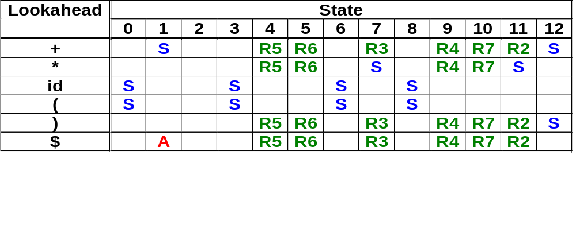
Optimizing
Parse tables (1)
Step1:
Merge Action table and Go-to table
Action table

Slide 52
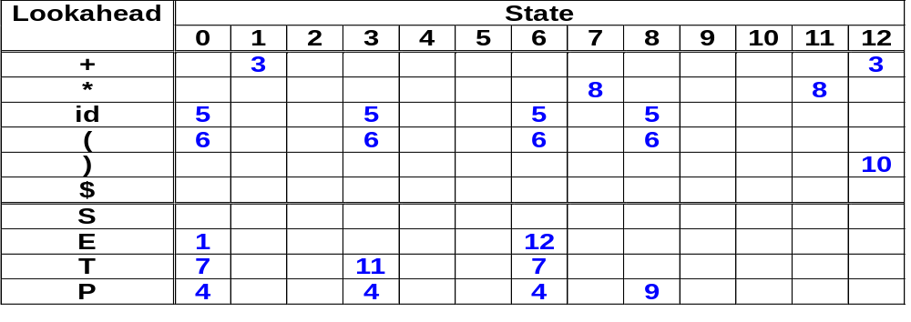
Optimizing
Parse tables (1)
Optimizing Parse Table
  Step1:Merge Action table
  and Go-to table
Goto table

Slide 53
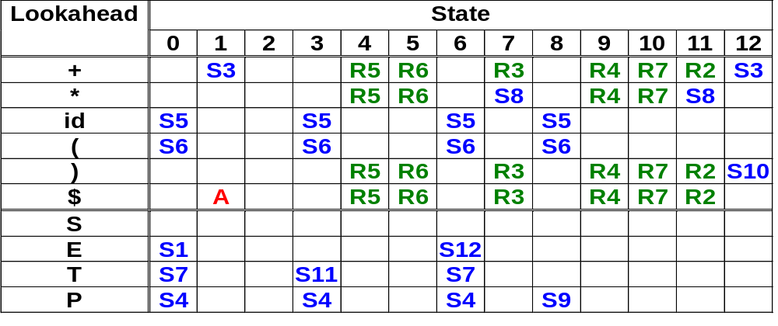
Optimizing Parse tables (3)
Action table
+
Goto table
Complete table

Slide 54
Optimizing Parse Tables (2)
Single Reduce State
  The state always simply reduce
  Because of always reducing , can we simplify using another display?

Slide 55
Optimizing Parse Tables (2)
  Step2:
    Eliminate all single reduce states.
      Replaced with a special marker--- L-prefix
      Example
        Shift to state4 would be replaced by the entry L5
      Make only one possible reduction in a state, we need not ever go to that state
Cancel this column
Replace S4 to L5
L5
L5
L5

Slide 56
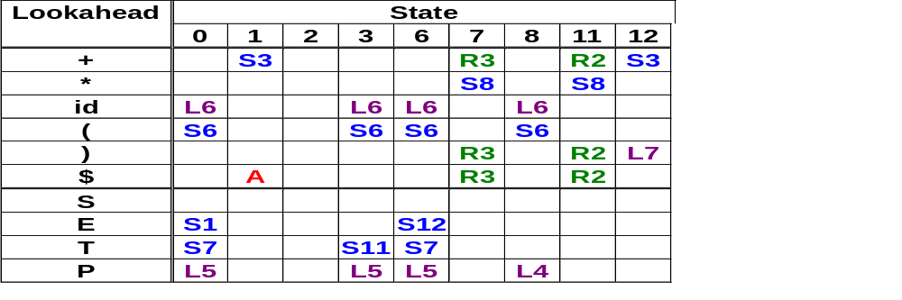
Optimizing Parse Tables (3)

Slide 57
Shift-Reduce Parsers
void shift_reduce_driver(void)
{
/* Push the Start State, S₀,
* onto an empty parse stack. */
push(S₀);
while (TRUE) { /* forever */
/* Let S be the top parse stack state;
* let T be the current input token.*/
switch (action[S][T]) {
case ERROR:
announce_syntax_error();
break;
case ACCEPT:
/* The input has been correctly * parsed. */
clean_up_and_finish();
return;
case SHIFT:
push(go_to[S][T]);
scanner(&T);
/* Get next token. */
break;
case REDUCE_{i}:
/* Assume i-th production is
* X → Y₁ ⋅ ⋅ ⋅ Y_{m}.
* Remove states corresponding to
* the RHS of the production. */
pop(m);
/* S' is the new stack top. */
push(go_to[S'][X]);
break;
case L_{i}:
/* Assume i-th production is
* X → Y₁ ⋅ ⋅ ⋅ Y_{m}.
* Remove states corresponding to
* the RHS of the production. */
pop(m-1);
/* S' is the new stack top. */
T = X;
break;
}
}
}

Slide 58
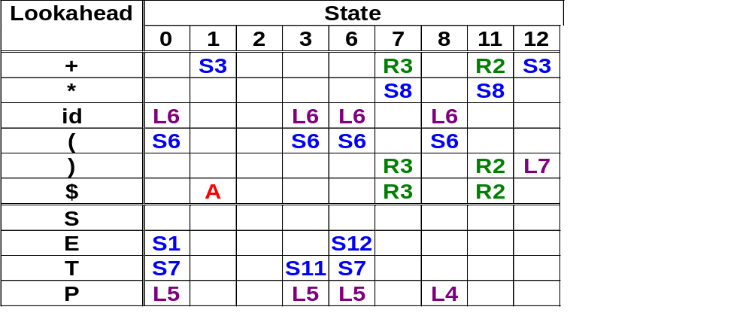
Example(1)
Input:(id+id)$
for grammar G₃ :
  1. S → E $
  2. E → E + T
  3. E → T
  4. T → T * P
  5. T → P
  6. P → id
  7. P → ( E )

Slide 59
Example(2)
for grammar G₃ :
  1. S → E $
  2. E → E + T
  3. E → T
  4. T → T * P
  5. T → P
  6. P → id
  7. P → ( E )
Initial :(id+id)$
step1:0 (id+id)$ shift (
Tree:
(

Slide 60
Example(3)
for grammar G₃ :
  1. S → E $
  2. E → E + T
  3. E → T
  4. T → T * P
  5. T → P
  6. P → id
  7. P → ( E )
Initial :(id+id)$
step2:0 6 id+id)$ L6
Tree:
(
id

Slide 61
Example(4)
for grammar G₃ :
  1. S → E $
  2. E → E + T
  3. E → T
  4. T → T * P
  5. T → P
  6. P → id
  7. P → ( E )
Initial :(id+id)$
step3:0 6 id+id)$ L5
Tree:
(
P
id

Slide 62
Example(5)
for grammar G₃ :
  1. S → E $
  2. E → E + T
  3. E → T
  4. T → T * P
  5. T → P
  6. P → id
  7. P → ( E )
Initial :(id+id)$
step4:0 6 id+id)$ shift id
Tree:
(
T
P
id

Slide 63
Example(6)
for grammar G₃ :
  1. S → E $
  2. E → E + T
  3. E → T
  4. T → T * P
  5. T → P
  6. P → id
  7. P → ( E )
Initial :(id+id)$
step5:0 6 7 +id)$ Reduce 3
Tree:
(
T
+
P
id

Slide 64
Example(7)
for grammar G₃ :
  1. S → E $
  2. E → E + T
  3. E → T
  4. T → T * P
  5. T → P
  6. P → id
  7. P → ( E )
Initial :(id+id)$
step6:0 6 12 +id)$ shift +
Tree:
(
E
+
T
P
id

Slide 65
Example(8)
for grammar G₃ :
  1. S → E $
  2. E → E + T
  3. E → T
  4. T → T * P
  5. T → P
  6. P → id
  7. P → ( E )
Initial :(id+id)$
step7:0 6 12 3 id)$ L6
Tree:
(
E
+
id
T
P
id

Slide 66
Example(9)
for grammar G₃ :
  1. S → E $
  2. E → E + T
  3. E → T
  4. T → T * P
  5. T → P
  6. P → id
  7. P → ( E )
Initial :(id+id)$
step8:0 6 12 3 id)$ L5
Tree:
(
E
+
P
T
id
P
id

Slide 67
Example(10)
for grammar G₃ :
  1. S → E $
  2. E → E + T
  3. E → T
  4. T → T * P
  5. T → P
  6. P → id
  7. P → ( E )
Initial :(id+id)$
step9:0 6 12 3 id)$ Shift id
Tree:
(
E
+
T
T
P
P
id
id

Slide 68
Example(11)
for grammar G₃ :
  1. S → E $
  2. E → E + T
  3. E → T
  4. T → T * P
  5. T → P
  6. P → id
  7. P → ( E )
Initial :(id+id)$
step10:0 6 12 3 11 )$ Reduce 2
Tree:
(
E
+
T
)
T
P
P
id
id

Slide 69
Example(12)
for grammar G₃ :
  1. S → E $
  2. E → E + T
  3. E → T
  4. T → T * P
  5. T → P
  6. P → id
  7. P → ( E )
Initial :(id+id)$
step11:0 6 12 )$ L7
Tree:
(
E
)
E
+
T
T
P
P
id
id

Slide 70
Example(13)
for grammar G₃ :
  1. S → E $
  2. E → E + T
  3. E → T
  4. T → T * P
  5. T → P
  6. P → id
  7. P → ( E )
Initial :(id+id)$
step12:0 )$ L5
Tree:
P
(
E
)
E
+
T
T
P
P
id
id

Slide 71
Example(14)
for grammar G₃ :
  1. S → E $
  2. E → E + T
  3. E → T
  4. T → T * P
  5. T → P
  6. P → id
  7. P → ( E )
Initial :(id+id)$
step13:0 )$ Shift )
Tree:
T
P
(
E
)
E
+
T
T
P
P
id
id

Slide 72
Example(15)
for grammar G₃ :
  1. S → E $
  2. E → E + T
  3. E → T
  4. T → T * P
  5. T → P
  6. P → id
  7. P → ( E )
Initial :(id+id)$
step14:0 7 $ Reduce 3
E
Tree:
T
P
(
E
)
E
+
T
T
P
P
id
id

Slide 73
Example(16)
for grammar G₃ :
  1. S → E $
  2. E → E + T
  3. E → T
  4. T → T * P
  5. T → P
  6. P → id
  7. P → ( E )
Initial :(id+id)$
step15:0 1 $ Accept
E
Tree:
T
P
(
E
)
E
+
T
T
P
P
id
id

Slide 74
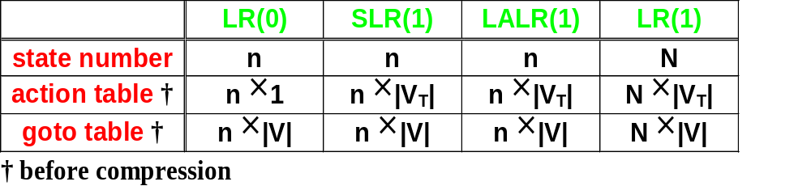
LL(1) or LALR(1) , That is the question(1)
--Modified by http://www.csie.ntu.edu.tw/~compiler/
power --
LR(1) grammar
LALR(1) grammar
SLR(1) grammar
LR(0) grammar
LALR(1) is the most commonly used bottom-up parsing method

Slide 75
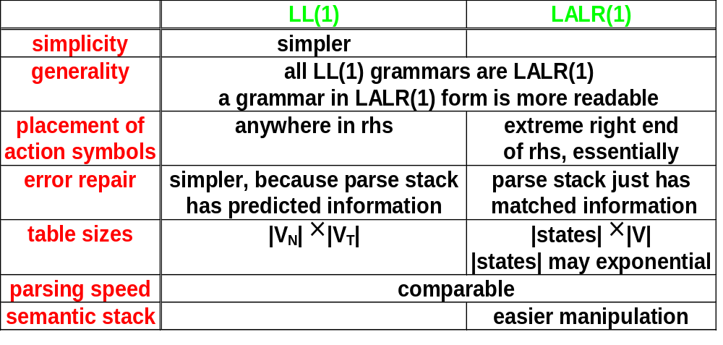
LL(1) or LALR(1) , That is the question(2)
--Modified by http://www.csie.ntu.edu.tw/~compiler/
Two most popular parsing methods

