Slide 1
Chapter 2 A Simple Compiler

Slide 2
Outlines
2.1 The Structure of a Micro Compiler
2.2 A Micro Scanner
2.3 The Syntax of Micro
2.4 Recursive Descent Parsing
2.5 Translating Micro

Slide 3
Micro
Micro: a very simple language
  Only integers
  No declarations
  Variables consist of A..Z, 0..9, and at most 32 characters long.
  Comments begin with -- and end with end-of-line.
  Three kinds of stmts:
    assignments, e.g., a := b + c
    read(list of ids), e.g., read(a, b)
    write(list of exps), e.g., write(a+b)
  Begin, end, read, and write are reserved words.
  Tokens may not extend to the following line.

Slide 4
The Structure of a Micro compiler
One-pass type, no explicit intermediate representations used
  See P. 9, Fig. 1.3
The interface
  Parser is the main routine.
  Parser calls scanner to get the next token.
  Parser calls semantic routines at appropriate times.
  Semantic routines produce output in assembly language.
  A simple symbol table is used by the semantic routines.

Slide 5
Source
Program
Scanner
Tokens
Parser
Syntactic
Semantic
Routines
(Character
Stream)
Structure
Intermediate
Representation
Symbol and
Attribute
Tables
Optimizer
(Used by all
Phases of
The Compiler)
Code
Generator
The structure of a Syntax-Directed Compiler
Target Machine
Code

Slide 6
A Micro Scanner
The Micro Scanner will be a function of no arguments that returns token values
  There are 14 tokens.
typedef enum token_types {
BEGIN, END, READ, WRITE, ID, INTLITERAL,
LPAREN, RPAREN, SEMICOLON, COMMA, ASSIGNOP,
PLUOP, MINUSOP, SCANEOF
} token;
Extern token scanner(void);

Slide 7
A Micro Scanner (Cont’d)
The scanner returns the longest string that constitutes a token, e.g., in
    abcdef
  ab, abc, abcdef are all valid tokens.
  The scanner will return the
  longest one (i.e., abcdef).

Slide 8
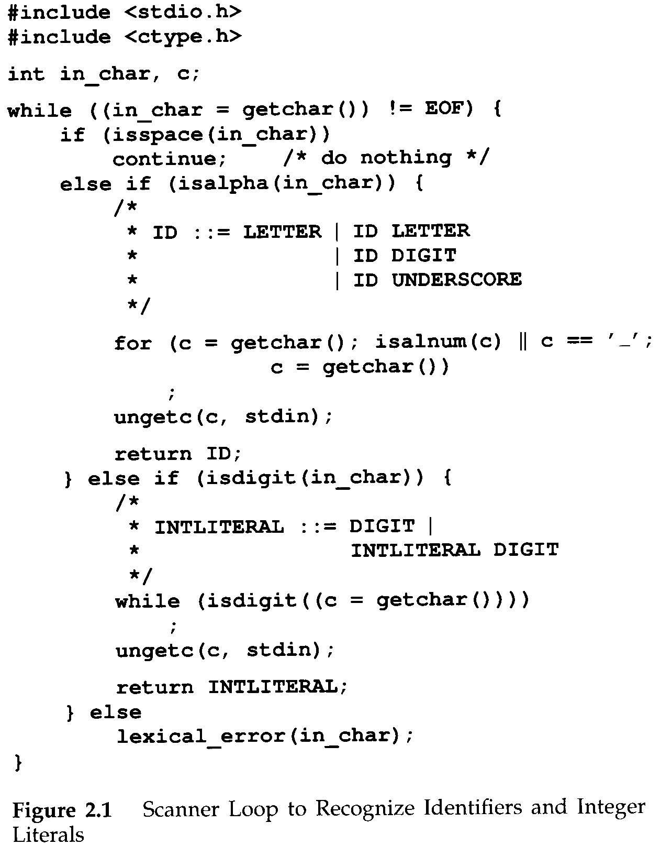
Continue: skip one iteration
getchar() , isspace(),
isalpha(), isalnum(),
isdigital()
ungetc(): push back one character

Slide 9
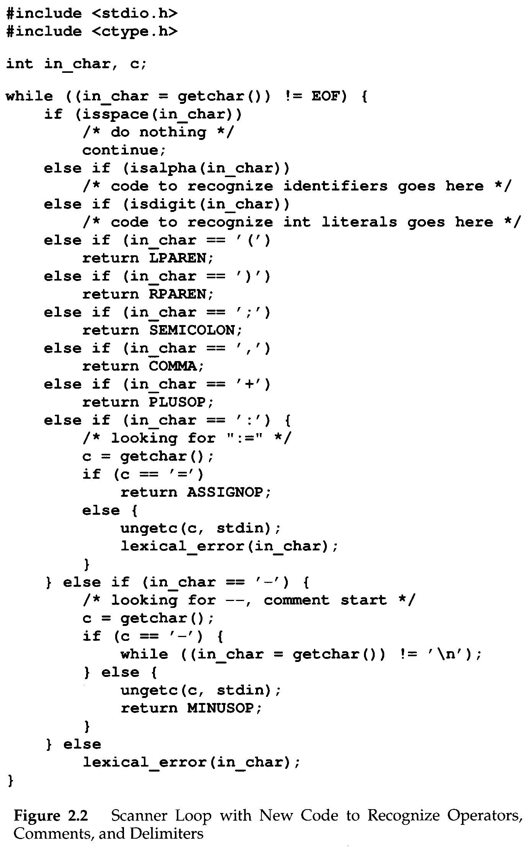

Slide 10
A Micro Scanner (Cont’d)
How to handle RESERVED words?
  Reserved words are similar to identifiers.
Two approaches:
  Use a separate table of reserved words
  Put all reserved words into symbol table initially.

Slide 11
A Micro Scanner (Cont’d)
Provision for saving the characters of a token as they are scanned
  token_buffer, buffer_char(), clear_buffer(), check_reserved()
Handle end of file
  feof(stdin)

Slide 12
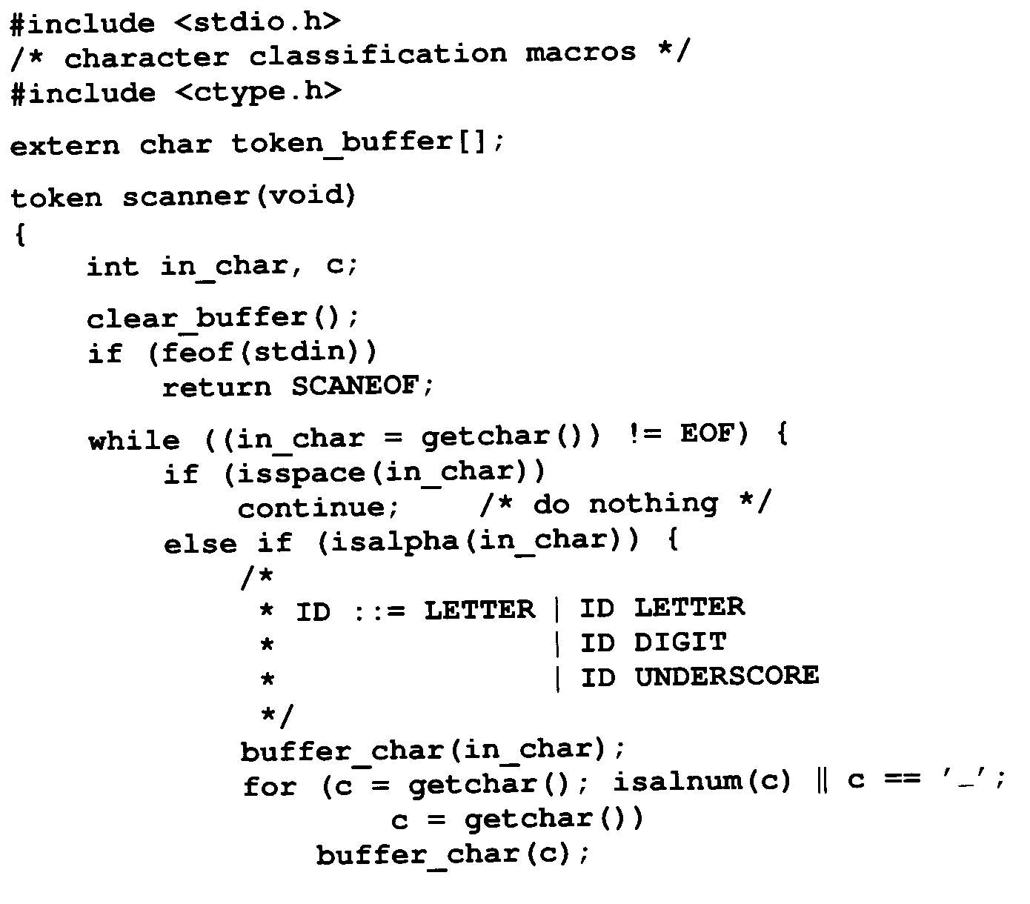
Complete Scanner Function
for Micro

Slide 13
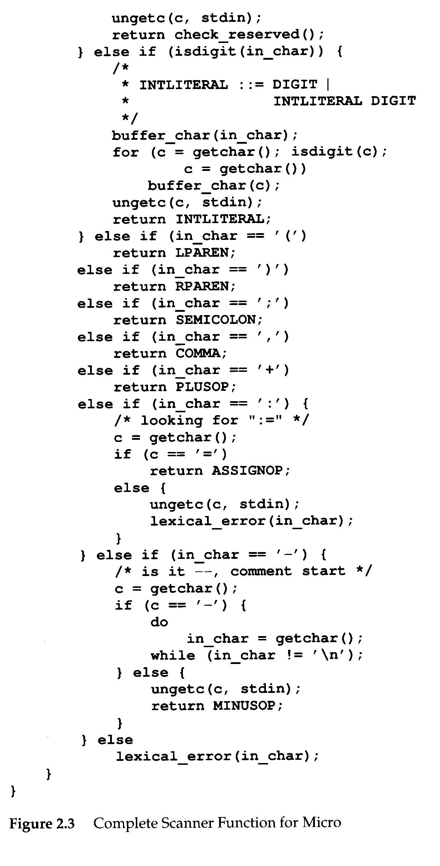

Slide 14
The Syntax of Micro
Micro's syntax is defined by a context-free grammar (CFG)
  CFG is also called BNF (Backus-Naur Form) grammar
CFG consists of a set of production rules,
A→B C D… Z
    LHS must be a single nonterminal
  RHS consists 0 or more terminals or nonterminals
LHS
RHS

Slide 15
The Syntax of Micro (Cont’d)
Two kinds of symbols
  Nonterminals
    Delimited by < and >
    Represent syntactic structures
  Terminals
    Represent tokens
E.g.
<program> → begin <statement list> end
Start or goal symbol
λ : empty or null string

Slide 16
The Syntax of Micro (Cont’d)
E.g.
<statement list> → <statement><statement tail>
<statement tail> → λ
<statement tail> → <statement><statement tail>

Slide 17
The Syntax of Micro (Cont’d)
Extended BNF: some abbreviations
  1. optional: [ ] 0 or 1
    <stmt> → if <exp> then <stmt>
    <stmt> → if <exp> then <stmt> else <stmt>
    can be written as
    <stmt> → if <exp> then <stmt> [ else <stmt> ]
  2. repetition: { } 0 or more
    <stmt list> → <stmt> <tail>
    <tail> → λ
    <tail> → <stmt> <tail>
    can be written as
    <stmt list> → <stmt> { <stmt> }

Slide 18
The Syntax of Micro (Cont’d)
Extended BNF: some abbreviations
  3. alternative: | or
    <stmt> → <assign>
    <stmt> → <if stmt>
    can be written as
    <stmt> → <assign> | <if stmt>
Extended BNF == BNF
  Either can be transformed to the other.
  Extended BNF is more compact and readable

Slide 19
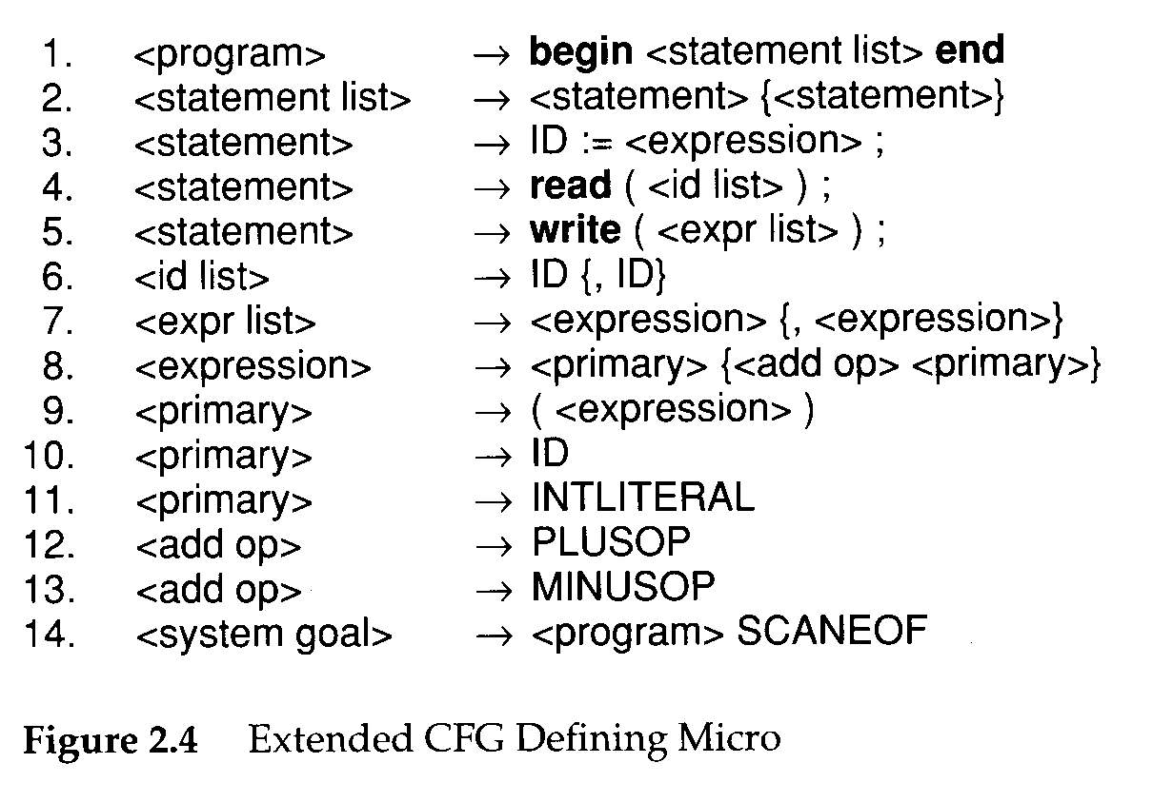
The Syntax of Micro (Cont’d)

Slide 20
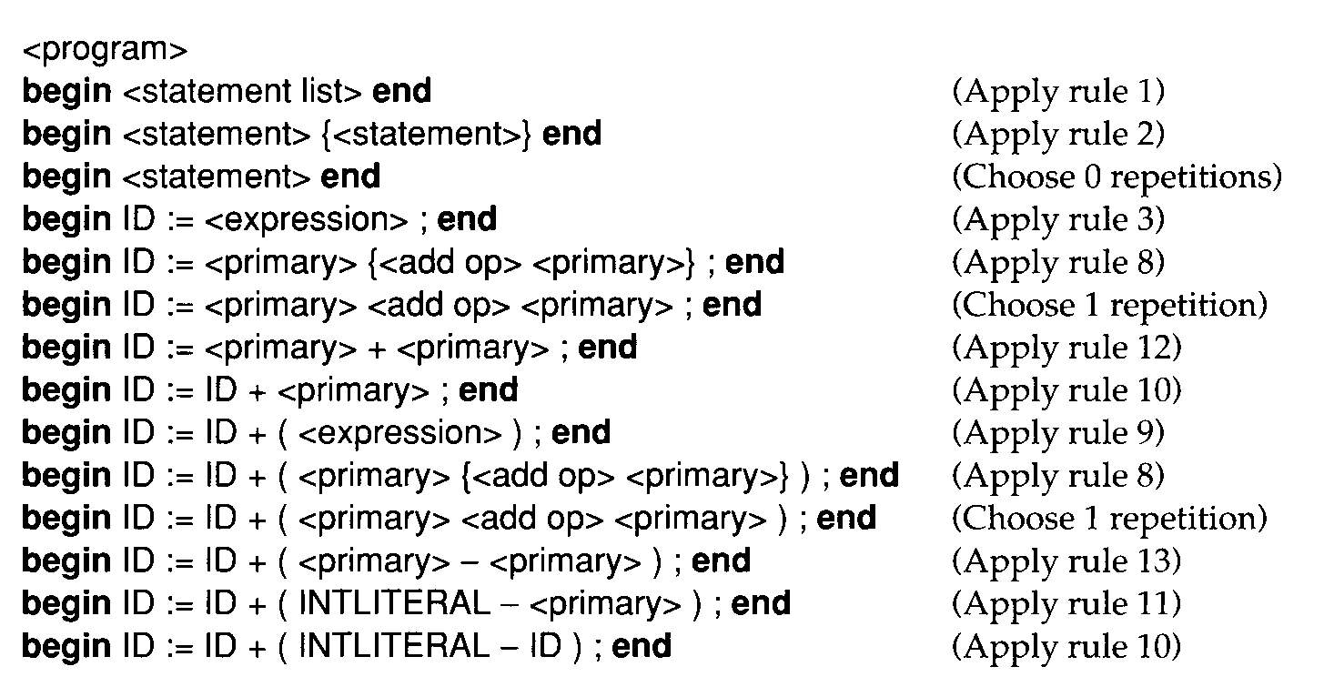
The derivation of
begin ID:= ID + (INTLITERAL – ID); end

Slide 21
The Syntax of Micro (Cont’d)
A CFG defines a language, which is a set of sequences of tokens
Syntax errors & semantic errors
  A:=‘X’+True;

Slide 22
The Syntax of Micro (Cont’d)
Associativity
  A-B-C
Operator precedence
  A+B*C

Slide 23
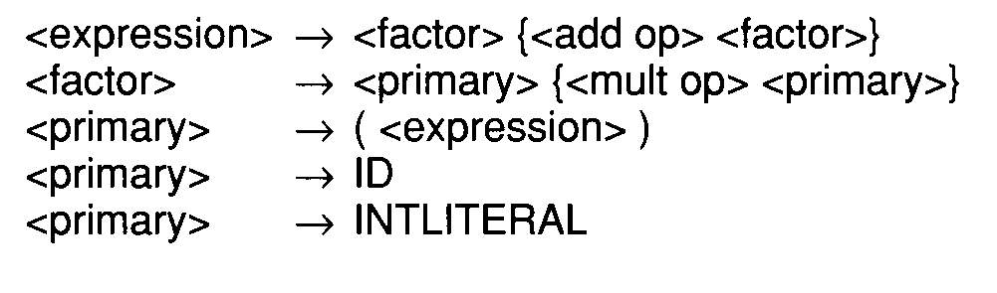
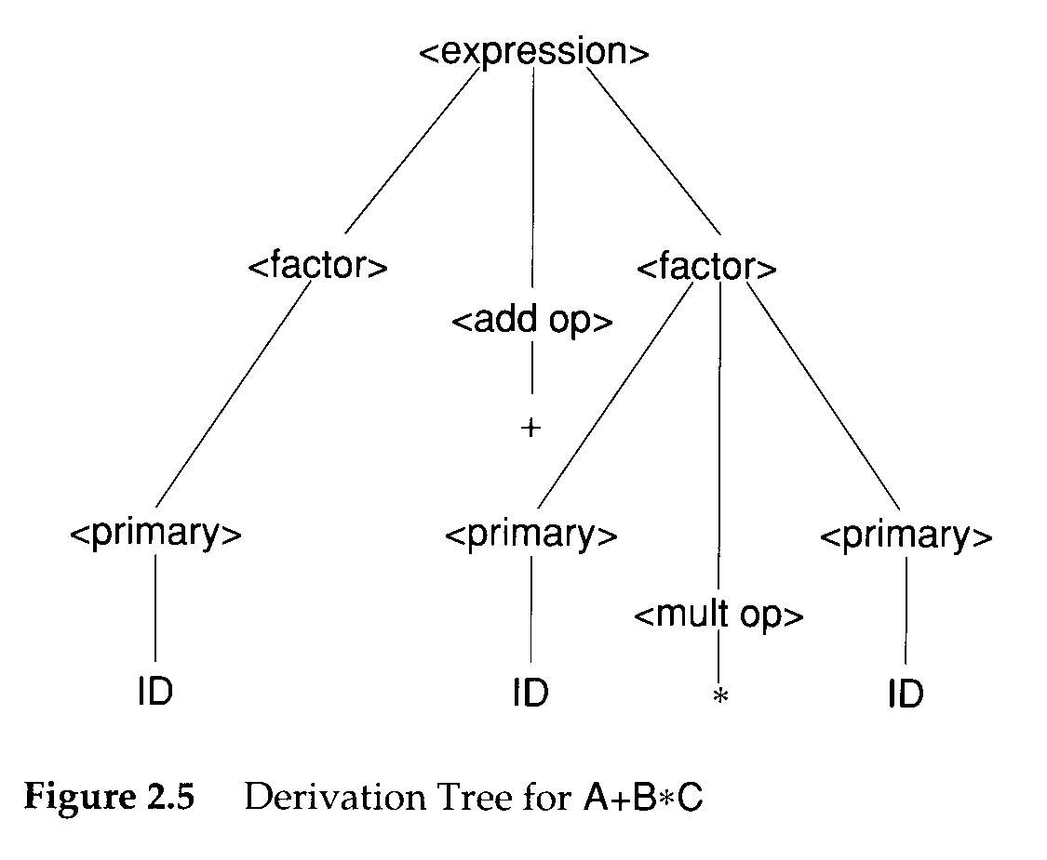
A grammar fragment defines such a precedence relationship

Slide 24
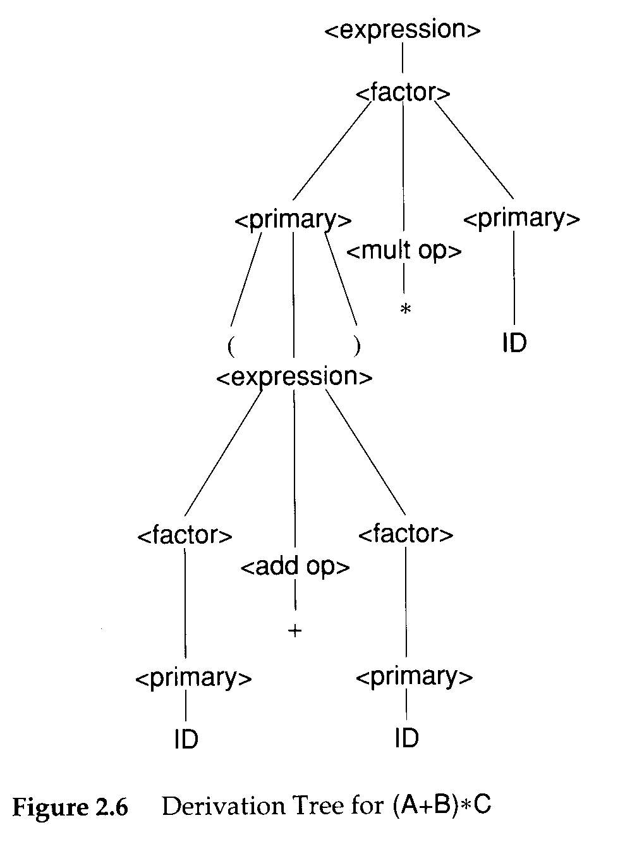
With parentheses, the desired grouping can be forced

Slide 25
Recursive Descent Parsing
There are many parsing techniques.
  Recursive descent is one of the simplest parsing techniques
Basic idea
  Each nonterminal has a parsing procedure
  For symbol on the RHS : a sequence of matching
    To Match a nonterminal A
      Call the parsing procedure of A
    To match a terminal symbol t
      Call match(t)
        match(t) calls the scanner to get the next token. If is it t, everything is correct. If it is not t, we have found a syntax error.

Slide 26
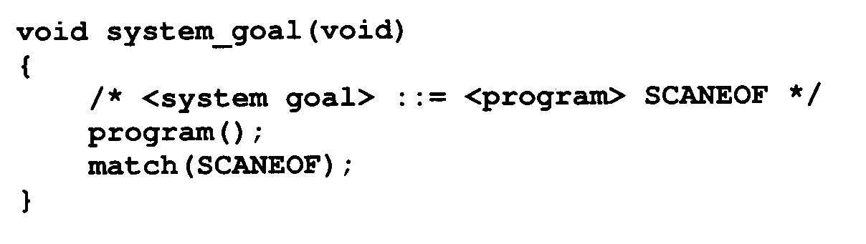
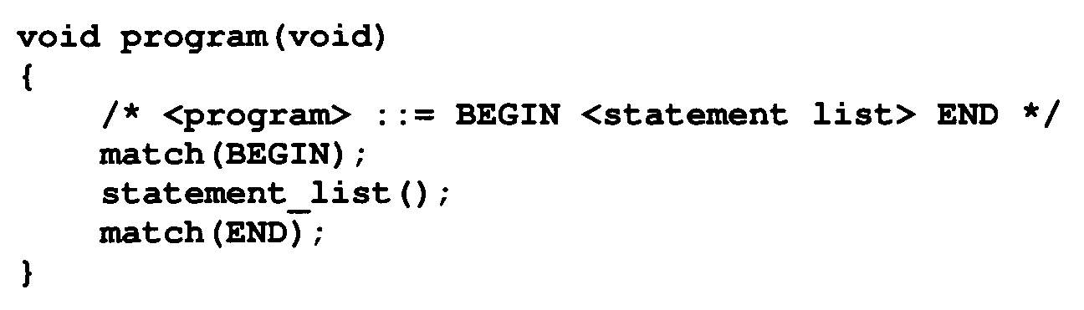
Recursive Descent Parsing
If a nonterminal has several productions, choose an appropriate one based on the next input token.
Parser is started by invoking system_goal().

Slide 27
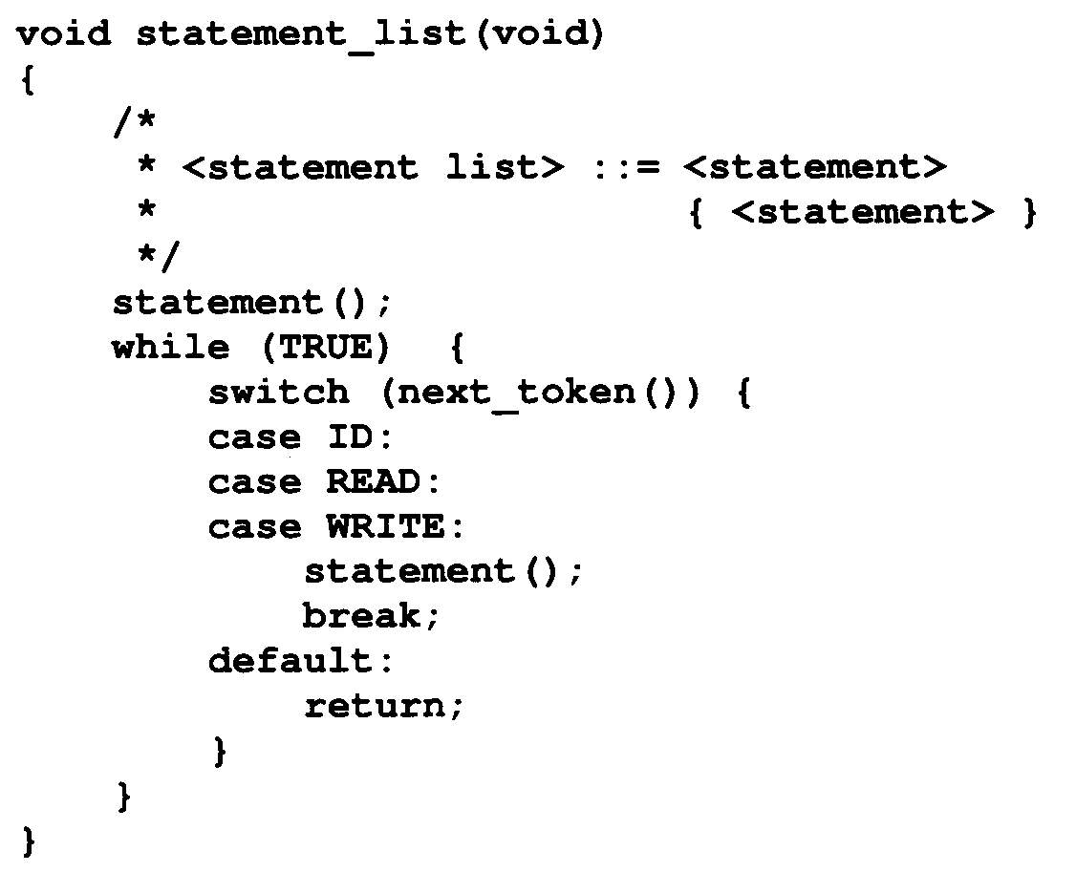
處理{<statement>}不出現的情形
next_token() : a function that returns the next token. It does not call scanner(void).

Slide 28
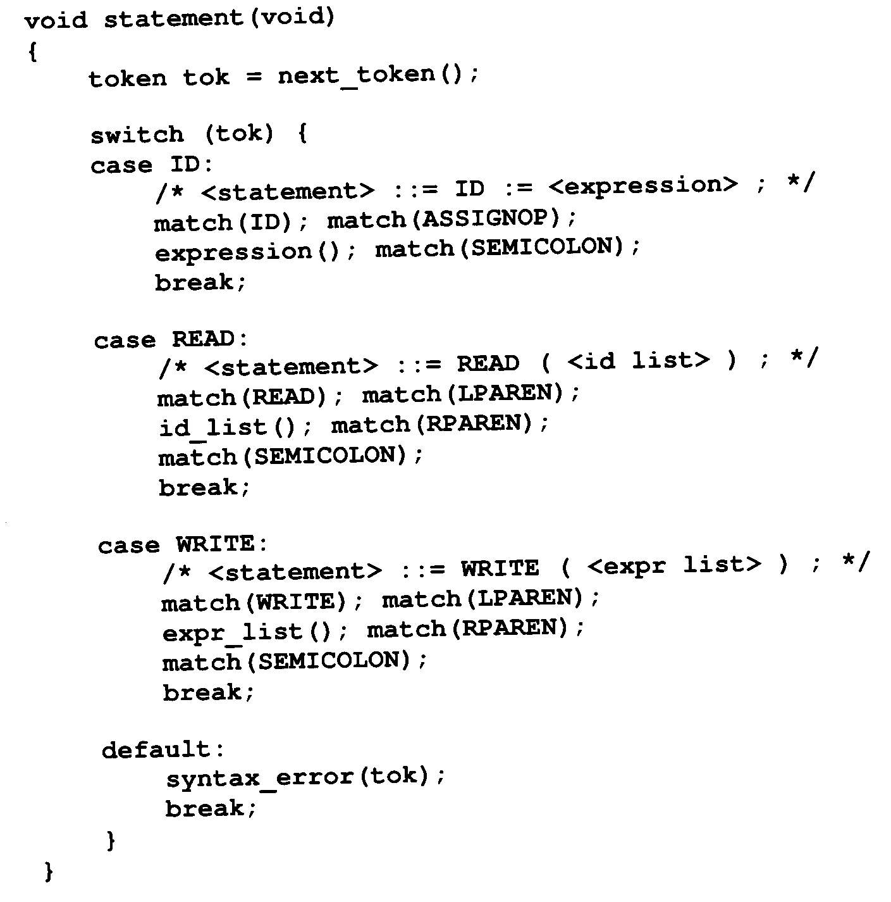
<statement>
必出現一次

Slide 29
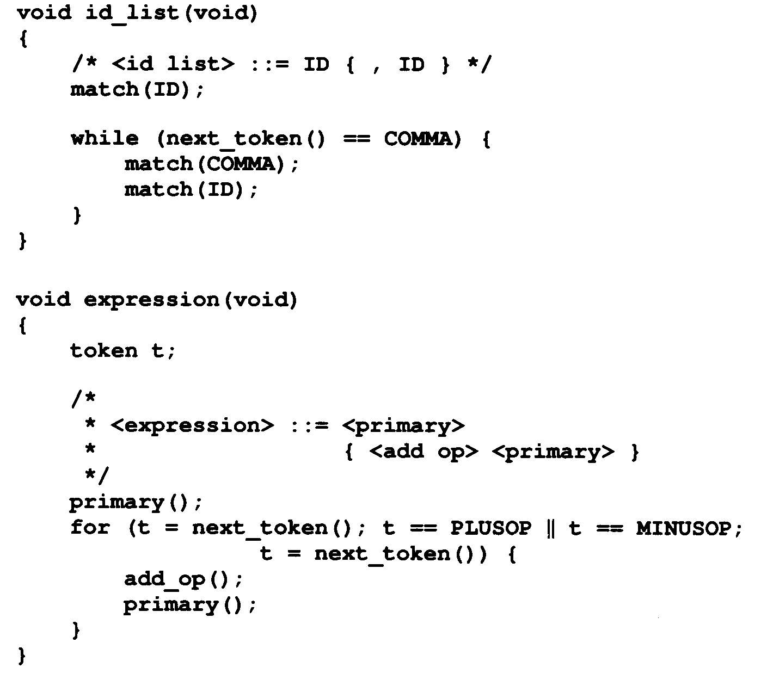

Slide 30
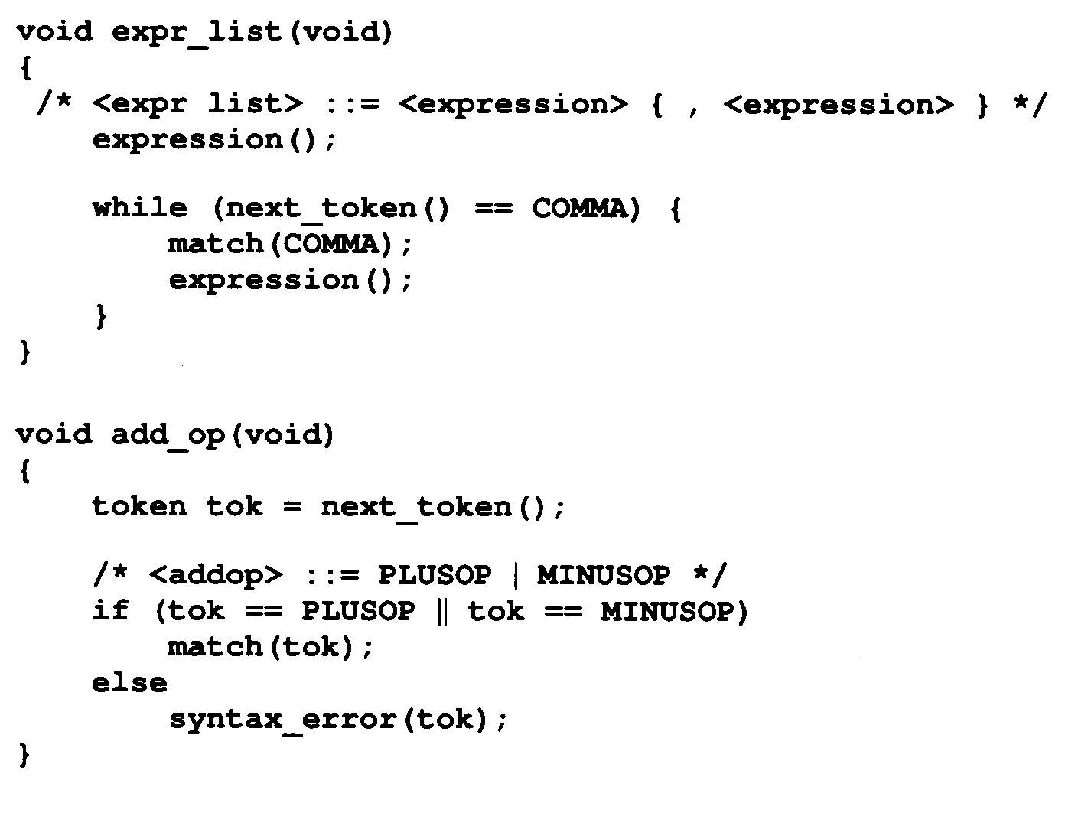

Slide 31
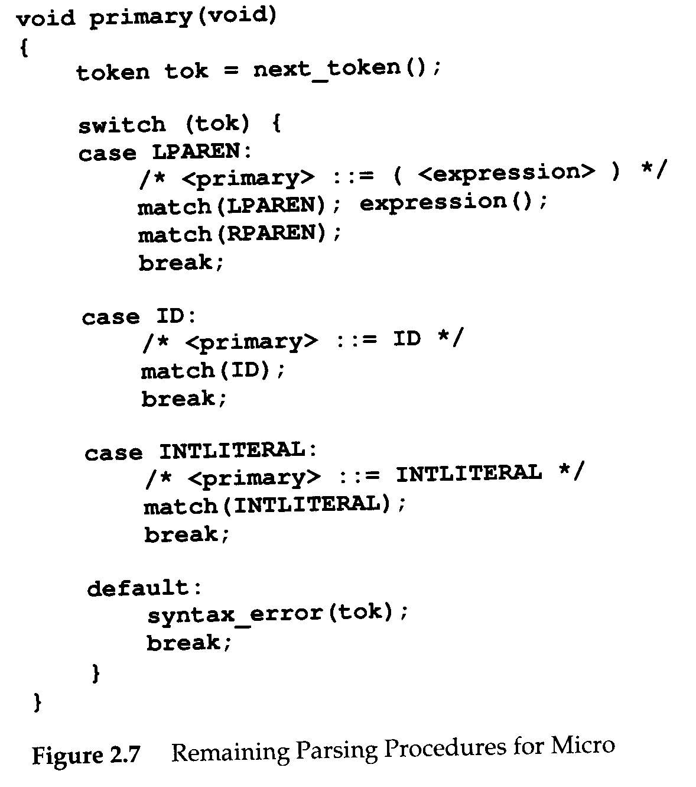

Slide 32
Translating Micro
Target language: 3-addr code (quadruple)
  OP A, B, C
Note that we did not worry about registers at this time.
  temporaries: Sometimes we need to hold temporary values.
    E.g. A+B+C
      ADD A,B,TEMP&1
      ADD TEMP&1,C,TEMP&2

Slide 33
Translating Micro (Cont’d)
Action Symbols
  The bulk of a translation is done by semantic routine
  Action symbols can be added to a grammar to specify when semantic processing should take place
    Be placed anywhere in the RHS of a production
  translated into procedure call in the parsing procedures
    #add corresponds to a semantic routine named add()
  No impact on the languages recognized by a parser driven by a CFG

Slide 34
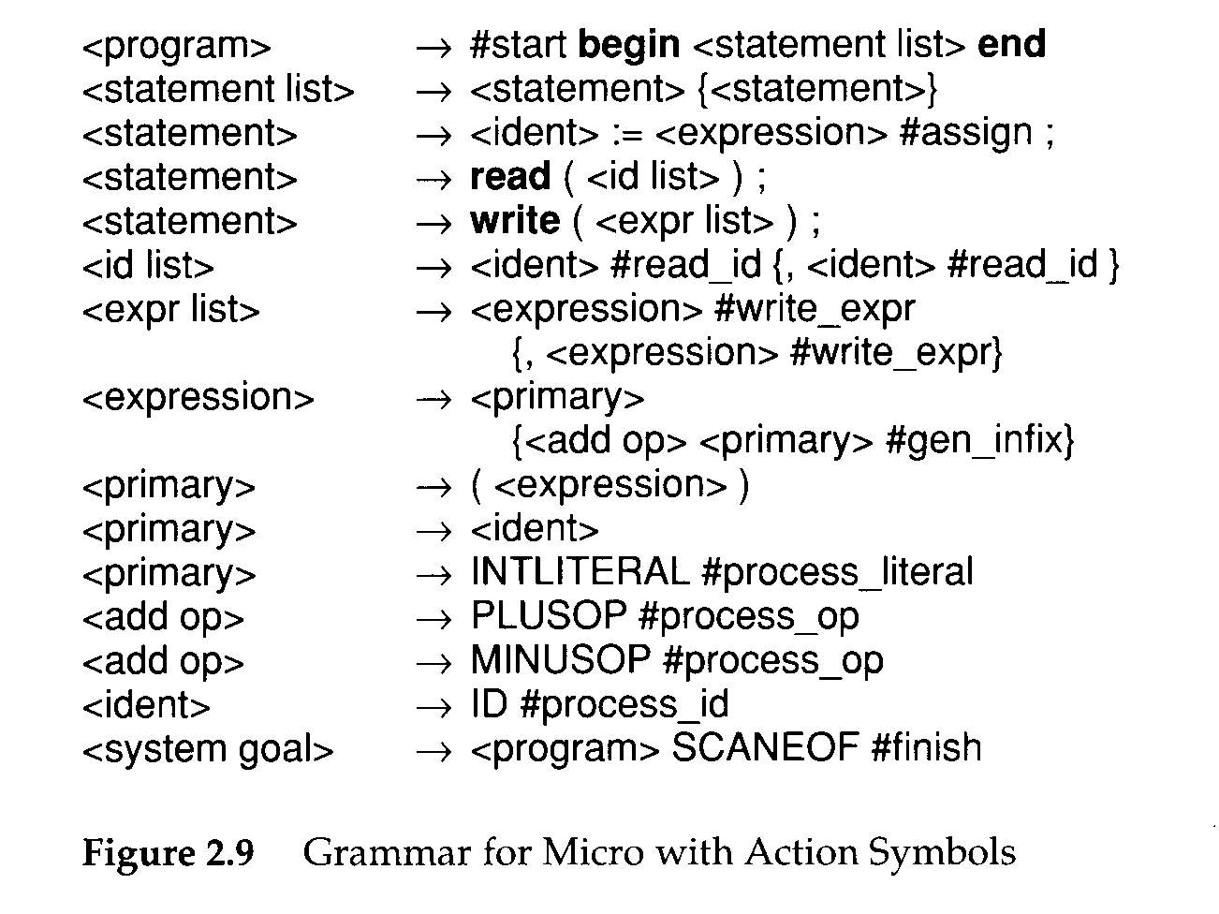

Slide 35
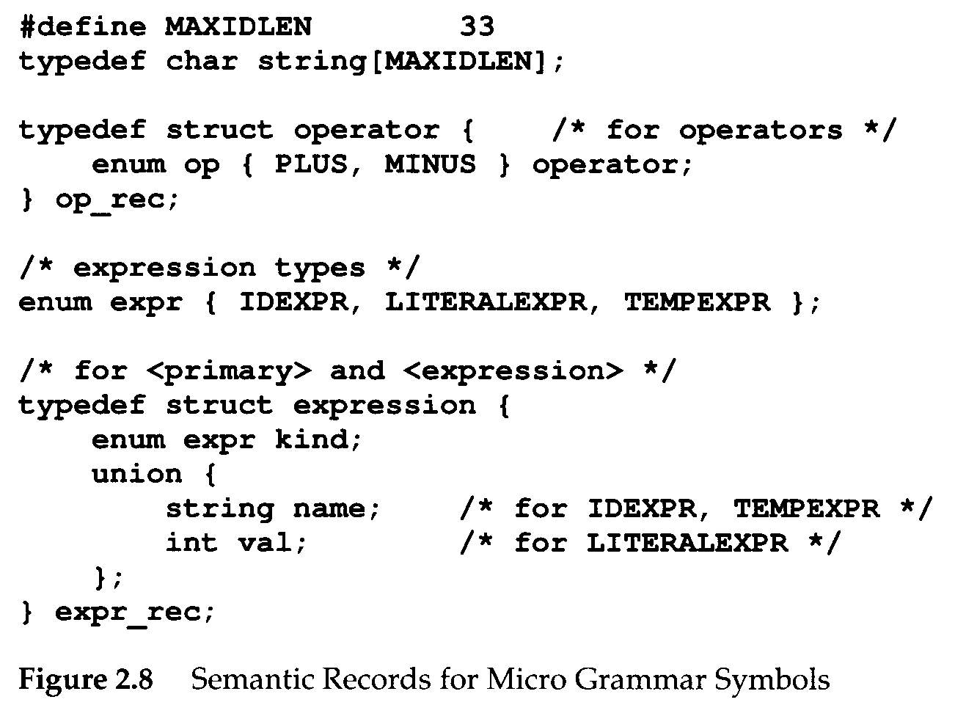
Semantic Information
Semantic routines need certain information to do their work.
  These information is stored in semantic records.
  Each kind of grammar symbol has a semantic record

Slide 36
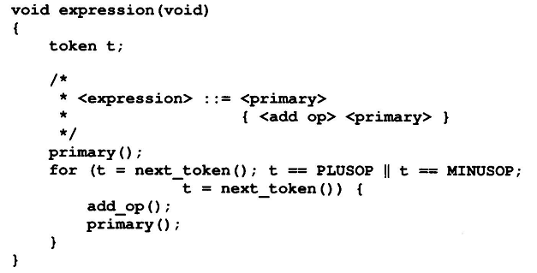
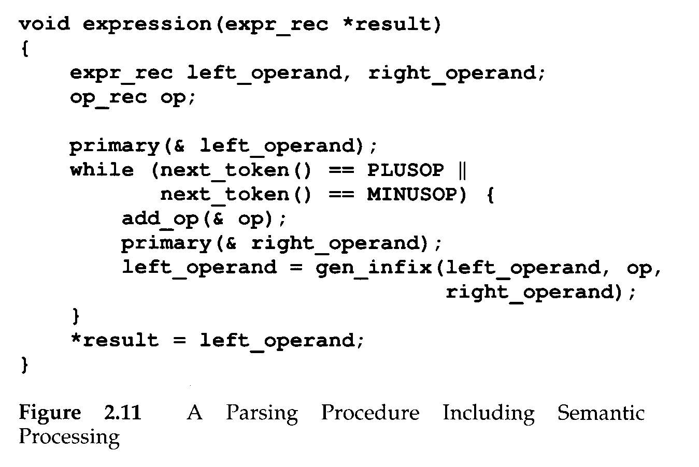
Old parsing procedure
P. 37
<expression> → <primary>
{<add op> <primary> #gen_infix
New parsing procedure
which involved semantic
routines

Slide 37
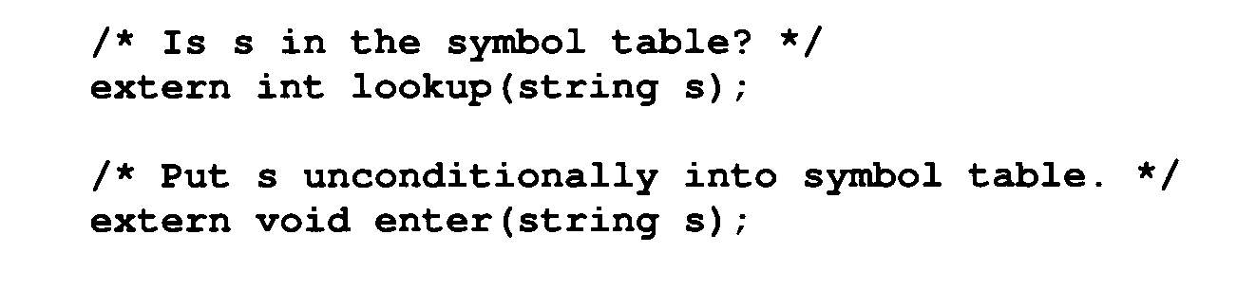
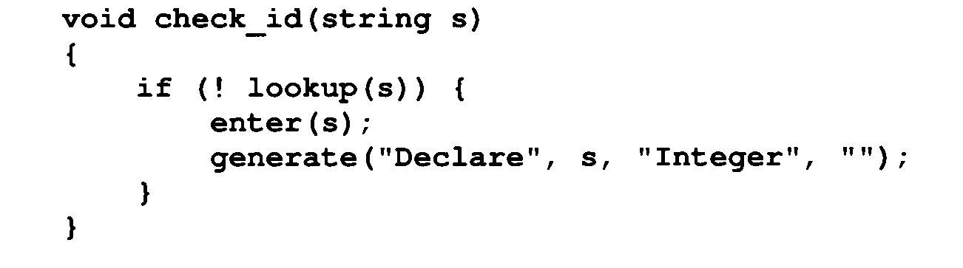
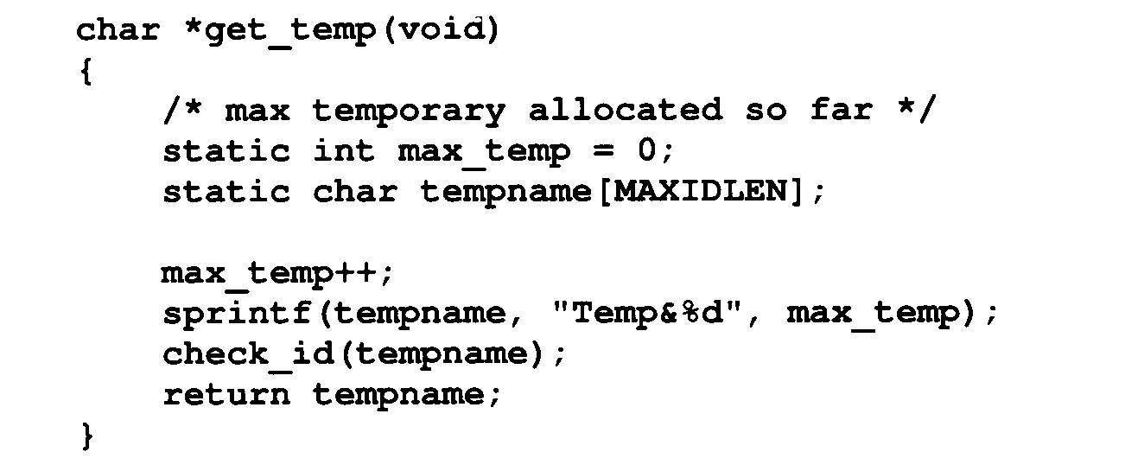
Semantic Information (Cont’d)
Subroutines for symbol table and temporaries

Slide 38
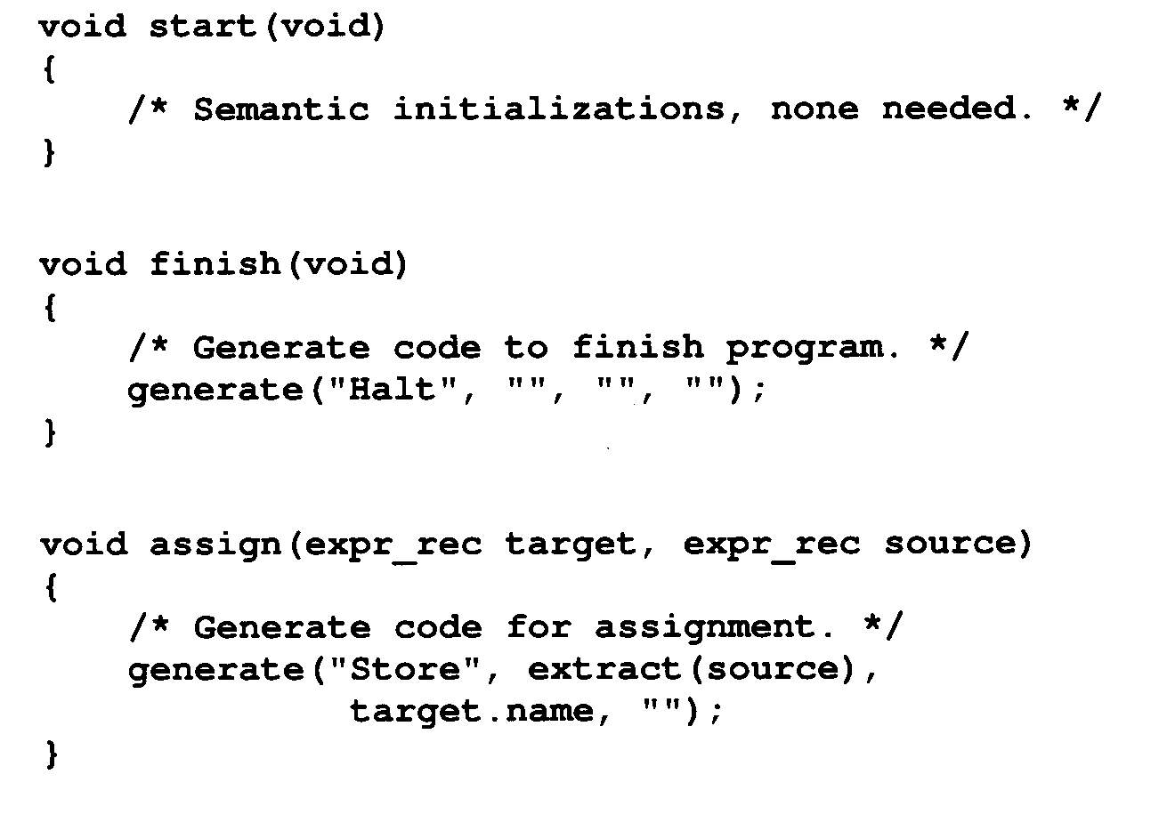
Semantic Information (Cont’d)
Semantic routines

Slide 39
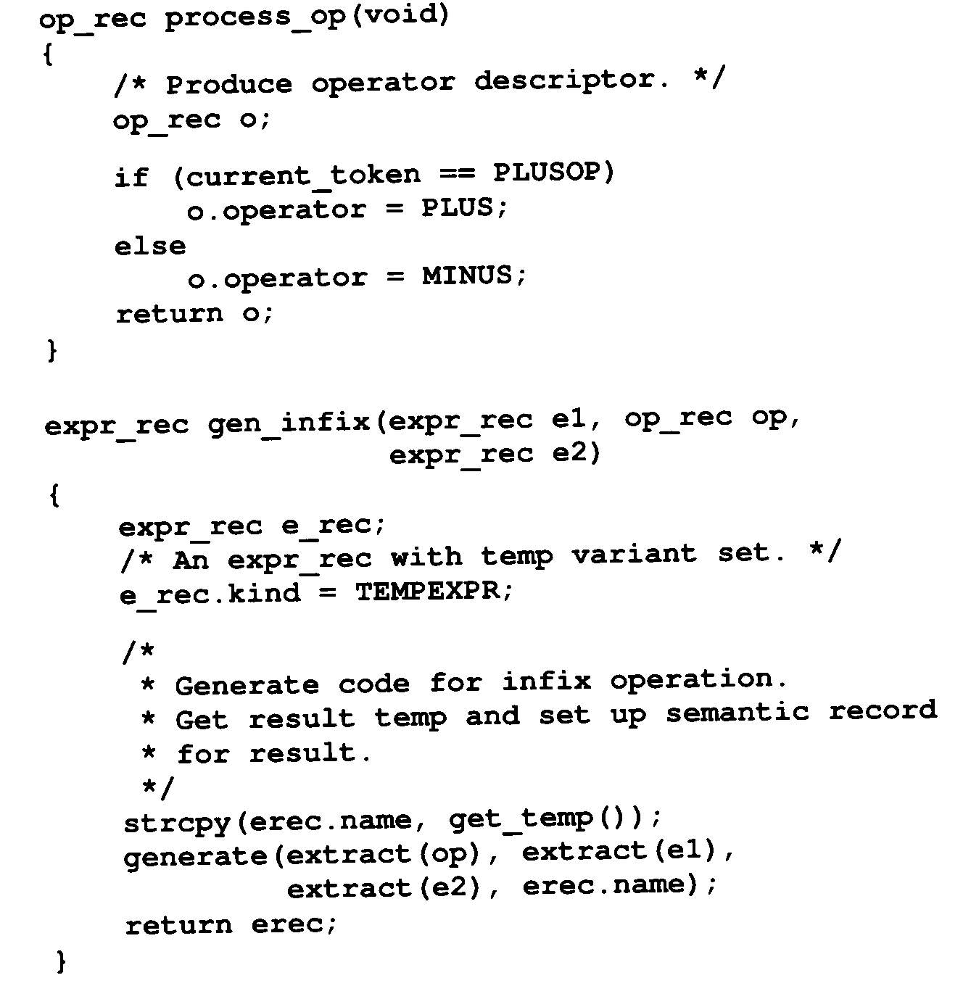

Slide 40
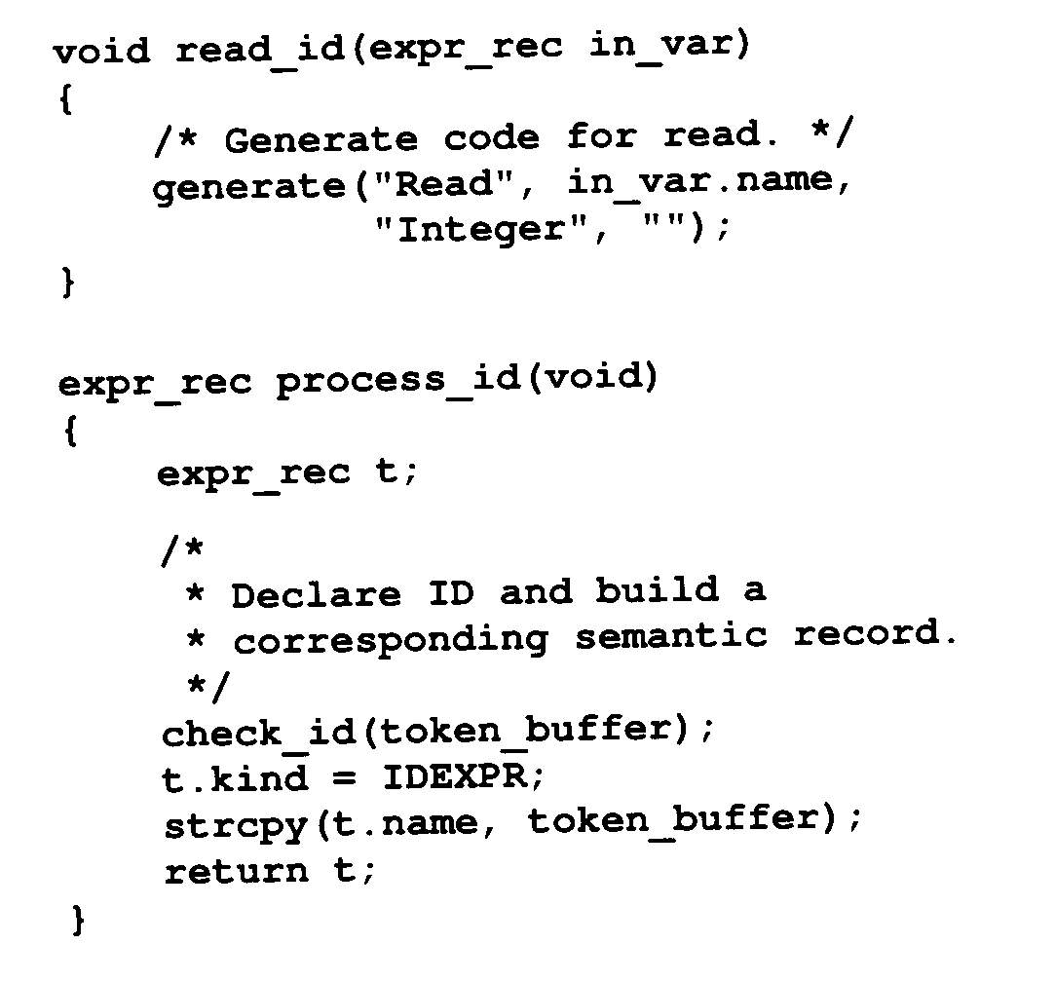

Slide 41
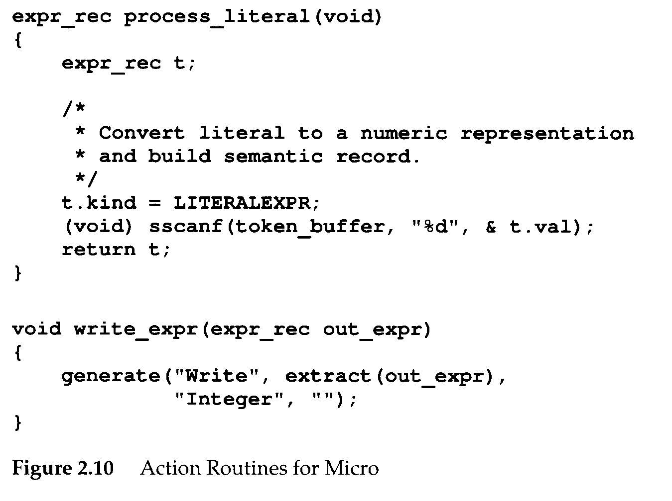

Slide 42
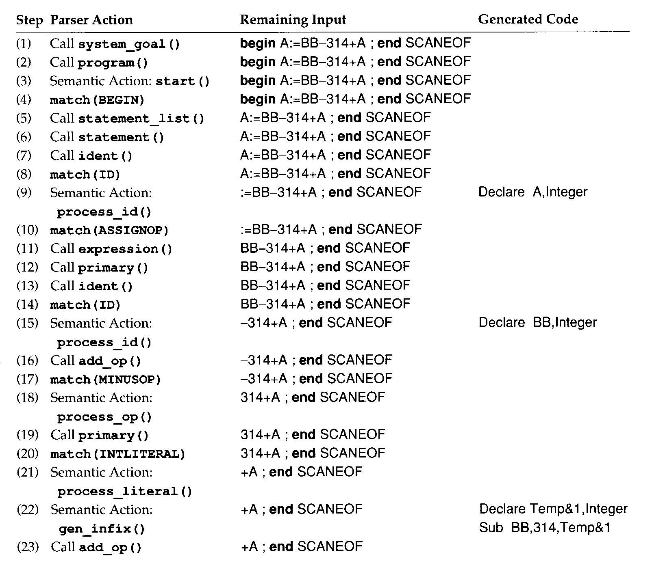

Slide 43
