Slide 1
Chapter 4 Grammars and Parsing

Slide 2
Context-Free Grammars: Concepts and Notation
A context-free grammar G = (Vt, Vn, S, P)
  A finite terminal vocabulary Vt
    The token set produced by scanner
  A finite set of nonterminal vacabulary Vn
    Intermediate symbols
  A start symbol S ∈Vn that starts all derivations
      Also called goal symbol
  P, a finite set of productions (rewriting rules) of the form A→ X₁X₂ … X_{m}
    A∈Vn, X_{i} ∈ Vn∪Vt, 1≤i ≤m
    A →λ is a valid production

Slide 3
Context-Free Grammars: Concepts and Notation (Cont’d)
Other notations
  Vacabulary V of G,
    V= Vn∪Vt
  L(G), the set of string s derivable from S
    Context-free language of grammar G
  Notational conventions
    a,b,c, … denote symbols in Vt
    A,B,C, …denote symbols in Vn
    U,V,W, …denote symbols in V
    α,β,γ,…denote strings in V*
    u,v,w, …denote strings in V_{t}*

Slide 4
Context-Free Grammars: Concepts and Notation (Cont’d)
Derivation
  One step derivation
    If A→γ, then αBβ⇒ αγβ
  One or more steps derivation ⇒⁺
  Zero or more steps derivation ⇒∗
If S ⇒∗β, then β is said to be sentential form of the CFG
  SF(G) is the set of sentential forms of grammar G
L(G) = {x ∈V_{t}*|S⇒⁺x}
  L(G)=SF(G)∩V_{t}*

Slide 5
Context-Free Grammars: Concepts and Notation (Cont’d)
Left-most derivation, a top-down parsers
  ⇒_{lm} , ⇒ _{lm} , ⁺⇒ _{lm} ∗
  E.g. of leftmost derivation of F(V+V)
E→Prefix(E)
E→V Tail
Prefix→F
Prefix→λ
Tail→+Ε
Tail→ λ
E⇒ _{lm} Prefix(E)
⇒ _{lm} F(E)
⇒ _{lm} F(V Tail)
⇒ _{lm} F(V+E)
⇒ _{lm} F(V+V Tail)
⇒ _{lm} F(V+V)
G₀

Slide 6
Context-Free Grammars: Concepts and Notation (Cont’d)
Right-most derivation (canonical derivation)
  ⇒_{rm} , ⇒ _{rm} , ⁺⇒ _{rm} ∗
  Buttom-up parsers
  E.g. of leftmost derivation of F(V+V)
E→Prefix(E)
E→V Tail
Prefix→F
Prefix→λ
Tail→+Ε
Tail→ λ
E⇒ _{rm} Prefix(E)
⇒ _{rm} Prefix(V Tail)
⇒ _{rm} Prefix(V+E)
⇒ _{rm} Prefix(V+V Tail)
⇒ _{rm} Prefix(V+V)
⇒ _{rm} F(V+V)
G₀
Same # of steps, but different order

Slide 7
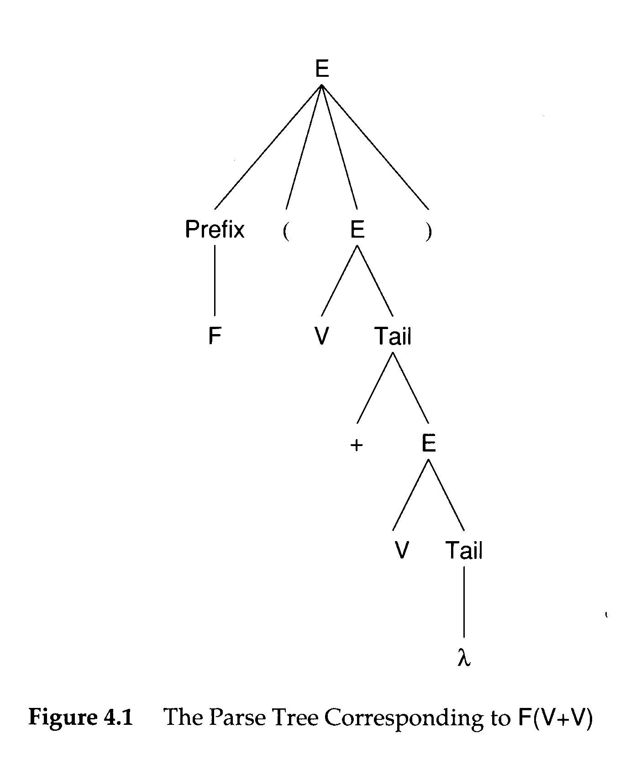
Context-Free Grammars: Concepts and Notation (Cont’d)
A parse tree
  rooted by the start symbol
  Its leaves are grammar symbols or λ

Slide 8
Context-Free Grammars: Concepts and Notation (Cont’d)
A phase of a sentential form is a sequence of symbols descended from a single nonterminal in the parse tree
  Simple or prime phrase
The handle of a sentential form is the left-most simple phrase

Slide 9
Context-Free Grammars: Concepts and Notation (Cont’d)
Regular grammars
  is of CFGs
  Limited to productions of the form
    A→aB
    C→λ
  See exercise 6
The handle of a sentential form is the left-most simple phrase

Slide 10
Errors in Context-Free Grammars
CFGs are a definitional mechanism. They may have errors, just as programs may.
Flawed CFG
  Useless nonterminals
    Unreachable
    Derive no terminal string
S→A|B
A→a
B→Bb
C→c
Nonterminal C cannot be reached form S
Nonterminal B derives no terminal string
S is the start symbol.
Do exercise 7.

Slide 11
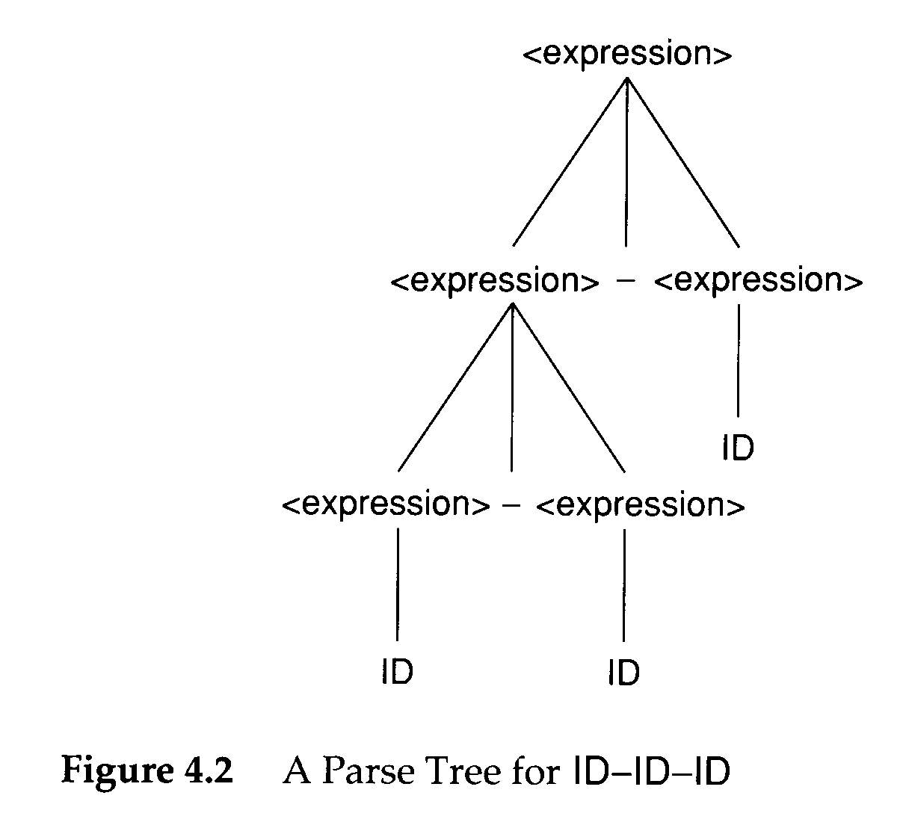
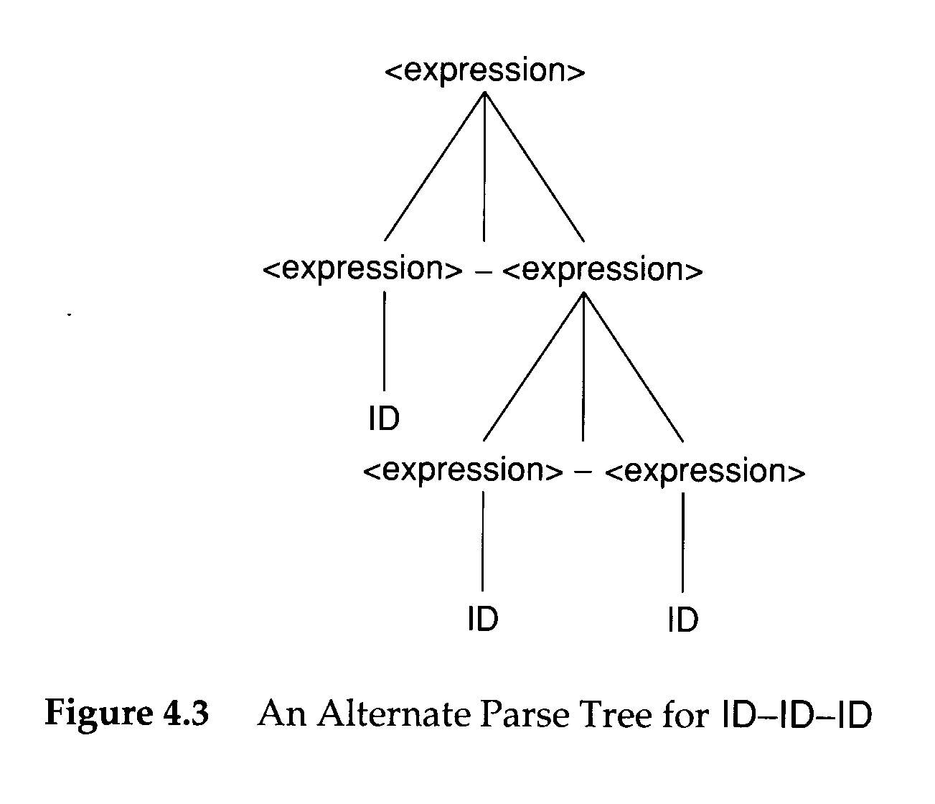
Errors in Context-Free Grammars
Ambiguous:
  Grammars that allow different parse trees for the same terminal string
It is impossible to decide whether a given CFG is ambiguous

Slide 12
Errors in Context-Free Grammars
It is impossible to decide whether a given CFG is ambiguous
  For certain grammar classes, we can prove that constituent grammars are unambiguous
Wrong language
A general comparison algorithm applicable to all CFGs is known to be impossible

Slide 13
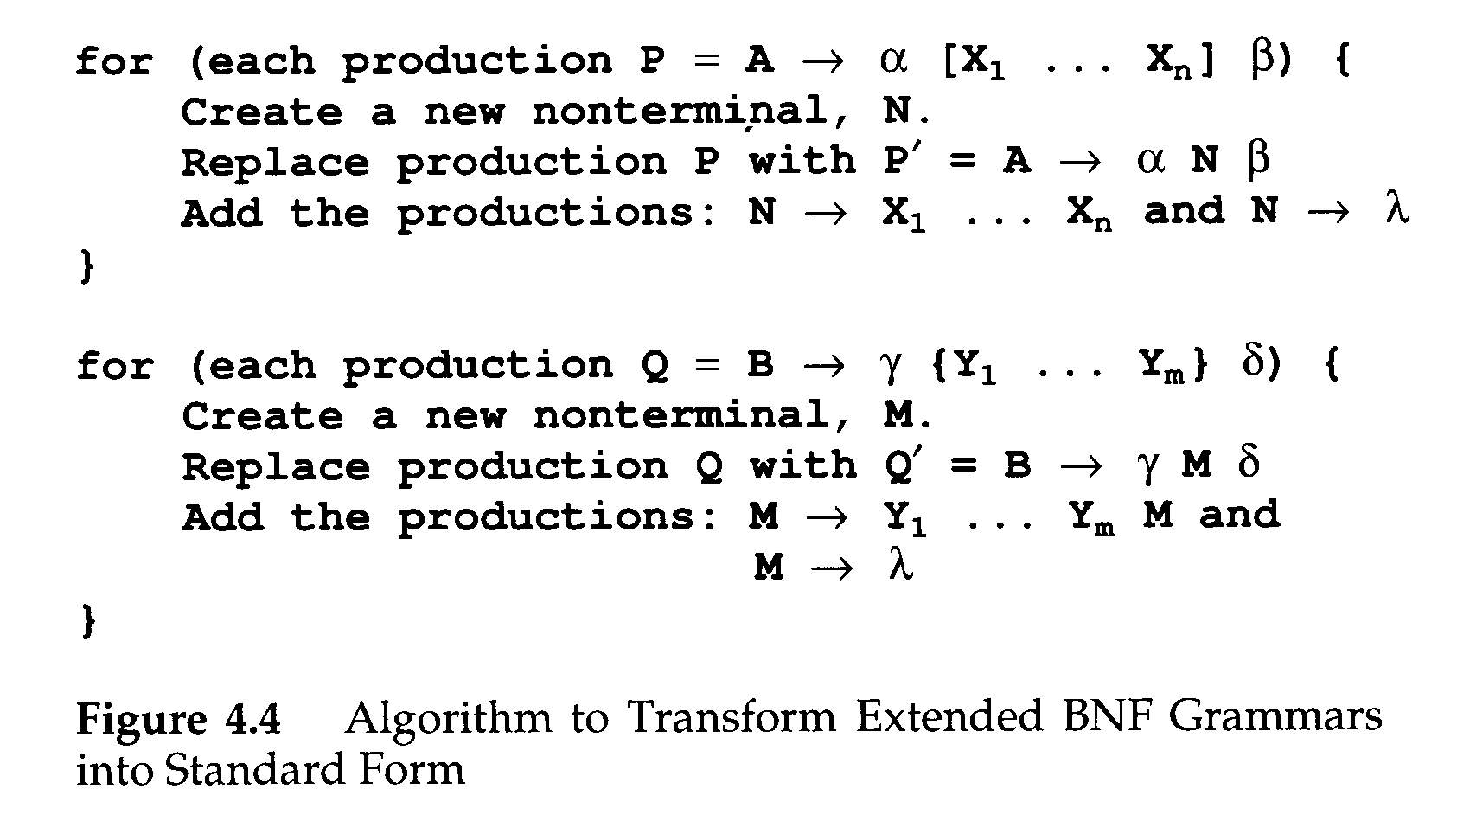
Transforming Extened BNF Grammars
Extended BNF≡ BNF
  Extended BNF allows
    Square bracket []
    Optional list {}

Slide 14
Parsers and Recognizers
Recognizer
  An algorithm that does boolean-valued test
    “Is this input syntactically valid?
Parser
  Answers more general questions
    Is this input valid?
    And, if it is, what is its structure (parse tree)?

Slide 15
Parsers and Recognizers (Cont’d)
Two general approaches to parsing
  Top-down parser
    Expanding the parse tree (via predictions) in a depth-first manner
    Preorder traversal of the parse tree
    Predictive in nature
    lm
    LL

Slide 16
Parsers and Recognizers (Cont’d)
  Buttom-down parser
    Beginning at its bottom (the leaves of the tree, which are terminal symbols) and determining the productions used to generate the leaves
    Postorder traversal of the parse tree
    rm
    LR

Slide 17
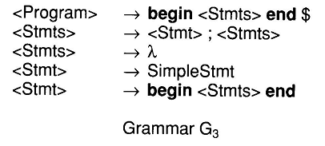
Parsers and Recognizers (Cont’d)
To parse
begin SimpleStmt; SimpleStmt; end $

Slide 18
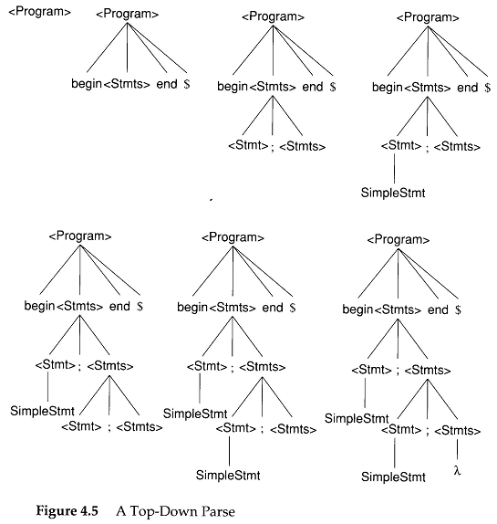

Slide 19
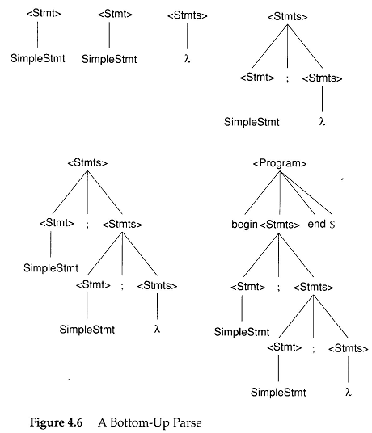

Slide 20
Parsers and Recognizers (Cont’d)
Naming of parsing techniques
The way to parse
token sequence
L: Leftmost
R: Righmost
Top-down
  LL
Bottom-up
  LR

Slide 21
Grammar Analysis Algorithms
Goal of this section:
  Discuss a number of important analysis algorithms for Grammars

Slide 22
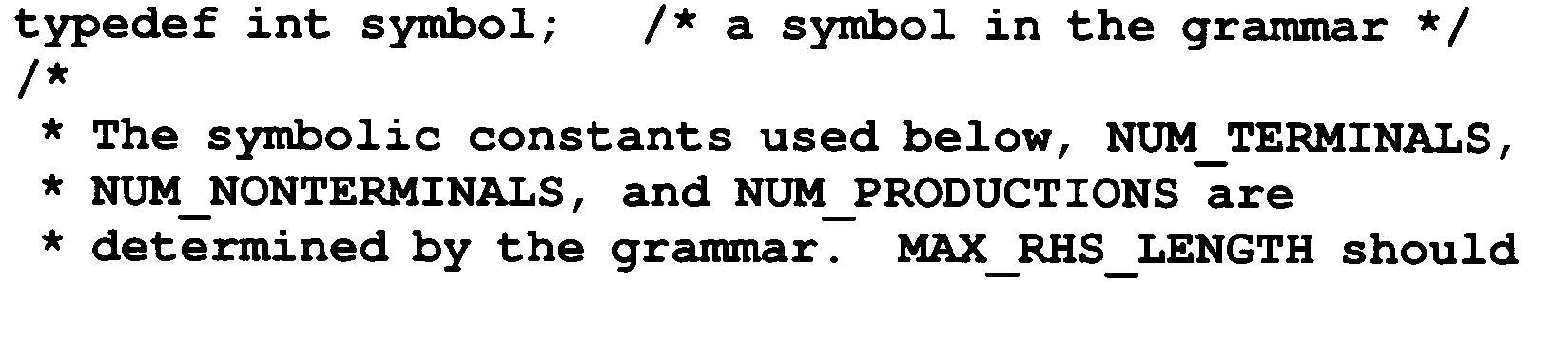
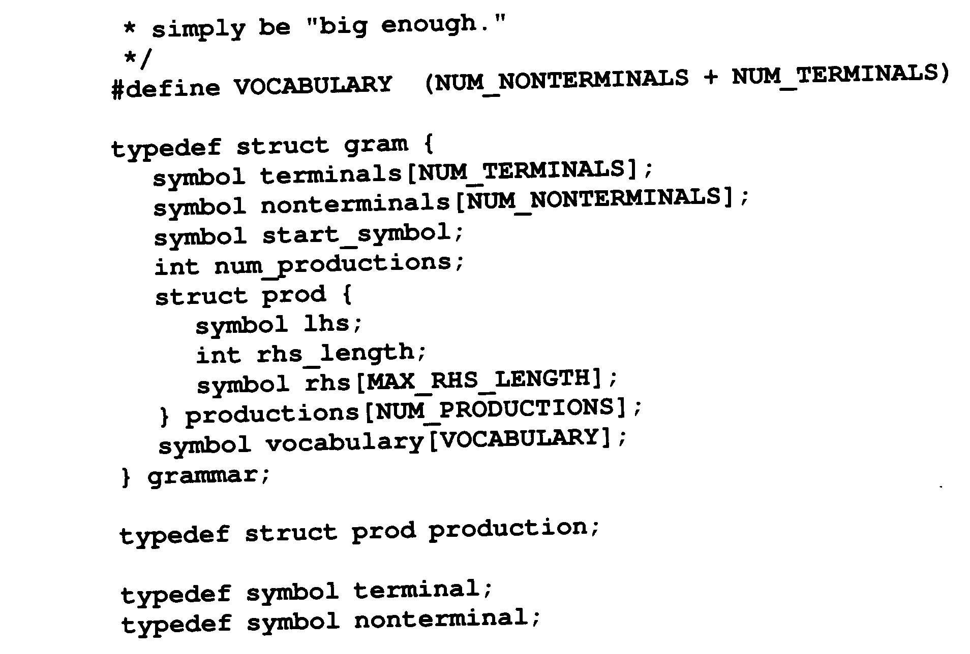
Grammar Analysis Algorithms (Cont’d)
The data structure of a grammar G

Slide 23
Grammar Analysis Algorithms (Cont’d)
What nonterminals can derive λ?
  A ⇒ BCD ⇒ BC ⇒ B ⇒ λ
  An iterative marking algorithm

Slide 24
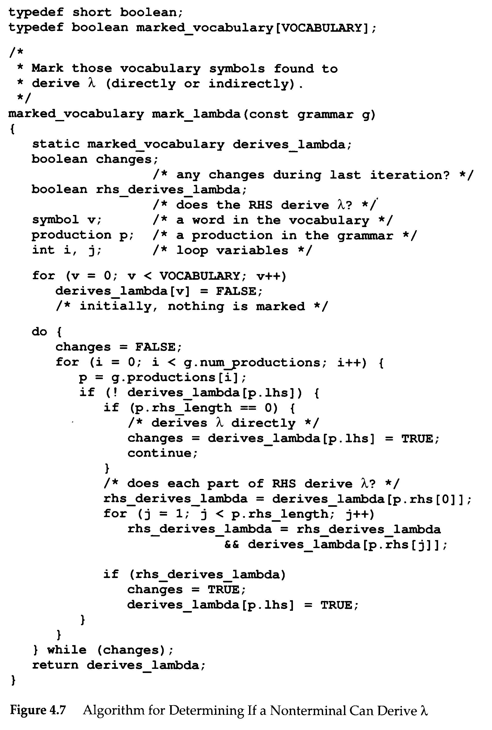

Slide 25
Grammar Analysis Algorithms (Cont’d)
Follow(A)
  A is any nonterminal
  Follow(A) is the set of terminals that my follow A in some sentential form
  Follow(A)={a∈V_{t}|S⇒* … Aa … }∪
  {if S ⇒⁺ αA then {λ} else ∅}
First(α)
  The set of all the terminal symbols that can begin a sentential form derivable from α
  If α is the right-hand side of a production, then First(α) contains terminal symbols that begin strings derivable from α
  First(α)={a∈V_{t}| α ⇒* aβ}∪
  {if α ⇒* λ then {λ} else ∅}

Slide 26
Grammar Analysis Algorithms (Cont’d)
Definition of C data structures and subroutines
  first_set[X]
    contains terminal symbols and λ
    X is any single vocabulary symbol
  follow_set[A]
    contains terminal symbols and λ
    A is a nonterminal symbol

Slide 27
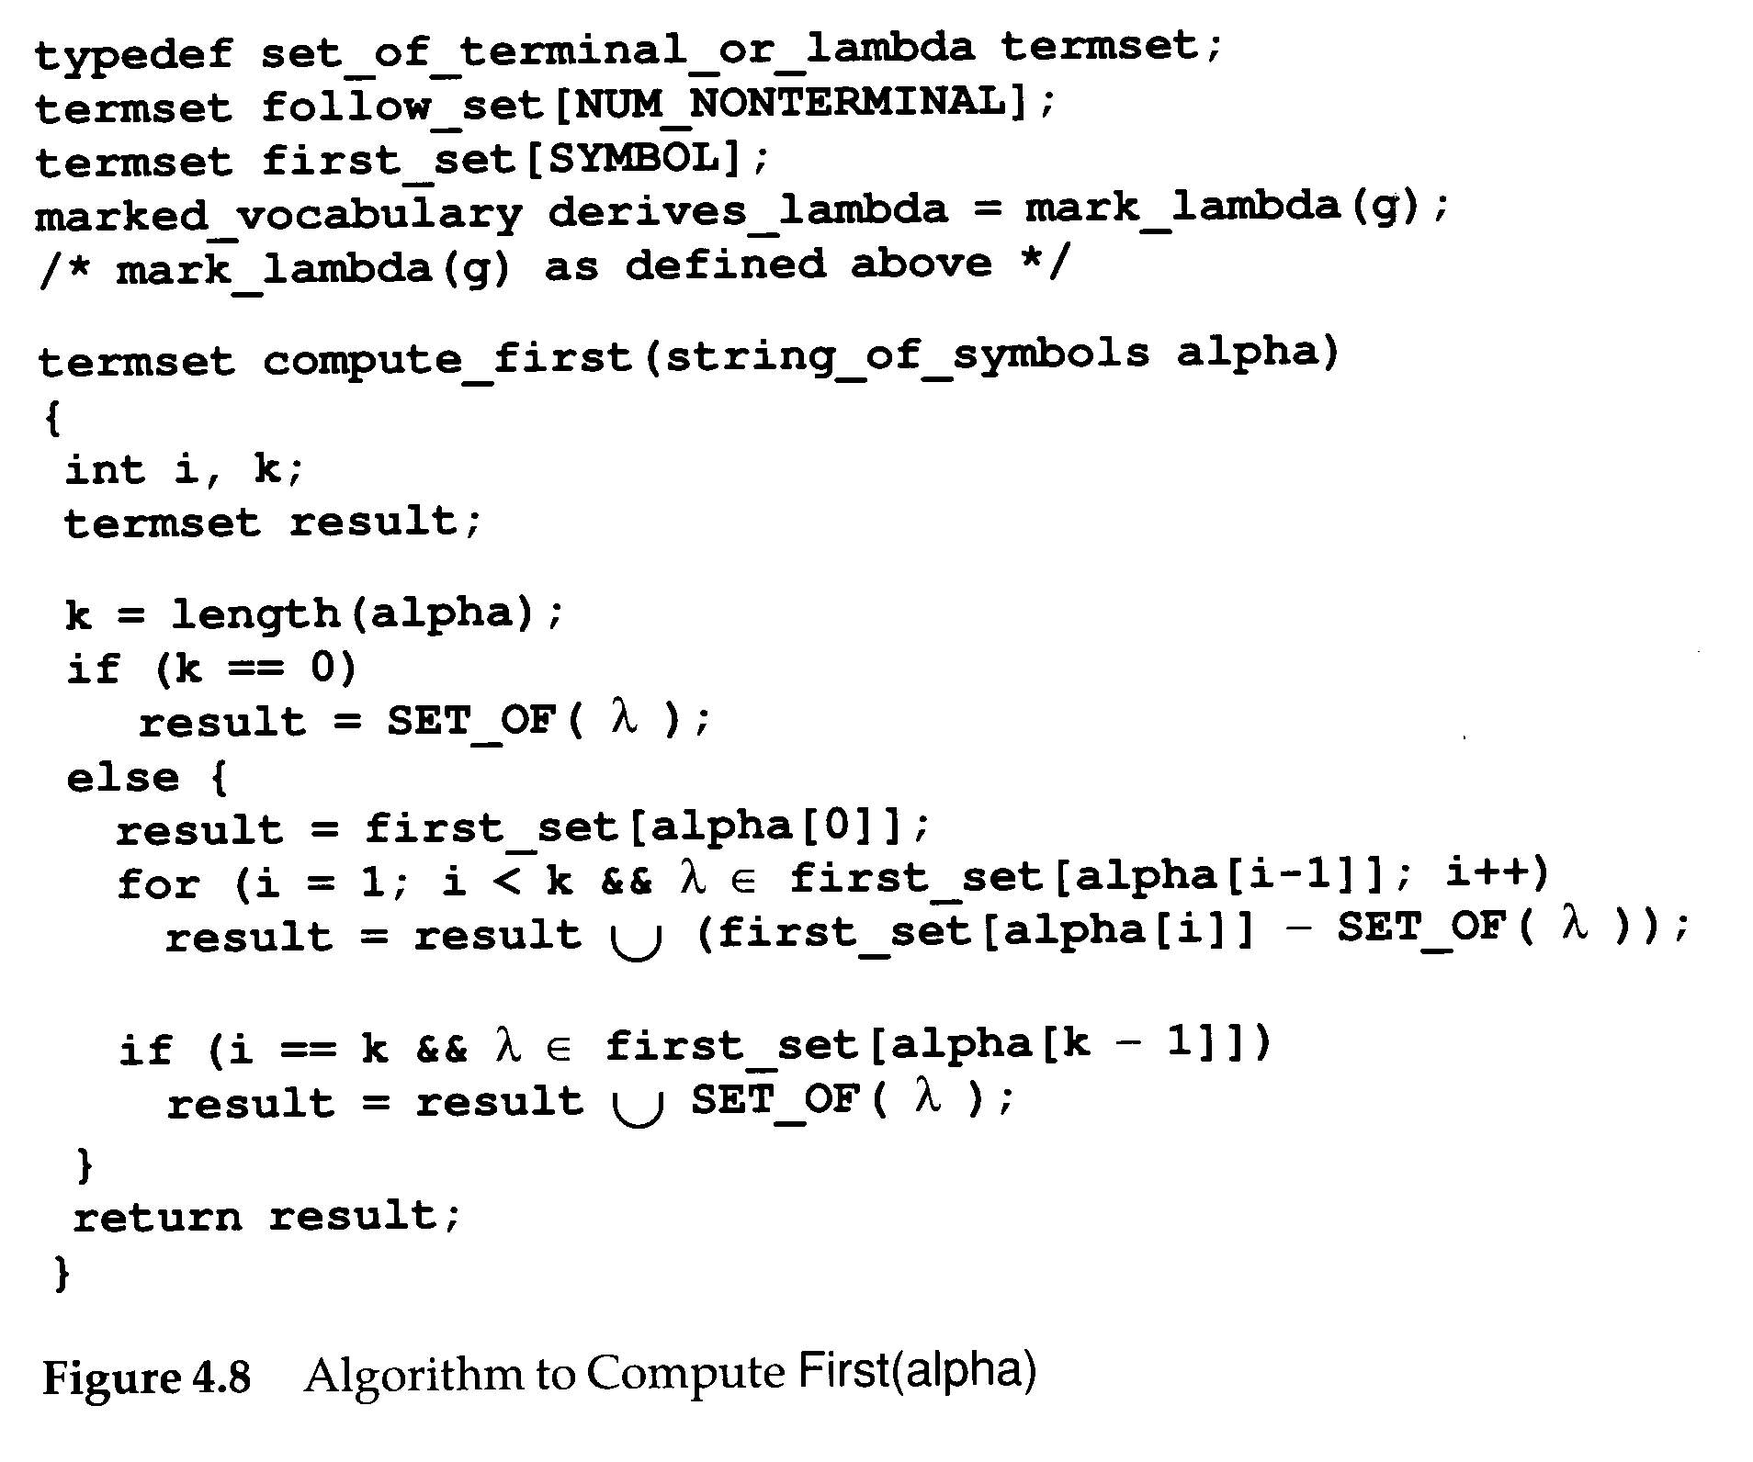
It is a subroutine of
fill_first_set()

Slide 28
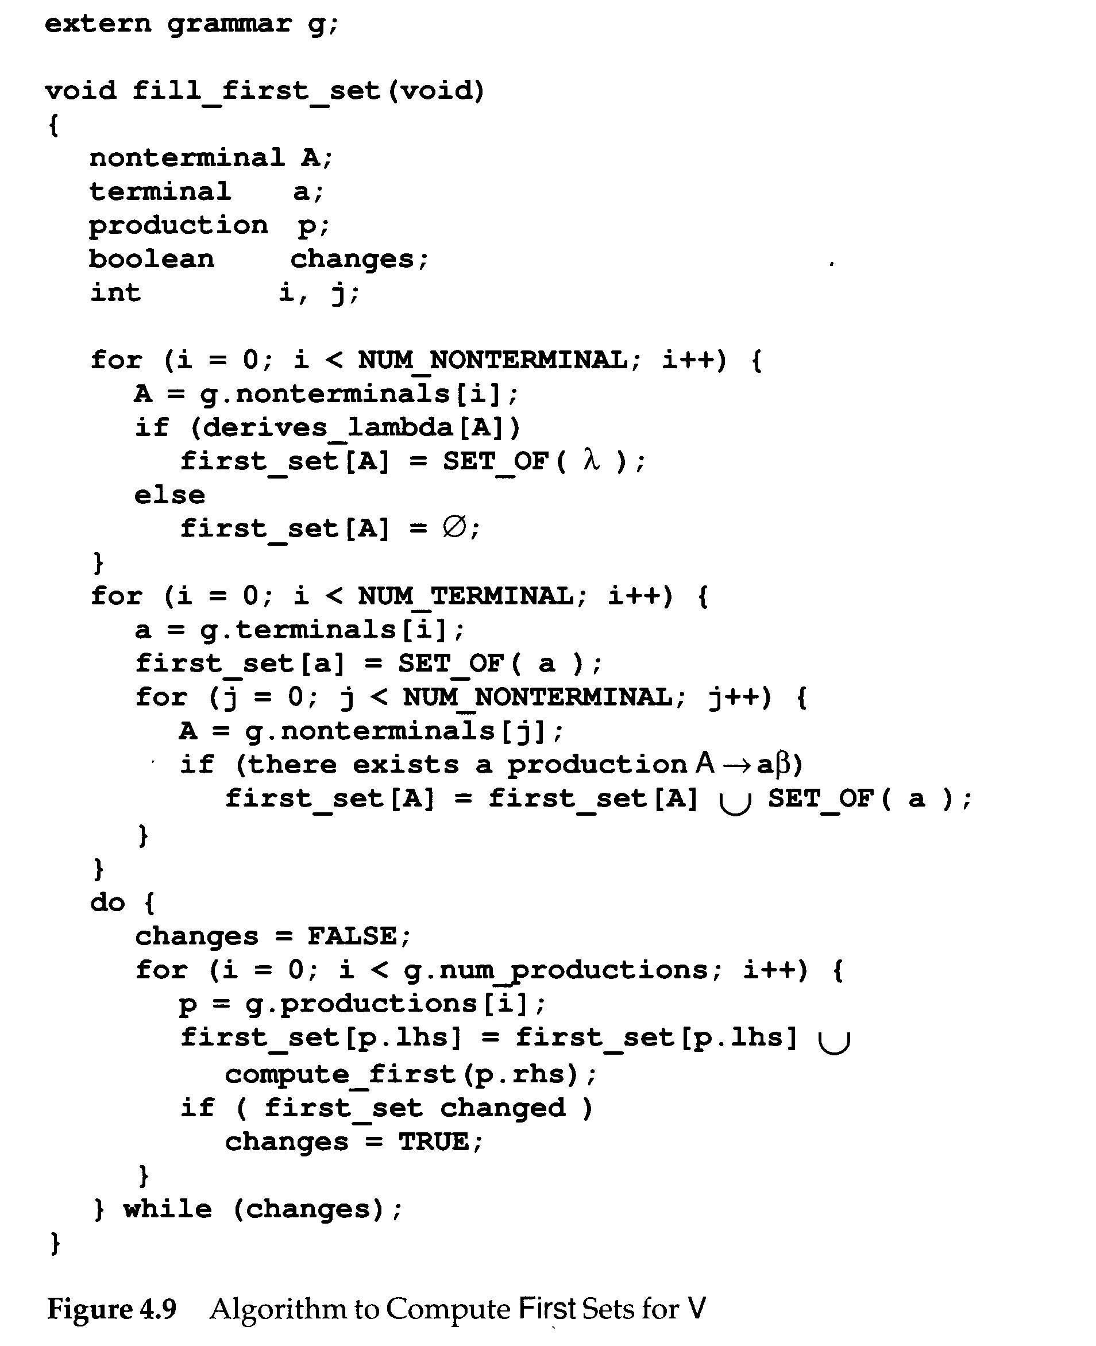

Slide 30
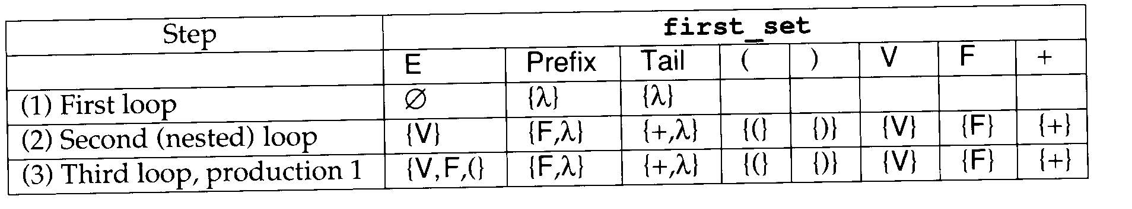
E→Prefix(E)
E→V Tail
Prefix→F
Prefix→λ
Tail→+Ε
Tail→ λ
G₀
The execution of fill_first_set() using grammar G₀

Slide 31
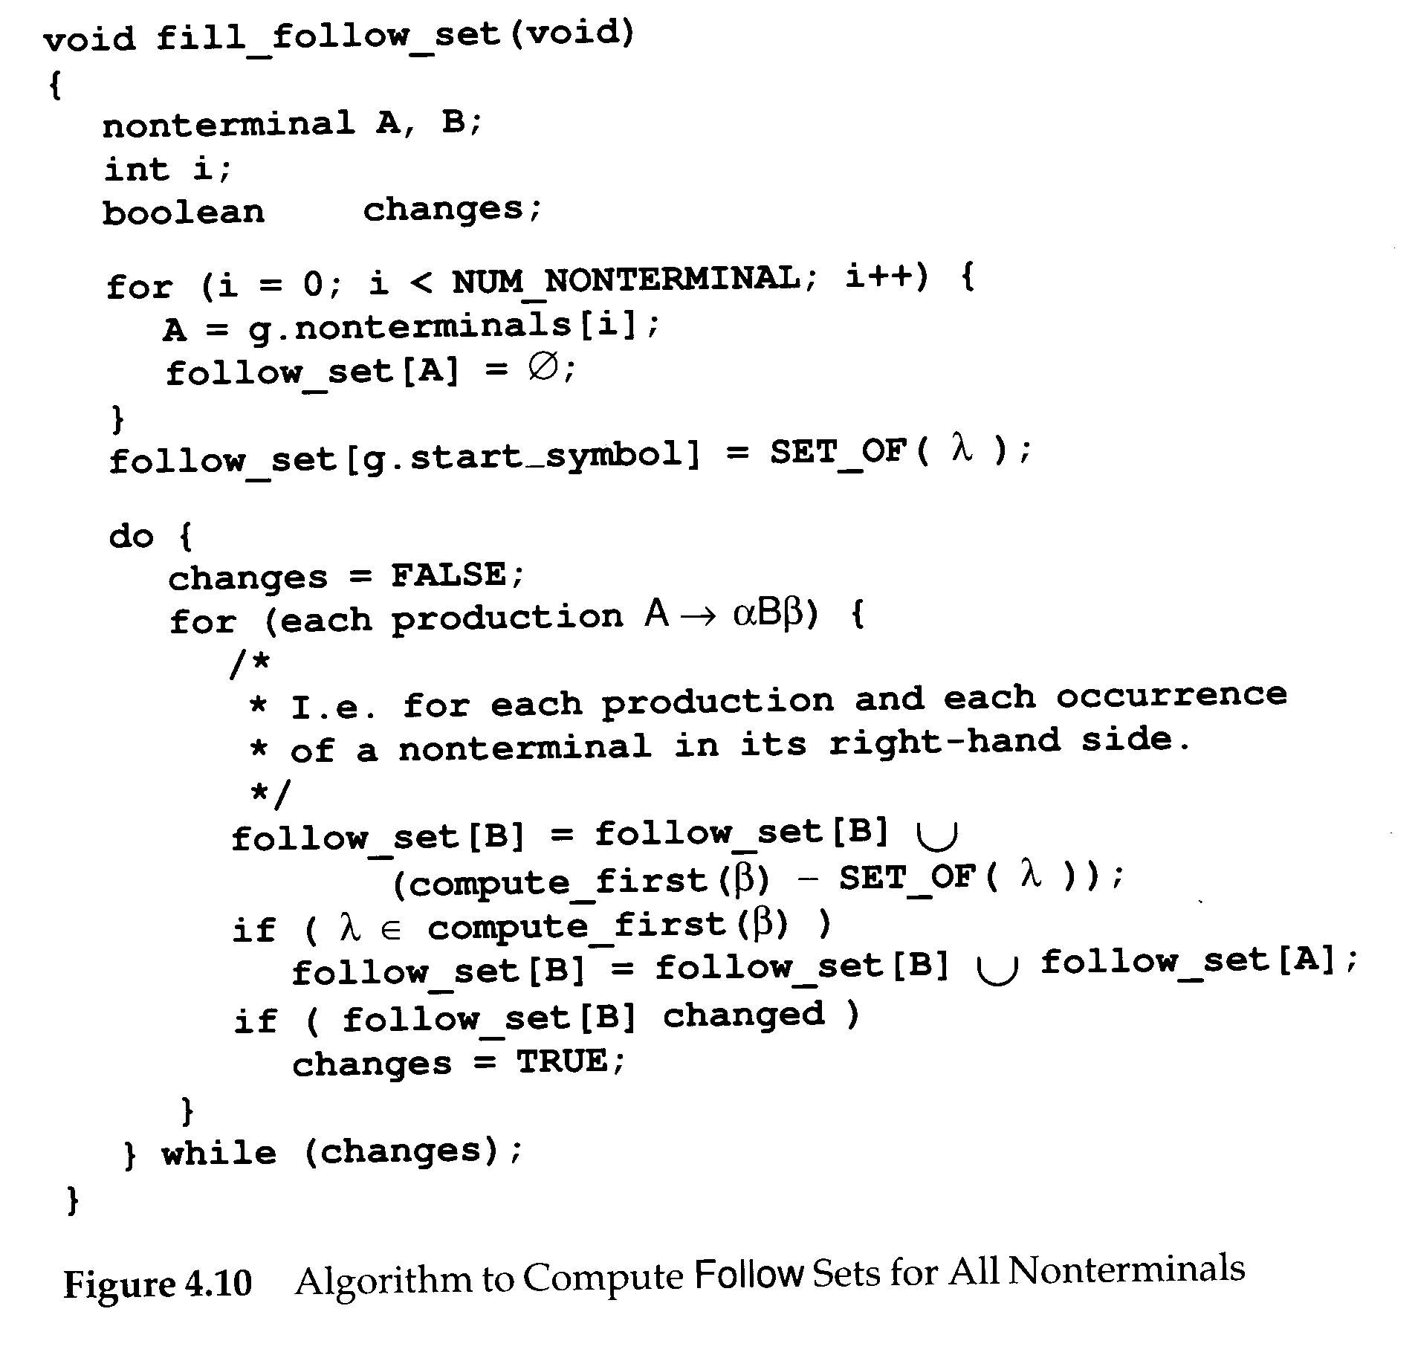

Slide 32
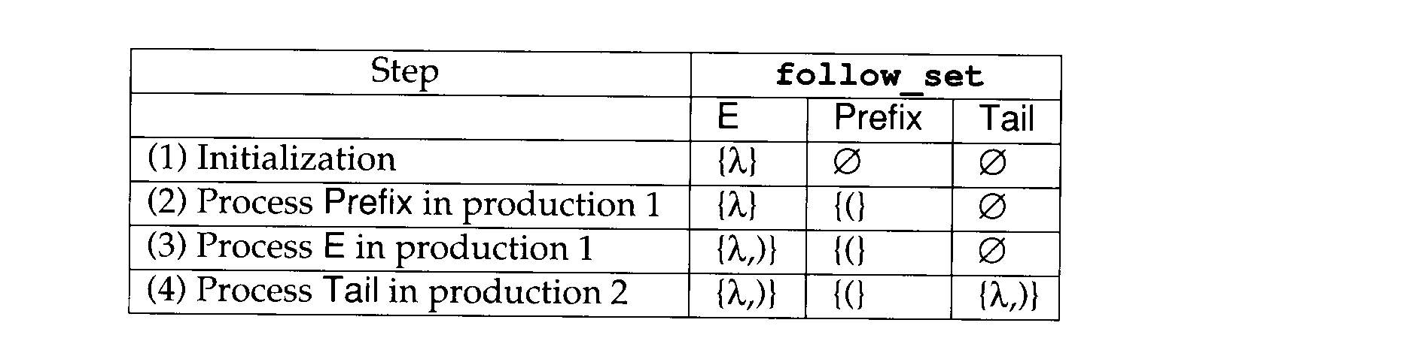
E→Prefix(E)
E→V Tail
Prefix→F
Prefix→λ
Tail→+Ε
Tail→ λ
G₀
The execution of fill_follow_set() using grammar G₀

Slide 33
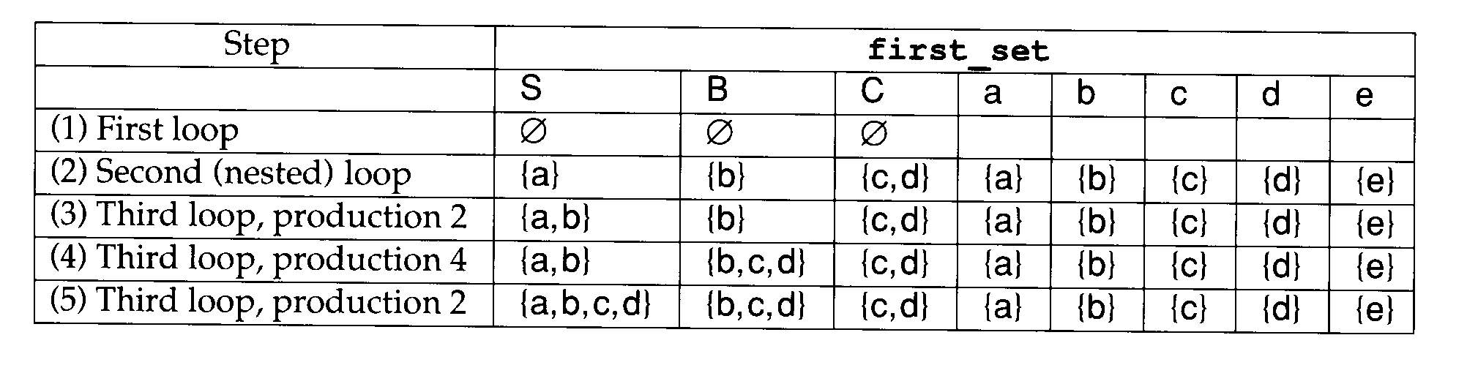
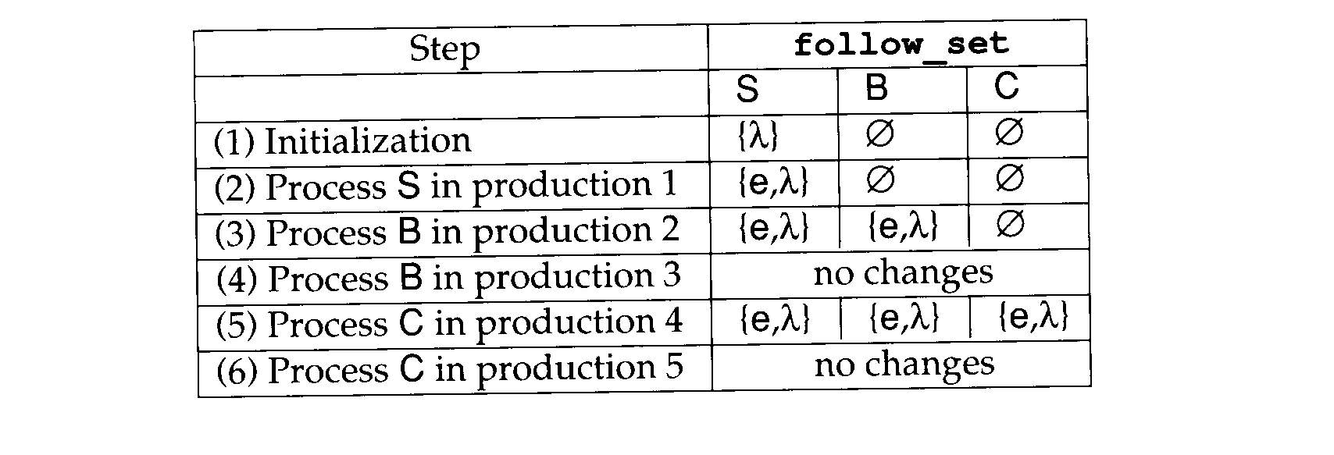
More examples
S → aSe
S → B
B → bBe
B → C
C → cCe
C → d
The execution of fill_first_set()
The execution of fill_follow_set()

Slide 34
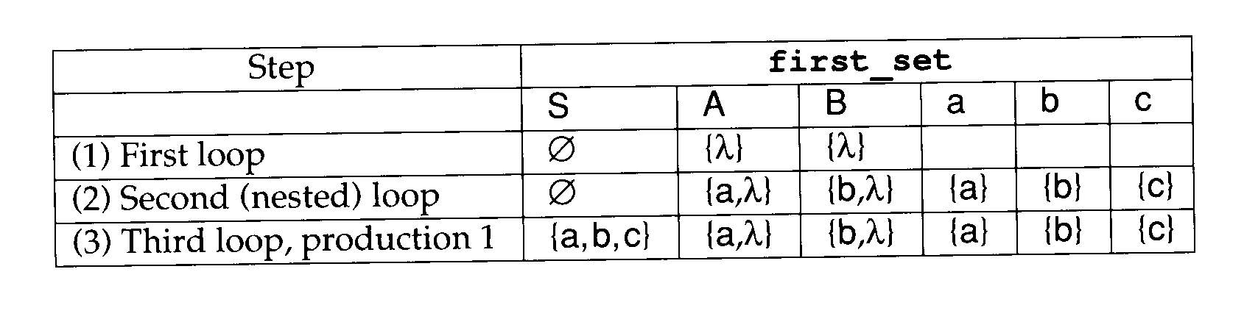
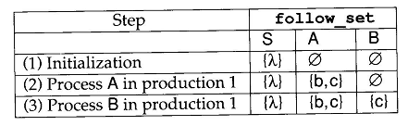
More examples
S → ABc
A → a
A → λ
B → b
B → λ
The execution of fill_first_set()
The execution of fill_follow_set()

