Slide 1
Chapter 5 Grammars and Parsers

Slide 2
The LL(1) Predict Function
Given the productions
  A→α₁
  A→α₂
  …
  A→α_{n}
During a (leftmost) derivation
  … A … ⇒ … α₁ … or
  … α₂ … or
  … α_{n} …
Deciding which production to match
  Using lookahead symbols

Slide 3
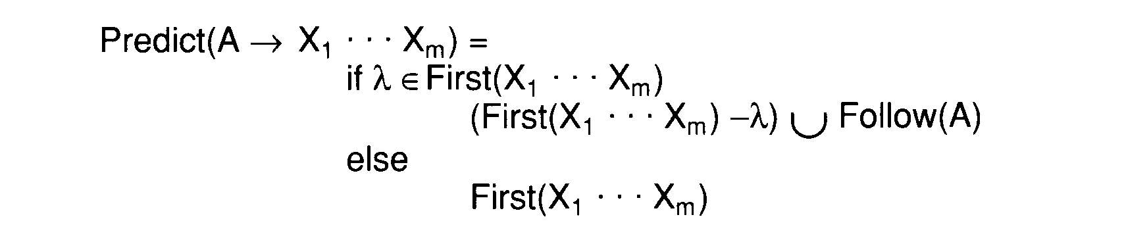
The LL(1) Predict Function
Single Symbol Lookahead
The limitation of LL(1)
  LL(1) contains exactly those grammars that have disjoint predict sets for productions that share a common left-hand side

Slide 4
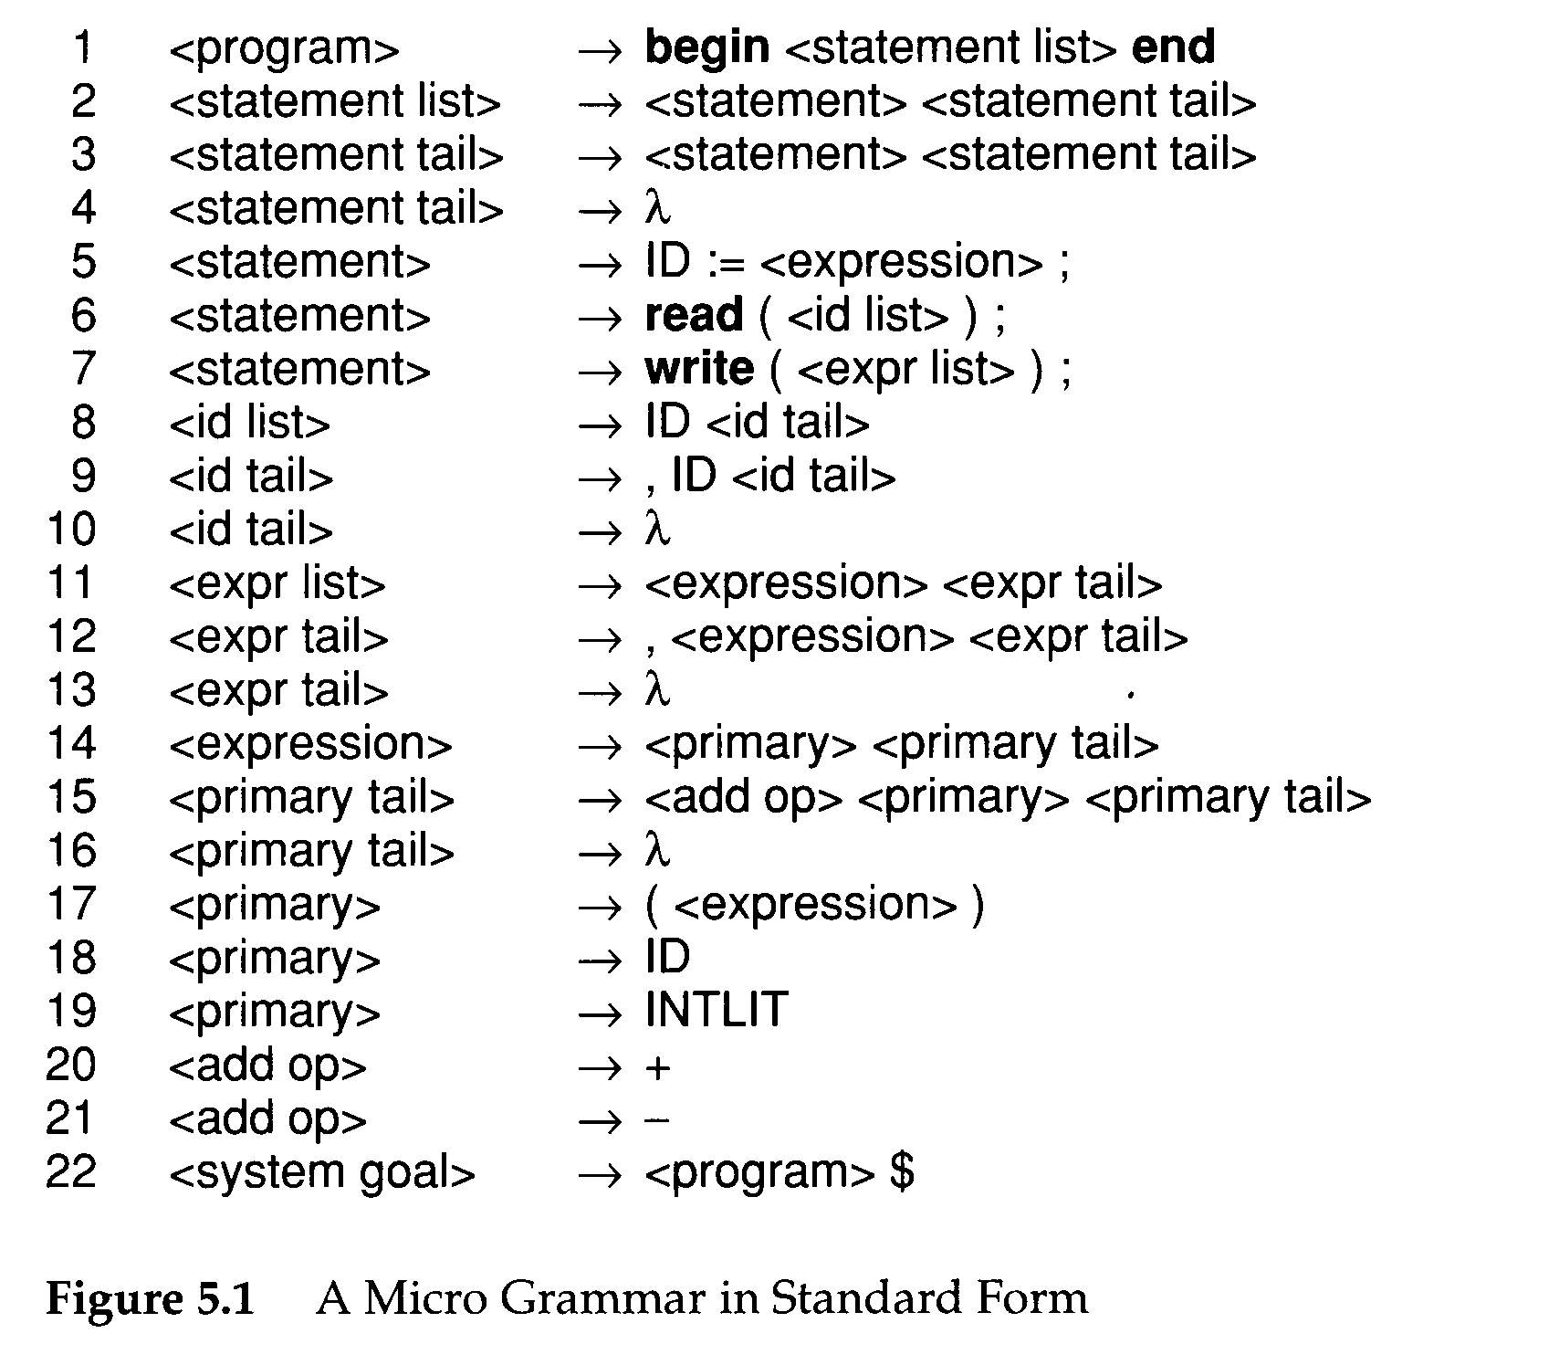
Not extended BNF form
$: end of file token

Slide 5
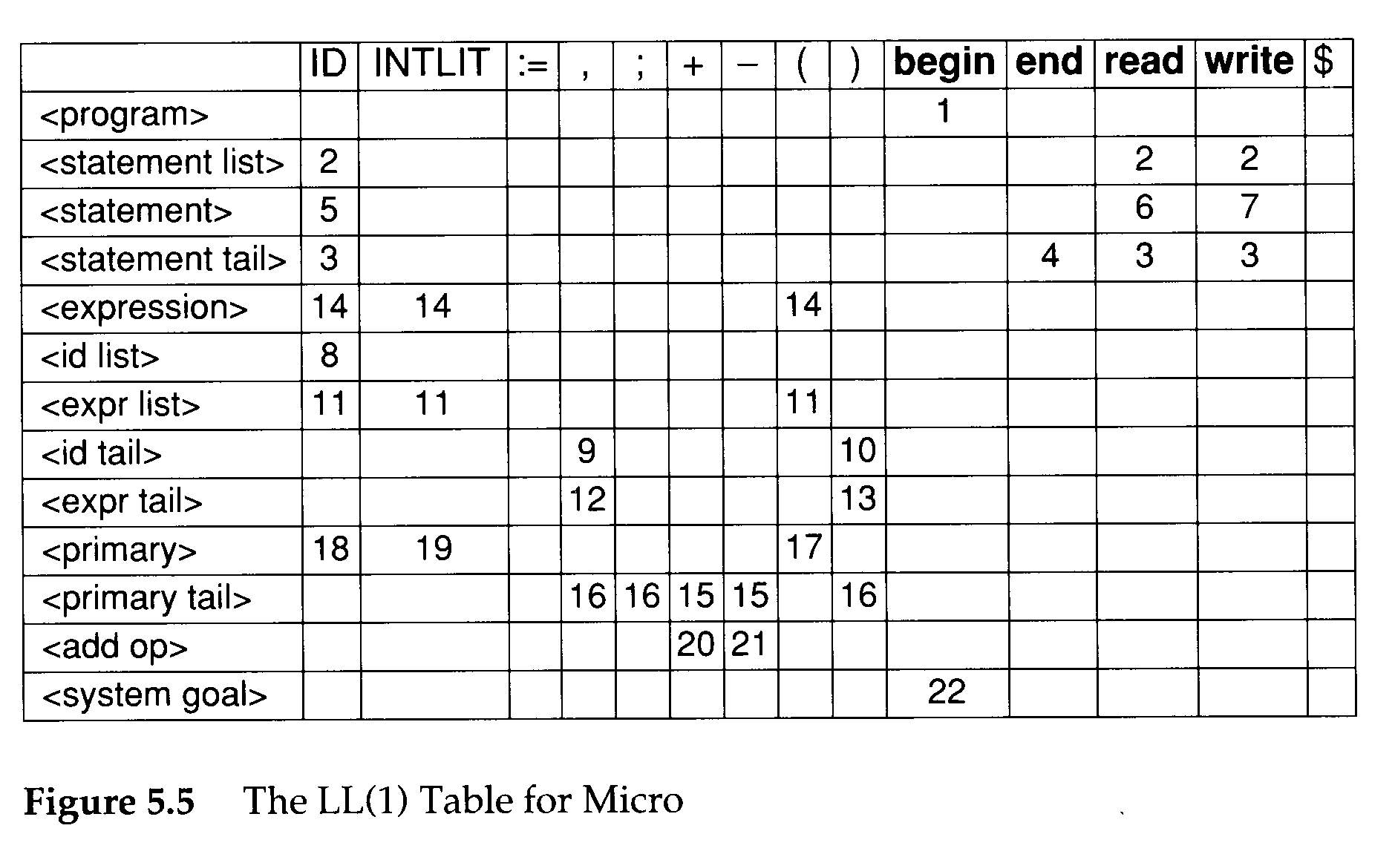
The LL(1) Parse Table
An LL(1) parse table
  T:V_{n} x V_{t} → P∪{Error}
The definition of T
  T[A][t]=A→X_{1…}X_{m} if t∈Prediction(A→X_{1…}X_{m} );
  T[A][t]=Error otherwise

Slide 6
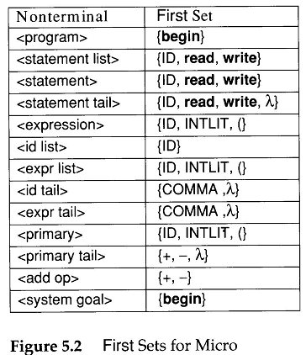
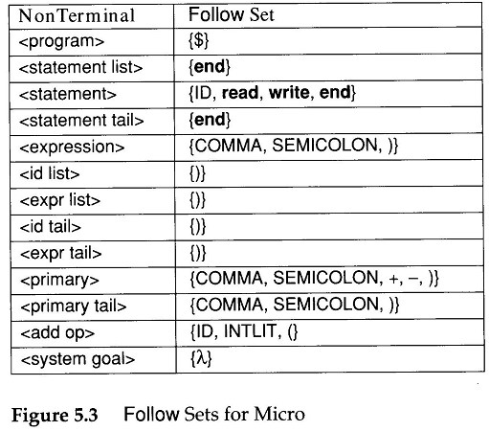

Slide 7
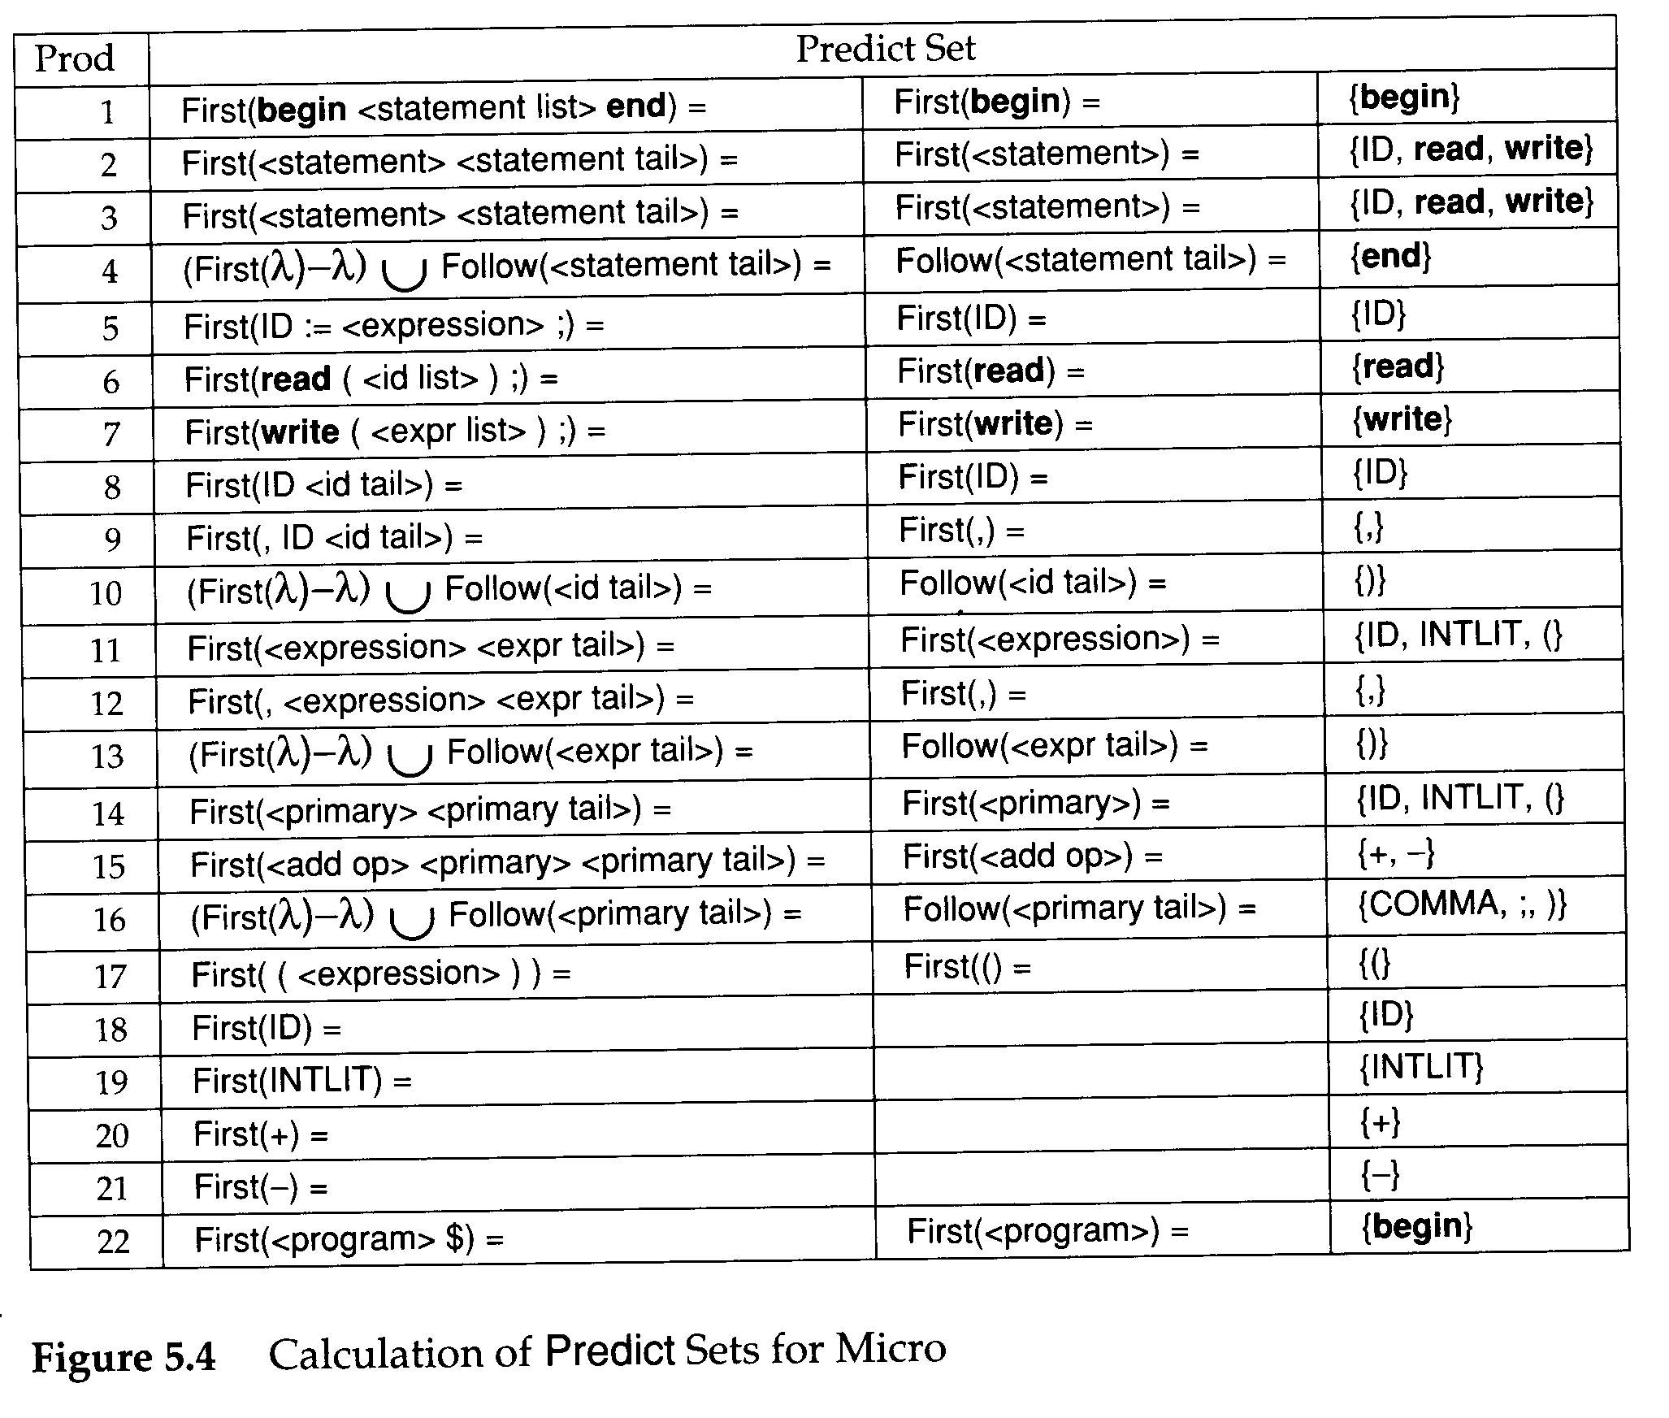

Slide 8
Building Recursive Descent Parsers from LL(1) Tables
Similar the implementation of a scanner, there are two kinds of parsers
  Build in
    The parsing decisions recorded in LL(1) tables can be hardwired into the parsing procedures used by recursive descent parsers
  Table-driven

Slide 9
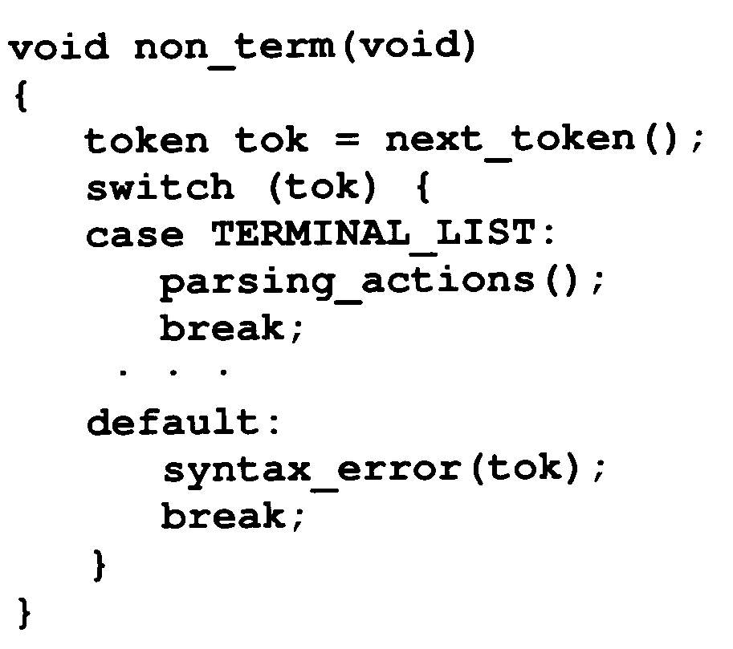
Building Recursive Descent Parsers from LL(1) Tables
The form of parsing procedure:

Slide 10
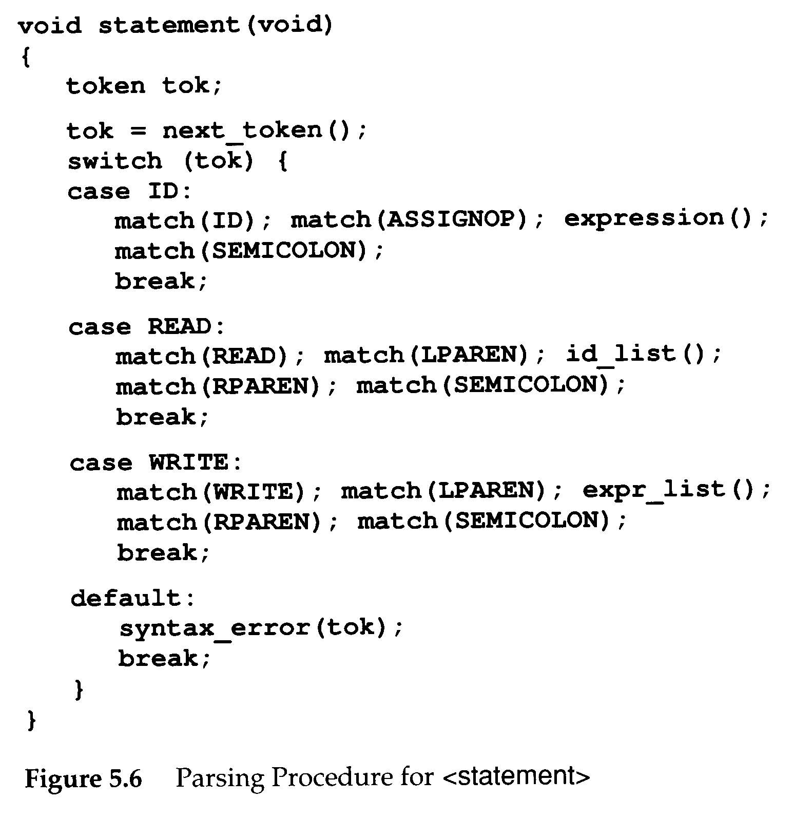
Building Recursive Descent Parsers from LL(1) Tables
E.g. of an parsing procedure for <statement> in Micro

Slide 11
Building Recursive Descent Parsers from LL(1) Tables
An algorithm that automatically creates parsing procedures like the one in Figure 5.6 from LL(1) table

Slide 12
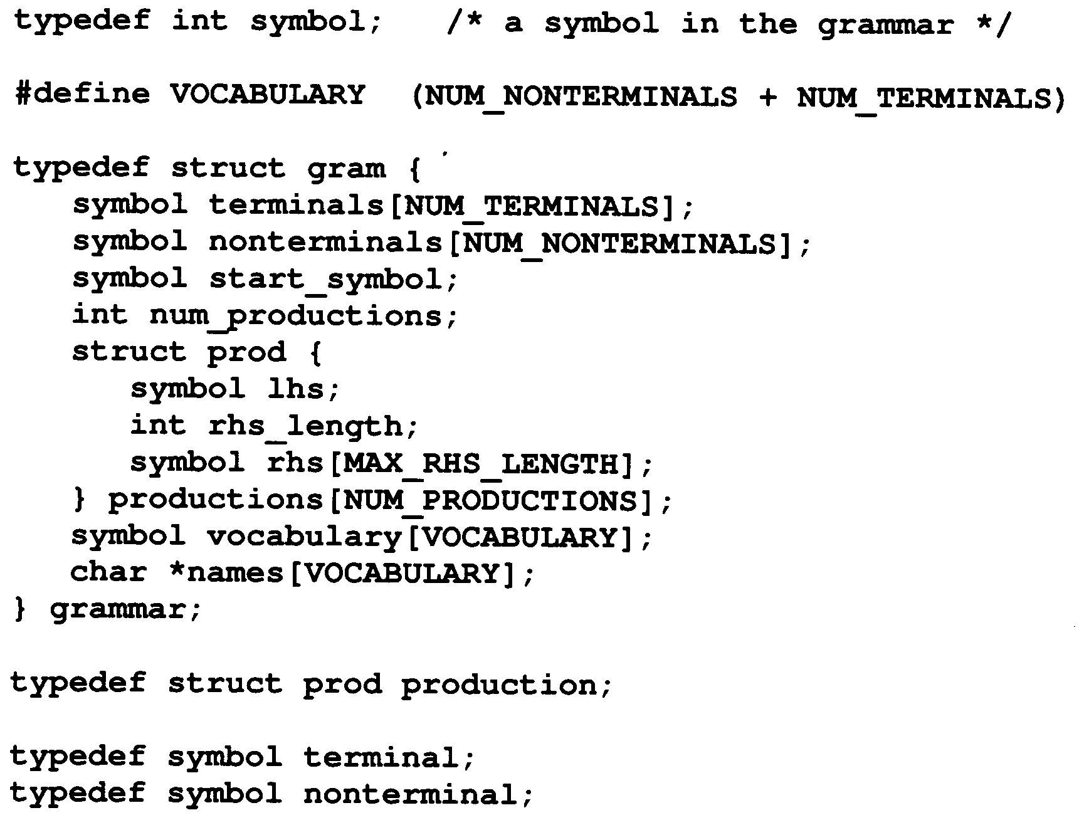
Building Recursive Descent Parsers from LL(1) Tables
The data structure for describing grammars

Slide 13
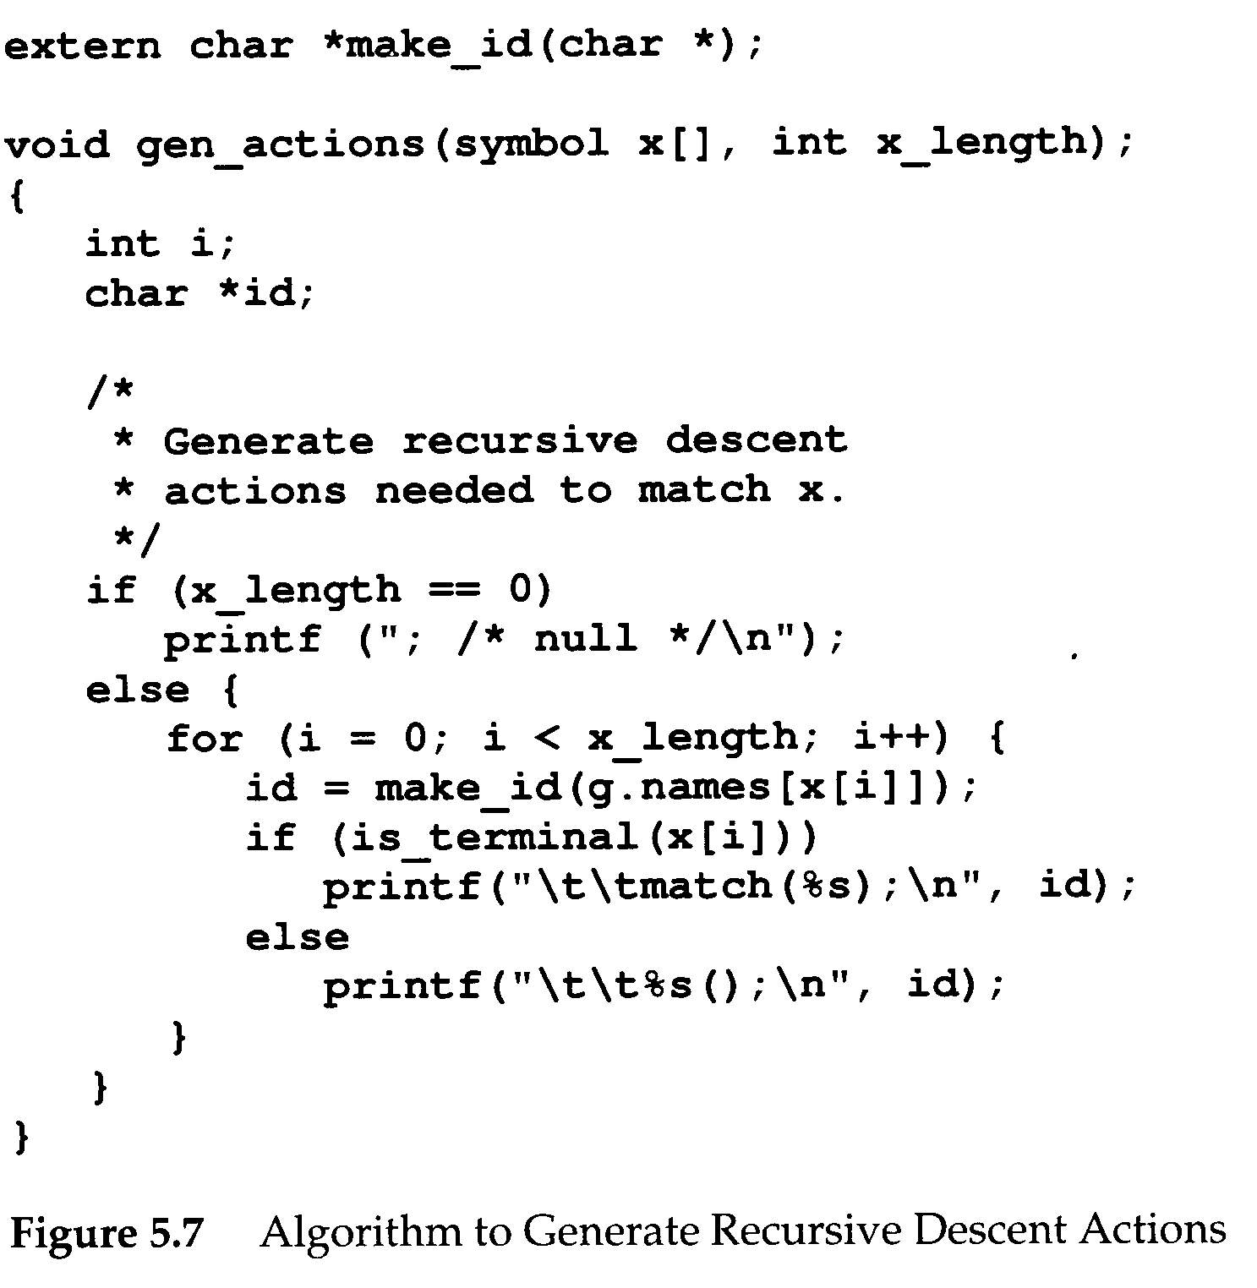
Building Recursive Descent Parsers from LL(1) Tables
gen_actions()
  Takes the grammar symbols and generates the actions necessary to match them in a recursive descent parse

Slide 14
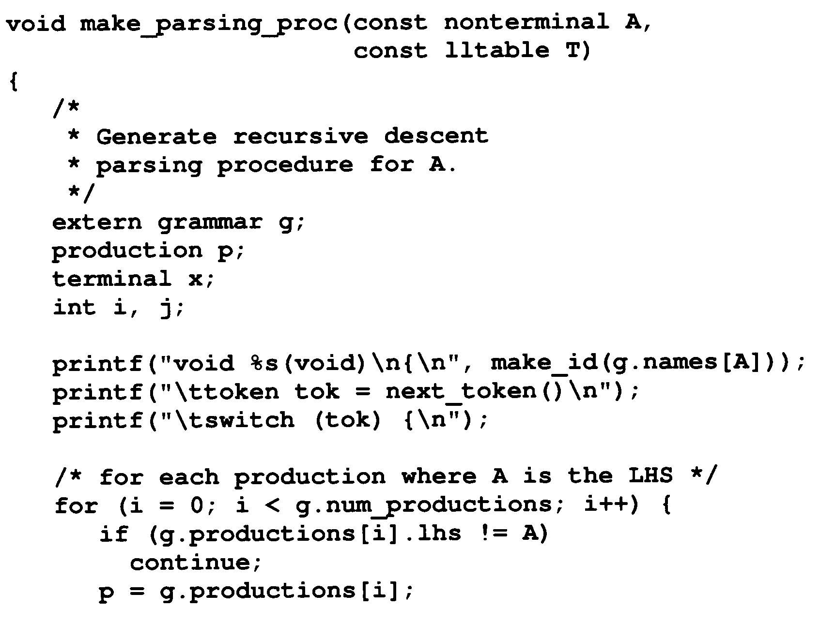
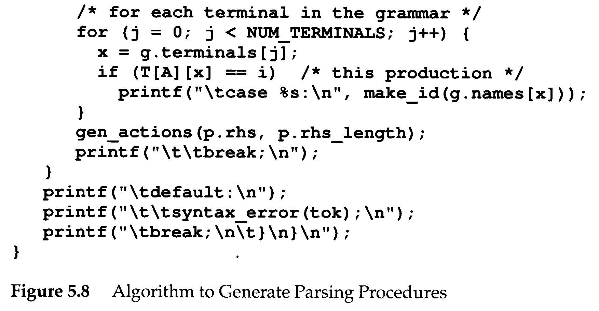

Slide 15
An LL(1) Parser Driver
Rather than using the LL(1) table to build parsing procedures, it is possible to use the table in conjunction with a driver program to form an LL(1) parser
Smaller and faster than a corresponding recursive descent parser
Changing a grammar and building a new parser is easy
  New LL(1) driver are computed and substituted for the old tables

Slide 16
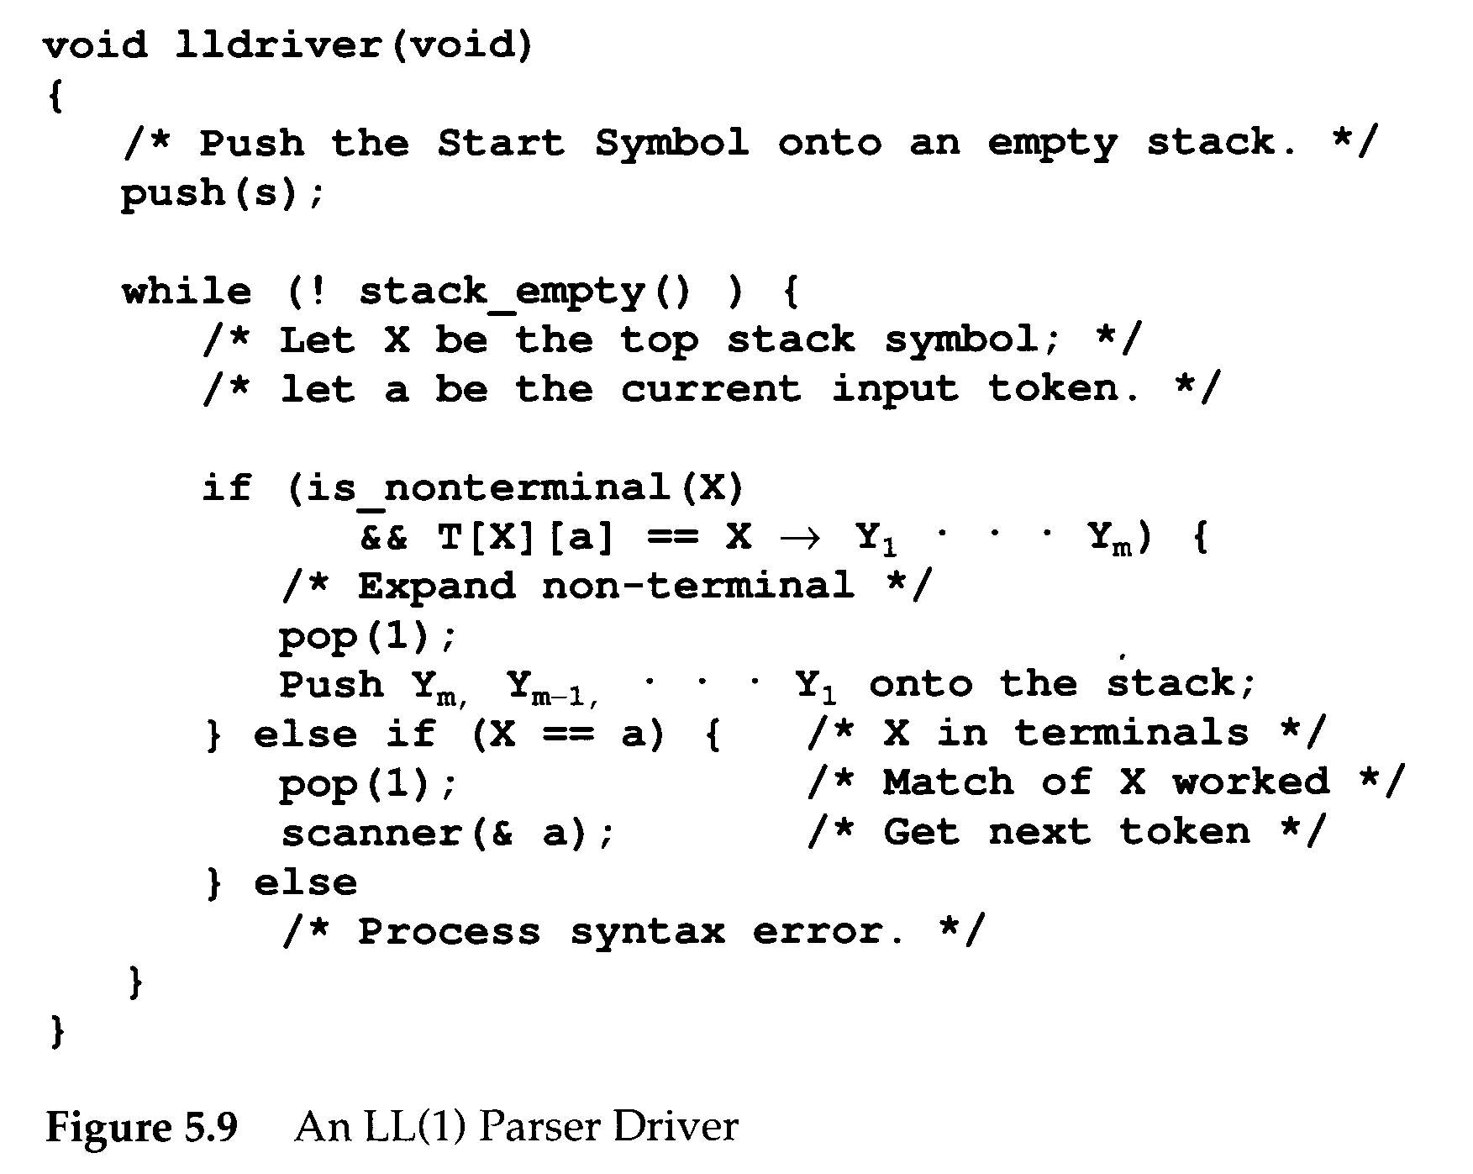
a
B
c
A
D
A→aBcD

Slide 17
LL(1) Action Symbols
During parsing, the appearance of an action symbol in a production will server to initiate the corresponding semantic action – a call to the corresponding semantic routine.
gen_action(“ID:=<expression> #gen_assign;”)
match(ID);
match(ASSIGN);
exp();
assign();
match(semicolon);

Slide 18
LL(1) Action Symbols
The semantic routine calls pass no explicit parameters
  Necessary parameters are transmitted through a semantic stack
  Semantic stack ≠ parse stack
Semantic stack is a stack of semantic records.
Action symbols are pushed to the parse stack
  See figure 5.11

Slide 19
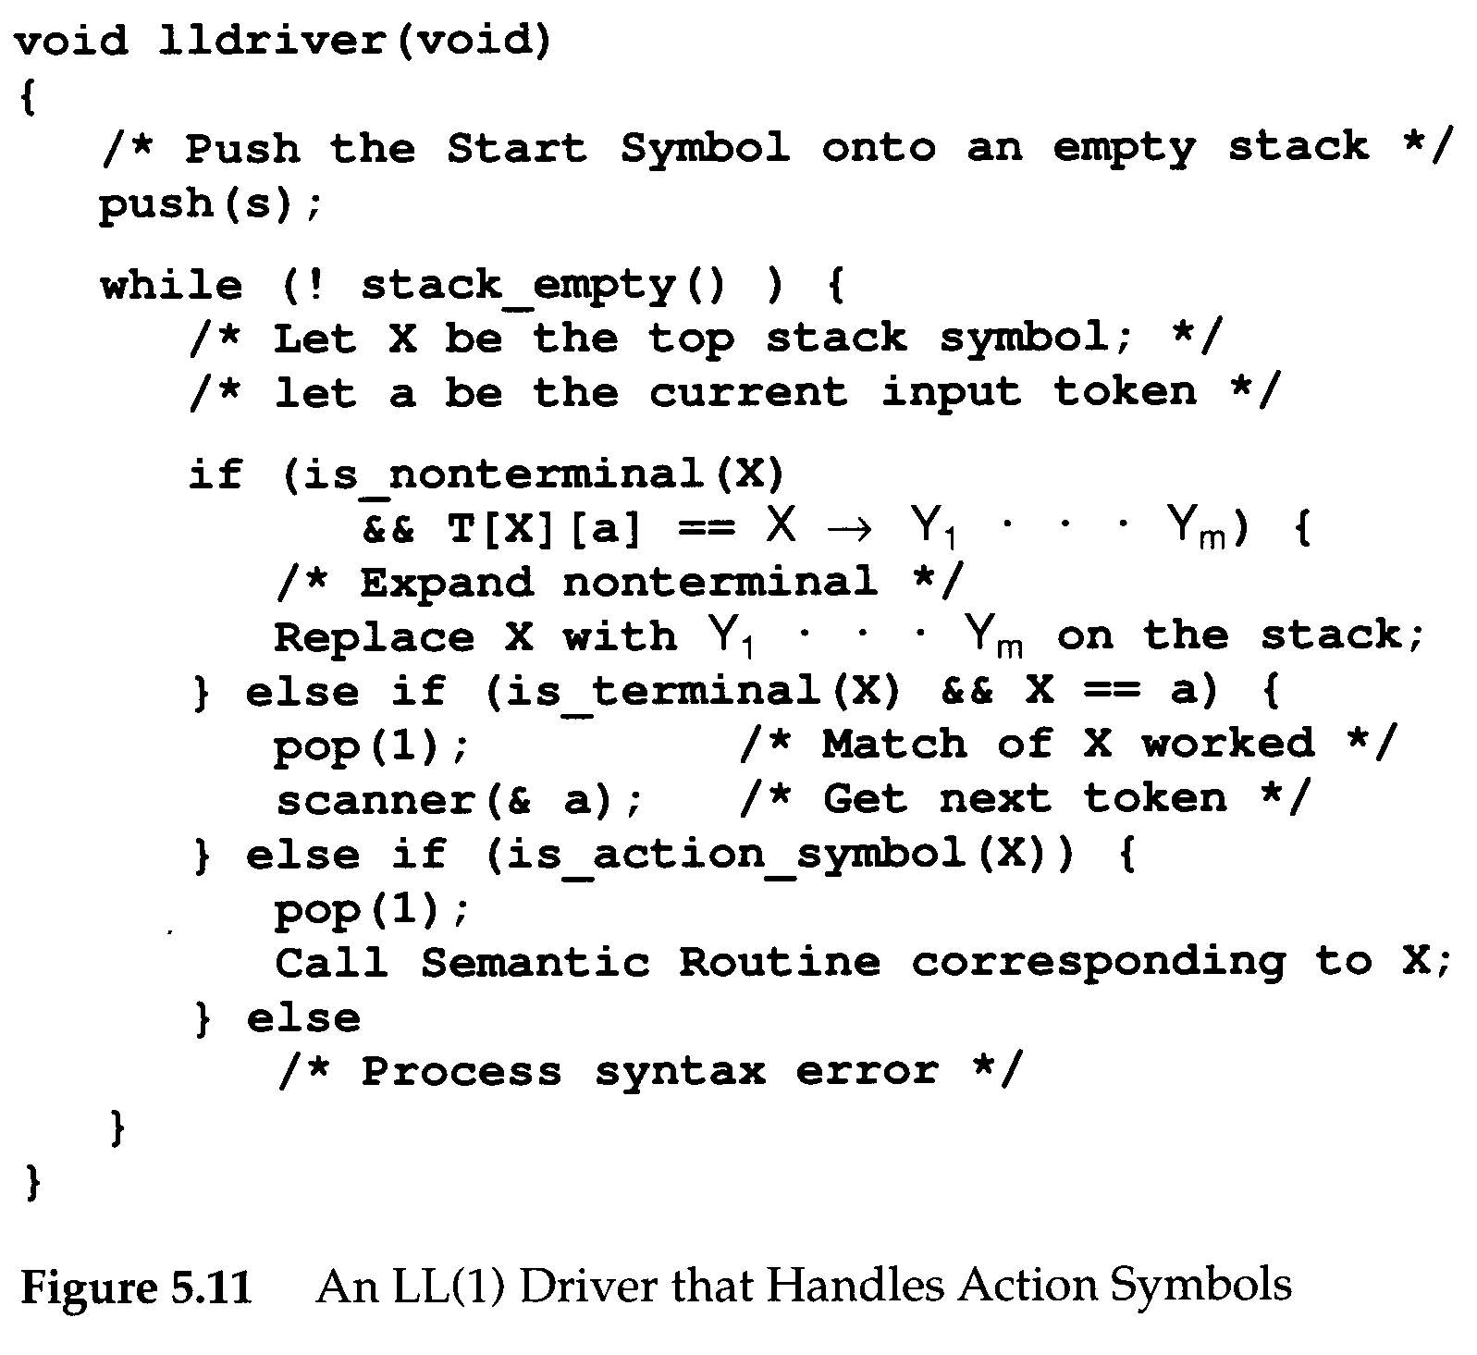
Difference between
Fig. 5.9 and Fig 5.11

Slide 20
Making Grammars LL(1)
Not all grammars are LL(1). However, some non-LL(1) grammars can be made LL(1) by simple modifications.
When a grammar is not LL(1) ?
This is called a conflict, which means we do not know which production to use when <stmt> is on stack top and ID is the next input token.
ID
<stmt>
2,5

Slide 21
Making Grammars LL(1)
Major LL(1) prediction conflicts
  Common prefixes
  Left recursion
Common prefixes
<stmt> → if <exp> then <stmt>
<stmt> → if <exp> then <stmt> else <stmt>
Solution: factoring transform
  See figure 5.12

Slide 22
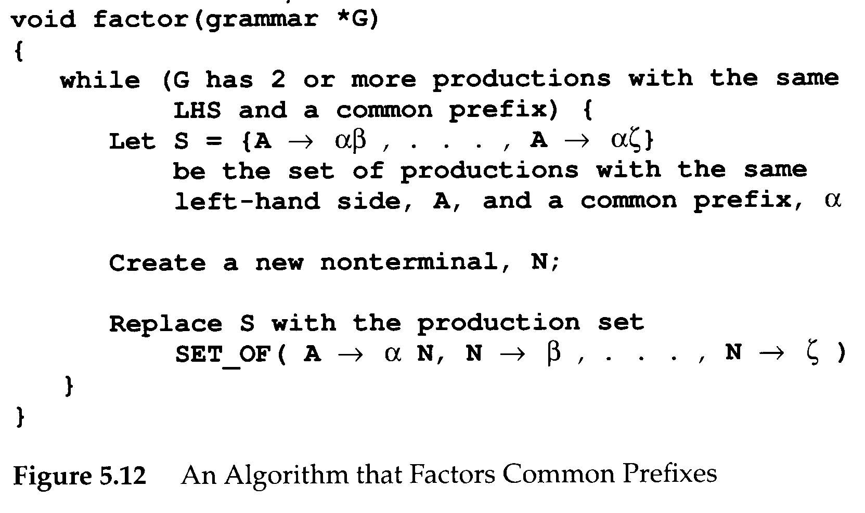
Making Grammars LL(1)
<stmt> → if <exp> then <stmt list> <if suffix>
<if suffix> → end if;
<if suffix> → else <stmt list> end if;

Slide 23
Making Grammars LL(1)
Grammars with left-recursive production can never be LL(1)
  A → A β
  Why? A will be the top stack symbol, and hence the same production would be predicted forever

Slide 24
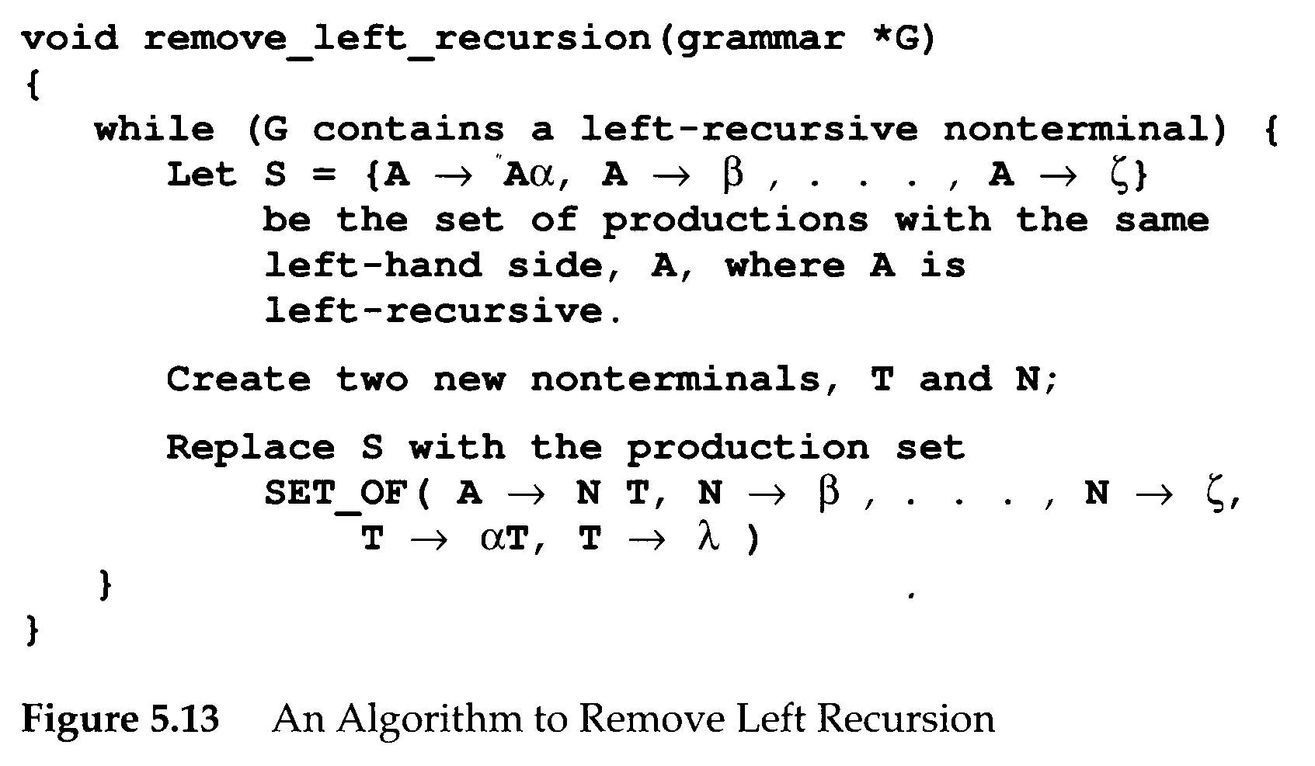
Making Grammars LL(1)
Solution: Figure 5.13
A→NT
N→β
…
N→ ζ
T→ αΤ
T→ λ
A→Aα
A→β
…
A→ζ

Slide 25
Making Grammars LL(1)
Other transformation may be needed
  No common prefixes, no left recursion
1 <stmt> → <label> <unlabeled stmt>
2 <label> → ID :
3 <label> → λ
4 <unlabeled stmt> → ID := <exp> ;
ID
<stmt>
2,3

Slide 26
Making Grammars LL(1)
<stmt> → ID <suffix>
<suffix> → : <unlabeled stmt>
<suffix> → := <exp> ;
<unlabeled stmt> → ID := <exp> ;
look ahead 2 tokens
Example
A: B := C ;
B := C ;

Slide 27
Making Grammars LL(1)
In Ada, we may declare arrays as
A: array(I .. J, BOOLEAN)
A straightforward grammar for array bound
<array bound> → <expr> .. <expr>
<array bound> → ID
Solution
<array bound> → <expr> <bound tail>
<bound tail> → .. <expr>
<bound tail> → λ

Slide 28
Making Grammars LL(1)
Greibach Normal Form
  Every production is of the form A→aα
    A is a terminal and is a α (possible empty) string of variables
  Every context-free language L without λ can be generated by a grammar in Greibach Normal Form
  Factoring of common prefixes is easy
Given a grammar G, we can
  G ⇒ GNF ⇒ No common prefixes, no left recursion (but may be still not LL(1))

Slide 29
The If-Then-Else Problem in LL(1) Parsing
“Dangling else” problem in Algo60, Pascal, and C
  else clause is optional
BL={[^{i}]^{j} | i≥j≥ 0}
  [ ⇒ if <expr> then <stmt>
  ] ⇒ else <stmt>
BL is not LL(1) and in fact not LL(k) for any k

Slide 30
The If-Then-Else Problem in LL(1)
First try
  G₁:
    S → [ S CL
    S → λ
    CL → ]
    S → λ
G₁ is ambiguous: E.g., [[]
S
S
[ S CL
[ S CL
[ S CL
λ
[ S CL
]
λ
]
λ
λ

Slide 31
The If-Then-Else Problem in LL(1)
Second try
  G₂:
    S → [S
    S → S1
    S1 → [S1]
    S1 → λ
G₂ is not ambiguous: E.g., [[]
The problem is
  [ ∈ First([S) and [ ∈ First(S1)
  [[ ∈ First₂([S) and [[ ∈ First₂ (S1)
  G₂ is not LL(1), nor is it LL(k) for any k.
S
[ S1
[ S1 ]
λ

Slide 32
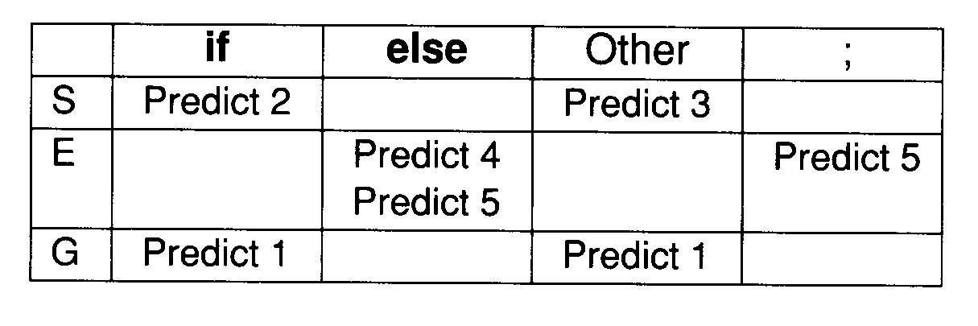
The If-Then-Else Problem in LL(1)
Solution: conflicts + special rules
  G₃:
    G → S;
    S → if S E
    S → Other
    E → else S
    E → λ
G₃ is ambiguous
We can enforce that T[E, else] = 4th rule.
This essentially forces “else “ to be matched with the nearest unpaired “ if “.

Slide 33
The If-Then-Else Problem in LL(1)
If all if statements are terminated with an end if, or some equivalent symbol, the problem disappears.
    S → if S E
    S → Other
    E → else S end if
    E → end if
An alternative solution
  Change the language

